Slide 1
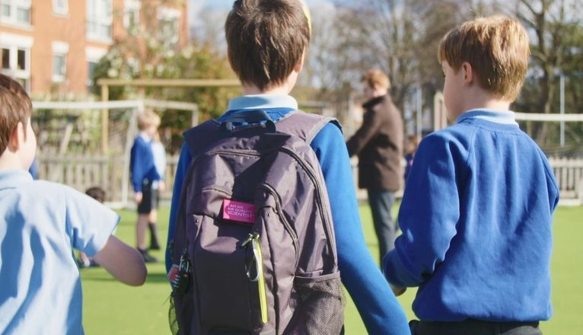




Monitoring children’s exposure to
air pollution:
The Breathe London Wearables Study
Dr Benjamin Barratt and Dr Diana Varaden
Environmental Research Group
School of Public Health, Imperial College London
February 2021
Notes:
What do we know so far?
Air pollution has been associated with a wide variety of health problems.
Air pollution contributes to about 40,000 early deaths a year in the UK.
The problem of air pollution is particularly significant in large urban settings.
and much more…..
However… although the impacts of air pollution on public health have been compared to those of obesity and smoking, the public and political awareness of the problem remains low.
This is partly a reflection of undeveloped methods for information dissemination and public engagement. Hence, it is of particular importance that we identify engaging and effective ways to communicate the health risks of air pollution to the general public

Slide 2
Breathe London Wearables
To tackle the air pollution issue and implement effective strategies to reduce child exposure, is important to understand how children are exposed to this risk, and where and when the risks are highest.
Children's exposures to air pollution are heterogenous, based on weather conditions, geography, commuting behaviour, school environment and home environment.
We conducted a large-scale study to (i) characterise school children’s exposure to air pollution during a typical school week using low-cost sensors and (ii) assess the extent to which a citizen science approach to data collection could contribute to and impact the research development and outcomes.

Slide 3
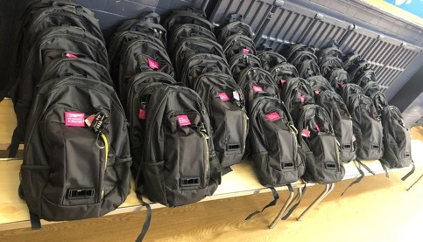
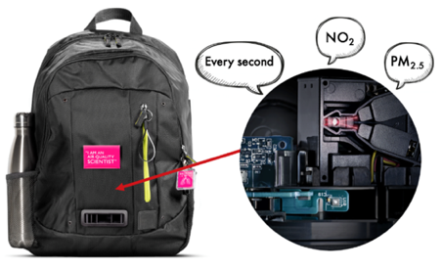
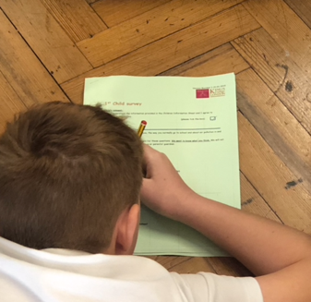

Breathe London Wearables
5 weeks
5 primary schools
258 children
30 teachers
80 Dyson sensor backpacks
2,000 school journeys
490 million measurements
10 education sessions
300 “I’m an air quality scientist” badges
700 surveys (children and parents)
20 focus groups (children and parents)
10 Interviews

Slide 4
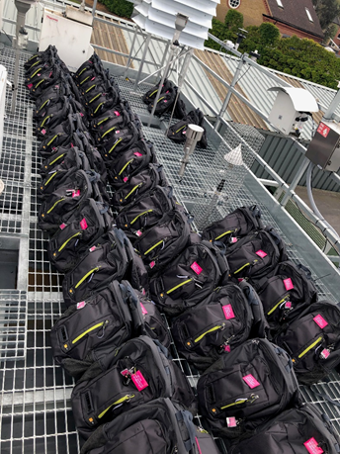
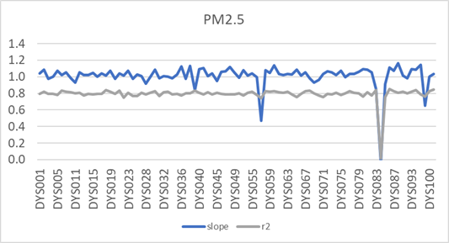
Sensor development and testing

Slide 5
Embedded video

Slide 6
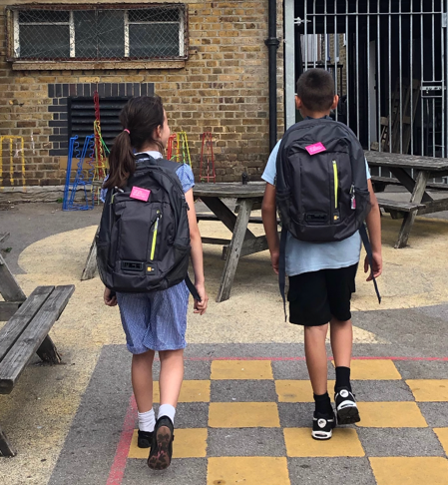
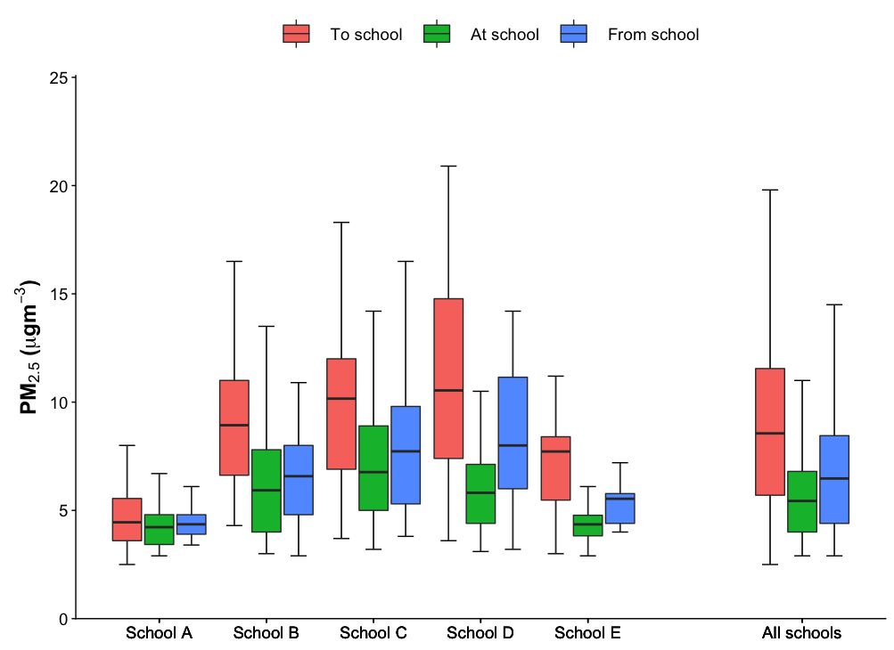
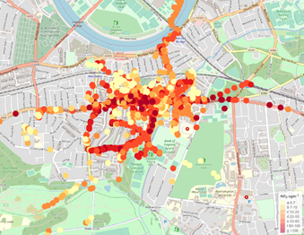
Children's exposure to PM_{2.5} during a typical school day

Slide 7
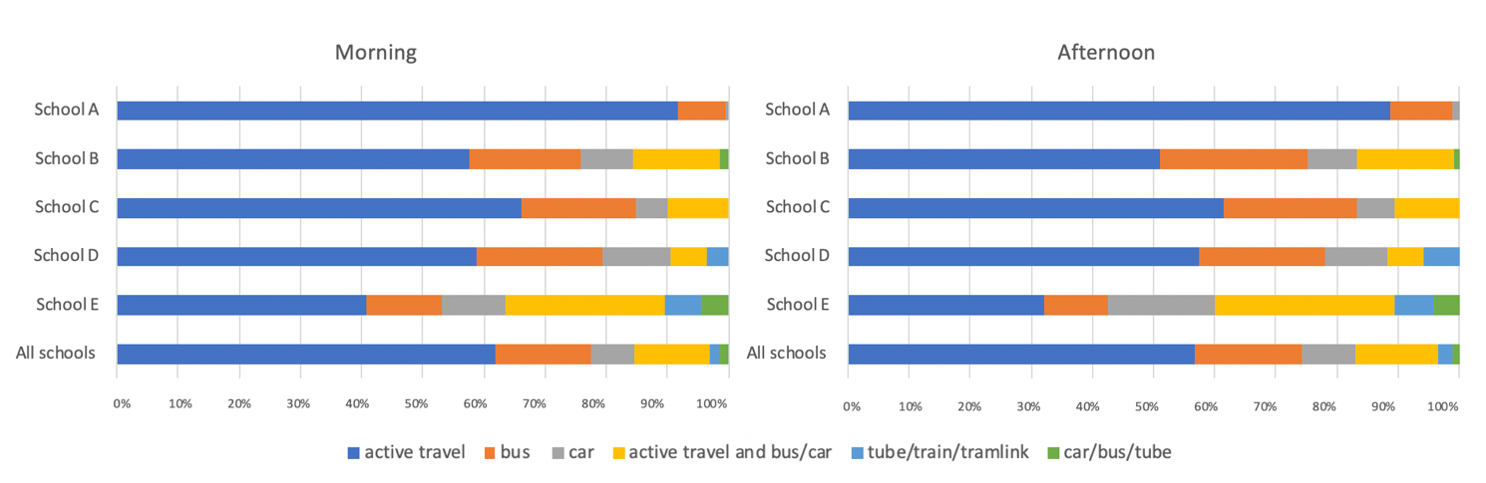
Transport modes of participating children during the monitoring periods
60% of journeys were by foot (42-88%)
45% of journeys were less than 10 minutes

Slide 8
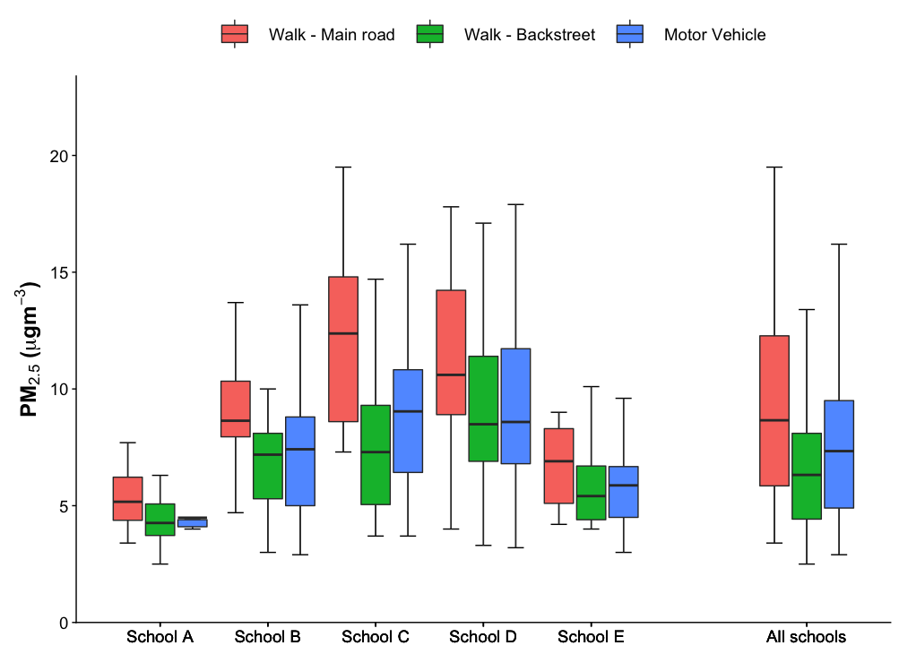
Transport activity patterns and exposure to PM_{2.5}
Those walking along back streets were exposed to the lowest levels
Some extremely high concentrations were recorded in cars and buses

Slide 9
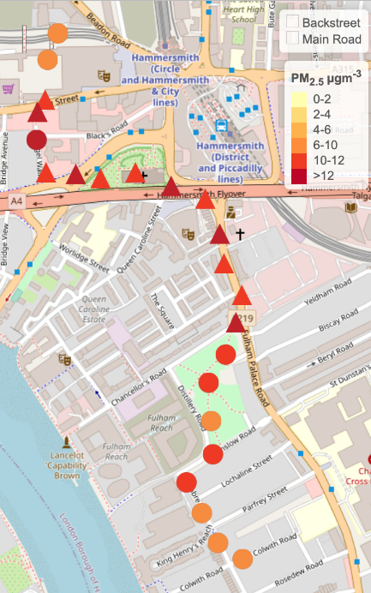
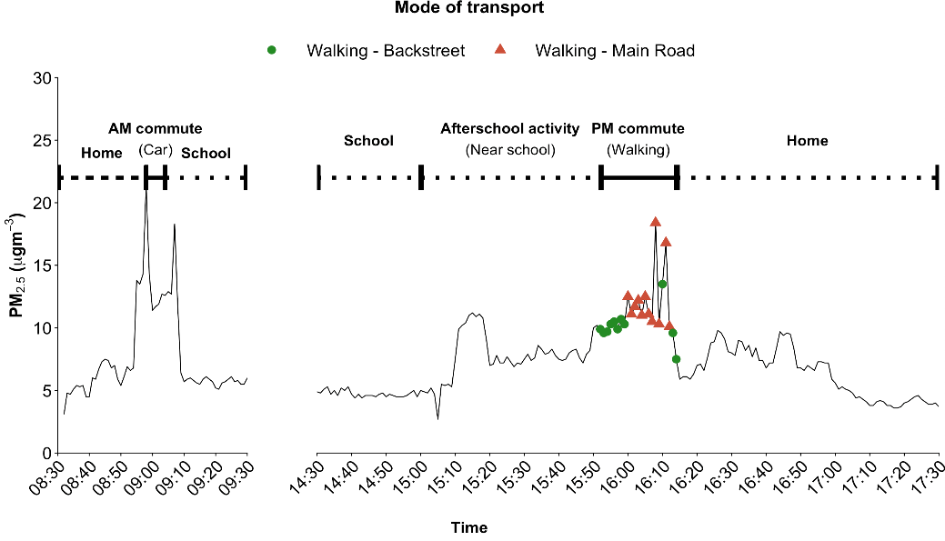
Child’s commute to and from school, on a typical school day
Note: Data points within 100m of the child’s home has been excluded.

Slide 10
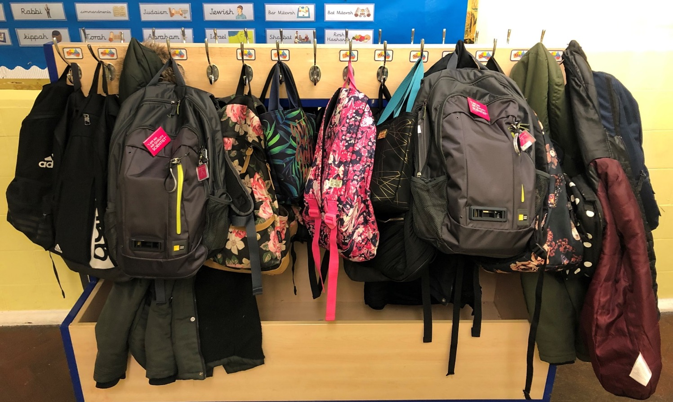
Sensors to engage, educate and empower

Slide 11
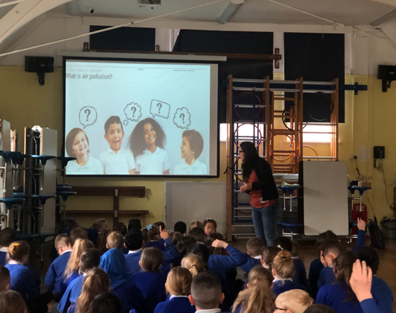
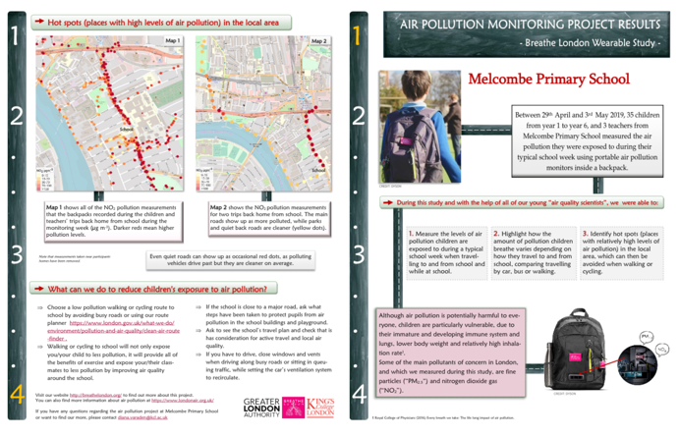
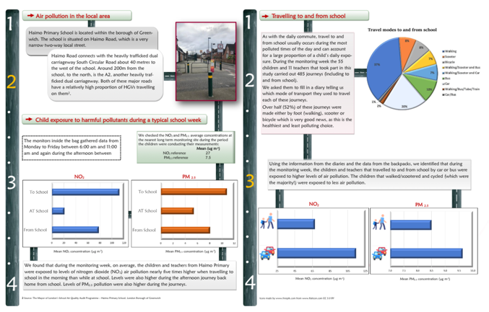
Our approach
Raising awareness
Raising understanding
Making air pollution ‘visible’
Making it personal (but avoidable)
Providing choice

Slide 12
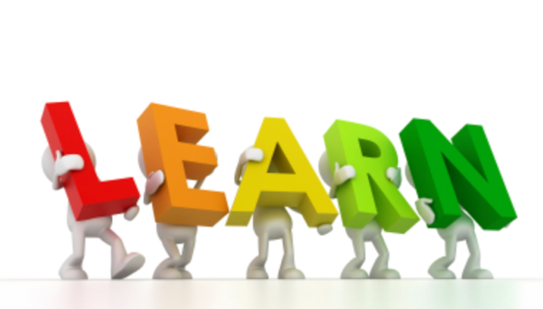
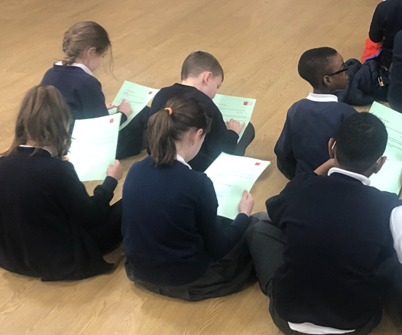
The impact of our approach
Children learn about air quality
“I was a bit scared before the project but now I am happy to know that I can do something about it because I didn’t know anything about it but now, I know that I could walk through the parks or back roads and try to stay away from traffic as much as possible”
(Child - year 4)
“With the project we found that is better to walk than drive and if you do drive to school, you could drive a bit, stop and get out of your car and walk the rest of the way. We also found out that is a lot more polluted on the main roads and that it is better to go through back streets to go wherever you are going” (Child –Year 3 ).
“I think this project is very important, It is important to empower the children and give the children knowledge about what is going on about a problem that is very real particularly for them and for their future” (Teacher)
“Thank you for working so hard on this project. It is good to get some empirical data. The kids have got involved, became aware and learnt a lot” (Parent)

Slide 13
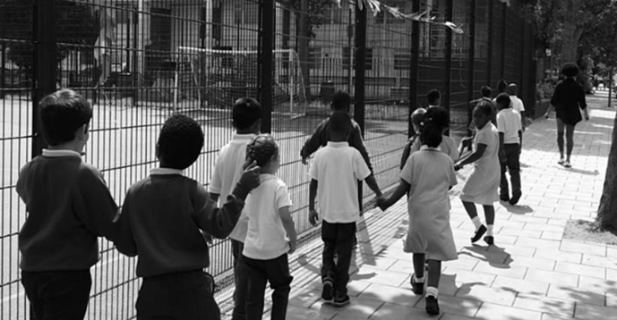
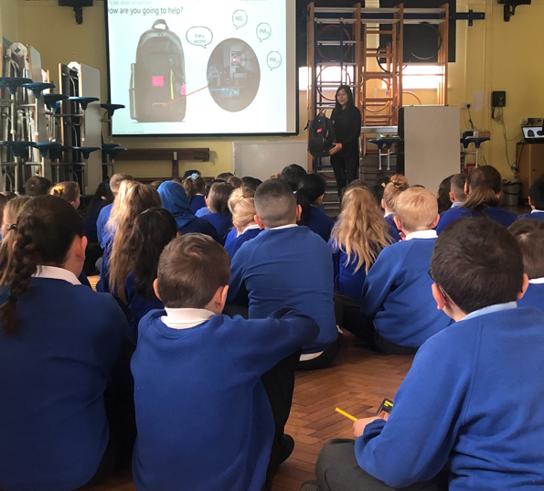
The impact of our approach
Children conduct research in air quality
“It mostly made me feel that I am doing something for the environment”
(Child – year 2 )
“My role in the project was to be a scientist and discover different types of pollution to help to see how much pollution is there and the difference in the different roads” (Child, Year 3)
Children were an active part of the research process.
“I actually got to help collecting information and help to see what we can improve” (Child – year 5 )
“I found interesting how the monitor can actually study the air in one second!” (Child – year 4 )
“The project make the children feel like real scientists, like they were taking part in something real” (Teacher)

Slide 14
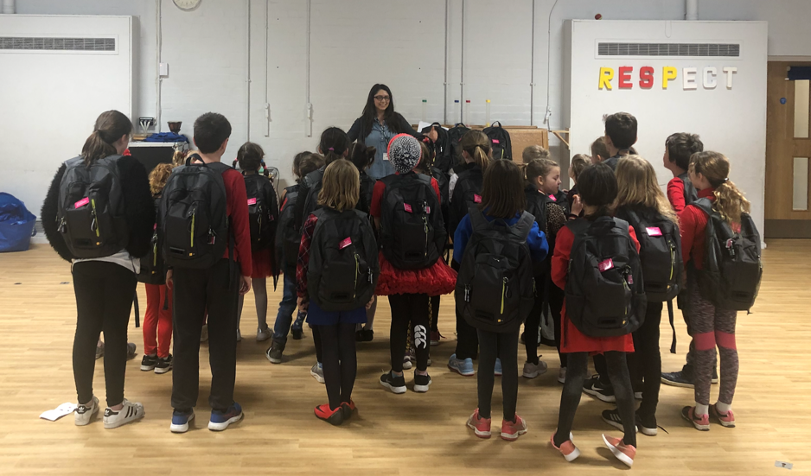
The impact of our approach
Children act for air quality
Did you tell your parents about the project? What did you say?
"Can we walk to school today?" "Let's go through a different route!" (Child Year 5)
“We need to don't make pollution, the earth is going to be a rubbish land” (Child Year 5)
“I said to my dad – try to use your car less” (Child, Year 4)

Slide 15
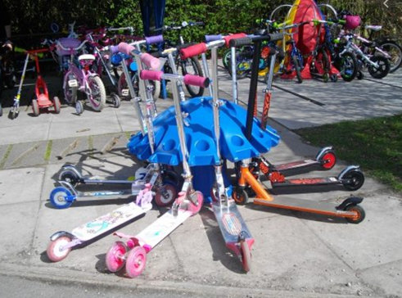
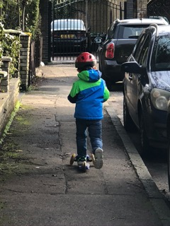
The impact of our approach
Positive changes in behaviour
Raising children’s awareness to air pollution and actively involving them in research activities can lead to positive changes in behaviour throughout the community.
“We have 54% of decrease in the number of people that come by car since we did the project, we got a huge increase in walking, I had to buy extra bicycle sheds now because the majority of the children are choosing to come by scooter and bike. Even though it was a small group, they did go and speak and it was talk about in the playground all of that week and afterwards”
(Teacher 1 school B)
As a result of taking part in the study, 31% of the children and parents questioned changed the way they commute to and from school in order to reduce their exposure to air pollution

Slide 16
Conclusions
With suitable technical support, portable air pollution technology offers the potential for school children to carry out their own air pollution monitoring projects.
Citizen science can encourage participation and stimulate compliance with study protocols.
Raising children’s awareness to air pollution and actively involving them in research activities can lead to positive changes in behaviour
Understanding where and when children are exposed to higher levels of air pollution will allow to focus resources in these areas.

Slide 17
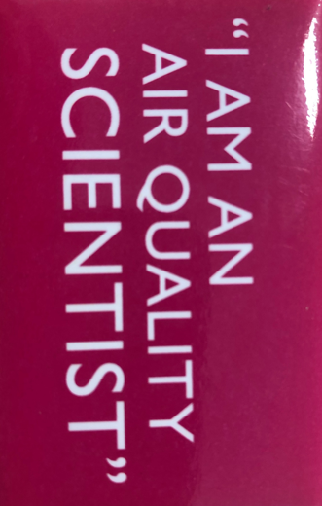
Many thanks to all our air quality scientists (the children), their parents and teachers
Backpacks were designed and provided by Dyson Ltd following a competitive selection process.
Approved by the King’s College Research Ethics Committee, King’s College London.

