Slide 1
How to use the DfE CO₂ monitors in our school (and why air quality matters for your children’s learning)
Template presentation – editing is required within each school prior to presentation

Slide 2
CO₂ monitor programme
In August 2021 the government announced education settings would be provided with environmental monitors that measure carbon dioxide, temperature and relative humidity.
These monitors can help identify spaces where ventilation needs to be improved.
In spaces with adequate ventilation, these monitors can help staff strike a balance between ventilation and warmth (thermal comfort)
https://www.gov.uk/government/news/all-schools-to-receive-carbon-dioxide-monitors

Slide 3
Why measure CO₂ levels?
When a room is occupied, CO₂ levels will increase until the level can be kept stable by ventilation changing stale air with outdoor air
CO₂ monitors give useful real-time indications of the ventilation in your spaces
CO₂ monitors allow you to ensure adequate ventilation while maintaining a thermally comfortable environment
Adequate ventilation is a key mitigation for airborne transmission of any airborne pathogens, e.g. the viral particles that cause COVID-19.
Adequate ventilation prevents build up of CO₂; high levels of CO₂ can affect learning and attainment.
CO₂ is often used as an indicator for air pollution. Children’s health, development and learning is particularly affected by the impacts of air pollution. When CO₂ levels are high, air pollutants such as nitrogen dioxide (NO₂), particulate matter (PM) and volatile organic compounds (VOCs) can be high too.

Slide 4
Why does ventilation matter?
Adequate ventilation is a key mitigation for airborne transmission of any airborne pathogens, including the viral particles that cause COVID-19.
Because of this, adequate ventilation will help reduce the spread of colds and flu, and thus absence levels, in the winter season when these illnesses are more common
Adequate ventilation also prevents build up of CO₂ which can affect concentration, learning and attainment in the classroom.
Adequate ventilation also reduces exposure to air pollution, which affects children’s physical and cognitive development and affects their ability to learn.

Slide 5
Where should the monitors be placed?
In densely occupied rooms for long periods of time (e.g. classrooms and other teaching spaces, indoor play spaces, large shared offices …)
If the monitor cannot be easily seen by the staff responsible for managing the ventilation (e.g. opening windows) then it is of little use
When possible it is best to place monitors:
At head height when seated
Away from doors or windows
At least 0.5 m away from people

Slide 6
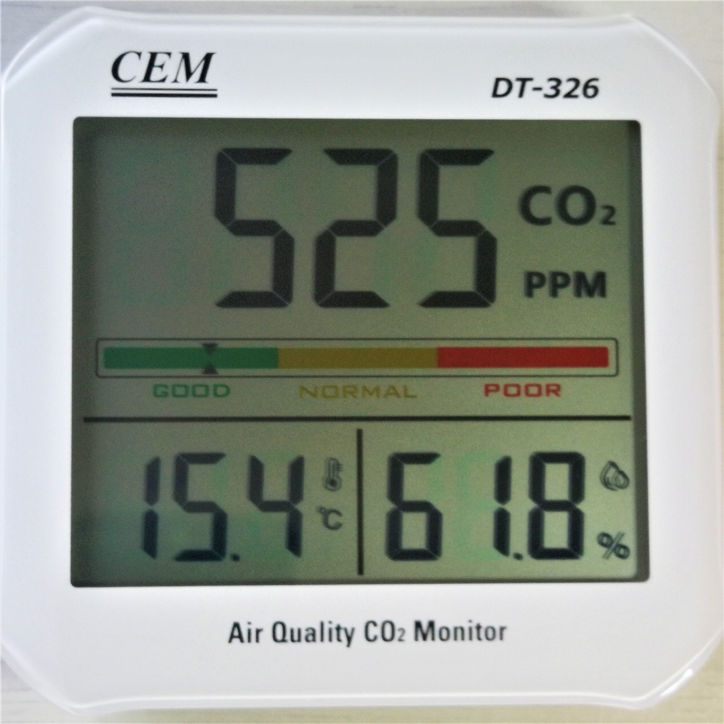
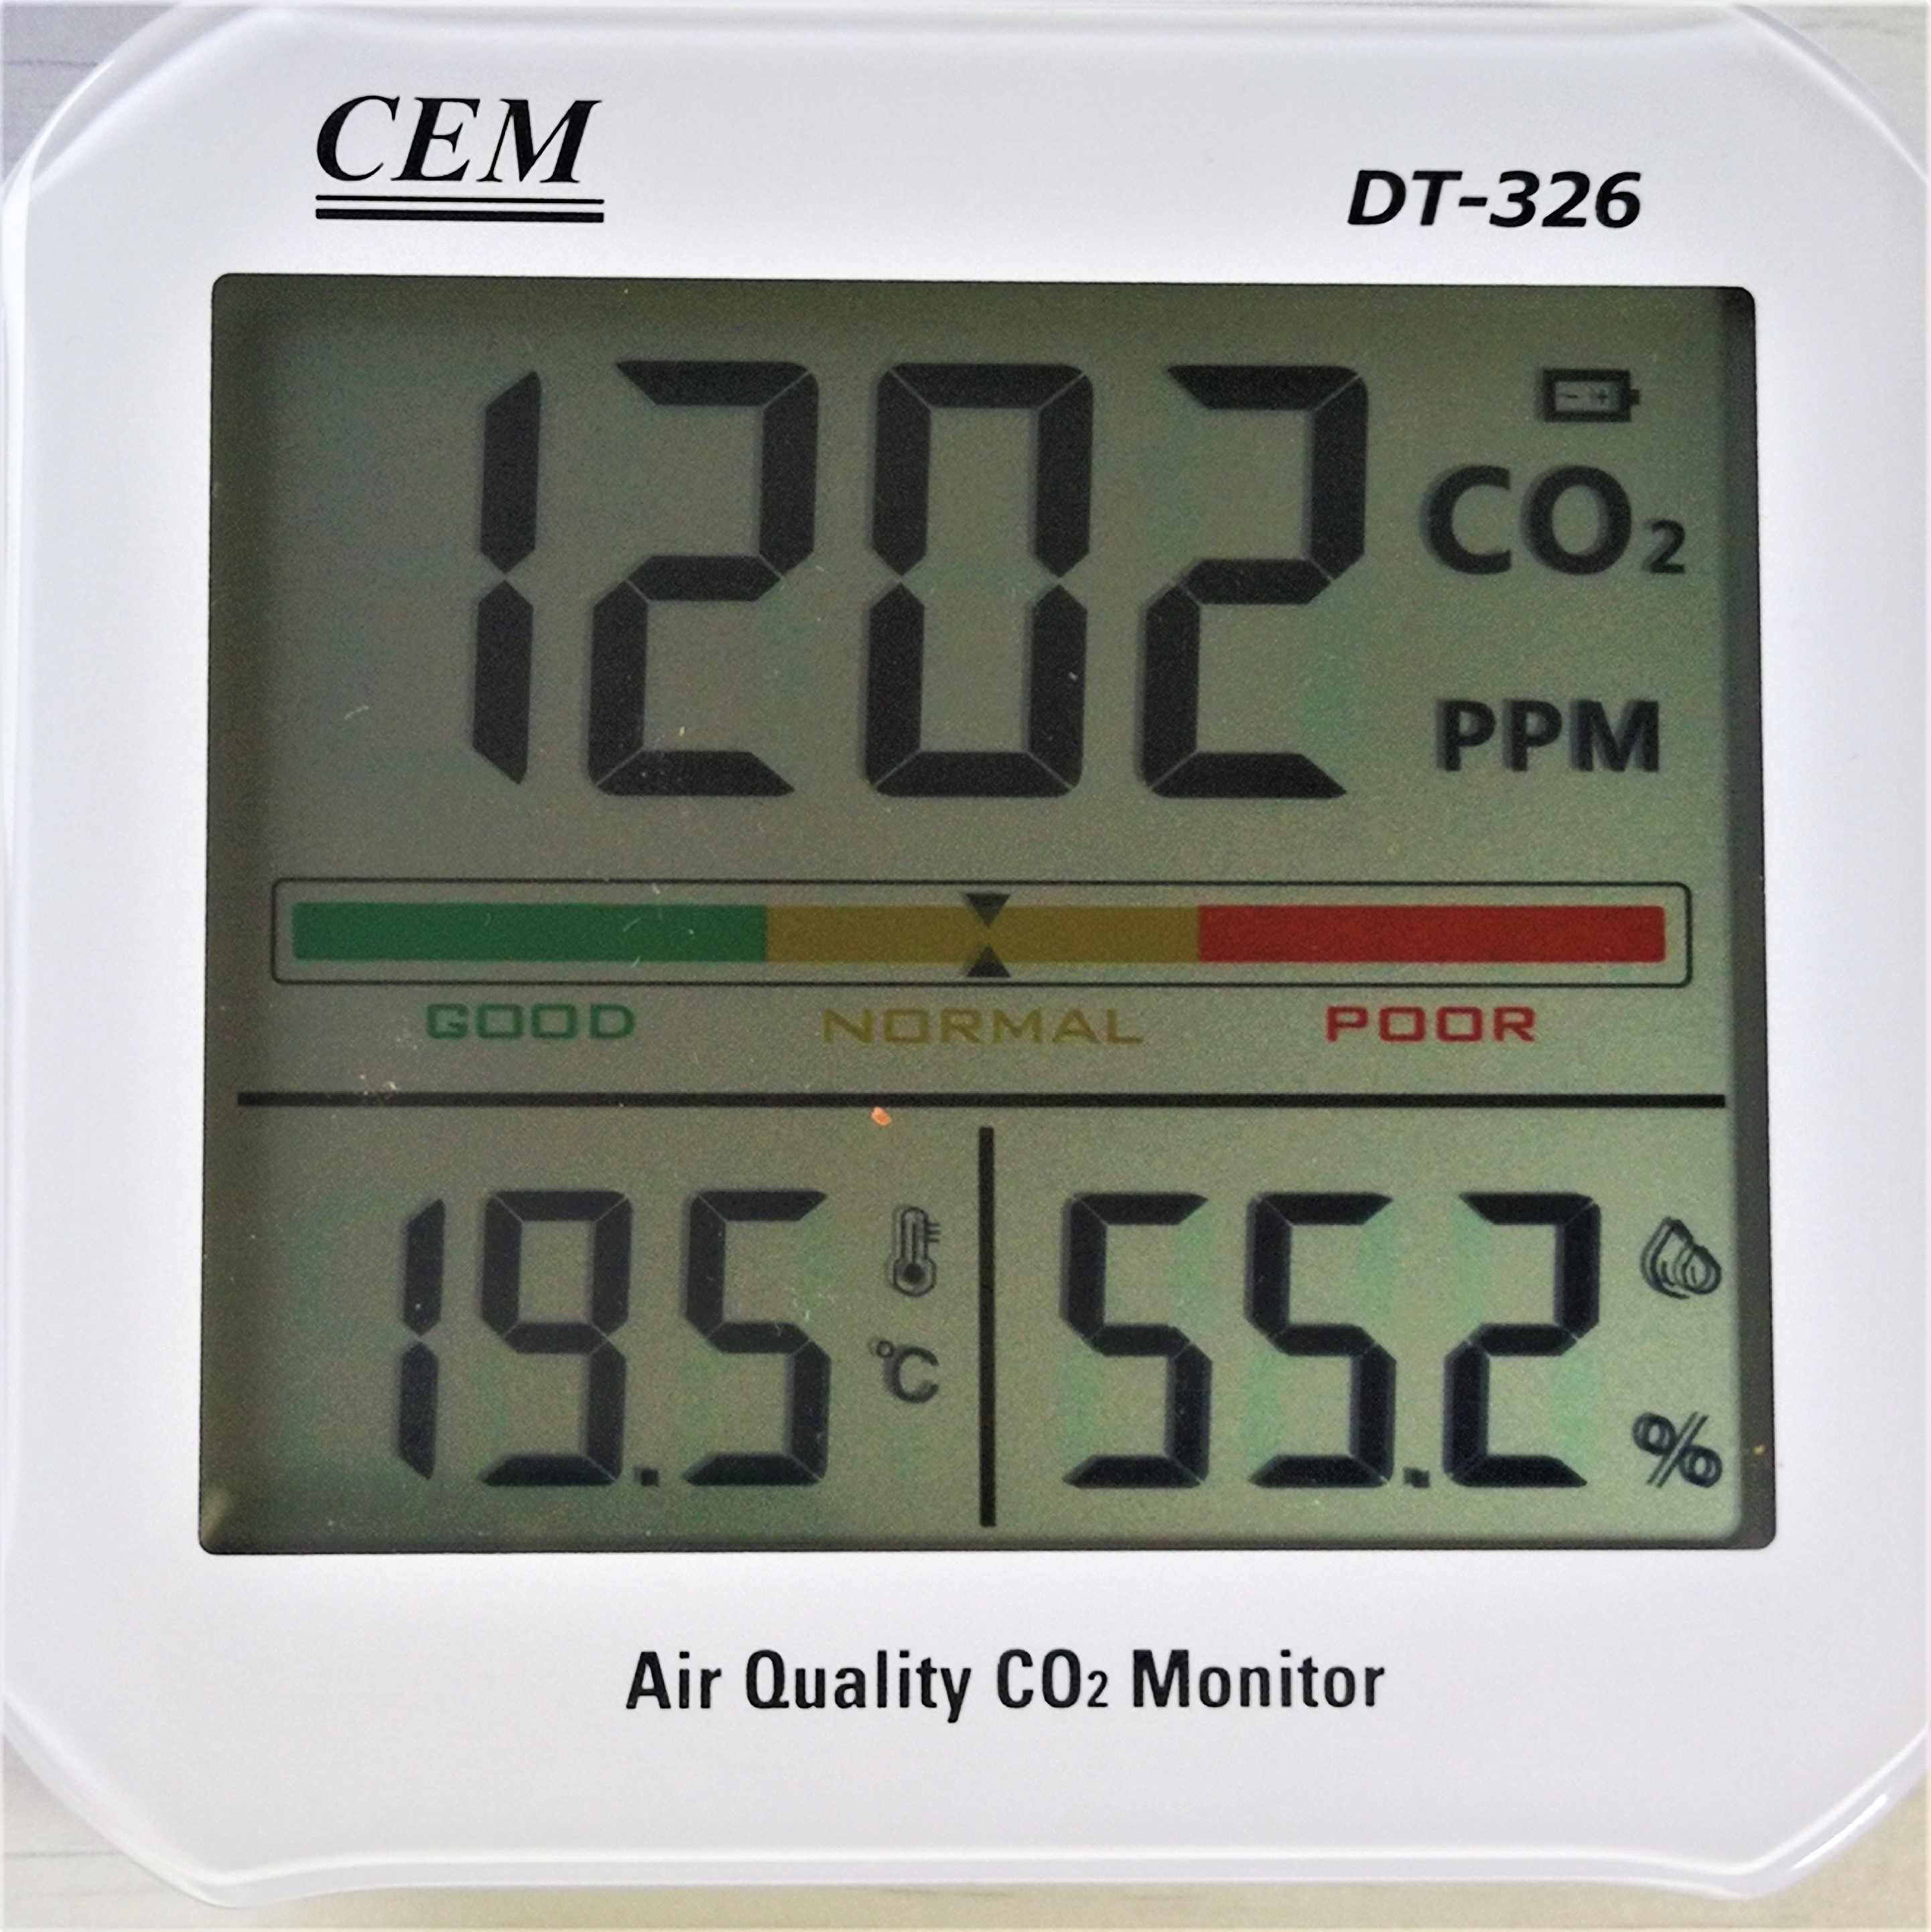
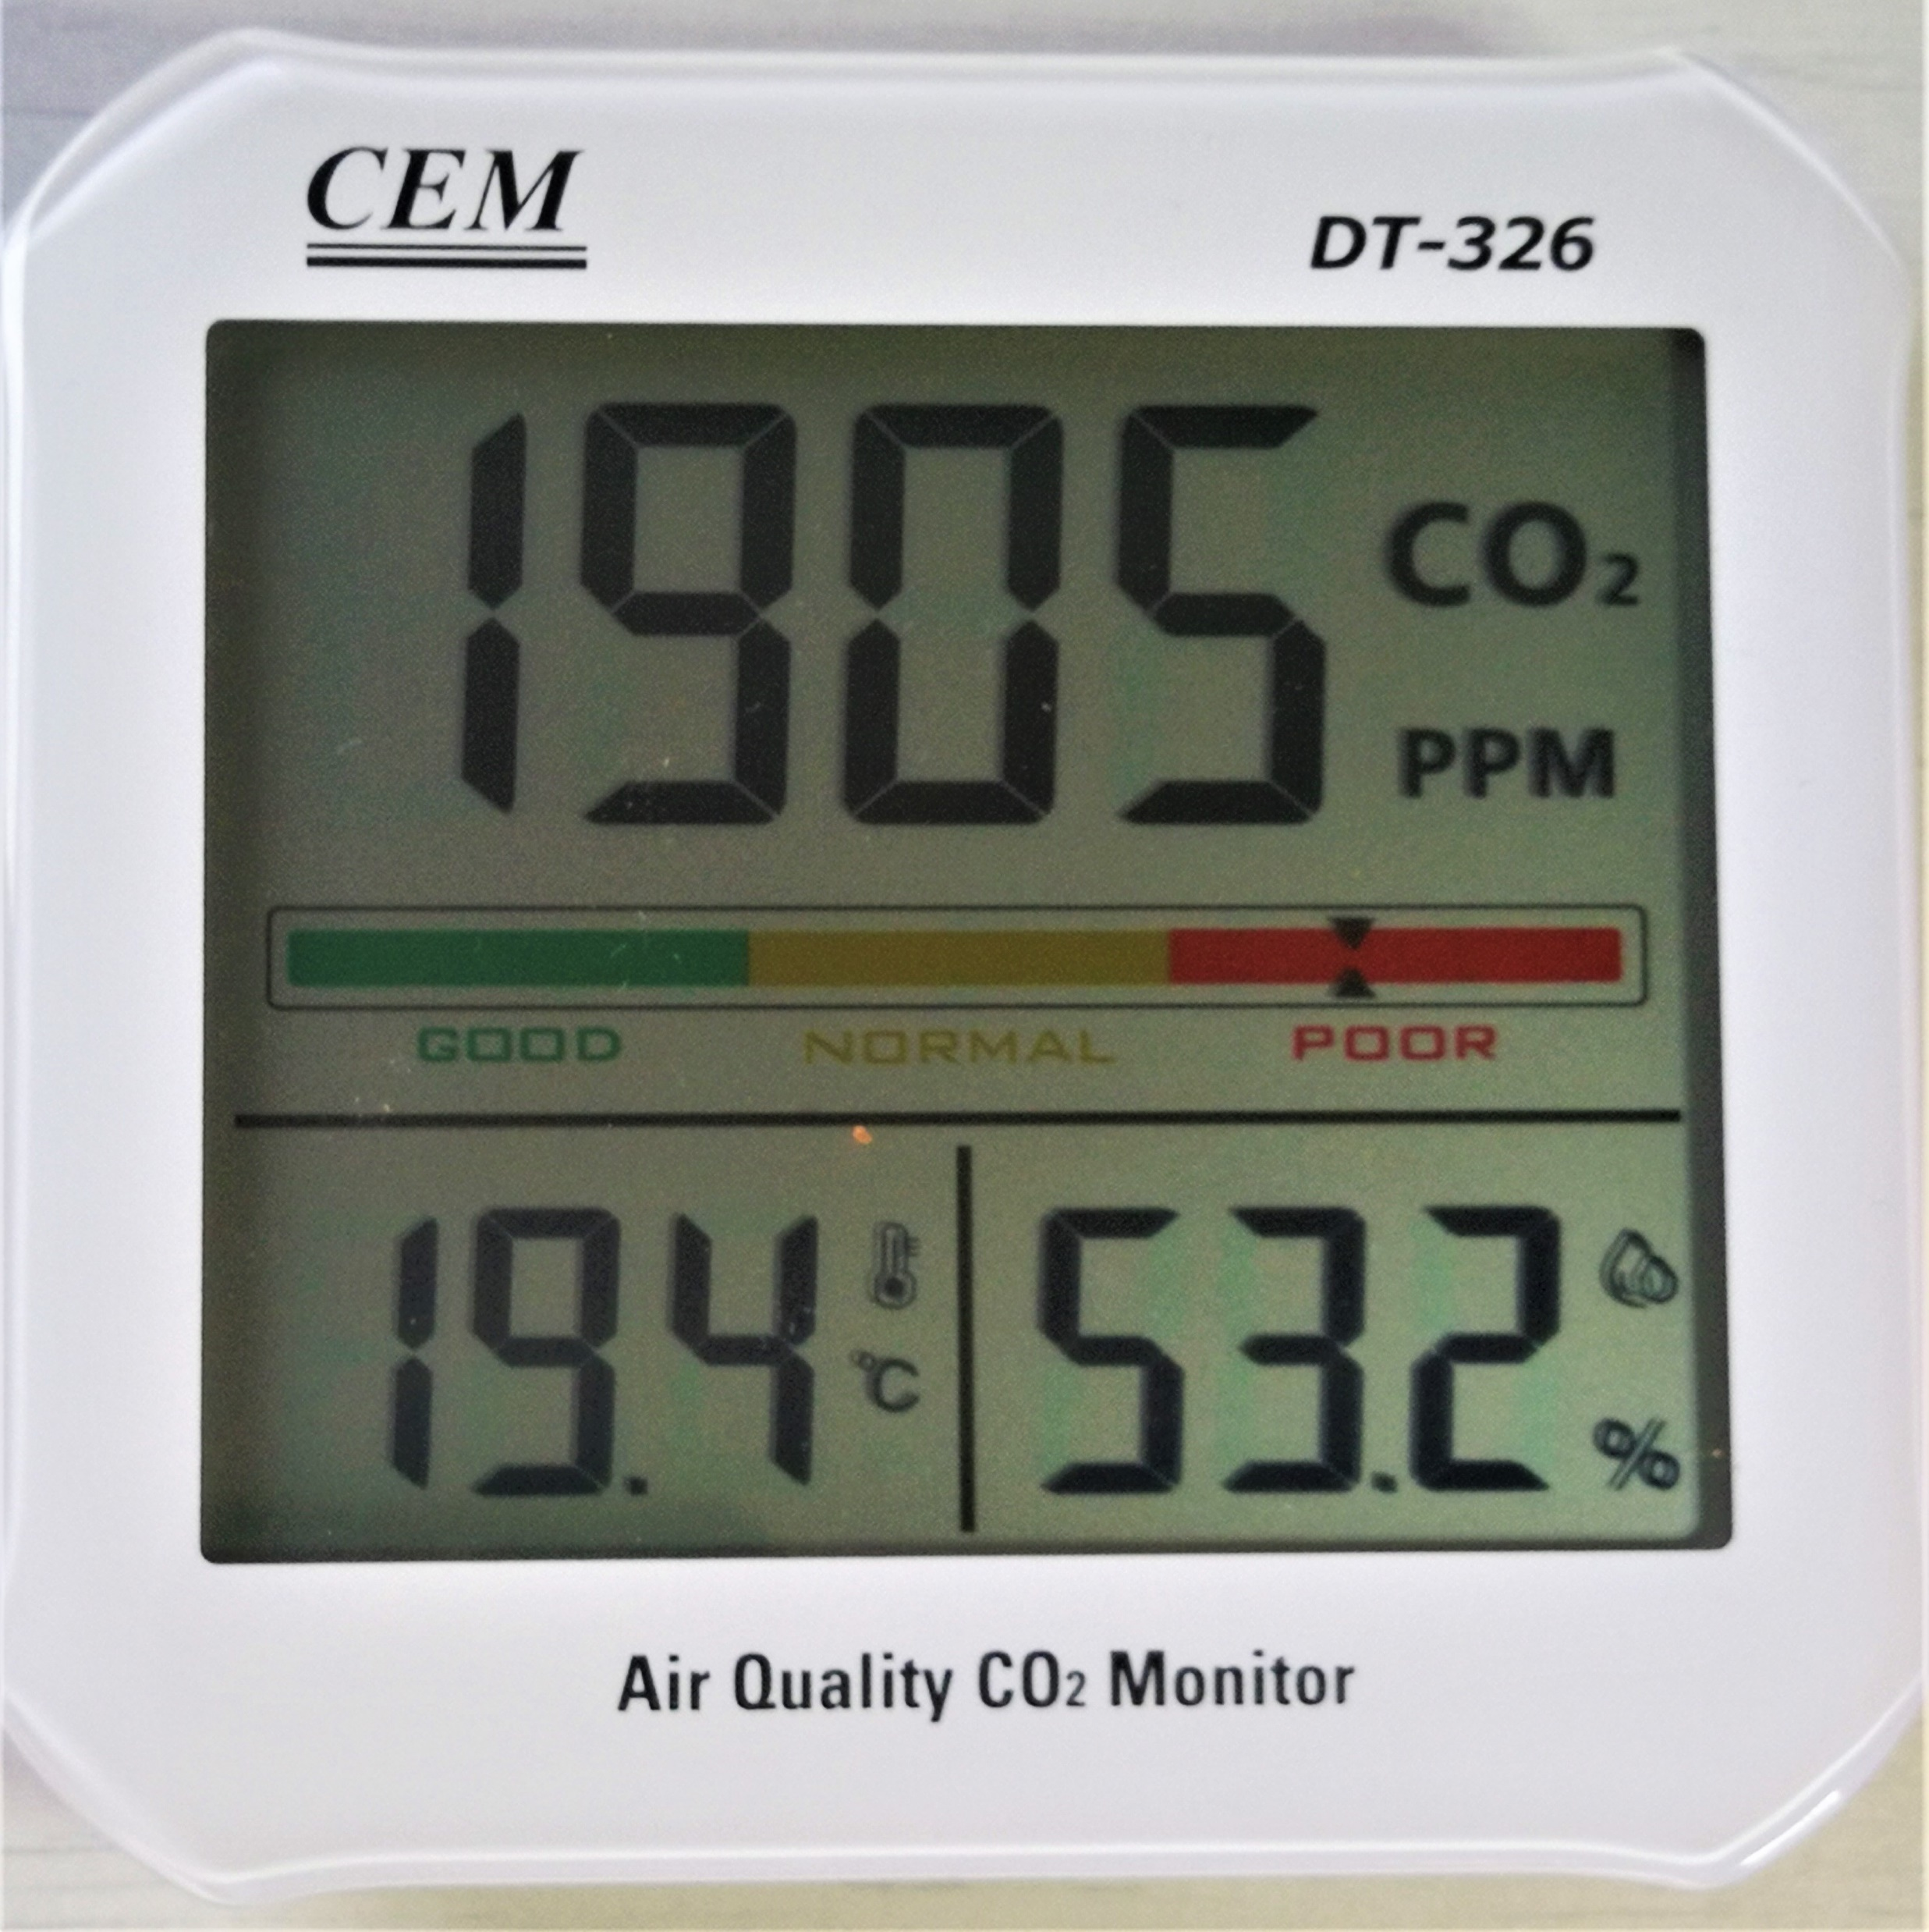
What do the monitors look like?
Update image with your school’s model if different
Update image with your school’s model if different
Update image with your school’s model if different
Green
Low CO₂ reading (525 ppm)
Amber
Medium CO₂ reading (1202 ppm)
Red
High CO₂ reading (1905 ppm)

Slide 7
What do the readings mean?
Value over 1500 ppm | Additional ventilation should be provided. There is no need to stop using the room
Values between 800 and 1500 ppm | Steps should be taken to increase ventilation if possible
Value under 800 ppm | The space is well ventilated and no further actions are required
If you see an amber or red reading wait for 5 minutes before taking any actions so the reading can settle.
Remember CO₂ is a proxy for ventilation and does not inherently indicate any risk

Slide 8
How accurate are the readings ?
Two monitors placed next to each other should show similar values but there might be a difference up to 100 ppm.
If a monitor shows consistent high values despite improvements in ventilation:
Check whether the monitor shows values below 500 ppm first thing in the morning.
If not, place the monitor in a sheltered spot outside for 15 minutes. If the readings are still above 500 ppm, ask the leadership team to contact the manufacturer

Slide 9
How to improve ventilation
How you maintain or improve ventilation will depend on the building. Buildings are ventilated by:
Natural systems such as windows, doors and vents
And/or by mechanical systems which drive airflows though fans.
Mechanical systems need to be connected to the outdoor environment (often through duct work that ends at the room with vents with grilles).
Any actions to improve ventilation should not compromise other aspects of safety and security (for example, avoid propping open fire doors), and should consider other consequences such as health and wellbeing impacts from cold environments.

Slide 10
How to improve ventilation using windows
Opening windows and doors is the simplest way of improving ventilation.
Ventilating rooms does not mean they should be cold. The weather can affect the amount of air that flows through openings. In colder weather you can open the windows slightly to reduce the impact of cold drafts while still providing adequate ventilation.
Make sure trickle vents (small vents usually on the top of a window) are open and not blocked. Air which flows in from these vents will mix with warm room air as it enters, which helps keep the room a comfortable temperature.

Slide 11
How to improve ventilation using windows
If you have high-level windows or your windows have openings at both the top and the bottom (such as sash windows), using just the higher opening may be sufficient and will help reduce cold draughts. Opening windows at both low- and high-levels will help provide even more airflow when appropriate or required.
Opening windows and doors on opposite sides, and/or on different walls, of your room will provide increased air flows, this is known as cross-ventilation.
Don’t close doors or windows completely when people are in a naturally ventilated area. This can result in very low levels of ventilation.

Slide 12
How to improve ventilation by airing rooms
Especially when occupancy changes from one group, or period, to the next; you should try to air the space between groups by fully opening windows and doors to increase the airflows.
When possible, do this when the room is unoccupied, such as during break times.
Depending on the size of your room you may not need to air the space for a while but remember anything is better than nothing!
CO₂ monitors can be used to assess how effective the airing has been and how long might be required next time.

Slide 13
How to improve air quality beyond ventilation
Improving air quality will help protect children's health, development and their ability to learn. There are many opportunities beyond ventilation alone to do this, for example:
Tackling the air pollution generated at the school gates e.g. through a student led active travel campaign, or by providing cycle training / scooter and bicycle parking.
Raising awareness of air pollution (sources, impacts & solutions) with the school community e.g. through student led campaigns, assemblies, events, or the school newsletter.
Cutting the air pollution that the school generates and reducing pollution levels in the classroom e.g. through consolidating deliveries or changing the cleaning products used on site.
Campaigning for change using student/school voices, e.g. by working with your local authority to have a school street put in, or changes to the local road layout. (This might also address road safety concerns).

Slide 14
How to improve air quality beyond ventilation
Free resources to help schools do this:
Clean Air for Schools Framework: an online self assessment tool, which creates a tailored action plan for your school and links to all the resources you need. http://www.transform-our-world.org/programmes/clean-air-for-schools
Action for Clean Air Schools website: practical tools to tackle air pollution, including curriculum linked resources and information on how air pollution affects children’s health. https://www.actionforcleanair.org.uk/
Tackling Air Pollution at School (TAPAS) Network: seminar series from academic experts on tackling air pollution at school https://tapasnetwork.co.uk/lunchtime-seminars

Slide 15
Summary
CO₂ level | Description | Actions | Outcomes
> 1500 ppm. | Indicative of inadequate ventilation. | Keep checking ventilation provision (e.g. windows and doors are open) and the CO₂ levels. If consistent, notify school leadership. | There are quite high levels of shared/rebreathed air in your classroom which, if maintained, might lead to poorer learning and poorer health outcomes.
800 ppm to 1500 ppm. | Potential for stuffy/stale air and lethargic learners. | Open windows and/or doors –higher-level openings first and then lower-level openings. | Potential to improve ventilation in your classroom should be considered for better health and learning outcomes.
< 800 ppm. | Indicative of good ventilation. | If CO₂ levels are not rising, and if the classroom is cold then you can consider slightly closing your window opening extents. Do so slowly and steadily. | Ventilation should be acting to help reduce the risk of airborne transmission but only as part of a fuller range of mitigation measures (https://www.gov.uk/government/collections/guidance-for-schools-coronavirus-covid-19).
Close to, or just above, 400 ppm. | Typical outdoor reading. | No actions required, but if your classroom is cold then the windows can be slightly closed. | Your classroom might be overventilated – this might not be any direct concern, but if your classroom is cold then you might be wasting energy and the learning experience affected.

