Slide 1
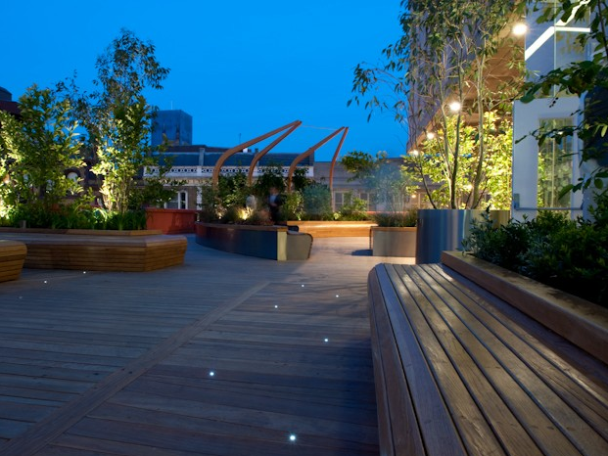
Groundwork: Improving air quality through partnership working

Slide 2
About Groundwork
London’s foremost social & environmental regeneration charity
30 years experience delivering projects to improve open spaces & support greener living and working
Multi Disciplinary Team: Landscape Design Services, Community Engagement Team, Education, Business, Employment Skills and Training Teams
Large staff team with wide range of skill sets and areas of expertise
Collaborative , flexible and responsive

Slide 3
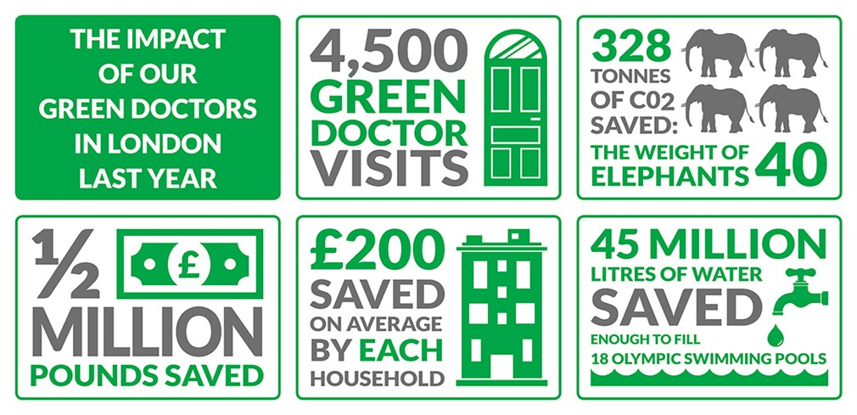
Our Core Themes & Experience
Creating better places- supporting greener living and working- improving people’s prospects
Open/ green space/ public realm improvements
Green infrastructure & behaviour change project
Grant management for GLA, TFL, etc.
Green Doctors
Employment, Skills & Training

Slide 4
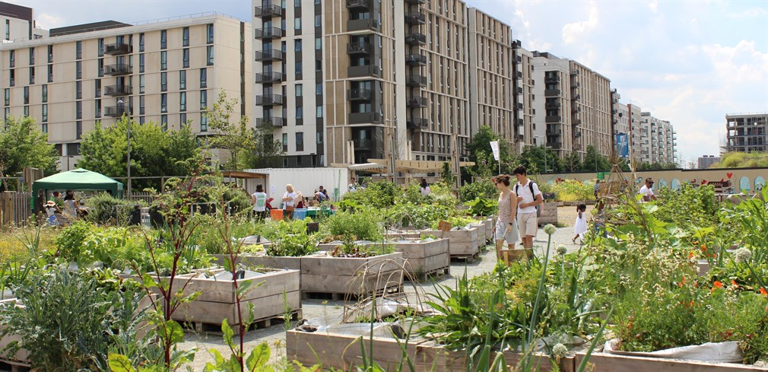
Air Quality: GW Priority Business Area
Enhancing/ creating green infrastructure
Awareness raising, education, engagement, behaviour change
Action research
Maximise impact by linking interventions

Slide 5
Air Quality and Education
Background: GPE funding / Education and Landscape team / co-design methodology / based on audits
Marner Primary - Landscape improvement project - creation of new air quality garden and new boundary hedge, consultation with school stakeholder
Netley Primary - Landscape improvement project - Installation of new boundary hedge, consultation with school stakeholder
Oliver Goldsmith - Community landscape project - Installation of ivy green screen, delivery of curriculum based AQ lessons, community planting days with parents and pupils
Ark Priory - Curriculum based AQ week programme

Slide 6
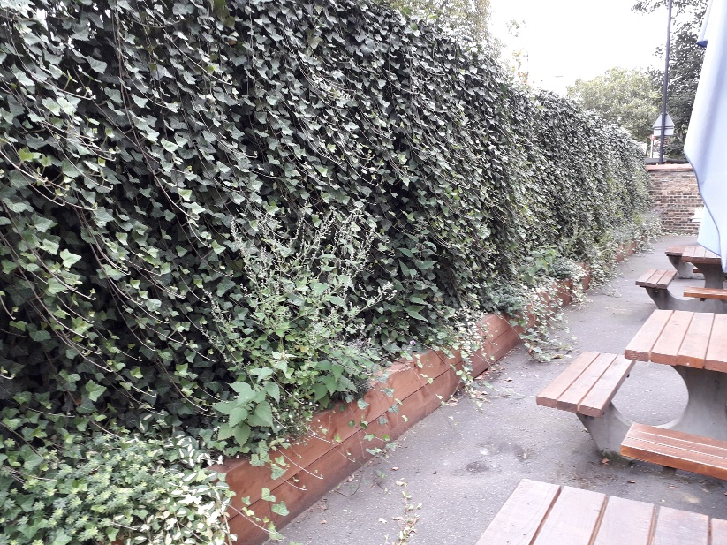
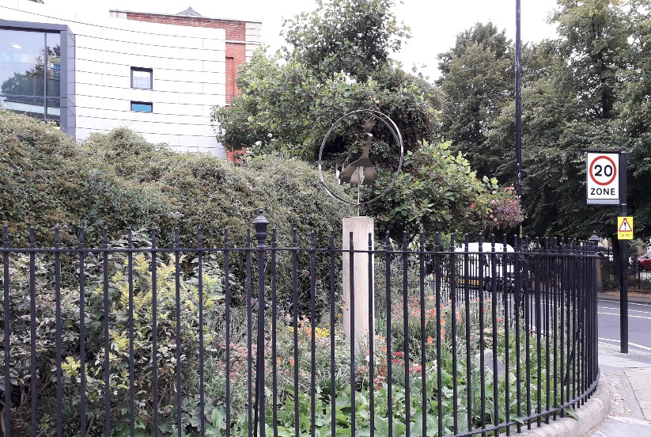
Pictures of school greening

Slide 7
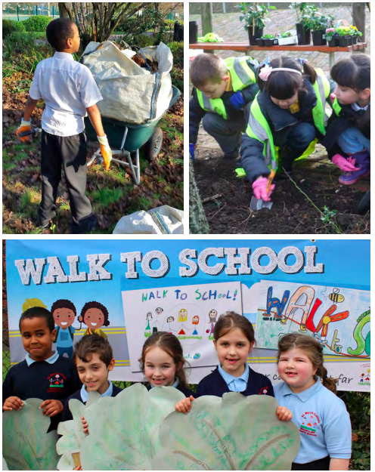
Pictures of school behaviour change
Experiments measuring particulates (Science)
Data analysis: of diffusion tube data (Maths)
Greening and planting (Biology)
Route mapping and traffic surveys (Geography)
Action Plans, Campaigns and Events e.g walk to school / car free day (English / PSHE)
Example stop frame animation produced by pupils themselves (facilitated by Groundwork): https://www.youtube.com/watch?v=eYhsW2en6js

Slide 8
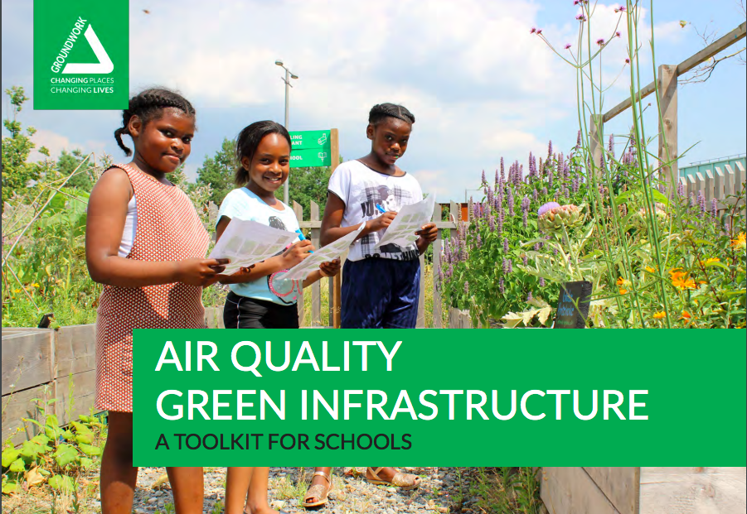
Toolkit – school greening
https://www.groundwork.org.uk/wp-content/uploads/2019/08/Air_Quality_GI_Toolkit_for_Schools.pdf

Slide 9
Plant toolkit

Slide 10
TAPAS network
We deliver practical interventions and want to ensure they’re based on latest technical knowledge
Collaborations, partnerships
Behaviour change Community engagement
Technical research & expertise
Infrastructure changes / landscaping etc

Slide 11
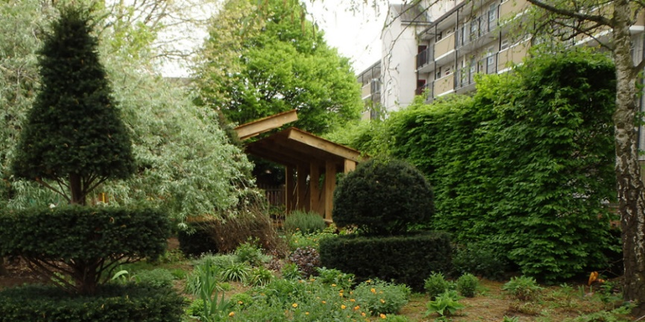
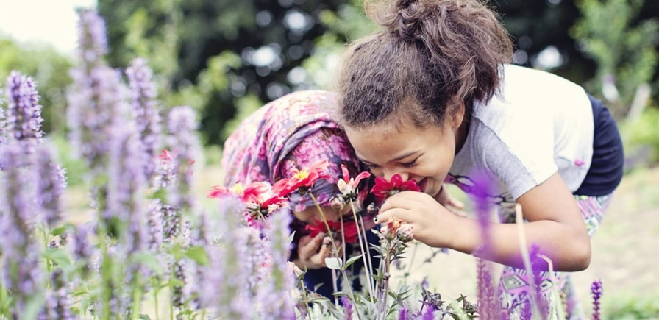
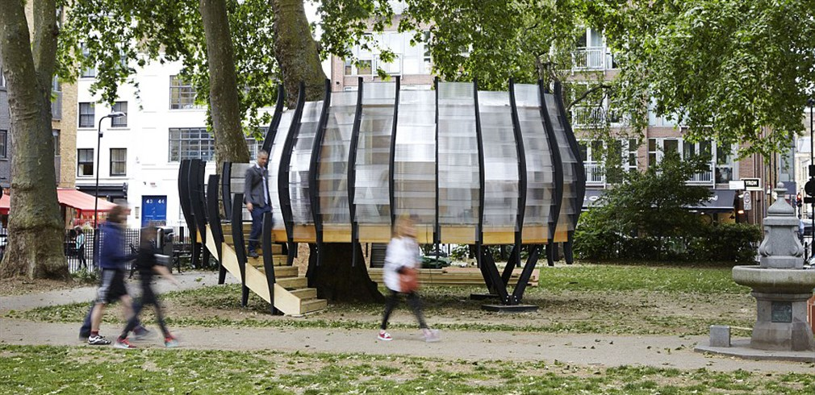
Thank you- any questions?

