Slide 2
HB23 Workshop: Indoor environmental quality in schools
Prepping decision makers – estimating the value of the wider benefits of improved IEQ in classrooms
Jørn Toftum
Technical University of Denmark

Slide 3
We know very well that……
- Poor classroom environment affects pupil well-being, illness absence, and performance
- Technical solutions are available, but at a cost and with implications for energy use
How to reach decision makers?

Slide 4
CO₂ CONCENTRATION AND PUPIL PERFORMANCE
Category
I
II
III
IV
Outside category
(Wargocki et al. 2020)

Slide 5
TEMPERATURE AND PUPIL PERFORMANCE
Category
I
II
III
IV
Outside kategori
(Wargocki et al. 2019)

Slide 6
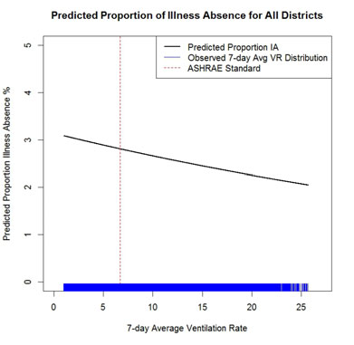
VENTILATION AND ILLNESS ABSENCE
(Mendell et al. 2013)

Slide 7
PUPIL PRESENCE (1 – ABSENCE)

Slide 8
TEACHER ABSENCE
(Milton et al. 2000)

Slide 9
CALCULATION MODEL
IEQ before renovation
Definition of renovation measures
Effect of pupil performance on learning outcome
Effect of pupil absence on learning outcome
Pupil illness absence
Teacher illness absence
Prediction of IEQ after renovation
Evaluation of socio-economy

Slide 10
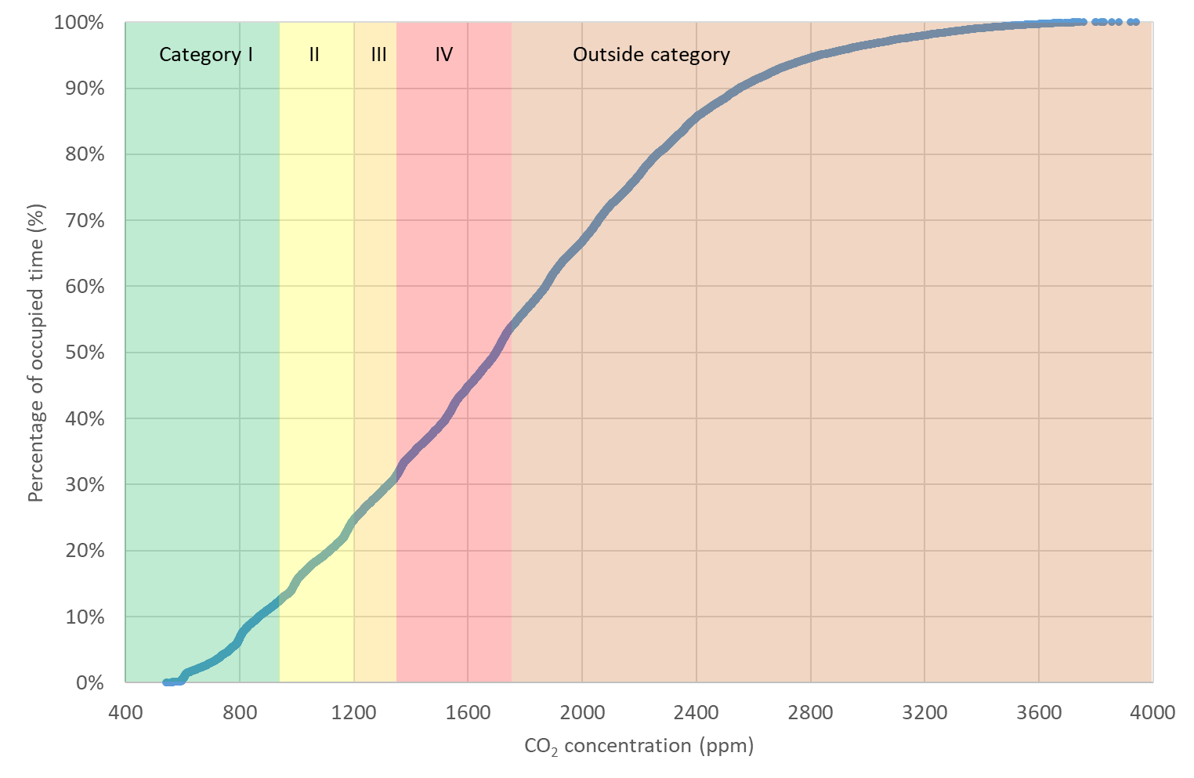
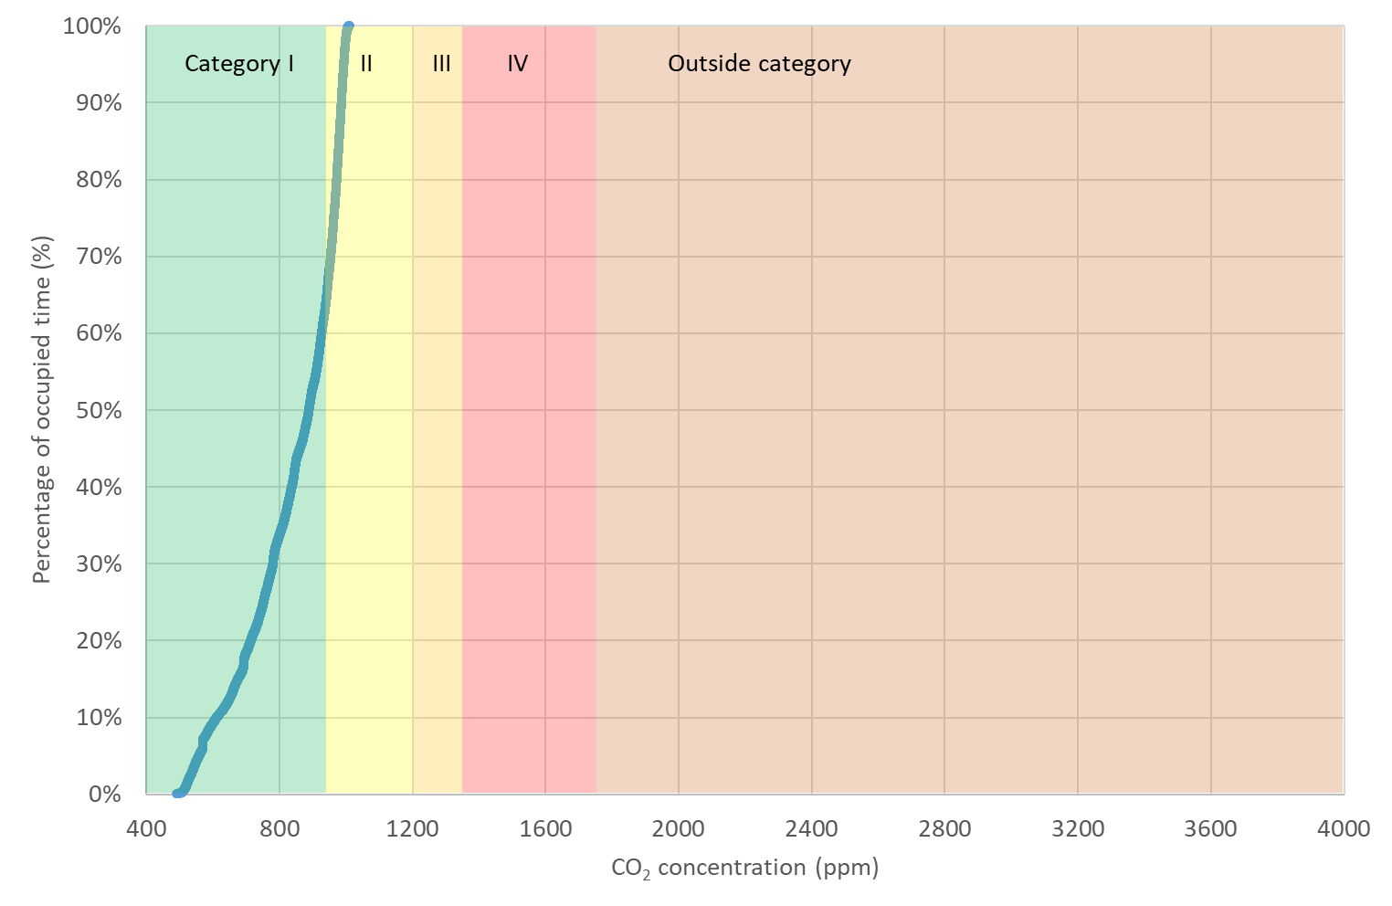
CO₂ CONCENTRATION BEFORE AND AFTER INSTALLATION
OF A VENTILATION SYSTEM
Before
After

Slide 11
BUSINESS CASE
Present values (mio €) | One-sided natural ventilation | Combined one-sided natural ventilation and mechanical ventilation (mio €)
Reduced absence pupils | - | 1.1
Reduced absence teachers | - | 0.1
Higher pupil performance | - | 1.0
Higher learning outcome due to reduced illness absence | - | 0.2
Total | - | 2.4
500 pupils
40 teachers
System lifetime 20 yrs
Installation and running costs:
0.5 mio €

Slide 12
Benefits exceed costs by a factor of 5!
Different accounts for investment and benefits
Benefits very long-term

Slide 13
