Slide 1
Focus Group 4: Dissemination and Participation

Slide 2
Co-Chairs:
Larissa Lockwood, Director of Clean Air, Global Action Plan
Mark Winterbottom, Faculty of Education, University of Cambridge
Members:
Sarah West, Stockholm Environment Network/University of York
Matteo Carpentieri, University of Surrey
Maarten van Reeuwijk, Imperial College
Mike Bithell, University of Cambridge
Marc Stettler, Imperial College
Notes:
Larissa – Works for an environmental change charity. Developed the clean air for schools framework, which helps schools to develop a clean air action plan. Also doing work on advocacy from practitioners to policy.
Mark – Senior lecturer in Education. Interest in Classroom Environmental variables and their impact on learning. Experience in inquiry projects, work with schools, teacher education
Sarah – Network sits across science policy and practice. Focus on sustainable development. Experienced in citizen science approaches. Keen to involve schools in all aspects of the science, and at all levels – students, teachers, parents, headteachers.
Matteo – Environmental flow research centre – research on outdoor air pollution. Interested in the correlation between indoor and outdoor air quality. Keen to disseminate research ideas in order for such ideas to be applied.
Maarten – Involved in modelling of air flow. Interested in making the case for a blue-green infrastructure. Keen to disseminate research findings.
Mike – Again involved in modelling, but agent-based modelling. Modelled a small primary school, and modelled epidemics before. Has undertaken some agent-based modelling of pollution, on the basis of simple diffusion (including estimates of how people move, and how people interact with their environment). Interested in understanding complex systems. For example, opening a window may seem like a good idea, but it may then affect the way in which students behave, which will itself then affect air flow. Agent-based modelling may be one effective route to dissemination: these models can be built for participation, and they can give a very visual impression of what’s going on. Seeing people moving around in the model provides a game-like environment. Dissemination to children through participatory modelling could be a good strategy.
Marc – Experienced in measuring air pollution – works with Maarten – has been involved in a number of outreach projects, having worked before with Larissa. Talked about a model of how decarbonisation would affect air pollution. Referred to people interacting with models / changing settings. Discussed a project involving measuring particles released when making toast. Interesting in getting students using equipment / taking measurements etc. Thought it important to work with children, but also to disseminate at a higher level.

Slide 3
Provide a service to the other FGs
Notes:
Our first priority is to use FG4 to enable the other FGs to achieve their aims.

Slide 4
FG4: 1) What support do schools need to tackle air pollution?
2) What’s the best way to reach schools and to secure impact?
Focus Group 1
Focus Group 2
Focus Group 3
FG4: 4) Communicate outputs of FGs to schools
FG 4: 3) Share tools and resources
SCHOOLS
TIME
Notes:
Hence, if you look on the left, we need to answer these two questions to inform the work of FG1-3.
We need to disseminate the tools and resources created by FG3
And we need to ensure the outputs of FG1-3 are communicated to schools.

Slide 5
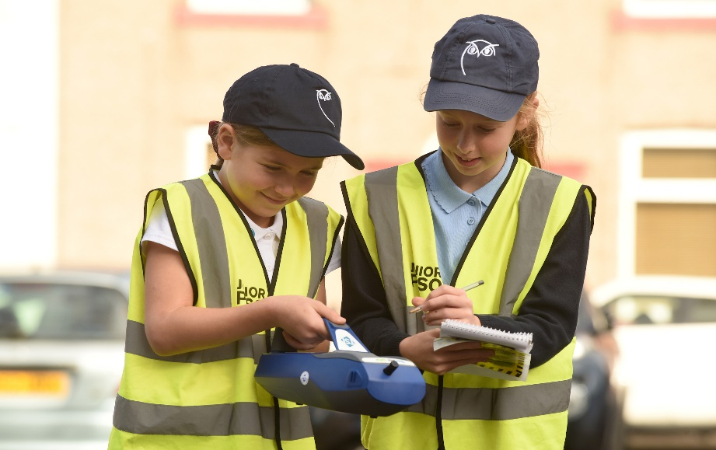
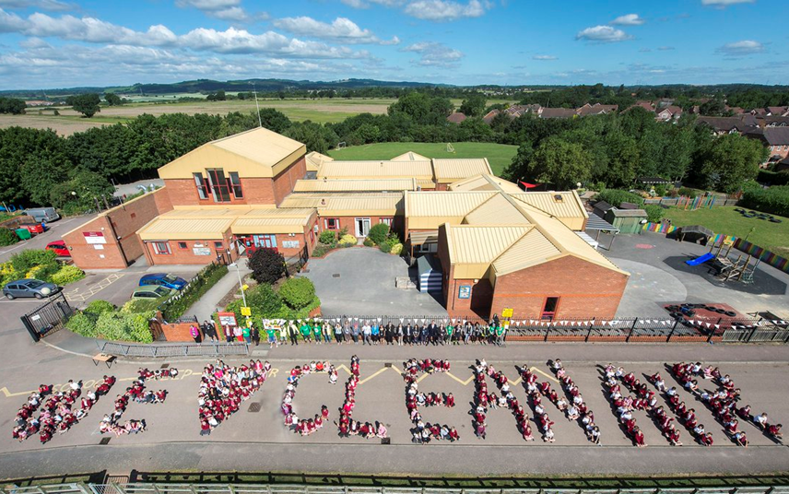
Role of Focus Group 4
PARTICIPATION
Co-development of solutions with schools (what do they want and need to help them tackle air pollution?)
COMMUNICATION
Articulate the case for action to schools (the problem & opportunity)
Share tools & resources with them
RESEARCH
Research the best approaches to
achieve impact
Inform and support other Focus Groups with learnings
Notes:
However, engagement with schools itself is not simple, and when we thought about dissemination, defined three approaches.
I’ve summarized those approaches above – read through the slide.
I’ve also included a little bit more detail about the rationale for each on the next three slides.

Slide 6
Participation
To achieve impact, different stakeholders need agency to take action in their own contexts. These stakeholders include students, teachers, middle leaders, headteachers, LEA/Academy chain leadership, parents’ organisations, DfE.
We need to find out stakeholders’ starting points in terms of their understanding, and in terms of their approaches to managing air quality and establish what they need to take action (e.g. clean air for schools framework, science club projects etc.). Involve them as participants in co-development of solutions.

Slide 7
Communication
We need to articulate the case for action to schools, targeting schools in areas with the worst air pollution, and making school leaders aware they may have a problem, and the opportunities that derive from solving such problems. These could involve improvement in learning, attendance etc.
Build a network of participating and interested schools, drawing on work with schools undertaken by other groups and institutes. Communicate information (and FG outputs) to different stakeholders (including policy makers) via Research Briefs, Case Studies, Scientists in schools (e.g. via Zoom), more classical comms. approaches.
Provide tools and resources to schools to support participation.

Slide 8
Research
Use research to inform and develop participation and communication. For example…
…to establish starting points, a research survey focused on teachers’ perceptions of the impact of air quality on learning and behaviour.
…to establish useful approaches to participant engagement, research the efficacy of e.g. role of inquiry, citizen science or student coding approaches in building stakeholders’ knowledge and impact on air quality.

Slide 9
Develop a network of schools, articulating the case for action to schools in areas of high pollution
Engage with stakeholders to establish what support they need / the best approaches to engage them in taking control of air quality in their context
Develop those approaches with stakeholders, drawing on the outputs of FG1-3 and the literature, providing tools and resources to schools, and researching / evaluating their efficacy to improve them
Notes:
To summarise what we’ve said, but in a chronological order, we see these three steps.

Slide 16
Tackling Air Pollution at School (TAPAS)
Web: www.tapasnetwork.co.uk
Twitter: @TAPASNetwork
Email: sb2257@cam.ac.uk

