Slide 1
FA2: Understanding the potential solutions.
Possible interventions, across design, technology and local/national policy
Co-leads: Nic Carslaw and Alan Short
Henry Burridge, Alan Robins, Liora Malki-Epshtei

Slide 2
Possible solutions
Building design and retrofit
Ventilation systems, facades, glazing, materials (buildings and furnishings)
External interventions e.g. traffic interventions like School Streets, green and blue spaces
Behavioural aspects – how we use buildings
Democratised ‘products’ to control the environment – e.g. intelligent devices, predictive models that can be accessed by schools
Managing school locale and travel to and from school
Public policy interventions

Slide 3
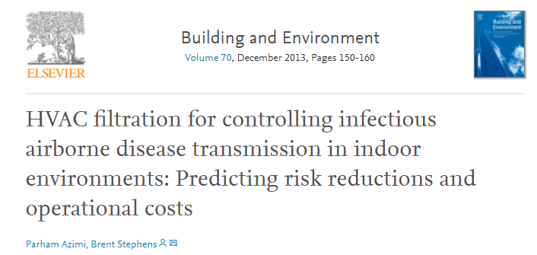
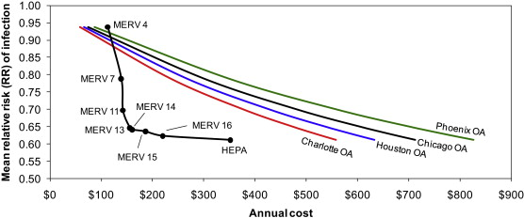
Balance against cost….
500 m² office space, 25 occupants, one with influenza.
Notes:
Abstract
This work describes and applies a methodology for estimating the impact of recirculating heating, ventilating, and air-conditioning (HVAC) particle filters on the control of size-resolved infectious aerosols in indoor environments using a modified version of the Wells-Riley model for predicting risks of infectious disease transmission. Estimates of risk reductions and associated operational costs of both HVAC filtration and equivalent outdoor air ventilation are modeled and compared using a case study of airborne transmission of influenza in a hypothetical office space. Overall, recirculating HVAC filtration was predicted to achieve risk reductions at lower costs of operation than equivalent levels of outdoor air ventilation, particularly for MERV 13–16 filters. Medium efficiency filtration products (MERV 7–11) are also inexpensive to operate but appear less effective in reducing infectious disease risks.

Slide 4
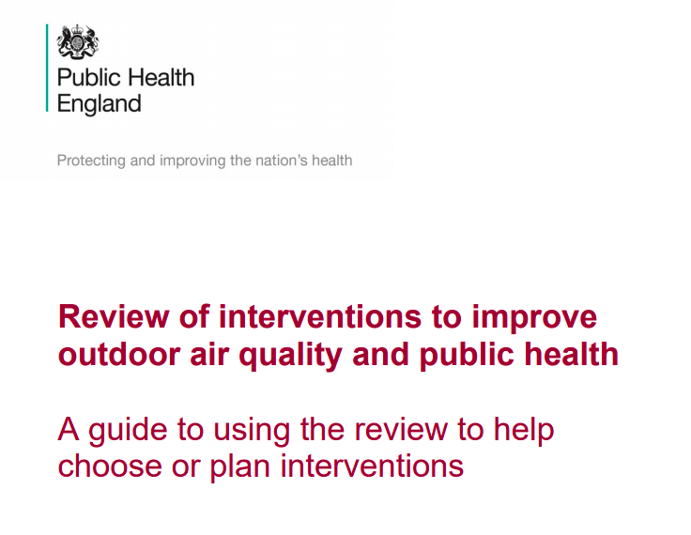
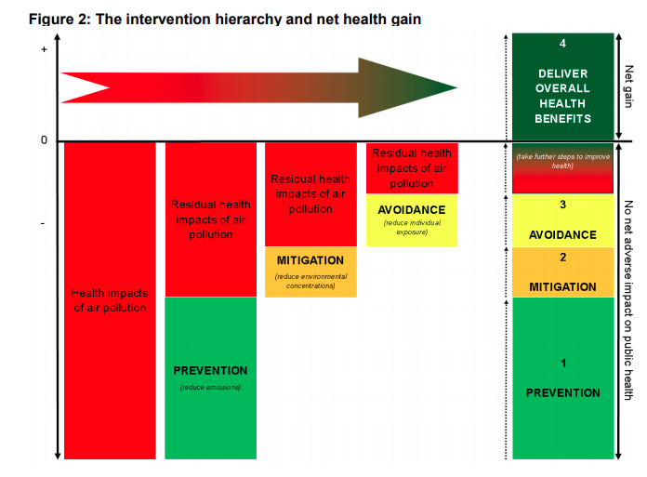
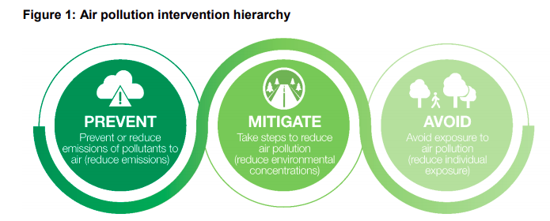

Slide 5
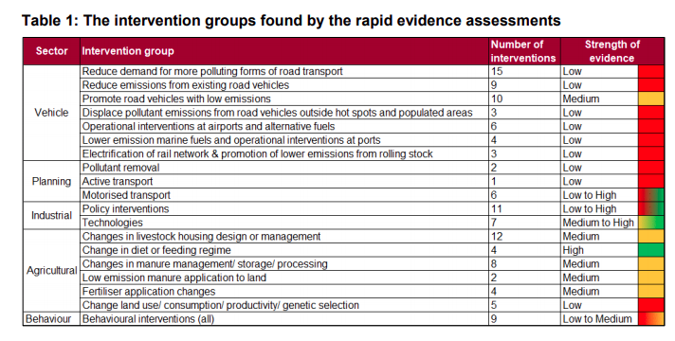
We will aim to provide a similar review for indoor air quality and then pass on to FA3 to rank effectiveness…

Slide 6
Ongoing Activities
Split interventions into internal and external
Sub-groups will review material to report back at group meetings
Review of school buildings to see if we can characterise them
Identify partners to help
Work towards a review paper and workshop next year
Start thinking about links to FA3
  need to decide what is the intervention we are aiming at (is it a change of temperature, air changes, pollutant levels etc.)
  providing a means of comparing the efficacy of different interventions.

Slide 7
Tackling Air Pollution at School (TAPAS)
Web: www.tapasnetwork.co.uk
Twitter: @TAPASNetwork
Email: sb2257@cam.ac.uk

