Slide 1
Working with schools in Waltham Forest to tackle air pollution
Peter Carey
Service Manager, Air Quality & Environmental Protection
23 October 2020

Slide 2
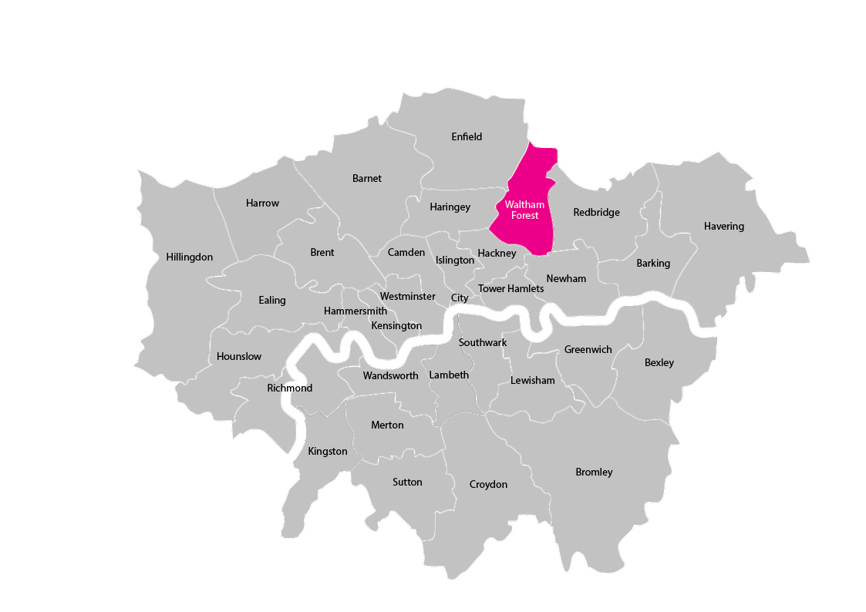
Waltham Forest
Borough in north east London
Population c.275,000
One of the host boroughs for 2012 Olympics
AQMA designated in 2001 regarding PM₁₀ and NO₂

Slide 3
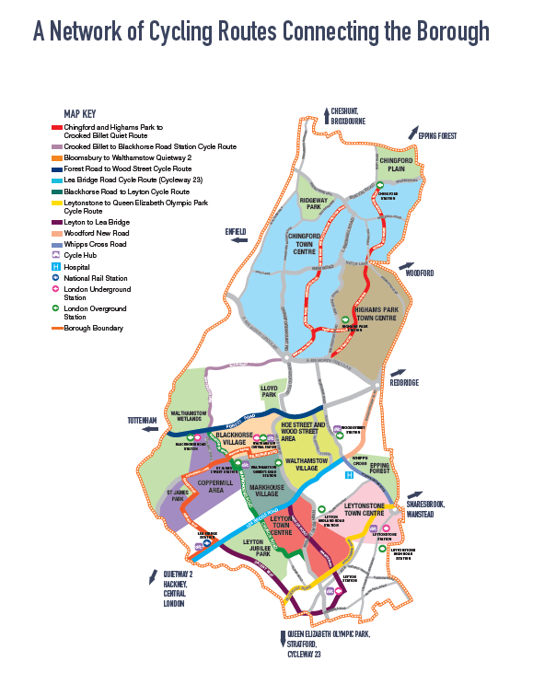
Mini-Holland
Mayor of London award to three London boroughs in 2014 of £27M to improve cycling in each borough.
WF’s priorities
  A network of excellent cycle routes
  Making our residential areas great places to cycle
  Making cycle parking easy
  Involving the community
  Encouraging more people to cycle
  Making cycling safer
  Monitoring our progress and learning from what we do
  https://enjoywalthamforest.co.uk/

Slide 4
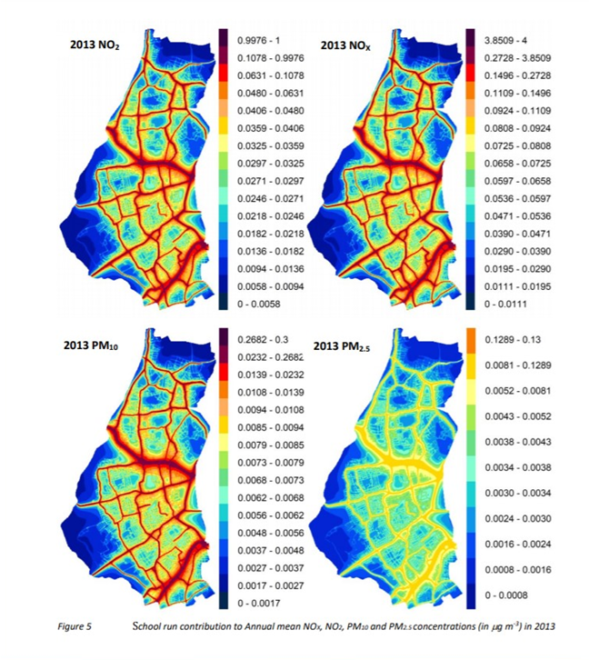
Working with schools
Half of car journeys in outer London less than two miles
‘School run’ journeys in London account for more than 1 in 5 car journeys
Children are particularly affected by air pollution
Opportunities to influence behaviour of children and their parents

Slide 5
Transport for London ‘STARS’ programme
STARS – Sustainable Travel: Active, Responsible, Safe
Range of activities tailored to what each schools wants to do. Bronze, Silver, Gold levels
57 schools in Waltham Forest currently accredited
https://stars.tfl.gov.uk/

Slide 6
Other activities and events
Walk to school week – 52 primary schools participated in 2019
Mini tour de Waltham Forest – 19 primary schools and 190 pupils taking part
Teen Tour de Waltham Forest – 5 secondary schools attended, held at the Velodrome in the Olympic Park
Pedometer challenge in 2019 to encourage walking to school, over 7000 pedometers distributed to school children

Slide 7
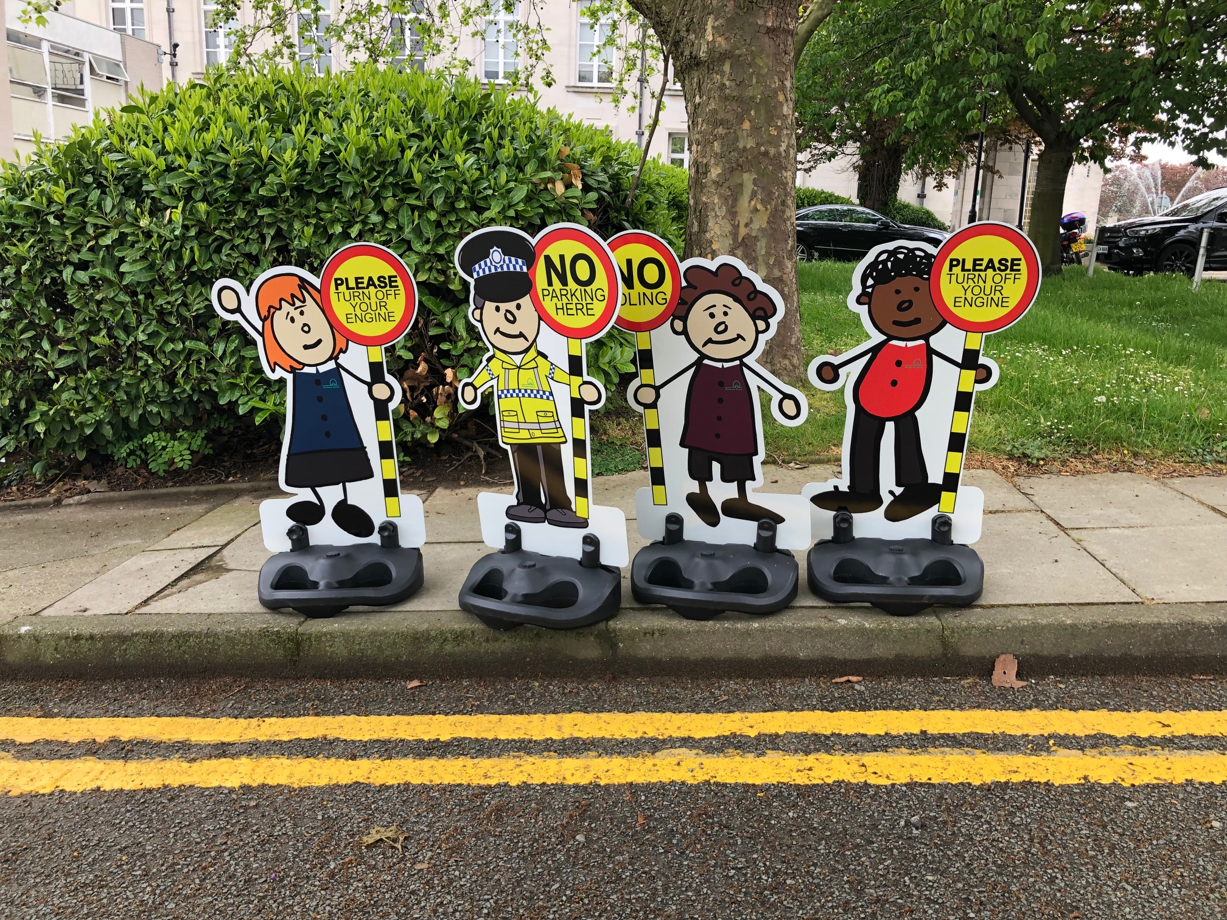
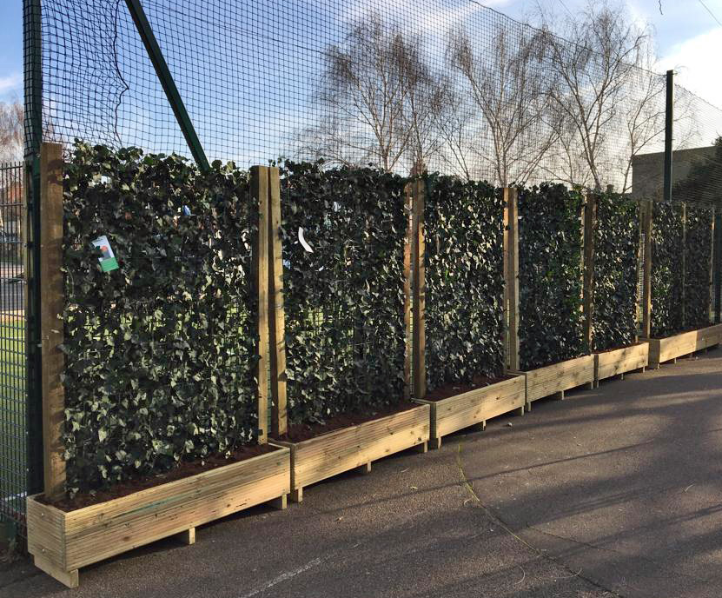
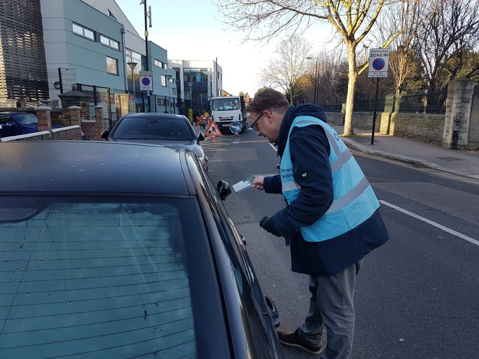
Anti-idling events at schools
including school assemblies
Green screens between
playgrounds and busy roads

Slide 8
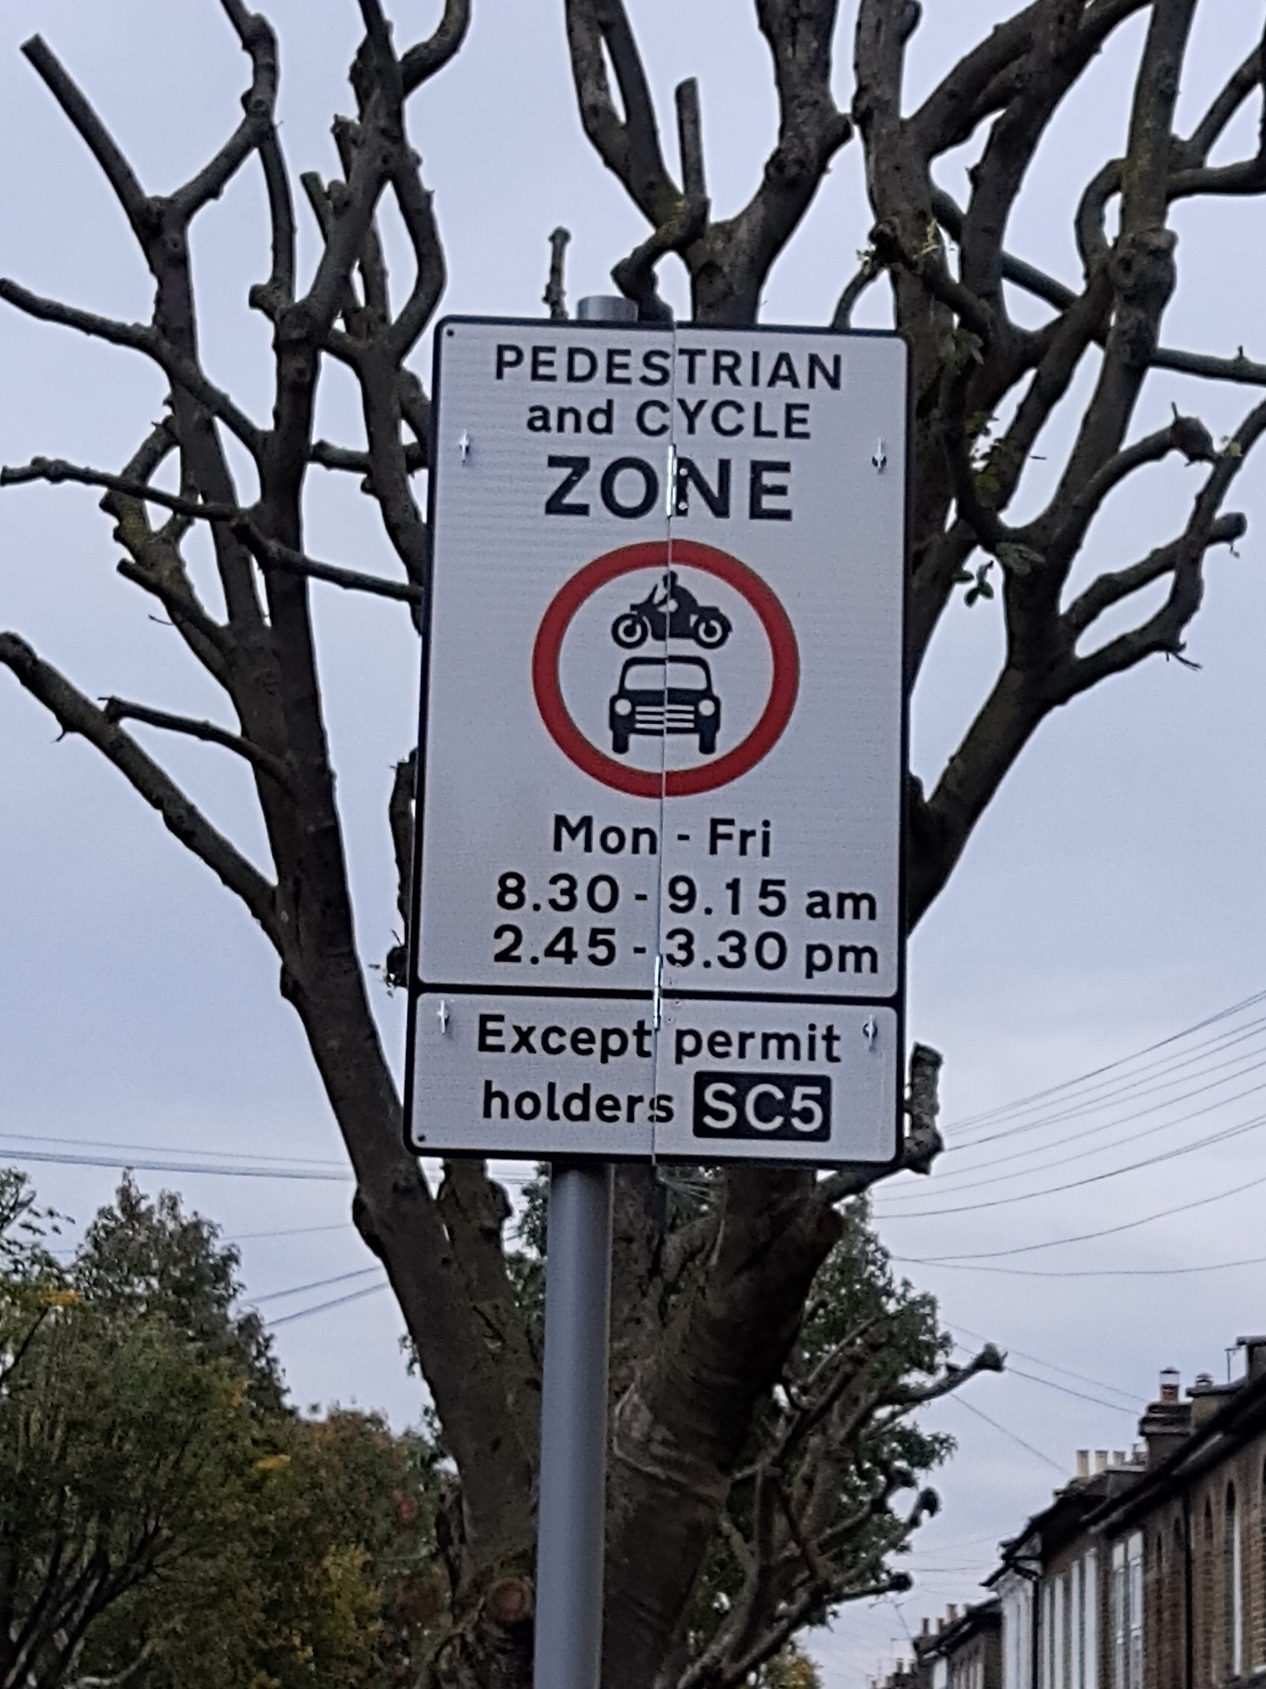
School Streets
Aim is to make the areas around school safer and healthier at the start and end of the school day
Driving into selected streets is prohibited during these times
Nine schemes in place, one more next month, and more next year

Slide 9
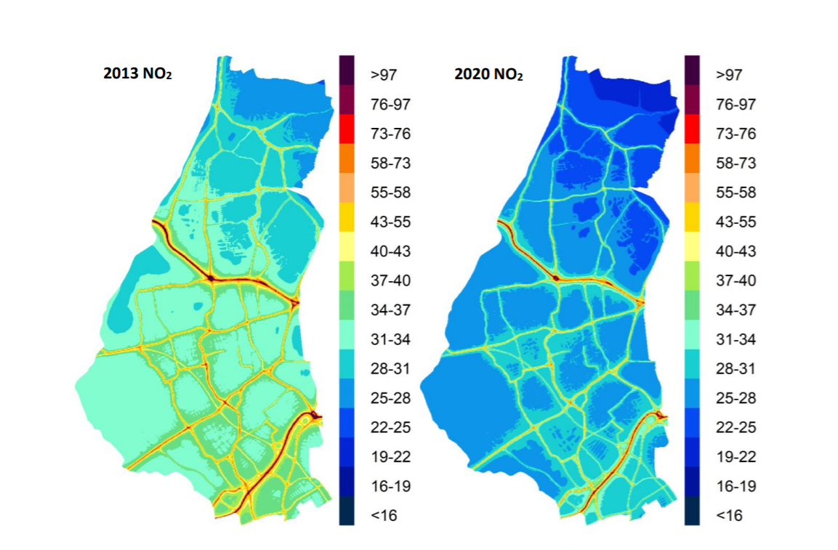
NO₂ levels 2013-2020
Annual mean NO₂ concentrations (µg m⁻³ )

