Slide 1
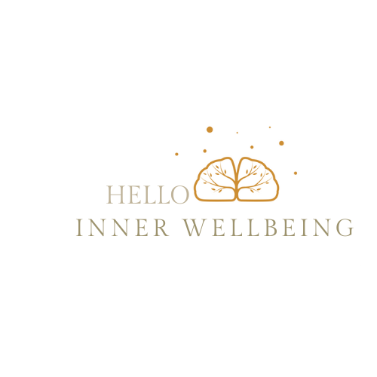


Stress psychoeducation
Yasamin Mansour

Slide 2

AMHSW – 6 years of experience
Aged groups 9-72
I am based in Sydney
Telehealth and Face to Face service
Free psycho education on stress

Slide 3
What is stress
“Stress is often described as feeling overloaded, tense and worried and occurs when we face a situation we feel we can’t cope with” APA.
Stress is usually referred to as a negative experience, not all stress is bad. Some stress can be helpful, motivating us to get a task finished.
Although, the stress response continues over a long period, this can impact negatively on our physical and mental health. Did you know there are different types of stress?
Notes:
According to the Australian Psychological Association.

Slide 4
Acute vs Chronic
Acute stress is stress that lasts only for a short period of time. For example, sitting an exam, faced with work deadlines or starting a new job.
We typically bounce well from acute stress. However, if stress experience is sever this can significantly impact mental health.
Chronic stress that continues for a long period of time. For example, experiences of bullying, loneliness, overworked, chronic health , violence etc.
Notes:
In this power point we are going to look at acute vs chronic stress. Acute refers to stressors that last only for a shot perido of time. Some examplees inludes, sittng an exam, faced with work deadlines or strating a new job.
Research suggest wetypically bounce well from acute stress. However, if the stress experinces are serever this can signficnayly impact mental health.
On the other hand, chronic stress contiues for a long period of time. For exmaoke, experince of bullying, lononlness, overweoked, chornic health violence etc.

Slide 5
Notes:
“Brain response: threats are detected at the level of
the amygdala , but the hypothalamus is responsible
for activating body systems in response to the
stress.
The hypothalamus releases hormones.
The adrenal glands respond by releasing
epinephrine (adrenaline) and cortisol which
stimulate a number of further systems with the
effect of preparing the body to respond to the
stress or threat.
Bronchioles dilate facilitating higher oxygen intake.
Heart rate increases facilitating greater oxygen and
glucose transport.
Blood pressure increases in response to the
increase in heart rate.
Liver converts gly (K) cogen to glucose allowing for
greater energy expenditure.
The (non-essential) digestive system is down-
regulated to facilitate greater energy expenditure
Elsewhere” Psychology Tools Reference

Slide 6
Physical & Psychological symptoms
Physical symptoms. Examples- fatigue, insomnia, other sleep disturbances, diarrhea, frequent headaches etc.
Psychological symptoms. Examples- worry, anger, irritability, helplessness, difficulties with concentration or memory etc.

Slide 7
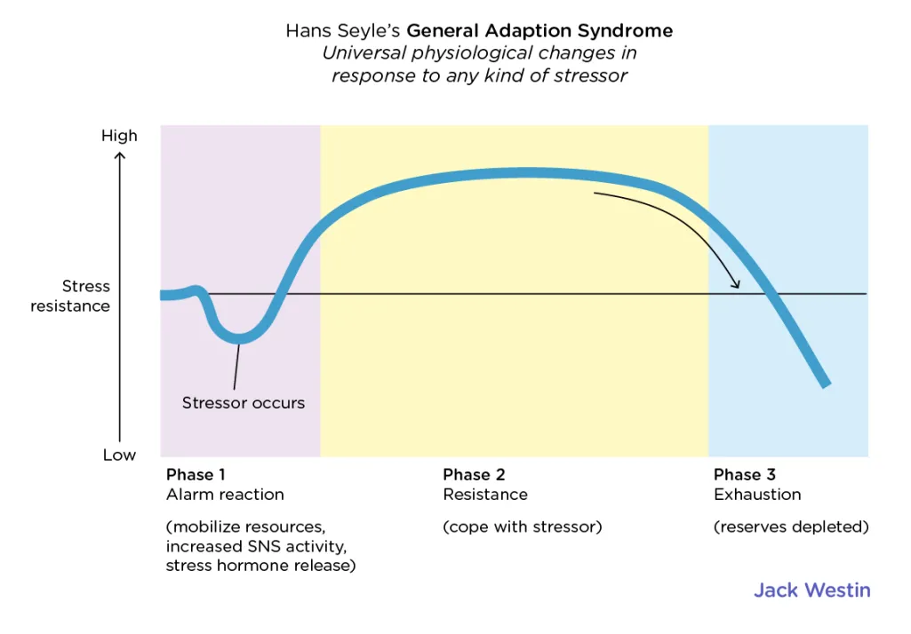
Stress and General Adaptation
Notes:
SELYE H. Stress and the general adaptation syndrome. Br Med J. 1950 Jun 17;1(4667):1383-92. doi: 10.1136/bmj.1.4667.1383. PMID: 15426759; PMCID: PMC2038162.
Hungarian scientist and researcher Hans Seyle defined general adaptation syndrome (GAS) as the body’s typical response to stress. Seyle concluded that stress typically manifests as a series of physiological changes that affect the whole body. These changes occur in three stages:
alarm reaction stage
resistance stage
exhaustion stage

Slide 8
Alarm stages
The alarm reaction stage is the initial stage that happens shortly after exposure to a stressor.
During this stage body goes into Fight, Flight or Freeze mode in an effort to confront or flee the threat.
This causes the body to release the stress hormones cortisol and adrenaline, which starts a series of changes in your body.
Notes:
Any stressor, whether real or imagined, alerts the brain to stimulate the autonomic nervous system.

Slide 9
The resistance stage
In the second stage, as your body adapts to the threat, it begins to counteract, or resist, the physiological changes.
Notes:
If the stressful event continues, the hormonal changes from the alarm stage continue to keep you in a state of alert. As a result, you may experience increased glucose levels and higher blood pressure.
If the stressful event passes, your stress hormones begin to decrease. Your heart rate and blood pressure return to normal as your body shifts to a state of repair.

Slide 10
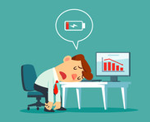
Exhaustion stage
Notes:
The third and final stage of is the exhaustion stage. In this stage, your body’s resources are depleted after attempting to repair itself during the resistance stage.
If the original threat has passed, your body will continue to recover. But if stress continues, the body no longer has the energy to fight it, which may lead to:
feeling tired or fatigued
irritability
anxiety
depression
other stress-related health conditions

Slide 11
Reference
https://psychology.org.au/for-the-public/psychology-topics/stress
SELYE H. Stress and the general adaptation syndrome. Br Med J. 1950 Jun 17;1(4667):1383-92. doi: 10.1136/bmj.1.4667.1383. PMID: 15426759; PMCID: PMC2038162.
Schneiderman N, Ironson G, Siegel SD. Stress and health: psychological, behavioral, and biological determinants. Annu Rev Clin Psychol. 2005;1:607-28. doi: 10.1146/annurev.clinpsy.1.102803.144141. PMID: 17716101; PMCID: PMC2568977.
Chaves T, Fazekas CL, Horváth K, Correia P, Szabó A, Török B, Bánrévi K, Zelena D. Stress Adaptation and the Brainstem with Focus on Corticotropin-Releasing Hormone. Int J Mol Sci. 2021 Aug 23;22(16):9090. doi: 10.3390/ijms22169090. PMID: 34445795; PMCID: PMC8396605.

Slide 12
Notes:
If you are living in Australia and need urgent support please contact our emergency services on 000. You can also contact 24 hour support line numbers such as lifeline on 13 11 14 if necessary.
Treatment CBT- Mindfluness based treatmmnet

