Slide 1

APARTMENT/
REAL ESTATE ADS CASE STUDY
01.
CLIENT GOALS
The goal is to book appointments so they can lease out apartments at these luxury buildings in Chicago, Illinois.
02.
CLIENT EXPECTATIONS
Hoping to get around 20 Leads/Month

Slide 2
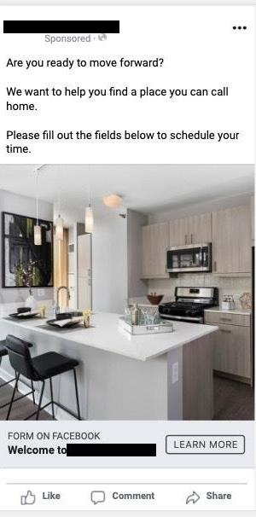
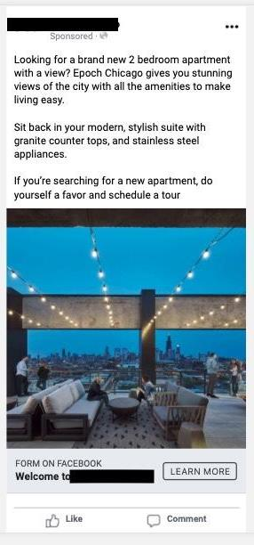


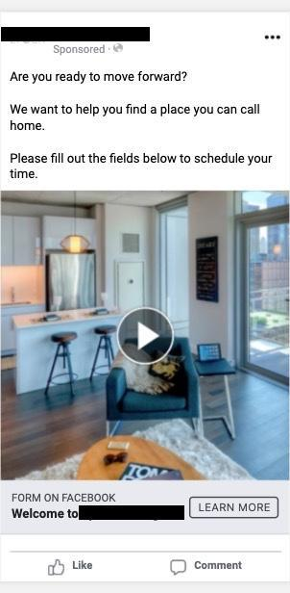
ADS USED IN THE CAMPAIGN

Slide 3
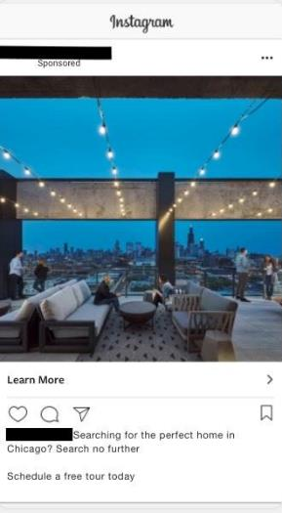
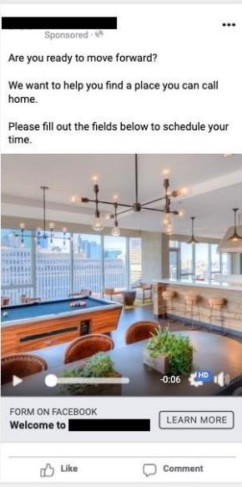
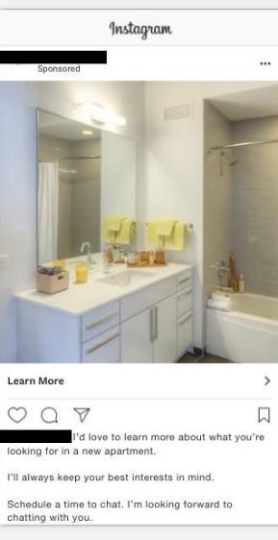
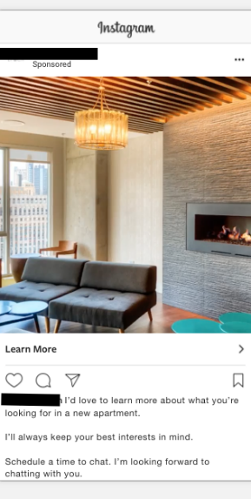

ADS USED IN THE CAMPAIGN
‹#›

Slide 4
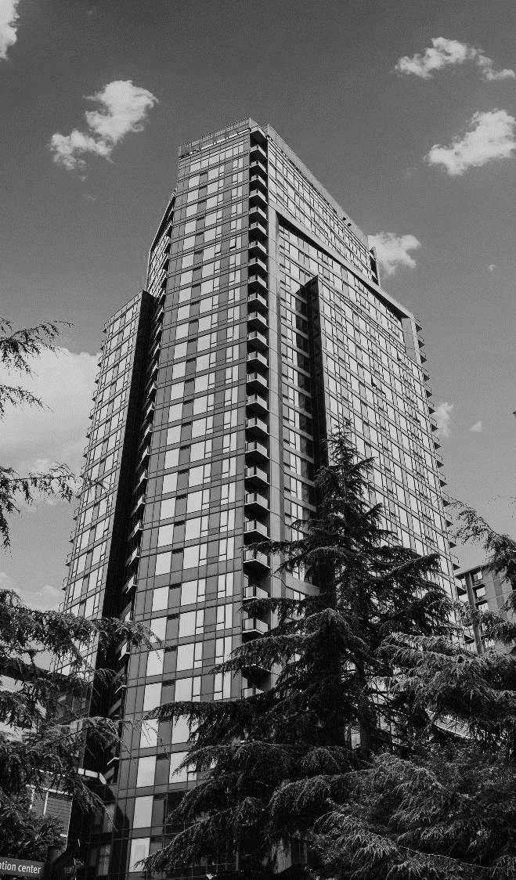
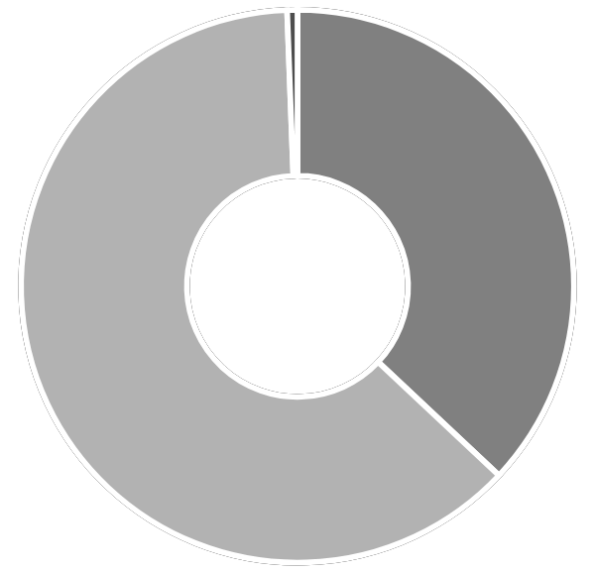
RESULTS
ADS SUMMARY
Reach
Impressions
On-Facebook leads
Clicks (all)
3,376
7,230
63
607
Page engagements
People taking action
People taking action rate %
Link clicks
CTR (all)
2,234
4,815
129.32%
230
8.40%
DEMOGRAPHICS
Region | Impressions 🞃 | Reach | Clicks (all)
Illinois | 6,279 | 2,915 | 537
Indiana | 951 | 461 | 70
Age | Impressions 🞃 | Reach | Clicks (all)
55-64 | 1,877 | 840 | 168
65+ | 1,404 | 596 | 168
45-54 | 1,331 | 571 | 101
25-34 | 1,288 | 698 | 96
35-44 | 812 | 409 | 53
18-24 | 518 | 262 | 21
37%
62.4%
Male
Female
Unknown
951
6,279
‹#›

Slide 5

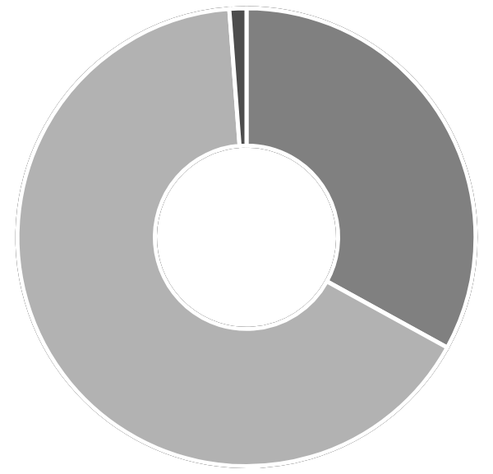
RESULTS
ADS SUMMARY
Reach
Impressions
On-Facebook leads
Clicks (all)
4,175
10,623
16
227
Page engagements
People taking action
People taking action rate %
Link clicks
CTR (all)
116
367
8.79%
113
2.1 4%
DEMOGRAPHICS
Age | Impressions 🞃 | Reach | Clicks (all)
25-34 | 6,991 | 2,685 | 150
18-24 | 3,325 | 1,378 | 70
35-44 | 307 | 113 | 7
33%
Male
Female
65.8
Unknown

Slide 6
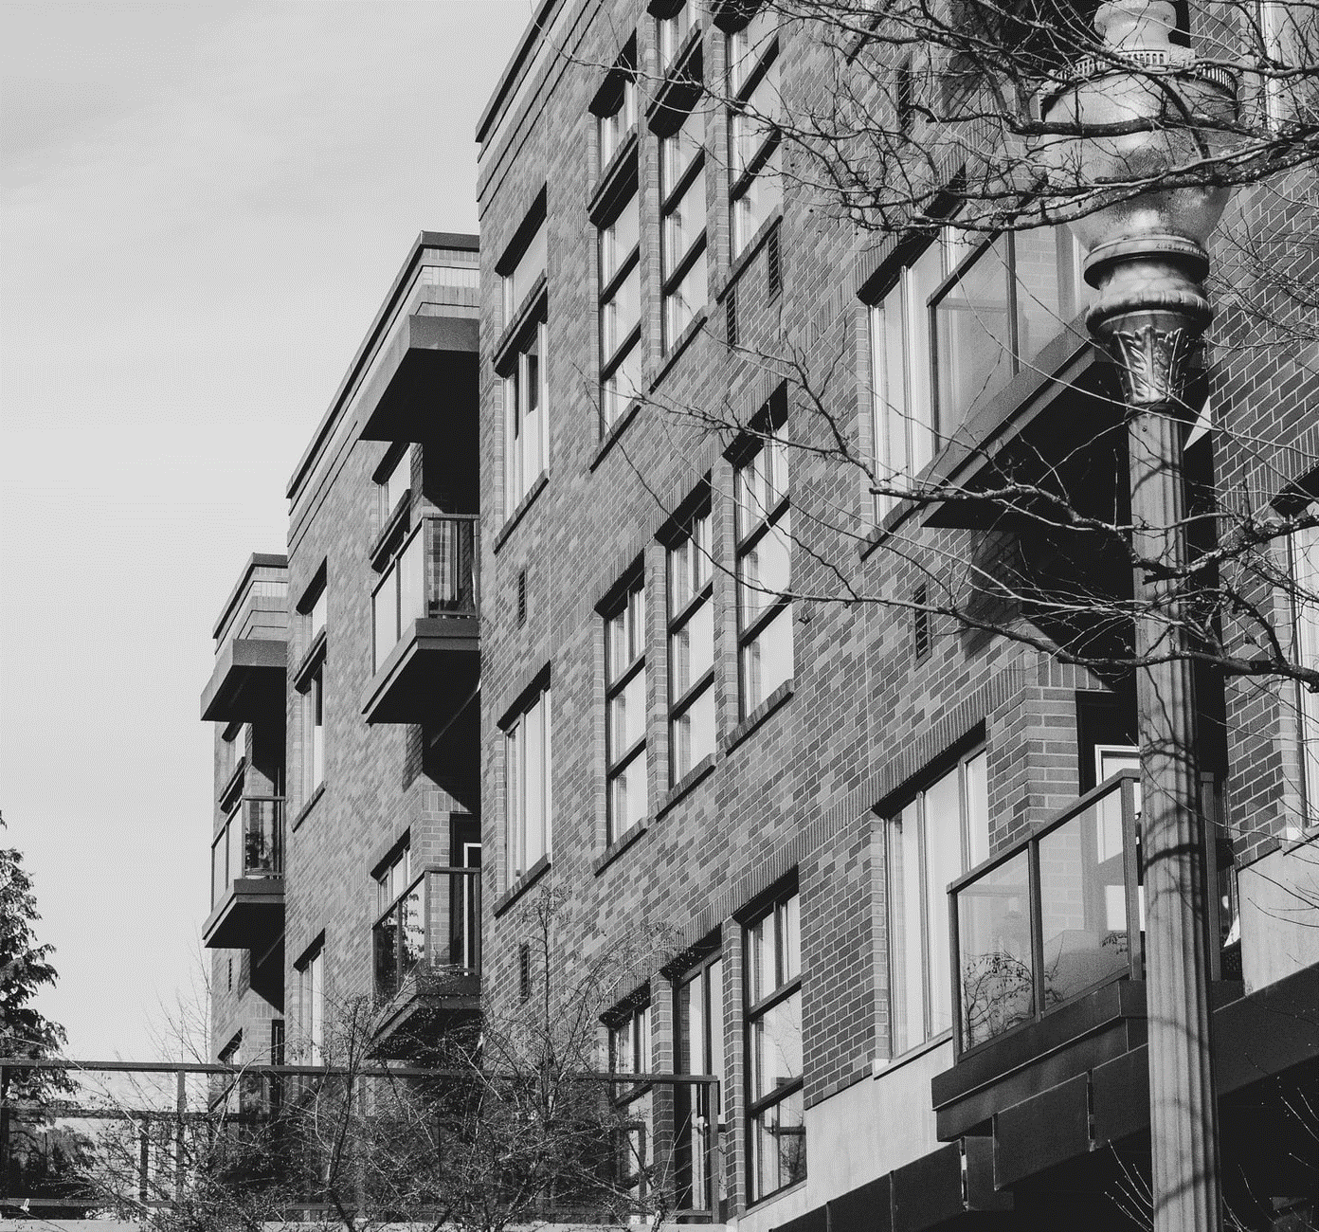
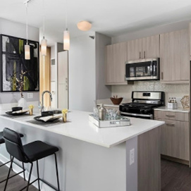
RESULTS
Region | Impressions 🞃 | Reach | Clicks (all)
Illinois | 10,346 | 4,023 | 221
Indiana | 277 | 152 | 6
277
10,346
Image asset photo 🞃
Ad body
Are you ready to move forward?
We want to help you ﬁnd a place you can call home.
Please ﬁll out the ﬁelds below to schedule your time.

