Slide 1
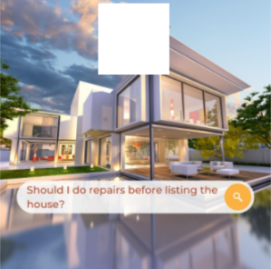


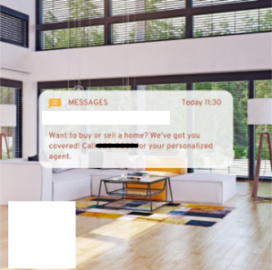

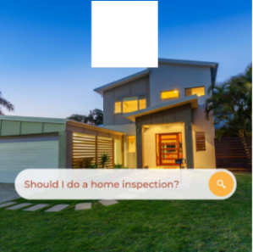



SOCIAL MEDIA MANAGEMENT STUDY
REAL ESTATE
01.
CLIENT GOALS
They want posts for their Instagram that are more engaging in hopes of attracting more clients. Other than regular property posts they need help with their content.
02.
CLIENT EXPECTATIONS
Promised number of Instagram posts, to increase engagement and awareness

Slide 2
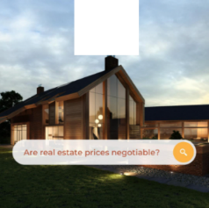









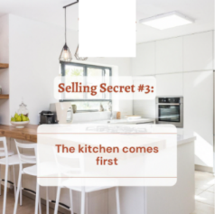

Slide 3


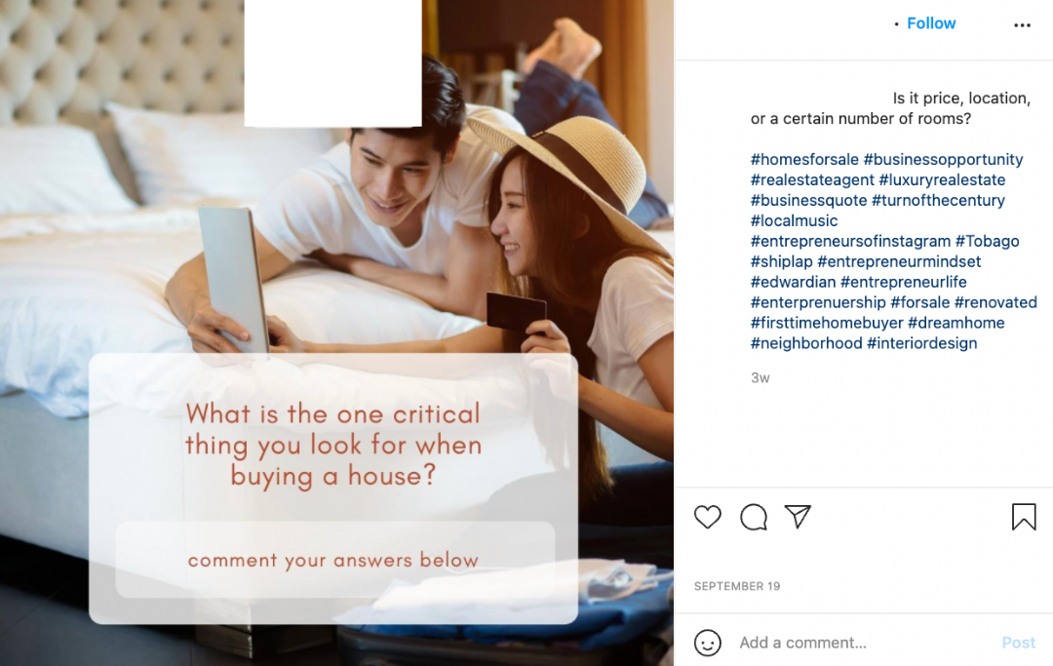

Slide 4
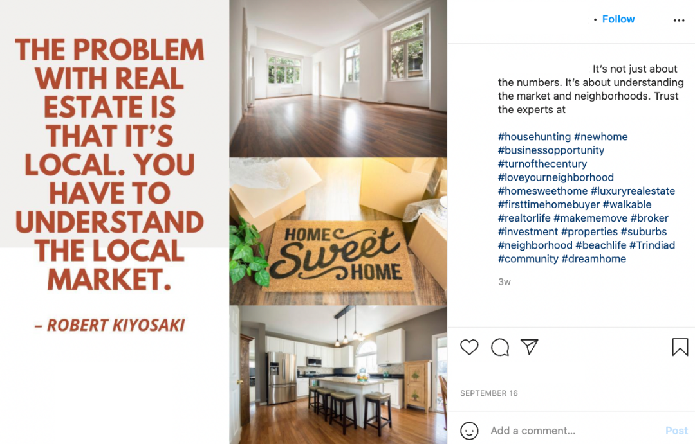

Slide 5

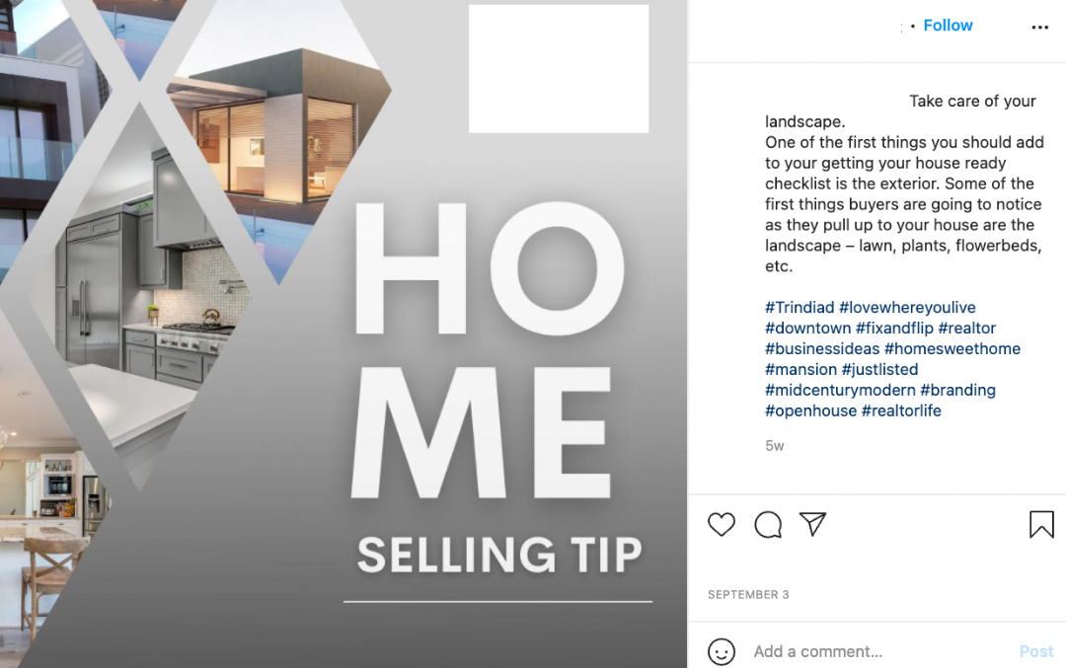
http://www.website.com
http://www.website.com
http://www.website.com

Slide 6
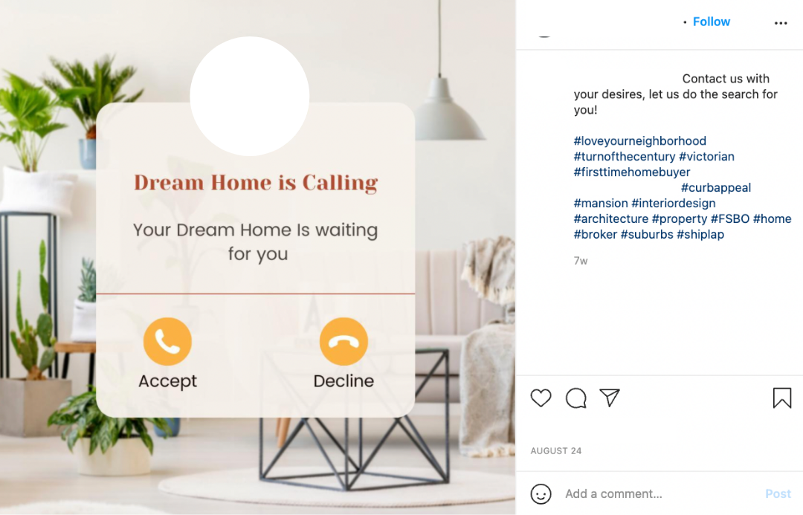
http://www.website.com
HASHTAGS 10-15 ARE RANDOMLY SELECTED FOR EACH POST:
#entrepreneurmindset #neighborhood #househunting #branding #homesforsale #makememove #business #forrent #sold #renovated #shiplap #firsttimehomebuyer #beachlife #walkable #enterprenuership #architecture #realestateagent #midcenturymodern #Trindiad #home #realestateinvestor #businessideas #broker #homesweethome

Slide 7

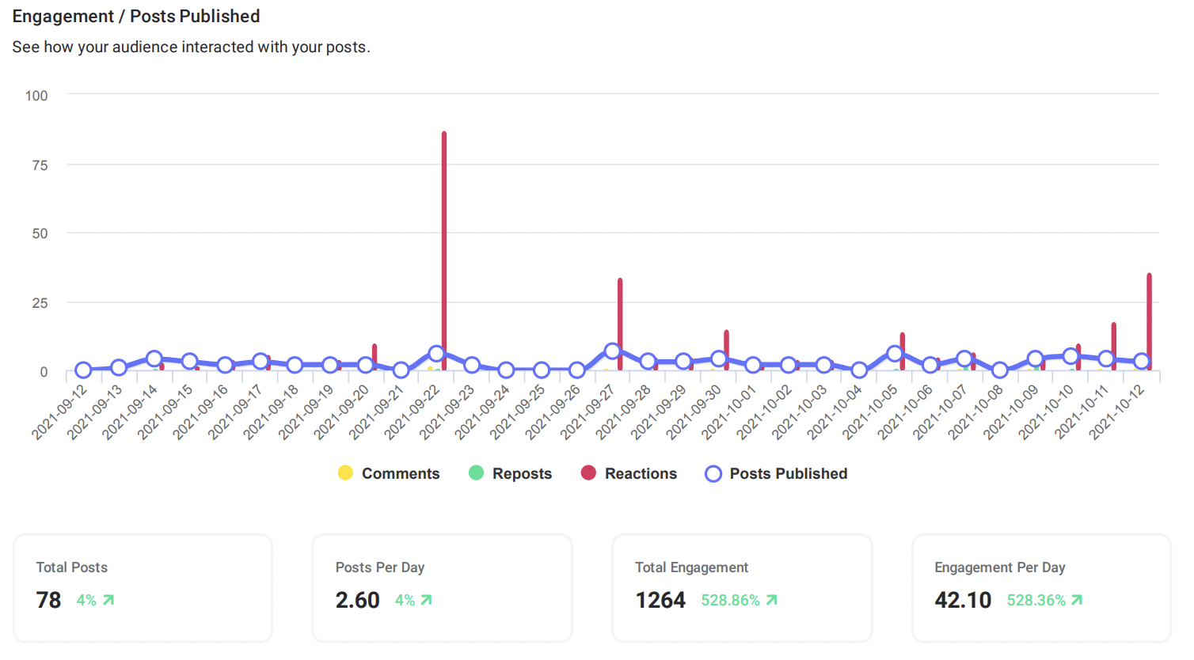
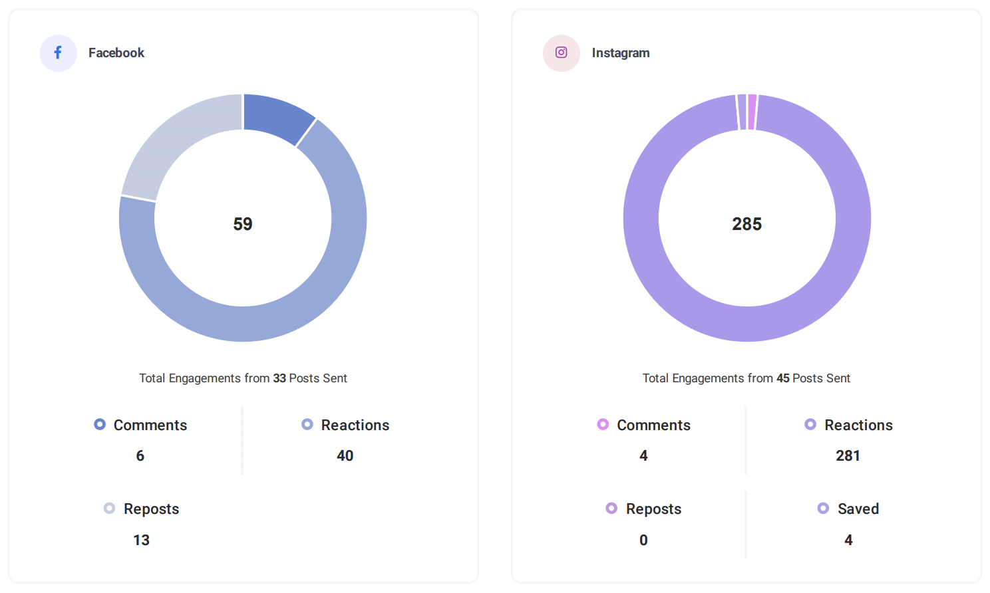
PROFILES PERFORMANCE SUMMARY

