Slide 1




DIGITAL
ADS
OUR RESULTS

Slide 2



OVERVIEW
OUR CLIENTS
We have worked with hundreds clients in dozens of industries running lead generation and digital ads for them. Our post popular industries are:
Attorneys
Auto dealers
Chiropractors
Coaches
gyms and crossfire centers
Day spas
Dentists
Hair salons
Home services and handymen
Martial art gyms
Medical spas
mortgage loans
Pest control companies
Realtors
Restaurants
Solar businesses
Yoga studios

Slide 3

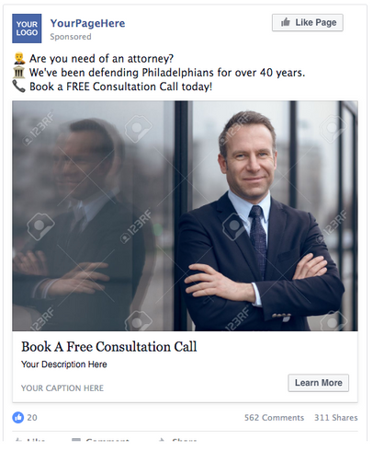



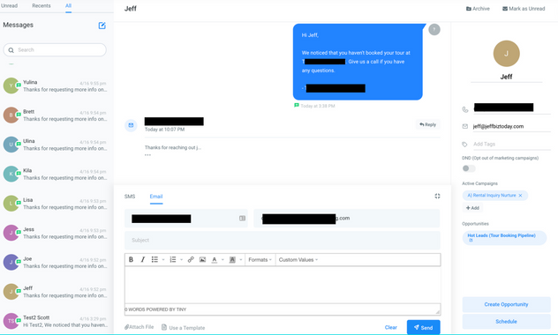
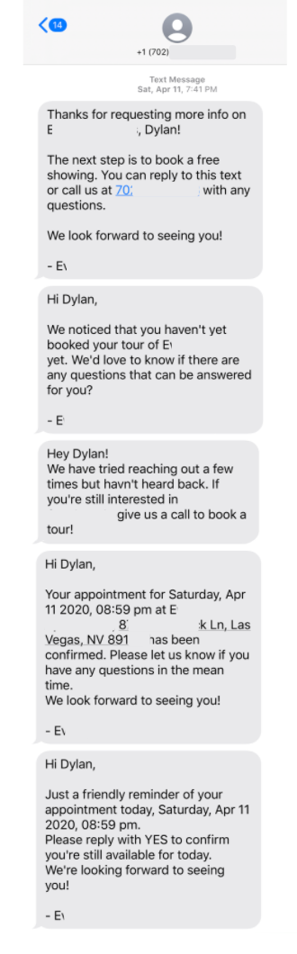
WHAT WE DID
OUR
ADS
We setup ads like this one with Facebook and Google PPC campaigns to find new clients.
LEAD NOURISHING
We also setup automated lead campaigns that send automated text reminders, follow ups, and more to the leads.

Slide 4


AUTOMATED FOLLOWUPS
Leads are contacted as soon as they respond to an ad.
They are encouraged to book a consult.
They receive automated follow ups over several days/weeks.
When they book their consult they are sent a confirmation.
And they receive appointment reminders so they don't forget.

Slide 5

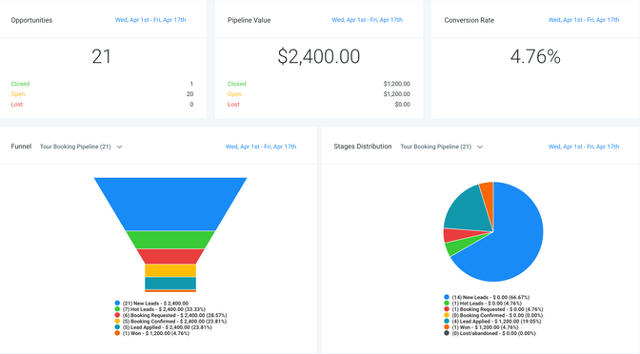
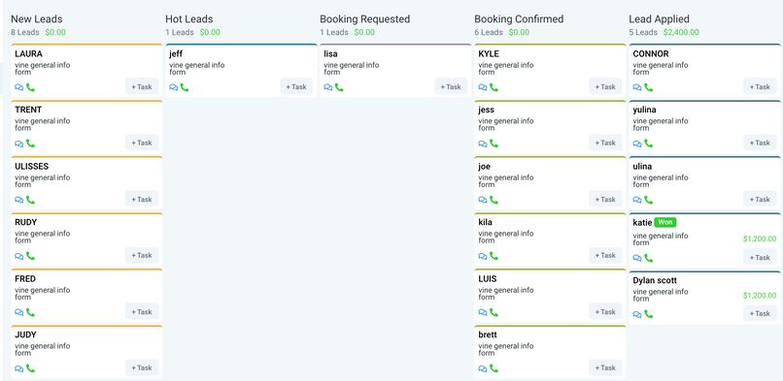
TRACKING AND ANALYTICS
tracking the data
CRM DASHBOARD
Included with this service is free access to our CRM dashboard that allows you see all the leads, communicate with them in real time, and track the results.

Slide 6

RESULTS
AVERAGE NUMBERS PER $2,000 SPENT
96
2803
204
THOUSAND
IMPRESSIONS (PEOPLE WHO SAW THE ADS)
PEOPLE CLICKED THROUGH OR ENGAGED WITH THE AD
TOTAL LEADS GENERATED
17%
leads book a consultation
35
appointments
25%
closing ratio
9 SALES MADE
THOUSANDS IN REVENUE
POSITIVE ROI
from the ads and lead campaigns

Slide 7

SUMMARY
from the work we did
Our ads are great for local and non-local businesses. Our special dashboard and automation ensures that you get the most our of all the advertising money you are spending, and your customers are always taken care of.
CONTACT
US
TODAY!

