Slide 1
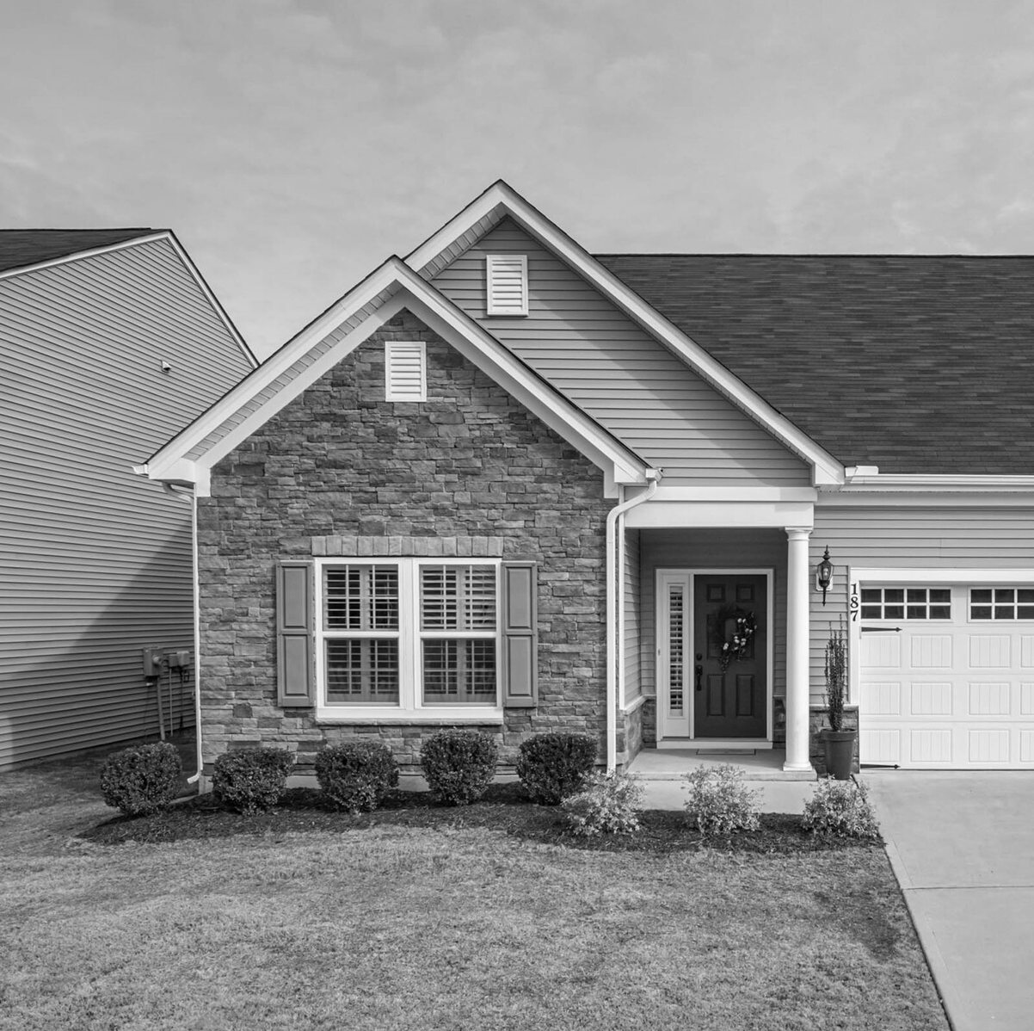
DIGITAL
ADS FOR
REAL ESTATE

Slide 2

OVERVIEW
A real estate company in Las Vegas, NV contracted us to run digital ads for their subdivision.
They wanted to sell the remaining 20 homes in their 122 home community.
THE CLIENT
They had exhausted all other "traditional" marketing methods and needed to expand online
We ran Google, Facebook, and Instagram ads to generate high quality leads for them.
We started on a 6 month contract with a fixed retainer of $4,000 a month.

Slide 3
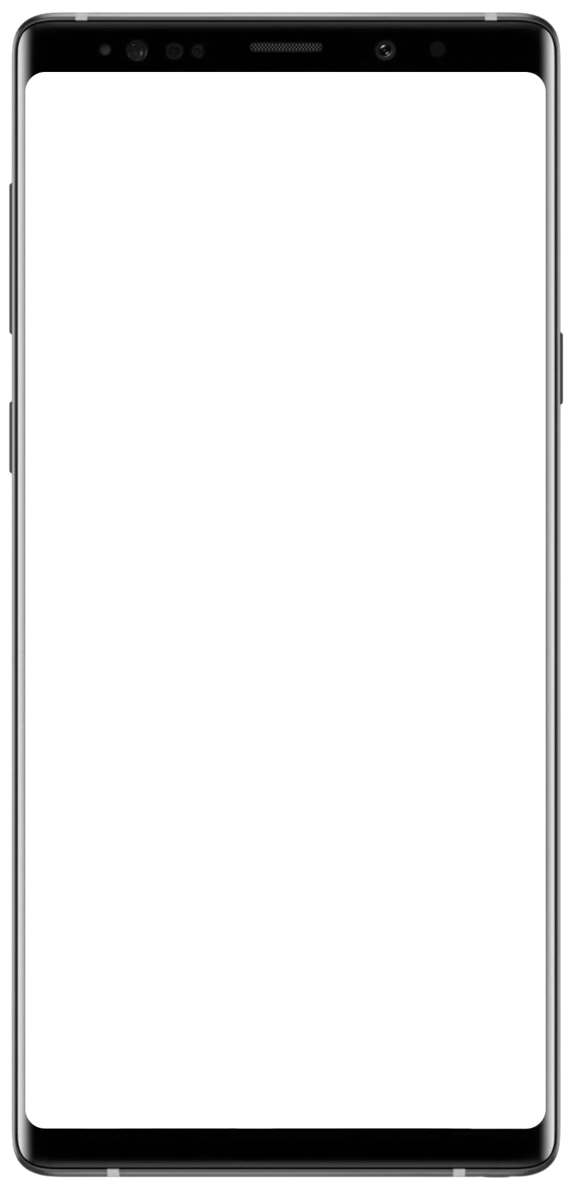
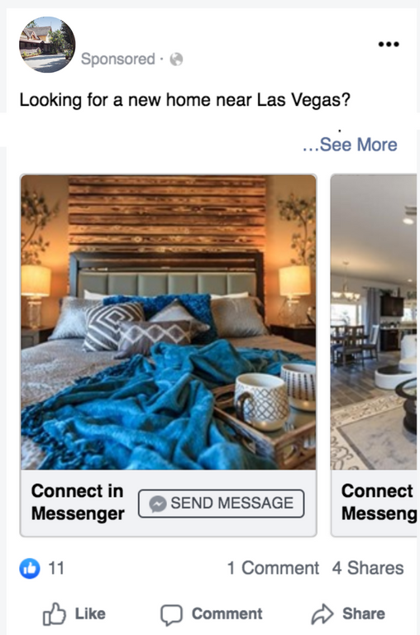

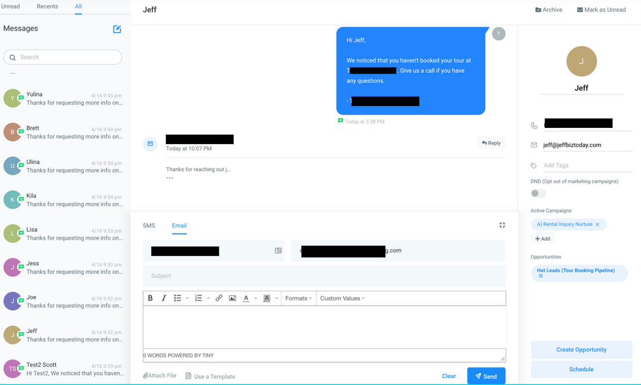
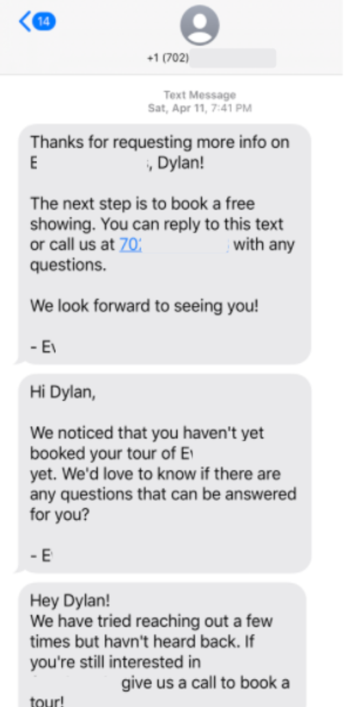
WHAT WE DID
OUR ADS
LEAD NOURISHING
We setup ads like this one on setup Google PPC campaigns to find buyers.
We also setup automated lead campaigns that send automated text reminders, follow ups, and more to the leads.

Slide 4

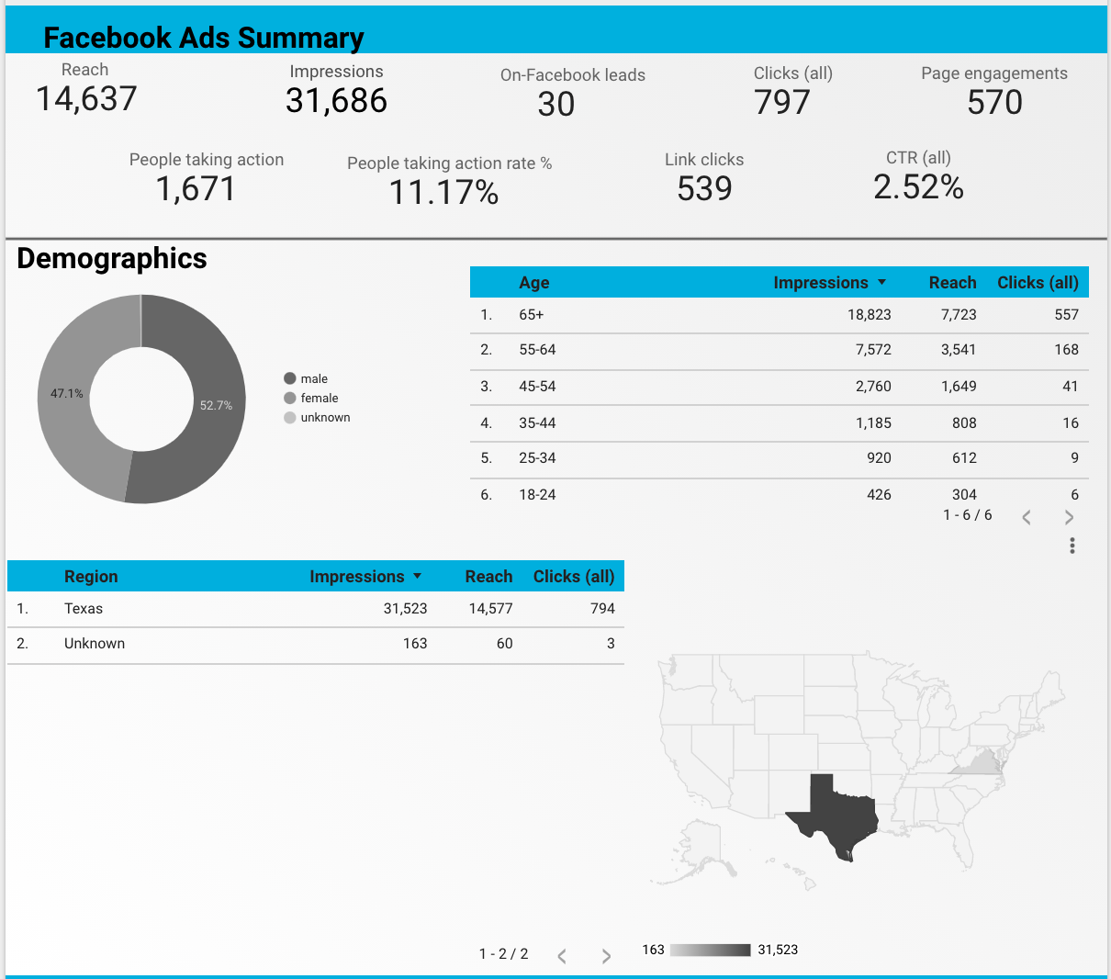
TRACKING AND ANALYTICS
LIVE REPORTING DASHBOARD
We provide full transparency!
Our clients get free access to a live reporting dashboard to track real-time advertising metrics, including CTR, impressions, reach, audience demographics, and more.
* *Image just for new dashboard view, see other slides for results

Slide 5

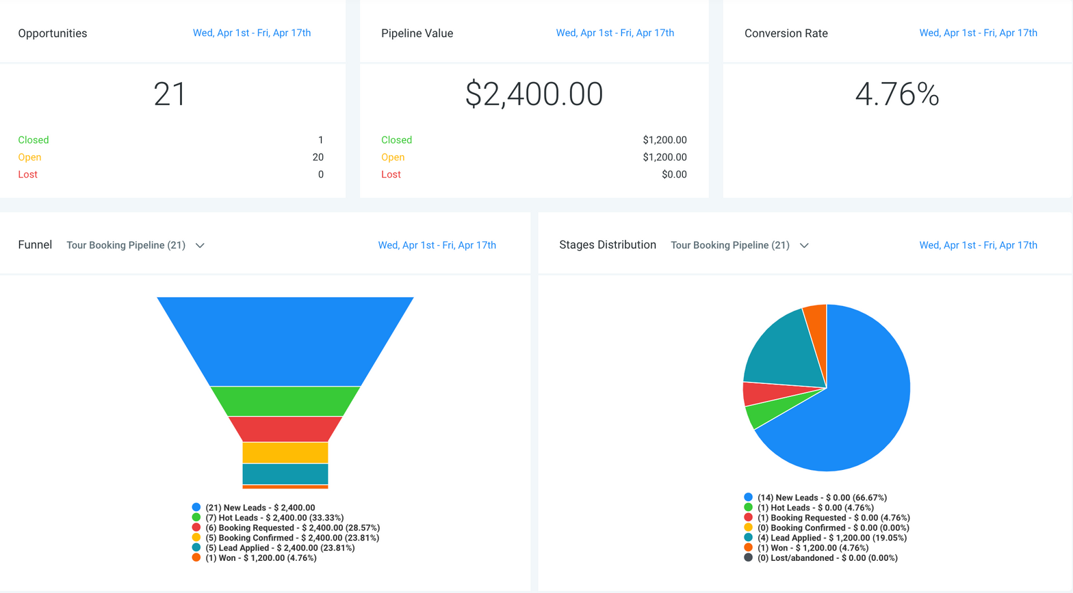
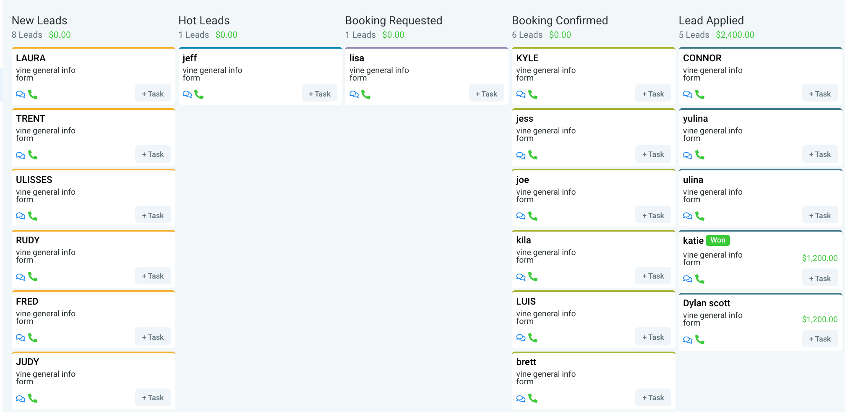
MONITORING THE LEADS
Track Your Leads
CRM INTEGRATION
For our lead generation campaigns, we set clients up with an account on our CRM dashboard. With it, we run automated lead follow-up campaigns to maximize the potential of each lead.
Using the CRM clients can monitor their leads, communicate with them in real time by text, voice, email, etc, schedule them for appointments, and more!*
*Some features such as SMS may be limited outside of the USA.

Slide 6

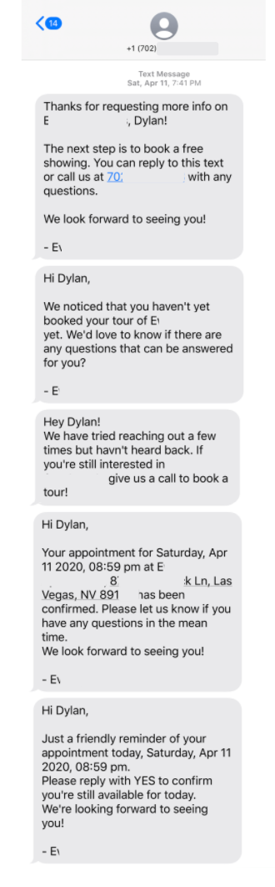
AUTOMATED FOLLOW-UPS
Our CRM maximizes the potential of each lead by automating a portion of the follow-up and communication.
01
Leads are contacted as soon as they respond to an ad.
02
They are encouraged to book their free trial, consultation, etc.
03
They receive automated follow ups over several days/weeks.
04
When they respond, they can book an appointment
05
And they receive appointment reminders so they don't forget.

Slide 7
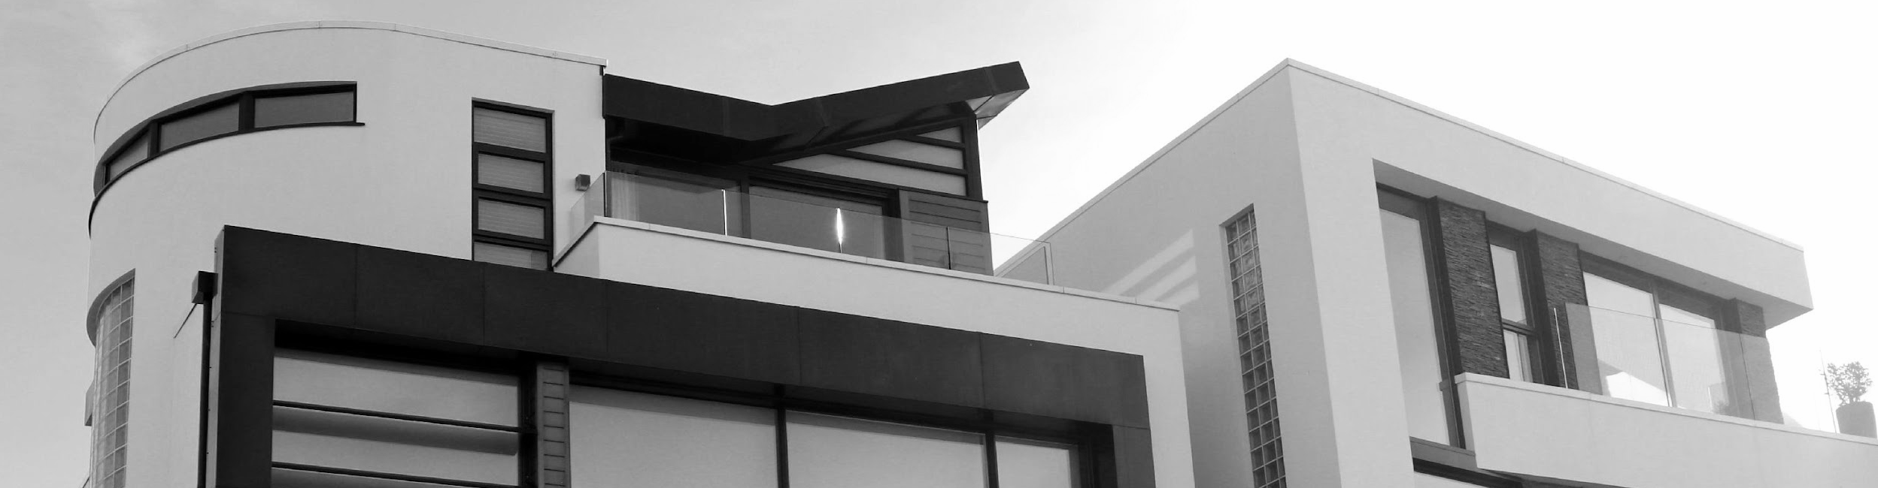
RESULTS
NUMBERS & ANALYTICS
21%
Leads book a strategy session
65
11%
Closing Ratio
Showings
Total Results | Total
Total impressions generated | 221,988
Total clicks generated | 7,632
Total leads generated | 306
Total Results | Total
Impressions generated on Google | 177,720
Impressions generated on FB/IG | 44,268
Clicks to website generated on Google | 6,774
Clicks generates on Facebook/IG | 858
Leads generates on Google | 42
Leads generates on Facebook/IG | 60
Leads generates on the website | 42
Leads generates on our landing pages | 204
222
Impressions (people who see the ads)
THOUSAND
7,632
People click through or engage with the ads
7 HOMES SOLD
from the ads and lead campaigns
306
Total Leads Generated
$2,083,515
8,700% ROI
In revenue
generated from the $24,000 marketing comtract

Slide 8
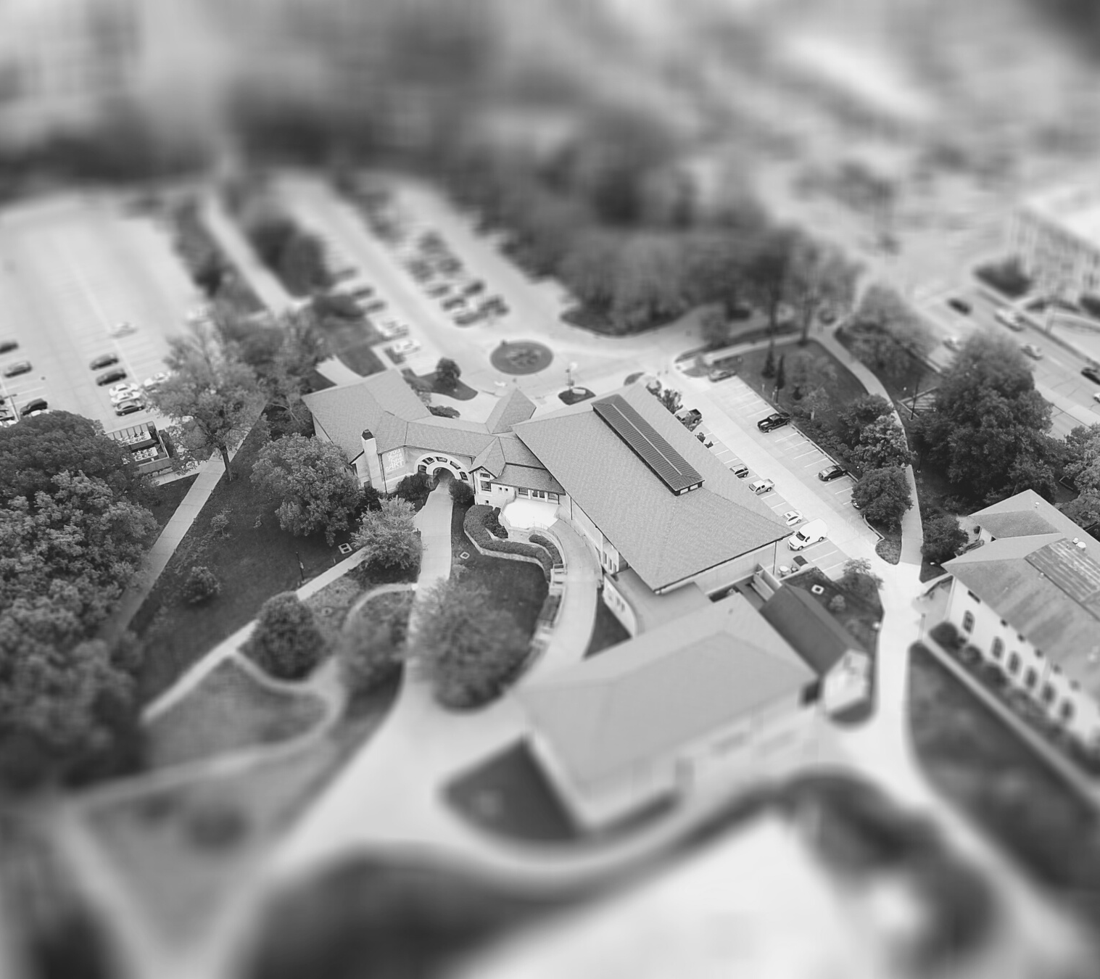
For this client we helped them sell the rest of their homes and close out the subdivision project.
SUMMARY
These campaigns can be done for realtors, home builders, brokerages and clients in other niches.
CONTACT
US TODAY!
from the work we do

