Slide 1
RESURGENT MONTREAL INC
Corporate Presentation

Slide 2
WHO WE ARE..
Incorporated in Canada in 2018.
Based out of Montreal.
Serving both Public Listed Companies and Private Companies
Our key offerings
  CFO Services
  Controller Services
  Book-keeping Services
  Tax – Income tax / VAT
  Due Diligence
  General advisory

Slide 3
SECTORS SERVED
Mining
Telecom Real Estate Pharma
Trading, etc.

Slide 4
OUR SERVICES
CFO Services
Reverse Take overs
Cost and ERP Implementation
Stock Exchange Reporting
Financing
Financial Modelling
Internal Controls
Controller Services
Full Cycle Accounting
GST/ PST Returns
Audit coordination
Book-keeping services
Upto date Book- keeping
24/7 services for follow-up
Zero back log
Expert in Quick Books, SAGE, Acomba, Xero, SAP, etc..
Due- Diligence
Buy-side financial due diligence
Financial Modelling
Valuation reports
General Advisory
Investor presentations
Preparation of Information Memorandum
Optimal structuring options
Design options for M&A transaction

Slide 5
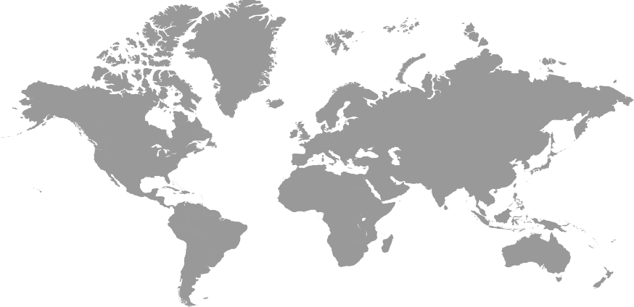
OUR FOOTPRINTS: OFFERING 24X7 RESPONSE
Our clients are located in Canada, USA, Mexico, UK, Ireland and Austria.
We are able to service our clients from Canada, India, Bangladesh and New Zealand

Slide 6
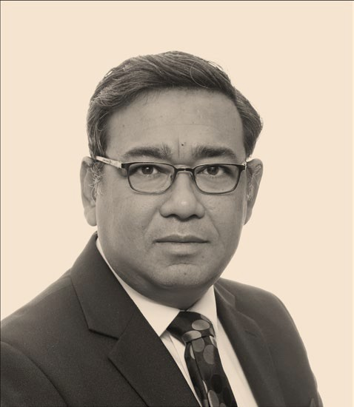
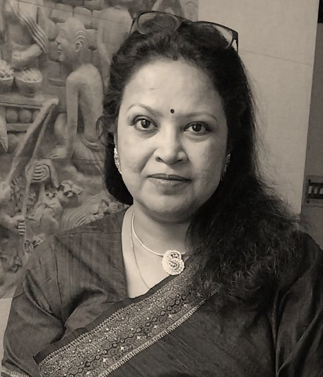
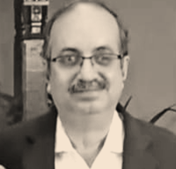
OUR TEAM
Rima Roychowdhury
ACA India
Arnab De
CPA Canada, CGMA UK, CMA Ind, MBA IIMC
Ahmed Reza
CMA India
Over 25 year of Industry Experience.
Ex- EY International Tax Head;
Currently Controller in Telus Telecom
Tax Services to High Net Worth Individuals
International Tax planning for Corporates
Over 25 year of Industry Experience.
Ex- CFO Suzlon
Accounting consultancy services to various clients in Canada and Europe
Over 25 year of Industry Experience.
More than 19 years in Tata Group.
Been CFO of Tata Steel Minerals Canada; CFO JCAPCL (JV with Nippon Steel);
Currently CFO in several Public Listed Companies and Private Companies

Slide 7
SOME OF OUR VALUED CLIENTS
Telecom
Telus
Real Estate
Adero Group
Mining
Canadian Metals Inc.
EDM Resources Corp
Fancamp Exploration Ltd.
A M Resources
Crestview Exploration Inc
QNB Metals Inc
Cosmetics
Poko Innovations
Pharma
Trading
Defence Therapeutics
Mesabi Metallics
Eurolegno
Analog Gold Resources
Manufacturing
Figura Machining
First Phosphate Inc

Slide 8
We Closely Work With
Audit
MNP
Crowe
Legal
Stikeman Eliott
McMillan
Consultants
DRA/ Metchem
Maazars
PWC
Deloitte
Lavery

Slide 9
OUR OFFER
Local support for
  Corporate Tax – compliance, interpretation and execution
  VAT
  Transfer Pricing – Setting up, preparation and compliance
  Fractional CFO Services
  Bookkeeping
  Review engagement

Slide 10
WHY RESURGENT?
Credible track record of delivery – A Tata grooming and training
Experience of servicing the industry for the past 5 years in North America.
Expertise in International Taxation
One stop solution for Finance / Accounts / Corporate Tax / VAT / Transfer Pricing / Tax Advisory / Administrative services
Local presence
24x7 Response as response centres are spread across the world

Slide 11
End of the deck
Resurgent Montreal Inc.
1216-3577 Ave Atwater
Montreal, H3H 2R2

