Slide 1


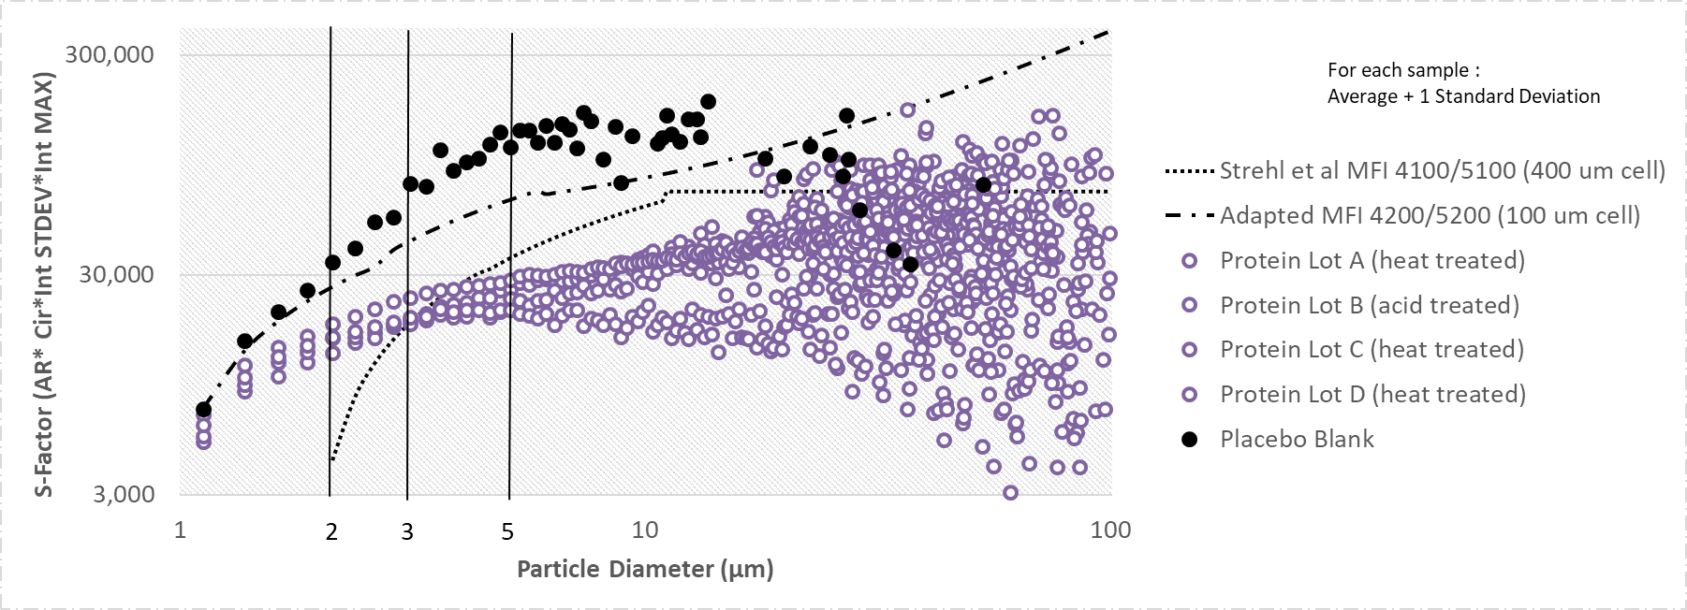
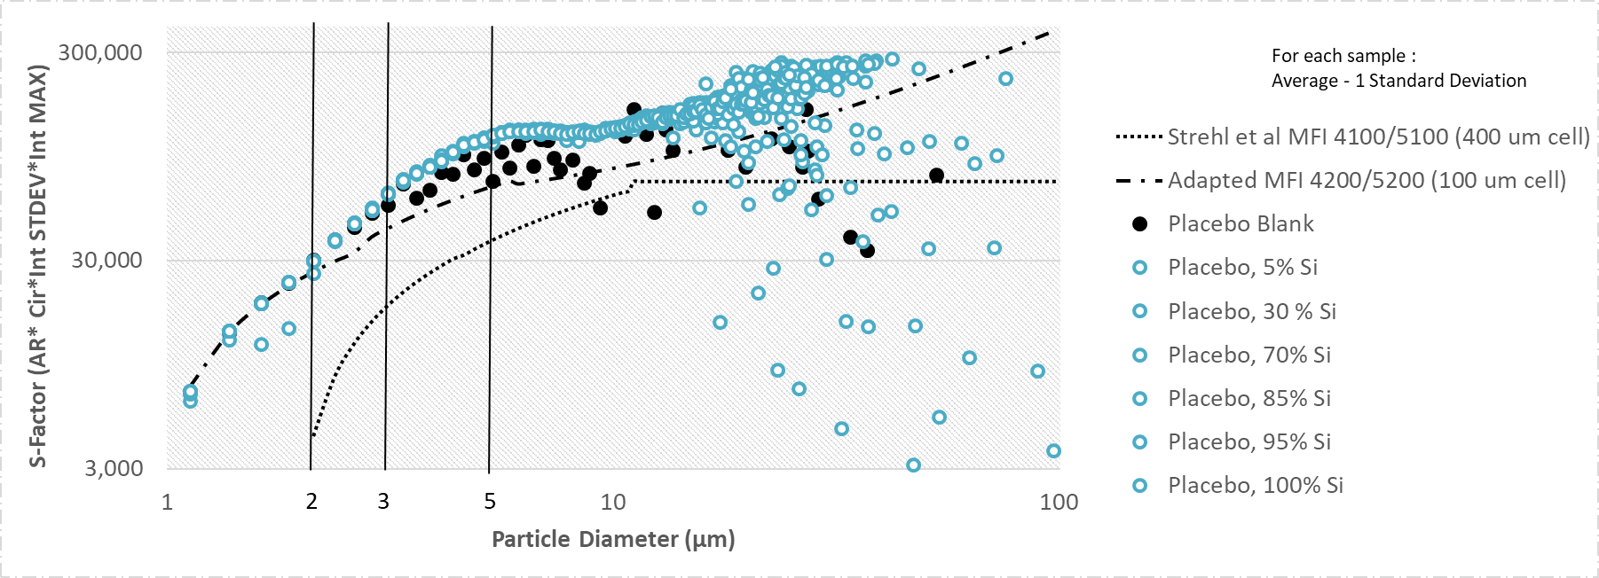
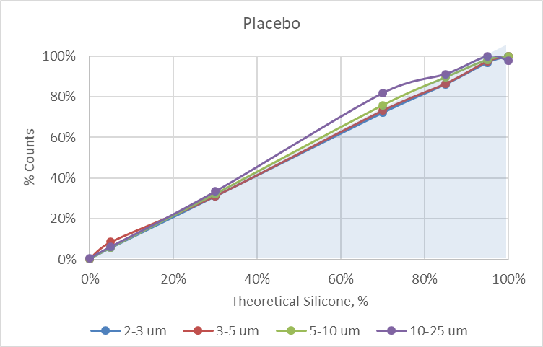
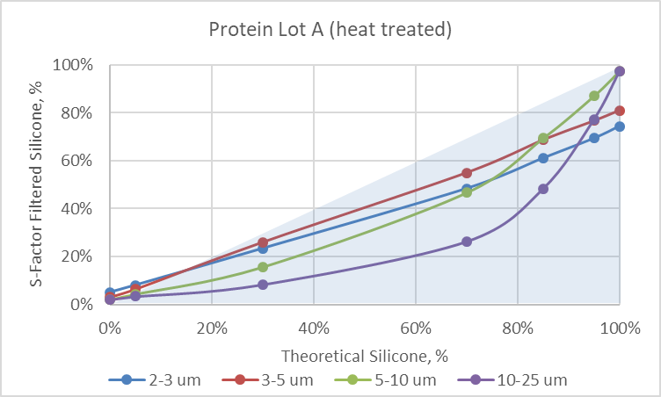
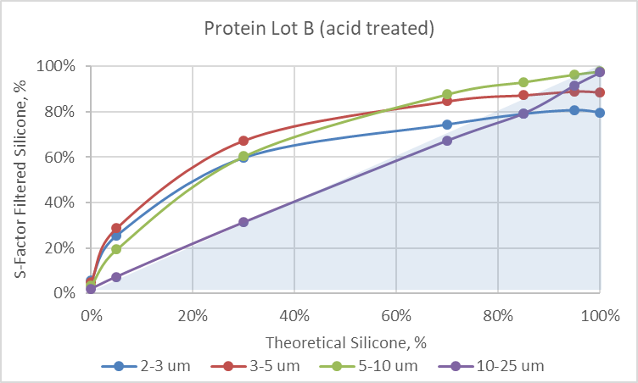
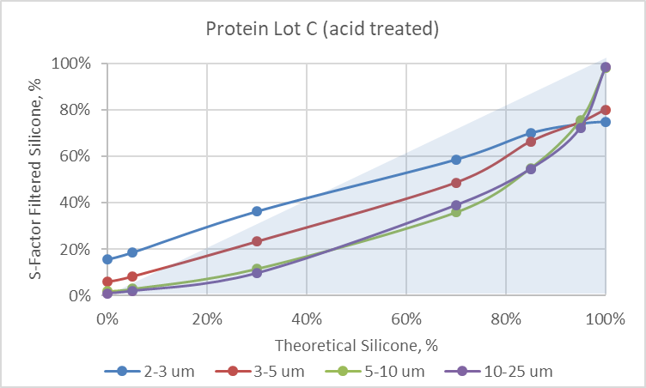
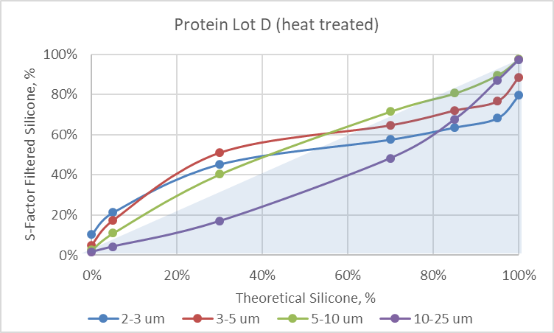
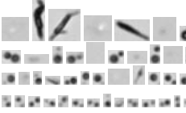
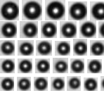
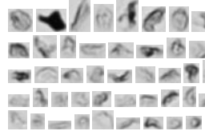
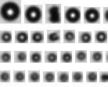
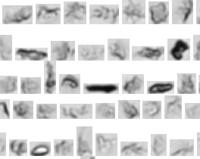
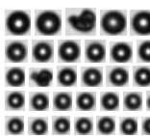
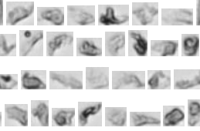
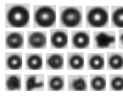
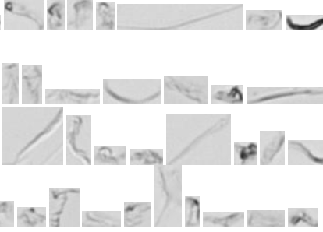
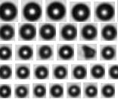
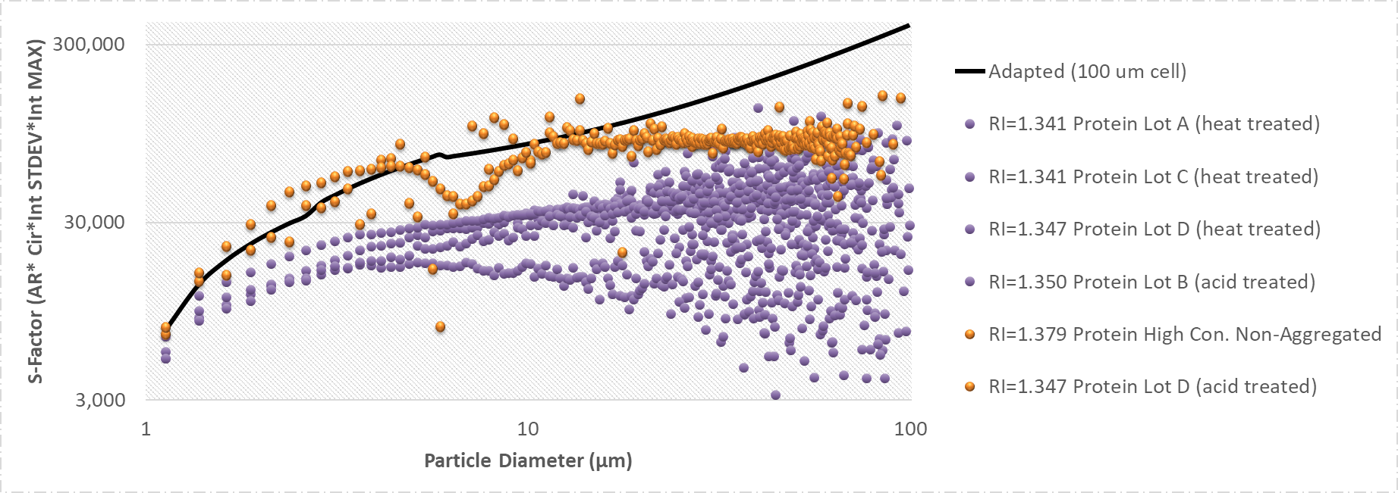
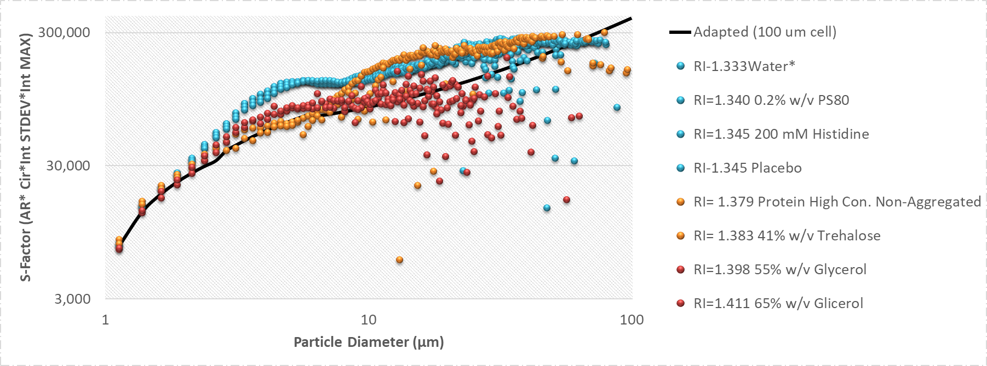
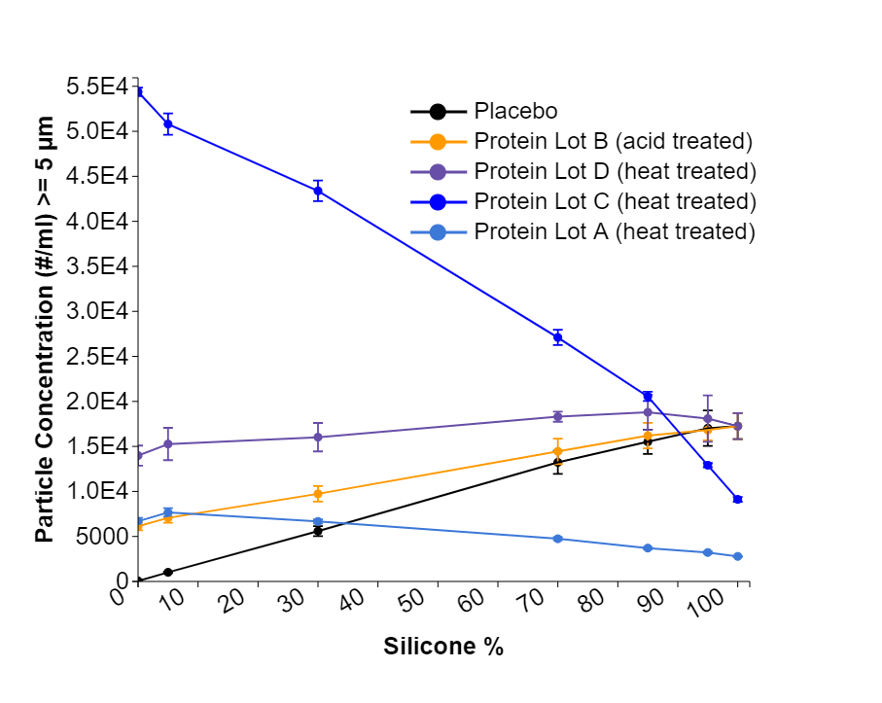
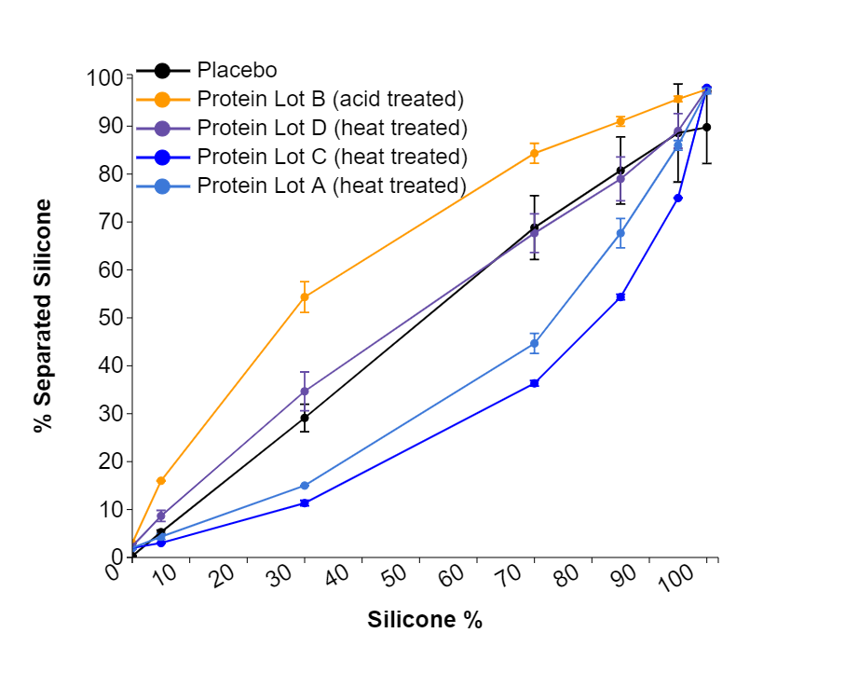


Aspects of silicone separation in protein-silicone mixtures using S-factor-style electronic filter
E. Torres ¹, A. Mehta ¹ ,L. Rosner ^{1 ,} M. Lisowski ¹, P. Kolhe ¹, C. Merchant ², D. Thomas ²
¹ Pfizer BioTherapeutics Pharmaceutical R & D; ² Lumetics Inc.
Data Management and Analysis for Scientists
ABSTRACT
Distinguishing between silicone oil vs. non-silicone oil particulates in protein formulations is important both in terms of accurately detecting protein aggregation during stress/stability, as well as for studying the protein-silicone oil interactions.
Strehl et al. first reported a multi-parametric S-factor function capable of electronically filtering particles from data generated using a ProteinSimple MFI 4100 flow microscopy system with a 400 µm flow cell. However, any function permitting distinction between silicone oil and proteinaceous particulates is dependent both on the optics and image processing of the flow microscopy system utilized, as well as the optical properties of the sample (i.e. difference in refractive Index between fluid and particulate). Therefore, time-consuming offline data processing may be needed for S-factor optimization in each instance. To simplify the time consuming assessment and address optical properties challenges, we took an approach of understanding refractive properties of silicone oil/protein mixtures and used this to create an effective silicone oil filter using the Lumetics LINK software package.
In this poster an S-factor style filter was generated and applied to silicone oil and protein mixtures from data collected with a MFI 4200/5200 system and a 100 µm flow cell. A discussion on silicone oil quantification limitations due to a shift in solution refractive properties, as well as the linearity observed within silicone oil/protein mixtures as a function of specific particulate size ranges, will be presented.
Figure 1. Protein and Blank separated by S-Factor
Figure 2. Silicone and Blank separated by S-Factor
Table 3. Separation of Silicone in Protein/Silicone Mixtures ≥ 5 µm
 | Placebo + Silicone |  |  |  | Protein A (heat treated) + Silicone |  |  | Protein B (acid treated) + Silicone |  |  | Protein C (heat treated) + Silicone |  |  | Protein D (heat treated) + Silicone
Theoretical Silicone (%) | counts/mL Average | % count from total | % separated Silicone | % Error from Theoretical | counts/mL Average | % separated Silicone | % Error from Theoretical | counts/mL Average | % separated Silicone | % Error from Theoretical | counts/mL Average | % separated Silicone | % Error from Theoretical | counts/mL Average | % separated Silicone | % Error from Theoretical
0 % | 58 | 0% (blank) | 74% ± 10% | -- | 6,683 | 2% ± 0% | -- | 6,133 | 3% ± 0% | -- | 54,381 | 2% ± 0% | -- | 13,986 | 2% ± 1% | --
5 % | 1,015 | 6% | 98% ± 2% | 2% | 7,663 | 4% ± 1% | 13% | 7,062 | 16% ± 0% | -220% | 50,802 | 3% ± 0% | 40% | 15,269 | 9% ± 1% | -73%
30 % | 5,596 | 32% | 99% ± 0% | 1% | 6,665 | 15% ± 0% | 50% | 9,733 | 54% ± 3% | -81% | 43,386 | 11% ± 1% | 62% | 16,024 | 35% ± 4% | -16%
70 % | 13,229 | 77% | 98% ± 1% | 2% | 4,743 | 45% ± 2% | 36% | 14,451 | 84% ± 2% | -20% | 27,102 | 36% ± 1% | 48% | 18,300 | 68% ± 4% | 3%
85 % | 15,517 | 90% | 98% ± 0% | 2% | 3,706 | 68% ± 3% | 20% | 16,195 | 91% ± 1% | -7% | 20,559 | 54% ± 1% | 36% | 18,791 | 79% ± 5% | 7%
95 % | 17,021 | 99% | 98% ± 0% | 2% | 3,218 | 86% ± 1% | 9% | 16,822 | 96% ± 1% | -1% | 12,912 | 75% ± 0% | 21% | 18,086 | 89% ± 4% | 6%
100 % | 17,254 | 100% | 98% ± 1% | 2% | 2,785 | 97% ± 1% | 3% | 17,254 | 98% ± 1% | 2% | 9,116 | 98% ± 0% | 2% | 17,254 | 98% ± 1% | 2%
Typical Protein Aggregates, classified as Protein
Typical Silicone particles, classified as Silicone
Figure 5. Separated Silicone at 2-3 µm, 3-5 µm, 5-10 µm and 10-25 µm, grouped by size bins
Protein Aggregates mis-classified as Silicone
Extrinsic/doublets in Silicone, mis-classified as Protein
Protein/silicone separation per selected size bins, compared to silicone-placebo mixture
Placebo, no protein
Protein Lot A
Protein Lot B (acid treated)
Protein Lot C
Protein Lot D
Extrinsic particles in a Blank, mis-classified as Protein
Extrinsic particles in a Blank, mis-classified as Silicone
Each point on Figures 1 and 2 represents an average of triplicate measurements in each 0.250 µm size bin. The points are off-set by the standard deviation from the average of the triplicate.
S-factor separates protein aggregates from silicone droplets based on the shape and intensity values calculated by the instrument from each individual particle image. For MFI instruments these properties start losing distinction for particles << 3 µm as can be seen on Figure 1 and Figure 2. These figures also demonstrate how a filter designed for an MFI 4100/5100 with 400 µm cell is no longer applicable to MFI 4200/5200 with 100 µm cell due to different instrument optical settings (magnification and aperture). This results in changes to the image of a given particle and therefore its measured morphological parameters. Particle data ≤3 µm collected by MFI do not contain enough shape & intensity information to be subjected to electronic separation.
It is nearly impossible to create a silicone-spiked sample free of extrinsic particulates, therefore minor presence of the extrinsic/environmental particles needs to be acknowledged. In addition to the background particulates, blanks are often contaminated with the small number of tiny silicone droplets from previous runs as well as small round particles. Therefore most particles in the blanks are classified as silicone. Fiber-like extrinsic particles, silicone doublets and any other non-spherical background particles are classified as protein.
The lowest quantification limit for the filter should be defined as the signal to noise ratio (SN) >10, which means that counts in sample divided by the counts blank in the given size range should be higher than 10. For MFI instruments S/N ratio was determined to be the lowest in the 5-10 µm region or ≥ 5 µm (data not shown).
Example of Images ≥ 5 µm separated for 75% silicone samples
Classified as Protein
Classified as Silicone
Classified as Protein
Classified as Silicone
Classified as Protein
Classified as Silicone
Classified as Protein
Classified as Silicone
Classified as Protein
Classified as Silicone
INSTRUMENTS
MFI data were collected using ProteinSimple MFI 4200 and 5200 instruments in manual mode, equipped with a 100 µm flow cell.
Refractive Index data were collected at room temperature on Reichert Arias 500 Leica instrument with 589 nm wavelength light source.
Figure 3. Proteins with different light properties
Figure 4. Protein/excipients with different light properties
Mixtures of protein and silicone can be separated using S-factor filter, as shown in Table 3, Figure 5 and Figure 6.
Figure 5 demonstrates randomly selected images for the 70% silicone + 30% protein mixture. After inspection of 5000 images for each set it was determined, that very few silicone-like images were visually detected in the protein population.
Yet separation did not follow linear trend for all the sizes :
For a mildly acid-treated protein (Lot B), linearity was observed for the large particles ≥10 µm, which suggests that pH-induced aggregates might lose ability to interact with silicone above certain size range. Silicone overcounting was observed for the sizes <10 µm. In acid-treated sample interaction phenomena for small aggregates < 10 µm is unclear.
The opposite case was observed for the heat-induced aggregates (Lots A, C) , whereby the linear relationship was observed for particles below <5 µm and undercounting was observed for silicone particles ≥ 5 µm, suggesting possible silicone-protein interaction.
For the heat-induced aggregates in Lot D undercounting was observed only for silicone particles ≥ 10 µm.
METHODS
Monoclonal antibodies (protein) were formulated in histidine buffer with PS80, trehalose, EDTA and methionine, and stressed by heat and acid treatments to generate aggregates. Protein samples were mixed with silicone leached from glass BD syringes filled with same formulation (placebo). Silicone oil suspension was mixed with each protein and placebo in the following ratios: 100/0%, 95/5%, 85/15%, 70/30%, 30/70%, 5/95%, and 0/100%. Each ratio was prepared immediately before the measurement. Placebo and Proteins lot B and D were analyzed by 2 analysts using 3 different MFI 5200 instruments and proteins lot A and C were analyzed using a single MFI 4200 instrument.
Additionally, histidine, trehalose powder, PS80 and glycerol were spiked into silicone suspension leached from glass BD syringes filled with water to simulate various Refractive Index (RI) conditions. Readings were collected on 2 MFI 5200 instruments. Silicone-free controls were prepared for each condition to normalize for the background.
Refractive index was measured in triplicate at 589 nm wavelength and 23.5 ºC.
No sample filtration was performed as silicone content and droplet size is known to be affected by filtration.
Electronic separation of silicone from non-silicone particles (Figure 1) was calculated for MFI4200/5200 systems using data from 100% and 0% samples and applying sum of the following functions:
S=AspectRatio * Circularity * IntensityMax * IntensitySTD
Modified MFI 4200/5200 (100 µm)
  ≥ 1.125 and ≤ 2.625 µm 29732* LN(ECD)+3913
  ≥ 2.875 and ≤ 5.875 µm 46609*LN(ECD)-10464
  ≥ 6.125 µm 3368*(ECD)+49124
Strehl et al: MFI 4100/5100 (400 µm)
  ≥ 2.13 and ≤ 4.38 µm 36375* LN(ECD)-23108
  ≥ 4.63 and ≤ 10.88 µm 38767*LN(ECD)-27428
  ≥ 11.13 µm 7200
Figure 6. Reported Results ≥ 5 µm
Table 4. Separation variability (% CV) in 3 replicate readings ≥ 5 µm
Total counts/mL
% Separated Silicone
 | Placebo + Silicone |  | Protein A (heat treated) + Silicone |  | Protein B (acid treated) + Silicone |  | Protein C (heat treated) + Silicone |  | Protein D (heat treated) + Silicone
Theoretical Silicone (%) | Counts /mL | % Separated | Counts /mL | % Separated | Counts /mL | % Separated | Counts /mL | % Separated | Counts /mL | % Separated
0% | 10% | 44% | 6% | 0% | 7% | 0% | 1% | 0% | 8% | 25%
5% | 8% | 4% | 6% | 13% | 8% | 0% | 2% | 0% | 12% | 13%
30% | 10% | 1% | 3% | 0% | 9% | 6% | 3% | 5% | 10% | 12%
70% | 10% | 1% | 4% | 5% | 10% | 2% | 3% | 2% | 3% | 6%
85% | 9% | 1% | 3% | 5% | 9% | 1% | 2% | 1% | 10% | 6%
95% | 12% | 1% | 4% | 1% | 7% | 1% | 2% | 0% | 14% | 4%
100% | 8% | 0% | 2% | 1% | 8% | 1% | 3% | 0% | 8% | 1%
As MFI images below 5 µm are too small to be used for the visual confirmation of the proper separation, it is suggested to report S-factor results for MFI 4200/5200 for the sizes ≥5 µm. Sizes ≥5 µm are shown to be representative of the trends observed in 2-5 µm region for all the tested proteins.
Figure 6 shows data plotted for the counts ≥ 5 µm and demonstrates how silicone separation trends are not affected by the total counts (as long as S/N ratio ≥10 is observed). Proteins A and C show high differences in total counts, yet separated results follow the same pattern.
Figure 6, Table 3 and Table 4 also demonstrate the method repeatability. For placebo, protein B, and protein D each of 3 replicates were collected on a different MFI 5200 instruments, and for proteins A and C, replicates were collected on MFI 4200, by 4 different analysts. Standard deviations in the S-factor generated results were tight for a particle-counting method.
Table 4 shows that for the majority of readings coefficient of variability (% CV) in triplicate measurements was smaller for the separated silicone compared to % CV in the total counts for the same set of replicates. %CV values for 0% theoretical silicone are expected to be high due to the low value of the result
Table 1. Separation of Silicone at different Refractive Indexes in Silicone-Spiked Samples ≥ 5 µm
Sample Type | RI at 589 nm | Delta RI from Silicone (1.41) | MFI Counts/mL ≥ 5 µm | % Classified as silicone | Detected Silicone Particulates
Water | 1.333 | 0.078 | 15,381± 1,399 | 99% ± 0%
0.2% w/v PS80 | 1.333 | 0.077 | 16,486±1,722 | 99%± 0%
200 mM Histidine | 1.340 | 0.070 | 22,378±3,394 | 97%±1%
Placebo | 1.345 | 0.065 | 16,833±1,441 | 98%±1%
High-concentration non-aggregated protein | 1.379 | 0.032 | 10,728±5,617 | 61%±7%
41% w/v Trehalose | 1.383 | 0.028 | 156± 33 | 48%±2%
55% w/v Glycerol | 1.398 | 0.012 | 1243 | 63%
65% w/v Glycerol | 1.411 | 0.000 | 531 | 70% | None
For silicone, S-factor is sensitive to the differences between the solution and particle refractive properties.
Same silicone stock dissolved in water was mixed with dry histidine, trehalose and concentrated PS80 and glycerol. In glycerol and trehalose solutions, as RI difference approached zero, counts decreased by 25-30-fold due to decrease in the detectability of the particle.
S-factor filter no longer provided proper separation when dRI approached 0.032 (RI=1.379). The edge of robustness can be noted visually from the circular images obtaining light center. If separation would be desired for such samples, the S-factor would need to be re-calibrated.
Delta RI ≥0.065 provides separation accuracy of ≥97%
Theoretical Silicone, %
Theoretical Silicone, %
CONCLUSION
S-factor can be calculated for various flow imaging systems with different optical configurations. Yet silicone filters are strongly affected by the optical properties of a flow imaging system.
While electronic separation can be used for the sizes in the 3-5 µm range, for MFI 4200/5200 it is suggested to limit the use of S-factor to ≥ 5 µm range where the errors are expected not to exceed 3% and images are available to confirm the separation quality. Caution needs to be used with interpreting information received from low count samples. In order to obtain the highest quality data, counts in the samples need to exceed those in the background at least 10-fold (signal to noise ratio ≥10).
Silicone oil is transparent for visible wavelengths, and therefore particle imaging/detection in a bright-field system such as MFI is due to the refractive index difference (delta RI) alone between the silicone oil and the carrier fluid. The combination of delta RI effects and the spherical shape of silicone oil droplets provides a lensing effect in the particle image, which can result in image characteristics that change as a function of delta RI. For cases where the carrier fluid’s refractive index gets close to that of silicone oil, very little light is refracted, and the particle can disappear to the imaging system completely. For the S-factor to work properly, it is suggested not to exceed delta RI of 0.065 unless additional validation is performed.
For the mixture of protein, source of aggregation (such as heat or pH), as well as type of the source a protein, may have an effect on the separation linearity for different size ranges. Interaction of silicone and protein is suspected. Further work is needed to understand the exact phenomena of silicone and protein aggregates interactions in these systems by utilizing biophysical instrumentation.
Table 2. Separation of Silicone at different Refractive Indexes in Protein Samples ≥ 5 µm
Sample Type | RI at 589 nm | MFI Counts/mL ≥ 5 µm | % Classified as protein | Classified as Protein
Protein Lot A (heat treated) | 1.341 | 6,554 ± 356 | 98% ± 0%
Protein Lot C (heat treated) | 1.341 | 53,478 ± 467 | 98% ± 0%
Protein Lot D (heat treated) | 1.347 | 13,669 ± 1,070 | 98% ± 1%
Protein Lot B (acid treated) | 1.350 | 5,958 ± 435 | 97% ± 0%
Protein High Con. Non-Aggregated | 1.379 | 81 | 87%
Protein Lot D (acid treated) | 1.347 | 18,256 ± 7,590 | 80% ± 1%
For protein, S-factor is sensitive not only to the differences between the solution and particle refractive properties but also protein particle shape.
The harshly acid-treated lot D had 2 types of aggregates formed: large dark particles, which were easily separated, and small light particles, which were classified as silicone due to roundness and similarity in intensity deviation. RI of the acid treated protein D was similar to the heat-treated protein D.
This data demonstrates that individual aggregates may have different individual refractive properties, which are impossible to measure in bulk. Therefore images need to be examined before application of the S-factor filter to a previously not studied protein.
REFERENCES
Strehl, R., Rombach-Riegraf, V., Diez, M., Egodage, K. , Blumel, M., Jeschke, M., Koulov, A. V. "Discrimination between Silicone Oil Droplets and Protein Aggregates in Biopharmaceuticals: A Novel Multiparametric Image Filter for Sub-Visible Particles in Microflow Imaging Analysis." Pharm Res 29 (2011): 594-602
Zolls, S., M. Gregoritza, R. Tantipolphan, M. Wiggenhorn, G. Winter, W. Friess, and A. Hawe. "How Subvisible Particles Become Invisible-Relevance of the Refractive Index for Protein Particle Analysis." J Pharm Sci 102, no. 5 (May 2013): 1434-46.
ACKNOWLEDGEMENTS
The authors would like to thank Satish Singh and Priya Saambhavi for their contributions to the study.
Based on Figures 1, 2, 3 and 4 re-optimization of the S factor cutoff function can and should be considered when the RI of the fluid varies significantly.
Poster #

