Slide 1
2022 CFMA Conference
WIFI Sponsor: Rubin Brown

Slide 2
Building Borders: Internal Controls and Fraud Prevention beyond Covid-19
Presenter: Nicole Landau, CFE

Slide 3
Nicole Landau, CFE Owner, Landau Consulting Solutions
Nicole Landau, owner of Landau Consulting Solutions, obtained her Bachelor's Degree in Accountancy from California State University, Sacramento. After college she joined Michaels Arts and Crafts corporate headquarters in Dallas, Texas as a Property Management Accountant, focused on tracking all rent, utilities and taxes for over 1,200 stores. She quickly grew a passion for internal audit and moved to the Michaels Internal Audit department where she expanded her skillset by working with the Loss Prevention team. This is where her interest in fraud prevention, detection and identification started. She would tour stores and attend interviews with the Loss Prevention team as it related to internal theft. She would also beg the team to let her go with them to local flea markets as they looked for stolen product.
During this time, she also obtained her Certified Fraud Examiners certificate in 2011 and she knew she wanted more experience. Nicole headed to public accounting with the 5th largest public accounting firm (at the time), McGladrey, now RSM. She continued with her internal audit experience, but quickly used her CFE for her clients where she investigated to two internal frauds with one of her largest clients. She worked with the FBI and OCC on both cases.
After leaving RSM and a two-year stint as a Manager of Internal Audit with a bank, she decided it was time to start her own firm. Landau Consulting Solutions was created in January 2017. Nicole focused LCS on two divisions; 1) construction accounting and 2) forensic accounting. She brings the internal controls framework and fraud prevention to her construction clients, but also uses her construction expertise to be a subject matter expert in construction fraud cases.

Slide 4
POLLING QUESTIONS
Join at slido.com #CFMALCS
ⓘ Start presenting to display the joining instructions on this slide.

Slide 5
What is your role?
ⓘ Start presenting to display the poll results on this slide.

Slide 6
Association of Certified Fraud Examiners Annual Report to the Nations Study (2022)
Based on 2,110 real cases of occupational fraud
Data from 133 countries
23 major industry categories included
Explores the costs, schemes, victims and perpetrators of fraud
A typical fraud case lasts 12 MONTHS before detection and causes a MEDIAN LOSS of $117,000
CFEs estimate that organizations LOSE 5% of revenue to FRAUD EACH YEAR

Slide 7
How is Occupational Fraud Committed?
Source: ACFE Report to the Nations, 2022

Slide 8
Occupational Fraud and Abuse Classification System
Notes:
Asset misappropriation schemes – most common, but least costly ($100,000 median loss)

Slide 9
How long do occupational fraud schemes last?
Source: ACFE Report to the Nations, 2022

Slide 10
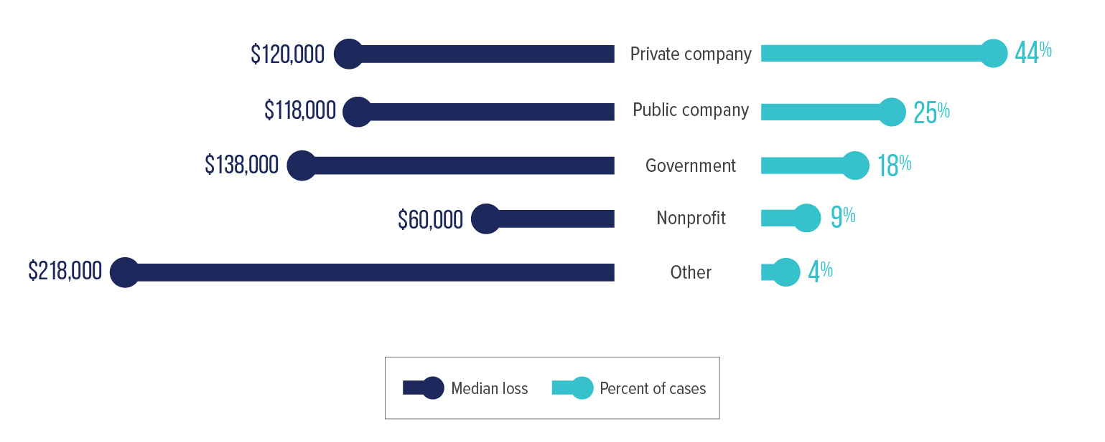
What types of organizations are victimized by occupational fraud?
Source: ACFE Report to the Nations, 2022

Slide 11
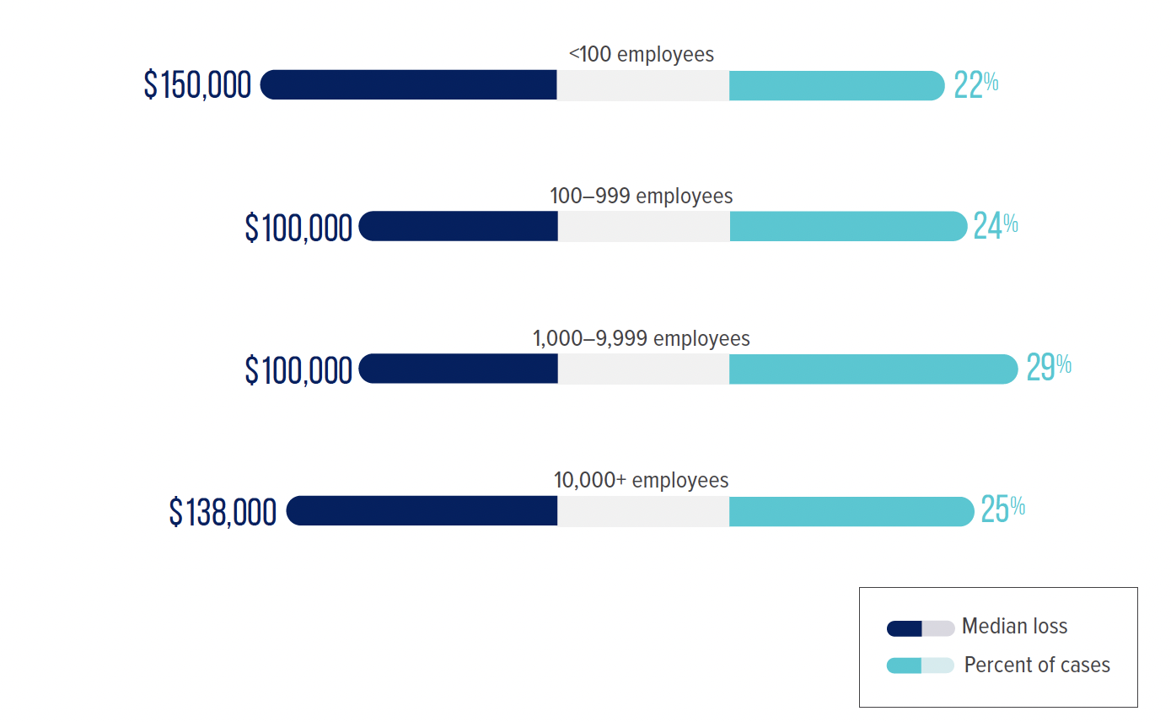
How does an organization’s size relate to its occupational fraud risk?
Source: ACFE Report to the Nations, 2022

Slide 12
How does an organization’s gross annual revenue relate to its occupational fraud risk?
Source: ACFE Report to the Nations, 2022

Slide 13
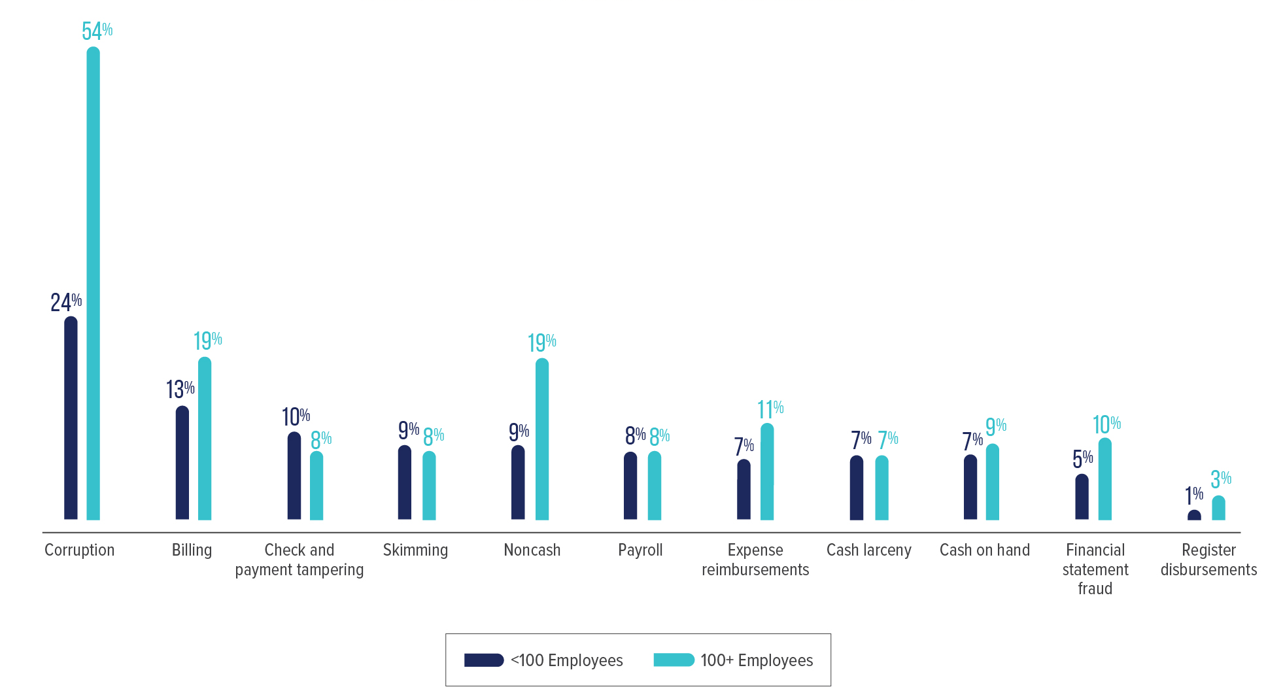
How do fraud schemes vary by organization size?
Source: ACFE Report to the Nations, 2022

Slide 14
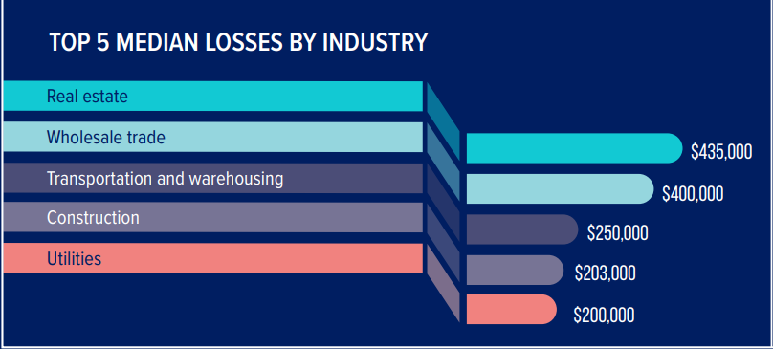
Top 5 median losses by industry
Source: ACFE Report to the Nations, 2022

Slide 15
Have you experienced fraud in your company?
ⓘ Start presenting to display the poll results on this slide.

Slide 16
After-the-fact modifications
Management review
Proactive data monitoring
Surprise audits
Internal audit departments
Anti-fraud training

Slide 17
What can we do now?
01
See
Be informed and know how it could happen.
02
Shape
Prepare a blueprint.
03
Build
How to eat an elephant: one bit at a time.

Slide 18
Fraud doesn’t happen here
My employees wouldn’t do that
I trust my employees
They were like family

Slide 19
SEE
Macro-economy
Inflation
High interest rates
Supply chain slowdowns
High gas prices
Great Resignation - unemployment
War in Ukraine & Russia
Recession
Notes:
Inflation, rising interest rates, houses on the market longer, high gas prices, lack of labor force, war in Ukraine & Russia
Layoffs, high gas prices, high interest rates
Demand on employees to keep up with the hot markets (construction has not slowed down), pressures with layoffs (tech companies even some health care)
Range Rovers

Slide 20
SEE
Internal Accounting & Finance Departments
Assisted with applications for:
PPP
EIDL
ERC
Uncertainty of ongoing operations
Demands from CEOs to help keep the doors open
Labor shortage
Long hours
Notes:
As a practioner:
COVID burned out a lot of accountants – applying for PPP, EIDL, ERC, uncertainty and trying to keep all businesses open
Burnout
Labor shortage – hard to find resources, abundance of work, more demands on those who are working, higher salary demands

Slide 21
SEE
Internal Employees
Always watching
Back-office ops working from home
Operations may have taken a pause during the beginning of COVID
Layoffs – spouses, close family members, personally
Unemployment – additional stimulus
Pressure from the top to keep up with production
Pressure from clients to keep within timelines and budget
Notes:
As an employee:
They are always watching – internal resources may have applied for the PPP, EIDL KNOWING that the information was not correct, but instructed to apply anyway for the most amount possible.
Experienced family members or themselves being laid off
Heard of friends, neighbors, family being laid off and applying for unemployment – additional stimulus; make more staying at home, fraudulent unemployment claims

Slide 22
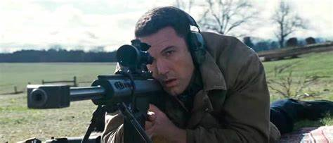
What’s to come?
INCREASED IRS Audits - 87,000 new IRS agents
INCREASED Payment Protection Program Audits
INCREASED Employee Retention Credit Audits
Surfaced fraud
Recession (here now?)
“Only when the tide goes out do you discover who’s been swimming naked.”
- Warren Buffet

Slide 23
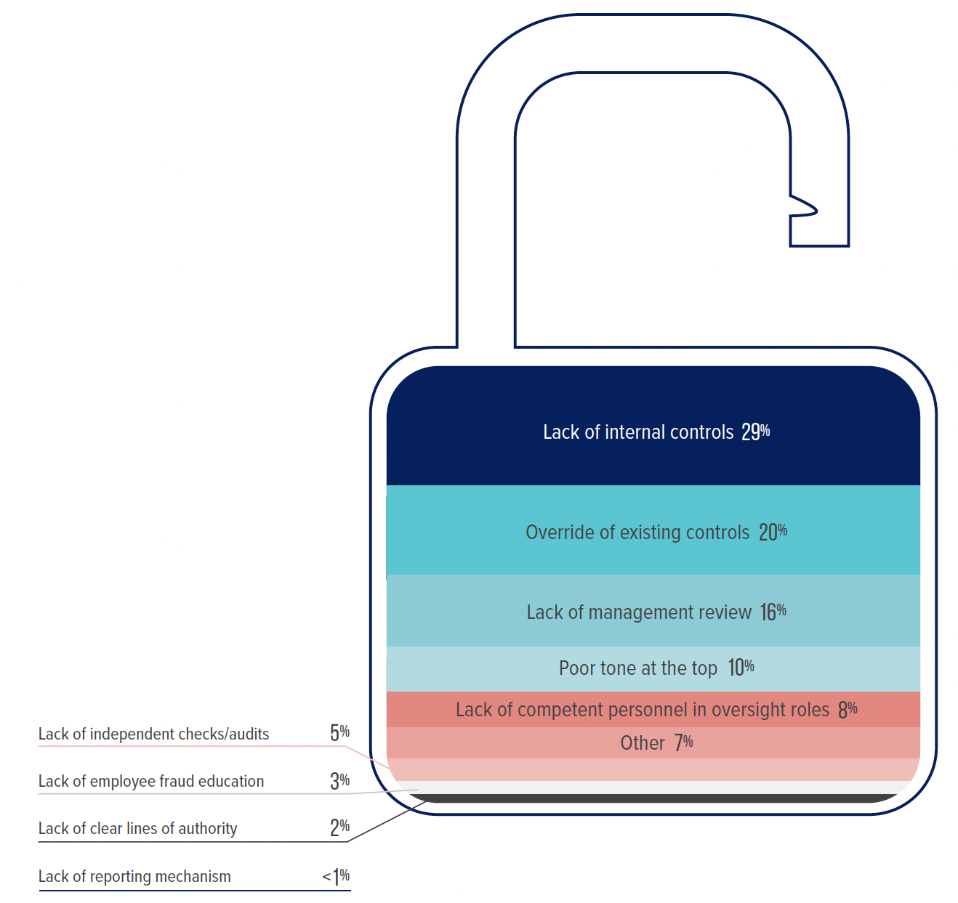
SHAPE
Notes:
Primary internal control weaknesses that contributed to occupational fraud

Slide 24
SHAPE
Notes:
Does your current workflow look like this?
It looks like an email comes in, I go on coffee break to think about it, I enter into a computer and send it around the office/company, then someone replies and then I produce a report.
It’s hard to understand, follow or nonexistent
It’s not consistently used and implemented because nobody knows what to do and everybody makes it up the best they can

Slide 25
Preparing for the next valley
Top-Down Approach
Open, honest communication with employees
Lean teams
Success for continued operations
Automation
Checks & balances
AI
Set processes and stick to them
Can’t rely on others to be watching
Notes:
The one constant in business is change. There are always peaks and valleys, are you prepared to weather the next valley?
McAllen OCC/FBI Case

Slide 26
Honolulu bookkeeper indicted for $1.2 million fraud and money laundering
Fictitious Vendor
Created company name almost the same as one of his clients vendors
Charged $146,000 on credit cards
Payroll Scheme
Transferred $1M disguised as payroll payments to his personal accounts
6 counts of wire fraud, 7 counts of money laundering
Notes:
https://www.justice.gov/usao-hi/pr/honolulu-bookkeeper-pleads-guilty-12-million-fraud-and-money-laundering

Slide 27
THREE AREAS TO REVIEW
PROCEDURES
TECHNOLOGY
PEOPLE

Slide 28
BUILD

Slide 29
Payroll Workflow

Slide 30
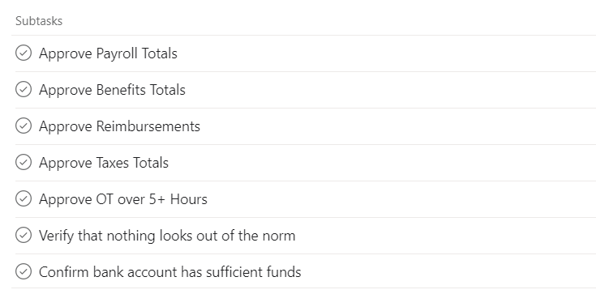
Payroll Workflow

Slide 31
Dashboards / Management Oversight
Exception Reporting
Data Visualization
Automation
Especially when there is limited number of resources in one area
Bill.com – approval chain, vendors enter their own information
Divvy – parameters on credit card spend
Ethics Hotline
Inexpensive options available for small businesses

Slide 32
Do you have an anti-fraud program in your company?
ⓘ Start presenting to display the poll results on this slide.

Slide 33
Conclusion
See
Build
Shape
See better. Build better. Shape better.

Slide 34
Ways to get in touch
Nicole Landau, CFE
Email: nicole@landauconsultingsolutions.com
Linkedin: https://www.linkedin.com/in/nicolelandau1/
Instagram: https://www.instagram.com/landau_consulting_solutions/
Podcast: Construction by Numbers

Slide 35
Session Password
[TBD]
(Must record password for CPE credit)

