Slide 1
2020 CFMA Conference
WIFI Password: BRAYNTaxIncentives

Slide 2

WIP Your Operating Cash Flows Into Shape
Eric Newton, CPA

Slide 3

Background
Eric Newton, CPA
Director of Construction
36 Years Industry Experience
  6 Years in Public Accounting Auditing Contractors
  10 Years as a CFO for a contractor,
  20 Years SVP at Technology Companies (Comdata, Dexter and Chaney, Viewpoint)

Slide 4
Agenda
01
Introductions
02
The Cliff We Faced
03
Key KPI’s for Cash in Construction
04
How to Manage Your WIP for Cash
05
Forecasting Cash Flow Example
Notes:
Here is our agenda for today
We are going to be talking about challenges in construction
Key KPI’s for Cash in Construction
How to Manage Your WIP Report for Better Cash Management
Using Cross Company Planning for Better Cash Forecasting
Show an example of how a contractor can forecast cash

Slide 5

The Cliff We Faced
COVID 19 has impacted all aspects of our jobs and performance
How do we know exactly where and how much?
What information do we need to know to pivot our response?
Notes:
Covid 19 has impacted all aspects of our jobs and our personal lives. We will probably not know exactly how much for years to come, but there are some things we can do now to pivot our response and be proactive in helping our businesses manage through this pandemic.

Slide 6
Fast Growing, but Risky
Tight Margins
Project Delivery Delays
Labor Shortages
COVID - 19
Contractors go out of business every day trying to manage their cash
Build an accurate statement of cash flows and forecast into the future
Reduce barriers to accurate cash flow forecasting
Adopt multidimensional forecasts for a comprehensive view and insights
Monitor KPI’s like margin fade, job borrow, days of cash on hand
Analyze the WIP report for under billings and see which jobs use cash of the company
Everyone is trying to
Notes:
For the last 10 years construction has been a fast growing, but risky industry to be in. Contractors have always had to deal with tight margins, project delivery delays, labor shortages and now we have COVID-19. Contractors had issues with managing cash flow even before COVID-19 hit us, but now it is getting even worse.
Contractors are really scrambling to build an accurate statement of cash flows and forecast cash into the future. But they are finding many barriers to accurate cash flow forecasting. They can’t look at cash management the way they always have. They have to adopt a multidimensional approach to forecasting to gain a comprehensive view and insights.
Contractors need to be monitoring key KPI’s like margin fade, job borrow and days of cash on hand and they need to be doing this daily, not just monthly or quarterly or annually.
Every contractor has a WIP report and they need to be watching it closely for under billings to see which jobs are using cash. The WIP report needs to be flexible and viewable over time to allow deeper analysis.
The challenge is having access to this data in a fast and easy way to make quick decisions. Many contractors are having to pull the data from multiple systems and that is complicated and time consuming.

Slide 7
Today, many environments look like this…
Accounting
System
0
0
0
1
0
1
1
1
Accounting
Project
Management
0
1
0
1
0
1
0
V1
1
V2
V3
Massive
Spreadsheets
PM
0
0
1
1
0
0
1
CRM
1
Owner
And you have all of this for budgets, actuals and forecasts!!!
Resulting in overwrites, deletions, lost versions, late nights and confusion!
Notes:
Today, many environments look like this. Data resides in multiple systems. The accounting system holds the majority of the data especially around cost and billings. The project management and scheduling solutions have the cost to complete and timeframes required. The CRM solutions have the pipeline of jobs coming up to bid. The estimating solutions have the jobs currently being bid but not yet awarded. To accurately forecast, contractors have to pull data from all of these systems and then coordinate with multiple individuals within their company to get this information. They then have to deal with combining it into a large spreadsheet with lots of formulas that can easily get corrupted or deal with version control and emailing back and forth.
It’s inefficient, cumbersome and error prone.
Maybe some of the contractors on this webinar have experienced similar issues. When you are trying to quickly forecast cash you don’t have time to deal with these types of problems.

Slide 8
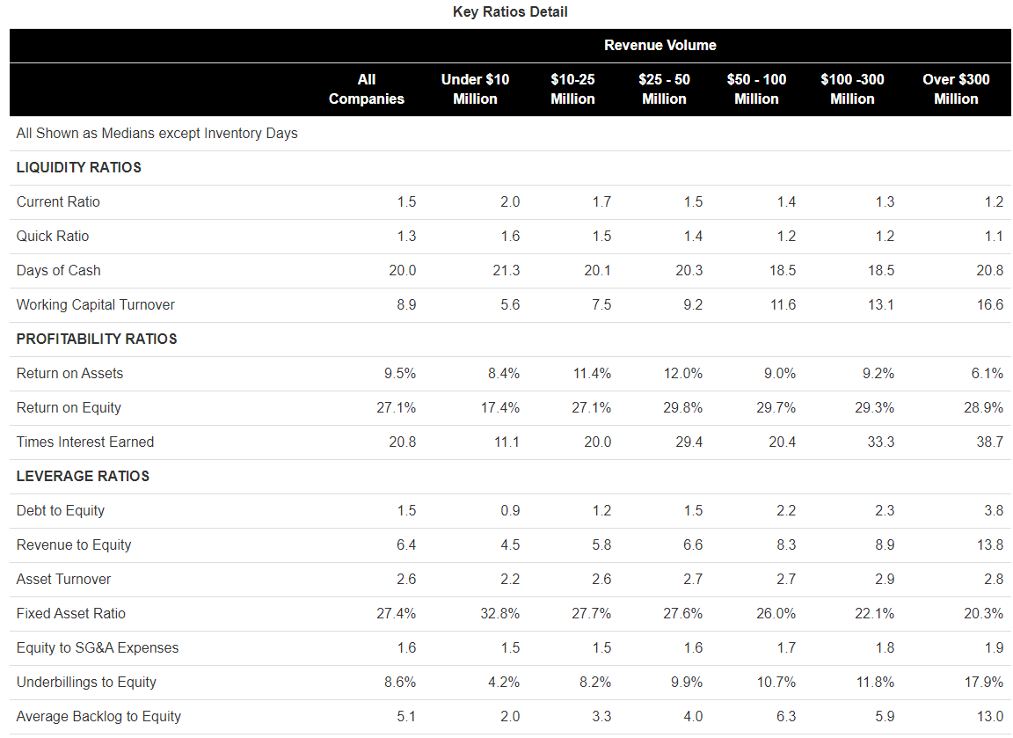
CFMA Benchmarker Results for 2019
The Average Contractor only has 20 days of cash on hand!
Notes:
CFMA (Construction Financial Management Association) puts out a benchmarking tool every year that allows contractors to benchmark or compare themselves to other contractors to see how they stack up.
I pulled their results a few weeks ago to see what the average days of cash a contractor had on hand. I was a little surprised to see how close the days of cash on hand were across all sizes of contractors. It ranged from 18.5 days to 21.3 days with the smallest contractors having the most days. The average contractor in the United States only has 20 days of cash on hand.
And this survey was done before the impact of Covid-19!

Slide 9
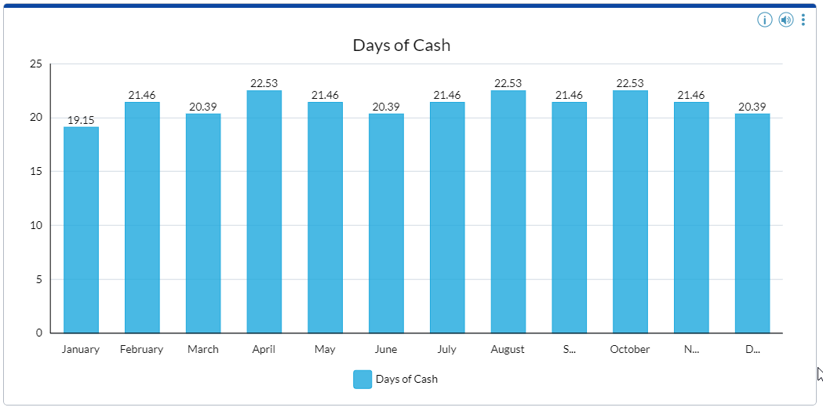
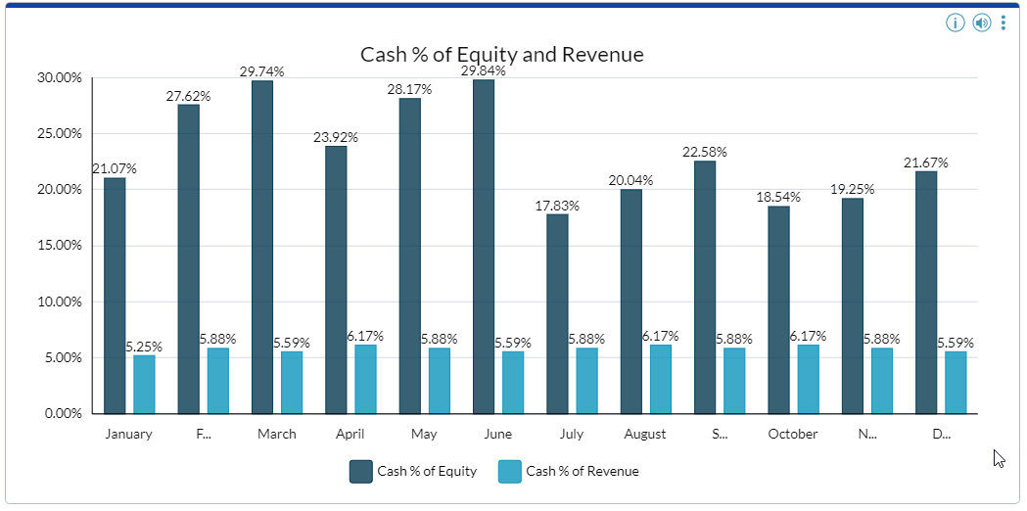
KPI’s for Cash
Cash as a percentage of equity indicates the percentage of equity in the cash balance. Generally, a percentage of 10% or more is considered adequate.
The days of cash ratio indicates the number of days of revenue in the cash balance. Generally, a ratio of 20 days or more is considered adequate.
Cash as a percentage of revenue indicates the percentage of revenue in the cash balance. Generally, a percentage of 5% or more is considered adequate.
Notes:
I want to go over a few KPI’s (key performance indicators) that I used when I was a CFO for a contractor and in public accounting, working with contractors. These are KPI’s that are more focused on cash and liquidity and should be monitored regularly to spot trends and make sure your company is staying financially healthy.
Days of cash KPI. This is the number of days in revenue you have available in cash. A contractor under normal circumstances should have at least 20 days of cash on hand. In today’s difficult circumstances, they need to have more and need to look at drawing down on their line of credit and typical cash saving strategies like better collections, delaying payments to vendors and faster billing to help drive up their cash balances up before it is too late.
Cash as a percent of Equity and revenue KPI. This is how much of your equity you have tied up in cash to fund your daily operations and how much cash you have to drive your revenue. If you always keep the same amount in cash, but revenue (and related cost) are rising, then you need to be putting aside more cash to fund operations. It takes more cash to run a $30M construction operation than it does to run a $10M construction business especially if you are self performing and having to make weekly payroll. It is common sense but some contractors don’t stop to think about this.

Slide 10
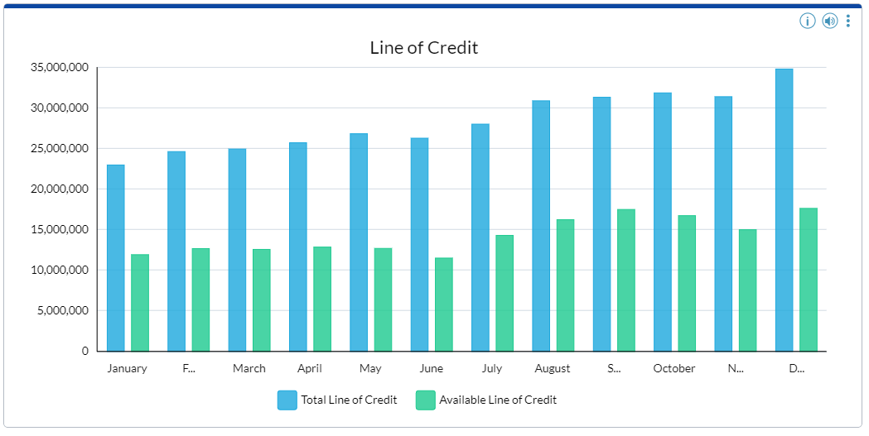
KPI’s for Cash
Notes:
Do you have a line of credit that can help you fund down times and if so how much do you have available on it? If it is already maxed out and you only have 20 days of cash in the bank, then you have a problem right now.
Many of the banks are really tightening up credit right now. It is more important than ever to be working with a bank that understands construction and the cycles we go through in this industry.

Slide 11
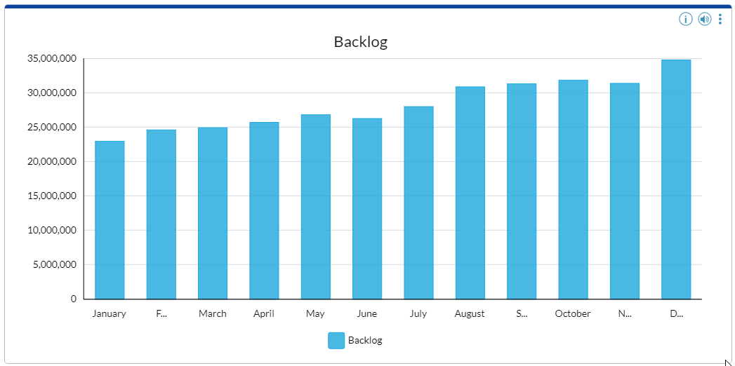
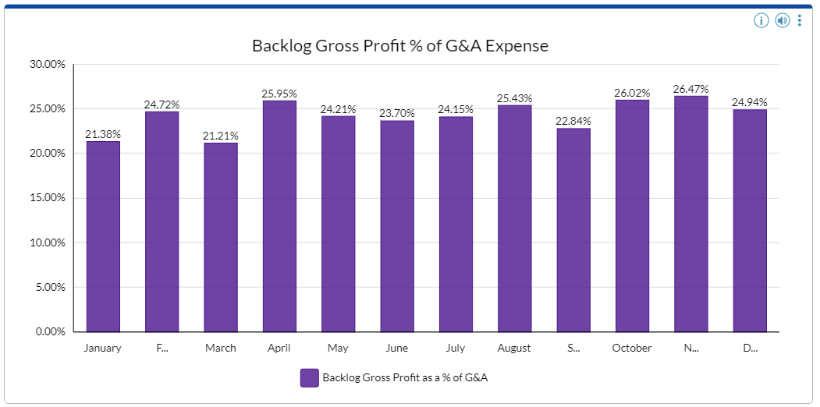
KPI’s for Cash
Total backlog is the amount of work under contract not yet completed.
Backlog gross profit represents the amount of future gross profit not yet earned on uncompleted contracts. Generally, backlog gross profit should exceed 50 percent of general and administrative expenses.
Notes:
Backlog KPI’s!
All contractors should be watching their backlog to make sure it is growing to drive revenue growth or if it is falling, then making the appropriate cost cutting measures now to align to the new levels of work.
Backlog comes from the WIP report. We are going to show you later, but you now need to look at backlog in a new way. You could have work on the books, meaning valid contracts, but if that work is halted or chance of collection is low, then you have now reduced your backlog significantly and cost cutting measures will have to be taken. You have to look at each job and assess your likelihood of the job continuing or not and adjust accordingly. It is time to re-assess the credit worthiness of every customer you are working for.
How much gross profit do you have in the remaining backlog. Have you adjusted your estimated cost to complete for the effects of Covid? Is it enough to cover overhead expenses like G&A. Even in good times, your backlog could be going up while your backlog gross profit could be going down. This is a good KPI to be watching to assess your overhead. Typically the backlog GP should exceed 50% of your G&A expenses if you want to turn a profit.

Slide 12
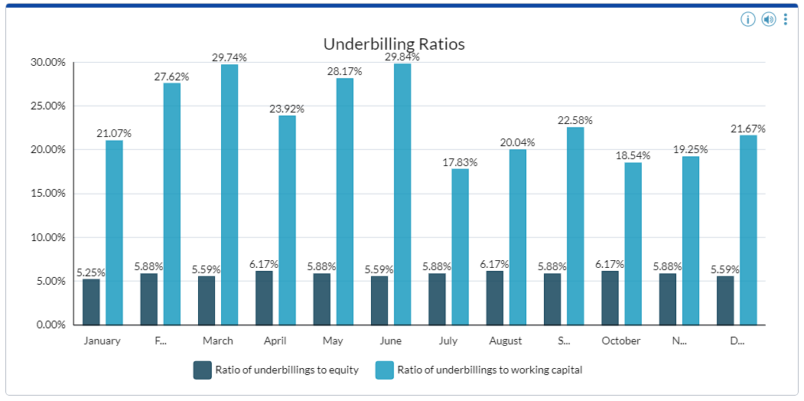
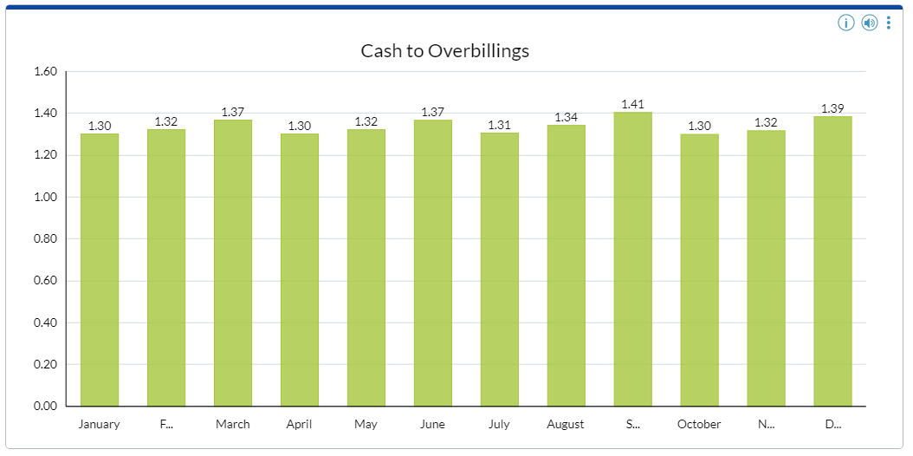
KPI’s for Cash
Underbillings to equity is the percentage of the contractor's net worth which is represented by work which has been performed but not yet billed. A ratio in excess of 10% is considered unusual by most sureties.
The ratio of cash to overbillings represents the amount of cash in the bank as a ratio of billings in excess of costs and estimated earnings on uncompleted contracts. All overbilled amounts should be represented by cash in the bank. Therefore, an acceptable ratio of cash to overbillings is generally 1 or higher.
Underbillings to working capital represents the portion of the contractor's working capital which is comprised of underbillings. A ratio in excess of 20% is considered unusual by most sureties.
Notes:
One thing I learned long ago in construction accounting. Underbillings are bad and overbillings are good. This is as basic in construction accounting as debits equal credits or assets equals liabilities plus equity. You have to drill this in your head.
Contractors will always have jobs with underbillings which just means you have recognized more earned revenue on the job than you have billed the customer for. But that should be the exception, not the norm. And each job with underbillings should be scrutinized.
If you get too high of a % of underbillings in relation to your equity, the sureties and banks are going question your real profitability and how well you are running your company.
Cash to over billings. It should always exceed a ratio of 1. If you think about it, if you have overbilled, unless it is still sitting in receivables, you have not incurred the cost yet and you will therefore need this cash in the future to fund your job. While we normally think of overbillings as good. If you are taking that cash and using it for other non-operational items like buying equipment, you could have a problem funding operations in the future.

Slide 13
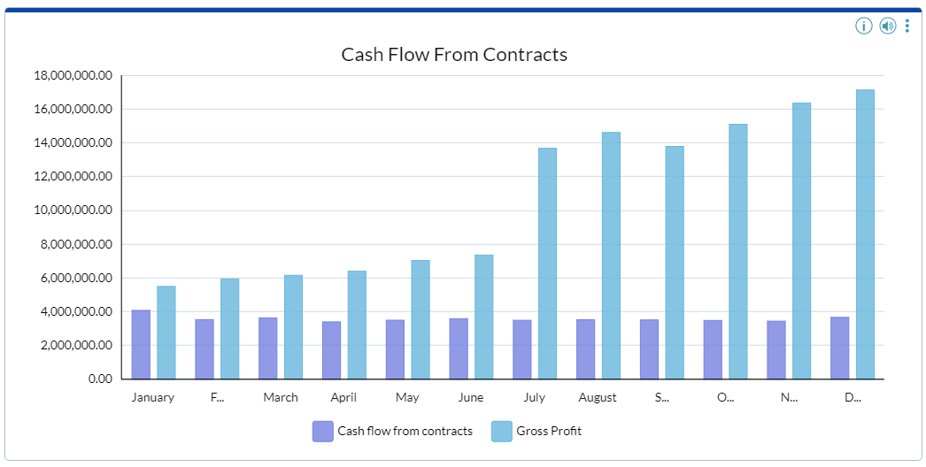
KPI’s for Cash
KPI’s for Cash
Cash flow from contracts represents the amount of gross profit which has been collected. This is calculated by deducting job receivables and underbillings from gross profit and adding payables and overbillings.
Notes:
Cash flow from contracts – This represents the amount of gross profit which has been collected. This is calculated by deducting job receivables and underbillings from gross profit and adding payables and overbillings.
This ratio makes sure you are collecting on the profits your company has generated. You could be making a lot of profit on the income statement and paying your bills, but still have a large amount of cash sitting in AR. If you are not collecting then you need to know why. It could indicate a credit problem with the customer or it could represent an overbilling issue by the PM who may be overstating the work completed on the job that will show up as margin fade later.

Slide 14
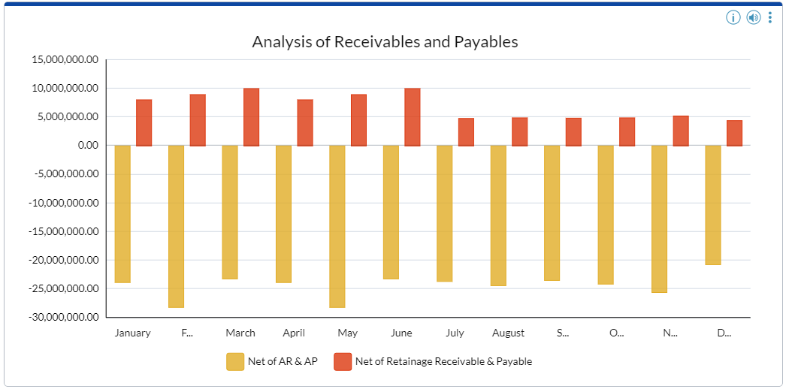
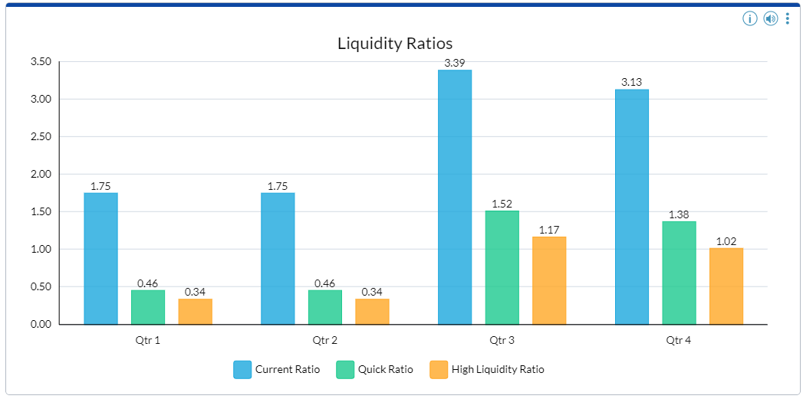
KPI’s for Cash
The net of current receivables and payables is an indicator of how a contractor is managing its cash flow. An unusually low number could indicate that a contractor has experienced cash flow problems.
Retainages are typically receivable or payable upon completion of a contract. Because retainages are receivable or payable within the contractor’s operating cycle, the amounts are generally considered current assets and liabilities even if due after one year.
The current ratio indicates the extent to which current assets are available to satisfy current liabilities. Usually stated in terms of absolute values, a minimum current ratio is generally 1.25.
The quick ratio indicates the extent to which the more liquid assets are available to satisfy current liabilities. Usually stated in terms of absolute values, A quick ratio of 1.0 is generally considered a liquid position.
The high liquidity ratio indicates the ratio of assets which could be liquidated within 30 days to the liabilities which were due on demand or within the next 30 days.
Notes:
The Net of current receivables and payables KPI is an indicator of how a contractor is managing their cash flow. An unusually low number could indicate that a contractor has experienced or about to experience cash flow problems.
Retainages are typically receivables or payables upon completion of a contract. Because retainages are receivable or payable within the contractor’s operating cycle, the amounts are generally considered current assets and liabilities even if due after one year. Retainage for both receivables and payables should be tracked separately on the balance sheet so they can be excluded for cash analysis and aging purposes. Most construction ERP’s handle this well.
And of course Contractors should also be looking at the standard liquidity ratios
Current Ratio
Quick ratio
High Liquidity ratio. Right now the high liquidity ratio is the most important and it should exceed a ratio of 1
The high liquidity ratio is assets that can liquidated within 30 days vs. payables due on demand or within 30 days.

Slide 15
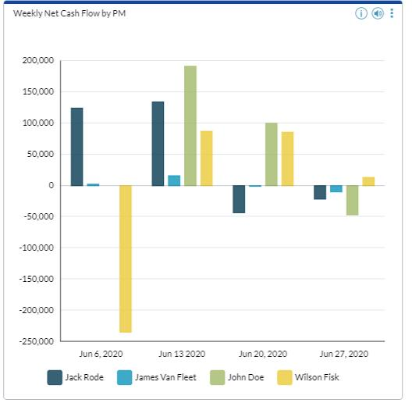
Cash Flow by PM and Job
Notes:
Do you have a KPI showing cash flow by Job or PM? It is not only important to know if the job is profitable, but you need know how the PM’s are doing managing cash across all their jobs. This dashboard gives a quick summary of how each PM is doing on a weekly basis. From the dashboard, you want to be able to drill down to a report for more detail.

Slide 16
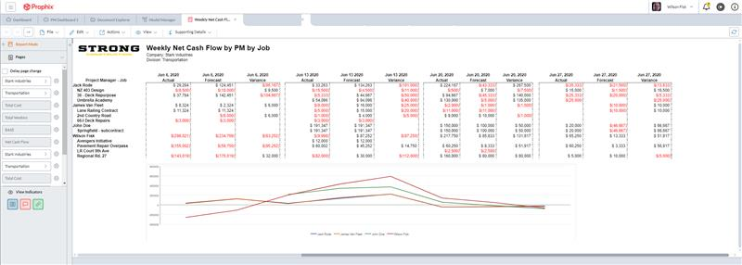
With Drill Down to Report for Detail
Notes:
On this report, you can now see how the PM’s are doing against their forecast on a weekly basis and by job. You can quickly see which PM’s are good at forecasting cash and how much cash each job is using on a weekly basis.

Slide 17
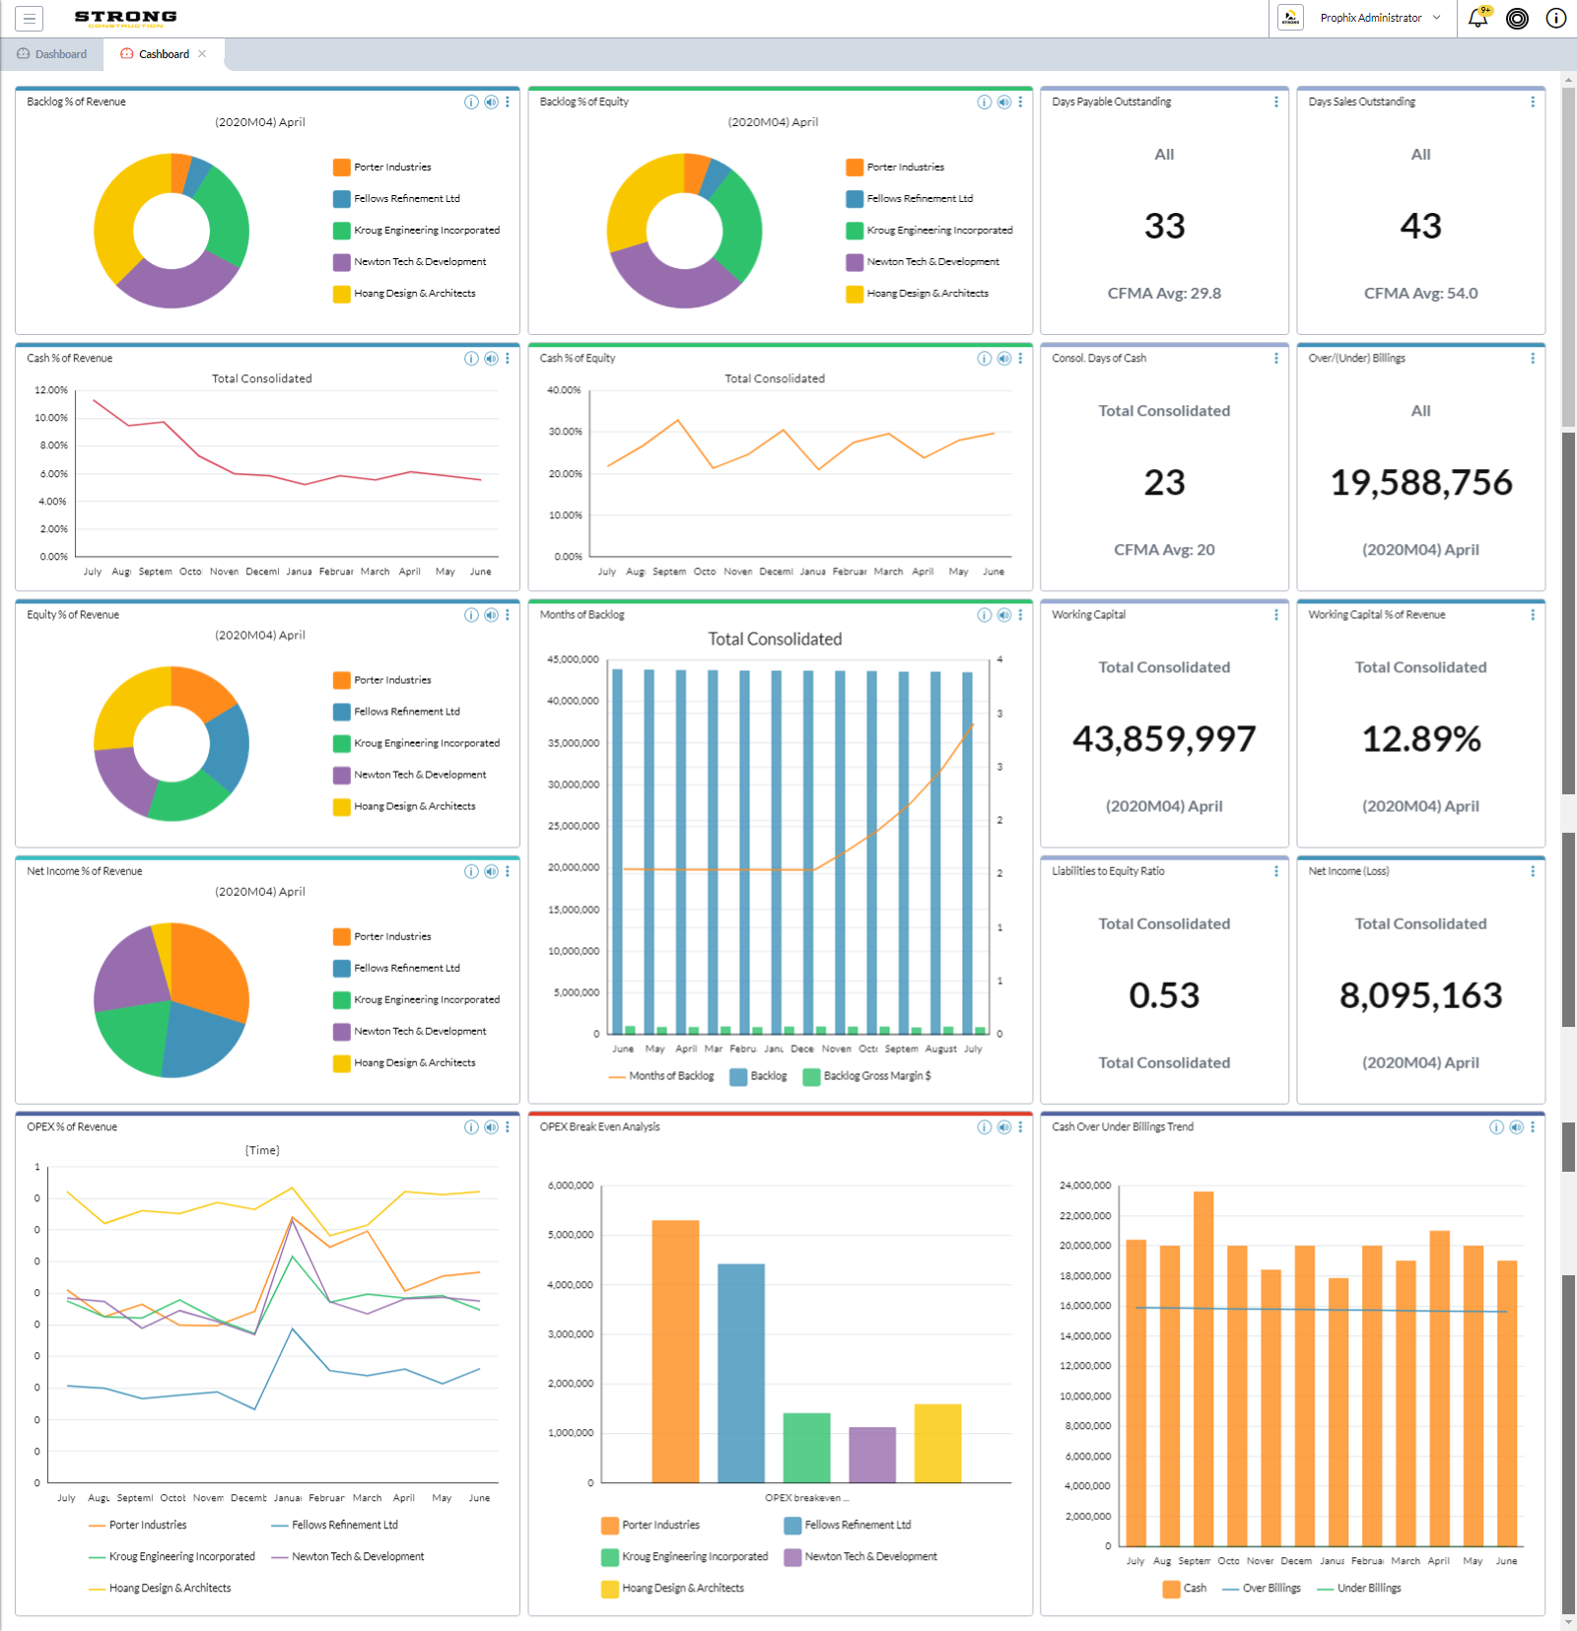
Cash Dashboard
To Pull It All Together
Notes:
CPM (Corporate Performance Management) solutions allow you to have all of these KPI’s on one dashboard with the ability to act on that data from the dashboard. That is the main difference from a CPM solution and a BI solution. You can not only drill into the detail behind the KPI, but you take it and do what if scenarios off it.

Slide 18
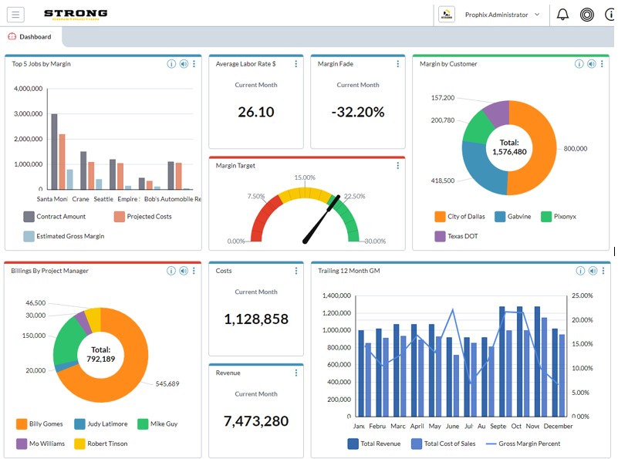
And Other Metrics
Notes:
I just covered a lot of KPI’s specific to cash, but you should also be looking at other metrics that will eventually impact cash like
Job Margin by job
Avg labor rate to help you forecast cost reduction measures
Margin fade for the current month that let’s you quickly spot issues with jobs that are having profit fade.
Margin by customer to help determine the customers you make the most profit or least profit on.
Billings by project manager to know who is keeping their billings up to date and who isn’t.
12 month trailing gross margin to show trends in profitability by month.
Now let’s talk some about the WIP or Work in Progress Report!

Slide 19
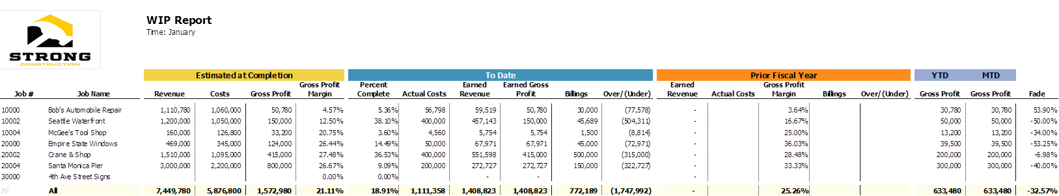
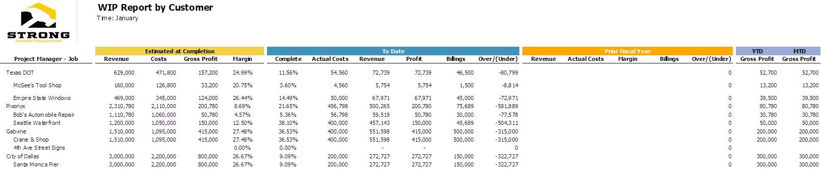
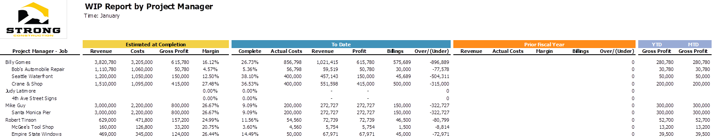
Multiple Views of WIP Report
Notes:
All contractors have a WIP report as I said earlier. The problem is they typically look at it one way. You need to be able to slice and dice the WIP in multiple ways to really spot trends that impact cash flow.
So maybe you have a standard WIP report in job number order like the top one that gives you your typical information but includes fade by job for the current month.
But what about one by customer, that shows backlog and profitability by customers and maybe includes aging data as well. We did not show that in this example but we typically put that on our customers WIP’s reports by customer.
WIP by PM to show how profitable jobs are by PM. Are over (under) billing by PM to spot issues with billing
The point is you need to be able to analyze your WIP in a lot of different ways. Type of work, to show what work you make the most money on. Estimator – To show what estimators do the best job estimating.
What about state or city right now with shutdowns?

Slide 20
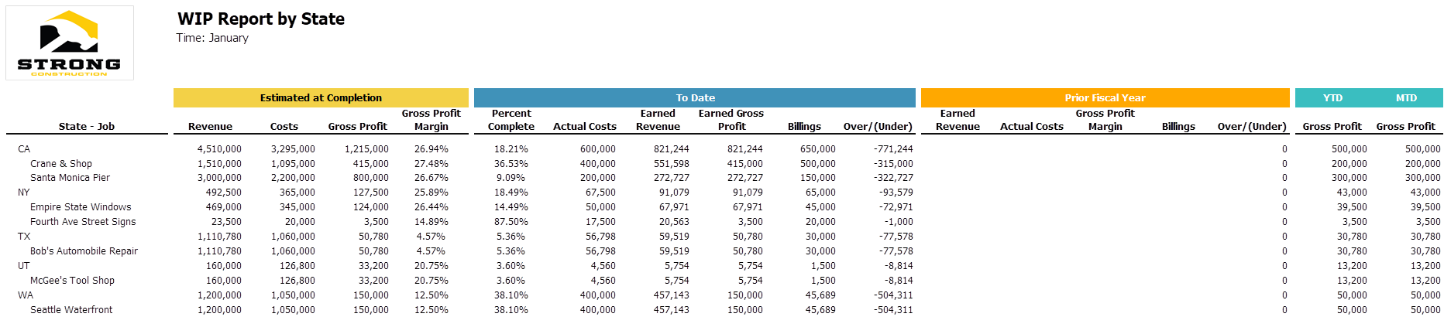
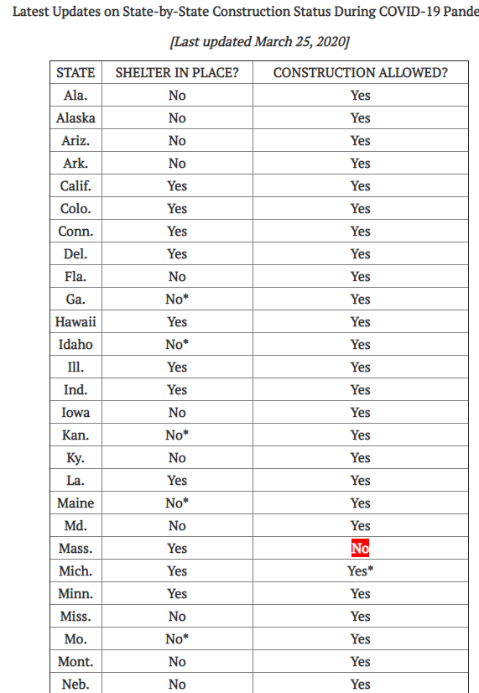
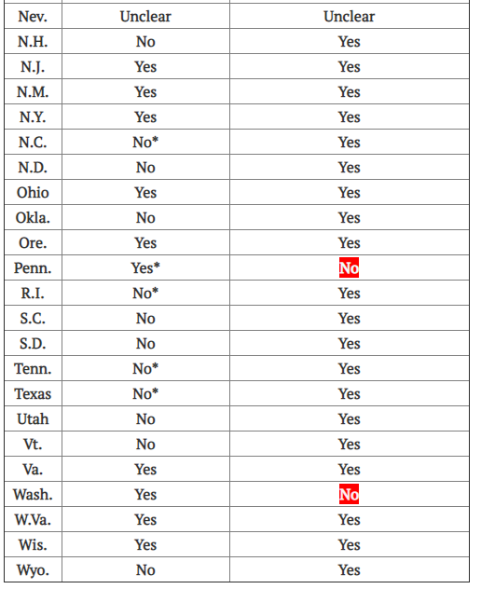
How About a WIP by State?
Notes:
ENR is one of the main publications in construction. Here is a list of states that were shutdown for construction due to COVID-19 back in March. With states and cities shutting down, you had to be able run your WIP by city and state to see what work is still really active. It is no longer about what you have contracts for. It is about where can you really work!

Slide 21
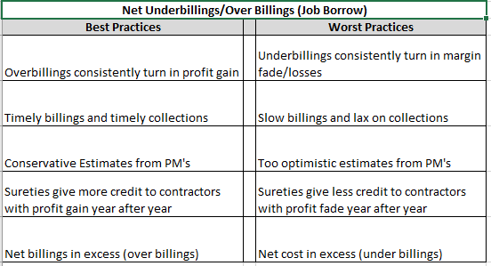
Best Practices for Over/Underbillings
Notes:
Here are a few things to consider around over and under billings and why it is so important to manage this through your WIP review.
Over billings tend to consistently turn into profit. Underbillings tend to turn into fade.
Timely billings lead to timely collections. Slow billings lead to slow collections which lead to bad debt
PM’s should be taught to be conservative in their estimate. Being aggressive leads to profit fade which is frowned on by the sureties and banks
You should always have a high ratio of Net over billings to under billings

Slide 22

Cross Company Planning
What is It?
Reactive vs Proactive
Static & Siloed vs. Agile & Aligned
Dynamic Timelines and Benefits
Notes:
In order to forecast accurately in times of uncertainty, contractors need to be doing cross company planning.
This basically means finance needs to be working with estimators and operations to get a complete picture of where the company stands.
Contractors need to be proactive rather than reactive. This means you need to setup systems now to be agile and aligned rather than static and siloed.
Cross Company Planning allows for a higher frequency of preparation (e.g., daily or weekly) which benefits the company with better management decisions leading to greater profits.
In order to forecast cash properly, you need input from multiple people within your company. It is important we remove the silos of data within our companies to be able to accurately forecast cash in the future. When I was a CFO I met weekly with our head of estimating and VP of operations and went over job cost vs. budget reports to spot jobs that were not performing well. This helped us get ahead of problems before they got to be big.
I unfortunately did the cash projections on my own using avg payment times for receivables and payables. I had trouble being very accurate because what I didn’t know what issues were happening on the job. If a customer was unhappy with something on the job and going to hold up payment until it was fixed, I didn’t know until they were past due. The PM’s typically knew much quicker than this.

Slide 23
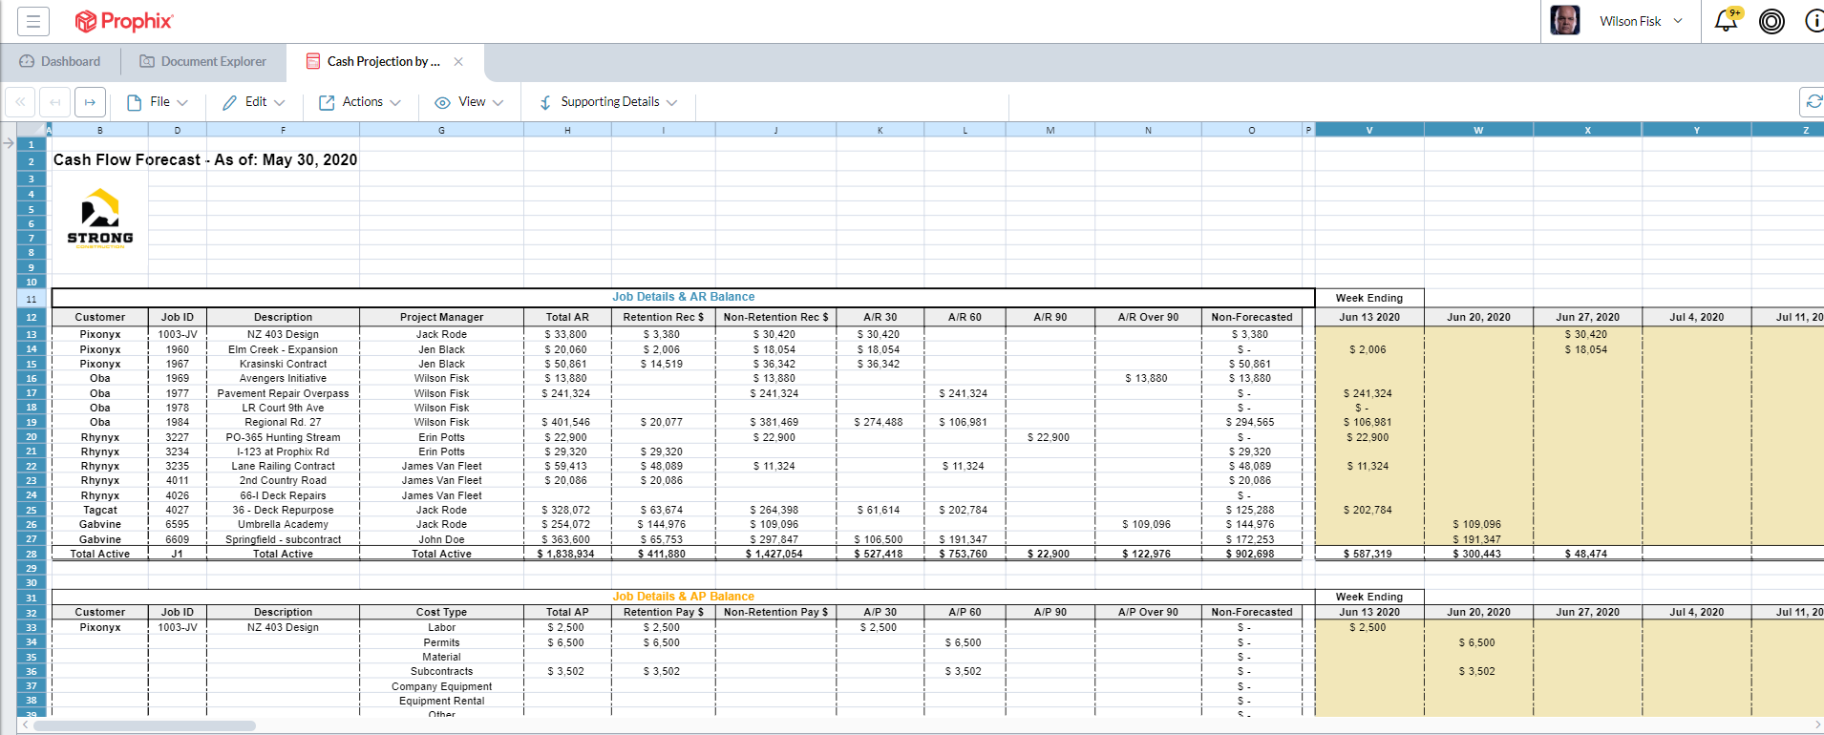
Cash Flow Forecast by Job
Notes:
Here is an example of a weekly cash flow forecast that could be used by a project manager. It is pulling in accounts receivable and payable information by job and PM and showing the PM the amount outstanding in AR and AP for each job. They can then help accounting forecast when the billings will be collected and give input on when the payables need to be paid.
This information would then flow into a master cash forecast that would include other cash items like labor, overhead and note payments.
If you are not doing it already, please consider getting the PM’s more involved in your cash forecast. It will make them more aware that cash is important and probably lead to faster billings and better collections.

Slide 24
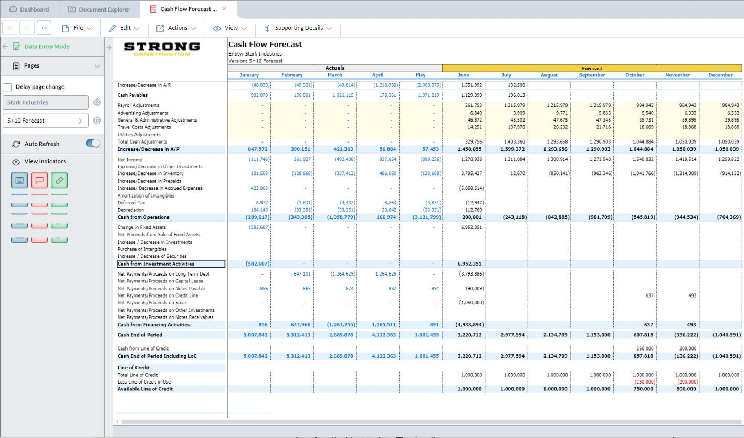
Overall Cash Forecast
Notes:
The increase or decrease in AR and AP would then flow into the overall cash forecast. The overall cash forecast would then take into account other cash items like payroll, note payments, lease payments, overhead expenses, line of credit advances or payments, etc.
With a CPM solution you have this data flow in with actuals from the ERP and then forecast into the future using historical data and adjusting it based on factors, like what if I cut my overhead my 10%, how much will that impact my cash position. What if I cut my payroll cost by 10%, how would that impact me, etc.

Slide 25
Questions?
Email Us: construction@prophix.com
Learn More: www.Prophix.com
Eric Newton: enewton@prophix.com
LinkedIn: www.linkedin.com/in/eric-newton-cpa-4388554/

Slide 26
Session Password
(Must record password for CPE credit)

