Slide 1
2020 CFMA Conference
WIFI Password: BRAYNTaxIncentives

Slide 2

Update from the Hill
Key Considerations for Employers to Address During A Pandemic
Kristen Deevy

Slide 3

Update from the Hill
Key Considerations for Employers to Address During A Pandemic
FOR PLAN SPONSOR USE ONLY. Pensionmark® Financial Group, LLC (“Pensionmark”) is an investment adviser registered under the Investment Advisers Act of 1940. Pensionmark is affiliated through common ownership with Pensionmark Securities, LLC (member SIPC).

Slide 4


Meet Your Presenter
Kristen Deevy, C(k)P
Managing Director, Pensionmark
Kristen.deevy@pensionmark.com
720-289-3833

Slide 5
Retirement Plan Specialists
A boutique experience with the strength and resources of a national firm.
3,350
Retirement Plan Clients
As of 6/1/2020
$48B
Assets Supported¹
With Pensionmark you get the best of both worlds, working with an experienced independent advisor backed by a network of support specialists.
310
Team Members
As of 6/1/2020
60
Locations
As of 6/11/2020
As of 12/31/19 the Pensionmark network of advisors and firms collectively provides support to over $48 billion in assets across a variety of channels including investment management and retirement plan consulting services. This includes regulatory assets under management (AUM) of over $19 billion.
Notes:
We are a boutique advisory firm with a national footprint serving close to 3,400 plans a specialized skill set and intellectual capital to support the needs of employers of different sizes, employee demographics and various industry challenges.
In addition, our scale allows us to obtain competitive pricing with plan providers and leverage technology to provide comprehensive services to our clients and their employees, in a cost-effective way.

Slide 6

Who is NAPA
Sister organization of the American Retirement Association
Only advocacy group exclusively focused on the issues that matter to retirement plan advisors
Advocacy
Business Intelligence
Networking
Notes:
NAPA
Sister org to American Retirement Association
Advocacy group
The advisors who attended the Fly In were a very exclusive group of retirement focused specialists advisors that attended the conference. Typically advisors that have 10 or more plans and $50M or more in assets under management. It was by invite only.
Why important to our clients in that we are providing a direct link to policy makers in Washington and can recommend and frame to policy makers what impact different types of legislation may have on our clients and their employees.

Slide 7
New Regulations in the last 9 months
Secure Act
  Signed by President Trump on December 20, 2019
CARES Act
  Signed by President Trump on March 27, 2020
Colorado Secure Savings Act
  Signed by Governor Polis on July 14, 2020
Notes:
Read slide

Slide 8
SECURE Act Highlights
Modification of Eligibility Rules for Long Term Part-time Employees
  Starts in 2024: if have 3 consecutive years of services with 500 hours you are eligible (take away here – track your hourly employees for eligibility)
Increased Tax Credit for Small Employer who start a 401(k) Plan
  $500 or the lesser of $250 for each eligible non highly compensated employees of $5000
Tax Credit for adopting automatic enrollment
  Employers with up to 100 employees would be eligible for a credit of $500/year for up to 3 years
Modifications to the Required Minimum Distribution (RMD) Rules
  Formerly set at age 70 ½ is now increased to age 72
Source: Voya Financial (February 10, 2020). Highlights of the SECURE Act - what you need to know now.
Retrieved from voyainsights.voya.com.
Notes:
Will read from slide

Slide 9
CARES Act Highlights
Elimination of Required Minimum Distributions (RMDs)
Coronavirus-related Distributions of up to $100,000 that is exempt from the 10% early withdrawal penalty
Increase in the participant loan limit to the less of $100,000 or the vested participant balance
1 year extension on the due date of any participant loan currently due between March 27, 2020 and December 31, 2020
Source: Voya Financial (February 10, 2020). Highlights of the SECURE Act - what you need to know now.
Retrieved from voyainsights.voya.com.
Notes:
Will read from slide

Slide 10
Colorado Secure Savings Act
Impacts any employer with 5 or more employees
Mandates having a retirement plan in place otherwise you will have to offer the state-run plan
Likely will be implemented in 2021
The state Treasurer may solicit gifts, grants, donations, or investments not required to be repaid, from public or private sources to cover the costs associated with the administration of the program
State Run plan includes
  Automatic enrollment of 5% of employee pay into a payroll deducted IRA
  Source: Colorado General Assembly HB17-1290 - https://leg.colorado.gov/bills/hb17-1290
Notes:
Will read from slide

Slide 11

✓
Connect with staff who develop and influence laws.
Hill Meetings:
Importance
of Advocacy
✓
Give them inside perspective of the retirement plan industry, and
show them why what we do matters.
✓
Remember: constituents are the most effective
advocates –keep it local.
12
Notes:
So that gives you a little history of what’s happened in the last 9-10 months. So what’s in store for us in the future? In July I met with Senator Bennet and Senator Gardner’s staffers to address future concerns as it relates to retirement plans and most importantly providing small employers with retirement plan relief in the next package.

Slide 12

Message to Capitol Hill
Prevent Termination of 401(k) Retirement Plans
•
•
A Financial Transaction Tax that does not exclude retirement savings
means higher fees, smaller nest eggs
•
New Electronic Disclosure Safe Harbor
20
Notes:
Our primary message to the Senators we met with includes four main bullet points
Prevent termination of retirement plans
Concerns around the impact a Financial Transaction Tax would impose on investors
Making sure the new electronic disclosure rules give employers a safe harbor

Slide 13
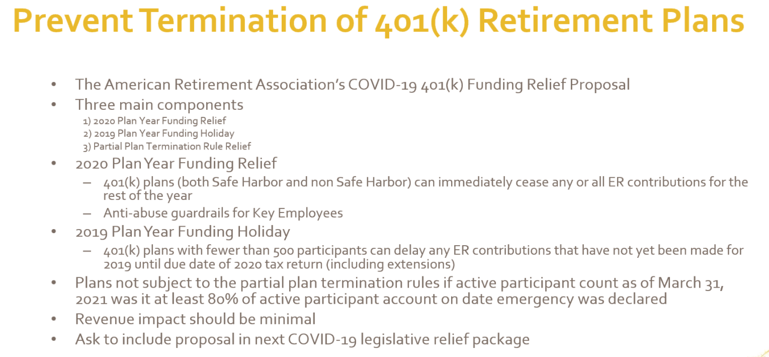
25
Notes:
The American Retirement Association strongly supports federal legislation to provide immediate 401(k) plan funding relief. Small businesses face significant cash flow problems due to the COVID-19 pandemic and are
considering 401(k) plan termination to decrease payroll costs. We propose that employers that have suffered a business hardship get relief from their 2020 plan year compliance obligations after satisfying certain
conditions to prevent abuse. For small employers that still owe contributions for the 2019 plan year, we
propose a one-year delay for those contributions. We also propose that plans not be subject to the partial plan termination rules if the active participant count as of March 31, 2021 is at least 80% of the active participant count on the date the national emergency was declared.

Slide 14
Financial Transaction Taxes
Legislation on Capitol Hill, like the Wall Street Tax Act, would impose a financial transaction tax (FTT) of 0.1 percent of 10 basis points on the sale of stocks, bonds, and derivatives
•
•
The Wall Street Tax Act does not exclude the $10.7 trillion of retirement assets from the financial transaction tax.
This tax translates into a 31 percent increase in 401(k) fees that would require savers to work 2 ½ years longer to achieve the same level of retirement savings.
The American Retirement Association opposes any financial transaction tax that applies to the retirement savings of middle-class Americans.
•
•
25
Notes:
Every time your employees get paid and make a contribution to their 401(k) or 403(b) they would be taxed at .10%. This is as much as some advisory firms charge for their ongoing service!
Over eighty million American workers participate in employer-based defined contribution
retirement plans, and in the 30 years since 401(k) plans gained acceptance, 401(k) plans have become the most popular defined contribution savings arrangement.
The overwhelming majority of participants in 401(k) and similar plans are far from wealthy. In fact,
66% of active participants in 401(k) plans make less than $100,000 per year and 34% percent make less than $50,000.
The Wall Street Tax Act would impose a financial transactions tax (FTT) on the sale of stocks, bonds
and derivatives at 0.1 percent (10 basis points).
While the legislation targets “unproductive and speculative” trading, the Wall Street Tax Act’s FTT on the sale of stocks and bonds does not exclude those held within the trillions of dollars of retirement savings invested in mutual funds and collective investment trusts by pensions and
401(k)s. This would mean an across-the-board fee increase on 401(k) plans for regular, hard-
working Americans, working to achieve a secure retirement.
The Investment Company Institute, a trade association of mutual funds, estimates that the tax
would have the same effect as raising the average 401(k) plan expense ratio for equity mutual funds by 31%.
Every week millions of Americans sacrifice to set aside part of their hard-earned pay for retirement, investing those savings to help provide a secure financial future. The financial transaction tax would be imposed on every contribution, transfer of funds and distribution involving a 401(k) plan. Congress should implement policies to improve retirement savings, not punish middle class Americans working to achieve a secure retirement.

Slide 15
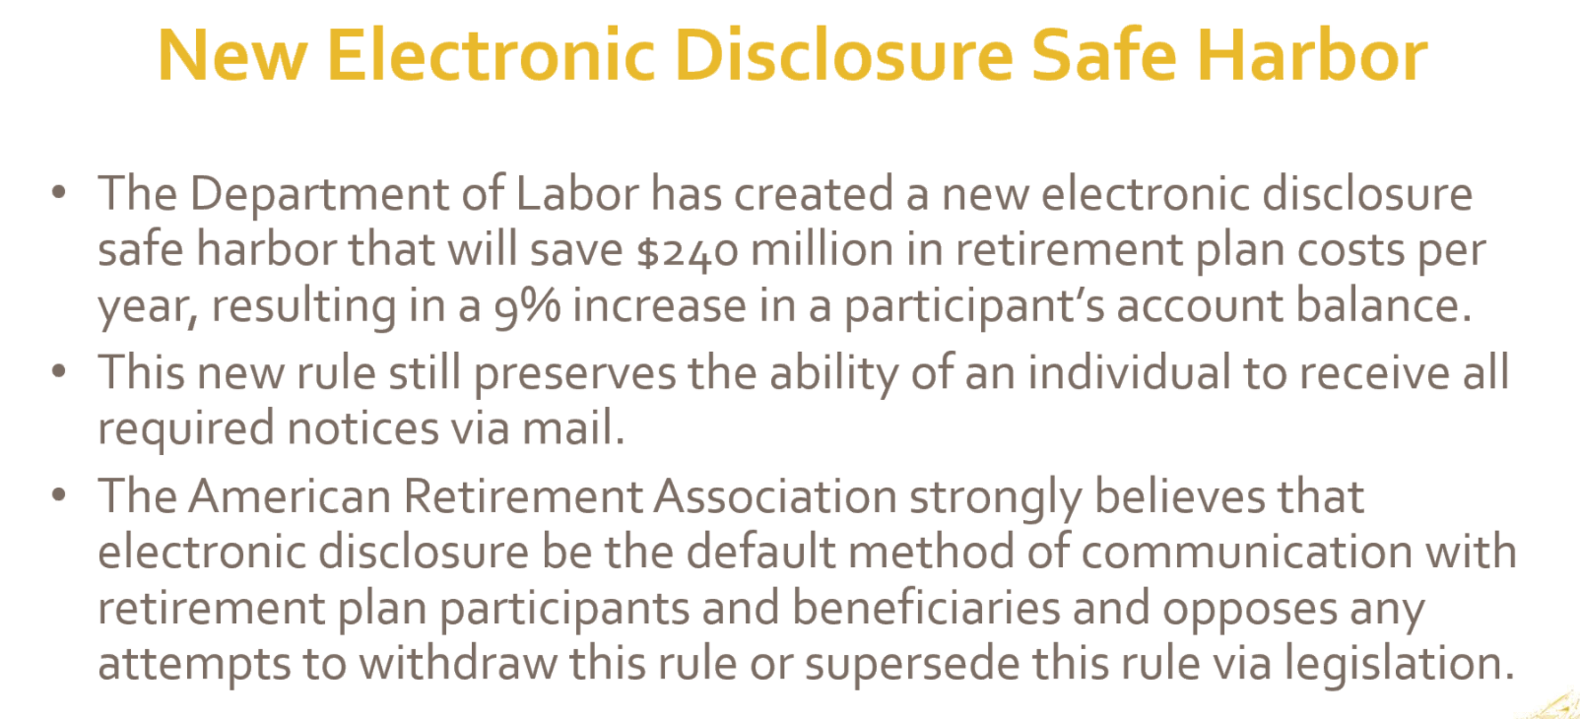
Notes:
While electronic disclosure recently was approved by the DOL there are still some folks in Washington wanting to unwind this new piece of guidance by the DOL. Our message included making sure electronic disclosures be the default method of communication with retirement plan participants and beneficiaries.

Slide 16

Reflecting on the Crisis
How were you impacted?
Where did you adapt?
Who did you rely on for counsel?
What lessons were learned?
What are your key priorities for moving forward?
Notes:
The recent pandemic crisis was an incredible shock to the business community that inflicted significant economic and organizational pain. Leadership within business and the non-profit community was confronted with great uncertainty, fear and anxiety as they navigated through the storm.
As Winston Churchill was once quoted as he worked to form the United Nations after WWII, “Never let a good crisis go to waste”. So too, those words seem appropriate as leaders reflect on the recent pandemic and how their enterprise has been reshaped, maybe redefined and perhaps even strengthened by that experience.
For those who have survived the crisis, they have been battle tested under extreme conditions and can perhaps now step back and reflect on “how” they were impacted as an organization, “where” they have adapted, “who” they may have relied on for counsel, and “what” lessons were learned and how those might fundamentally change their business going forward.
Although there may be some significant scar tissue -- and still more time needed for healing--there also seems to be a bright side of the experience – for some, it was getting to know colleagues and teammates on a more personal level, time together in the foxhole. For others, it jolted the organization into taking action that otherwise would have been too risky, as events forced the need to change, and now glad they did and never looking back…
With those crisis level decisions behind you and the transformation that took place – a new beginning of sorts - what’s critical is that the enterprise operates with laser like focus and tenacity with everyone executing at a high level toward new objectives.

Slide 17
What plan risks or exposures need to be addressed?
Fiduciary Advocate
Impacts from Managing Cash Flow
Employee Financial Anxiety and Vulnerability
Investment Exposures
Provider Blind Spots
Unprotected Data
Increased Regulatory Complexity
Retirement Recovery Plan
Notes:
So, why even consider the 401(k) plan at a time like this? Why should this be an area of priority?
The simple answer is that critical decisions and key actions taken to ensure the business survived may have raised potential exposure in your role as plan sponsor that you’d likely want to minimize before creating larger problems. On the flip side, there may be some real opportunities under recent legislation as well as from lessons learned, to reshape the plan into a more vital and useful employee tool.
As we said a minute ago, it’s critical that the company be laser like focused in executing on your objectives, and not distracted by things that may later blindside you. We know that by being a little proactive, employers can clean up small deficiencies today in order to prevent and avoid much bigger issues and liability down the road.
We’ve identified 6 key areas that employers are vulnerable to potential exposures that we believe should be addressed in the 401(k) Roadmap to Recovery
The impact from key decisions and actions around managing business cash flows – this includes employee layoffs and furloughs that may have been necessary and may require special attention with the plan and certain processes be followed otherwise penalties can be severe. It would not be surprising given distractions, disruptions and personnel changes that errors were made and need to be cleaned up and corrected.
Several major pieces of legislation have been signed into law during 2020. You may not yet be familiar with The Secure Act but it’s a major piece of legislation that has significant implications (mostly positive) for company sponsored retirement plans. Before we could even unpack that piece of legislation signed in December 2019, the pandemic hit and congress passed the CARES Act which offered plan sponsors to adopt several plan provisions to provide greater flexibility to tap retirement funds with new loan and distribution options. Adopting those provisions was voluntary, however, compliance has fiduciary implications and given the quick passage of legislation, the regulators continue to work through uncertain guidelines, which invariably leads to greater complexity and need for detailed attention that most employers have limited resources to devote.
Unprotected data is a huge issue for plan sponsors as Cybersecurity has been a growing threat and the need for careful diligence has only increased when everyone’s attention is distracted and additional access to retirement funds was opened with the CARES Act. Working remotely just adds to the challenge of unprotected data getting into the wrong hands so added security and policies in this area have risen to the forefront.
Employee anxiety around finances has skyrocketed. With pay cuts and furloughs, those with fragile finances have experienced emotional stress that is similar to PTSD. It’s going to be really difficult for a company to be executing at a high level if their employees are struggling and distracted by financial problems.
The investment menu can still be a real blind spot for employers as the run up in the markets over the past ten years may have hidden some underlying issues that may create real exposure. We know that down markets combined with employee layoffs are a red flag for finger pointing and complaints. Employers need to be more proactive than ever with due diligence the investment menu, ensuring appropriate choices and monitoring fees and performance.
Lastly, is the risk of Provider Blind Spots. One of the things that a crisis teaches us is that partners really matter. This crisis has allowed everyone to take a hard look at their providers and how they performed under a stressful environment. We don’t know when the next crisis is going to pop up, but this moment is wasted if we haven’t conducted a stress test to be better prepared and not be blind sided by future events.

Slide 18

Impacts from managing business cash flow
Understanding the impacts:
Employee furloughs and terminations
Reducing or eliminating 401(k) employer contributions
Changes in HR staff administering the retirement program
Notes:
In an environment of great uncertainty and survival mode, business leaders were forced to make some hard financial decisions surrounding their workforce. In some cases, this has led to employee furloughs and layoffs.
From a retirement plan perspective, each has implications and that need to be carefully monitored.
If you experienced furloughs with active participants, their contributions running through payroll would have ceased but automatically start up again once work resumed. For non-eligibles, however, it would be important to track requirements carefully to ensure that they are afforded the benefit when eligible.
Regarding terminations, generally if the company has laid off 20% or more of their work force – subject to facts and circumstances – it’s considered a Partial Termination and those affected employees immediately vest in any employer contributions. Therefore, if this is questionable, it’s important to take a look at the potential impact to ensure vesting is accurate because if the terminated employee receives less than what they’re entitled, the IRS could disqualify the plan unless the error is corrected.
Some companies needed to reduce or eliminate employer match or profit-sharing dollars in order to protect their finances.
If the employer match was “discretionary”, then no obligation exists but a standard practice would be to provide notice to the employees that such a match had been suspended until further notice.
However, if the employer contribution was a fixed match amount, the company is obligated to amend the plan and provide a 30-day notice. Many companies have shifted their plan design in the last few years to a Safe Harbor Match that requires a more diligent process. If a reduction or suspension occurs, a supplemental notice must explain 1) the consequences of the suspension or reduction of contributions; 2) how participants may change their deferral elections as a result; and 3) when the amendment takes effect. Other procedural requirements the employer must follow: 1. Give participants a reasonable opportunity after they receive the supplemental notice and before the reduction or suspension of employer contributions to change their contribution elections; 2. Amend the plan to apply the actual deferral percentage (ADP) and/or actual contribution percentage (ACP) tests for the entire plan year; and 3. Allocate to the plan any contributions that were promised before the amendment took effect.
Lastly, it’s quite possible that the HR department itself has been affected by layoffs or terminations, in particular the administrator of the retirement plan. Who’s running the plan or payroll for that matter? If there are changes in personnel, or if those people are picking up more items on their plate, you can imagine the distraction and potential for increased errors. 401(k) plans have many moving parts that without attentive, knowledgeable administrative support, can quickly lead to errors that balloon into major headaches, liability and corrective expense.
Our 401(k) Roadmap to Recovery action plan calls for plan sponsors to review any furloughs and terminations to ensure eligibility and employer contributions were processed in accordance with the plan document. In addition, if you suspended any match or profit sharing, it would be wise to review any actions taken to ensure plan procedures, notifications and required fundings were in compliance.

Slide 19
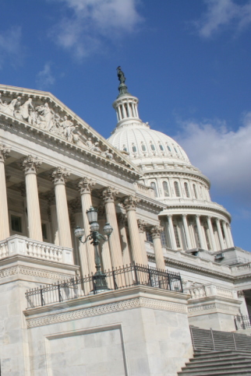
Increased Regulatory Complexity
New burdens to address
CARES Act
SECURE Act
Electronic Disclosure
Notes:
Another risk stems from the increased regulatory complexity resulting from several key pieces of legislation that were signed into law since December 2019 --that leave employers with several new issues to address. On the one hand this legislation provides real benefits to plan participants but increases the workload and potential exposure to employers from an operational and fiduciary oversight standpoint.
You may be familiar with the CARES act that provided plan sponsors with tools to offer financial relief to those affected by Covid – increased loan limits, suspend payments and tap savings via a new distribution. Employers were given the choice on whether to add each feature and nearly 60% did. For those that did, they have taken on a fiduciary responsibility to be in compliance with some fluid regulatory changes that many are unprepared.
The SECURE Act enhances retirement plans in many ways allowing plan sponsors more tools to help employees distribute their accumulated balances into a source of guaranteed income and more flexibility in when they tap those savings. It also brings more participants in the fold by mandating that part time employees be given access to the retirement plan. Many of the provisions have already taken affect, and yet, like the CARES Act the regulations and guidelines remain fluid. What we do know is that plan sponsors bear a greater burden in tracking employee hours to determine eligibility and that the legislation has raised the punitive fines for areas of non-compliance by a factor of 10. As an example, nearly 20k employers filed their 5500 late in 2019 and paid a daily fine of $25. Beginning this year, the fine has increased from $25 per day to $250 per day – a significant reason that employers need to be concerned about their 401(k) responsibilities.
As such it is important that employers remain vigilant in their oversight and proactively attend to any plan governance or operational concerns that could lead to potential exposure. We are advising plan sponsors that they would be wise to ensure they maintain industry best practices, strengthen internal controls, and retain operational integrity.

Slide 20

Avoid pitfalls from unprotected data
Assess your cybersecurity risks
Educate employees on handling sensitive data
Review provider cybersecurity protocols
Review insurance coverage
Encourage participants to protect 401(k) accounts
Source: Javelin 2020 Identity Fraud Study: Genesis of the Identity Fraud Crisis
Notes:
According to the Javelin 2020 Identity Fraud Study, total identity fraud reached $16.9 billion (USD) in 2019 and criminals are targeting smaller numbers of victims and while inflicting damage that is more complex to prevent or remediate. The type of identity fraud has drastically changed from counterfeiting credit cards to the high-impact identity fraud of account takeover. At a time when consumers are feeling financial stress from the global health and economic crisis, account takeover fraud and scams will increase because criminals become more active during times of economic hardships. During the next twelve months, criminals will strike at the heart of the financial services industry and negatively affect consumers. Areas of concern range from fraudulent account openings (synthetic identities), person to person (P2P), and full takeover of all accounts, not just checking or cards but also investment accounts and other high-dollar balances. The challenge of reducing fraud losses is not always the lack of technology investment. It can also be the failure to focus on increasing consumer adoption of safer methods of safeguarding their information and managing their finances. To counter fraud and ensure data privacy, the conversation needs to change from monitoring activity that is occurring to securing the information before it is stolen.
For employers whose employees are working from home and especially those handling sensitive employee data, make sure that employees are securing their online devices by instituting a screen lock, encrypting data stored on the devices, avoiding public Wi-Fi and/or using a VPN, and installing anti-malware. Use of secure email, portal or a share file system should be used to transmit PII such as census information, testing data and payroll reports. Employers should review their cybersecurity protocols and regularly conduct cybersecurity training including how to identify potential breaches.
Employers should review their providers service contracts for cybersecurity protocols. Some providers have cybersecurity warranties and remedies available for losses resulting from cybercrimes.
Estée Lauder Sued Over Security Breach – A former participant filed a lawsuit against all fiduciaries for violating their fiduciary duties and not adequately protecting the participant’s account against unauthorized withdrawals when $99,000 was withdrawn from their account in three separate unauthorized distributions.
Our 401k Roadmap to Recovery strongly advises employers to:
Ensure your 401(k) internal/external policies and protocols address the current work environment and best practices for data protection
Review your insurance coverage to determine if there is coverage for losses resulting from cybercrimes.
Encourage plan participants to protect their retirement accounts, including turning on two-factor authentication, using biometrics, signing up for account alerts and keeping their contact information (email address, cell phone, mailing address) up to date.

Slide 21
Employee Financial Anxiety and Vulnerability
67%
of US workers are significantly burdened by financial stress and it affects their work productivity
% of Employees interested in benefit
% of Employers offering benefit
Source: MassMutual Workplace Benefits Study 2018.
Notes:
Prior to the COVID-19 pandemic, a little over 40% of Americans lived paycheck to paycheck and over half spent more than their annual income. (PwC’s 2019 employee financial wellness survey) Employee financial stress in today’s workforce is a well documented problem and according to a recent survey, 67% are significantly burdened by financial stress (Pwc Study) which has only increased during the recent crisis. Some have shown signs of stress similar to that of PTSD (Post Traumatic Stress Disorder) and we’re seeing evidence that it’s affecting all generations, particularly among millennials.
And while most employers offer education on retirement, only one quarter offer education on budgeting, debt management and financial planning, which as you can see from this slide, employees really want support in these area. Financially distressed employees have trouble functioning in their jobs, and this is hurting their physical health as well as taking a bite out of the employer’s bottom line by absenteeism, turnover costs, or healthcare costs.

Slide 22
Rebuilding Finances Starts with Emergency Savings
Other Financial Goals
Retirement Savings to get 100% On-Track
Debt Management
Retirement Savings to Get Full Company Match
Emergency Savings to cover 3+ Months of Expenses
Notes:
One clear lesson that we can take away from this pandemic and the 2008/2009 meltdown, is that too many people do not have an adequate level of emergency savings to weather a financial storm and are therefore in a fragile position and very vulnerable to and unprepared for economic challenges.
The 401(k) seems to be considered by many as a financial safety net, that can be turned to when financial difficulties arise.
Unfortunately, we know that liquidating the 401(k) creates serious and unrecoverable long-term consequences to workers future financial security. This is a huge problem and simply reinforces the need for us within the retirement community to refocus our efforts to encourage and assist employees in making “Emergency Savings” their top priority, over that of saving within the 401(k) itself.
We have this great infrastructure in place through 401(k) plans to help people save a little each payroll period into a long-term savings vehicle – this same architecture can help to address the emergency savings problem.
Our 401k Roadmap to Recovery makes it our mission:
To bring awareness to employers and support their efforts to focus on, develop creative ideas and incentives to build and implement an Emergency Savings program as the number one objective – ahead of retirement savings in order to help move beyond the inevitable short term crisis that so many face that leads to such self-inflicted damage and stress faced by those that do not have an adequate emergency savings.

Slide 23
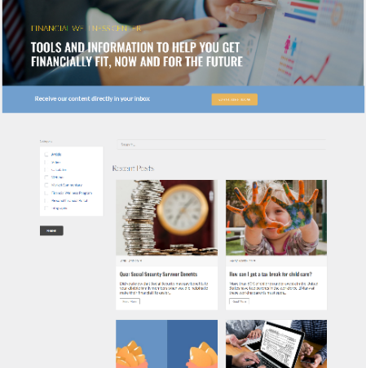
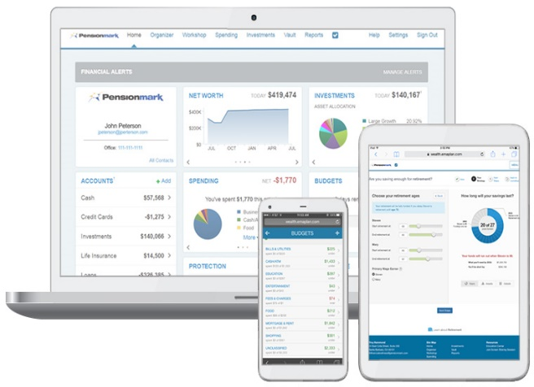


Comprehensive Model for Financial Wellness
Self Learning | Personalized Support | Tools for Action
Online financial education center Articles Videos Market recaps Financial calculators | Bilingual Financial wellness call center Live webinars Employee education meetings Individual consultations Group seminars | Our Personal Financial Portal Aggregates financial accounts for a full financial picture Calculates retirement gap analysis Tracks spending & budgets Provides solutions to make actionable results Employs advanced security features and encryption
Notes:
We know that a comprehensive financial wellness model includes:
Self Learning
Targeted education sent directly to employees. Online articles, webinars, market recaps, interactive education center, videos, and social media updates accessible 24/7 online.
Personalized Support
A team of financial specialists to assist employees with questions and provide holistic coaching support on an individualized basis in the area of budgeting, building emergency savings, debt management, and financial goal setting.
Tools for Action
A digital platform to provide a simple and secure online location where employees can monitor the financial components of their life, allowing them to make more informed investment and lifestyle decisions.
At Pensionmark, we’ve made financial wellness a core component of our plan advisory services. We know that different employees engage and consume information in different ways. In addition to a monthly thematic outreach, during the recent market volatility we reached out in a proactive and visible manner through our digital platform to reassure and provide comfort to employees and to provided tips on coping with market volatility. In addition, our investment team held weekly COVID-19 calls to keep employers and participants alike updated on how the pandemic was affecting the markets and retirement savings, provided information on Coronavirus scams, and several workshops on managing personal finances in times of uncertainty and with debt counselors to create a debt management plan.
This holistic approach to personal finances really paid off with our call center touching over 5k participants, counseling employees on taking CARES Act withdrawals, repositioning investments, and helping them deal with their emotions of uncertainty.
Our 401(k) Roadmap to Recovery calls for employers to implement a comprehensive financial wellness program as an added support mechanism to the 401(k) plan. This needs to become a standard expectation that employers demand from their 401(k) partners.

Slide 24

Investment Exposures
Review plan investments
Review your process and documentation
Ensure you are using the lowest cost share classes
Assess appropriateness of Target Date Fund glidepath
Provide education on market volatility
Consider guaranteed income solutions
Notes:
Investment exposures are a visible risk that during volatile markets can be easily scrutinized and make employers the target of participant complaints and potential lawsuits.
We’ve found that some employers have not been as diligent during the last 10 years of rising markets. During current volatile markets, we need to rethink plan investment options.
Review your process and documentation. Do you have an Investment Policy Statement and does it contain the process for selecting, monitoring and replacing investments offered in the Plan? When was the last time it was updated? How often do you review the investments offered in your Plan? Do you receive quarterly investment reports from your provider or advisor? Do you document investment changes and decisions in writing (i.e. meeting minutes)?
Ensure you are using the lowest cost share classes. Are you familiar with the different investment cost structures available to retirement plans? Have you analyzed these different cost structures to determine what is best for your participants and if so, how often do you revisit it? The larger your Plan assets grow, you gain buying power and will have access to investments with lower cost structures, so it is important to make this analysis part of your process.
Assess appropriateness of TDF glidepath. How did you select the TDFs for your Plan? Are they proprietary to the provider? Did you look at your participant demographics and savings rates to determine which option was a best fit or did you just look at performance. The DOL has provided guidance on selecting TDFs which includes looking at more than just performance, so it is important to review the appropriateness of the TDF you offer now and in the future as your demographics, plan design and participant behavior change.
Provide education on market volatility. This is very important so employees keep a level head and don’t make decisions that may feel good in the moment but could be very detrimental to their long term retirement goals. Plus, efforts on the educational front helps mitigate risk to fiduciaries when the market drops and employees start pointing fingers.
Consider the need for guaranteed income solutions. The SECURE Act opened the door for employers to allow these products in retirement plans. Do you have participants who are getting closer to retirement and would benefit from having this type of option available?
The 401(k) Roadmap to Recovery requires a thorough rexamination of the investment menu by an objective and prudent investment specialist.

Slide 25

Avoid Provider Blind Spots
Stress test relationships
Minimum Requirements
&
Best Practices
Notes:
As with the investment menu, many plan sponsors have held onto provider relationships for long periods of time because they were satisfied and comfortable.
The problem is that, as a fiduciary steward, an employer’s decision over their providers can be really critical to the success of the program and may have a significant impact on participant outcomes and results.
A framework for ongoing review of your provider partners is fundamental to good plan governance with lasting consequences. What the pandemic revealed is that inertia often works against making positive changes but during a crisis mode, everything is on the table to be re-evaluated. So its perfect timing for employers to take a fresh look at your provider partners to ensure that you avoid any blind spots.
When one thinks of a stress test, they might envision an individual on a treadmill with monitors attached to their body so that the doctor can measure the health of their heart. That’s the same concept that we’re advocating with the 401(k) plan. We know that the health of the plan is directly attributed to the provider relationship and services that support the efforts of an employer.
Under the 401(k) Roadmap to Recovery we believe its critical that you stress test your provider relationships and reassess your minimum requirements and develop an awareness of what today’s best practices might look like. The recent crisis provides a new perspective for employers to rethink what services and support you believe will be most important to your success moving forward.

Slide 26
Stress Test Recordkeeper
 | Minimum Requirement | Best Practices
Retains compliant, streamlined and accurate processing | √ | √
Provides full administrative services – notices, testing, 5500 filing, statements | √ | √
Consistent support requirements | √ | √
Reasonable fees | √ | √
Full Integration with payroll provider |  | √
Personalized digital experience – online, mobile and human touch points |  | √
Robust wellness and retirement tools |  | √
Cybersecurity protection |  | √
Proactive assistance with legislative changes |  | √
Crisis Management Plan – Formalized and Tested |  | √
Notes:
So what does a healthy recordkeeper look like?
Minimal requirements may include a compliant, streamlined and accurate processing environment. In addition, employers tend to seek out providers that can offer the complete package – not only recordkeeping but full administrative services that allows the employer to offload the burden of notices, testing and filings. And no one wants surprises, so plan sponsors want to know that their recordkeeper has policies and procedures in place to retain consistent service levels. Finally, all the services provided by the provider need to pencil out such that they meet the reasonableness test from a cost perspective.
From a Best Practices perspective, several areas that really stand out for employers pertain to offloading manual processes, reducing human error and services that deliver a better participant experience and offer tools that can drive financial wellness.
We talked earlier about the advantages of integrating payroll so that employers can eliminate manual processes and the errors that inevitably occur, then there is the significant investment to provide personalized digital interfaces that provide participants with transactional and analytical data as well as the trend toward financial wellness and the tools that recordkeepers have developed to educate and engage employees beyond retirement planning. Cybersecurity risk is very real within the 401(k) plan and the need for protection with recordkeeping partners playing a critical role with technology and protocols to keep your data safe.
In 2020, we can add several other best practices whereby recordkeepers have taken a lead role in proactively unpacking the nuances of 401(k) legislation, helping the advisor and plan sponsor community digest the issues so that employers are in a position to make prudent decisions for their plan.
The recent crisis taught us is that it’s really critical for recordkeepers have a formalized and tested crisis management plan – their ability to operate in a seamless fashion during a stressful environment. They need to be able to transact business in a fully remote capacity, while adhering to the same compliance standards and to be available on a 24/7 basis, whereby participants can reach someone live to talk to that could soothe over emotions. We know of examples where this really made a difference and have other examples where the inability to reach a “live” person added to frustration and raised stress levels. It’s not just technology, its adding staff, ongoing training and ongoing preparation for the next crisis that makes a difference and why Crisis Management has been added to our list of best practices.

Slide 27
Stress Test Advisor
 | Minimum Requirement | Best Practices
Plan Fiduciary – 3(21) or 3(38) | √ | √
Transparent, Fee-based service model | √ | √
Educate committee | √ | √
Rigorous and objective investment process | √ | √
Specialist |  | √
Comprehensive service model that covers all the bases |  | √
Participant financial coaching and wellness platform |  | √
Crisis Management Plan – Formalized and Tested |  | √
Notes:
Now let’s take a look at the advisor relationship – in similar fashion, what does a healthy advisor partner look like?
Over the past decade, employer demands on their advisors has grown in substantive ways:
For the majority of employers, “fiduciary status” of the advisor is minimal table stakes as plan sponsors look to offload more areas of potential liability. And, especially since fee disclosure requirements, demand for a transparent and conflict free fee-based service model has grown in importance.
Functionally, most employers expect their advisor to educate and guide the committee on plan governance and their oversight responsibilities, as well as to take a lead role in the selection and monitoring of the investment menu through a rigorous and objective process. Finally, many employers lean on their advisor to at a minimum answer participant questions surrounding investment choices and the plan operation.
Over the past decade, Fidelity has conducted an annual survey of Plan Sponsors to determine their evolving needs. While in years prior, advisor fiduciary services and investments have been a top consideration, however, in 2020 the number one priority of employers was for their advisor to help with the increasingly complicated process of managing a retirement plan. The same survey emphasized the big shift of employers to focus more on participant outcomes. (Fidelity 2020 Plan Sponsor Attitudes Study)
This trend and desire by employers to offload the burden and liability of the 401(k) plan wherever possible has led to many seeking advisors who are Specialists who can offer a comprehensive service model that covers all the bases: plan governance, design, investments, administrative support and participant engagement. Employers have to a large extent embraced a greater responsibility for the wellbeing of their employees which has translated to the growth of financial wellness programs and the expansion of their advisor relationship, leaning on their unique skillset to provide employees with holistic financial coaching and becoming actively involved in the strategy, structure and execution of financial wellness initiatives.
The recent crisis highlighted another best practice for advisors, the need for their own crisis management plan. For our group, we’ve long believed in the importance of contingency planning and maintaining a formalized process to ensure our ability to serve our clients. The recent crisis made us reflect, however, on ways that we could do more to serve our clients on a broader level.
We learned that employers needed us to proactively intercede with their recordkeeping partners to ensure they remained viable and had the business plan and resources to pivot to a fully remote working environment. Our clients needed us to be their advocate and be able to lean on these partners to make sure everything continued to operate in a seamless and compliant fashion. Anticipating problems that can occur is baked into our updated crisis plan.
We also quickly realized that we play a broader role in counseling our clients. A number of our clients are small businesses that faced economic ruin and a desperate need for capital. Because of the work we do, we are at the intersection of the financial and professional services industries that offers a tremendous network of resources that we tapped to help our clients through several immediate business challenges. 1. Obtain PPP financing and 2. Help them gain maximum loan forgiveness. Our crisis management plan has now been revised to include a robust network of professionals as added asset that can be mobilized in an instant to serve our clients in a broader business fashion beyond the 401(k).

Slide 28

How We Can Help
Conduct a diagnostic assessment that provides critical plan insight
A comprehensive review of participant outcomes, investment process and plan administration
Helps the committee create a unified vision and roadmap for decision making
Uses analytical insights to drive better retirement outcomes
Identifies potential fiduciary blind spots and exposures
Attain maximum leverage from partner resources
We can equip employers with more informed decision making to improve overall plan performance
Notes:
Great retirement plans like great organizations don’t just happen. They require setting a vision, gaining a unified vision to aspire and getting the various stakeholders to execute on a plan and hold everyone accountable for results.
Unfortunately in its 40-year history, retirement plans continue to fall short of expectations to help workers secure adequate financial security in retirement.
As part of the 401(k) Roadmap to Recovery – we believe its important that 401(k) plans evolve to meet today’s challenges and have developed PlanSuccess Blueprint for the purpose of defining and measuring those critical attributes that will drive better outcomes for participants while helping employers further minimize their exposure in offering this important benefit.
We hope to partner with proactive employers with a similar mindset to strengthen the 401(k) into a more resilient, flexible benefit that can help participants rebuild their financial footing, get on track for a more secure retirement and improve their ability to better weather future financial storms.

Slide 29
Questions?
FOR PLAN SPONSOR USE ONLY. Pensionmark® Financial Group, LLC (“Pensionmark”) is an investment adviser registered under the Investment Advisers Act of 1940. Pensionmark is affiliated through common ownership with Pensionmark Securities, LLC (member SIPC).

Slide 30
Session Password
(Must record password for CPE credit)

