Slide 1
2020 CFMA Conference
WIFI Password: BRAYNTaxIncentives

Slide 2


Current State of ERP Solutions and Considerations for Change

Slide 3

Frank T. Di Lorenzo, Jr.
Graduated Boston College – Computer Science and Accounting
35 Years in the Construction Industry
  President, Con-Tec Management Systems, Inc. - 18 Years
  Consulting – Several Construction Specific Platforms – 10 Years
  Recently Joined Preferred Strategies focusing on Data Analytics and Power BI Reporting

Slide 4

Steve Hathaway
Civil Engineering Degree – Marquette University
MS – University of Colorado
35 Years In the Construction Industry
  15 Years Construction Operations
  10 Years Construction Information System
  7 Years Construction ERP Software

Slide 5
Percent of Companies that Fully Utilize Their Software.

Slide 6
Maximize Utilization of your ERP
Improve
Re-Implement
Replace
Good Foundation
Add Functionality
Replace Spreadsheets
Replace Manual Processes
Solid Technology
Functionality Exists
Poor Core Setup
Engage ERP Partner
Possible Third Party Assistance
Technology No Longer Supports Objectives
Partnership No Longer a Fit
Ease of Use
Peers
Functionality

Slide 7
Best Practices to leverage your ERP Investment
Rigorous Process Review
Success is in the details
Implementations never end
Consistent process feedback
People Factor
Availability of time for extra workload
Content Knowledge
Fear factor – Managing Change

Slide 8
Process Review
Apply to each functional area
Breakdown by each process
Find Efficiencies / Inefficiencies
Document New Process
Test Process
Implement Process
Repeat
Examples: **Get information into the database**
  Time collection
  Daily collection
  Field materials
  Equipment Utilization
Needs Assessment
Process Reengineering
Pilot Solution
Training
Phased Implementation
Software Selection
System Implementation

Slide 9
Technology Adoption
Technology | User Experience | Technology Invented | Technology Adopted in Construction | Delay
Mainframe (dumb terminal) | Green Screen Character based system | 1951 | 1976 | 25 Years
Client Server | Windows application connected to server | 1956 | 1991 | 35 Years
Cloud – Browser | Web Browser, but no server | 1990 | 2015 | 25 Years
Cloud – Browser, Apps | Web Browser and Mobile Apps | 2007 | 2015 | 8 Years
Advanced Intelligence, Automation |  | 2016 | ???? | ????

Slide 10
Technology Timeline
1951
2007
2015
1990
1956
Mainframe
1976
1991
1999
Client Server
Mainframe
Browser
Client Server
Browser
Mobile Apps
Mobile Apps
Year Created
Year Introduced to Construction

Slide 11
Acquisitions
A few examples:
Best Software
Master Builder
Timberline
Sage
Master Builder (Sage 100)
Timberline (Sage 300)

Slide 12
Acquisitions
A few examples:
Maxwell
Cheetah Software
American Contractor
Viewpoint
Dexter and Chaney
Bain Capital
Viewpoint
Maxwell
Construction Imaging Systems
Keystyles
Resource Commander
Trimble
Viewpoint

Slide 13
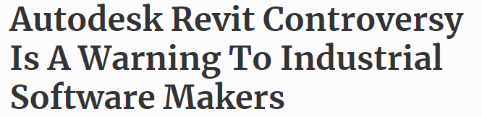
Thousands of leading architects signed open letters to Autodesk complaining about escalating software costs and lackluster development. This is a warning to all software providers: Customers are fed up with being locked in and are demanding open platforms with rapid innovation.

Slide 14
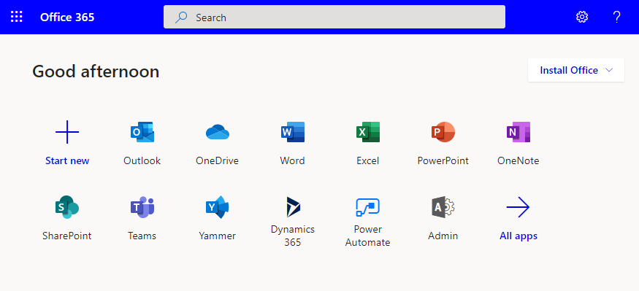
Microsoft Office 365....More than 4 Apps!

Slide 15
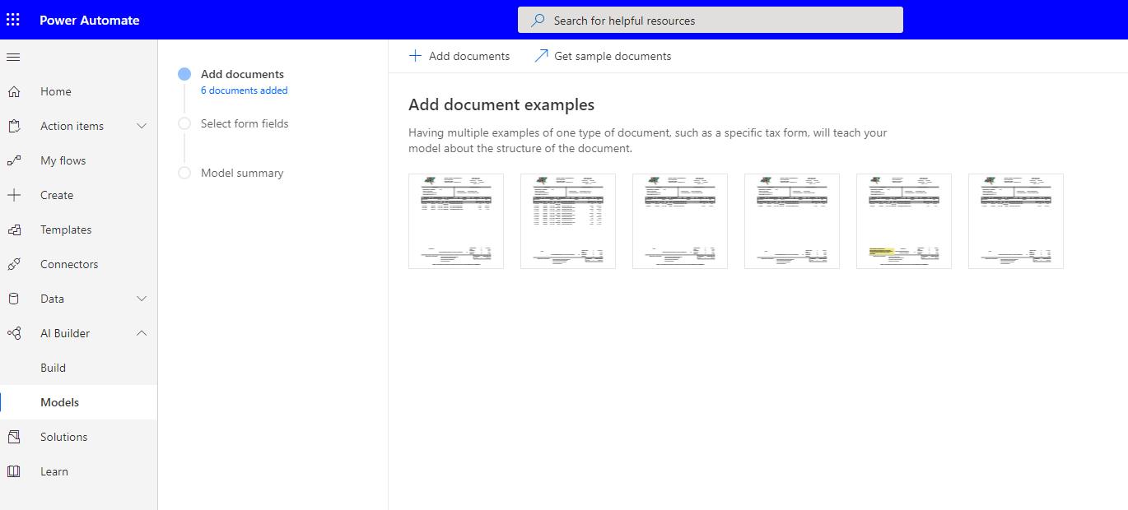

Slide 16
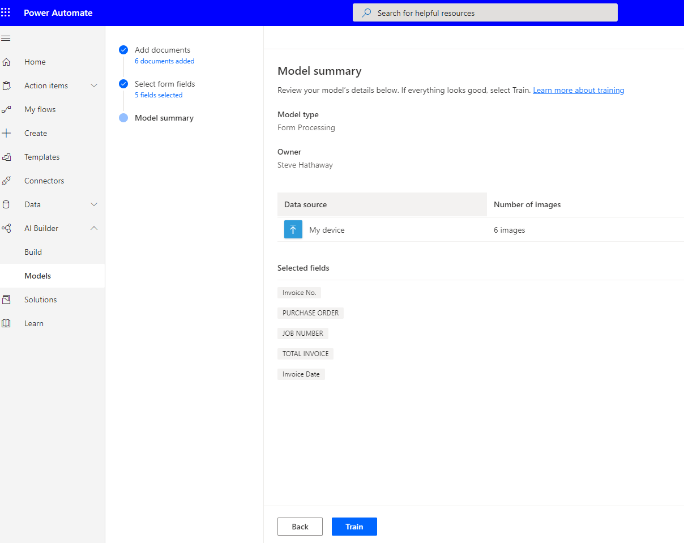

Slide 17
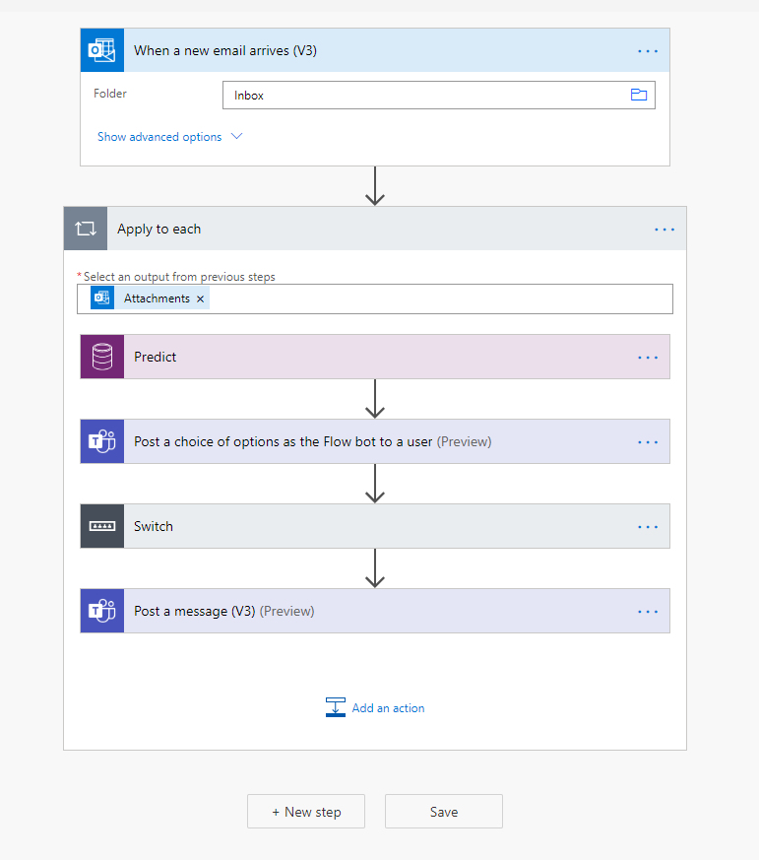
Workflow Automation

Slide 18
Construction ERP Generational Change
Past Generation
What does the Client Need?
“We can build it”
New Generation
What does the Client Need?
“We can integrate it”
Who is your Partner?
Past Generation
Your ERP Provider
New Generation
Your Technology Partner

Slide 19



Next Generation ERP Solutions
Discussion Points:
- Open Integration Platform
- Cloud-Based
- Mobile Options
- Rapid Development
- Feature Set Challenges
- Older Systems can’t keep up with Technology
Next Gen: Where's the value?
- Hundreds of Integration Partners
- New level of flexibility
- Configuration
- Custom Apps, Modules
- Support for Data-Analytics
All Came from Manufacturing

Slide 20
Partner Value - "The New Norm"
VAR becomes Technology Partner
  Integration Support of Multiple Solutions
  Not completed vested in a single ERP System
  Expert in Construction Processes
  Value is knowledge, training, support assistance – not product sales

Slide 21
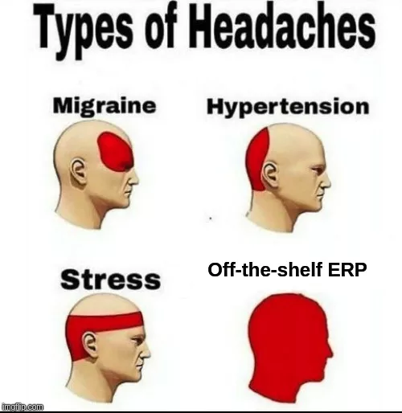

Slide 22
Thank You!! Questions!!

Slide 23
cold
(Must record password for CPE credit)

