Slide 1
2020 CFMA Conference
WIFI Password: BRAYNTaxIncentives

Slide 2
Trade Contractor Prequalification
James Bly | Bob Kinder | AJ Jain

Slide 3
AGENDA
Industry Forecast - Surety and SDI Defaults
Prequalification Tool (C2M) - How it Works and the Benefits
Past Scores vs Future Scores
Additional Measures - 90 Day Liquidity Stress Test

Slide 4
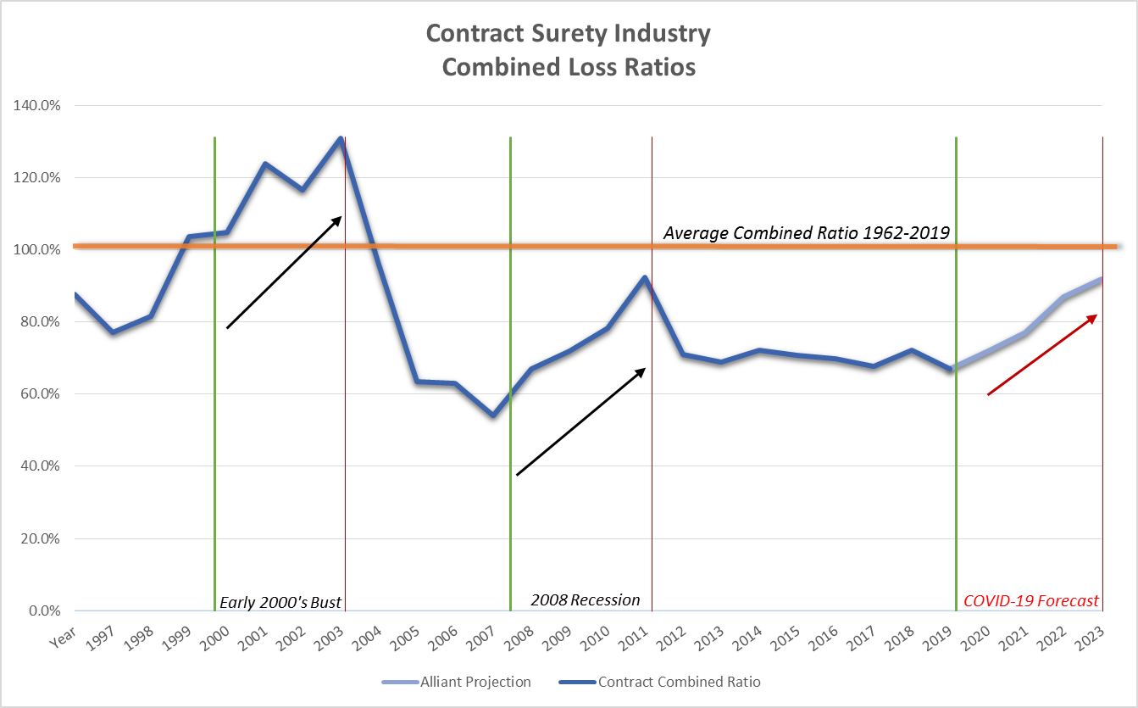
INDUSTRY FORECAST
Peak of SDI Losses
*Historical Data provided by The Surety & Fidelity Association of America

Slide 5
SUBCONTRACTOR INSOLVENCY TRENDS
PreCOVID Subcontractor Insolvency risk was on the rise as the market expanded with larger projects and growth in backlog for trade contractors that were facing labor shortages and an overextension of resources.
COVID benefits to subcontractors – Less labor shortages + PPP funding helped many subcontractors through Q2 and Q3. Long term impact – COVID expected to lead to weakened financial positions that may cause subs to fail due to inadequate financial resources when challenges arise.
The number one cause of financial failure for prime or subcontractors is taking on work that exceeds their financial or operational capabilities. Larger projects lead to greater scheduling, project execution and quality challenges that turn in to delays, project losses, defective work and ultimately defaults or insolvency.
Red flags that point to heightened insolvency risk include delayed or late financial statements, inability to meet project schedules, liens or surety bond claims on other projects, changes in ownership, taking on work outside their territory, projects 1.5X or more than the largest project completed, working with an unfamiliar developer or architect.
Weak subcontractor risk management processes may lead to the default of CM’s and GC’s if they are undercapitalized for the size of work they undertake.
4

Slide 6
SUBCONTRACTOR DEFAULT INSURANCE LOSS RATIO
SDI Loss History Trends:
Losses exceeding 200% of Subcontractor Value = 13.3% of Total (Most losses in this category are for subcontract values of $5M or less).
Losses between 100% and 200% of Subcontractor Value = 12.8% of Total (Most losses in this category are for subcontract values of $5M or less).
Losses less than 100% of Subcontract Value = 73.9% of Total.
Subcontract Values over $10M rarely lead to loss exceeding 100% of Subcontract Value.
Surety losses are generally 30% of the Subcontractor Value or less. SDI’s added coverage and claim process provide added coverage.
5

Slide 7
ALLIANT CONSTRUCTION CREDIT MODEL (C2M)™
Creating Novel Ways to Enhance Value
Alliant Construction Credit Model (C₂M)™ is an innovative analytical tool to evaluate a subcontractor insolvency risk based upon single and aggregate project capacity limits established by the model.
Alliant C₂M™ can be used to:
Generate considerable cost savings on a project by minimizing default risk
Replace traditional surety program with client centric state of the art insolvency analysis.
Determine if a particular subcontractor(s) is qualified for certain project(s)
Evaluate the need to bond a subcontractor or include an SDI program
Decide if it is necessary to employ other risk mitigation tools, such as funds control or joint checks
Understand and mitigate subcontractor default risk
Avoid the impact of subcontractor failure
C2M procedures – Risk Mitigation for High Risk subs, Subs exceeding single project limit or subs with aggregate enrollment more than 50% of Aggregate limit.

Slide 8
WHAT IS C2M?
Proprietary Contractor Credit Model
  Evaluate the risk of prime and subcontractor insolvency.
Surety Underwriting Algorithm
  Credit score and recommended Single project and Aggregate backlog limits
Evaluate thousands of contractors for the past twenty years.
  C2M has helped our clients identify subs as high risk two years or more in advance of their insolvency causing surety or SDI losses exceeding $100M.
  SDI CARRIERS RECOGNIZE THAT C2M IS A BEST IN CLASS PREQUALIFICATION SERVICE

Slide 9
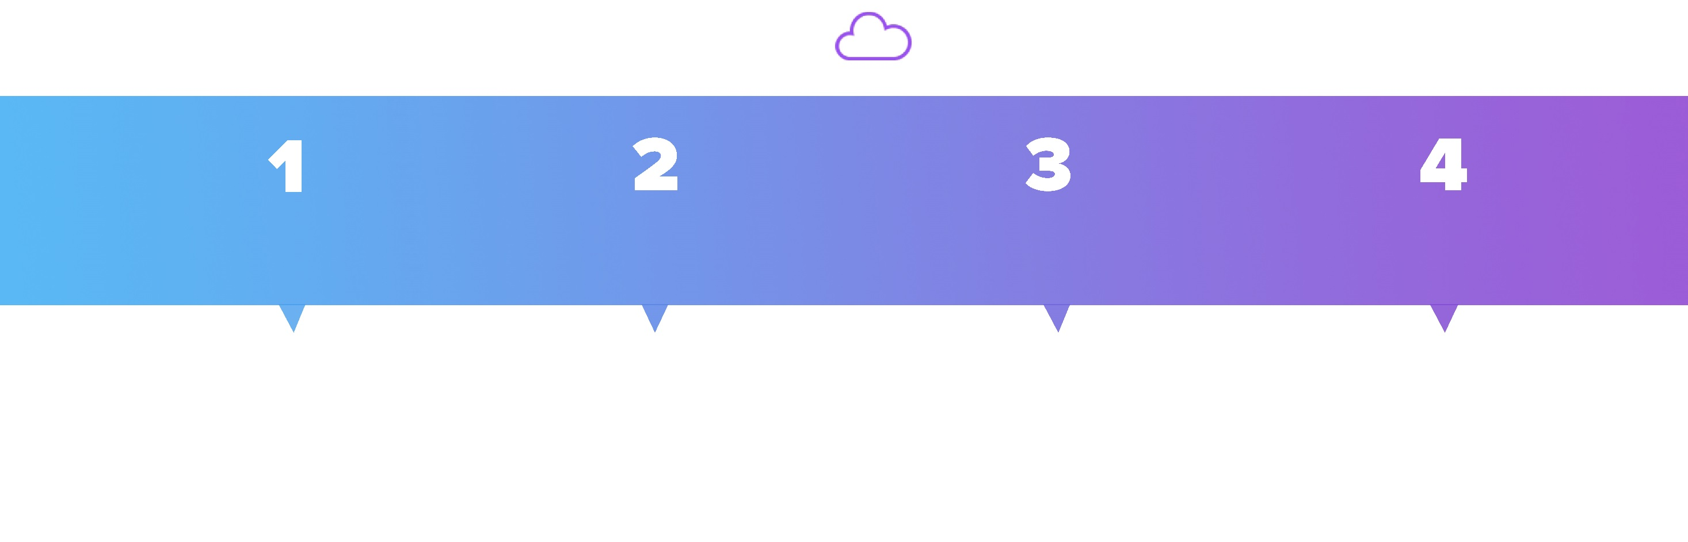
C2M CLOUD PLATFORM
Subs Portfolio
Compare Mode
Credit Model
Sub Interface
Subcontractor Portfolio contains data listed and sorted from the client, as well filtered by trade, location and region
Compare different subcontractor data and see the results side by side
Credit Model features an extended view of the data provided for the subcontractors with informative charts, key data, highlighted fields…
Subcontractor will complete questionnaire and upload necessary documents

Slide 10
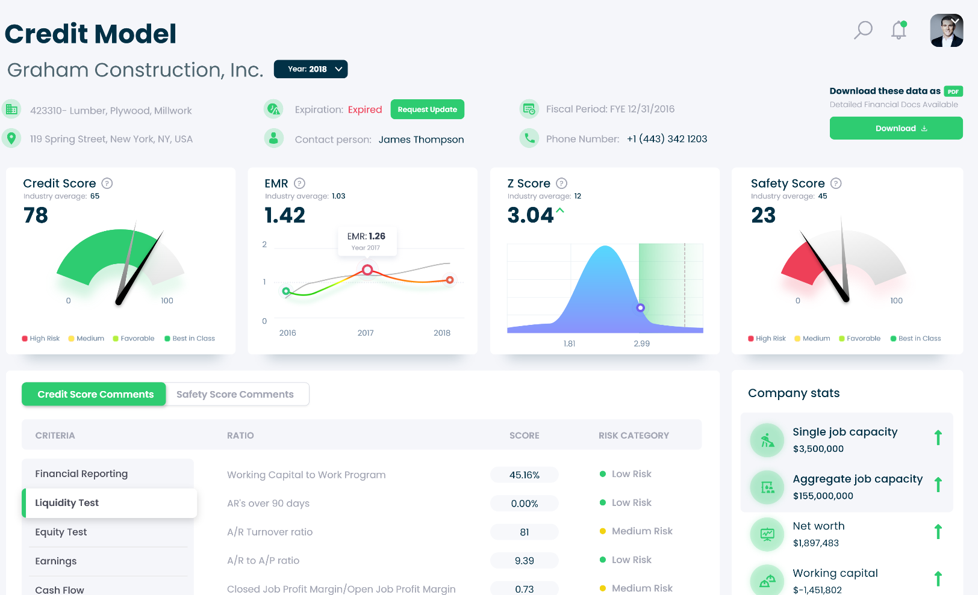

CREDIT MODEL

Slide 11
CREDIT SCORE CRITERIA
Financial Reporting: Preparation of financial statements-audit, review or compilation/Timeliness of reporting
Liquidity Test: Working Capital to backlog/ Underbillings/ Accounts receivable (i.e. collection) issues
Equity Test: Net Worth to backlog/Net Worth to overhead
Earnings: Margins on open and closed jobs (based upon WIP)/ Gross profit to overhead
Cash Flows: Review of cash flows in relation to net income
D&B Paydex Score: Score in relation to industry median/ Disclosure of liens, suits, and judgements
Bank Line of Credit: Amount of facility versus volume/ Amount borrowed against BLOC versus total
Debt to Equity: Measures whether a subcontractor is too leveraged in relation to industry standards
Work Capacity: Single project limit based upon largest prior job completed/ Recommended work program limit
Org Capacity: Prior work history/ Years in business

Slide 12
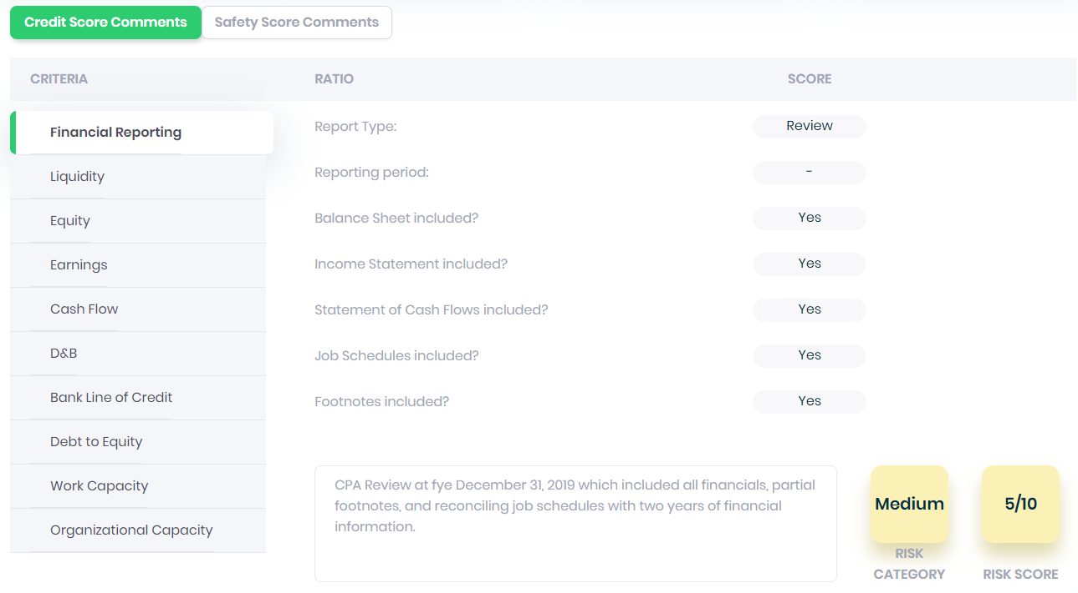
FINANCIAL REPORTING

Slide 13
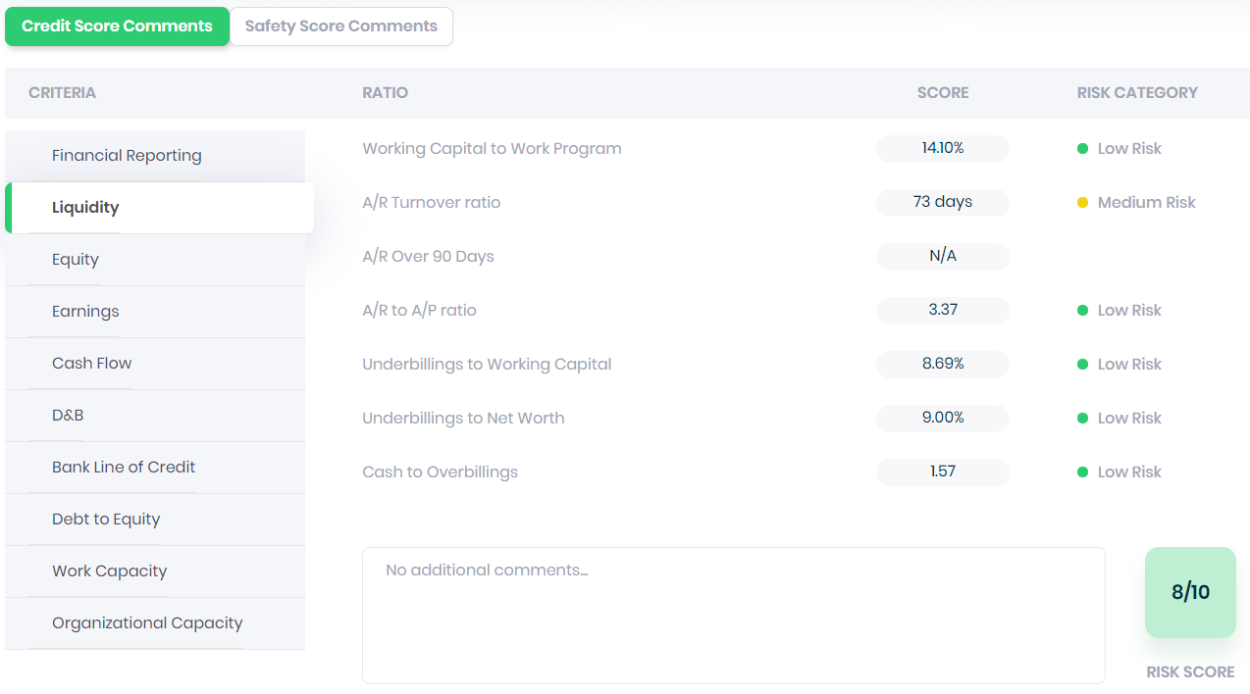
LIQUIDITY

Slide 14
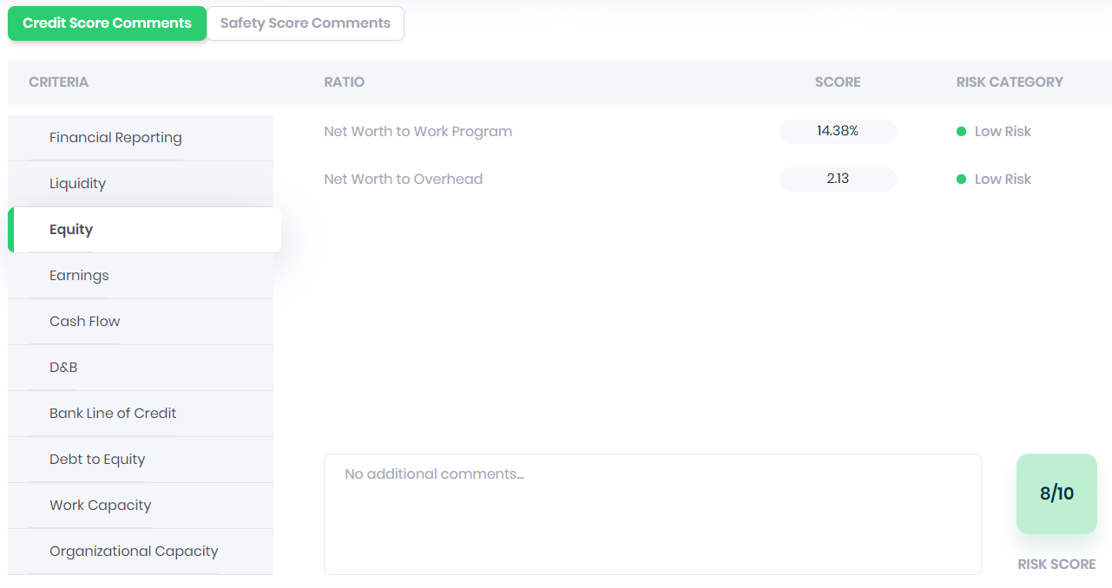
EQUITY

Slide 15
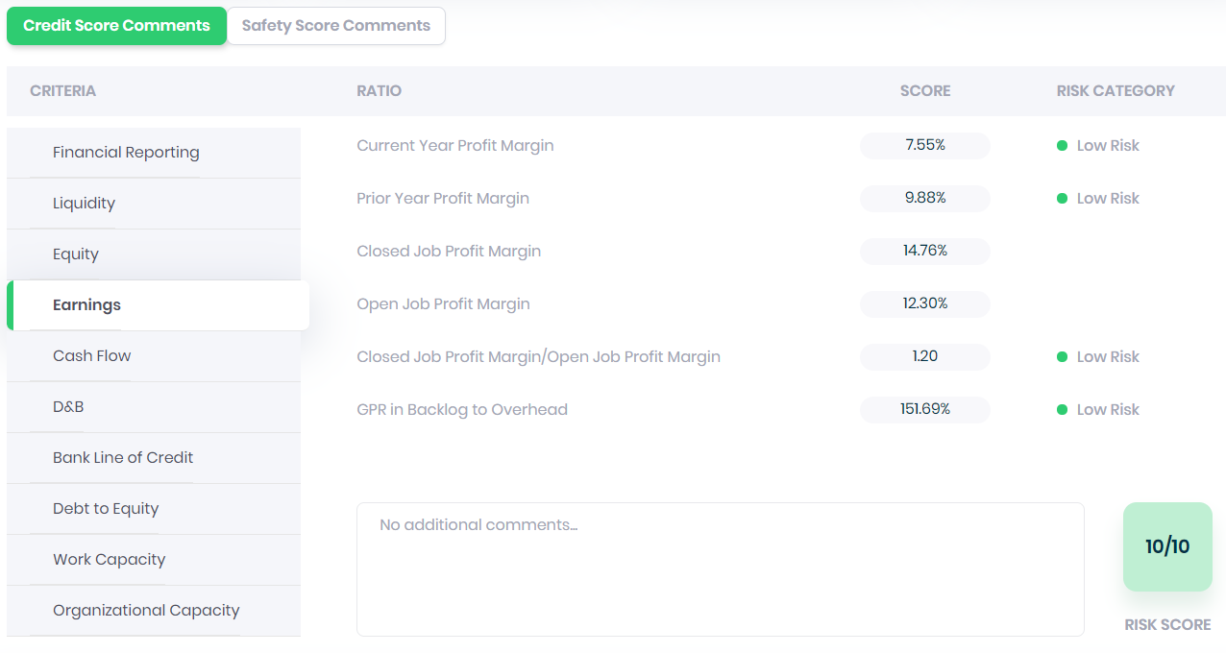
EARNINGS

Slide 16
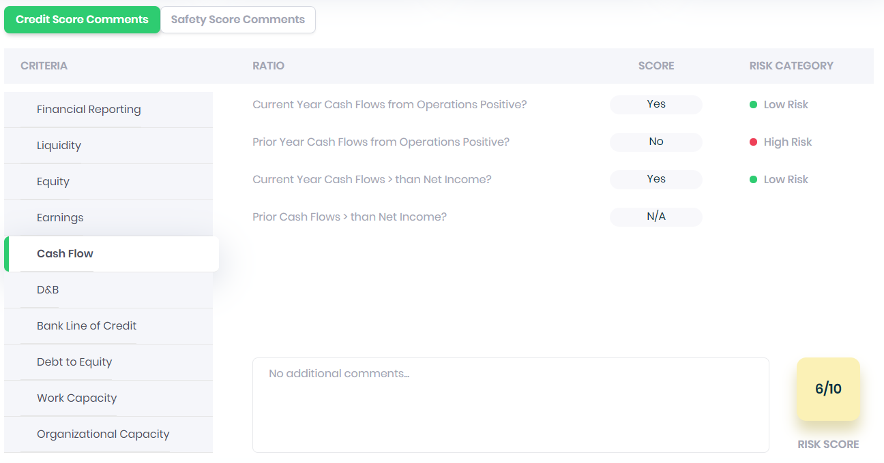
CASH FLOW

Slide 17
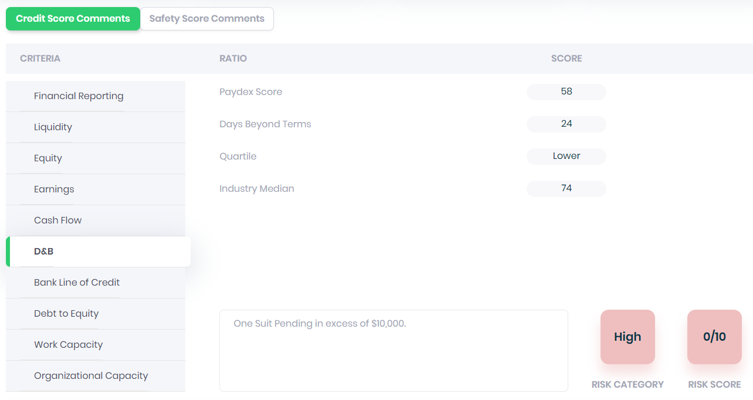
D&B PAYDEX

Slide 18
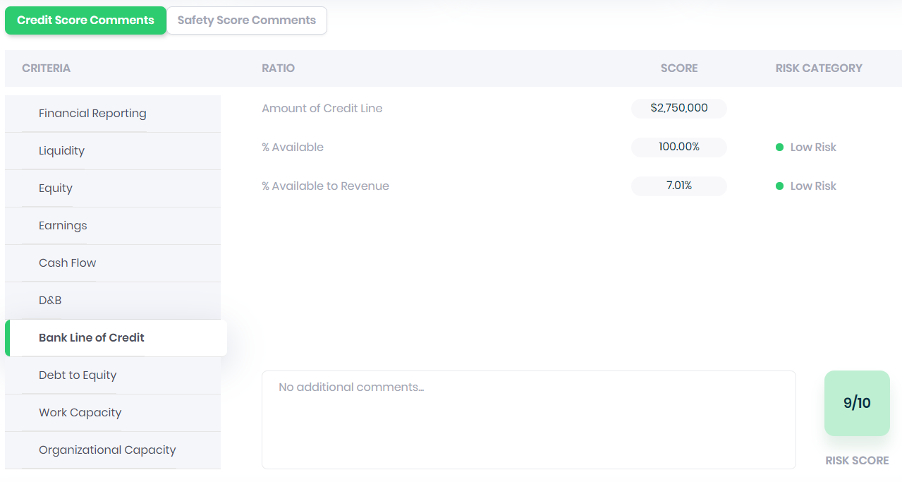
BANKLINE CREDIT

Slide 19
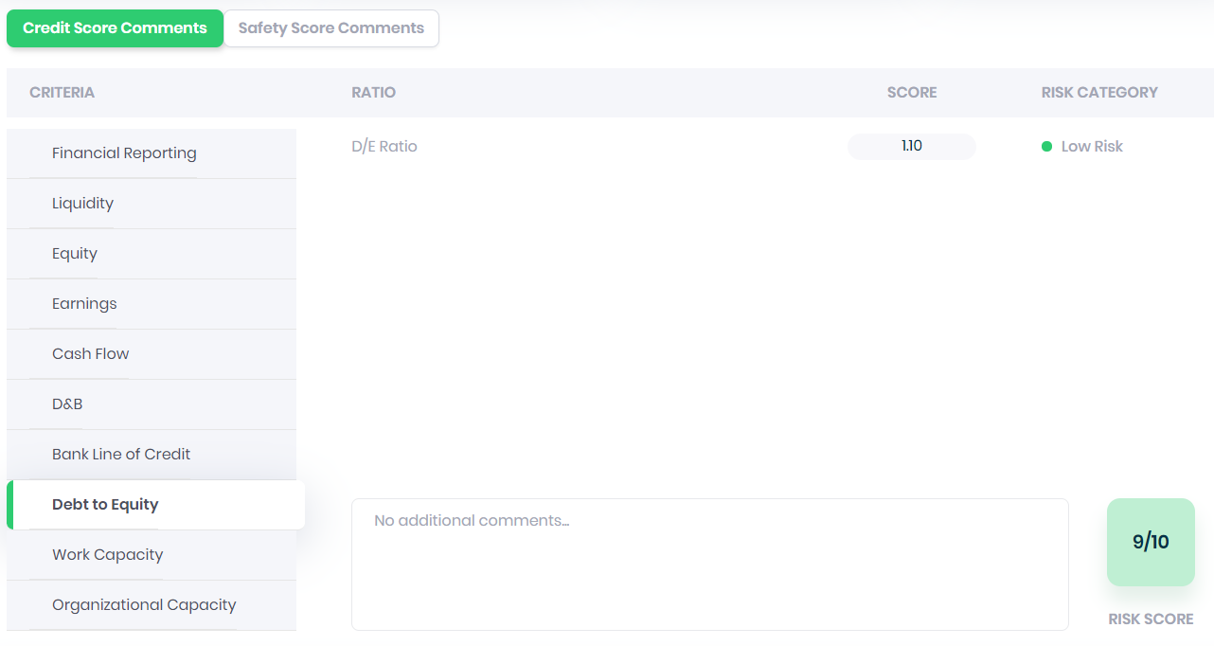
DEBT TO EQUITY

Slide 20
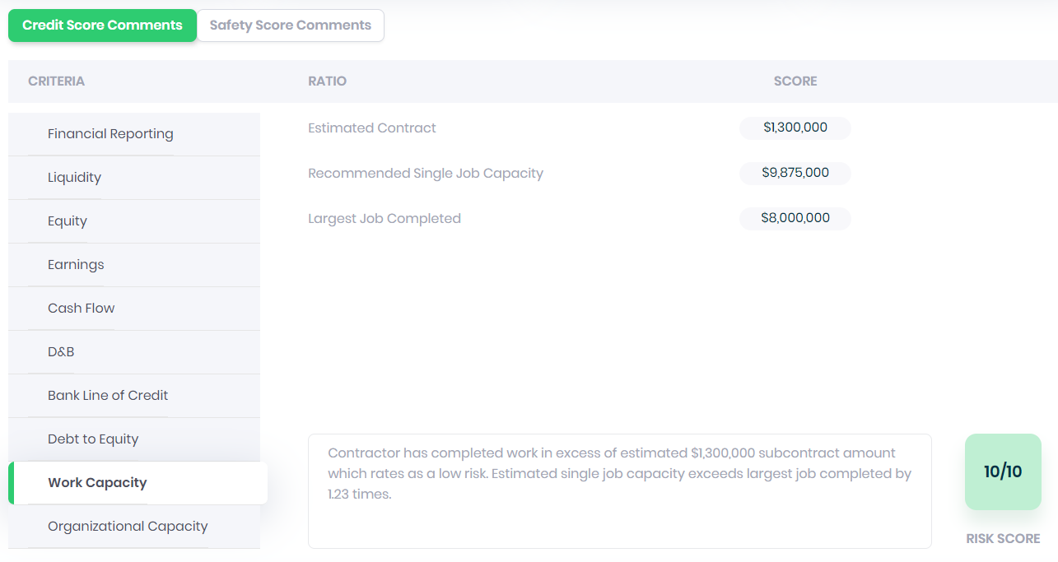
WORK CAPACITY

Slide 21

ORGANIZATIONAL CAPACITY

Slide 22
CREDIT MODEL

Slide 23
CREDIT MODEL

Slide 24
CREDIT MODEL

Slide 25
SAFETY SCORE CRITERIA
EMR: experience modification rate
BLS: recordable incident rate / fatalities in last 5 yrs
Safety Program: written program / policy signed by senior management
Fall Prevention: working above 6 feet in elevation
Safety Director: OSHA certified / active safety credentials and certificates
Safety Training: senior management / field supervisor / new hire orientation
Accident Investigation: written / root cause analysis / near misses / lessons learned
Drug & Alcohol policy: pre-employment / random / suspicion / post accident
Disciplinary Policy: oral / written /suspension / termination
Safety Metrics: accountability / compensation for senior management or field

Slide 26
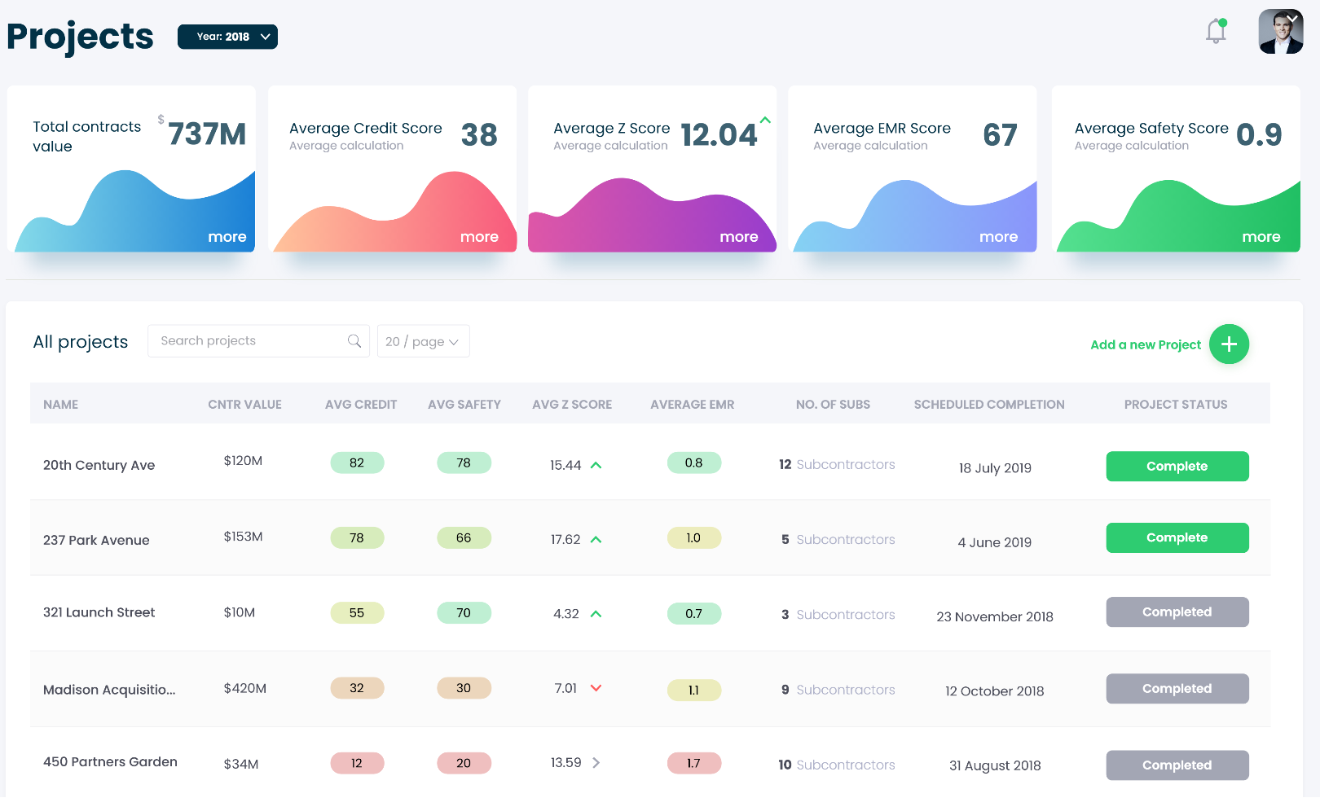
PROJECTS TAB

Slide 27
PROJECTS TAB

Slide 28
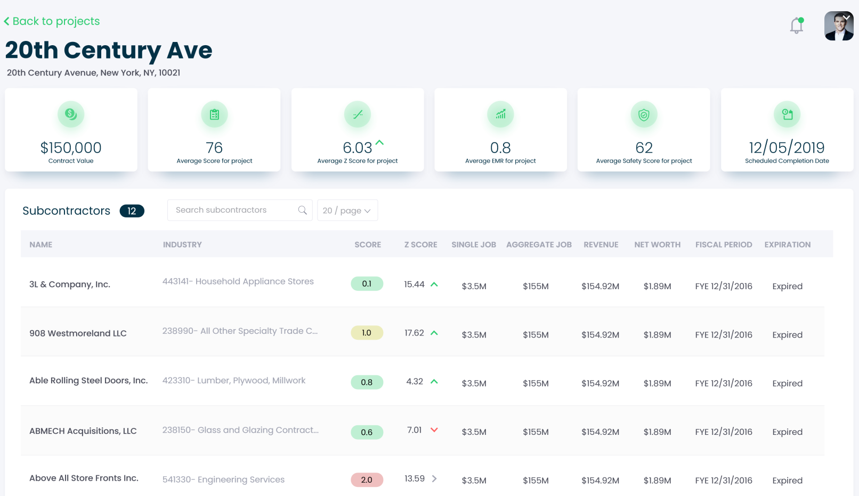
PROJECTS TAB

Slide 29
PROJECTS TAB

Slide 30
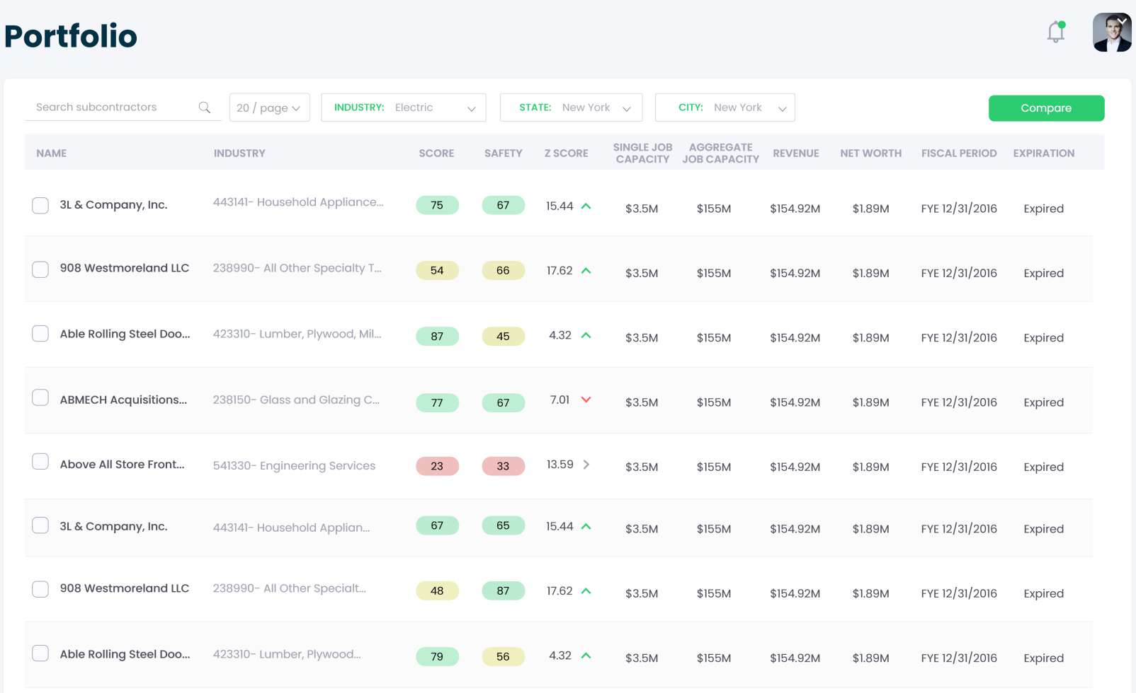
PROTFOLIO TAB

Slide 31
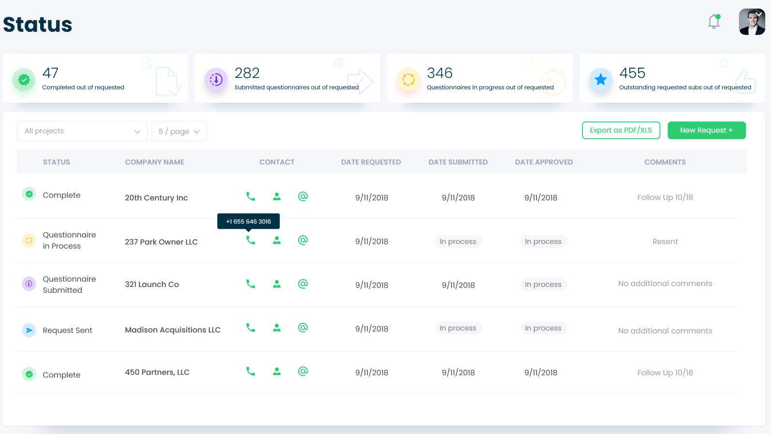
STATUS TAB

Slide 32
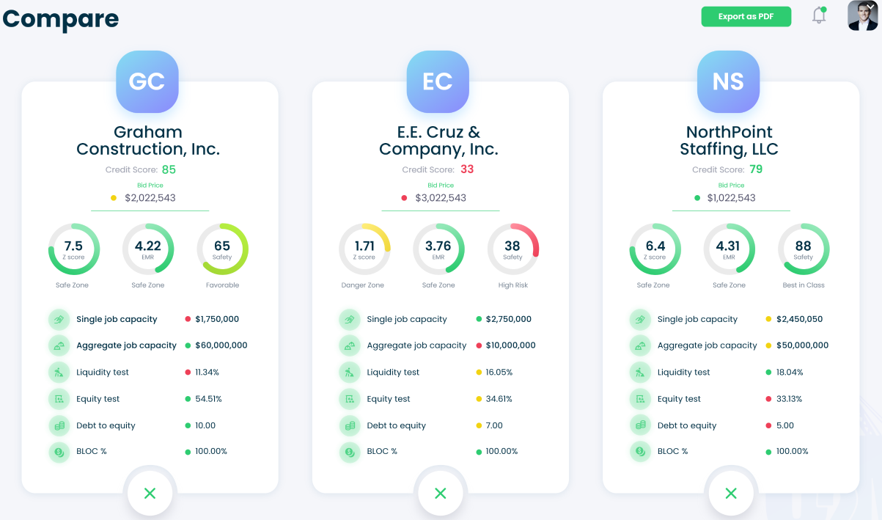
COMPARE TAB
Mechanical B
Mechanical C
Mechanical A
Mechanical C

Slide 33
ALLIANT CONTRACTOR CREDIT MODEL™
CREDIT SCORE: | 63
Single Job Capacity: | $1,500,000
Aggregate Capacity: | $2,250,000
Alliant Construction Credit Model
Criteria | Score | Comments:
Financial Reporting | 10 | The Financial Statements analyzed at June 30, 2015 include the Consolidated Balance Sheet, Income Statement, Statement of Cash Flows, and Job Schedules. The company delivers timely and complete audited financials Annually which puts them at a low risk in this category.
Liquidity Test | 10 | Strong Liquidity of 21.2% to Work Program. A/R to A/P ratio of 5.6x. Both ratios score in the low risk category. A/R Turnover ratio of 71 days is considered medium risk.
Equity Test | 0 | Negative Equity test due to a significant amount of Goodwill on the company's Balance Sheet as a result of the purchase of the company in 2010 .
Earnings | 3 | Net Profit margins of 1.7% at 6/30/15 and -13.4% in 2014. Overall Job Profit margins of 17.0%. Gross Profit remaining in Fye backlog covers 97% of annual overhead.
Cash Flows | 10 | Cash Flow from Operations was positive for the past 2 years and greater than Net Income.
D&B Paydex Score | 5 | Paydex shows ability to make payments in a timely manner.
Bank Line of Credit | 10 | The company had no borrowings at the end of 6 months. The overall amount available on the company's line covers 31.6% of its Revenue which is considered low risk.
Debt to Equity | 0 | Debt to Equity ratio of -2.6x.
Work Capacity | 10 | Company has completed work over $90M, showing the ability to complete work in excess of the $2.25M capacity.
Organizational Capacity | 5 | The largest project currently in progress is 34% of the Work Program which rates as a medium risk.
Additional Comments:
Financial Benchmark | 63 | Favorable Group
Company |  | The Company
Z Score | 1.24 | At risk of insolvency - 1.81 < Grey Zones < 2.99 - Financial Security
Surety Line | 0 | 0
Bank Line of Credit | $2,500,000
D&B Litigation |  | No Liens, Suits, or Judgments were reported in the D&B report.
 | FYE 2014
Revenue: | $7,909,300
Gross Profit: | $2,143,600
Net Income: | $131,500
Cash Flow: | $639,500
Working Capital: | $2,120,900
Net Worth: | $1,488,640
High Risk Group
Watch List
Better Risk Group
Best in Class
High Risk
Low Risk

Slide 34
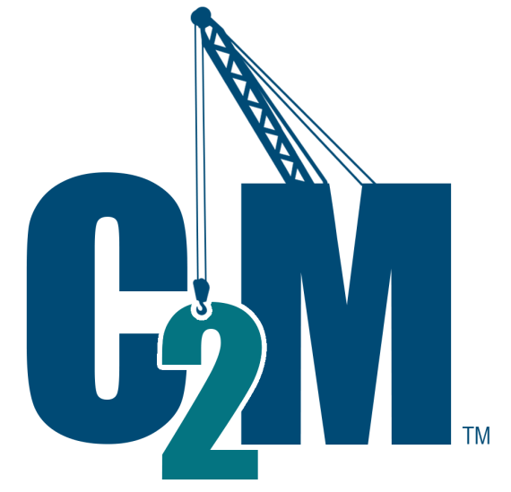
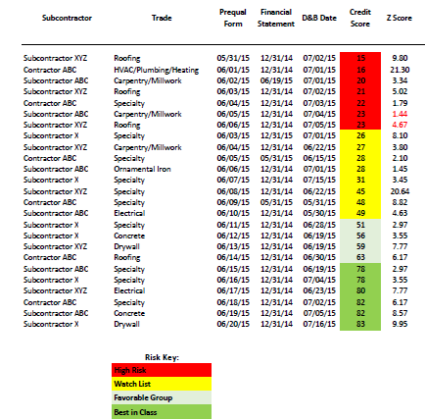
ALLIANT C₂M™
Alliant Contractor Credit Model™ - Helping the Insured Prequalify its Subcontractor Insolvency risk.
Subcontractor Financial Benchmarking Tool
Identifies High Risk Subs
Score Sheet for Each Sub Sets credit limits
Alliant’s proprietary model helps clients identify high risk subs to mitigate risk.

Slide 35
Subcontractor
Trade
Prequal Financial
D&B Date
Credit
Score
Z Score Surety Company
Surety
Program
Benchmark Limits
EMR
Revenue NIBT / Liquidity Equity BLOC
Largest job in
WIP / Work
Program
Form
Statement
Inc/Dec Revenue
Test
Test
Available
(Single) (Aggregate)
Subcontractor XYZ
Contractor ABC Subcontractor ABC Subcontractor XYZ Contractor ABC Subcontractor ABC Subcontractor XYZ Subcontractor X Subcontractor XYZ Contractor ABC Subcontractor ABC Subcontractor X Subcontractor XYZ Contractor ABC Subcontractor ABC Subcontractor X Subcontractor X Subcontractor XYZ Contractor ABC Subcontractor ABC Subcontractor X Subcontractor XYZ Contractor ABC Subcontractor ABC Subcontractor X
Roofing
HVAC/Plumbing/Heating Carpentry/Millwork Roofing
Specialty Carpentry/Millwork Roofing
Specialty Carpentry/Millwork Specialty Ornamental Iron Specialty
Specialty Specialty Electrical Specialty Concrete Drywall Roofing Specialty Specialty Electrical Specialty Concrete Drywall
05/31/15
06/01/15
06/02/15
06/03/15
06/04/15
06/05/15
06/06/15
06/03/15
06/04/15
06/05/15
06/06/15
06/07/15
06/08/15
06/09/15
06/10/15
06/11/15
06/12/15
06/13/15
06/14/15
06/15/15
06/16/15
06/17/15
06/18/15
06/19/15
06/20/15
12/31/14
12/31/14
06/19/15
12/31/14
12/31/14
12/31/14
12/31/14
12/31/15
12/31/14
05/31/15
12/31/14
12/31/14
12/31/14
05/31/15
12/31/14
12/31/14
12/31/14
12/31/14
12/31/14
12/31/14
12/31/14
12/31/14
12/31/14
12/31/14
12/31/14
07/02/15
07/01/15
07/01/15
07/02/15
07/03/15
07/04/15
07/05/15
07/01/15
06/22/15
06/15/15
07/01/15
07/15/15
06/22/15
05/31/15
05/30/15
06/28/15
06/19/15
06/19/15
06/30/15
06/19/15
07/04/15
06/23/15
07/02/15
07/05/15
07/16/15
15
16
20
21
22
23
23
9.80
21.30
3.34
5.02
1.79
1.44
4.67
8.10
3.80
2.10
1.45
3.45
20.64
8.82
4.63
2.97
3.55
7.77
6.17
2.97
3.55
7.77
6.17
8.57
9.95
Surety X
Surety X Surety X Surety X Surety X Surety X Surety X Surety X Surety X Surety X Surety X Surety X Surety X Surety X Surety X Surety X Surety X Surety X Surety X Surety X Surety X Surety X Surety X Surety X Surety X
$2.5M/$5M
$1M/$7M
$14M/$40M
$10M/$25M
$2.5M/$7M
$3M/$6M
$10M/$30M
$3.5M/$12M
$3M/$6M
$20M/$52M
$1M/$3M
$12M/$36M
$1M/$10M
$23M/$100M
$20M/$200M
$12M/$24M
$25M/$100M
$575K/$5M
$3M/$8M
$400K/$3M
$1M/$3.5M
$3M/$8M
$2.5M/$10M
$10M/$24M
$3M/$8M
$2,250,000
$1,802,500
$4,000,000
$2,250,000
$1,802,500
$4,000,000
$4,434,167
$11,566,250
$4,625,000
$819,593
$953,313
$3,263,905
$4,477,000
$853,346
$83,500,000
$10,250,000
$12,500,000
$9,250,000
$5,087,670
$2,750,000
$9,250,000
$5,087,670
$2,750,000
$9,250,000
$5,087,670
$9,000,000
$7,210,000
$8,000,000
$9,000,000
$7,210,000
$8,000,000
$7,070,000
$46,265,000
$18,500,000
$3,278,371
$3,813,253
$13,055,621
$17,908,000
$3,413,382
$334,000,000
$41,000,000
$50,000,000
$37,000,000
$20,350,680
$11,000,000
$37,000,000
$20,350,680
$11,000,000
$37,000,000
$20,350,680
1.00
0.93
0.55
1.50
0.93
1.70
0.80
0.66
0.89
1.23
1.12
1.30
0.87
0.40
0.65
0.60
0.85
0.98
0.93
1.08
0.98
0.93
1.08
0.98
0.93
‐3.0%
282.9%
4.2%
‐16.0%
282.9%
4.2%
6.3%
‐4.0%
24.6%
3.0%
5.2%
1.1%
0.4%
1.0%
21.3%
‐18.2%
‐72.5%
2.0%
3.0%
8.1%
6.0%
2.0%
8.1%
1.0%
5.0%
11.5%
8.1%
21.1%
11.5%
8.1%
21.1%
21.1%
6.1%
1.2%
5.8%
0.1%
17.5%
2.5%
29.3%
1.3%
1.7%
5.2%
1.9%
7.7%
8.9%
1.9%
7.7%
8.9%
1.9%
7.7%
‐0.2%
1.4%
‐2.4%
‐0.2%
1.4%
‐3.0%
‐2.0%
0.6%
4.3%
‐0.2%
‐13.9%
3.0%
16.1%
25.6%
13.7%
7.4%
16.5%
15.0%
12.8%
18.8%
15.0%
12.8%
18.8%
15.0%
12.8%
3.8%
‐2.0%
5.3%
3.8%
‐2.0%
5.3%
5.3%
8.2%
3.7%
0.6%
4.2%
13.1%
18.5%
24.9%
14.2%
9.1%
18.3%
16.9%
14.8%
22.9%
16.9%
14.8%
22.9%
16.9%
14.8%
3.0%
10.0%
5.2%
6.4%
10.0%
35.0%
42.0%
36.0%
10.0%
100.0%
100.0%
100.0%
56.0%
65.0%
71.0%
100.0%
100.0%
100.0%
50.0%
60.0%
100.0%
50.0%
60.0%
100.0%
50.0%
51.0%
47.0%
22.0%
51.0%
47.0%
22.0%
122.0%
45.0%
13.0%
13.0%
39.0%
15.0%
2.0%
23.0%
5.0%
47.0%
32.0%
13.0%
7.0%
4.0%
13.0%
7.0%
4.0%
13.0%
7.0%
26
27
28
28
31
45
48
49
51
56
59
63
78
78
80
82
82
83
Risk Key:
High Risk
Watch List
Favorable Group
Best in Class

Slide 36
RISK MITIGATION RECOMMENDATIONS
Sample below – based on C2M reports
CFO to review monthly reconciliation of the amount of work performed in relation to the amount billed.
Maintain 10% (or higher) retainage until project completion
Implement subcontract‐specific QA/QC Procedures (attach details).
Affidavits or Lien Releases from the subcontractor/supplier vendors (cross‐reference with subcontractor's Subcontractor/Supplier Log).
CFO approve monthly pay applications.
Monthly review of subcontractor's overall A/R and A/P summary aging reports.
Immediate delivery of materials for storage on site…OR…payment for stored materials conditioned upon materials being tagged, segregated, insured, and receipt of Bill of Sale.
Joint Checks to all second tier subs, material and equipment suppliers, or pay those parties direct.
Quarterly lending statement (line of credit and amount in use) issued from an independent/third‐party institution.
Review of Financial Statements and WIP Reports.
Monthly verification that union dues have been paid.
Require 100% Performance and Payment Bonds or Enroll in SDI Program
Require parental guaranty or guaranty of owner
35

Slide 37
PRE AND POST COVID-19 SCORES

Slide 38
AVERAGE C2M SCORES BY TYPE OF SUBCONTRACTOR
Other Trades
Framing
Demolition
Interior
Structural Steel
Elevator
Heavy Highway

Slide 39
UPDATE TO PREQUALIFICIATION STANDARDS
Post-COVID 19 Qualification
C2M Scores

Slide 40
COVID-19 LIQUIDITY STRESS TEST
A 90 day look ahead using balance sheet and backlog cash generation assumptions
13 week cash flow analysis for high risk subs

Slide 41
90 DAY LIQUIDITY STRESS TEST
Understanding CARES ACT Liquidity Enhancement
Cash & Debt
A/R & A/P
Backlog Billing (Less Comp Cost)
90 Day Overhead
90 Day Cash Flow
PPP Loan Applied for?
Approval?
90 Day Cash Flow
CARES ACT FUND Financing Received
Enhanced 90 Day Cash Flow
Funding Received?
Startup
Cash Shortfall
90 Day Enhanced Cash Flow
Job Cost
Overhead for 60 Days
Prior Period Net A/R & A/P
2019 Payroll?
(2019 Payroll / 12mo)
X 2.5

Slide 42
QUESTIONS…

Slide 43
Session Password
(Must record password for CPE credit)

