Slide 1
2022 CFMA Conference
WIFI Sponsor: Rubin Brown

Slide 2
Sell-side Financial Due Diligence
Seth Bounds
Director – Transaction Services

Slide 3
Course Objectives
To understand what financial due diligence is (and is not)
To understand how sell-side financial due diligence supports the seller
To understand how financial due diligence fits into a deal process and timeline
To understand key accounting considerations before beginning a sale process

Slide 4
What is Financial Due Diligence?

Slide 5
Financial Due Diligence What is diligence?
Often referred to as ‘Quality of Earnings’, this consists of a seller or buyer engaging an independent third-party (usually an accounting firm with professionals specializing in transactions) in order to undergo rigorous analysis of the business.
A financial diligence report will cover a range of deal-related topics such as:
Quality of Earnings – A normalization of revenue and costs over a period of time, typically three years. This helps buyers understand recurring cash flows.
Net Working Capital - Are near-term sources of cash (e.g., A/R) sufficient to take care of uses of cash (e.g., A/P)
Debt and Debt-like - What obligations are on or off-balance sheet that buyers may pursue for Seller to extinguish pre-close or pay Buyer for
Discussion of KPI’s and financial trends

Slide 6
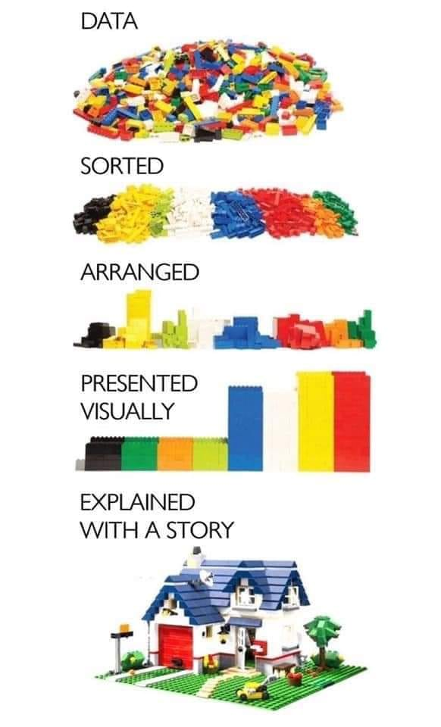
Financial Due Diligence What is diligence?
The goal is to explain the “story” of the business through financial results.

Slide 7
Sell-Side Due Diligence Service
Sell-side due diligence is designed to help sellers maximize the value and minimize surprises throughout the deal evaluation, negotiating, and closing process. Procedures include:
GENERAL Financial and operational performance assessment to understand the value proposition and business trends for positioning purposes. Identify risk factors and develop near term fixes that will enhance value. Evaluate the reporting and internal control environment that impact the quality of financial information, as well as identify any potential transactional issues. Consider GAAP accounting practices and changes in policy that affect the comparability of earnings or cash flows. |  | QUALITY OF EARNINGS Assess the quality of earnings and identify any revenue recognition issues, cost capitalization issues, non-recurring charges or credits, changes in estimates, or reserves that may impact the quality of reported earnings and cash flows. Evaluate all Management/Advisor proposed EBITDA Adjustments and supporting analysis. Identify additional EBITDA adjustments during our review of the income, balance sheet, and cash flow statements. Analyze operating trends by major business unit, product line, and customers and bridge results to projections.
BALANCE SHEET Analyze the quality of assets, completeness of liabilities, debt like items, and any contingent obligations. Evaluate monthly working capital trends (balances and turnover statistics), with a focus on elements directly attributable to operations. Advise on a target working capital level to be included in the purchase agreement. Review capital expenditure requirements and the sufficiency of the assets to deliver on the projected results. |  | TAX High level tax analysis or deep tax due diligence. Determine the optimal transaction structure of the seller and evaluate the impact on potential buyers. Identify tax risks, including federal, state, and sales tax obligations. Quantify potential exposures. Tax valuation & make whole analysis. Accounting for uncertain tax positions. Transfer pricing & international tax considerations.

Slide 8
How does financial due diligence compare to an audit?

Slide 9
Audit vs Sell-Side Due Diligence Key Differentiators: Deal process speed & latest months analyzed
Performed in accordance with the numerous standards (e.g., Generally Accepted Auditing Standards, PCAOB, COSO, GAAP, etc.)
Give an opinion on the financial statements
Includes testing of underlying transactions (invoices, bank reconciliations, contracts)
Financial statements must be presented within strict guidelines
Primarily balance sheet focus
Primarily historical focus
Adjustments proposed based on materiality thresholds
Provides buyer comfort and serves as the starting point for “Deal Financials”
AUDIT
“GAAP Financials”
Performed under an advisory capacity providing issues-based findings, observations, and recommendations; all of which may be qualitative as well as quantitative
Do not provide assurance or opinion
Based on most recent financial data
Testing and rely on management assertions
Deliverables are tailored to client’s needs and the particular transaction
Focused on historical P&L (EBITDA), working capital and debt-like items (the three pillars of value which drive a buyer’s valuation)
Historical focus always with the thinking of how it will affect the future
No materiality thresholds (i.e., an adjustment viewed as immaterial for an audit could be material for QofE due to EBITDA multiples)
Deal financials are used as the basis for buyer’s valuation and purchase price
SELL-SIDE DUE DILIGENCE
“Deal Financials”

Slide 10
Why should a seller consider sell-side financial due diligence?

Slide 11
Benefits of Sell-Side Due Diligence
SELLER KEEPS CONTROL OF PROCESS
Seller maintains access to outputs
Lessens purchasers driving the process
Fewer surprises
Prospective investors get identical information
BENEFITS
REDUCE TIME
Simplifies process
Lessens the amount of time management spends with buyers and their advisors
Speeds up the buyer’s due diligence process
ENHANCE VALUE
Lowers bid cost, increasing number of bids
Maintains competition to maximize price
Minimizes the risk of price deterioration
Optimizes deal structure

Slide 12
Sell-Side Transaction Support
Both the seller and the buyer want to optimize their agendas during the due diligence process; a TAS Provider’s goal is to balance both objectives and facilitate a smooth transaction.
SELLER OBJECTIVES
BUYER OBJECTIVES
SELL-SIDE TAS OBJECTIVES
Negotiate for the highest price possible
Minimize management’s involvement during the process
Adhere to a realistic transaction timeline
Protect confidentiality and limit unnecessary access to privileged information
Avoid “surprises” during the transaction
Uncover any potential pitfalls, liabilities, risks
Challenge sustainability of operations and earnings
Question the quality of forecasts and accounting treatments
Downplay historical performance
Use discoveries in due diligence as negotiating leverage
Support the “story” and preserve valuation
Ensure a smooth process and add strength to the investment thesis
Minimize interruptions and eliminate surprises
Add credibility and put control in the hands of the seller
Provide support throughout the transaction
Offer insight, perspectives, and recommendations

Slide 13
Where does financial due diligence fit into a sale process?

Slide 14
Due Diligence Timeline Where does FDD participate in the deal continuum?
Negotiations finalized and purchase agreement executed.
FDD assists with definitions of NWC and Debt
Bankers/Company release Teaser that typically includes a summarized high level overview of the Company.
Offers are received from potential buyers and a Letter of Intent (“LOI”) is executed with selected potential buyer. Exclusivity period begins.
Investment Banker Selected
Company for Sale
Marketing
Potential Buyers
Identified
LOI & Buyer Diligence & PSA
Buyer Diligence
Post Transaction
Sell-side Transaction Advisory Services Selected
FDD
Tax
Legal
Others
Buy-Side Transaction Advisory Services Selected
FDD
Tax
Legal
Environmental
People/HR
Others
TAS to provide optional services including:
Post-closing assistance
Purchase price allocation
Integration Consulting
Audit/Tax Compliance
Field is narrowed to serious potential buyers, at times requiring an Indication of Interest (“IoI”) and bankers/Company release Confidential Information Memorandum (“CIM”).
Sell-side FDD figures are included in CIM

Slide 15
Sell-Side Transaction Support Process
TAS providers are value-added participant in the sell-side process; teaming with clients and their other advisors to minimize surprises during buyer diligence.
WORKING WITH CLIENT’S LEGAL COUNSEL
TAS works with client’s legal counsel to translate diligence findings into the sale and purchase agreement, e.g., providing advice on drafting the accounting policies, net working capital mechanism, TSA agreement (where applicable), and tax sections of the agreement.
Provide ongoing and open discussions with the client’s legal counsel in regards to the tax representations, warranties, and disclosure schedules made in the definitive agreement.
TAS works with client’s legal counsel to design and implement structuring alternatives to help ensure the post-transaction business operates in a tax efficient manner.
WORKING WITH INVESTMENT BANKERS
Sell-side due diligence services complement the investment banking process.
The outputs of TAS work can be leveraged as inputs to the process, whereby pro forma adjusted financials from our Quality of Earnings analysis form the basis of the financial section of the Offering Memorandum, dataroom population, etc.
Minimizes surprises during buyer diligence, and gives confidence in the financials and overall risk level of the client’s tax profile.
Communicate any identified tax benefits or tax attributes of the client that contribute to additional value.
Client’s Legal
Counsel
Seller
TAS Provider
Investment Banker

Slide 16
What are some of the key accounting considerations to be aware of before starting a sale process?

Slide 17
Accounting Considerations
Does your accounting structure support telling the story of the business?
Departures from GAAP?
Changes in accounting policies and procedures during the historical period?
Changes in the business that impact the financial “story” of the business?
Accounting IT infrastructure –
Has the business used a single accounting system used during the historical period?
If not, what access is available to previous system reports? And, is there a detailed mapping of previous chart of accounts to current?
What reports are available from the current system?
Are monthly financials available and what level of detailed close is performed on a monthly basis?
Revenue recognition – how is this calculated and documented?
Potential obligations not included on the balance sheet

Slide 18
Other Considerations
Deal Fatigue
Be prepared for a long, demanding process that will test your patience.
The more you are able to prepare alongside your ‘deal team’ of outside advisors, the smoother the process will go.

Slide 19
Session Password
(Must record password for CPE credit)

