Slide 1
2020 CFMA Conference

Slide 2
Government Contracting Entry Considerations & Guidance
Matt Griffin & Jim Gilbert

Slide 3
Overwhelming or Not?
Resources – Internal and External
Technology and ERP Considerations
Project Plan
Locate Government Work
Government Contracting – Why?
Where to Begin
COVID-19 Impact
Government Compliance
Company Preparedness
Fixed Price vs Cost Reimbursable
AGENDA
Technology
1
2
Field Operations
Workflow and Reporting
Direct Costs/Contracts
DATA
Regulation
Internal Control
Enterprise Compliance Efforts
3
4
Policy and Procedure

Slide 4
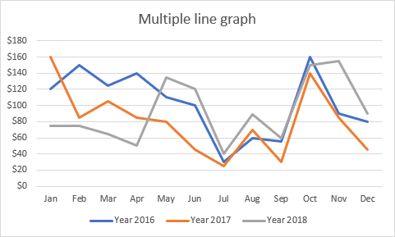
GOVERNMENT CONTRACTING
WHY?

Slide 5
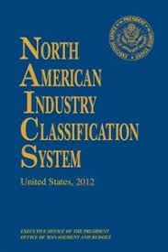
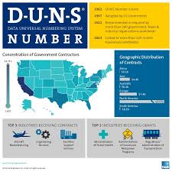
WHERE TO BEGIN?

Slide 6
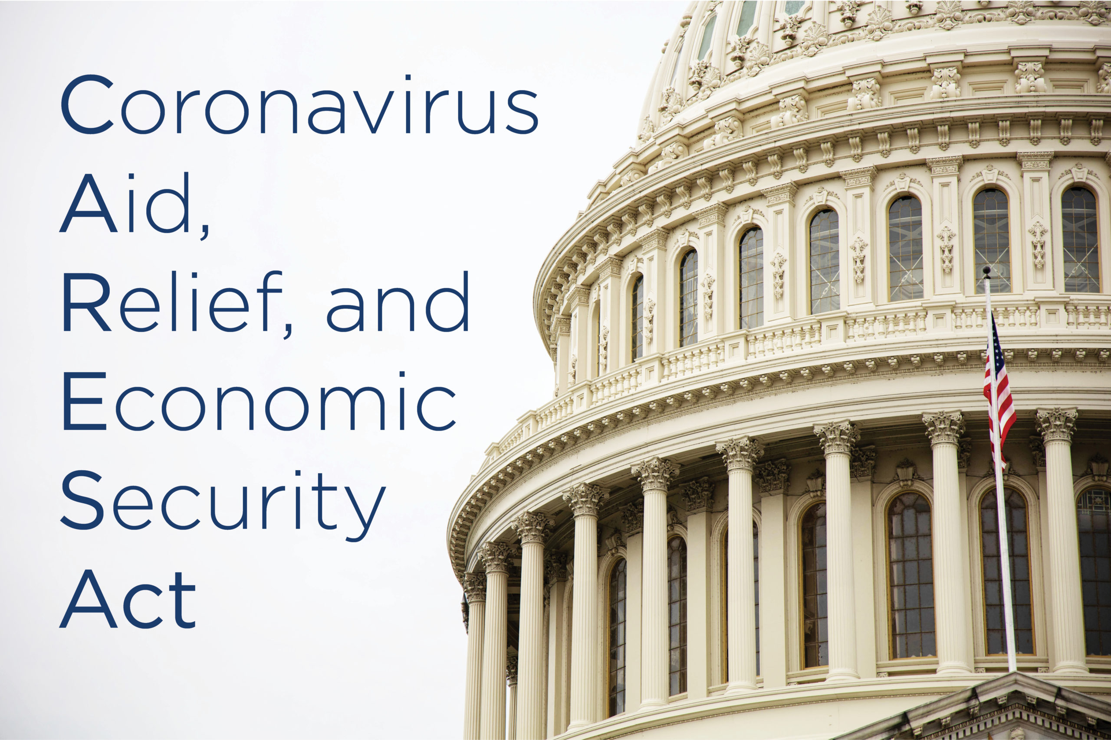
COVID-19 IMPACT TO GOVERNMENT CONTRACTING

Slide 7
Federal
DCAA
DCMA
FAR
DFAR
CAS
GAAP
State/ DOT
CDOT
Audit (CPA)
AASHTO
FAR
Rate Mgt
GOVERNMENT COMPLIANCE
Municipal/Regional
Procurement
FAR
Rates
Audits
GAGAS

Slide 8
GOVERNMENT COMPLIANCE
DOT
AASHTO
FAR 31
State Rates and Contracting
State Highway Contractors and DOT
Chart of Accounts and Job Set Up
Auditor (DOD) and Demand Audits
Contracting and Other Compliance
DCAA
DCMA

Slide 9
1
Assessment of Opportunity
Government Contracting101:
What do we need to do and how will this impact our company?
How much does this cost?
2
Compliance Changes and Bidding Changes
Considerations
GOVERNMENT COMPLIANCE
Change Management and Leadership
3
4
Full Autonomy to Adherence to
Uncle Sam
5
Culture Change and Financial Impact

Slide 10
FAR, CAS, DFAR
Rules and Regulation
Compliance
Indirect Rates and Compliance
Expertise
GOVERNMENT COMPLIANCE
Internal and External Expertise?
DCAA, DCMA, DOT and Municipal
Government Oversight
Accounting System Audits
Are my systems ready?
Business Partners
Who do I trust?

Slide 11
GOVERNMENT COMPLIANCE
>$50M
1
2
3
4
7.5M to 50M
<7.5M
Estimating and Pricing
Accounting System
Contracts Management
Provisional Billing Rates
Small Business
Modified CAS
Full CAS
Pricing and Procedure
Job and Financial Information
Contract Review and Brief
Annual Approved Indirect Rates
CAS Coverage
FAR Part 9,15, 31
48 CFR 9903.201-2

Slide 12
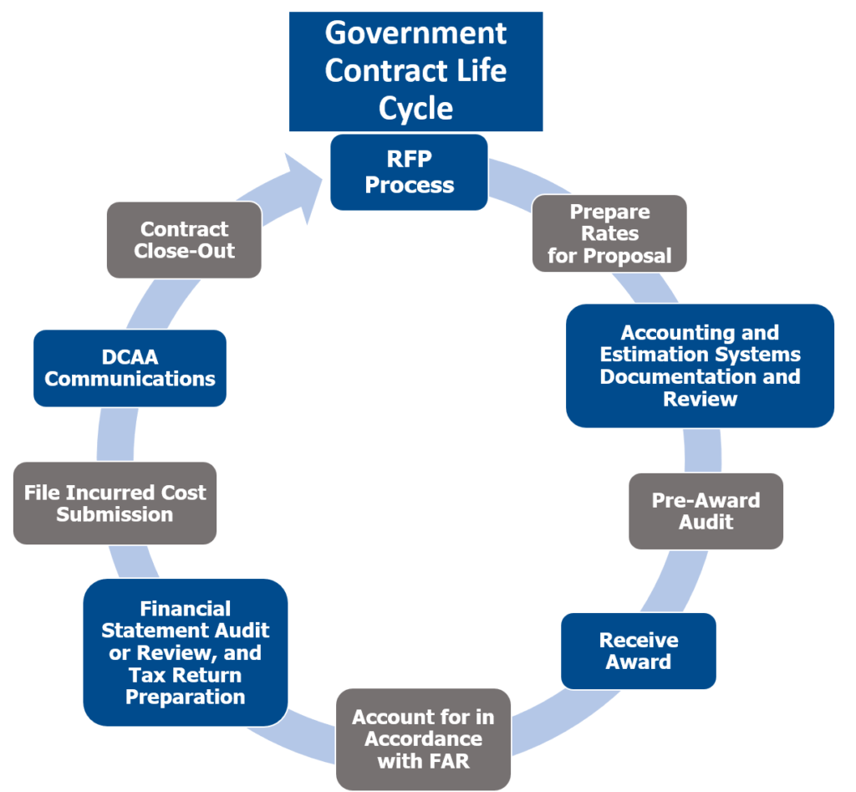
1
Cost Reimbursable Contracts
2
FAR Part 15
GOVERNMENT COMPLIANCE
3
Pre-Award 1408 Audit
4
Life Cycle Management (end to end)

Slide 13
GOVERNMENT PREPAREDNESS
Indirect Rates
G&A
Payroll Fringe
Indirect Costs
Direct Costs
Consistency
Business Segments
Company-wide Methodology
6
1
Synergies and Teamwork
Internal Control
Critical
Areas
Contracts
5
2
Policy and Procedure
Understand and Implement
Unallowable
4
3
Timesheets
Tracking and Understanding
Indirect vs Direct

Slide 14
Is the company able to perform and demonstrate?
Financial Capability
1
Team Capability
Is the team able to handle compliance and contracts?
2
COMPANY PREPAREDNESS
HR and Payroll
Do we have minimum compliance?
3
4
Legal
What happens if there is a stop work on suspension?
5
Technology
Do we have the systems and capability to track costs?

Slide 15
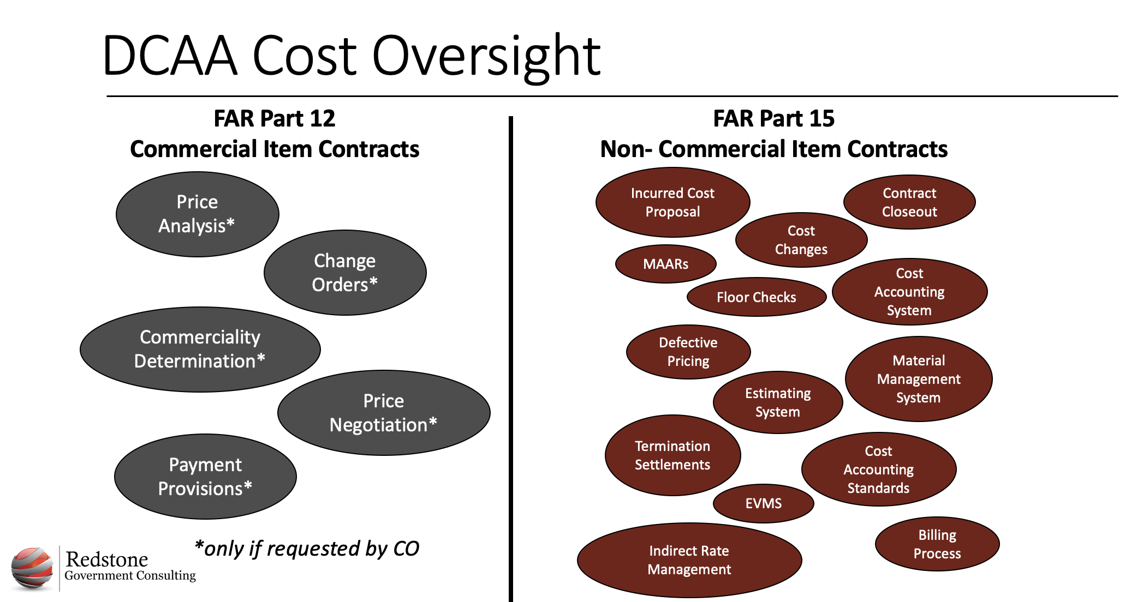
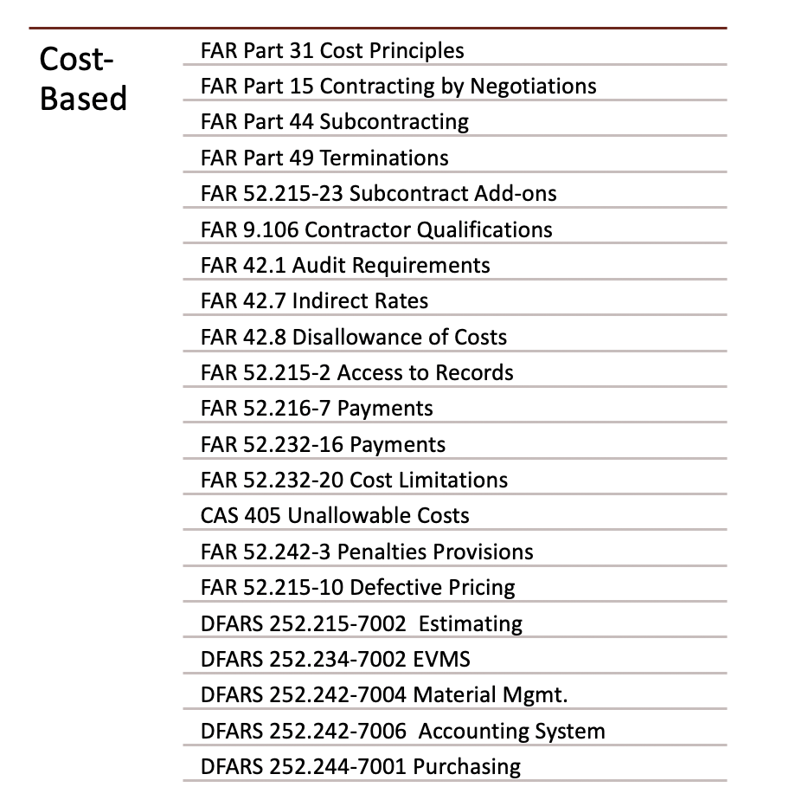
FIXED PRICE VS COST REIMBURSABLE

Slide 16
FFP
FPPI
Cost Reimbursable
CFP
CPFF
T&M
GMAX
NTE
CPIF
Fixed Price
Start Here!
FIXED PRICE VS COST REIMBURSABLE
Ready to Support This Effort?
**Start out as a Subcontractor
**Get ready to work for larger contractors – observe and learn!

Slide 17
OVERWHELMING OR NOT?
Overwhelming Considerations – What should I do?

Slide 18
REQUIREMENTS – INTERNAL AND EXTERNAL
Enterprise Wide Risk
Incurred Cost
Submission
Fraud Risk
Internal Controls
Contractor Business
Systems
Financial Reporting
Government Contract
Risks
Inventory & Asset Management
CAS, FAR, TINA, DFARS
Compliance
Ethics & Code of Conduct
Human Resources
Cost Allowability & Allocability
Procurement
Indirect Rate Structure Design
Revenue Recognition
Shared Services
Contracts Administration
Government Auditor (e.g.
DCAA, DCMA, OIG, DOJ)
findings, response &
remediation
Time Keeping
Information Technology
Contracts Administration
Supply Chain
REAs/Claims, Disputes
Data Analytics
Payroll
Pricing and Estimating

Slide 19
RESOURCES

Slide 20
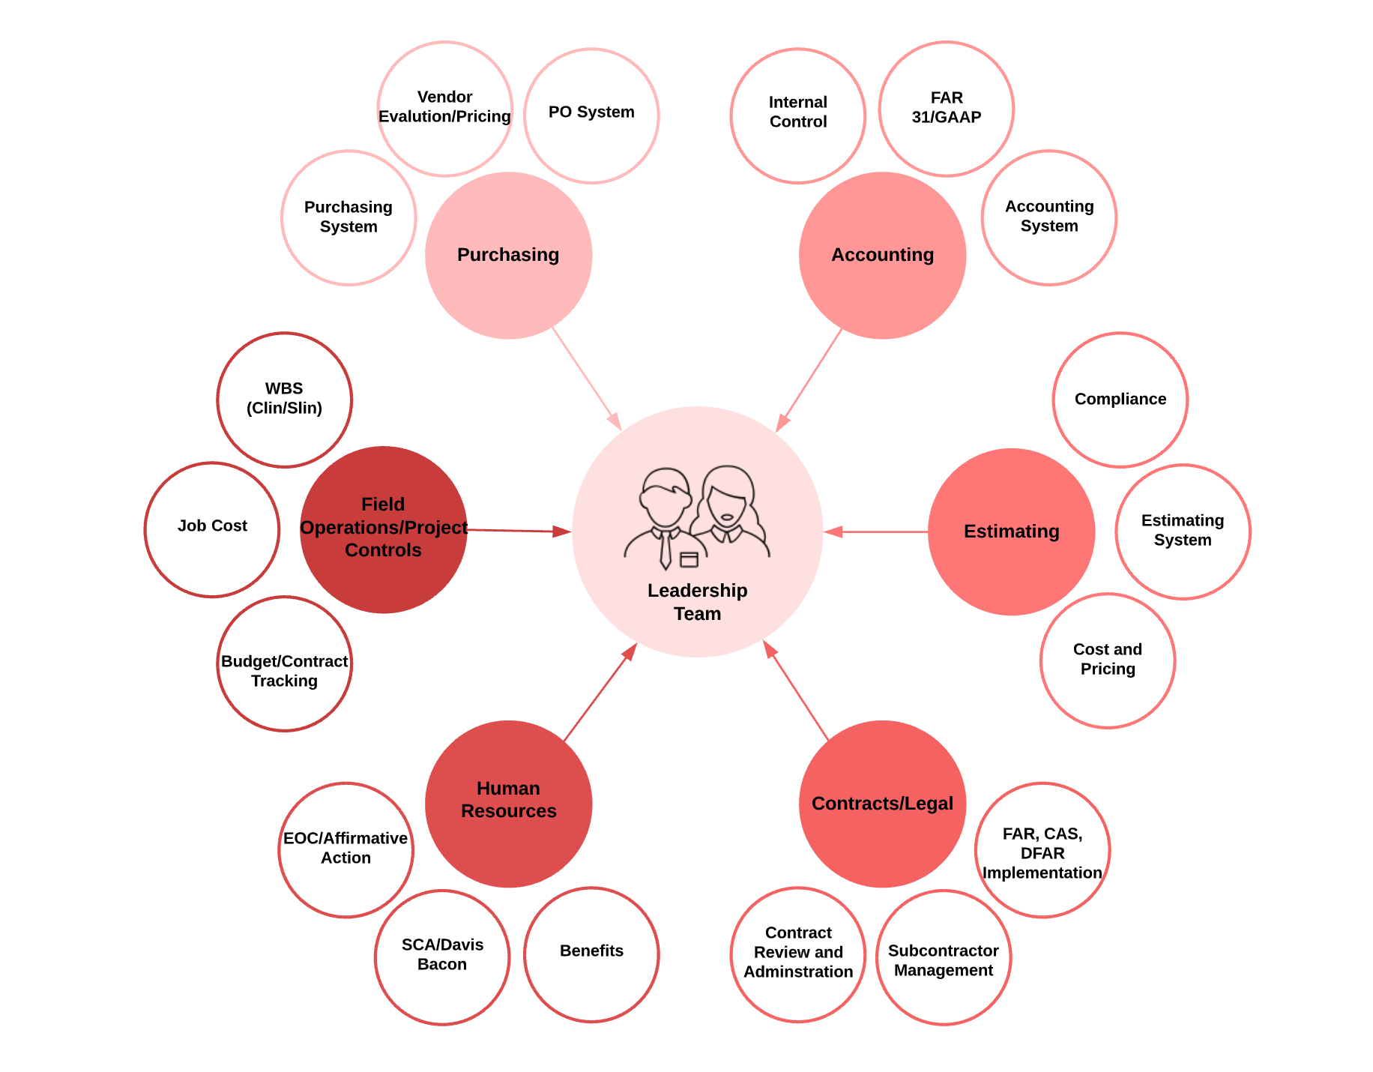
RESOURCES - STEERING COMMITTEE
Representation - Company
Functional Business Leaders
Charter and Purpose
Periodic Review
Near-Term Goals
Strategic Goals
FFP to Cost Reimbursable
Technology
Strategic Hires
Clients and Markets

Slide 21
TECHNOLOGY CONSIDERATIONS
Can my auditor easily audit my records?
Process Owner
Disparate Systems
Audit and Reporting
Chart of Accounts
FAR 31
How do I manage one off systems?
DATA & Workflow easy to follow?
Budget/WBS
Timesheet
Payroll - Labor Distribution
Job Cost
Billing
General Ledger
Cash Receipts
Contract

Slide 22
Data Analytics
Data Management
DISPARATE SYSTEMS
Data Integration

Slide 23
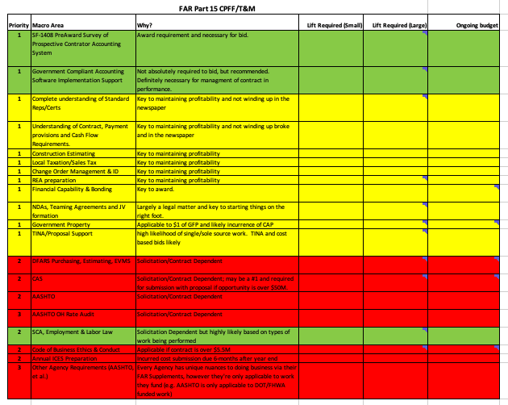
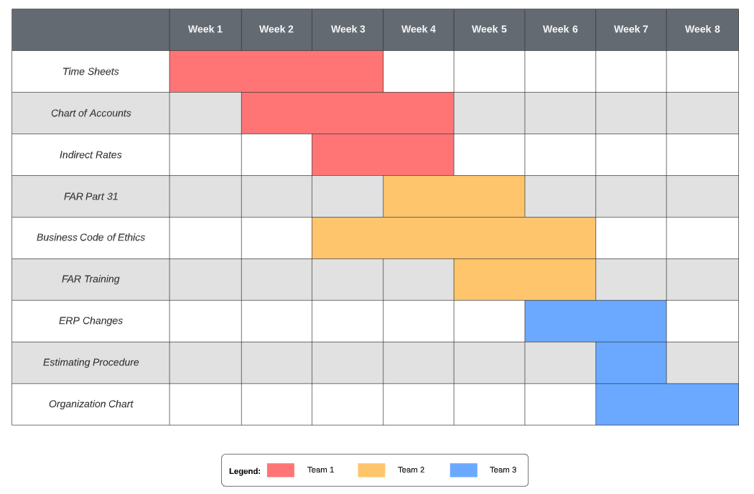
PROJECT PLAN
What’s Our Plan?

Slide 24
PROJECT PLAN
Estimating
Executive Mgt
Field
Contracting
Risk Mgt
PM
BD
Human
Resources
Purchasing
Near-Term Strategies
Long-Term Strategies
Strategic Planning Integration
Accounting
Compliance
Technology
Equipment
Assets

Slide 25
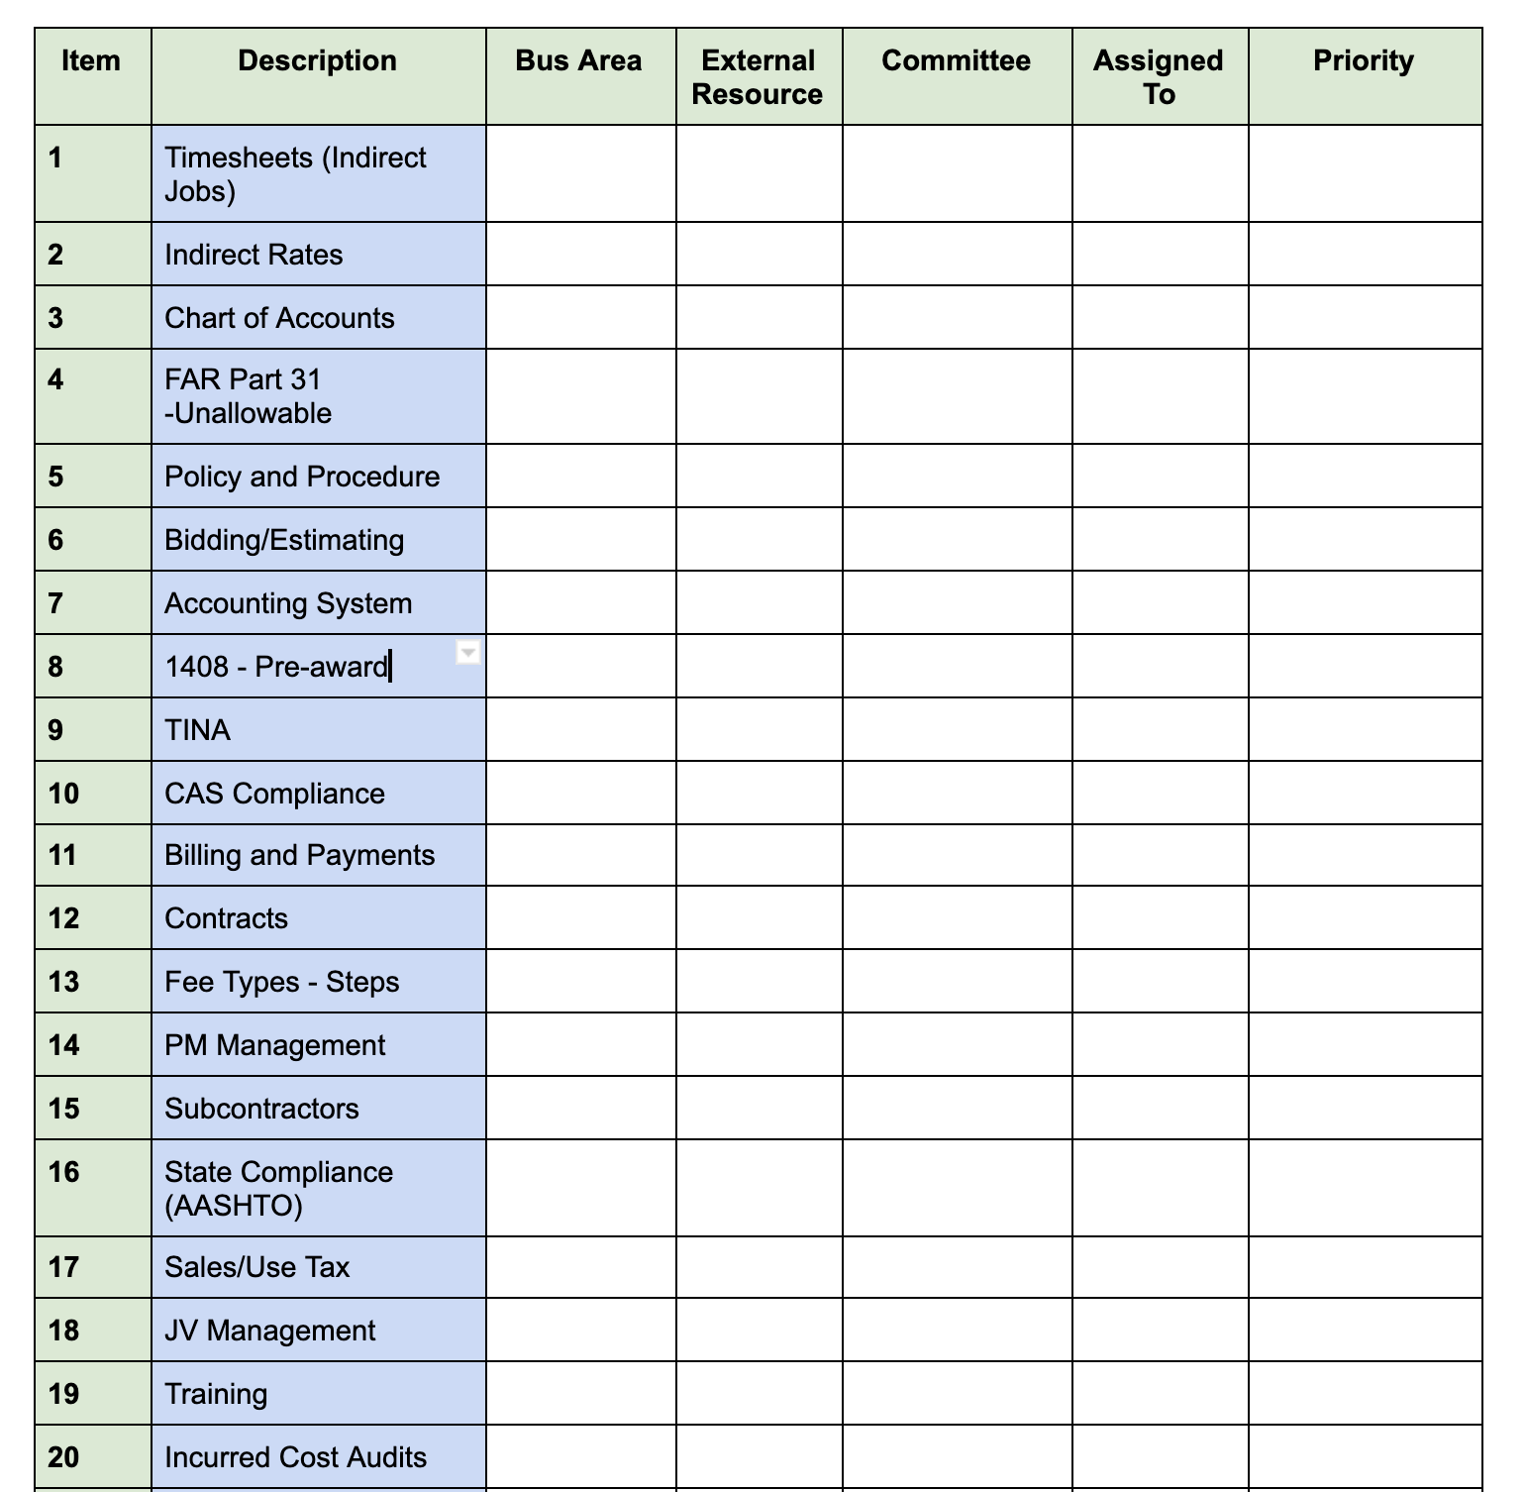
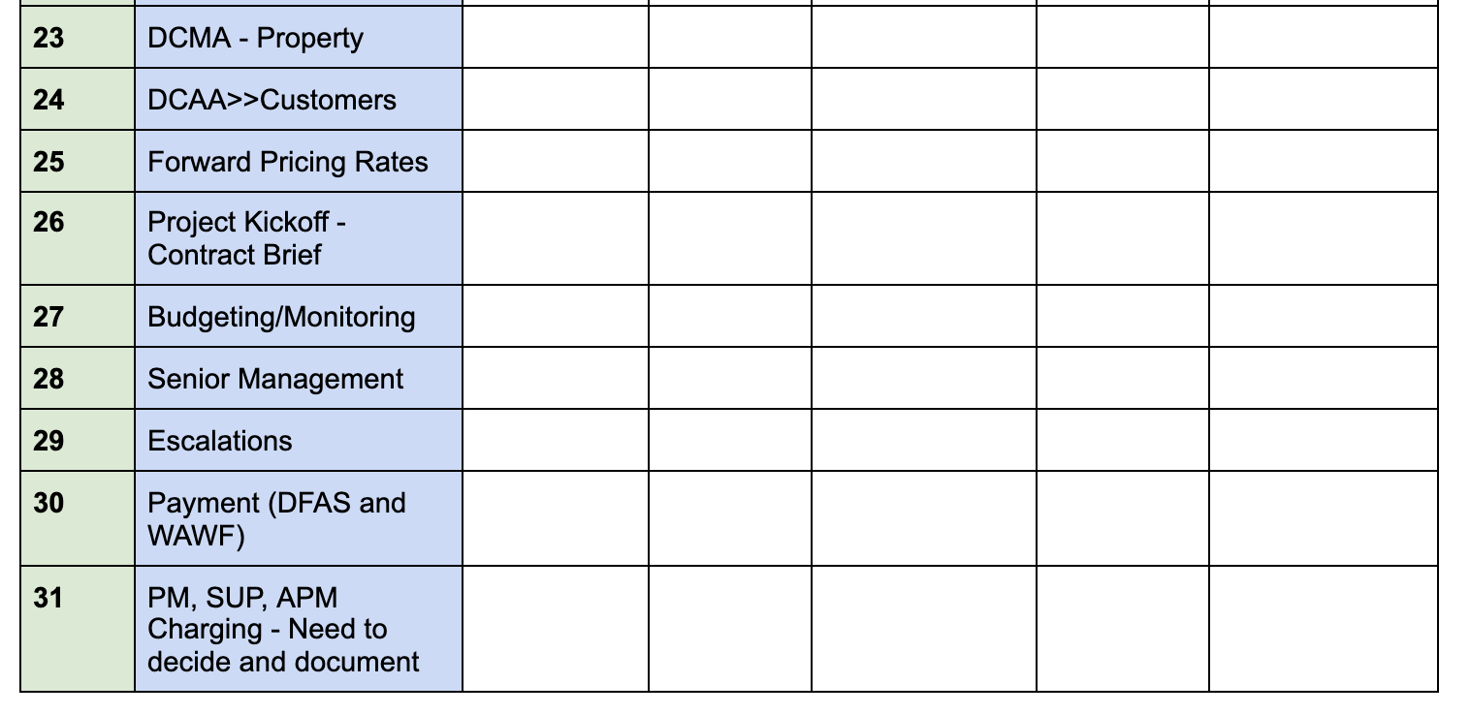
PROJECT PLAN
Needs
Measure
Assess
Improve
Control
Estimating
Contracts
Project Management
Accounting
Procurement
Compliance
Project Close Out

Slide 26
GET WORK

Slide 27
TAKEAWAYS
1
Leadership and Company Buy-In
Team Ready and Trained
2
Government Compliance Advisor(s)
Compliance, Technology, Accounting, and Legal
AWS Web Services
“Company DATA”
3
Technology
Right system(s) to perform and stay compliant
4
Project Plan and Strategy
Near-Term and Long-Term
5
Training and Education
FAR, CAS, GAAP, Internal Control, and Contracts

Slide 28
Q&A

Slide 29
Jim Gilbert
720-212-1715
jim@jimgilbertcpa.com
THANK YOU!
Matt Griffin
720-827-6519
mgriffin@ironwomancon.com

Slide 30
Session Password
(Must record password for CPE credit)

