Slide 1
2020 CFMA Conference
WIFI Password: BRAYNTaxIncentives

Slide 2
THE HARD MARKET IS HERE - WHY GROUP CAPTIVES SUCCEED IN THESE MARKET CONDITIONS
Jason Oswald ACI, ARM, CRIS

Slide 3
Agenda
Review of the industry loss drivers that are impacting the overall market pricing, coverages and structures
Review the captive market outlook
What is a group captive?
Discuss the benefits of a group captive program and the value add in a hardening market

Slide 4
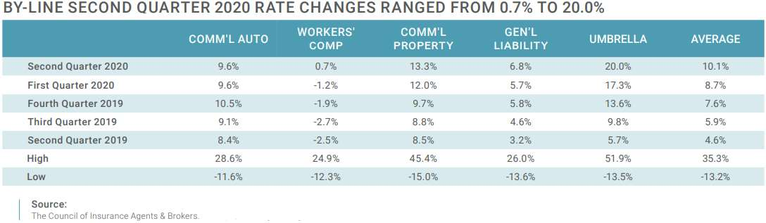
The Hard Market
In general, we have experienced our 11th consecutive quarter of increased premium pricing (all account sizes and industries).
All lines of business, including Workers Compensation, experienced slight-to-significant premium increases.
  The Workers’ Compensation increase becomes the first increase in the past 21 quarters.

Slide 5
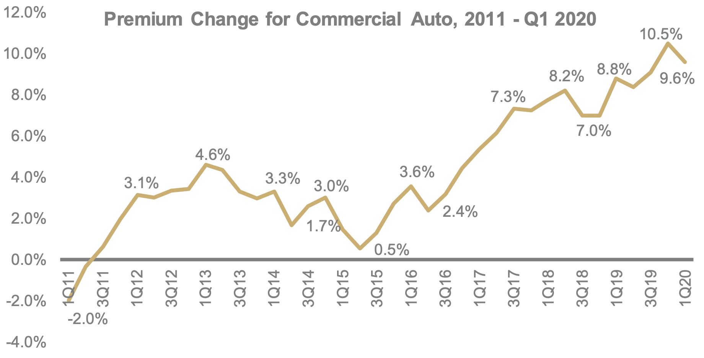
The Hard Market – Commercial Auto
Commercial Auto recorded an average premium increase of 9.6% in Q2 2020, the 36th consecutive quarter of increased premium pricing.
  Density and miles driven have been increasing over this period of time
  Distracted driving continues to influence results
  Increased social inflation – increase in the number of nuclear / vertical verdicts
    Impact goes beyond the primary auto coverage and into the umbrella / excess
                SOURCE: Council of Insurance Agents & Brokers Commercial Property/Casualty Market Report Q2 2020

Slide 6
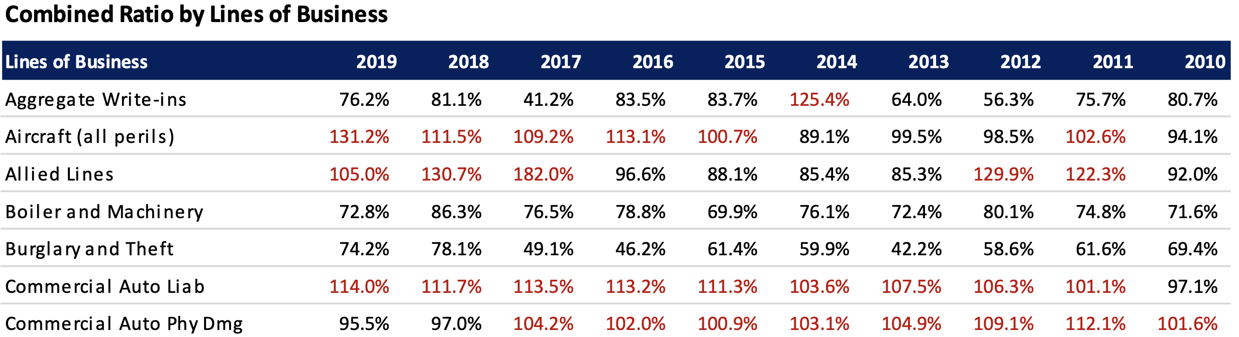
The Hard Market – Commercial Auto
Marks the 9th consecutive year that the combined ratio has exceeded the 100% threshold despite rate increases spanning 36 consecutive quarters.
  REMINDER: Commercial Auto recorded an average premium increase of 9.6% in Q2 2020, the 36th consecutive quarter of increased premium pricing.
  SOURCE: NAIC US Property & Casualty and Title Insurance Industries 2019 Full Year Results

Slide 7
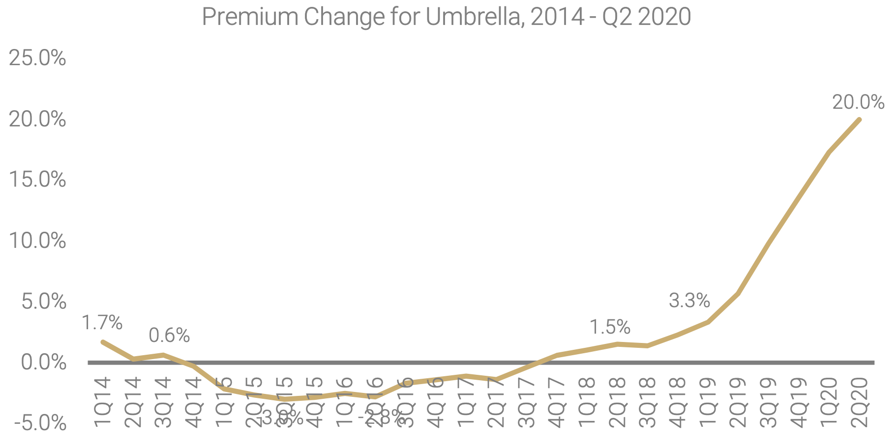
The Hard Market – Umbrella / Excess
As previously mentioned, the Commercial Auto is heavily impacting the rise in umbrella pricing.
  Secondarily, General Liability policies have also had an increasing influence on results.
Beyond pricing increases, carriers are also taking the following actions:
  Capacity reduction
    Fewer want the lead position
    Movement toward attaching over a $2m / $4m or even a $5m / $10m structure
                SOURCE: Council of Insurance Agents & Brokers Commercial Property/Casualty Market Report Q2 2020

Slide 8
The Hard Market – Long-term View
Most hard markets last between 2-10 years.
Key items for to monitor in the short term include:
  Combined Ratio improvement
  Rate filings
  Investment income
  Impacts of Covid 19
    Revenue / payroll impacts
    Legal battles
    Coverages, in particular exclusions

Slide 9
Captive Introduction
  Captives became an alternative risk transfer mechanism in the late 60s as a result of hard markets that were the result of:
    Poor insurance industry results
    Increased premiums and higher retentions
    Reduced coverage offerings
  A captive is a special purpose legal entity which is licensed as an insurer, and is established primarily to insure a proportion of the risks of the shareholders, often a corporate parent, group or association.
  Creates a long-term solution to insurance requirements, while establishing a mechanism to fully capitalize on the many benefits

Slide 10
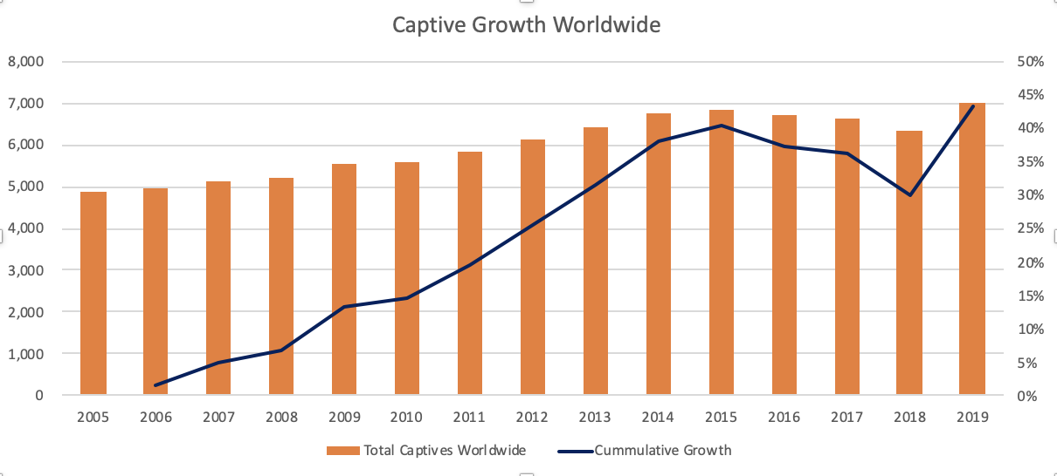
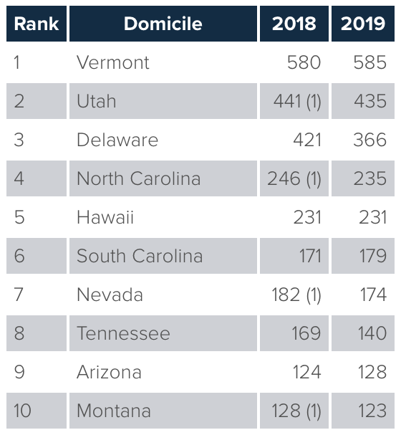
Captive Market Outlook
  Recent captive growth

Slide 11
Captive Market Outlook
  Small Captives
  IRS rulings have caused activity in this space to drop considerably in recent years.
  IRS has several high-profile court cases that brought negative attention.
  Many companies have elected to avoid the scrutiny, despite having legitimate reasons for formation.
  Continued scale back.
  Property & Casualty
  Hardening markets are creating significant growth in new captive formations.
  Hardening market, in particular the elimination of coverage has generated expansion of existing captives.
  Expansion of state domiciles seeking to take advantage of growth
  Expansion of coverage offerings as market contracts.
  Medical Stop Loss
  Rising health care costs are creating greater interest for companies seeking to control their rates.

Slide 12
Individual Factors for Captive Growth in a Hard Market
  Cost Management
    Control Insurance Costs
      Captives can perform at lower expense ratios
    Capture Underwriting Profit
    Price Stability
      Advantageous during hard markets
  Cash Flow
    Retention of Premiums
    Tax Benefits
    Capture of Investment Income
    Creation of Profit Center
  Insurance Coverage and Services
    Unbundling of services and increased control
      Claims handling & risk control are two key elements
    Expanded coverage, flexibility and capacity
    Direct access to alternative markets, leveraging of group purchasing power

Slide 13
Session Password
(Must record password for CPE credit)

