Slide 1
Hot Topics

Slide 2
Hot Topics
Ownership / Leadership Transition
Company Culture
Construction Industry Trends
Technology Advancements

Slide 3
Ownership / Leadership Transition
Does your company have a succession plan in place?
How to secure the future of an entity with so many construction professionals nearing retirement age?
Given the challenging labor pool, companies need to dedicate resources to securing and grooming new talent for top roles.

Slide 4
Ownership / Leadership Transition
TIMING • 10 Years to Implement • Needs/Desires of Seller
“OWNER”
• Needs/Goals for Retirement
• Responsibility & Control must Transition
TRANSACTION • Many options for Transaction Structure. Find one that fits best.
“FUTURE OWNER” • Ideally You Want to Align Ownership with Leadership
• Success is Most Dependent Upon Having the Right Team
OVERARCHING GOAL:
The Long-Term Success of the Company and its People
Notes:
Len & Tom – Real examples
Diversification of Risk
Retirement
Retention of Key Management
Various Options to Provide Funding / Labor
Sale / Merger
Employee Stock Programs

Slide 5
Ownership / Leadership Transition
Do’s
• Leaders with Strong Character & Drive
Don’ts
• Be greedy
• Designate leaders because they are family
• Keep control too long
• Get hung up on Employee Financial Resources
• Develop all Levels of Talent
• Collaborative Leadership Team
• Give Responsibility

Slide 6
Ownership / Leadership Transition
Selection - Identification (Annually) - Expectations
Assessment -360 Reviews -Meyers Briggs -Strength Finder
Training -Coaching -Mentoring -Financial -Legal
Leadership - Reading List - Associations
Sample Leadership Development Plan
Notes:
Marco Capitelli

Slide 7
Company Culture
CULTURAL - Values - Attitudes - Passion - “Vibe” - Leadership
PHYSICAL - Demographics -Collaborative - Amenities - Tools - Prefabrication -Safety Gear
TECHNOLOGICAL - Tablets - Training - Software - Timecards
Team
Experience
Notes:
Culture
Technological
Physical
Company culture includes a variety of elements, such as work environment, values, ethics, expectations, and goals
Firm Culture & Brand Promise
Create Opportunities for Training, Development, Education

Slide 8
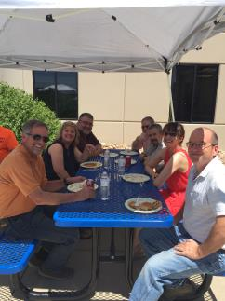
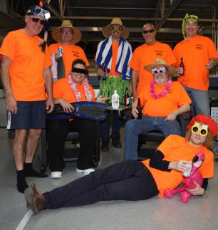
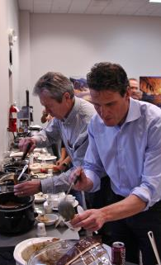
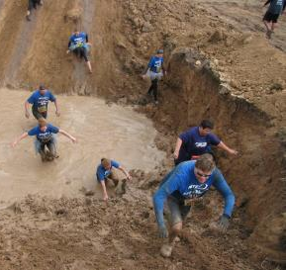
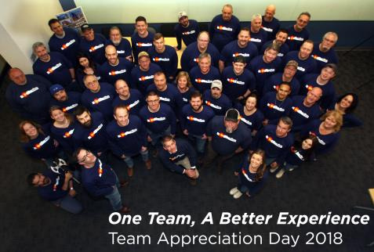
Company Culture
Find time for Team Building / Social Activities
Wellness – “Colorado Life”
Workspace – Physical or Mobile

Slide 9
Company Culture
Offsetting People Shortages & Turnover – What Does It Take?
Mutually Beneficial for Both Your Organization and Your Employee
Collaborative Environment
Shared Resources
Coaching & Mentoring
Cross-Training
Work-Life Integration Flexible Work Schedules
Intelligent Growth Creating Opportunity

Slide 10
Construction Industry Trends
GOOD
Shift to Design-Build & IPD
BAD
Flat Public Sectors
Tariff Tax
UGLY
Lack of Skilled Workers
Construction Cost Escalation
Booming Private Sectors
Mergers & Acquisitions
Technology
Delayed Leadership Transitions
Rise in Legal Activity
Value Adds: Sec 179D & R&D Tax Credits

Slide 11
Technology Advancements
Trimble & GPS
Drones
Automation
Prefabrication
BIM
VR & AR
Social Communication
CRM
Collaboration
Communication
Productivity & Processes
Contribution & Insight
Global outreach
Spec and Procurement Strategies

