Slide 1
Designing Better Wellness Programs
How to build a wellness program that will connect with your employees
Presented by Kristen Deevy, Managing Director
720/289-3833 kristen.deevy@pensionmark.com
Notes:
How to build a Wellness Program that will connect better with your employees.

Slide 2
Retirement Plan Specialists
5000+
$86B
300+
65+
Retirement Plans
As of 12/31/2021
Assets Supported*
As of 12/31/2021
Team Members
As of 12/31/2021
Locations
As of 12/31/2021
A boutique experience with the strength and resources of a national firm.
With Pensionmark you get the best of both worlds, working with an experienced independent advisor backed by a network of support specialists.
As of December 31, 2021, the Pensionmark network of advisors and firms collectively provides support to over $86.0 billion in assets across a variety of channels including investment management and retirement plan consulting services. This includes regulatory assets under management (AUM) of over $16.8 billion.
Notes:
A common recurring comment we hear from clients and Plan Sponsors is that it is hard to tell financial advisors apart. We all talk about fees, funds and fiduciaries. We all come in with nice suits and shiny shoes and makes it hard to tell us a part. We all have charts, graphs and reports. It makes it hard to tell a good advisor from a mediocre advisor. While we do all of those things we are going to spend the day discussing what sets us apart from other advisors and how we look at things differently.
A lot of our differentiators come from our size. We now have over 3,350 plans representing over $80B in plan assets. We are now represented in 65 locations with a team of over 300 people.
This size is an asset as it gives us different demographics, experience, knowledge to better help our clients.
We have seen so many different scenarios it is very hard to surprise. With our intellectual capital across these branches we can address most of your plan goals, issues or concerns.
Our centralized support and scale allow us to give a boutique support and do a better job as an advisor because we are able to outsource some of the mundane tasks to individuals focused in that particular area.
** If presenting to a smaller employer, emphasize the boutique experience. A large corporation with multiple locations will likely enjoy the option of many locations.

Slide 3






Work toward an informed and strengthened plan, with a lot less effort.
Employer Support
Whether it be plan design, costs, vendor management, Employee engagement, plan health, or compliance, think of us as your outsourced plan management team.
INVESTMENT
ANALYSIS
INDUSTRY EXPERIENCE
FINANCIAL
WELLNESS
PLAN
OPTIMIZATION
FIDUCIARY
OVERSIGHT
Notes:
The services we offer can seem daunting to employers. We’re going to be talking about a lot of services you may not realize are available or may not currently have as part of your current plan. Whether that discussion involves investment services, education support, vendor reviews, financial wellness and participant advice, the most important consideration is the realization of our ability to take the bulk of this work off your plate by outsourcing it to us.
Whether it’s plan enhancement, or the addition of services not currently being utilized, we do the heavy lifting and you can rely on us to serve as your centralized team.

Slide 4

Is this how you feel?
Notes:
So I have a question for you – when it comes to pulling together a wellness initiative for your organization…
…is this how you feel? Like you are shooting in the dark?
You implement programs that employees say they want only to find few use them?
Employees ask / suggest / even seem excited
No participation
CFO askes why spend?
ROI / ROV – nailing jello to the wall
If I told you that if only 10% of employees using a program is actually considered a success – would you believe me?
Advisor for 20+ years to 401k plans – always hit my head in frustration about wellness plans – then I found out why
Will share with you today.
Why scientifically we should only expect about 5-10% participation – depending on the wellness initiative and the identified risk behavior.
By the end of this presentation not only will you have a better understanding, & might even believe me, of why I say that – you will have strategies you can use to design and implement wellness programs that connect with and meet employees where they are at in their wellness journey.
You are making meaningful change

Slide 5




Designing a wellness program that connects with your employees
Why Wellness is Important
The Expansion of Wellness Programs
Pulling it all together
The importance of Emergency Savings

Slide 6
Why is Wellness Important?
Notes:
We’ve been discussing wellness initiatives for a long time – financial wellness for more than a decade now & health wellness for even longer than that.
Term first used in 1961 when Halbert Dunn first coined the term in his book High Level Wellness
Since then, lots of progress – in fact we now have over 5,000+ companies that promise wellness of some sort…
Still employers feel like they are shooting in the dark – why is that?
Maybe a good place to start is with what we do know…

Slide 7
Why is Wellness Important?
What do we know?
Employees have competing priorities
Employers can have a positive impact on employee well-being
Unhealthy employees impact the bottom line
Employees are looking for help
Employee well-being and mental health top 5 strategic priority for 2021 and beyond
Notes:
We know that employees have competing priorities.
We know that employers like you can have a positive impact on your employees’ overall Wellbeing through comprehensive education and solutions.
And we also know that this topic of Wellbeing isn’t going away any time soon. If anything, the recent pandemic has increased the need for employer sponsored wellness programs. The number of employers offering comprehensive Wellness programs has risen and is expected to continue to grow in the future.
According to HR Executive Mag – of the top 5 strategic priorities for 2021 and beyond is employee wellbeing and mental health.
So what now? What does this mean for your organization? & for your employees? & how do you select and implement programs that your employees will really use?
Before we get into that, let’s spend a little time recapping some of the latest research regarding the continued need for wellness programs…

Slide 8




The health of your employees is impacting the health of your organization
$1.1
Trillion
for chronic diseases
$250
billion
for work-related illness and injury
$200
billion
for work-related stress
$550
billion
for disengagement
https://globalwellnessinstitute.org/industry-research/the-future-of-wellness-at-work/
https://www.virginpulse.com/bettertogether/employee-health-company-health/
Notes:
Here is a scary stat: worldwide, the cost of unwell workers represents 10 to 15 percent of global economic output. & again, this may increase once the dust settles from this global pandemic. In the United States alone, an unhealthy workforce costs $2.2 trillion a year – a stunning 12 percent of gross domestic product.
Costs include:
$1.1 trillion for chronic diseases
$250 billion for work-related illness and injury
$200 billion for work-related stress
$550 billion for disengagement

Slide 9
Wellness issues are not without cost
$1 out of every $4
11-14%
per employee
$10,000
per employee
$3,000
per employee
How much employers pay for healthcare ties back to unhealthy lifestyle choices or conditions related to smoking, stress, and obesity.
Payroll expenses per employee, per year, due to lost productivity.
62% lose an hour/day due to COVID stress
32% lose 2 hours/day
Average healthcare cost for an employee with at least one medical condition.
47% of the population is living with a chronic condition
Average healthcare cost for a healthy employee.
https://news.umich.edu/unhealthy-choices-cost-company-health-care-plans-billions-of-dollars/
Hot Topics in Retirement Study, Alright Solutions (2017)
Notes:
One way or another employers are paying for Wellness issues faced by todays employees.
The cost of an unhealthy workforce can be felt in many ways by today’s employers:
1 out of every 4 dollars is spent on healthcare ties back to unhealthy lifestyle choices or conditions related to smoking, stress, and obesity
Employee stress is impacting the bottom line. One estimate is that 11-14% of payroll expenses per employee, per year were due to lost productivity.
& a more recent study found that 62% of workers report losing at least an hour a day in productivity because of COVID-19 related stress. & 32% of workers say they are losing more than two hours a day.
The average healthcare spend for an employee with at least one medical condition is about $10,000 & goes up with each additional condition. & most employees once they have one condition it is not uncommon for one or more to show up. 47% of population is living with at least one chronic disease.
Whereas the average healthcare spend for a healthy employee is about $3,000 – this is just healthcare spend, does not include other factors that impact the bottom line
This is the impact – this is what we are trying to solve for
It used to be that the main & perhaps sole, purpose of a corporate wellness strategy was minimizing healthcare costs.
But the definition of wellness for the employer has been expanding over the years.
Gallup pole – all generations are looking for employers that care about their wellbeing (top 3). #1 for Millennials & Gen Z.
Important for employers to understand their new role in employee wellness…

Slide 10
The Broader Objectives: Expanding the Definition of Well-being
Notes:
So what are those broader objectives that employers are looking at? & employees are wanting…

Slide 11



3 Key Trends Driving the Impact of Well-being on the Employee Experience (Pre-Pandemic)
Blurred Lines
Stressed Workforce
Companies lose $30B in absenteeism
1/3 miss work due to stress
Personalization
75% want it!
40% feel its not relevant
25% feel it’s too difficult/time consuming
https://www.virginpulse.com/bettertogether/employee-health-company-health/
Notes:
Employers expectations (think about)
Blurred Lines:
The never-ending work day. Add more at home working to find a dividing line between work and play. Work stress in general still has a major impact.
A Stressed Workforce:
Juggling more than just finances and health – add children, aging parents, a global pandemic, political environment, and so much more…
Companies lose $30 billion through absenteeism caused by work-related stress.
40% of employees face high stress in their jobs, which negatively affects their productivity, health and family stability
About 1 in 3 people say they have missed work due to stress related issues
Personalization:
Maintaining a healthy lifestyle requires daily engagement, focus and practice, but this can be challenging for many employees.
Three-quarters of participants in wellness programs say that incorporating a personalized, customized approach is an important part of a health, wellness and fitness program.
40% of people who decide not to take advantage of their workplace health, financial and wellness programs say it’s because one or more components of such programs is not relevant to them, or that the program has no apparent value.
& the last stat is that about 25% of people report that the program is too difficult or takes too much time.
Well-being is not a “one-size-fits-all” solution. Every person’s path to lead a healthier life is truly unique.

Slide 12





Five Well-being Elements
Career
Well-being
Social
Well-being
Financial
Well-being
Physical
Well-being
Community Well-being
2021© Razem Ventures, LLC | (469) 301-8057 | kelly@razemventures.com
Gallup, Inc. (2021). State of the Global Workplace 2021 Report. Retrieved from https://www.gallup.com/workplace/349484/state-of-the-global-workplace.aspx
Notes:
Gallup’s State of the Global Workplace 2021 Report
They are looking to their employers to offer programs that support employees across at least five primary areas:
Career Well-being – you like what you do every day. Developing employees’ strengths to foster long-term careers
Social well-being – You have meaningful friendships/relationships in your life creating family-friendly policies & encouraging friendships at work
Financial well-being – you manage your money well Providing financial services and education
Physical & Emotional Well-being – you have energy to get things done encouraging physical activity & making it easier to choose healthy foods (environment)
Community well-being – you like where you live (pandemic impact) celebrating those who give back to the community through service
Gallup found that compared with those who score high on physical wellbeing alone, those who score high on all five elements report 41% fewer unhealthy days.

Slide 13
Five Strategic Priorities for the Future of HR
2020 HR Sentiment Survey Top 5 Priorities | 2021 HR Sentiment Survey Top 5 Priorities
1. Employee Experience | 1. Employee Well-being / Mental Health
2. Leadership Development | 2. Diversity, Equity, and Inclusion
3. Learning Transformation | 3. Leadership Development
4. Next Generation Leaders | 4. Employee Experience
5. People Analytics | 5. Manage Remote Workers
Future Workplace, 2021 HR Sentiment Survey: Five Strategic Priorities for the Hybrid Workplace. www.futureworkplace.com, https://futureworkplace.com/ebooks/2021-hr-sentiment-survey/
Notes:
Given the 5 wellbeing elements identified by employees it is makes sense to see that the top 5 strategic priorities for HR have shifted to meet the current post-pandemic environment.

Slide 14
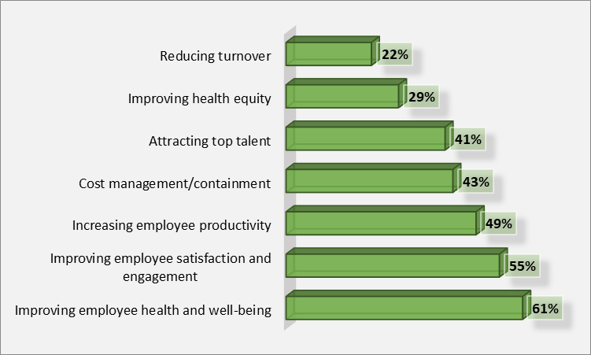
7 Top Benefit Goals
Artemis Health, How 2020 Has Changed Employee Benefits. www.artemishealth.com, https://www.artemishealth.com/research-papers/how-2020-has-changed-employee-benefits
Notes:
The Artemis Health Survey asked Benefit leaders “What are your organization’s top benefit goals?”
Not surprisingly employee health came out on top. & will continue to be a top priority in the foreseeable future.
This was a shift from 2019 when productivity was a top priority
Measures of success for benefit teams based on their ability to improve:
Employee health and well-being (46%)
Improve employee satisfaction (42%)
Employee productivity (40%)

Slide 15

What drives behavior change
A Scientific Approach
Notes:
Now you know the components of a wellness program initiative & the definitions, what next?
How do you know what your employees really want out of their wellness offering? & what will get them to engage?
That’s the million dollar question!
Get a little geeky – scientific

Slide 16
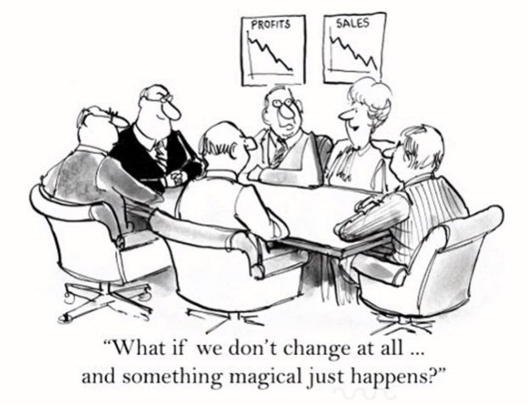
Understanding Behavior Change
Notes:
Profit & sales going down
Make no changes – all will work out - NOT
Think about a behavior you have wanted to change or have changed…
THE END GAME FOR PARTICIPANTS MUST BE BEHAVIOR CHANGE.
Let’s talk about what makes us change our behaviors…

Slide 17






Behavior Change Stages
Precontemplation
Maintenance
Contemplation
Not Ready
Keeping it up
Getting Ready
Action
Preparation
Doing it
Ready
2021© Razem Ventures, LLC | (469) 301-8057 | kelly@razemventures.com
Evers, Kerry. Lesson on Transtheoretical Model of Change. ADAPT Health Coach Training Certification Program. 4 April 2020 – 7 May, 2021, https://kresserinstitute.com/adapt-health-coach-training-program/
Notes:
5 stages
Typical order- relapse happens
Every behavior we go through these stages
Change does not equal action
You are still helping your employees even if you cannot tag an ROI / ROV to their change

Slide 18
Not ready to change
No intention to change behavior in next 6 months
Cons > Pros
Defensive
Resistant
Change experienced as coerced
Demoralized
30% to 85% of population at risk
Precontemplation
Not Ready
Evers, Kerry. Lesson on Transtheoretical Model of Change. ADAPT Health Coach Training Certification Program. 4 April 2020 – 7 May, 2021, https://kresserinstitute.com/adapt-health-coach-training-program/
Notes:
Precontemplation stage
Excuses
I would but…
Not now…
I can’t…
Things are ok…
Key to know is that about 30 to 85% of the population at risk are in precontemplation at any point in time.
At risk means they are currently engaged in the negative behavior or not engaged in a good behavior (like smoking, loosing weight, or getting out of debt)
That can be a huge portion of the population and why we see such an issue with chronic disease and the stats we went over earlier in this presentation.

Slide 19
Getting ready to change
Showing interest in a topic and thinking about changing in the next 6 months
Pros = Cons
Ambivalent
Lack commitment
Lack confidence
“Chronic” contemplation
From 10% to 50% of population at risk
Contemplation
Getting Ready
Evers, Kerry. Lesson on Transtheoretical Model of Change. Health Coach Training Certification Program. 4 April 2020 – 7 May, 2021, https://kresserinstitute.com/adapt-health-coach-training-program/
Notes:
Next is the Contemplation stage
Walking the fence.
I’d like, but…
Maybe I will…
I will when…
At some point in the future…
They will be excited about new features you roll out but might not ever engage.
They are not exactly sure what to do or how to do it, and they tend to get off track really easily.
About 10 to 50% of people who are at risk are in contemplation at any point in time.

Slide 20
Ready to change
Intend to adopt behavior in next 30 days
Already taking small steps
Pros > Cons
Have a plan
Decisive/Committed
More confident
“Ideal” participants in wellness initiatives
From 5% to 35% of population at risk
Preparation
Ready
Evers, Kerry. Lesson on Transtheoretical Model of Change. ADAPT Health Coach Training Certification Program. 4 April 2020 – 7 May, 2021, https://kresserinstitute.com/adapt-health-coach-training-program/
Notes:
Preparation stage
Climbing down off that fence
I’m ready to…
I will…
It is time to…
Asked about some type of wellness initiative that they are interested in
About 5 to 35% of people who are at risk are in the preparation stage at any point in time. These are the employees you see engaging in the wellness benefits you are offering; they are the ones asking questions and are actively looking for help.

Slide 21
Doing it
Adopted behavior less than 6 months ago
May experience strong urge to revert back to old behavior
Greatest risk of relapse to old behaviors
Action
Doing it
Evers, Kerry. Lesson on Transtheoretical Model of Change. ADAPT Health Coach Training Certification Program. 4 April 2020 – 7 May, 2021, https://kresserinstitute.com/adapt-health-coach-training-program/
Notes:
Action stage –
I’m ready to…
I am…
Just getting started….
Anything to help them stay consistent with the behavior change they are wanting to stick with they tend to be open to participating in.

Slide 22
Keeping it up
Adopted behavior more than 6 months ago
Higher self-efficacy
Dynamic, not static
Consolidating gains
Improved coping skills
10% - 15% of at risk population are in Action and Maintenance stage
Maintenance
Keeping it up
Evers, Kerry. Lesson on Transtheoretical Model of Change. ADAPT Health Coach Training Certification Program. 4 April 2020 – 7 May, 2021, https://kresserinstitute.com/adapt-health-coach-training-program/
Notes:
Maintenance stage –
I have been!
It’s a habit
There are usually only about 10-15% of the population who are in Action and Maintenance stage for any given behavior at any point in time.
This is why when you get the reports back and find that only about 10% of your employees have engaged in one particular wellness benefit might be discouraging, but now I hope you see that it is actually a good indication of the efficacy of your program.

Slide 23
Putting it All Together: Steps to Implement a Wellness Program
Notes:
Now that you have an understanding of the stages of change, how do you apply this to your wellness programs?
Remembering that most programs are action oriented when people are not, how can you tailor your programs to better suit your employees and to meet them where they are?
To get more clarity – ask more questions…

Slide 24
Employer
Employee
Engagement & Education Strategy
Other Wellness Programs or Initiatives
Deploy & Maintain
Reassess
Current Benefits
Wellness Initiative Decision Cycle®
Notes:
Employer assessment – corporate vision & culture, constraints, barriers, structure, leadership style, deployment support, technology, HR staff. Answers the question – what does the employer want to and willing to support.
According to the HERO Health and Well-Being Best Practices Scorecard management support remains as the most impactful on participation in health & well-being initiatives. Gallup’s State of the Global Workplace 2021 found that managers account for 70% of the variance in team engagement. No well-being program will be effective until employees can trust that their leaders and managers truly care about their well-being.
Employee assessment – Health Risk Assessment questionnaire, Interests and Intention questionnaire, & focus groups. Answers the question – what are employees really looking for & what will they participate in
Review Current Benefits – what is already available but has not been utilized?
Fill in the gaps – is there a wellness need that cannot be met by current benefit programs?
Engagement & Education strategy – participant analysis – what motivates employees – what’s in it for them? What will connect with them
Deploy & maintain – working with providers or internal wellness team create and deploy a communication strategy
Assess annually – redo HRA and engagement questionnaires, check in with decision makers to report & support wellness initiatives – usage data from wellness providers selected
Repeat – it is an ongoing, evergreen process

Slide 25


Financial Wellness
Help lay the groundwork by building healthy habits with your employees’ financial goals in mind - so they can stay focused, happy, and productive, instead of stressed with their finances.
You dictate the level of support your employees receive—from financial literacy to on-going advice. Work with a provider that can determine what is best for your unique demographic.
Notes:
This is where SMARTMap adds value.
[READ SLIDE]

Slide 26
Finding a Wellness Provider that can…
1
Define Financial Wellness Goals & Objectives
Work with you to create goals that
are specific to your employees
2
Identify Financial
Wellness Topics
Analyze data to pinpoint topics that are most relevant to your workforce
Find a team that will work with you every step of the way on engagement strategies unique
to your organization’s demographic
3
Optimize Engagement
4
Measure Progress
& Success
Through reporting, track results and adjust the strategies as needed
Notes:
Our SMARTMap team will work alongside [advisor firm/name] to ensure we implement the best strategy that fits your needs. We start with:
[READ SLIDE]

Slide 27
Comprehensive and Personalized Services for Every Employee
Financial Literacy
Foundational Planning
Ongoing Advice
DISCOVER what your retirement plan has to offer and the basics of personal finance. This is a safe space to improve your day-to-day money management, build good habits, and take charge of your finances.
DESIGN your foundation to build
your wealth. Receive tailored recommendations to help you reach your financial goals beyond the retirement plan and basic money management.
This is where you can begin to build
goals-based financial sustainability.
DEEP-DIVE into advanced strategies that enable you to protect and continue to grow your assets. Leverage more out-of-the-box wealth building opportunities and savings vehicles
for long-term financial success.
Notes:
We have compiled feedback over the years from retirement plan participants and employers like you to understand the issues affecting your employees.
The foundation of our program includes the following modules:
[READ SLIDE]

Slide 28



Find a Financial Wellness call center
FAs Are Available:
7 AM – 7 PM (all time zones)
On various channels (live chat, email, phone)
A key element of the success of a financial wellness program is that your employees have access to Financial Advocates across all levels of support.
FAs Are:
Registered (Series 6, 7, 65, 66)
Bi-lingual (English & Spanish)
FAs Provide:
100% unbiased guidance and advice
Resources on financial topics
Notes:
Our main priority is the financial well-being of your employees! We have a team of Financial Advocates that are available to assist them throughout their financial journey.
[READ SLIDE]

Slide 29


Financial Education and Engagement
We recognize the importance of customizing your financial journey and the desire for independence. So, provide financial education and engagement strategies for all learning styles.
Self-Learning
Personalized Support
Gamified Education
Online Financial Education Center
Video Tutorials
Market recaps
Financial Calculators
Access to Financial Advocates
Educational Webinars
Financial Workshops
Individual Consultations
Live Chat
Notes:
We have combined cutting-edge technology with live human support to provide you the perfect combo to start personalizing your financial wellness journey.
So, what is available to you today?
[READ SLIDE]

Slide 30

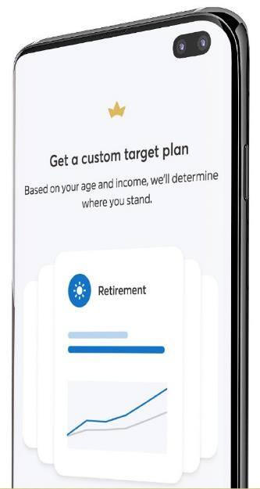





Engaging Technology
Consider a program that has an app! Users enter their age and income, allowing Incentive to generate a target plan, including various areas of financial importance such as:
EMERGENCY SAVINGS
3-6 months of income
DEBT MANAGEMENT
<36% annual income
BUDGETING
On track / off track
50% Essential expenses
15% Retirement savings
5% Other savings
RETIREMENT
On track / off track
Salary in savings by age
30 - 1x
40 - 3x
50 - 6x
60 - 8x
67 - 10x
LIFE INSURANCE
5-10x annual income
Notes:
[READ SLIDE]
The SMARTMAP app combines Financial Industry best practices and just two data points (age and income) to provide you information on where you should be in 5 important areas
Emergency Savings
Budgeting
Insurance
Debt
Retirement
Our team of Advocates will provide your employees with the necessary information to download and sign up for the App, which is available in both the App store and Google store.

Slide 31
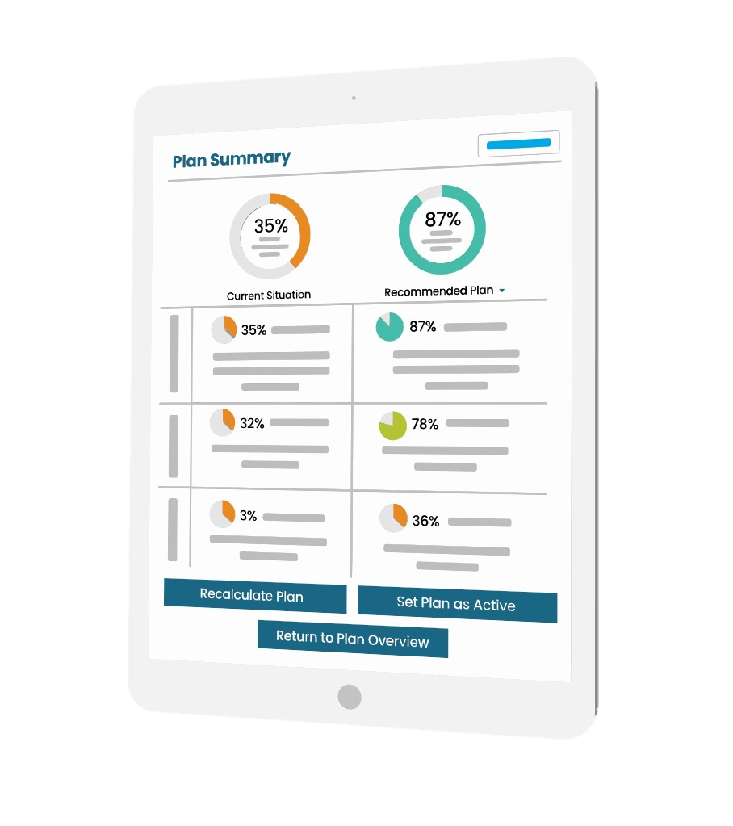
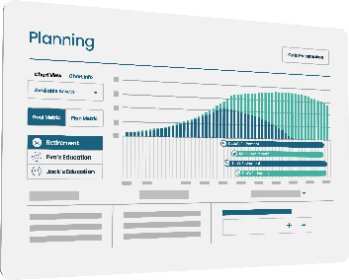




Foundational Planning
For those looking for more advanced planning services to take a deeper dive into their financial picture.
Build personalized Foundational Plans through:
Analyzing their current financial situation using portal data
Discussing their financial goals for the future
Accounting for unique life events and understanding rainy day requirements
Reviewing and updating plan as needed
Additional costs may apply. Please see pricing slide for more details.
Notes:
For those looking for more advanced planning services to take a deeper dive into their financial picture, our Financial Advocates are here to help.
Our team of advocates can work with your employees one-on-one to provide them a comprehensive report of their financial picture. We leverage the data collected through the SMARTMap App to begin the conversation. Employees who interact and engage throughout the process will receive a report with tailored recommendations on what actions to take to reach their goals.
[read slide]

Slide 32
The Importance of Emergency Savings
Notes:
Now you know the components of a wellness program initiative & the definitions, what next?
How do you know what your employees really want out of their wellness offering? & what will get them to engage?
That’s the million dollar question!
Get a little geeky – scientific

Slide 33




Why You Need an Emergency Fund
Your hedge against unemployment or unanticipated expenses – aim for up to 3-6 months of living expenses.
Medical Emergencies
Job Loss
Home Repairs
Rainy Days
Notes:
An emergency fund--money that’s readily available to meet unexpected expenses--is really the foundation for any successful financial plan. Without money to fall back on when an unexpected expense crops up, you may be forced to tap savings that you’ve earmarked for retirement, college, or another savings goal.
But if you have an emergency fund, it will be much easier to handle a job loss, temporary disability, or other event that might prevent you from saving for the future or even tempt you to pile up debt.

Slide 34
Building Your Emergency Fund
Multiply by the number of months (3-6)
Calculate your bare-bones expenses
Add this as an item in your Saving & Spending plan
Keep this money easily accessible
Having money stashed away will increase your control over an uncertain situation.
Notes:
How much should you have in your emergency fund? A popular rule of thumb is that you should have an emergency fund equal to three to six months of your living expenses. The ideal amount depends on many factors. However, we encourage you to start with an amount that fits your financial situation. (PROVIDE STRATEGY)
How stable is your income? Do you work in an industry where layoffs are common, or are you in a growing field? Do you have adequate health and disability insurance? Do you have other assets that you could tap without penalty in an emergency?
To calculate how much you need for your emergency fund, look at your budget and add up all your necessary expenses (debt payments, fixed costs, healthcare) and multiply that by the number of months you are saving for. We recommend 3-6, but even 1 month is a great start. Add this into your saving and spending plan until you’ve saved your target amount, (bucket strategy) and revisit your emergency savings goal whenever you experience a big lifestyle change (e.g. changing jobs, having a child, moving, etc.).
Where you keep your emergency fund is also important. In a jar is probably not the best idea. You’ll want to keep your money in an account where it’s readily available, but not so available that you spend it on things other than an emergency. Consider an entirely separate account. Once the money is out of your checking account it is out of sight, out of mind. Keep in mind through this should not be invested money, this needs to be easily accessible
There are many strategies you can use to build your emergency fund, and the keys to a successful strategy are to stay motivated and stay consistent. If you need to start small, consider trying out a passive saving strategy like “keeping the change” where you commit to saving your change from each transaction over a certain period of time – for example, saving all the change you get back from spending $20 bills for a month and adding that balance to your emergency savings.
Or automate a draw from your checking – a comfortable amount that you can keep consistent with.

Slide 35

Get Your Financial House in Order
6
Emergency Savings
Maximize Employer Match Contributions
Pay Down High Interest Debt
Maximize overall contributions to HSA & Employer Retirement Plan
Pay Down Low Interest Debt
Other Investment Accounts (IRA, brokerage, etc.)
5
4
2
3
1
Notes:
We covered a lot today and it can be a bit overwhelming to some. But like many things, this is a marathon not a sprint, you do not need to tackle all these items at once.
What might be helpful for you is to pick the most important topic to you at this moment and start working on that one. The one that will move the needle for you either a bit or a lot. Then move to the next one. Before you know it you will have logged a lot of miles and made significant progress toward building and completing your financial house.
Need or want some help – not a problem – we are here for you.

Slide 36


Next Steps:
Understand organization and employee/employer interests AND intentions
Modify current benefits to encourage stage based participation
Multi-dimensional approach – current benefits, internal programs, external programs, social support, think outside the box!
Integration of technology, targeted communications, multi-level access
Personalized engagement – meeting employees where they are
Rewards/Incentives to support program engagement & encourage taking assessments
2021© Razem Ventures, LLC | (469) 301-8057 | kelly@razemventures.com
Notes:
Understand – HRA / HRI assessments, employee focus groups, wellness champions &/or team to help assess employee desires, leadership questionnaire and focus groups (all levels)
Multi-dimensional approach & integration of benefits. Remember the 5 broad categories
Personalized engagement
Review & modify current benefits – you might already have to wellness initiatives you need as part of your core benefits (financial wellness & EAP programs)
Integration of technology – we are all on overload these days – make it as easy as possible. Consider technology overlay programs or benefit providers that allow access to all benefits through one portal.
Rewards & Incentives – where appropriate. Don’t waste your money trying to encourage pre-contemplators to make a change – they won’t bite. Where will you find the value in using rewards? Where people will really connect with them.

Slide 37

Actionable Session Takeaways
Today we covered:
Employee and employer goals and objectives for wellness programs
The five categories of wellness programs
How to put together a wellness initiative decision cycle and program

Slide 38
Thank You!
Questions?

