Slide 1
2022 CFMA Conference
WIFI Sponsor: Rubin Brown

Slide 2
2022 Economic Outlook
And Financial Market Update
Scott Colbert, CFA

Slide 3
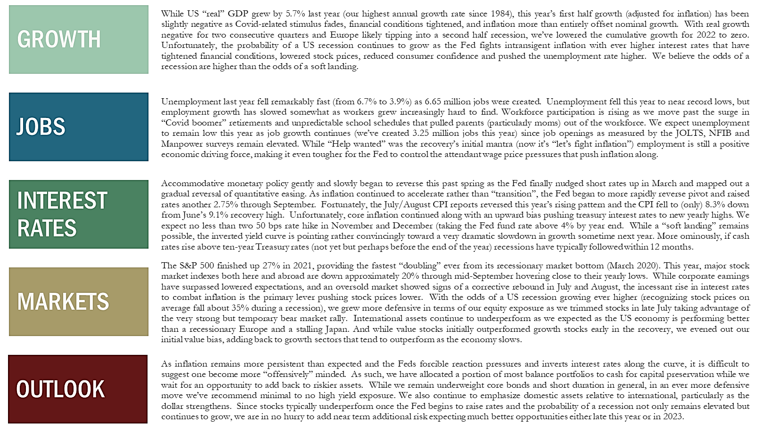
The Economy Today – Recession Risks
Rise Until Interest Rates Peak
Source: Commerce Trust Company

Slide 4
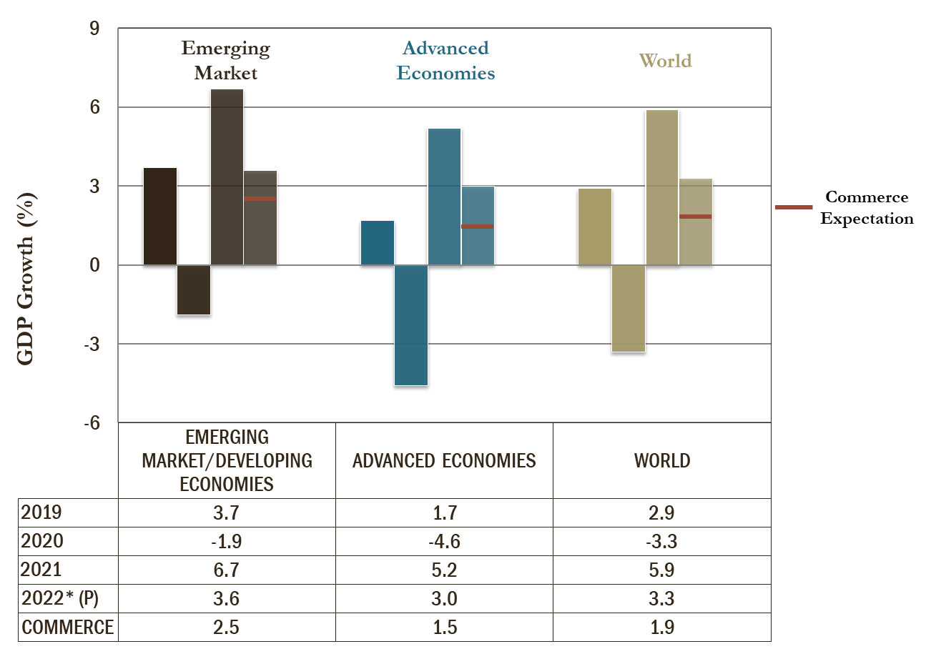
Global Growth Cooling Rapidly
(Growth Likely To Decline Even Further)
Source: International Monetary Fund, World Bank
*Projections based on average of both sources

Slide 5
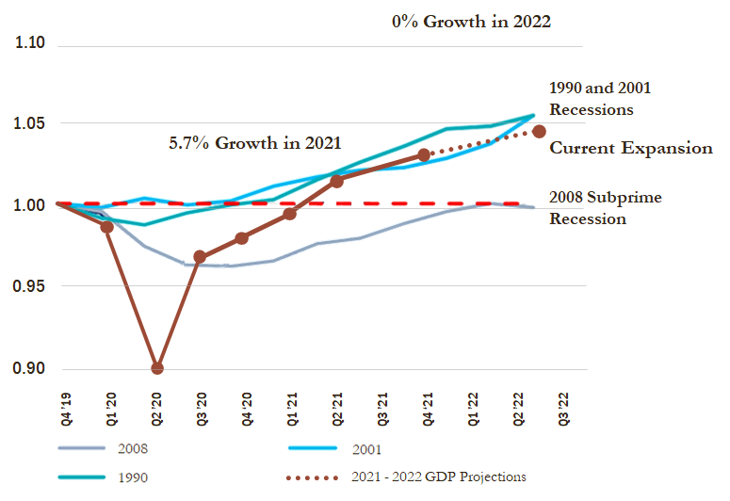
U.S. GDP Plunged, Recovered Quickly –
But Now Slows
Source: Citi Research Commerce Trust Company

Slide 6
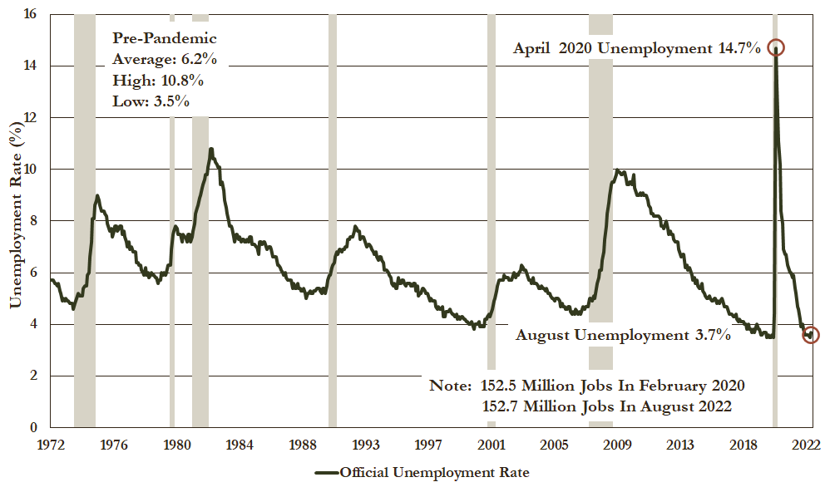
Official Unemployment Rate
(Lower Than Normal Due To Less Workforce Participation)
Source: Bloomberg

Slide 7
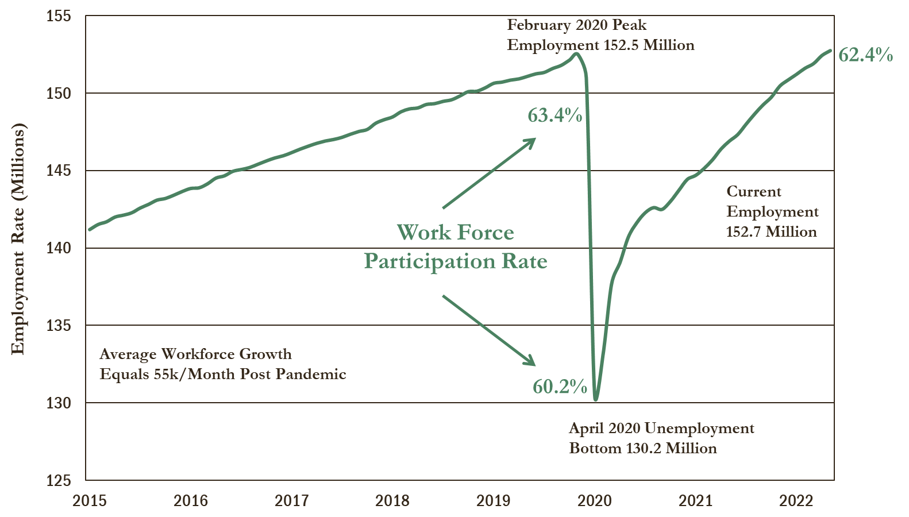
Total Non-Farm Employment
Source: Bloomberg

Slide 8
Consumer – Rattled By Inflation
Source: Bloomberg, FRB, BEA, Goldman Sachs Global Investment Research, Baird
*Consumer Confidence is the avg. of the Conference Board Consumer Index and the University of Michigan Consumer Sentiment Index

Slide 9
Housing Market Is Clearly Fading
(Affordability Tied To The 10 Year Treasury)
Source: Bloomberg, Baird

Slide 10
Limitations On Fiscal Policy
Source: JP Morgan, CBO, BEA, Treasury Dept

Slide 11
Consumer Finances – Positive Wealth Effect Fades
Source: FactSet, FRB, JP Morgan, BEA
*Revolving includes credit cards

Slide 12
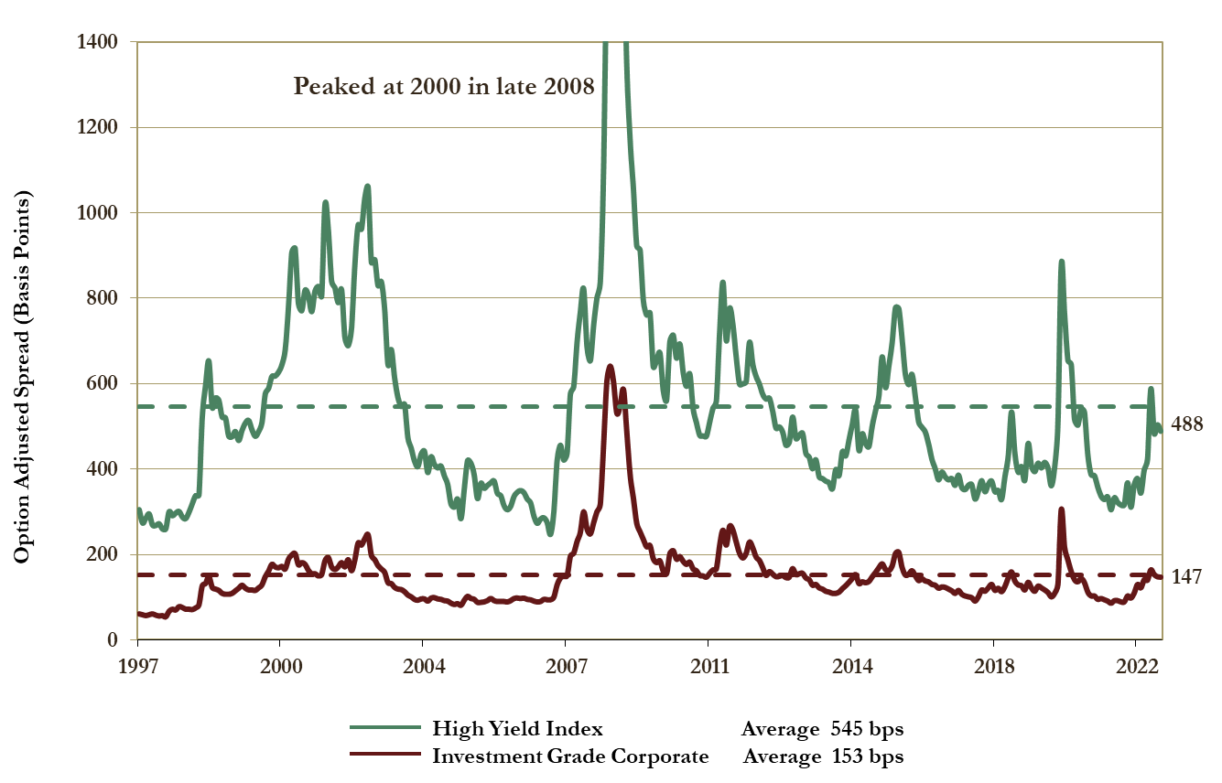
Corporate Credit Spreads – 1/31/97 through 09/20/22
Source: Bloomberg, ICE BofA ML

Slide 13
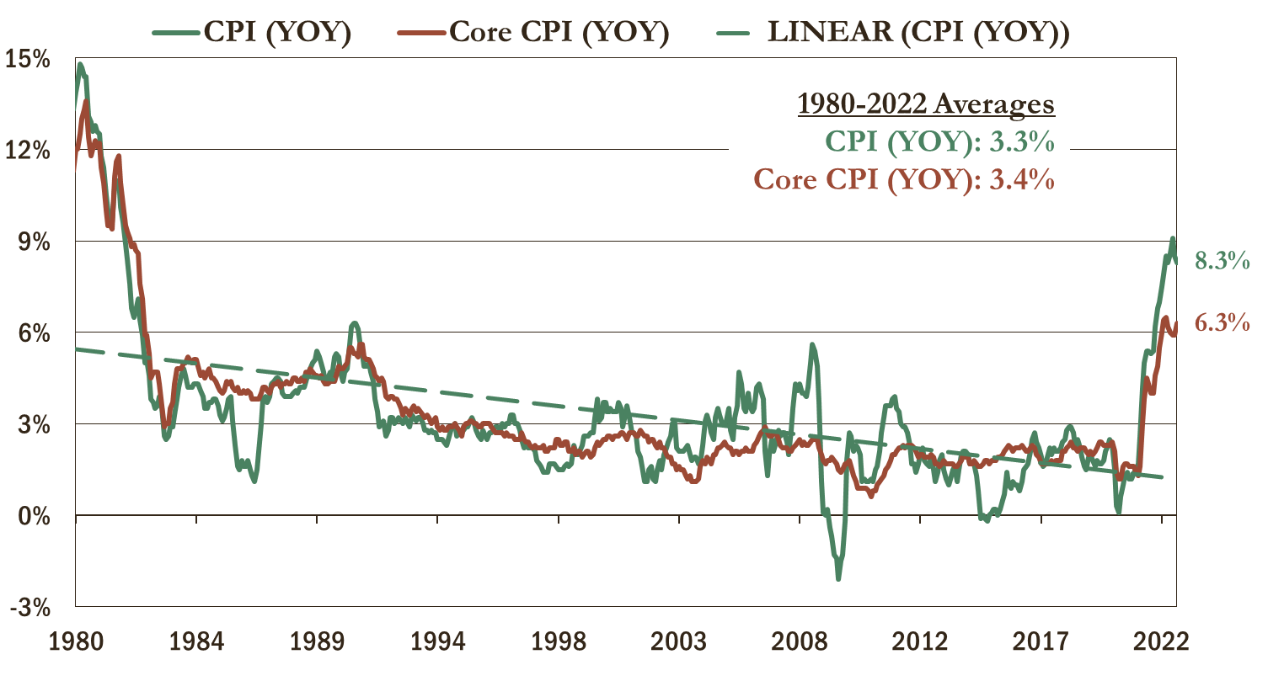
Inflation – Probably Peaked
Source: Bloomberg

Slide 14
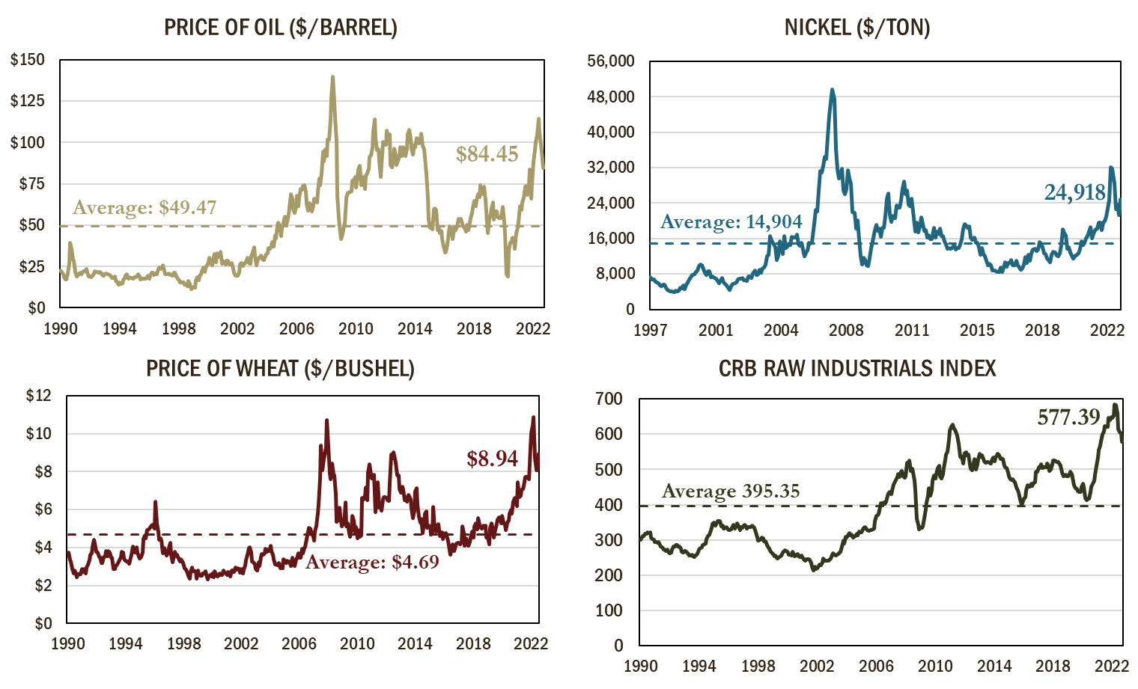
Commodity Prices Rolling Over as of 09/20/2022
Source: Bloomberg

Slide 15
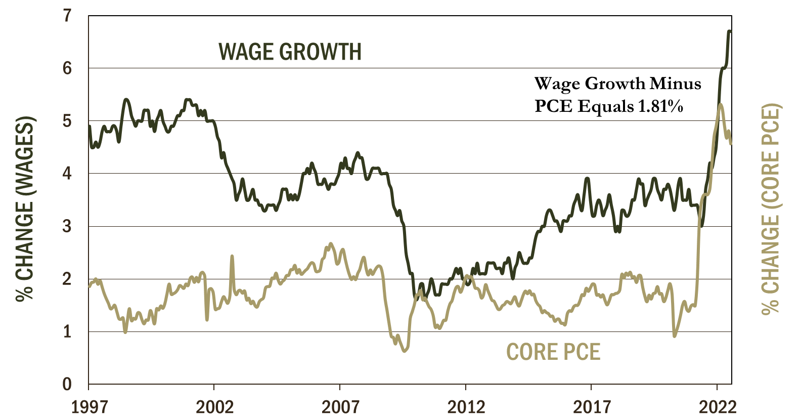
Wage Growth And Core Pce
(Inflation Tracks Wages)
Source: Bloomberg

Slide 16
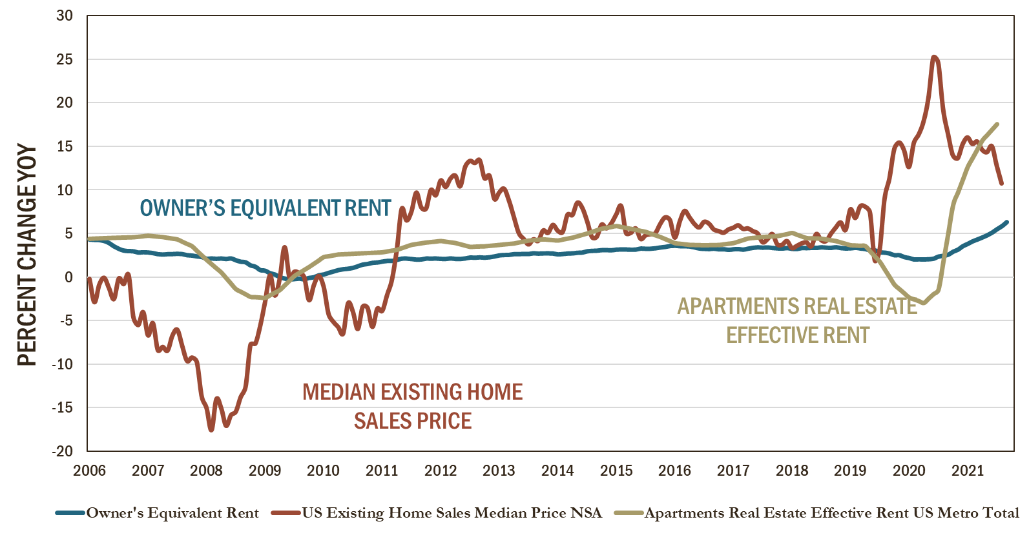
Owner’s Equivalent Rent Lags Home Prices And Forward Rents – Pushing Future Inflation Higher
Source: Bloomberg/Federal Reserve

Slide 17
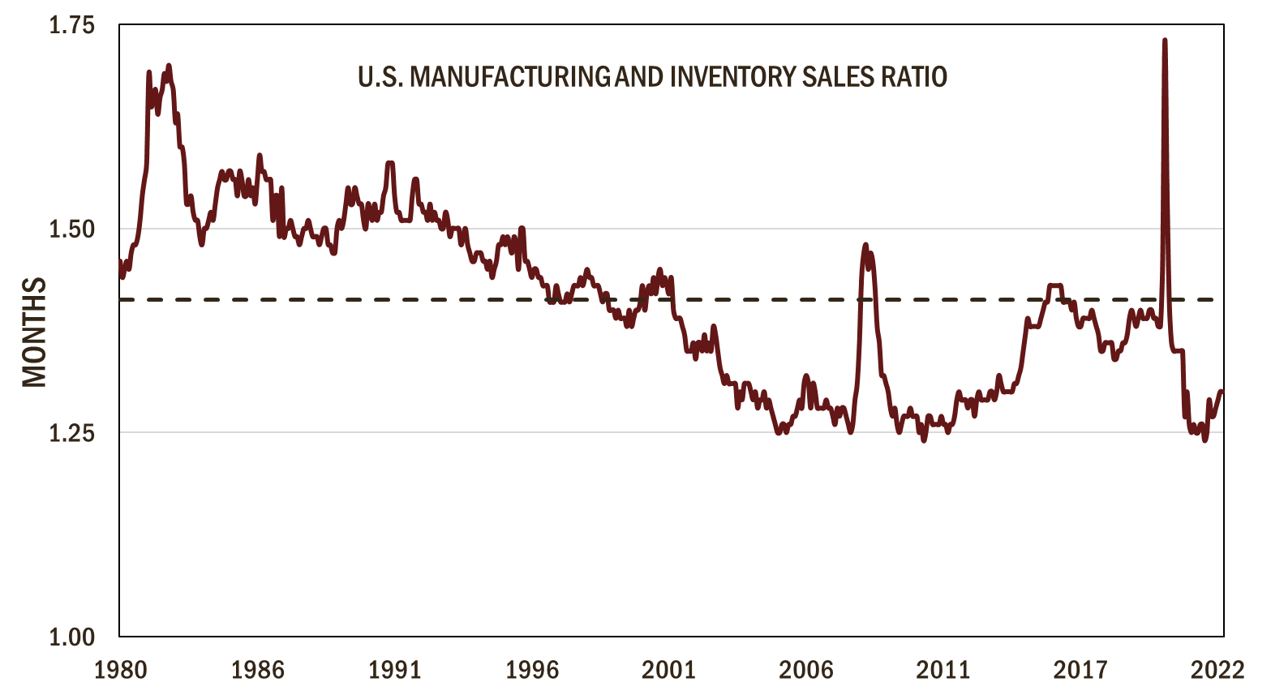
Inventories To Sales Ratio Turning Up
Source: Bloomberg

Slide 18
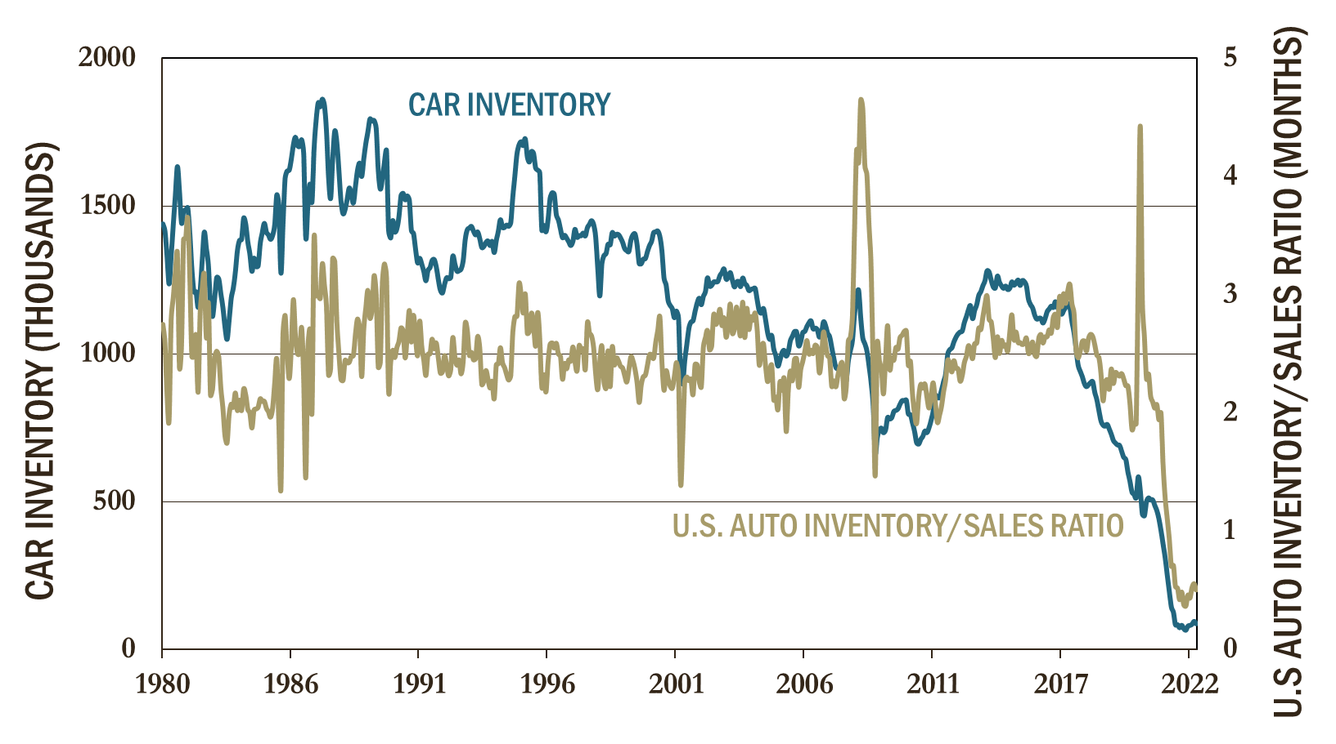
Car Inventories Still Exceptionally Low
Source: Bloomberg

Slide 19
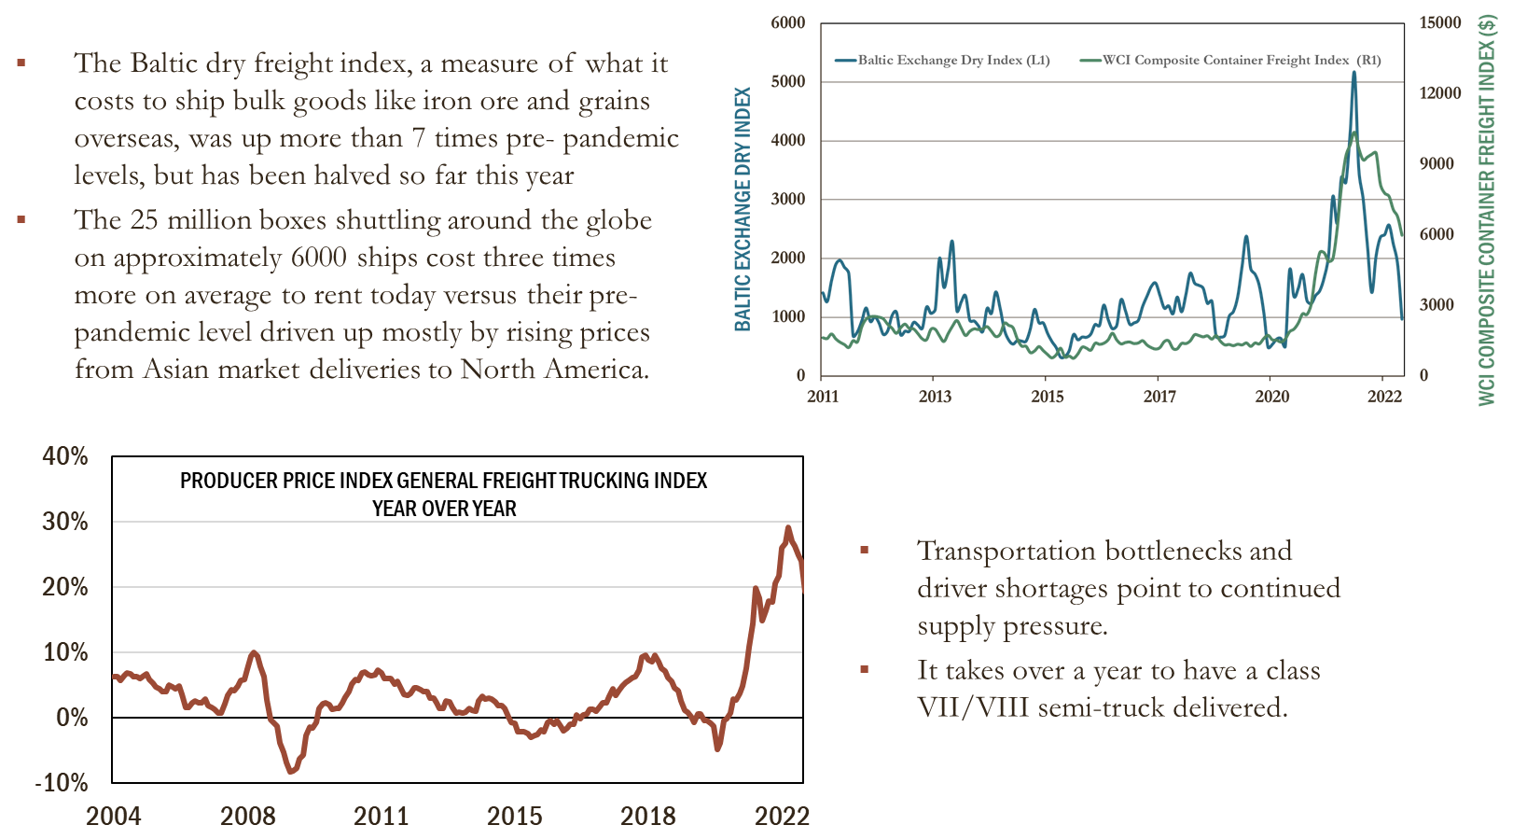
Transportation Costs Easing
Source: Bloomberg

Slide 20
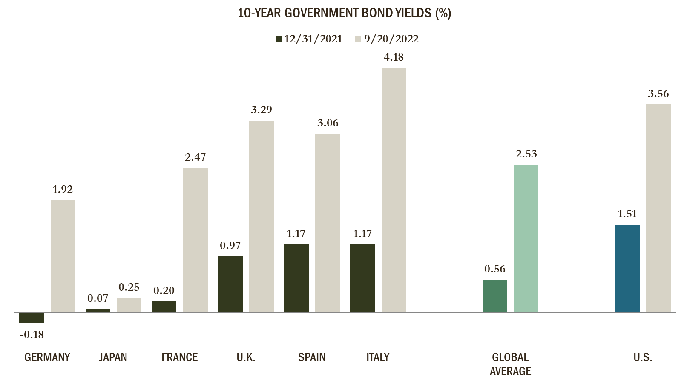
Global Government Interest Rates Have
More Than Doubled
Source: Bloomberg

Slide 21
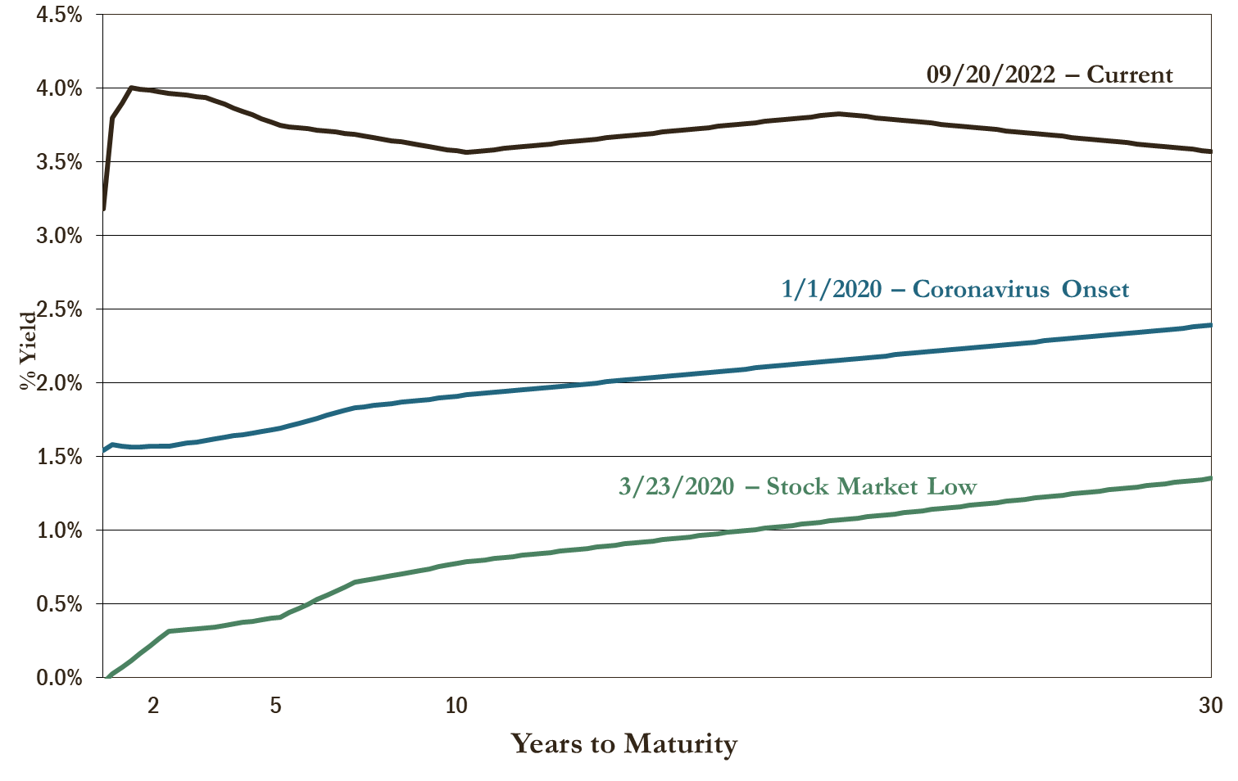
Treasury Yield Curve As Of 09/20/2022
(Average Interest Rates More Than 1% Higher Than Pre-pandemic Levels)
Source: Bloomberg

Slide 22
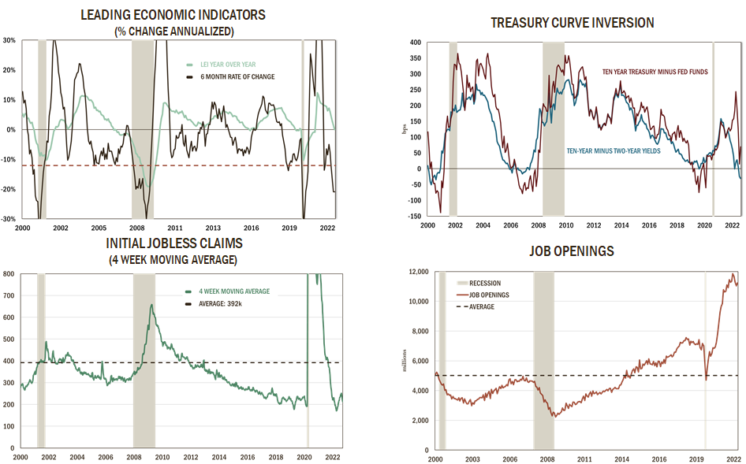
Potential Recession Indicators
Source: Bloomberg

Slide 23
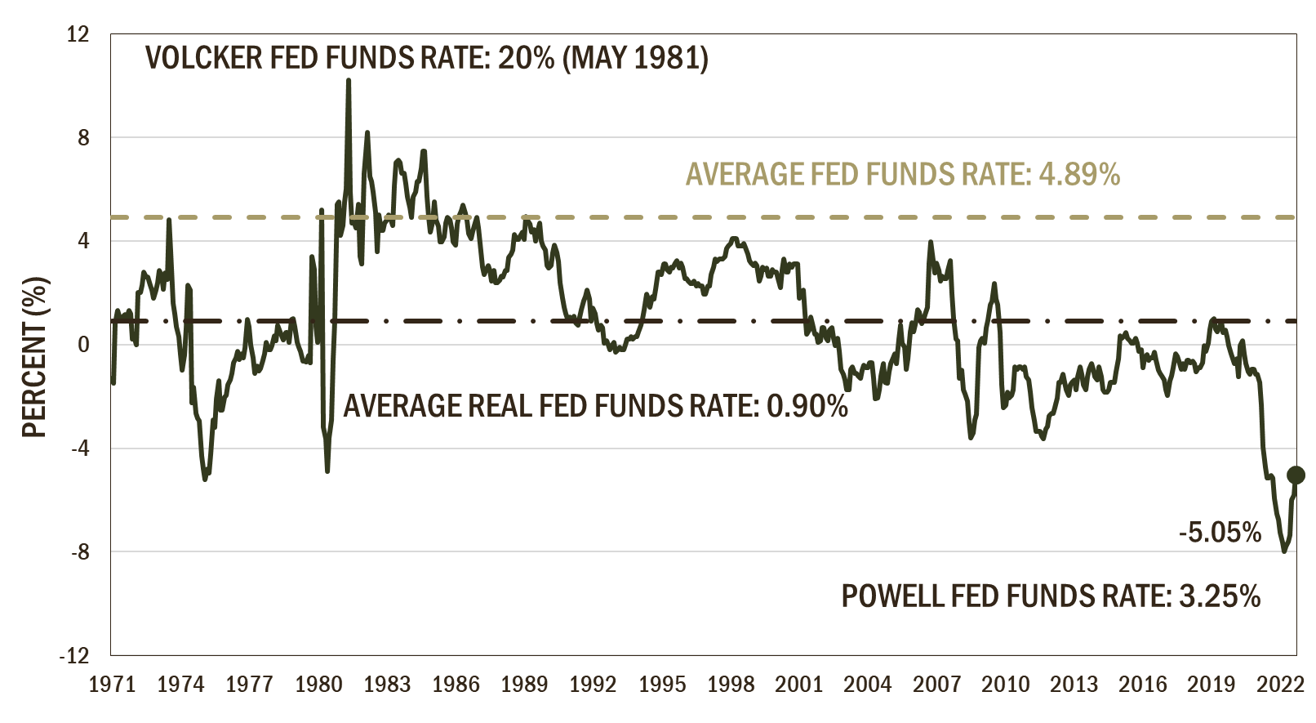
Fed Fund Rate Minus Inflation (Y-O-Y CPI)
(Federal Reserve Still More Accommodative Than They Were In The 1970’s)
Source: Bloomberg

Slide 24
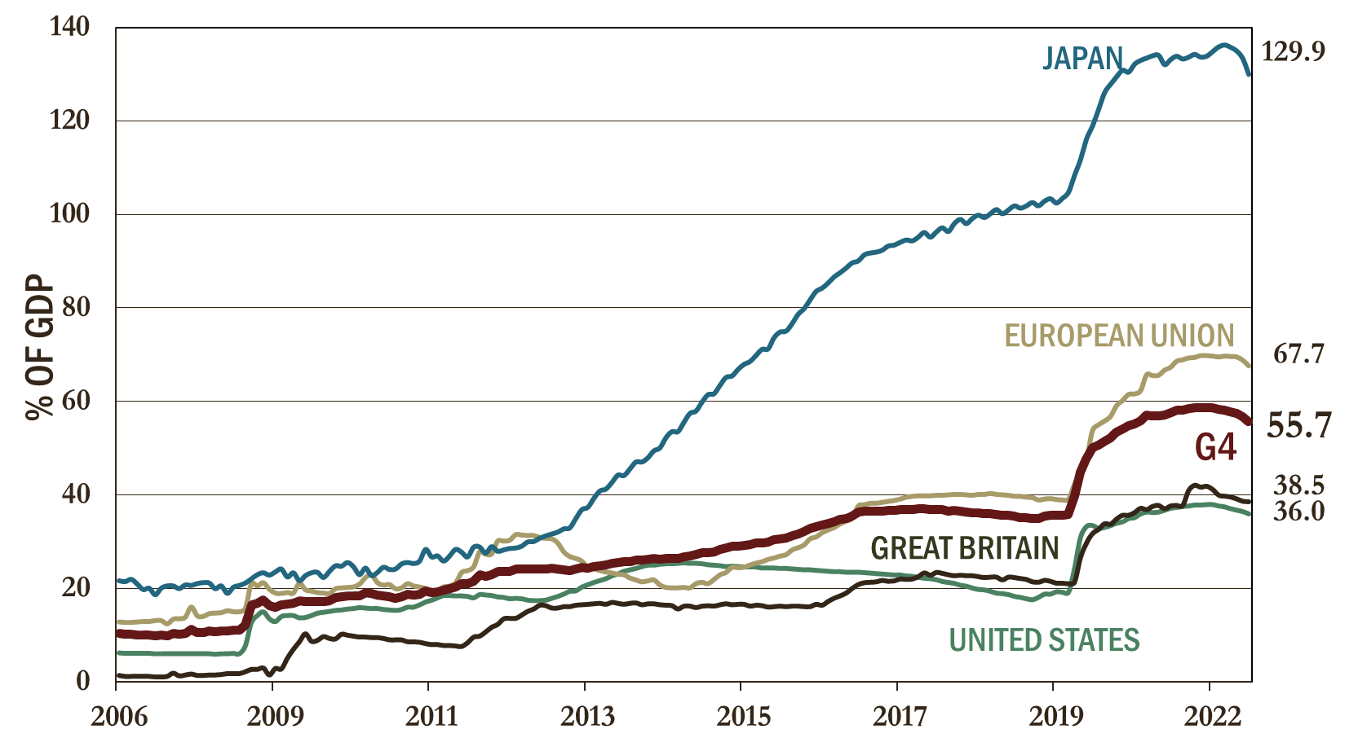
Quantitative Easing As A Percent Of GDP
Source: Bloomberg

Slide 25
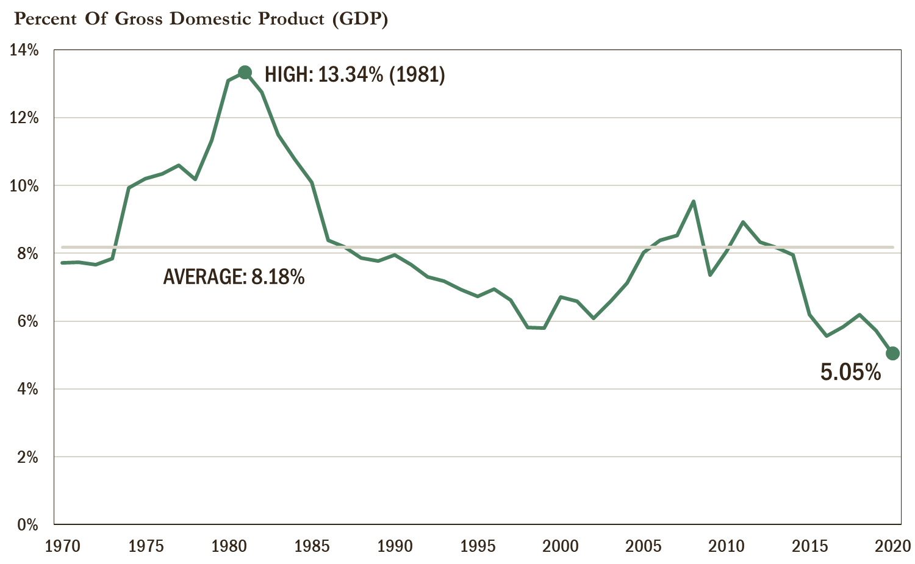
U.S. Total-End Use Energy Expenditures
(1970-2020)
Source: U.S. Energy Information Administration

Slide 26
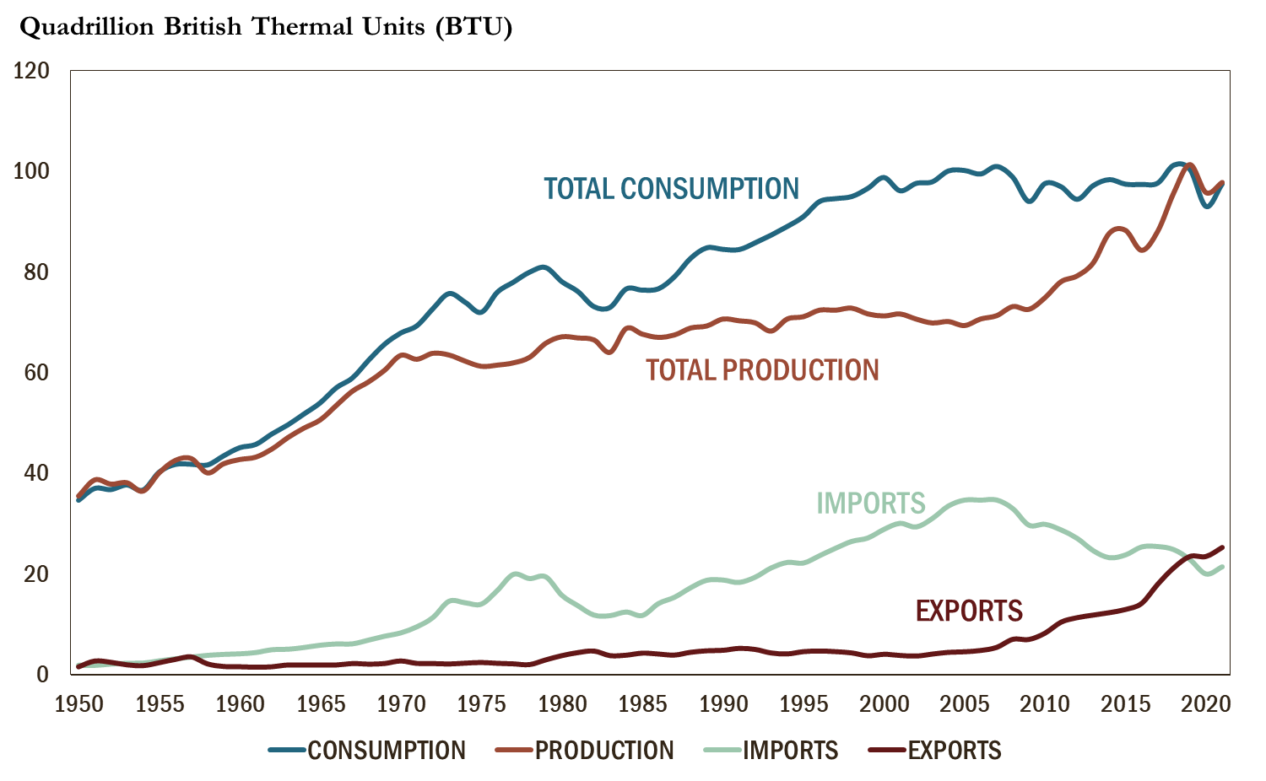
U.S. Primary Energy Overview
1950-2021
Source: Bloomberg

Slide 27
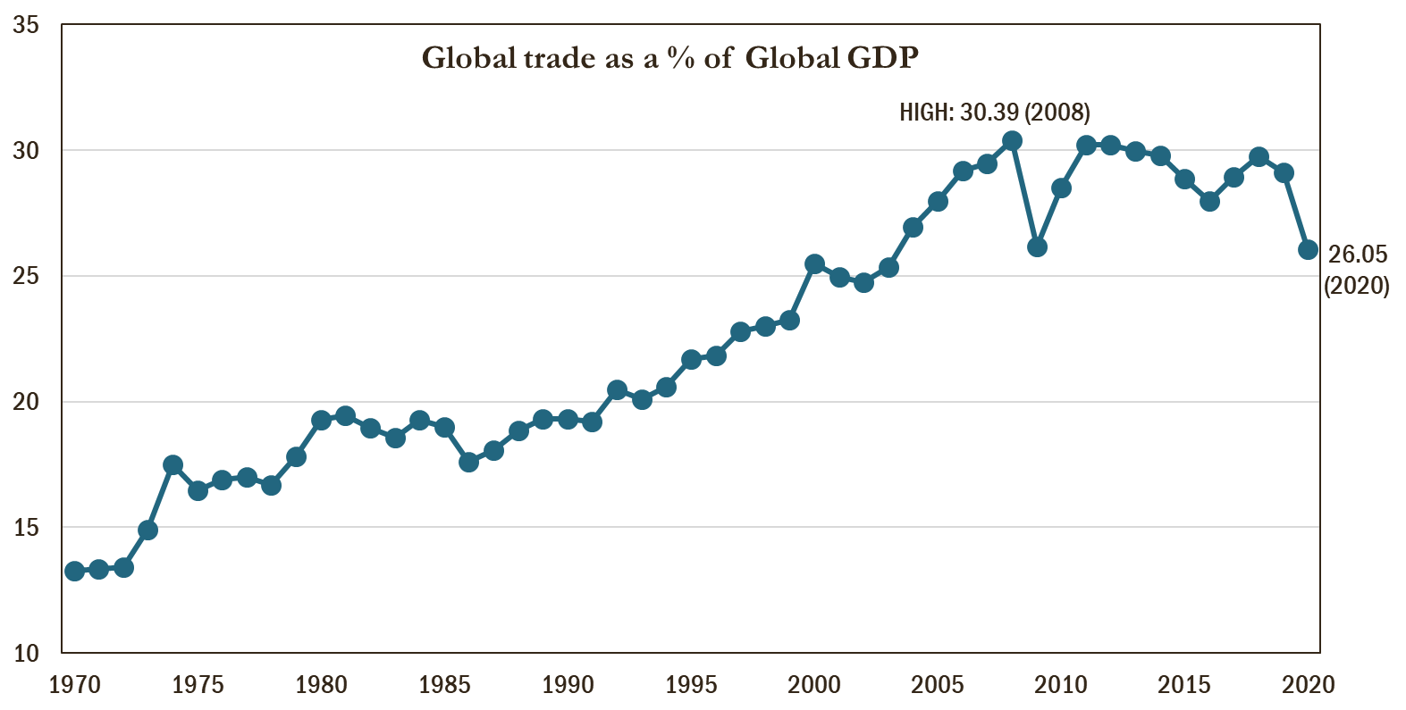
World Trade To GDP Ratio
Source: MacroTrends; World Bank

Slide 28
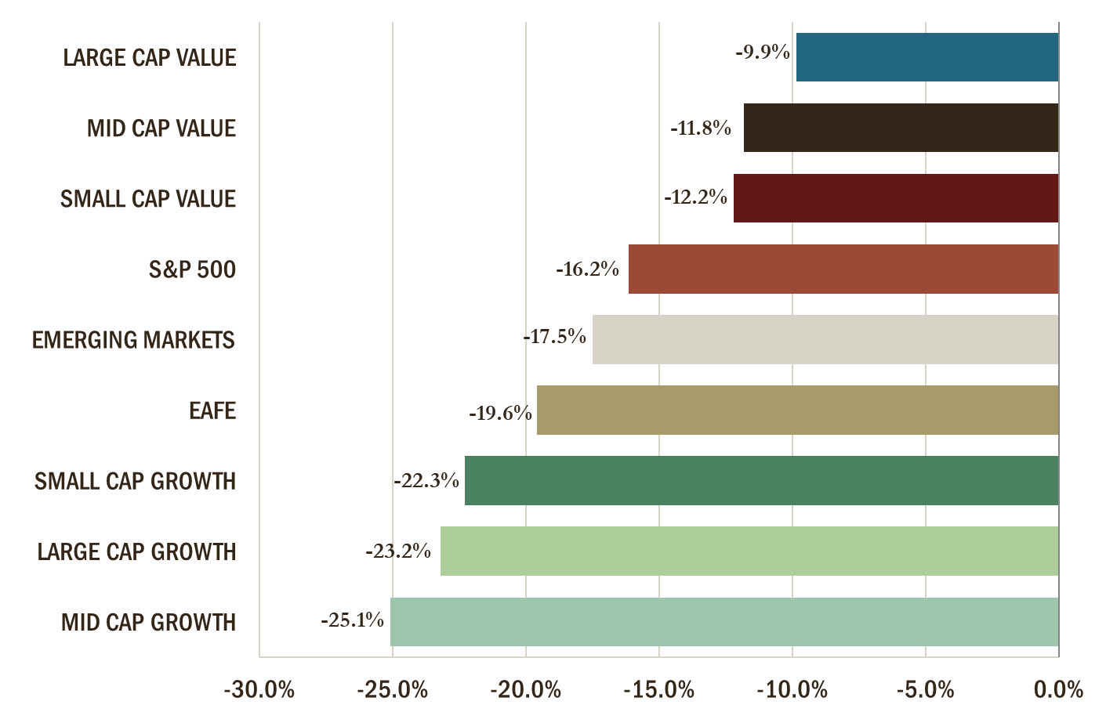
YTD Equity Returns as of 08/31/2022
Source: Bloomberg

Slide 29
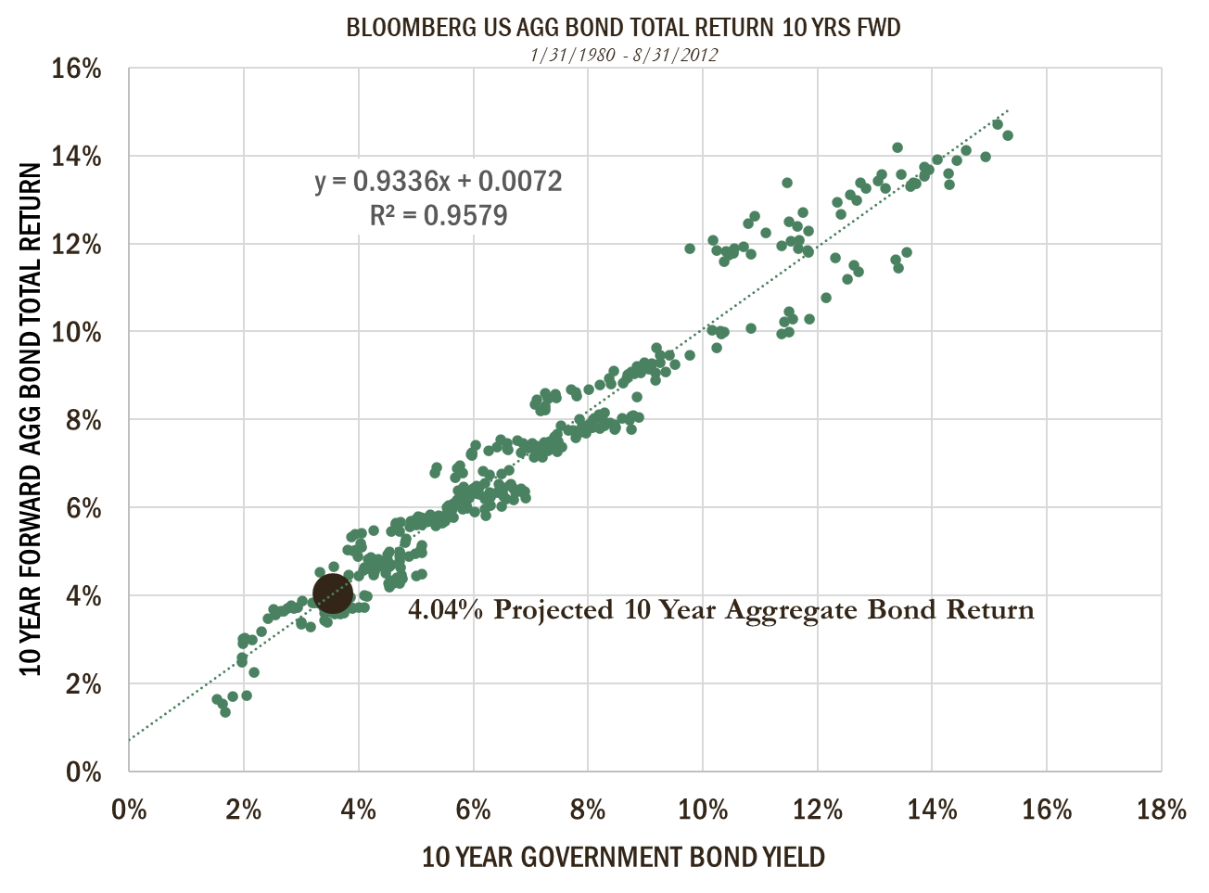
Bloomberg US Aggregate Bond Total Returns
(10 Years Forward Projection)
Source: Bloomberg

Slide 30
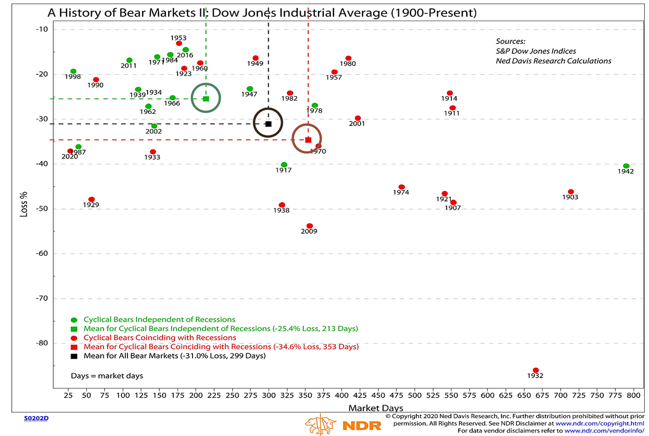
A History Of Bear Markets
Dow Jones Industrial Average (1900 – Present)

Slide 31
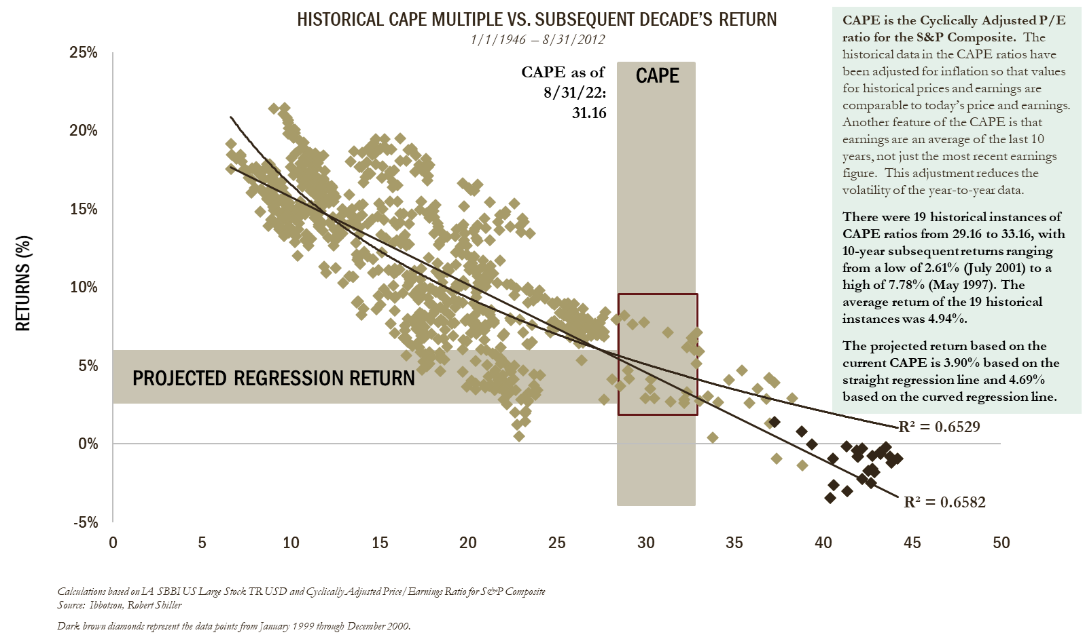
Cape Ratio & S&P 500 Index 10-Year Subsequent Annualized Return (%)

Slide 32
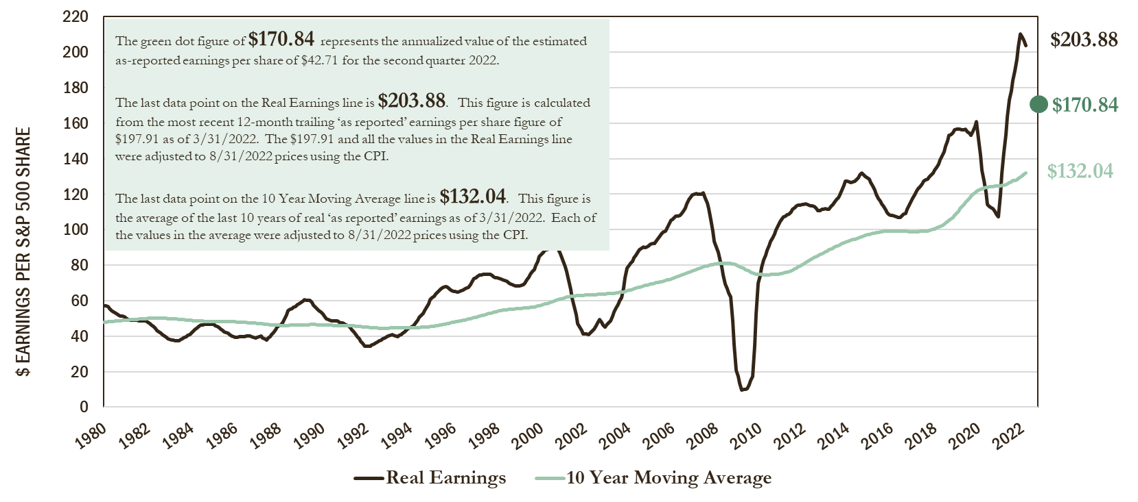
S&P 500 Real Earnings Growth And 10-Year
Moving Average (As Of 3/31/2022)
Source: Shiller Data, S&P Global website

Slide 33
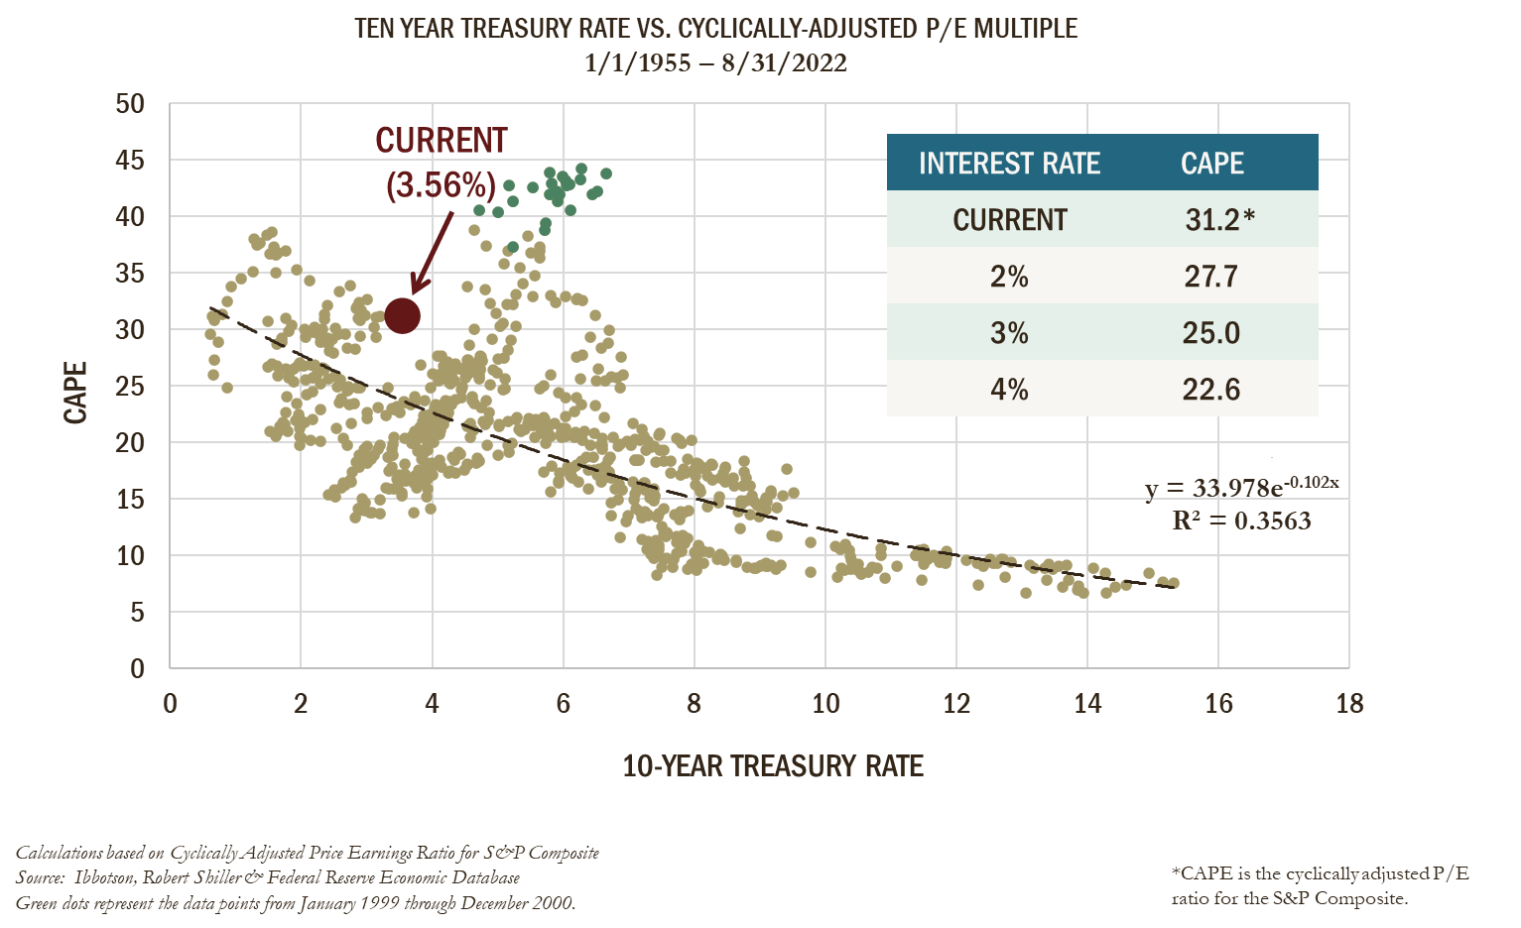
Yield Impact On P/E Multiple
(Valuation Will Compress)

Slide 34
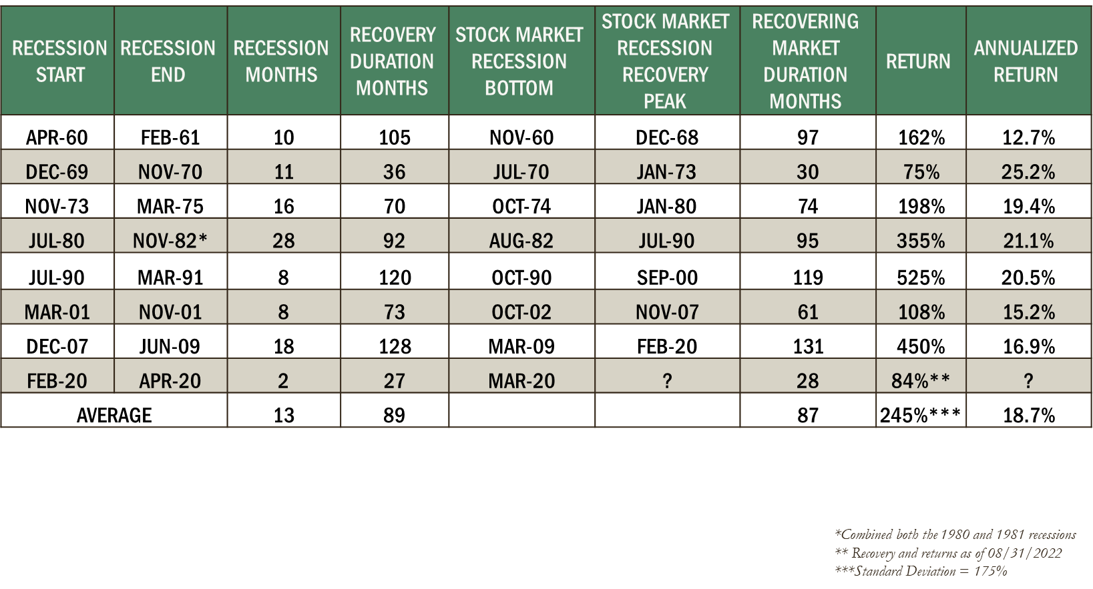
Post Recession Stock Market Returns During Economic Recoveries
Source: Commerce Trust Company

Slide 35
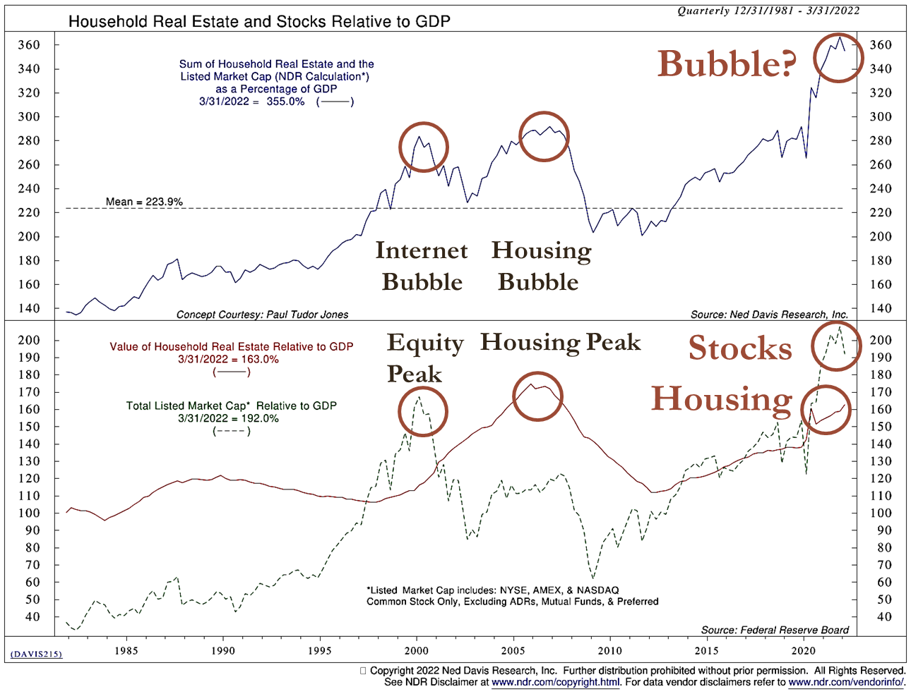
Housing And Stocks Vs. GDP (Expensive)

Slide 36
Session Password
(Must record password for CPE credit)

