Slide 1

Evaluating Your Tech Stack
For Construction Firms

Slide 2
Current State
Some ERP solutions are in legacy state - a few independent solutions exist
Movement to cloud-hosting and SaaS
Many partially or poorly implemented solutions exist
Batch-file file transfers
Is ERP still center of the universe?
Acquisition activity around tech solutions

Slide 3
What are we solving for?
I think we have forgotten to ask that question
Billing
Cost reporting
Payroll
Invoice processing
Commitments
Service management
Forecasting
Equipment charging
Inventory
Control
Risk mitigation
Efficiency
Access to information
Compliance
Not just a bookkeeping system

Slide 4

Symptomatic
Spreadsheets
Word documents
Banker boxes
Workflow through e-mail
Files on network drives
Manual processes

Slide 5
Conventional View for Construction

Slide 6
ERP Elsewhere
Scheduling
Service Management
Heavier Supply chain
End-to-end processing

Slide 7
Enterprise Architecture
ECM
Middleware
Data Warehouse and Analytics
Low-code/No Code
Mobile Strategy

Slide 8
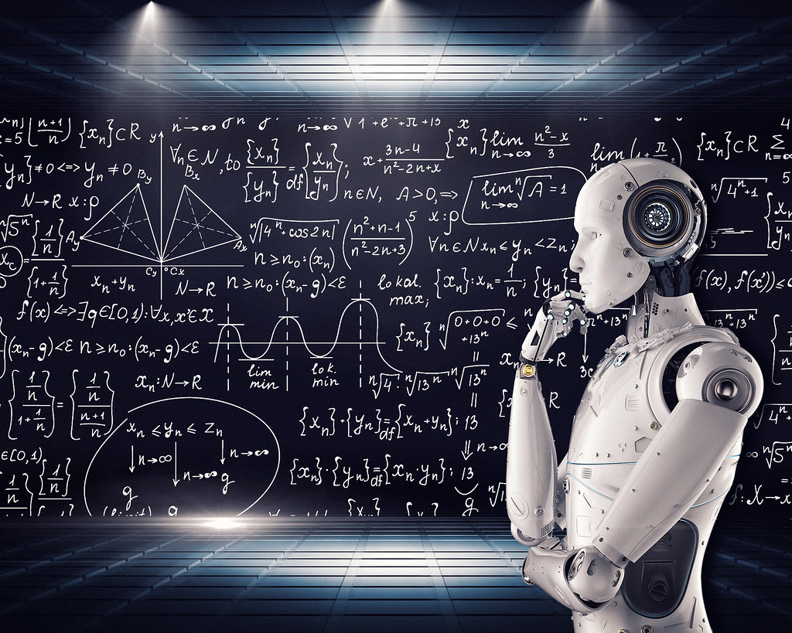
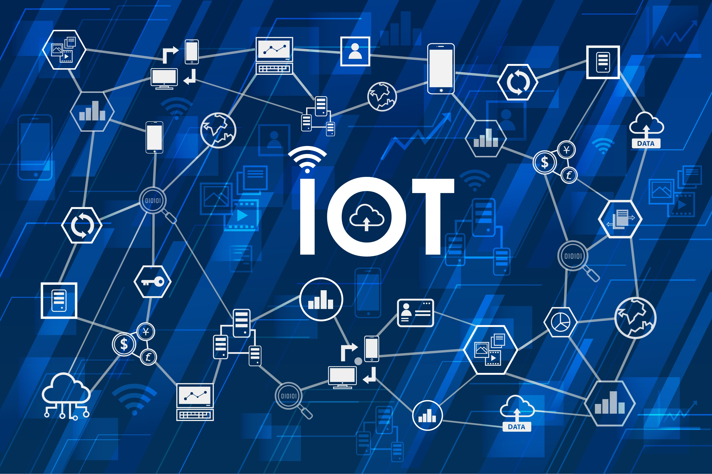
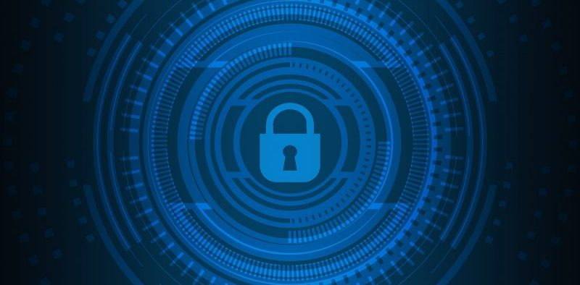
Larger ERP Advantages
API maturity, integration methodology and integration toolset
Low Code/No Code configuration tools for enhanced user experience
IoT support
AI/ML availability for enhanced analytics and process optimization
Enhanced security and authentication protocols (e.g. Identity and Access Management support, SAML)

Slide 9
Project Mgt. – Why do you care?
Cost reporting
Commitments
Contract and Billing
Change orders
Compliance

Slide 10
PM Options
Light-weight/smaller company
Owner oriented
Collaboration
File sharing

Slide 11
Other Considerations
Service Management
Fabrication
Payroll/HR
Other Considerations
  Process improvement
  Power users
  Business analyst
  Test environment

Slide 12
ERP Options
Tier 1
  Oracle
  SAP
  JDE
Tier 1.5
  Dynamics
  IFS
Tier 2
  Legacy
  Viable
  Next gen

Slide 13
IT Staffing
Highest-level IT manager
Business analyst
Power-users
LMS

Slide 14

Closing and Questions
Eliminate spreadsheets
Eliminate as much keying as possible
Treat this as one of your longer-term decisions and one with significant impact
Support the application(s)

