Slide 1
2020 CFMA CONFERENCE
WIFI Password: BRAYNTaxIncentives

Slide 2
CONSTRUCTION ANALYTICS: HOW ANALYTICS IS RELEVANT TO CONSTRUCTION AND WHERE TO BEGIN
John Killingsworth, CSU
Bruce Orr, ProNovos
Bryce Wisan, Eide Bailly

Slide 3
CONSTRUCTION ANALYTICS: LEADING CHANGE IN THE INDUSTRY
Why should I use analytics in my business?
Why CFMs are the change agents?
What are analytics?
How do I get started?
Descriptive, Diagnostic, Predictive and Prescriptive analytics, with practical examples
Why we should be using analytics, and ways to get started
How to get started, and why it is not a good idea to jump into the deep end of analytics straight away
Why CFMs are uniquely positioned to become the change agents for their companies across the country

Slide 4
DATA SOURCES AND ACTIVITIES
Accounting System
Daily Reports and Logs
Project Management Applications
GPS and Equipment Logs
Accounting
Site Management
Project Management
Communication and Collaboration
Weather Data
MS Excel
IoT Devices
Biometrics
Weather
Document Management
Equipment Usage
Labor

Slide 5
DATA SOURCES AND ACTIVITIES
Accounting System
Daily Reports and Logs
Project Management Applications
GPS and Equipment Logs
Data Silo
Data Silo
Data Silo
Data Silo
Weather Data
MS Excel
IoT Devices
Biometrics
Data Silo
Data Silo
Data Silo
Data Silo

Slide 6
HOW IT IS SUPPOSED TO WORK
GPS and Equipment Logs
Weather Data
Project Management Applications
Communication and Collaboration
Project Management
Weather
MS Excel
Daily Reports and Logs
Site Management
DATA LAKE
Document Management
Accounting
IoT Devices
Equipment Usage
Labor
Accounting System
Biometrics

Slide 7
MAKING THE CHANGE
GPS and Equipment Logs
Weather Data
Project Management Applications
Communication and Collaboration
CFM Change Agent
Project Management
Weather
MS Excel
Daily Reports and Logs
Site Management
DATA LAKE
Document Management
Accounting
IoT Devices
Equipment Usage
Labor
Accounting System
Biometrics

Slide 8
INFLUENCING PERFORMANCE MANAGEMENT
Analytics and Machine Learning
CFM Change Agent
Strategic Decision Maker
Data Warehouse
DATA LAKE
?

Slide 9
INCREASING COMPLEXITY, INCREASING VALUE
Value
Don’t start here!
04
03
Prescriptive
02
Predictive
01
Diagnostic
Descriptive
Complexity

Slide 10
INCREASING COMPLEXITY, INCREASING VALUE
Value
04
03
Prescriptive
02
Predictive
01
Diagnostic
Descriptive
The “what happened” of analytics. The shallow water of analytics and the easiest to engage in.
Complexity

Slide 11
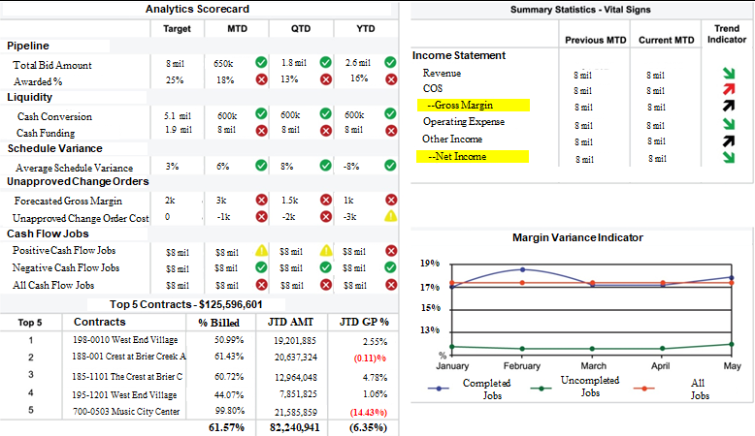
DESCRIPTIVE ANALYTICS
Answers the “What happened?” question
+
Overall profitability
Job profitability
Backlog
Labor productivity
Job cash flow
Job cost
Overhead cost
Safety record
Equipment maintenance
Idle time
+
+
+
+
+
+
+
+
+

Slide 12
INCREASING COMPLEXITY, INCREASING VALUE
Value
04
03
Prescriptive
02
Predictive
01
Diagnostic
Descriptive
The “Why did it happen” of analytics. This process works to associate, or correlate variables in the data.
Complexity

Slide 13
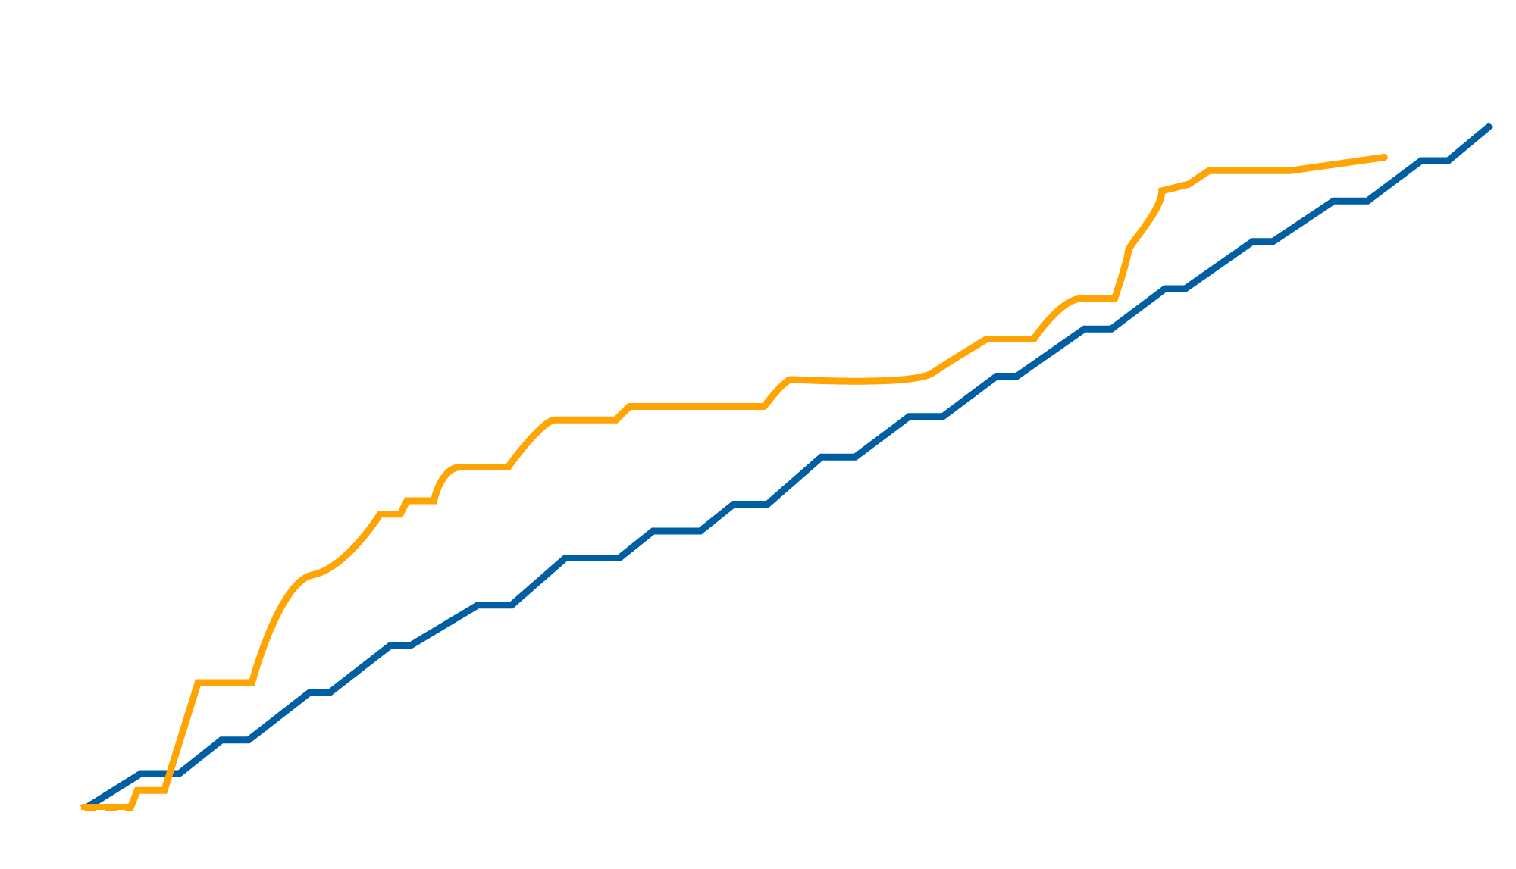
DIAGNOSTIC ANALYTICS
Answers the “Why did it happen?” question
Exterior Framing, sq. feet
+
Budget vs. Actual
Estimating issue
Labor efficiency issue
Scope creep
Problems with plans
Unexpected site conditions
Difficult inspector
Inability to convert change orders
Claims
+
+
+
+
+
+
+
+

Slide 14
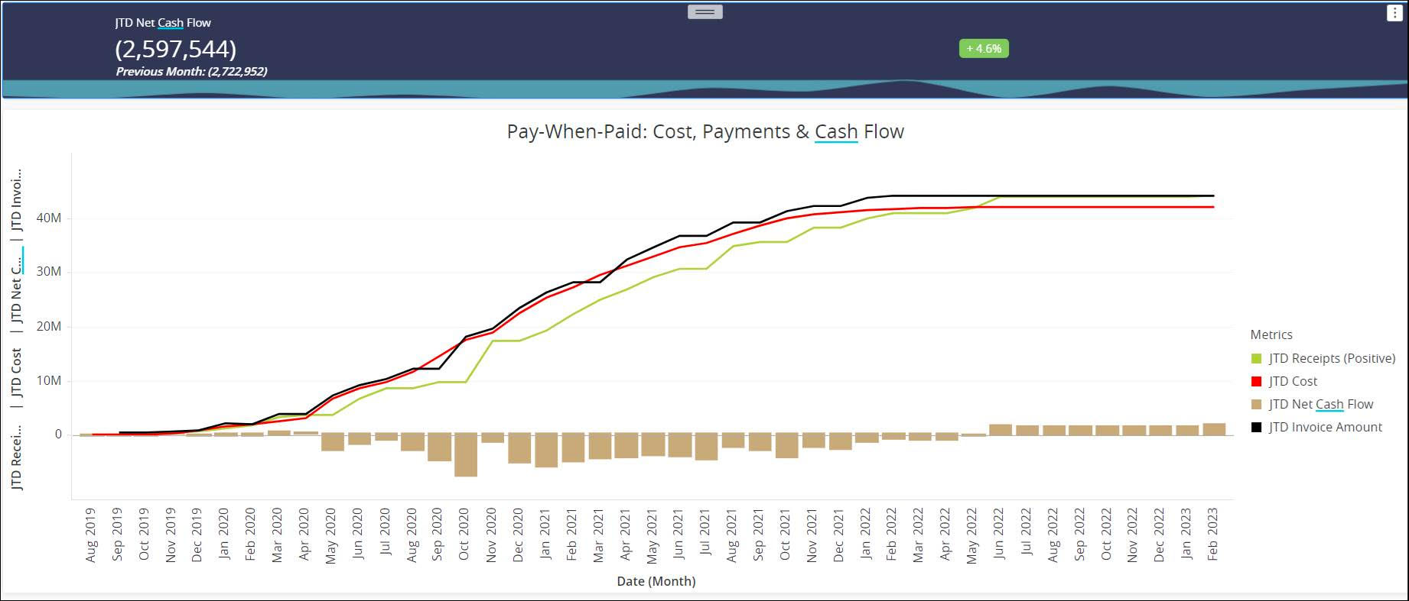
DIAGNOSTIC ANALYTICS
Answers the “Why did it happen?” question
+
Budget vs. Actual
Estimating issue
Labor efficiency issue
Scope creep
Problems with plans
Unexpected site conditions
Difficult inspector
Inability to convert change orders
Claims
+
+
+
+
+
+
+
+

Slide 15
INCREASING COMPLEXITY, INCREASING VALUE
Value
04
03
Prescriptive
02
Predictive
Diagnostic
Answers the “What will happen?” question.
01
Descriptive
Complexity

Slide 16
PREDICTIVE ANALYTICS
Answers the “What will happen?” question
+
Will this project be profitable?
Is this project in trouble?
Is this subcontractor bid reasonable?
To bid or not to bid
Buy vs. rent equipment
Scheduling of phases/subs
Sufficiency of labor
Cash flow projections
Working capital analysis
+
Historical Data, Statistics, and Trend Analysis
+
+
+
+
+
“Predict” the probability of future events
+
+

Slide 17
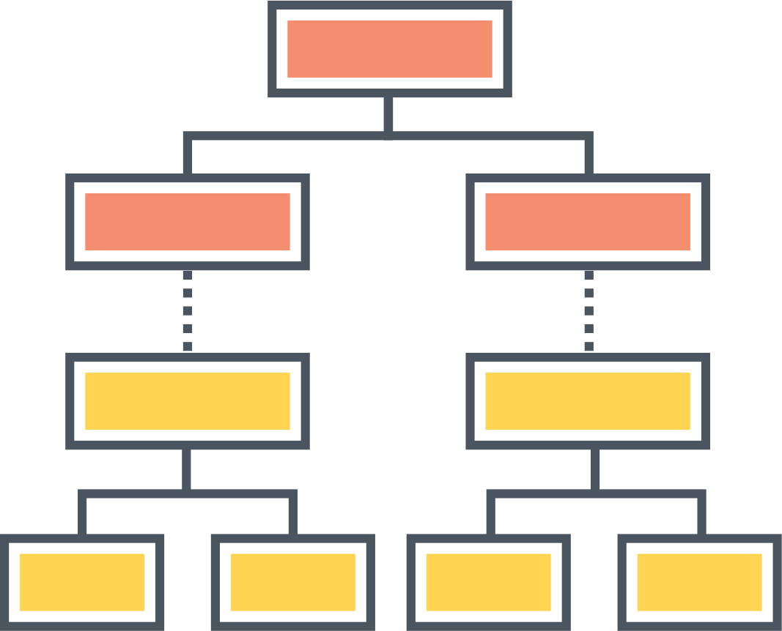
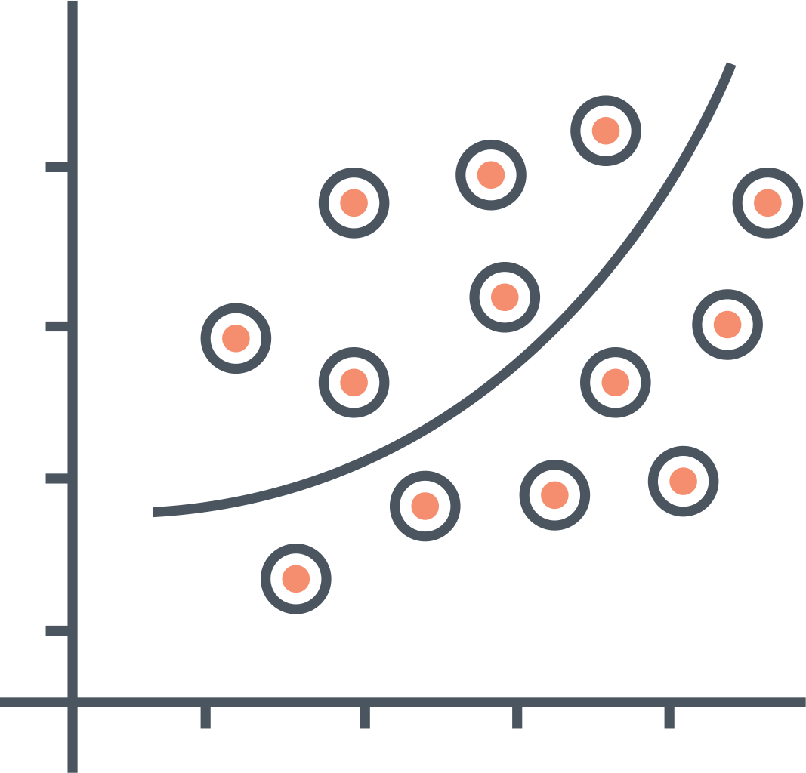
PREDICTIVE ANALYTICS: APPLICATION FOR ACCOUNTS RECEIVABLE
Decision Tree
+
Regression Report
Customer Behavior Trends
+
What will our DSO look like in 3 months?
Portfolio
Mix
+
What will our cash flow look like in 3 months?
+
Which customers will continue to fall behind and how far?
COLLECTIONS STRATEGY
+
How will this impact working capital?
Disputes and Relationships

Slide 18
KEY DRIVERS FOR EFFECTIVE ACCOUNTS RECEIVABLES
Parameters | Key Metric | Level 1 | Level 2 | Level 3 | Level 4 | Level 5
Cost | AR Cost as a % of revenue | >1% | >0.5% and <1% | >0.1% and <0.5% | >0.047% and <1% | <0.047%
 | AR Cost as a % of overdue | >1.75% | >1.5% and <1.75% | >1.25% and <1.5% | >.098% and <1.25% | <0.98%
Efficiency | # of FTE per million dollars of revenue | >20 | >15 and <20 | >12 and <15 | >7 and <11 | <7
 | # of credit customers per FTE | <100 | >100 and <321 | >321 and <542 | >542 and <763 | >763
 | AR Turnover Ratio (ART) | REL | REL | REL | REL | REL
Effectiveness | Gross overdue as a % of revenue | >30% | >23% and <30% | >16% and <23% | >10% and <16% | <10%
 | Collective Effectiveness Index (CEI) | REL | REL | REL | REL | REL

Slide 19
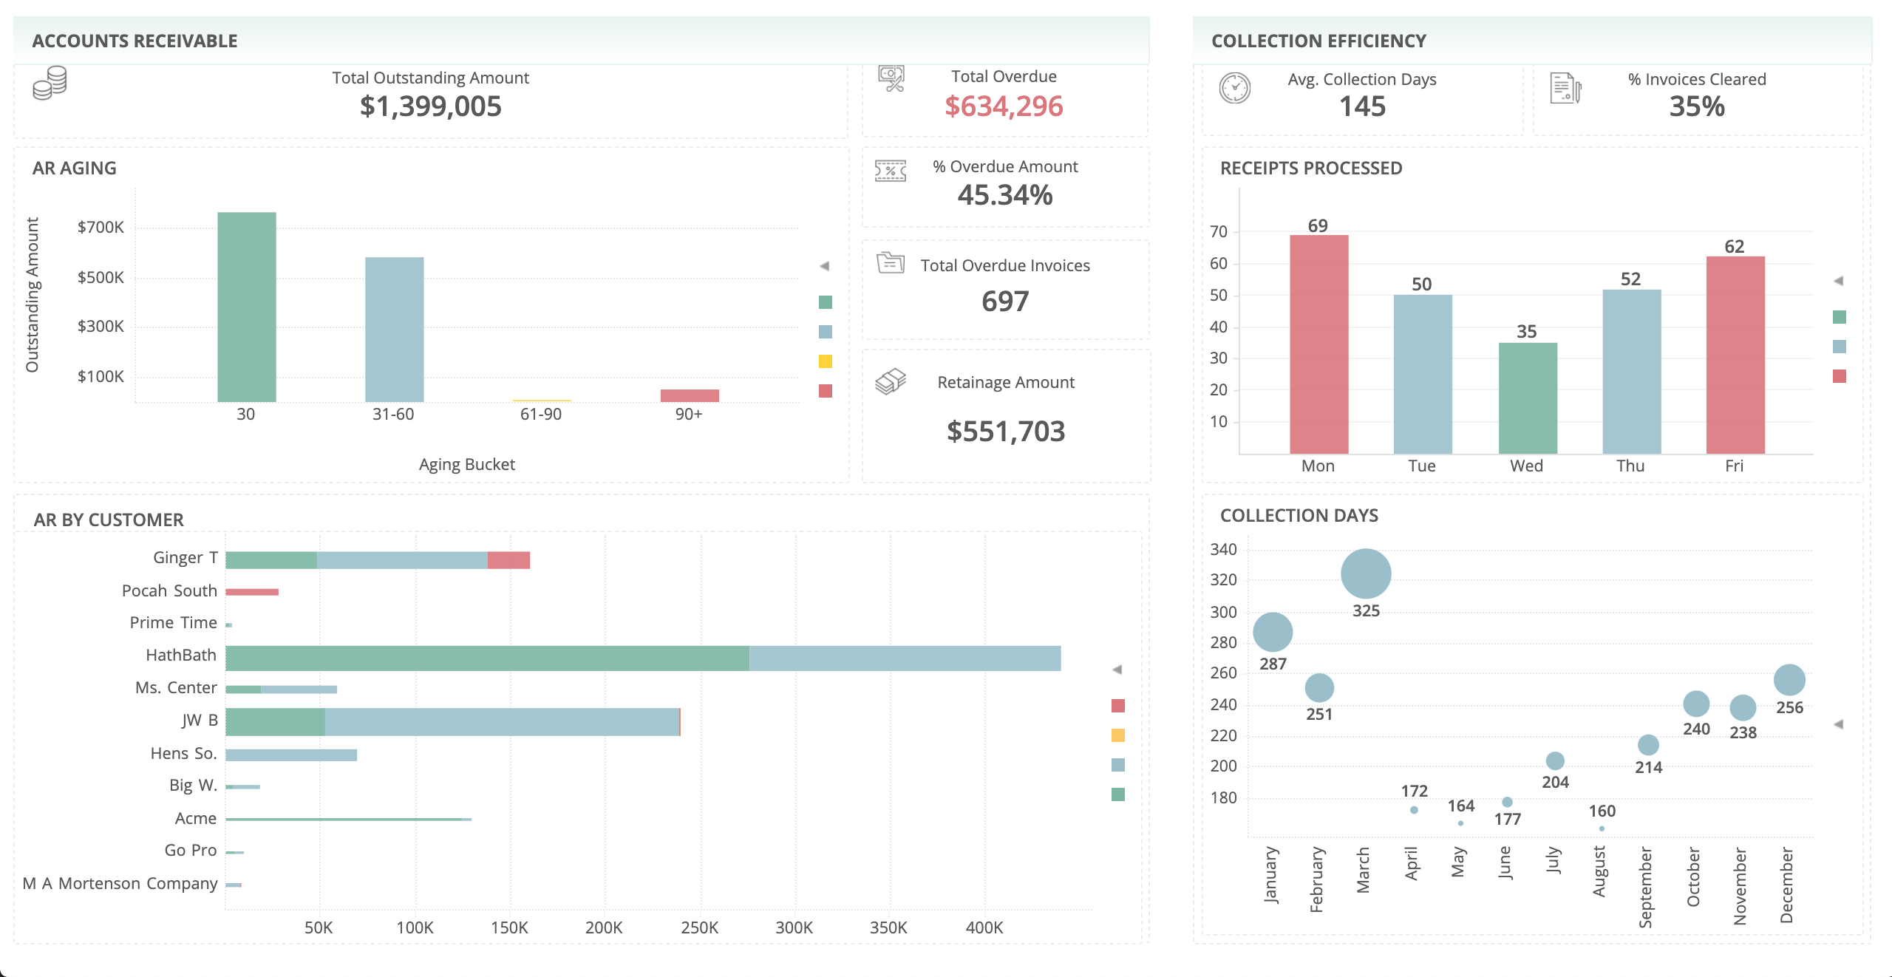
ACCOUNTS RECEIVABLE AND COLLECTIONS DASHBOARD

Slide 20
INCREASING COMPLEXITY, INCREASING VALUE
Value
04
03
Prescriptive
Predictive
Answers the “How can we make it happen?” question.
02
01
Diagnostic
Descriptive
Complexity

Slide 21
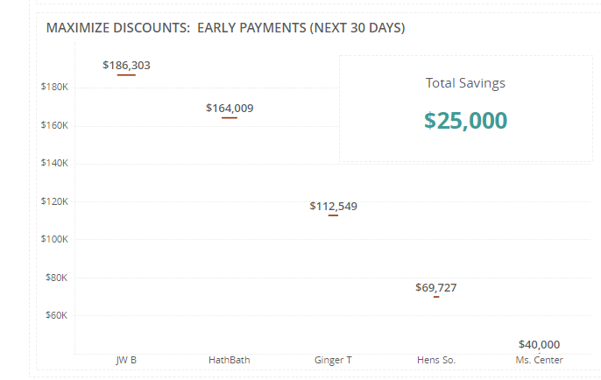
PRESCRIPTIVE ANALYTICS
Answers the “How can we make it happen?” question
+
Modeling to anticipate and prevent reconstruction
Optimize AP for greater cash position
Negotiate better payment terms
Subcontractor risk analysis
Identify ideal discount opportunities
+
+
+
+

Slide 22
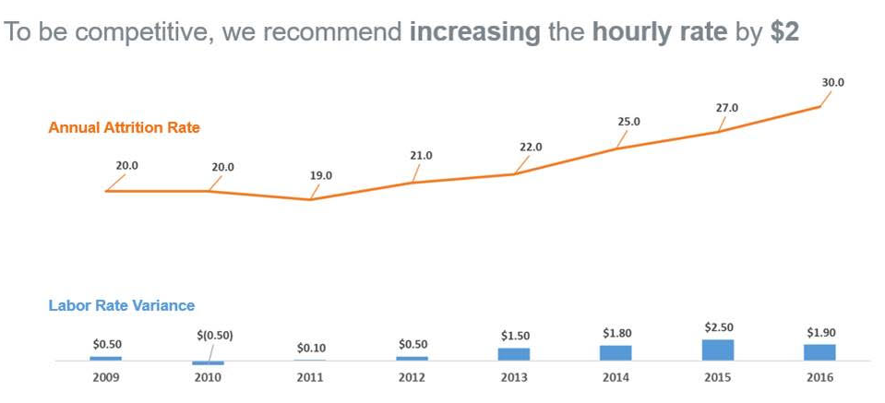
PRESCRIPTIVE ANALYTICS
Answers the “How can we make it happen?” question
+
Ideal pay compensation
Evaluate scheduling options
Rebalancing project teams
Self-perform vs. sub
Optimization of equipment utilization & levels
Optimization of staffing
Optimization of project portfolio
+
+
+
+
+
+

Slide 23
RECAP
+
Current State of the Industry
What the analytics model should look like
Maturity Model
Four Types of Analytics
+
+
+

Slide 24
WHERE TO BEGIN
+
CFM/Owner starts conversation about becoming a data company (not typically driven by IT)
+
Identify key stakeholders and develop consensus for project owners, CFMs, operations leadership, IT
+
Identify necessary advisors—most contractors use an outside consultant for data analytics services (not typically an in-house solution)
+
Agree on the opportunity or the business problem analytics is to address (know thyself)
Craft workplan with advisors and stakeholders
+

Slide 25

CFMs ARE THE CHANGE AGENTS
+
Vision
Experience
Independence
+
+

Slide 26




BRUCE ORR
bruce.orr@pronovos.com
BRYCE WISAN
bwisan@eidebailly.com
JOHN KILLINGSWORTH
j.Killingsworth@colostate.edu

Slide 27
Session Password
(Must record password for CPE credit)

