Slide 1
2020 CFMA Conference
WIFI Password: BRAYNTaxIncentives

Slide 2

Leading Through the Storm
Tina Nazier, MBA, CPC
Director, Strategic Advisory Services

Slide 3
Agenda
Welcome and Introductions
Critical Leadership Competencies for Tough Times
Evolving Your Strategy
Embracing the Change
Developing an Implementation Structure
Key Takeaways

Slide 4
Welcome and Introductions
“What’s the use of running if you are
not on the right road?”
– German proverb

Slide 5

Your presenter
Tina Nazier
Director, Strategic Advisory Services
Wipfli’s Construction and Real Estate Organizational Performance and Strategy Leader
Over 25 years experience in strategy, leadership, professional coaching, culture, change and performance management
Guiding innovative transformation and strategy execution to drive results

Slide 6
Critical Leadership
Competencies for Tough Times

Slide 7
Top 5 Leadership Development Trends for 2020
Forbes January, 2020
Applying and Sustaining Behaviors
Mobile Learning
Group Coaching
Alignment to Engagement Survey
AI Becomes Invisible
Notes:
1. spend as much time helping people sustain new knowledge and behaviors as they do helping those leaders acquire new knowledge and behaviors. Behavioral nudges are moving from the world of social psychology into everyday use by companies, governments, and other organizations. This might include nudges:
Reminding new managers to review weekly task lists and delegate to team members.
Prompting middle managers to practice inclusion in their meetings.
Encouraging senior executives to schedule time for strategic thinking.
2. Surveys from a variety of sources show that millennial managers value learning and growth experiences more than previous generations. They are also three times more likely than Baby Boomers to take responsibility for their own re-skilling, according to Upwork’s Future Workforce Report. They expect mobile access anywhere, anytime.
3. In this new decade, everyone needs to be a leader who actively engages their people. Awareness of this will see leadership development pushed down through the organization, and coaching will become a standard part of every manager’s experience. Use one coach for every 10 managers. AI powered coach bots and hyper-personalized nudges from companies like LEADx, Butterfly.ai, Qstream, and others.
4. Gallup research has shown that 70% of the variance in employee engagement ties back to the manager. People join a company, but they leave their boss. One reason? What is taught in leadership development academies and included in leadership competency models is often very different than what is measured in employee engagement surveys. Employee experience and employee engagement are hotter than ever before. While most of the emphasis has been on measurement, leadership development professionals must also now realize that changing managerial behaviors is the best way to move the needle on survey outcomes. In the book Knowing-Doing Gap, Pfeffer and Sutton use Intuit as an example of a firm that uses its engagement survey as more than a metric generator. "The measurement, nothing more than an employee survey, but one that is taken very seriously, affords a way of focusing managerial effort on those dimensions of the culture that most need attention at a given moment.”
5. With AI, leaders will be offered hyper-personalized content based on the manager’s personality, competencies, and objectives. As it does for Netflix, Amazon, and Spotify, AI can present targeted information in a learning management or nudge system.
AI is also going to support leadership development directors in gaining the respect of other senior leaders. The cold hard truth is those with the seats at the table can talk in numbers. With AI technology, leadership development can increase its use of dashboards and correlation matrices. More telling than the number of workshop participants or the latest smile sheet survey ratings, metrics in 2020 will quantify:
How many people are ready to move into leadership
How many people are ready to advance from front line to middle manager
Which training courses correlate to higher engagement scores
Which leadership development experiences correlate to faster promotions
Performance review rankings

Slide 8
How will this impact you as a leader?

Slide 9
Polling question
What is the top leadership competency getting you through these turbulent times?
  Resiliency
  Collaboration
  Strategic Focus
  Other

Slide 10
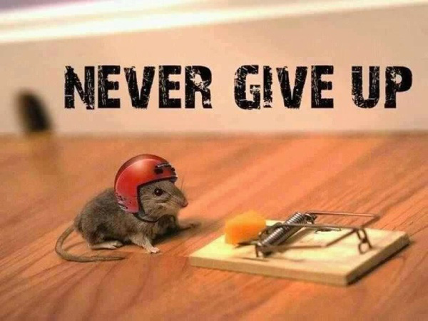
Perseverance

Slide 11

Adaptable change orientation
Notes:
Digitally proficient,

Slide 12
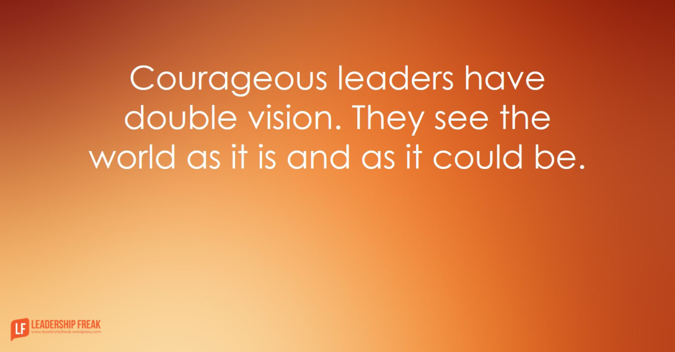
Courage
Notes:
Digitally proficient,

Slide 13
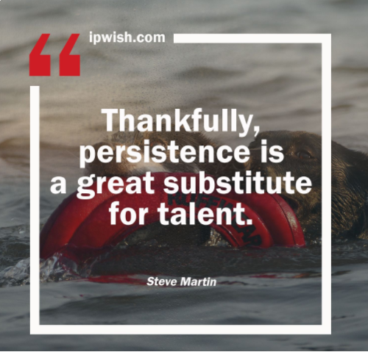
Persistence

Slide 14

Cultural agility

Slide 15
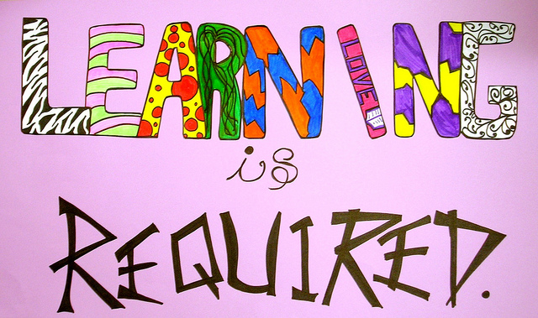
Learning agility

Slide 16

Collaborative developer of people

Slide 17
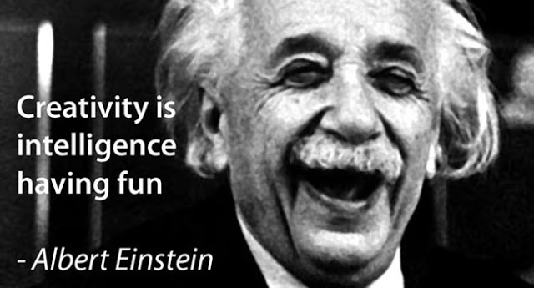
Innovative creative champion

Slide 18
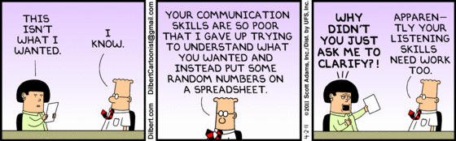
360 communicator

Slide 19
On a scale of 1-3 where 3 owns it, 2 sometimes, and 1 is not there, rate yourself on:
Perseverance
Adaptable Change Orientation
Courage
Persistence
Cultural Agility
Learning Agility
Collaborative Developer of People
Innovative Creative Champion
360 Communicator

Slide 20
Evolving Your Strategy
The “Critical Few” Priorities
“The essence of strategy is choosing what not to do.”
– Michael Porter

Slide 21
Agile planning
Agile planning is an iterative process of planning actions for short-term period, usually 1-3 weeks, and reevaluating as details become clearer. This method helps prioritize actions and offers flexibility to quickly adjust as new information becomes available. It also helps take the focus off “perfection” and onto delivering the best possible options for the given time.
Evaluate
Execute
Evaluate
Execute
Plan
Plan
Plan

Slide 22

Agility is for trends you don’t see.

Slide 23
Polling question
How much has your strategy changed in the last 6 months?
Not at all
Somewhat
Complete shift in a new direction

Slide 24
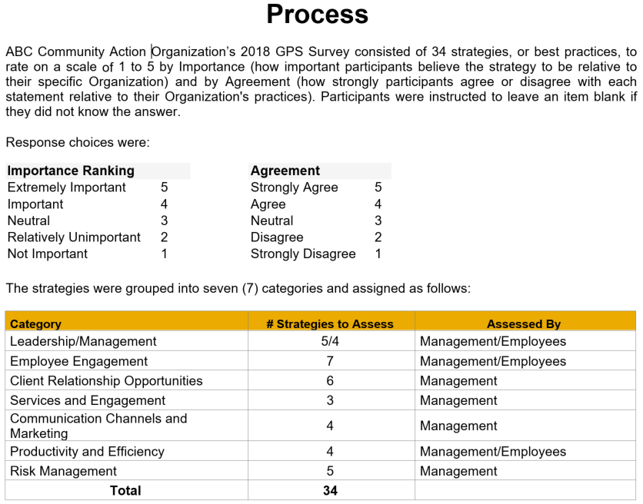
What’s going on? Take the Pulse…

Slide 25
Who do you serve?

Slide 26
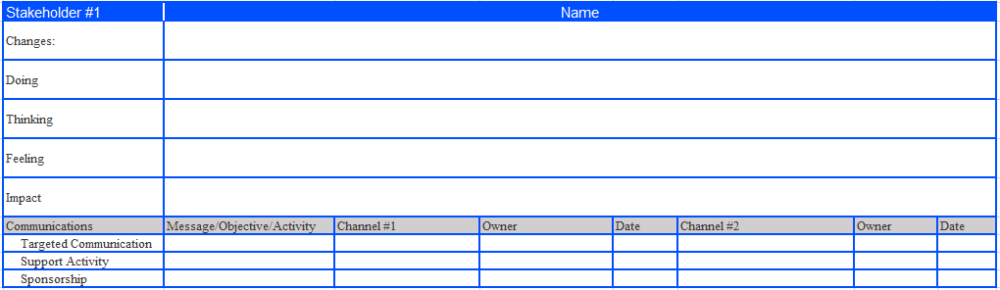
Develop stakeholder analysis

Slide 27
SWOT Analysis – Rapid fire, engaging all
Strengths (Leverage) Internal | Weaknesses (Improve) Internal | Opportunities (Capitalize) External | Threats (Minimize) External

Slide 28
How can you maximize your strengths and opportunities and address your weaknesses and threats?

Slide 29
High impact for those you serve
Strong urgency
Greatest potential for short and long- term outcomes
Quick traction to engage the team
Identify the “Critical Few”

Slide 30
Now, where, how
What do we need to focus on now?
Where do we need to focus?
How do we need to focus?

Slide 31
Scenario planning
Best Case Scenario
Most Likely Scenario
Worst Case Scenario

Slide 32
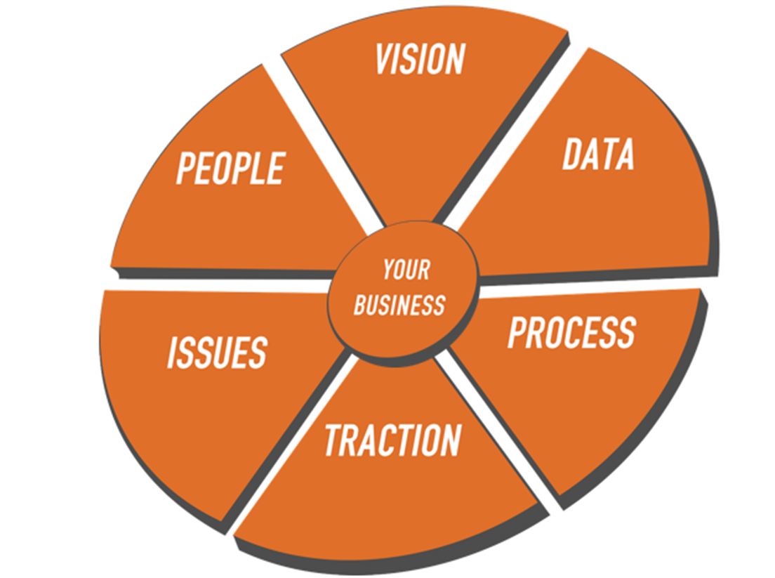
Entrepreneurial Operating System (EOS) Model
Six Key Components
Strengthen all six
Goal 100% Strong
Most organizations
are operating at 20-40%

Slide 33
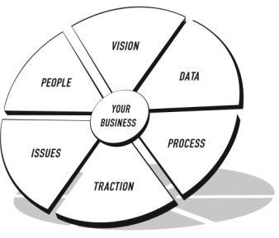
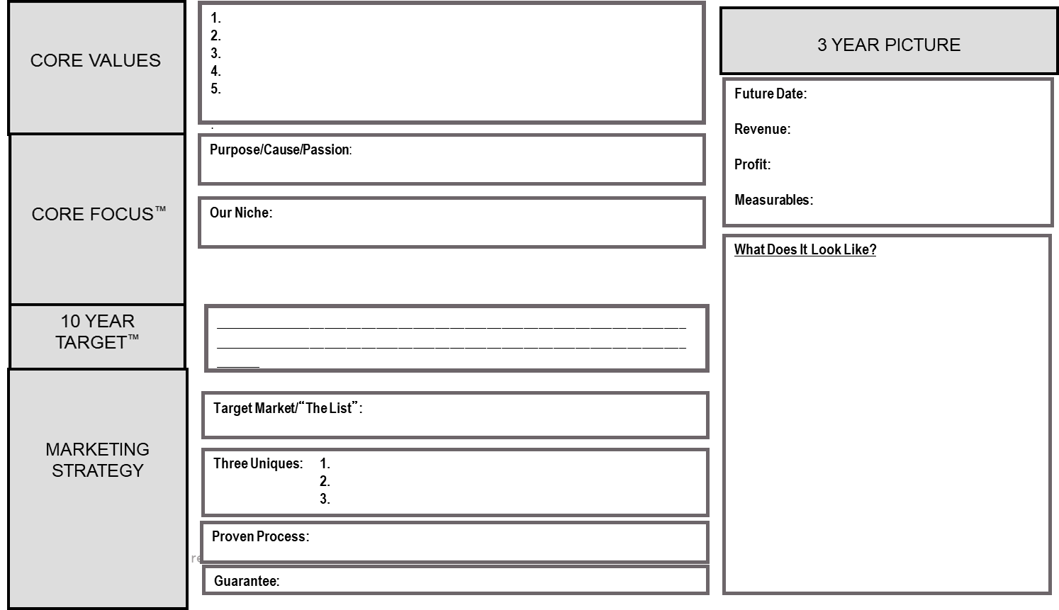
Vision Traction Organizer™
The EOS Model™

Slide 34
Embracing the Change

Slide 35
“A clear vision, backed by definite plans, give you a tremendous feeling of confidence and personal power.”
– Brian Tracy, The Gift of Self-Confidence
When an unanticipated change occurs, we can often feel pressure to take action without giving the proper resources and time needed to adequately prepare.
Taking a moment to step back and put supports in place can prove to be of tremendous value an environment filled with fear and uncertainty. The preparing for change phase sets the organization up to provide action led by intentionality and calmness instead of anxiety and concern.
Preparing for change

Slide 36
Change management definition
The process, tools, and techniques to manage the people side of change to achieve the required business results.
Individual Perspective
  Understanding how one person makes a change successfully.
Organizational Perspective
  The tools that project teams and managers have to support the “people side” of change.

Slide 37
Your role in managing change
Executives and Senior Managers
Why is this group important?
  Active and visible sponsorship is identified as the top contributor to overall project success in Prosci’s five benchmarking studies
  Senior leaders are one of two preferred senders of messages about change
What is this group’s role?
  Participate actively and visibly throughout the project
  Build the needed coalition of sponsorship with peers and other managers
  Communicate the business messages about the change effectively with employees
Executives and
Middle managers
senior managers
and supervisors
Change
management
resource/team
Project
Project
Employees
team

Slide 38
Engaging the team in change for a diverse, inclusive culture
Provide an environment for employees to feel comfortable offering their opinions based on their experiences and perspectives
Employees have the pulse on clients/communities/cultures that we serve and work in so we can better understand and anticipate their needs – as our clients and communities become more diverse having a diverse workforce to mirror them will allow us to continue to serve them at a high standard and connect with them in a more authentic manner.
Enable and tap into the potential of all employees

Slide 39
Benefits of engaging your diverse team in the change
Variety of different perspectives
Increased creativity
Higher innovation
Faster problem-solving
Better decision making
Increased profits
Higher employee engagement
Reduced employee turnover
Better company reputation
Improved hiring results

Slide 40
Managing your current changes
Collect & Analyze Feedback
Implement Corrective Action
Define your Strategy
Prepare your Team
Develop Plans
Implement Plans
Preparing for Change
Managing Change
Reinforcing Change
Notes:
Coming into an already existing/evolving process – not trying to undo the work that’s been done, but apply best practices for moving forward. And this is where we are coming in in the process – managing change.

Slide 41
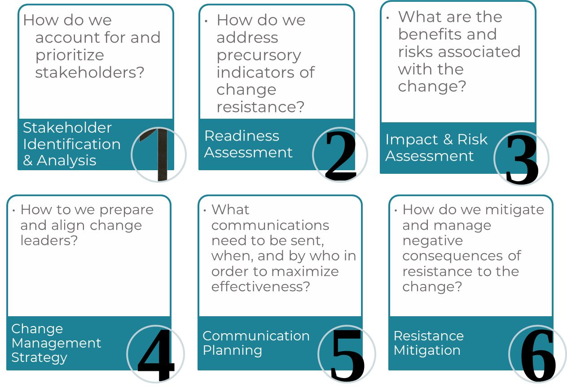


Slide 42
Developing plans
A common misconception about change is that communication equals change management. The reality is that communication is a tool for building awareness but does little in the way of managing natural resistance to change, building skills and capabilities for change, reinforcing commitment to change or providing a model for what successful change looks like.
Compliment your communication efforts with tactics for support (coaching, training and resistance management) and sponsorship.
Activity | Awareness of the need for change | Desire to participate in and support change | Knowledge on how to change | Ability to demonstrate skills and behaviors | Reinforcement to sustain the change
Communications | X
Sponsorship | X | X
Coaching | X | X | X | X | X
Resistance Management |  | X
Training |  |  | X | X

Slide 43
Polling question
Are you incorporating deliberate change management plans in your organization?
Yes
No
Somewhat

Slide 44
Developing an
Implementation Structure

Slide 45
Don’t suffer from
IADD
Implementation Attention Deficit Disorder

Slide 46

The “Critical Few”

Slide 47
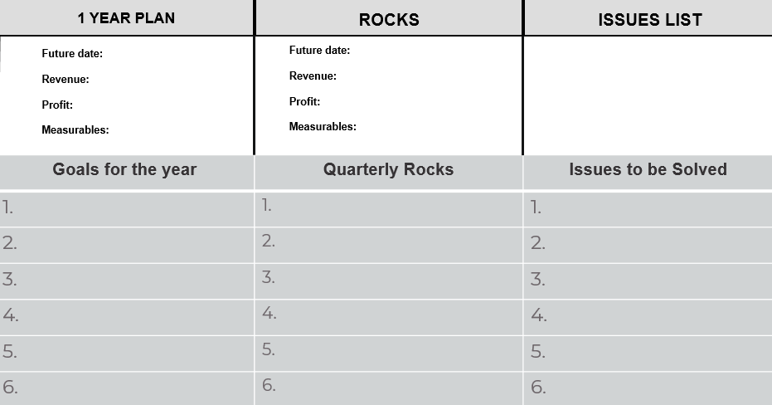
Vision Traction Organizer™
The EOS Model™

Slide 48
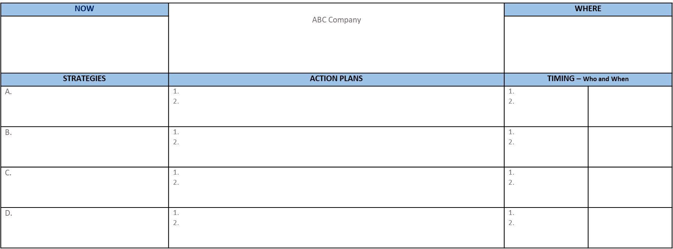
90-day action plan

Slide 49
Polling question
How successful is your organization at implementation?
Highly
Somewhat
Not at all

Slide 50
Prepare for challenges and barriers
What obstacles might you face?
How will you overcome those obstacles?

Slide 51
Key learnings
How are you capturing key learnings along the way?
How are you applying what you learn?
What creative tensions are you harnessing?

Slide 52
Key Takeaways

Slide 53

What are our takeaways?
What will we do differently?

Slide 54
Move to action
What are two things you will do today to ramp up your leadership in these turbulent times?
1.
2.

Slide 55
Questions? Comments?
Thank you for inviting
me into your journey!

Slide 56
Session Password
(Must record password for CPE credit)

Slide 57
Tina Nazier
Director, Wipfli LLP

Slide 58

Tina Nazier
Director, Wipfli LLP
Tnazier@wipfli.com
(715) 858-6640

Slide 59
Wipfli
The
Way

