Slide 1
2020 CFMA Conference
WIFI Password: BRAYNTaxIncentives

Slide 2

New Opportunities in 2020 for Construction Tax Incentives
Kevin Sullivan, PE

Slide 3

Kevin P. Sullivan, PE, HERS RATER
Partner
Experience
  10 years design & construction
  Licensed Prof. Engineer in 30+ states
  R&D Tax Credits
  179D & 45L Energy Efficient Incentives
  Cost Segregation
Education
  B.S.C.E– University of Houston
Resides in Houston, TX with wife and 2 children

Slide 4
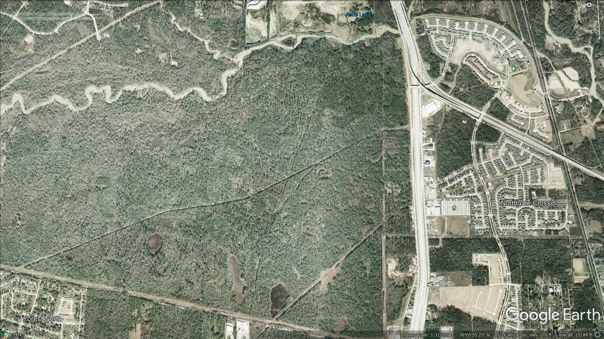

Slide 5
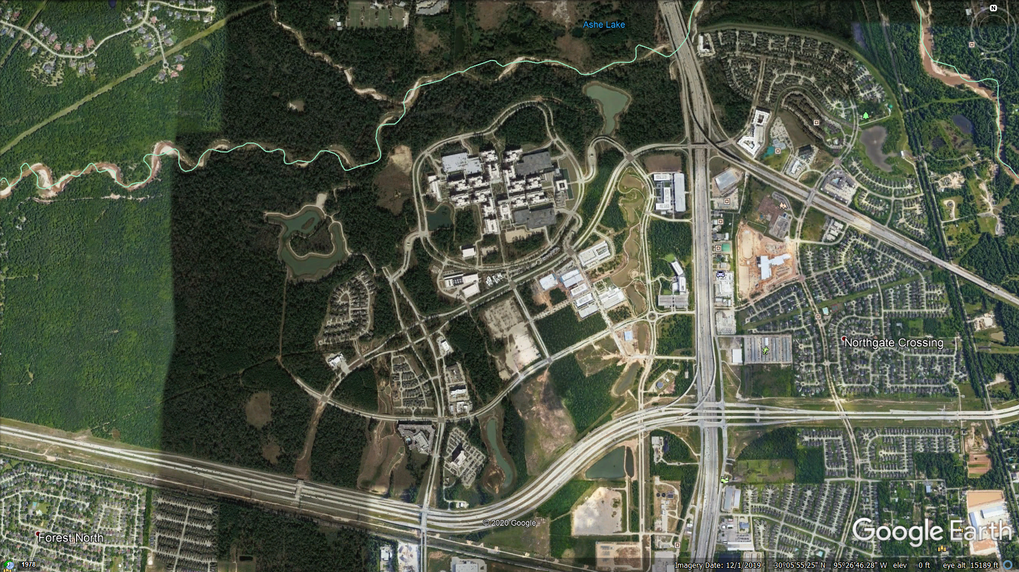

Slide 6
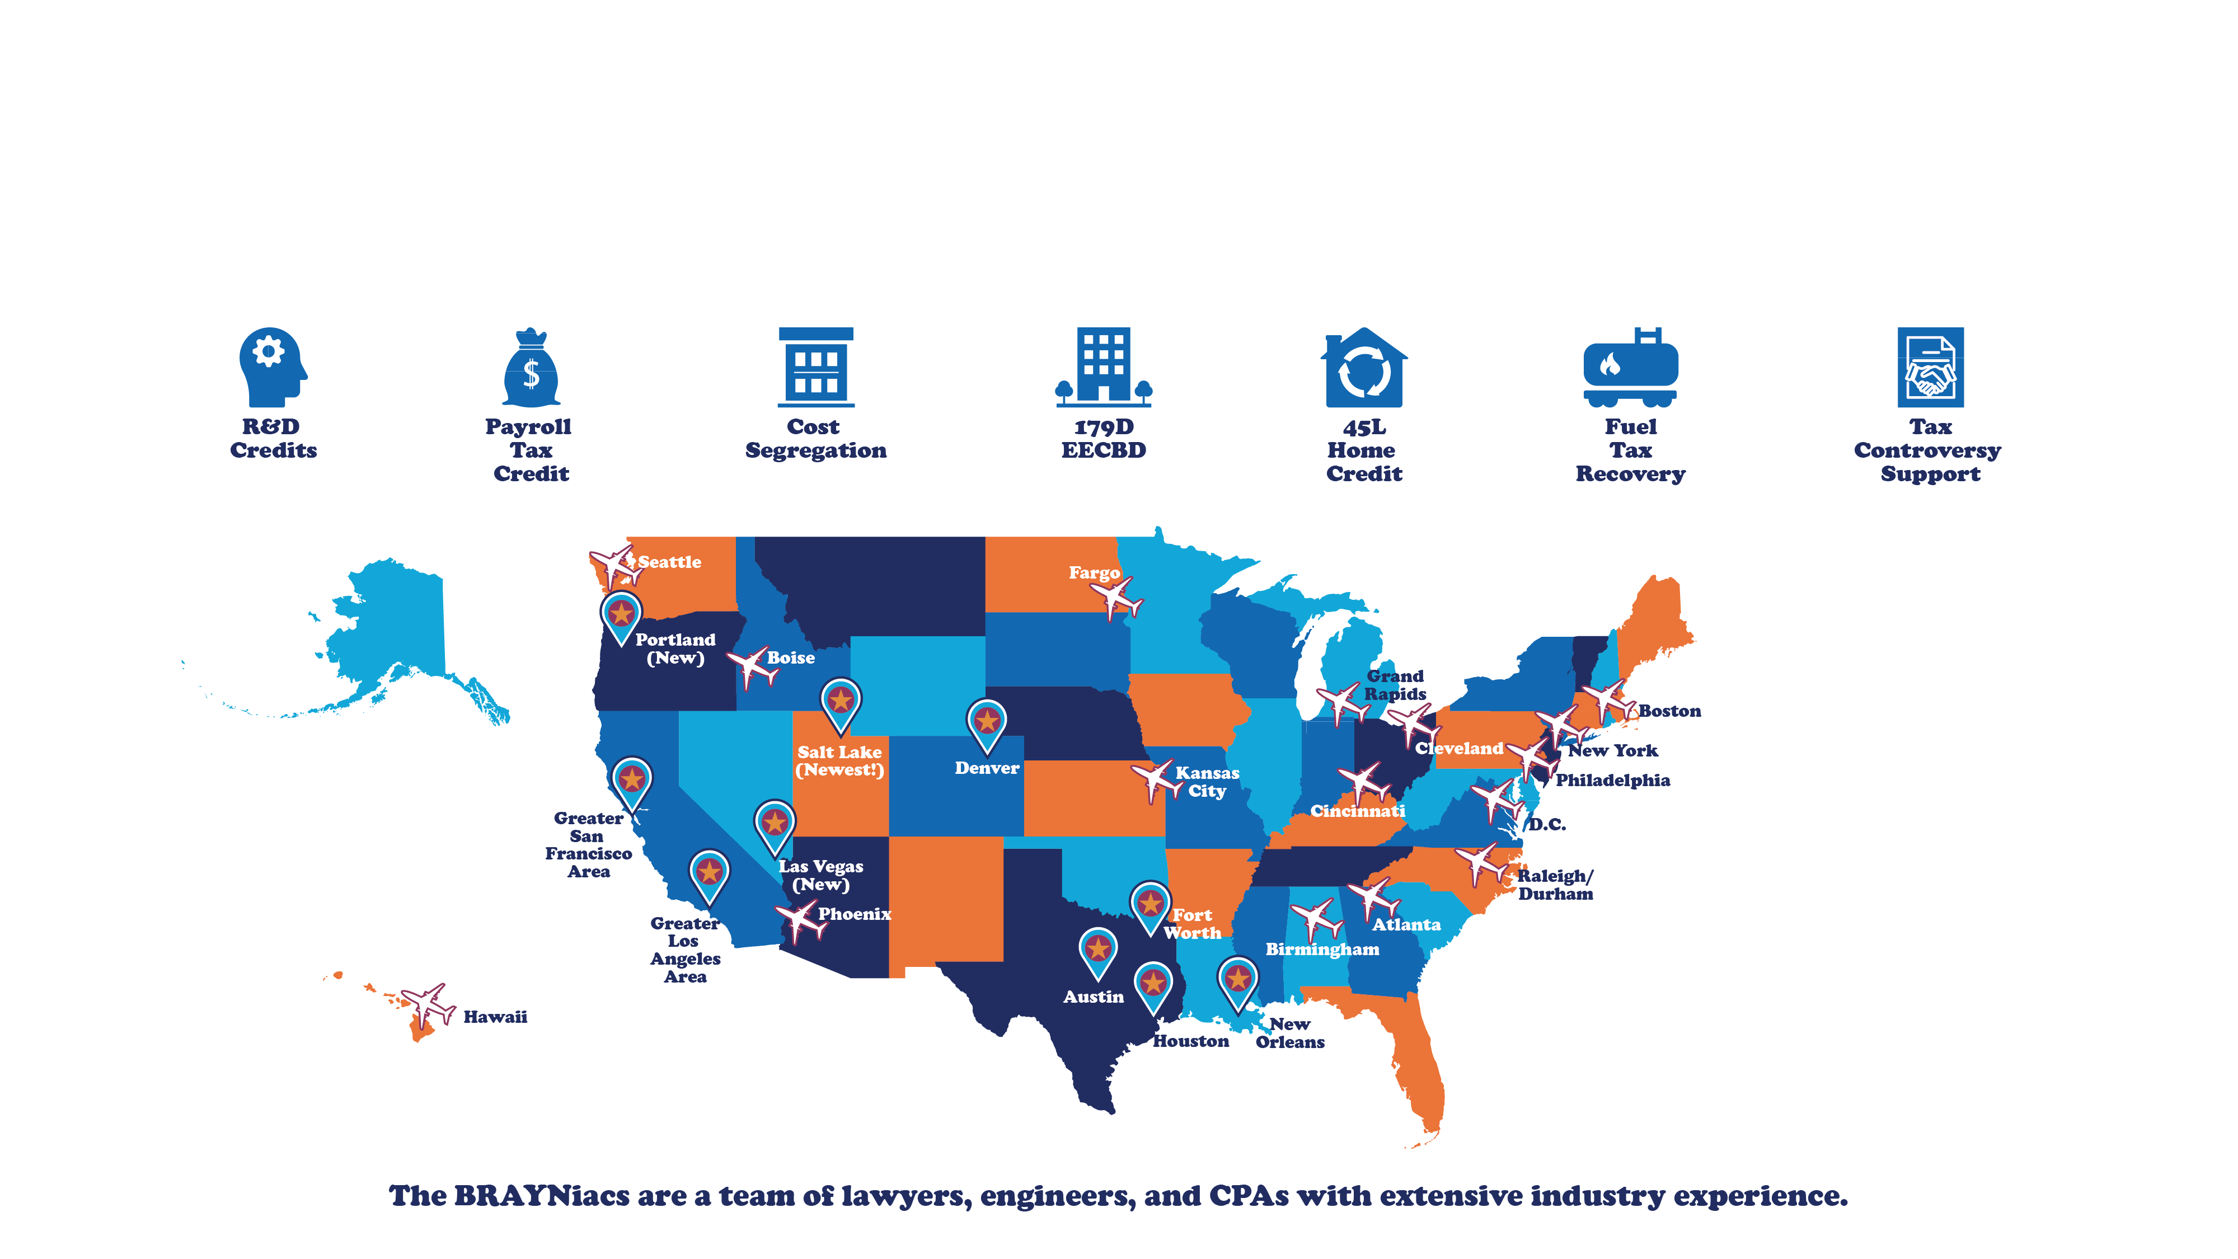

Slide 7

45L Energy
Efficient Home
Tax Credit
Extended 12/20/2019
for 2018 – 2020 Tax Years

Slide 8
45L TAX CREDIT BASICS
Federal Incentive
For Homes Sold/Leased: | 2006 through 2020
Value | $ 2,000 tax credit per home/unit
Eligible taxpayers | Home Builders & Multifamily Developers
Example qualified property | Apartments Assisted Living Student Housing | Single Family Homes Affordable Housing (LIHTC) Condos
qualification | Must own basis in property during construction Requires testing/inspection (Sampling used ~ 10-20% of homes) Certification by HERS Rater
}
3 stories or less

Slide 9
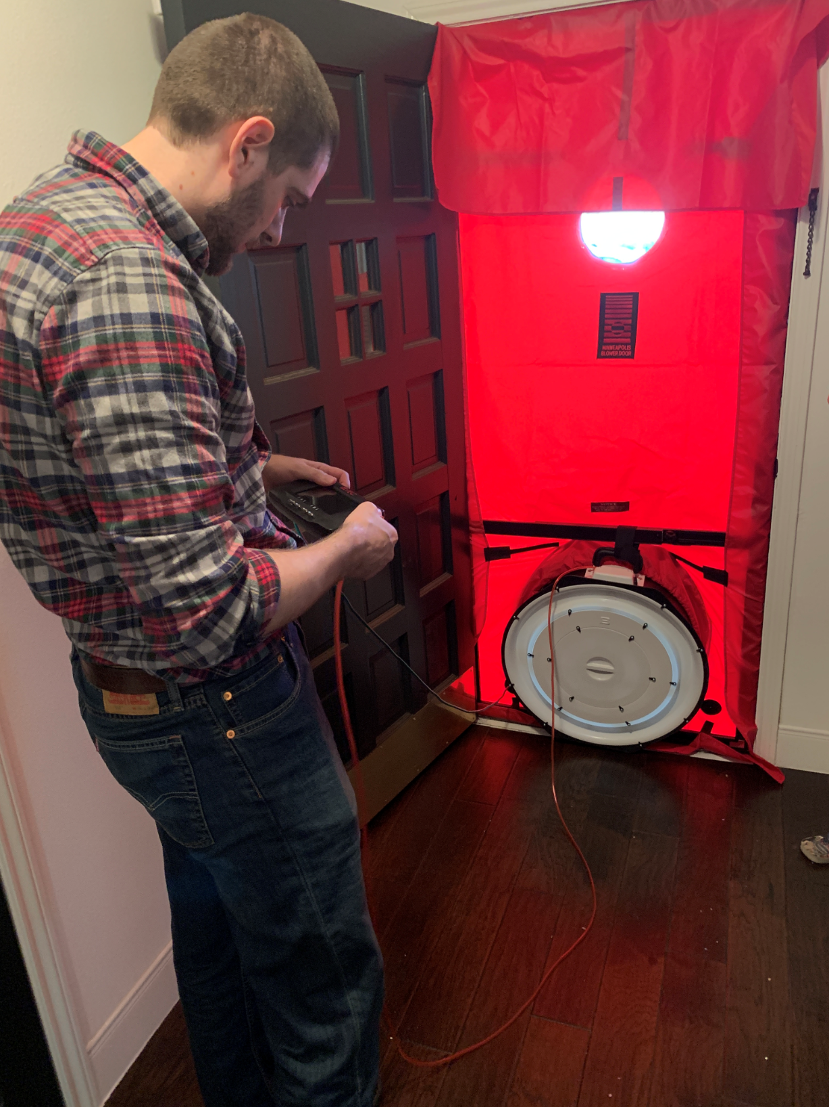
45L Home Builder Case Study
Tax Year | Homes Sold | Homes Tested | Qualifying Homes | Tax Credits
2018 | 700 | 100 | 625 | $1,250,000
2019 | 800 | 120 | 800 | $1,600,000
2020 | 800 | 120 | 800 | $1,600,000
Total Tax Credits |  |  |  | $ 4,450,000
Mailed 2,500+ homeowners requesting testing & inspection
  Offered Free Energy Audit, $50 Gift Card
Testing/inspecting vacant 2020 homes

Slide 10
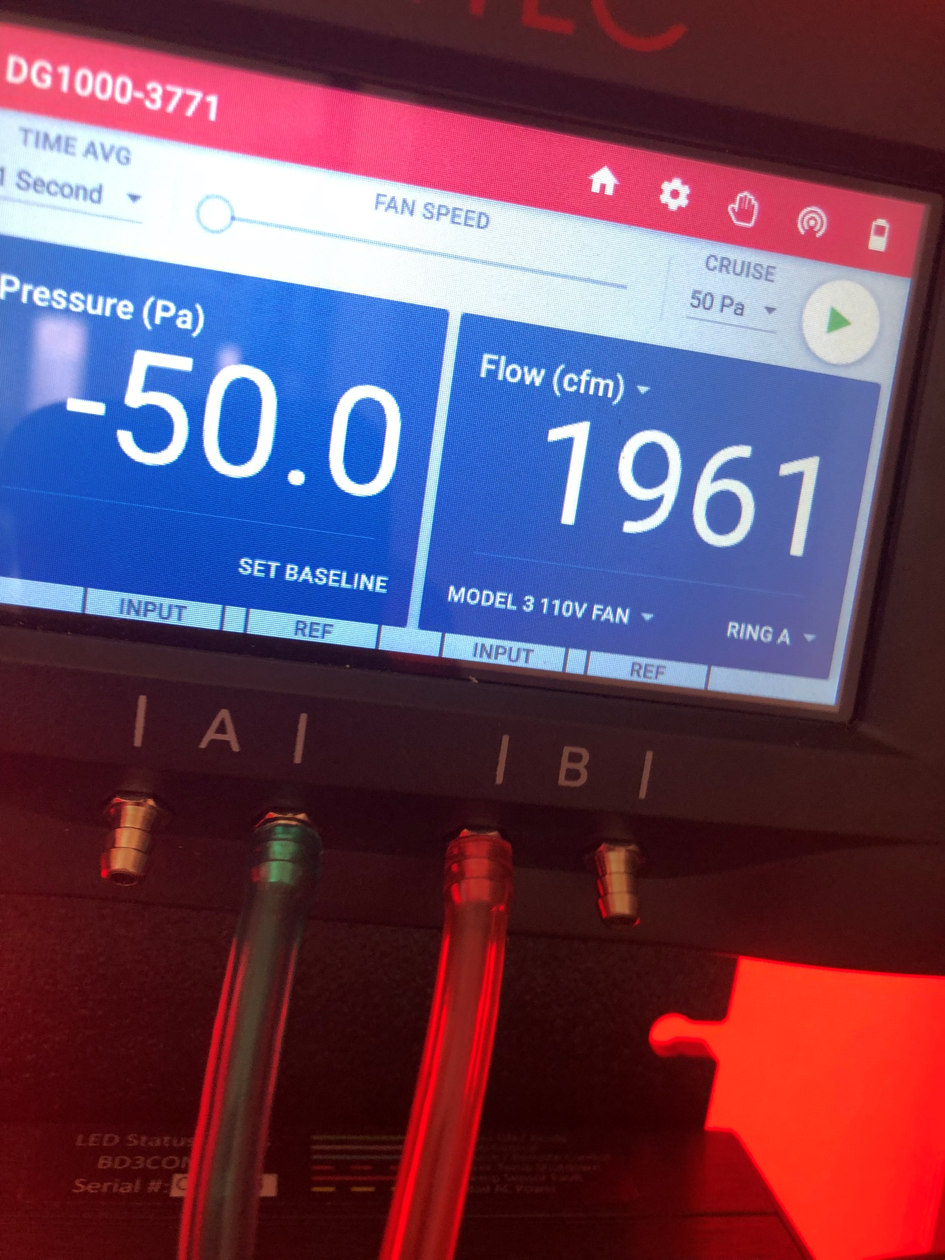
45L Apartment Developer Case Study
Tax Year | Apartments Rented | Units Tested | Qualifying Homes | Tax Credits
2017 | 85 | 13 | 85 | $170,000
2018 | 100 | 15 | 100 | $200,000
2019 | 150 | 25 | 150 | $300,000
Tax Credits Claimed |  |  |  | $ 670,000
Amended prior returns and claimed all credits in 2019
Apartment renters given notice for inspections by property management company

Slide 11
NEW OPPORTUNITIES
45L Tax Credits
  $2,000 Tax Credit per Home/Unit
  Home Builders & Apartment Developers
  Awareness is low
  Recently extended
  Virtual inspections

Slide 12
179D Energy
Efficient
Commercial
Building
Deduction
Extended 12/20/2019
for 2018 – 2020 Tax Years

Slide 13
179D ENERGY EFFICIENT INCENTIVE BASICS
Federal TAX DEDUCTION
For buildings constructed | 2006 through 2020
Value | Up to $1.80 per square foot federal tax deduction
Qualification | Designers / Builders of Govt Owned Buildings Commercial Property Owners
Eligible qualified property | HVAC / Hot Water Interior Lighting Building Envelope | New Construction Renovation Addition
NOTES | Subject to federal statute of limitations Typically available for projects completed prior 3 years Requires certification by 3rd party Professional Engineer

Slide 14

GOVT OWNER MUST ALLOCATE 179D INCENTIVE
Architect
Mechanical Engineer
Electrical Engineer
MEP Engineer
General Contractor
Mechanical Subcontractor
Electrical Subcontractor
Controls Companies
Specialty Designers/Contractors
K-12 Schools
State University Buildings
City, Town, County
Prisons
Airports, Port Authority
State/County Hospitals
Military
General Services Admin (GSA)

Slide 15
179D CASE STUDY – PERFORMANCE CONTRACTOR
Study Highlights
Combined w/ R&D Study
Leveraged ERP to ID projects
Received allocations on 80%+ of projects pursued
100% fully sustained under audit without requiring appeals process
Multi-Year Study | Number Allocated | Avg. Qual. Rate | Tax Deductions
Elementary Schools | 8 | $1.80/SF | $900,000
Middle Schools | 5 | $1.80/SF | $550,000
High Schools | 5 | $1.80/SF | $2,600,000
Misc. School Buildings | 2 | $1.80/SF | $150,000
Total Tax Deductions |  |  | $ 4,200,000

Slide 16
TAX CONTROVERSY
LB&I Compliance Campaign 11/03/2017 – issue-based examinations
IRS Office of Chief Council Memo 11/28/2018 – eligibility of designers and builders, with particular scrutiny on contractors
LB&I Practice Unit 12/18/2018 - addressing taxpayer requirements
US vs. Quebe 01/25/2019 – electrical contractor claimed 179D for lighting work on government buildings. Informative for implications based on placed in service dates, eligibility as designer, and allocation letter process

Slide 17

NEW OPPORTUNITIES
45L Tax Credits
  $2,000 Tax Credit per Home/Unit
  Home Builders & Apartment Developers
  Awareness is low
  Recently extended
  Virtual inspections
179D Tax Deductions
  Architects, Engineers, & Contractors Govt Buildings
  Recently extended

Slide 18
R&D Tax
Credits
New Opportunities from
TCJA, CARES Act

Slide 19
R&D Tax Credit Basics
 | Federal | Colorado
Years | Permanent! | Precertification starting 2012
Qualification | Qualified Research = 4-Part Test | CO Enterprise Zone
Eligible Qualified Research Expenses (QREs) | Wages W-2 Box 1 Wages and SE Earnings for Partnerships Supplies Contract Research Expenses
Approximate Effective Net Credit | 4% to 9% of US-QREs | 1% to 3% of CO-QREs
Utilization | Generally, RTL minus TMT Exceptions for small businesses | 25% Credit allowable per year
Carryovers | Back 1 year & Forward = 20 years | Unlimited Carryforward

Slide 20
R&D 4-PART TEST
BUSINESS COMPONENT FOR PERMITTED PURPOSE:
New or improved
Business component: Product, process, technique, formula, invention, or computer software
Purpose: Functionality, performance, quality, reliability, or durability
UNCERTAINTY:
Capability,
Methodology, or
Final or appropriate design of the business component
TECHNOLOGICAL IN NATURE:
Process of experimentation based on engineering, physics, chemistry, biology, or computer science
Existing principles are OK
PROCESS OF EXPERIMENTATION:
Systematic evaluation of one or more alternatives
Systematic trial and error process
“Evaluating solutions to overcome a technical uncertainty”

Slide 21
“Funded” Projects
RIGHTS: The taxpayer retains substantial rights in the research. Rights need not be exclusive (a right to use the results of research in the taxpayer’s business is sufficient).
Lockheed Martin Corp. v. United States, 210 F.3d 1366, 1375 (Fed. Cir. 2000). Populous Holdings, Inc v. Commissioner of Internal Revenue (Docket No. 405-17) (2019)
ECONOMIC RISK: The amounts payable under the agreement are contingent on the success of the research. Taxpayer must bear the expense or risk thereof even if research is unsuccessful.
Geosyntec Consultants, Inc. v. United States, 9:12-cv-80334 (S.D. Fla. 4/15/13)

Slide 22
R&D FOR ELECTRICAL CONTRACTOR
Example Qualifying Activities
Electrical Design & Engineering
Preconstruction Design Assist
Temp Services Design
Programming and Configuration
Value Engineering
Systems Design & Const. Coordination
Item | Average Annual Amount
Gross Revenues | $40,000,000
Total Payroll | $12,000,000
Qualified Research Expenses (QREs) | $2,000,000
Net Federal Credits | $150,000
Net State Credits | $50,000
Total Net Federal and State Credits | $200,000

Slide 23
R&D FOR GENERAL CONTRACTOR
Example Qualifying Activities
Engineering & Design
  Value engineering
  Means & methods
  BIM
  System detailing
  Shop drawing design & engineering
  New/improved fabrication processes
Item | Average Annual Amount
Gross Revenues | $300,000,000
Total Payroll | $33,000,000
Qualified Research Expenses (QREs) | $2,500,000
Net Federal Credits | $175,000
Net State Credits | $65,000
Total Net Federal and State Credits | $240,000

Slide 24
CARES ACT – NOL Changes
NOLs from 2018-2020 can be carried back 5 previous tax years
80% limitation repealed
Works in tandem with 179D Tax Deductions in 2018-2020
NOLs carried back can open opportunities in closed in tax years such as R&D tax credits
Recent article: https://brayn.com/cares-act-revises-nol-rules-and-opens-door-for-unclaimed-rd-tax-credits/

Slide 25
NEW OPPORTUNITIES
45L Tax Credits
  $2,000 Tax Credit per Home/Unit
  Home Builders & Apartment Developers
  Awareness is low
  Recently extended
  Virtual inspections
179D Tax Deductions
  Architects, Engineers, & Contractors
  Recently extended
R&D Tax Credits
  Available to many industries
  New opportunities with AMT, NOL changes
  Payroll of $1M+ or potential QREs of at least $500k

Slide 26
ELIGIBLE TAXPAYERS
45L Tax Credit
179D Tax Incentive
Multifamily Developers NAICS 236117, 531110
Home Builders NAICS 236117
Assisted Living Developers NAICS 236117, 531110
Student Housing Developers NAICS 236117, 531110
Affordable Housing Developers NAICS 236117, 531110
Real Estate Investors NAICS 236117, 531110
Residential Rental Property NAICS 236117, 531110
Commercial Property NAICS 531120, 531190
General Contractors NAICS 236220
Mechanical Subcontractors NAICS 238220
Electrical Subcontractors NAICS 238210
Controls Companies NAICS 238210
Specialty Contractors NAICS 238150, 238160
Architecture NAICS 541310
Mechanical Engineering NAICS 541330
Electrical Engineering NAICS 541330
MEP Engineering NAICS 541330

Slide 27
ELIGIBLE TAXPAYERS
R&D Tax Credit
Nonresidential Building Construction NACIS 236200
Other Heavy & Civil Engineering Construction NACIS 237990
Foundation, Structure, & Building Exterior Contractors NACIS 238100
Electrical Contractors NACIS 238210
Plumbing, Heating, & Air-Conditioning Contractors NACIS 238220
Other Building Equipment Contractors NACIS 238290
Building Finishing Contractors NACIS 238300
Other Specialty Trade Contractors NACIS 238900
Manufacturing Section 31 - 33
Oil & Gas Extraction NACIS 211110
Breweries NACIS 312120
Wineries NACIS 312130
Distilleries NACIS 312140
Pharmaceuticals & Medicine NACIS 325410
Other Misc. Manufacturing NACIS 339900
Architectural Services NACIS 541310
Engineering Services NACIS 541330

Slide 28
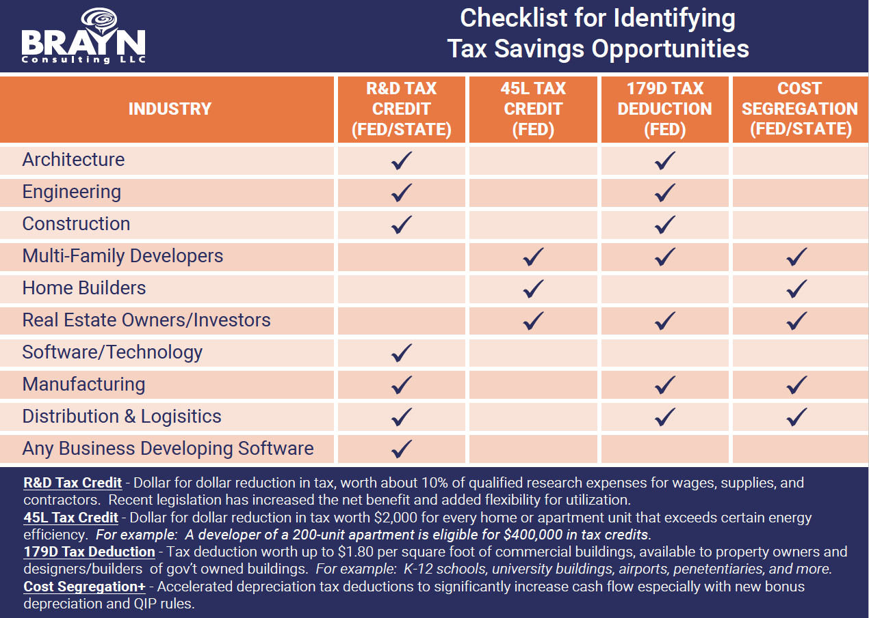

Slide 29





CONNECT WITH US
Connect with us on social media
 | http://www.linkedin.com/company/brayn-consulting-llc
 | https://twitter.com/BRAYNConsulting
 | https://www.facebook.com/Braynware
Contact BRAYN
 | https://www.linkedin.com/in/kevinsullivanpe/
 | 832-570-3112
 | kevin@brayn.com

Slide 30
BRAYN is a niche consulting firm that guides businesses to greater value through tax credits and incentives, such as R&D tax credits, Cost Segregation, 179D, 45L, and Fuel Tax Recovery. BRAYN Consulting LLC is not a CPA firm, finance, tax, law, or engineering firm, and nothing contained herein can be construed as legal, financial, accounting, tax, or engineering advice.
IRS Circular 230 Disclosure – To ensure compliance with requirements imposed by the IRS, we inform you that any U.S. tax advise contained in this communication (including any attachments) is not intended or written to be used, and cannot be used, for the purpose of (i) avoiding tax-related penalties under the Internal Revenue Code, or (ii) promoting, marketing, or recommending to another party any transaction or matter addressed herein.
©BRAYN Consulting LLC 2020

Slide 31
BRAYNTaxIncentives
(Must record password for CPE credit)

