Slide 1
2022 CFMA Conference
WIFI Sponsor: Rubin Brown

Slide 2

Overcoming Performance Review Challenges
M.J. Clark, Vice President, ILS

Slide 3


Performance Reviews… Ugh!
For employees AND managers, a face-to-face performance review can be the most stressful work conversation they’ll have all year.
3
Notes:
Performance management is a process, not an annual conversation.
How does the company benefit from performance reviews?
How does the employee benefit from performance reviews?

Slide 4
10 Biggest Mistakes Managers Make
Too short/vague
Everything’s fine, and then you’re fired
Recency Effect – focus on last mistake
No preparation
No review at all – “open door policy”

Slide 5
10 Biggest Mistakes Managers Make
No positive feedback/recognition for more work done
Cookie cutter approach with bad forms
Not being truthful about performance
No follow up during the year on goals
No discussion of career path

Slide 6
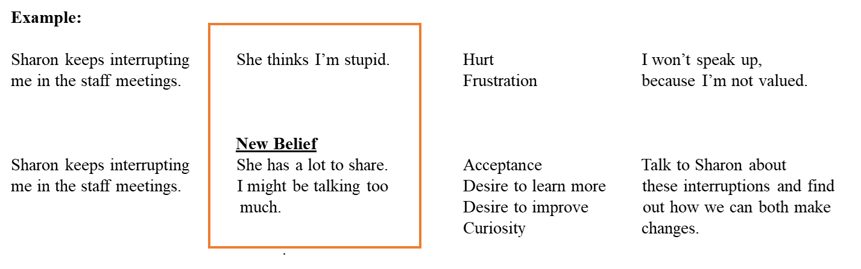
Controlling Our Thoughts
A
B
C
D
Activating event Belief Systems Consequent Emotions Dependent Behavior
6
Source: Psychologist Albert Ellis

Slide 7

10 Ways to Give an
Effective Performance Review
Hold "performance planning" sessions.
Meet with the employee throughout the year to discuss goal progress.
Ask employee to prep for review.
Source: Harvard Business Review
Notes:
Hold "performance planning" sessions with each direct report at the beginning of the year to discuss their goals and career objectives and your expectations.
Meet with the employee throughout the year to discuss progress.
Two weeks before the evaluation, ask the employee to note things she’s proud of and things she’d like to improve from the last year.

Slide 8
10 Ways to Give an
Effective Performance Review
Keep track of positive/negative behaviors throughout the year. Get feedback from others.
Give the employee a copy of the review an hour before your meeting.
Ask him how he thinks he’s performing. Then, give an honest assessment.
Notes:
Keep track of positive/negative behaviors throughout the year and talk to others who work with her.
Give the employee a copy of the review an hour before your meeting.
Ask him how he thinks he’s performing. Then, give him your honest assessment.

Slide 9

10 Ways to Give an
Effective Performance Review
Give behavior-focused feedback.
Hold your ground on ranking.
Evaluate the forms you use.
If compensation will be discussed, do it at the beginning of the meeting.
Notes:
What should the person start, stop and keep doing? Give specific, behavior- focused feedback.
Hold your ground on ranking. If 3 = average, most will land there. It’s not “mediocre” – it’s meeting your goals.
Evaluate the forms you use. Are they effective? If not, make changes.
If compensation will be discussed, do it at the beginning of the meeting. If you wait and they don’t know, they’ll be thinking of that the whole time and not listening.

Slide 10
Criticism vs. Constructive Feedback
Criticism Constructive Feedback
Past orientation Future orientation
Personal focus Behavior focus
Negative tone Positive tone
Expresses frustration Expresses confidence
Problem-oriented Solution-oriented
This idea was developed by Senn-Delaney Leadership.

Slide 11
The Assertiveness Continuum
 | Passive/Aggressive | Assertive | Aggressive
Confidence level | ? | High | ?
Motivation | Approval Seeking | Connection With others | Control over others
Self-talk | “Tell me I am lovable.” | “People are good, and so am I.” | “The world is a dangerous place. I must protect myself.”
Notes:
What do you think the confidence level is of Passive or Passive/Aggressive people and Aggressive People?
Both are high
Both are low
PassAgg high, Agg low
PassAgg low, Agg high

Slide 12

The “How To” of Assertiveness
Describe the behavior. (“I have noticed…”)
Explain how it makes you feel. (“When you do this, I feel… or I am … ONE WORD”)
Explain the changes you would like made. (“I would ask… or I would prefer…”)
Notes:
Let’s go through an example!
Do it poorly.
Do it scared.
Practice in safe places (family, friends, kids).

Slide 13
Performance Review Tips
Be gentle and validate them. How?
Stay calm; manage your thoughts.
Ask questions with curiosity, positive tone, eye contact.
Focus on their behaviors, not your assumptions.
Reflect on the conversation afterward.
Notes:
Be gentle and give them the benefit of the doubt (empathy). Explain validation.
Stay calm: Watch for emotional hijacking.
Ask questions with curiosity – don’t go into conversation with negative agenda – maintain appropriate eye contact!
Focus on observed behaviors, not personal assumptions.
After each conflict, think about what you would have done differently.

Slide 14
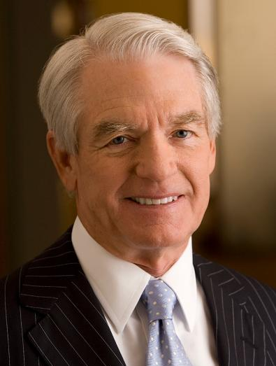
A Quote to Consider
“I have yet to find a man, however exalted his station, who did not do better work and put forth greater effort under a spirit of approval than under a spirit of criticism.”
Charles Schwab, businessman/investor
Notes:
Charles Robert Schwab, Jr is an American businessman and investor and the founder of the Charles Schwab Corporation.

Slide 15
Q&A
If you are looking for an executive coach, workplace trainer or leadership consultant, please contact me:
M.J. Clark, M.A., APR, PRSA Fellow
Vice President
Integrated Leadership Systems
614/214-7062 (cell)
mj@integratedleader.com
www.integratedleader.com
LinkedIn: http://www.linkedin.com/in/mjclark22

Slide 16
Session Password
(Must record password for CPE credit)

