Slide 1
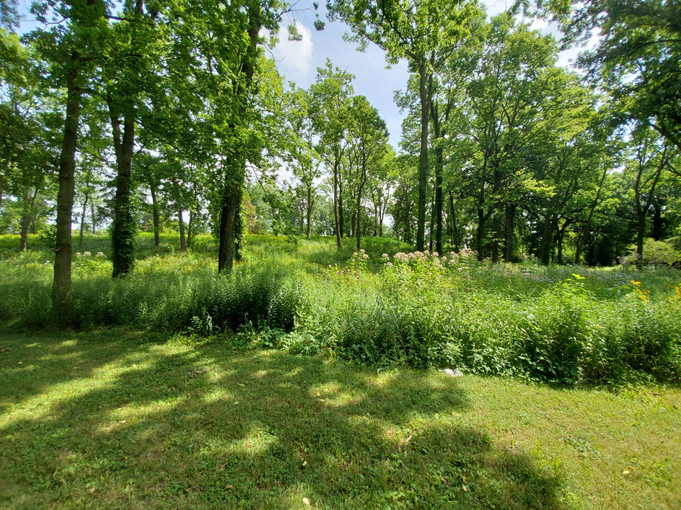
Historic Watson Park
Neighborhood Association
Meeting
9/14/2022

Slide 2
Introduction of HWPNA Board Members
Gil Amram - Board Member/Code Enforcement Liaison
Tonia Jackson - Board Member/Communications Officer
Ryan Johnson - Board Member/Special Projects/Safety
Nathan Abbott - Board Member
Gary Dilk - Board Member
Jack Burd - Board Member
Logan Wechter - Board Member

Slide 3
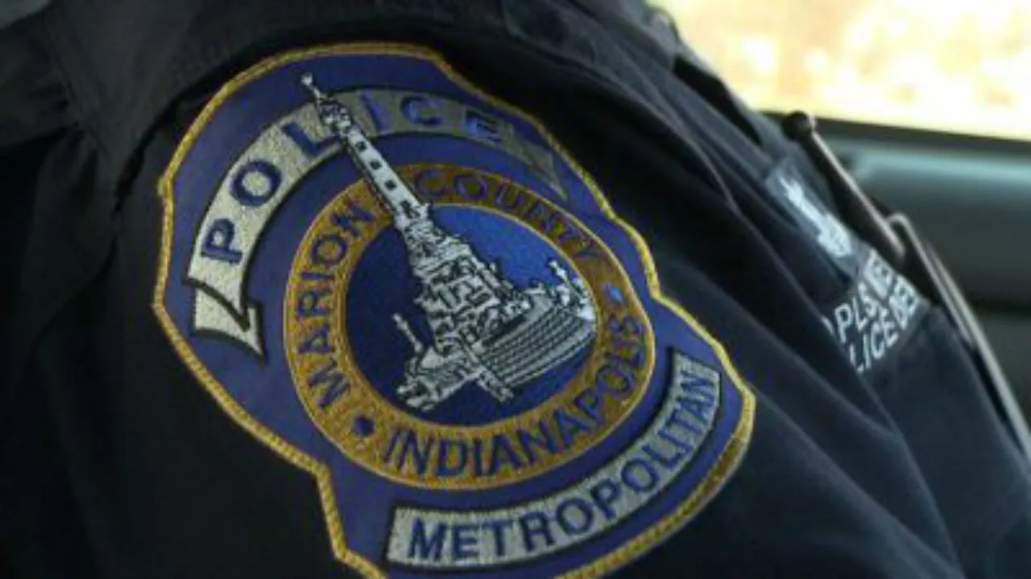
Updates from IMPD - Sergeant Vincent Stewart
-Neighborhood Criminal Activity/Trends
-Neighborhood Watch

Slide 4
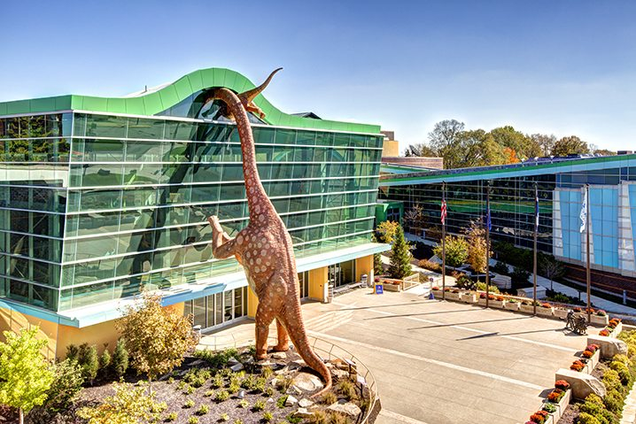
Children’s Museum Updates
-Still Offering FREE admission with proof of HWPN residency
-Hiring for Santa, $70/hr
-Free Indy Eleven Game Tickets! Form Here
-Emmett Till & Mamie Till-Mobley: Let the World See
-The Museum is Hiring!
-Jurassic World Live Tour at Gainbridge Fieldhouse
-Disney On Ice presents Find Your Hero
-Monster Jam
-Neighborhood Exclusive Scholarship Opportunities
-North Church Farmers Market
-Use What You've Got Keeping Families Connected Annual Awards and Dinner

Slide 5
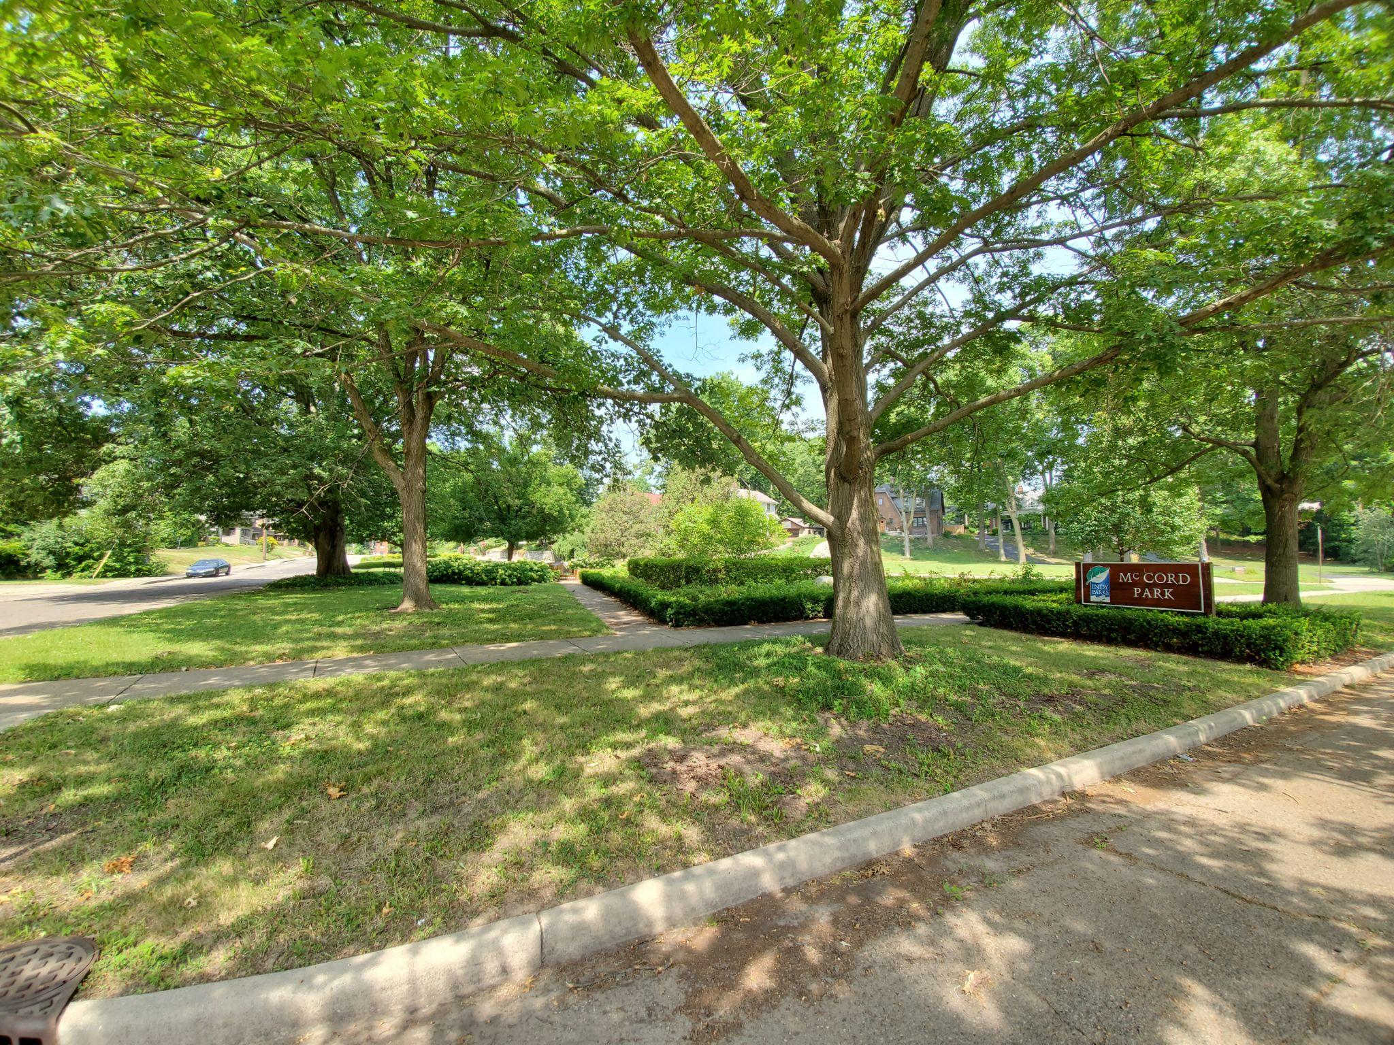
McCord Park Updates
-Subcommittee for Maintenance - Beth Burrows (Phone - 317-418-9235)
-Mow Schedule/Sign-Up Sheet
Week 22 September 18
Week 23 September 25
Week 24 October 2
Week 25 October 9
Week 26 October 16
Week 27 October 23
Week 28 October 30

Slide 6
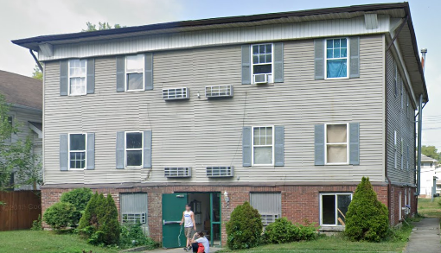
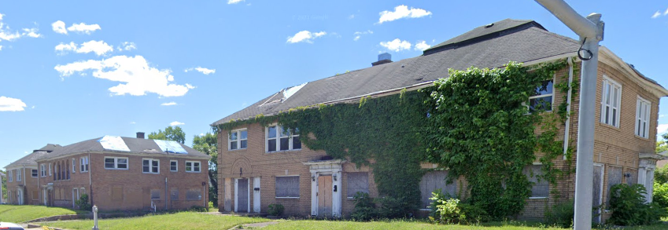
Neighborhood Variance Projects
-3544 Carrollton Ave
-Broadway Park Apartments

Slide 7
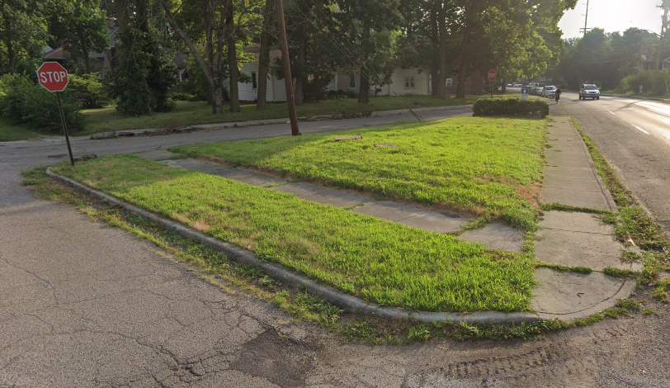
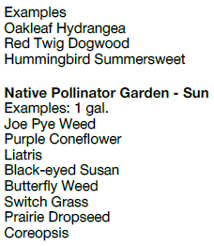
INRC Beautification Project
-Recently Approved for $9,654 INRC Grant to Upgrade lot at 36th and Winthrop Ave

Slide 8
Indy tactical urbanism permits
New DPW program

Slide 9
Tactical: small actions that serve a greater goal.
Urbanism: designing a city and specifically its public spaces.

Slide 10
What if our neighborhood…
Interconnected with new crosswalks?
Reclaimed empty asphalt to create little parks?

Slide 11
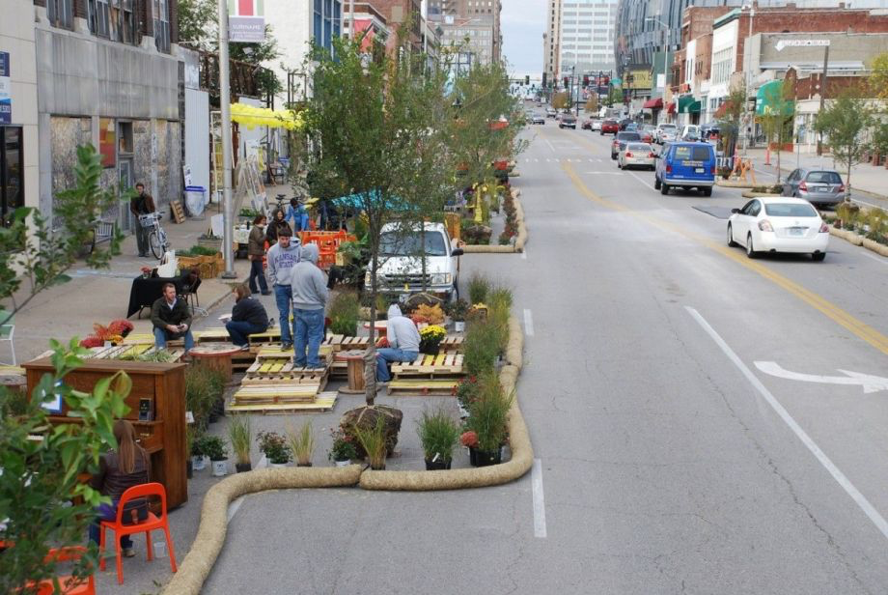

Slide 12
Tactical urbanism
increase the overall livability, vibrancy, walkability and resilience of neighborhoods
Slow down motorists
Enhance street safety and aesthetic appeal
Create “sense of place”
Showcase creativity and public spirit

Slide 13
DPW’s policy
Purpose:
test, pilot, demonstrate and collect data on changes within the public rights-of-way
small-scale, low-cost and temporary demonstration projects
Results inform future DPW planning

Slide 14
Potential elements and suggested materials
Signage
Parklets
Protected bike lanes
Bump outs
Micro-roundabouts
Public art
Overhead decor
Water-based paint
Traffic tape
Recycled tires
Planters
Rope
Wood
Signage
Reflective items
Bollards
Traffic cones
Straw bales
Sandbags

Slide 15
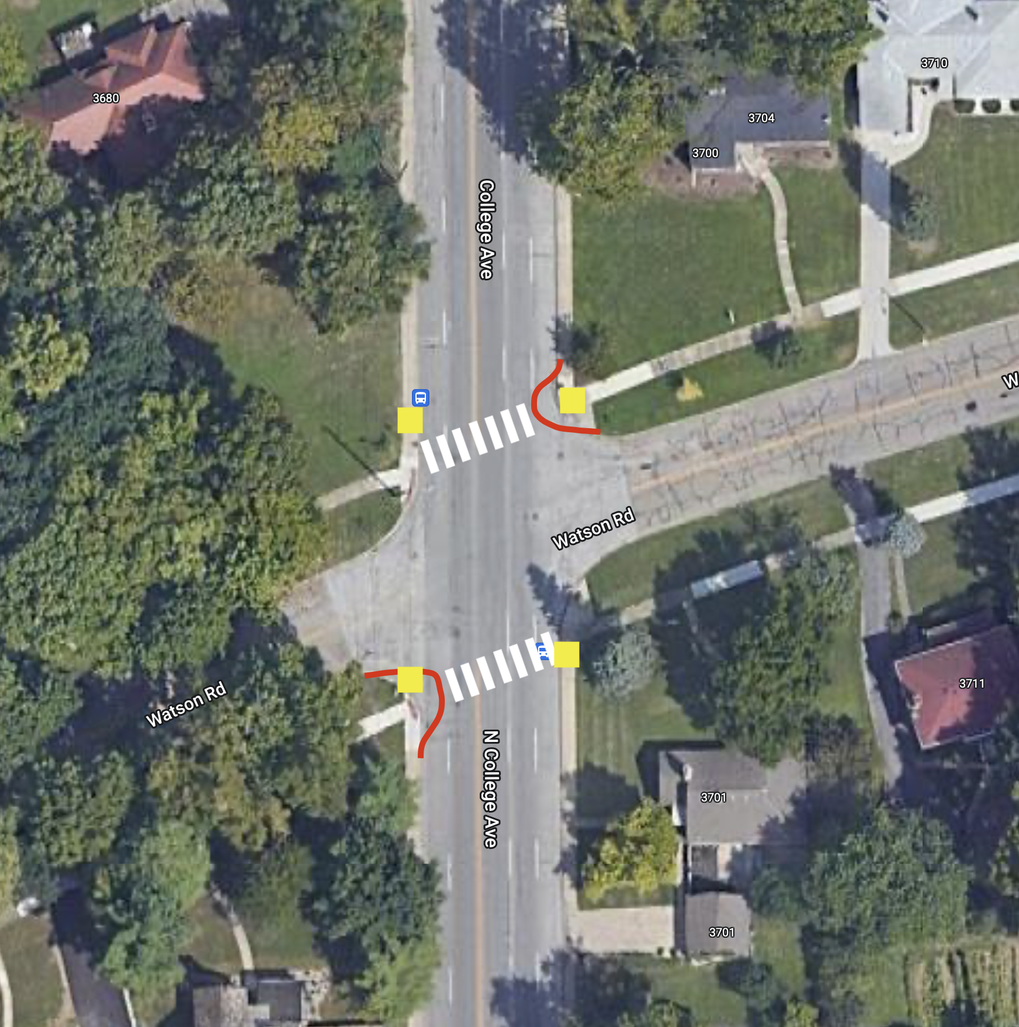
Potential projects
Watson Road crosswalk across College Ave

Slide 16
What’s in it for the neighbors?
If you have an idea for a project, we might be able to help you plan
If you want to financially support a project, let us know.
If HWPNA sponsors a project, you may be asked to complete a survey about the project.

Slide 17
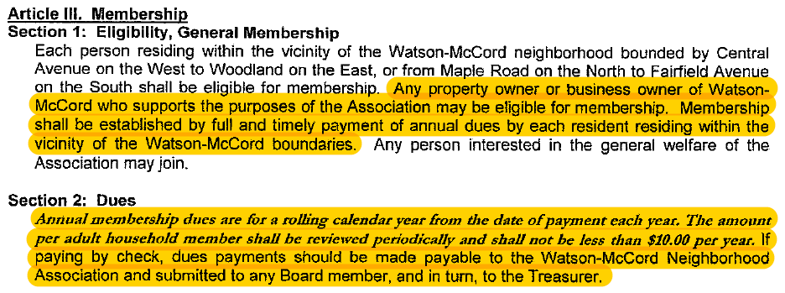
By-Law Updates
-By-Laws are dated, last signed copy is from 5/11/2010
-Will be changing Article III, Section 1 and Section 2 Effective Immediately

Slide 18
By-Law Updates Cont’d
-Will be changing Article X, Section 3 Effective Immediately
Link to Current By-Laws

Slide 19
Mayor’s Neighborhood Advocate - Nassif Kouton
-Introduction
-Mayor’s Action Line and Mobile App
-Open Discussion Relating to Ongoing Neighborhood Issues/Concerns

Slide 20
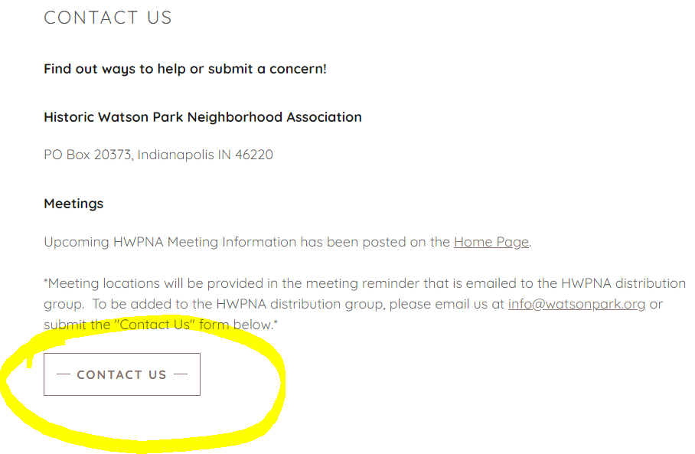
Ways to Contact HWPNA
Website
www.watsonpark.org
Email
info@watsonpark.org
Facebook (non-official HWPNA)
https://www.facebook.com/groups/WatsonMcCord

Slide 21
Open Discussion and Meeting Closure

