Slide 1
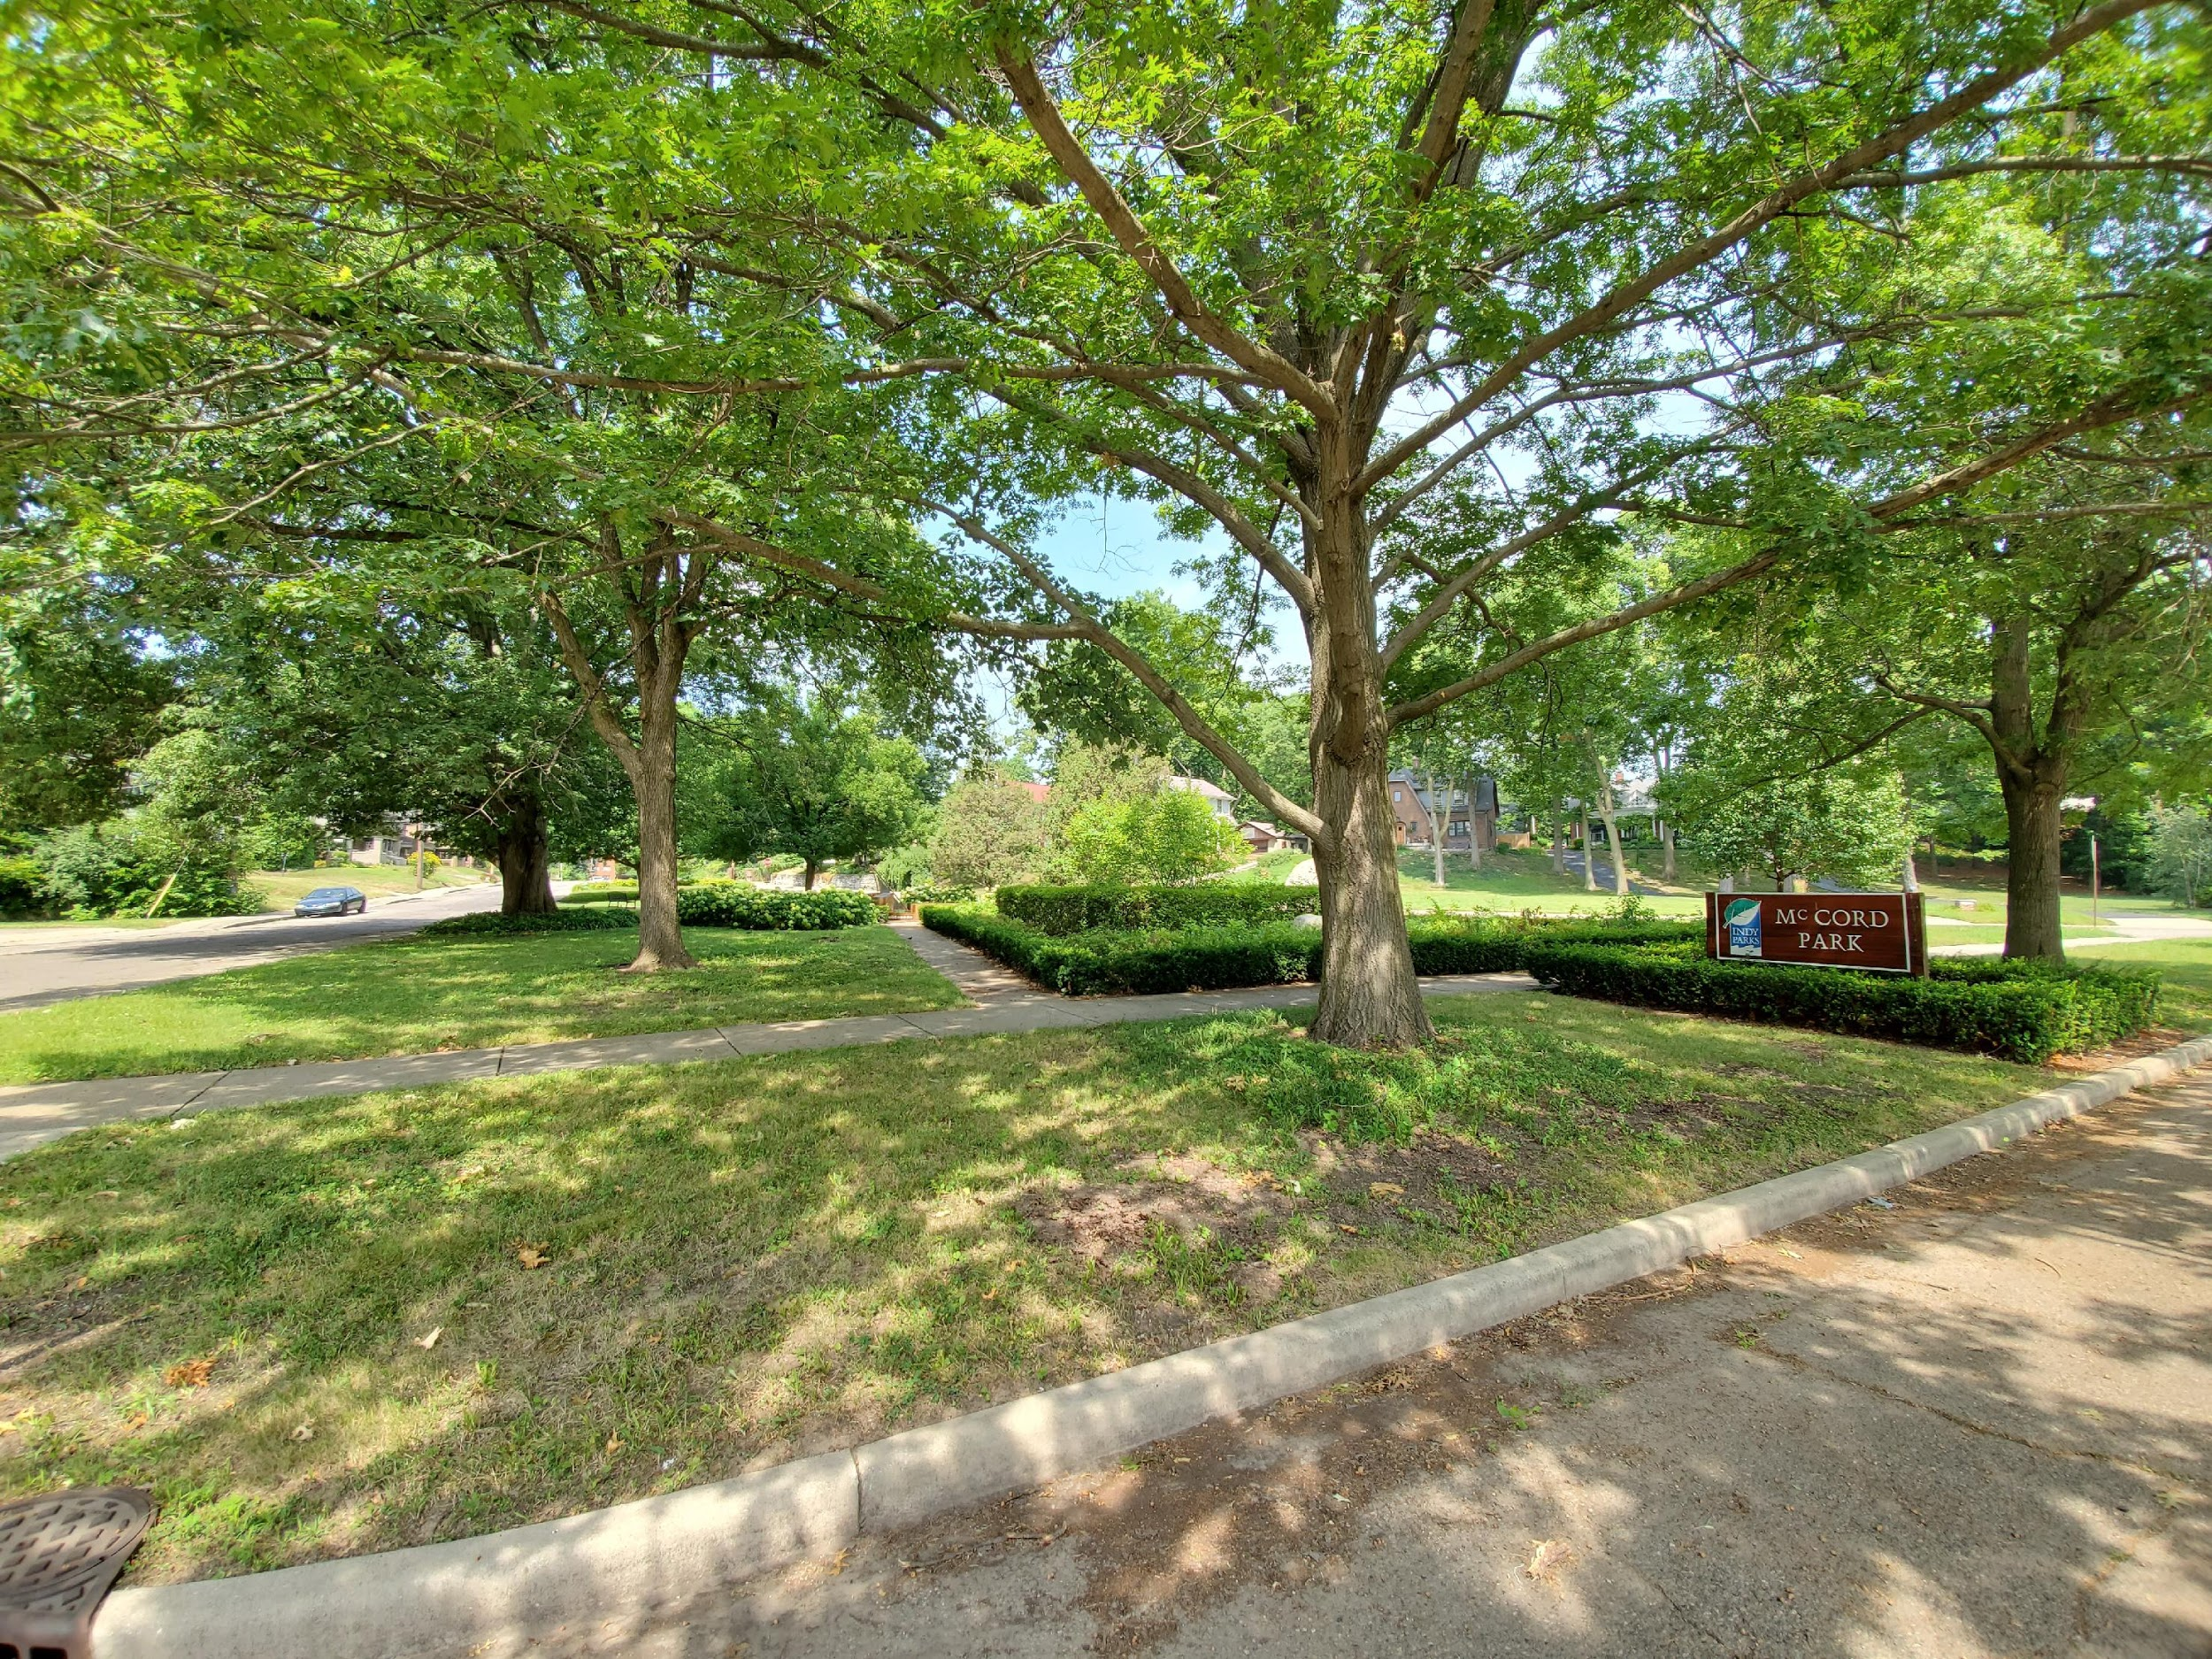
WATSON PARK NEIGHBORHOOD ASSOCIATION
MEETING
January 21st, 2020

Slide 2
CALL TO ORDER

Slide 3
ROLL CALL

Slide 4
IMPD
Officer Bill Murphy

Slide 5
Reading and Approval of Minutes

Slide 6
Treasurer’s Report
Total Balance………………………..$4,324.72
Expenses include neighborhood engagement, beautification, and Association expenses.

Slide 7
Follow-Up Items from Previous Meeting
Updates on the sewer work on Central Ave that is impacting traffic (Jeffery)
Updates on the 38th and College building and empty lot (Jeffery)

Slide 8
Highlights from 2019
Saved Ash trees in McCord Park
WPNA now has over 125 Members
Moved WPNA Meetings to RHC
Organized neighborhood trash pick-up with Keep Indianapolis Beautiful

Slide 9
Goals for 2020
Build and strengthen relationships with local community building organizations
Invite local business owners to WPNA meetings
Host more WPNA community building events
Add more WPNA Board members

Slide 10
Guest Speakers
Mapleton-Fall Creek Development Corporation
Mayor’s Action Advocate
Children’s Museum Director of Community Initiatives

Slide 11
Board Updates
Domonick Beard is now Vice President
Kyra Willingham and Jeremy Thompkins have joined the Board
Secretary position is available
Board seats are still available

Slide 12
OPEN FORUM

Slide 13
Guest Speaker Info
MFCDC
  Brittany Rasdall (brasdall@mfcdc.org)
Mayor’s Action Advocate
  Jeffery Burgin (Jeffery.Burgin@indy.gov)
Children’s Museum
  Shanna Martin (SMartin@childrensmuseum.org)

Slide 14
ADJOURNMENT

