Slide 1
WATSON PARK NEIGHBORHOOD ASSOCIATION MEETING
September 17, 2019

Slide 2
Board Updates
Dianne and Domonick joined Board
Kent resigned as Secretary, Sarah is now interim Secretary until December elections
Yard Signs!

Slide 3
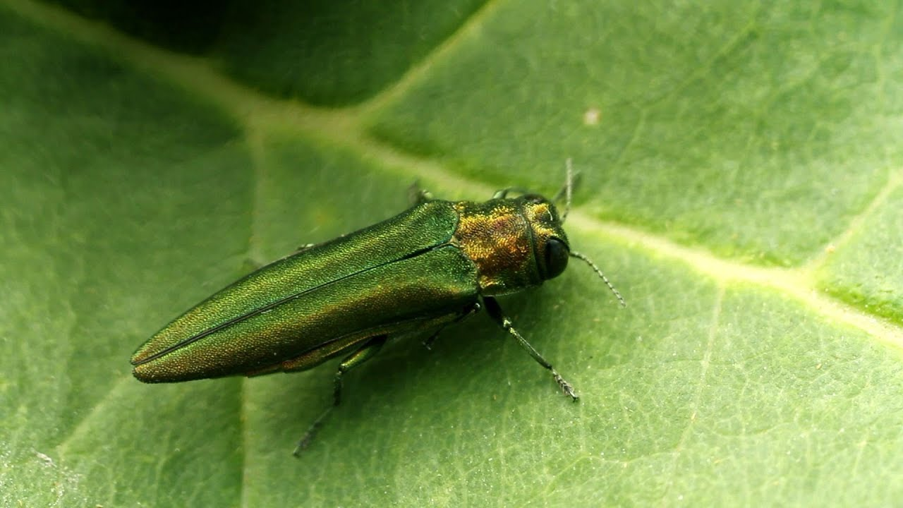
McCord Park Updates
New Subcommittee led by Vince Burton and Curt Miller
Emerald Ash Borer Preventative Treatment

Slide 4
McCord Park Updates
KIB Stewardship Assistance Program Grant
Landscaping Day – October 12th

Slide 5
Neighborhood Projects
2800 to 3000 block of Central – MFCDC Housing Project
150 units of mixed-use, mixed-income multi-family and single-family housing
Will create 100 jobs
Projected to cost $60M

Slide 6
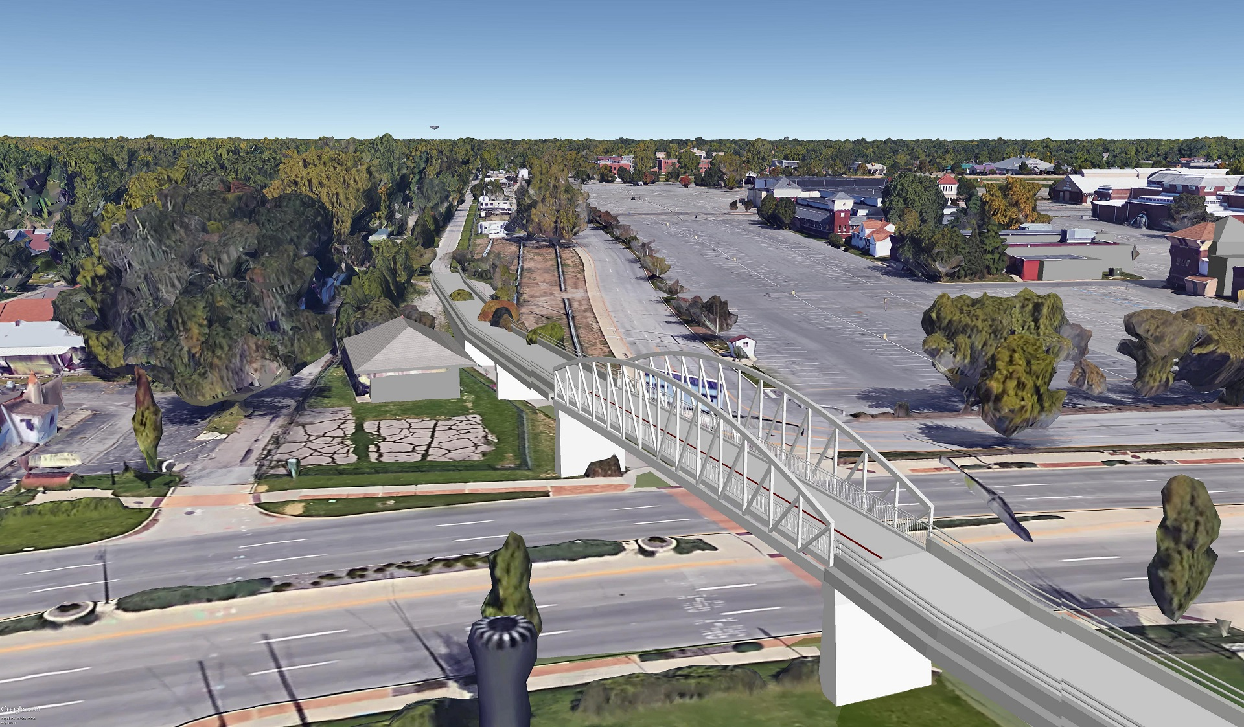
Neighborhood Projects
38th and The Monon – DPW Project BR-18-002

Slide 7
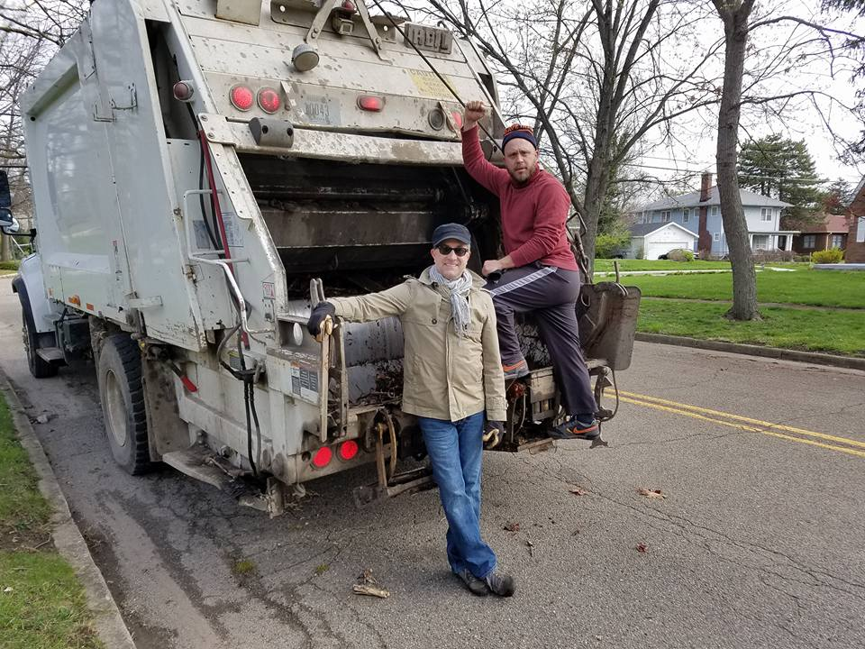
Neighborhood Events
KIB Great Indy Cleanup – October 26th

Slide 8
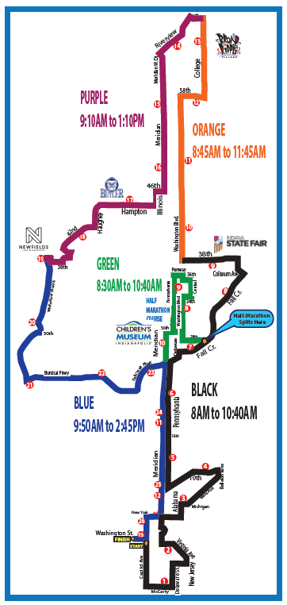
Neighborhood Events
CNO Monumental Marathon – November 9th

Slide 9
Neighborhood Events
WPNA Christmas Party – December 7th
Hosted by Glenn Lewzader

Slide 10
Feedback?
What do you like about the Association meetings? What could be improved?
Are you interested in local law enforcement being present at the Association meetings?

