Slide 1

Week 1 - Intro To Camp

Slide 2
Description:
The first week of summer camp is all about creating a welcoming and comfortable environment for children. It focuses on fostering positive relationships, establishing boundaries, and providing opportunities for free expression and creativity. During this week, children will engage in various art activities and have free time to explore their interests.

Slide 3

Lesson Plans
for Ages 0-3:

Slide 4
Lesson Plans for Ages 0-3:
1. Sensory Art Exploration
Materials: Finger paint, textured objects, sensory bins
Duration: 20-30 minutes
Description: Encourage infants and toddlers to explore different textures and colors through sensory art activities. Let them use their hands and fingers to create unique art pieces, fostering sensory development and self-expression.
2. Creative Movement
Materials: Music, open space for movement
Duration: 15-20 minutes
Description: Engage children in interactive music and movement sessions. Incorporate songs, nursery rhymes, and simple dance movements to enhance their gross motor skills, rhythm, and social interaction.

Slide 5





Lesson Plans for Ages 0-3:
3. Nature Collage
Materials: Leaves, flowers, sticks, glue, paper
Duration: 30-40 minutes
Description: Collect natural materials from the surroundings and guide children in creating a collaborative nature collage. Encourage them to stick the materials onto a large sheet of paper using glue, promoting creativity and connection with the natural world.

Slide 6
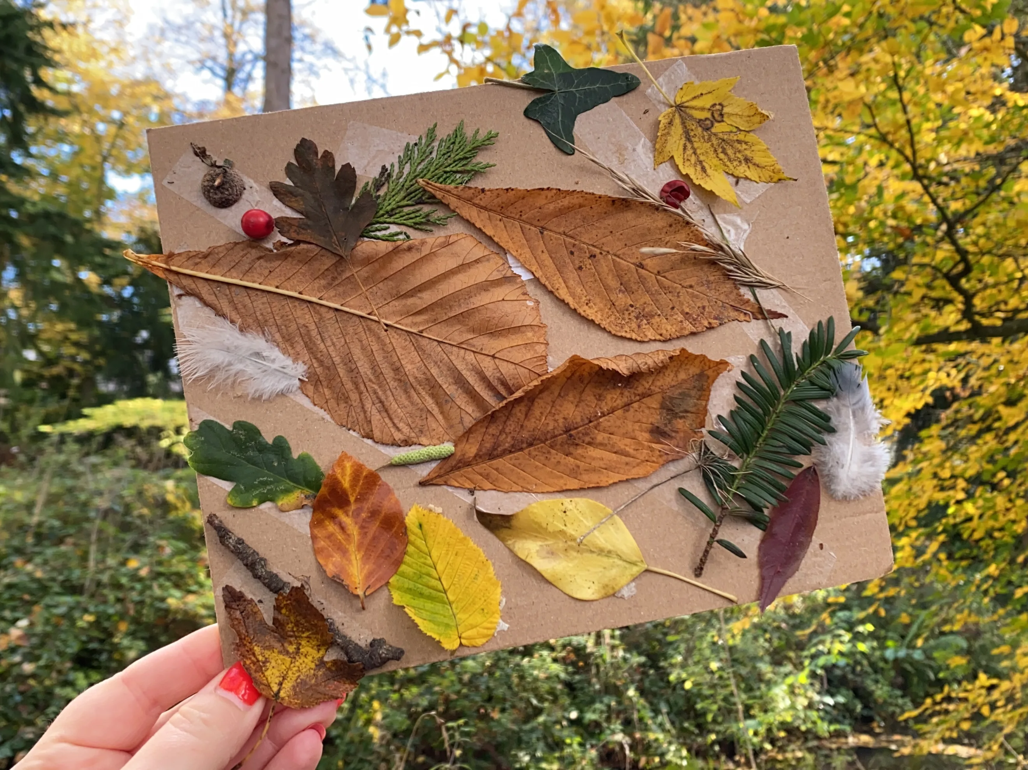

Slide 7

Lesson Plans
for Ages 4-7:

Slide 8
Lesson Plans for Ages 4-7:
1. Summer-themed Crafts
Materials: Paper plates, markers, beads, yarn
Duration: 30-40 minutes
Description: Let children create summer-themed crafts like sun catchers, paper plate crafts, and friendship bracelets using colorful materials. Encourage them to express their creativity and personal style while fostering fine motor skills.
2. Outdoor Games
Materials: Music, cones, balls, hula hoops
Duration: 30-45 minutes
Description: Organize group games like freeze dance, relay races, and scavenger hunts to promote teamwork, physical activity, and social interaction. Provide clear instructions and ensure a safe and inclusive environment.

Slide 9

Lesson Plans for Ages 4-7:
3. Storytelling and Dramatic Play
Materials: Storybooks, costumes, props
Duration: 20-30 minutes
Description: Engage children in dramatic play activities where they can act out their favorite summer stories and use their imaginations. Provide storybooks and props to enhance their storytelling experience, promoting language development and creativity.

Slide 10
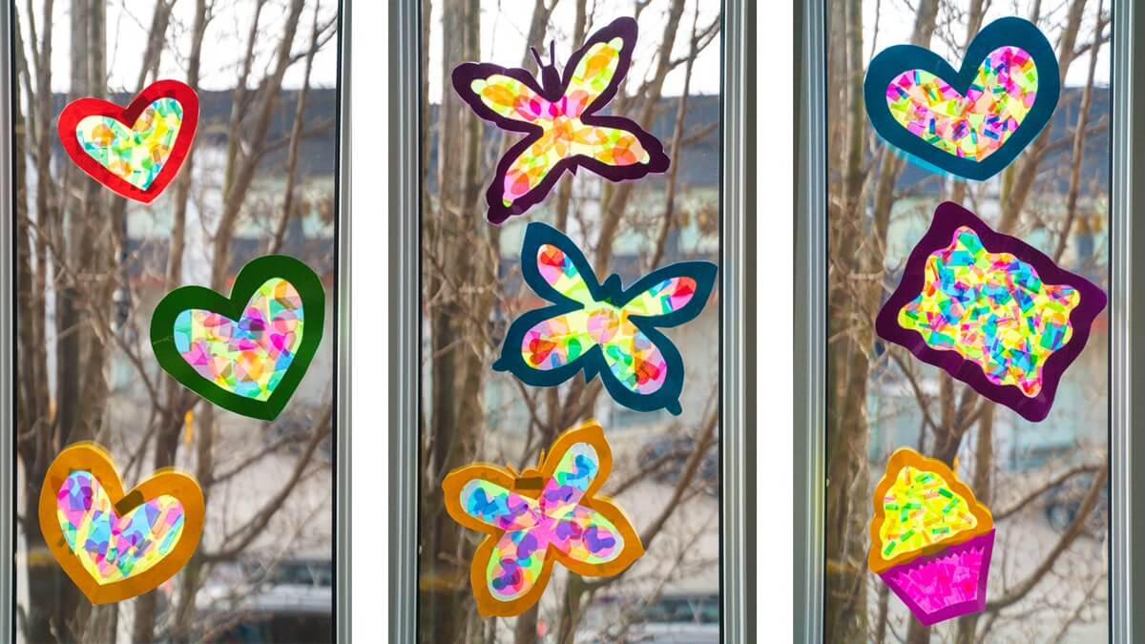

Slide 11

Lesson Plans
for Ages 8-11:

Slide 12
Lesson Plans for Ages 8-11:
1. DIY Art Project
Materials: Tie-dye kit, paper, markers, origami paper
Duration: 40-60 minutes
Description: Introduce various art techniques like tie-dye, papercrafts, and origami. Let children create their own unique art pieces, following step-by-step instructions and exploring their creativity. Encourage them to share their artworks and discuss their inspirations.
2. Team-Building Activities
Materials: Cones, ropes, blindfolds
Duration: 30-45 minutes
Description: Plan team challenges and problem-solving activities to promote cooperation, communication, and critical thinking skills. Engage children in activities like building human pyramids, obstacle courses, and trust exercises, fostering teamwork and leadership qualities.

Slide 13


Lesson Plans for Ages 8-11:
3. Talent Show Preparation
Materials: Music, props, costumes
Duration: Multiple sessions (1-2 hours each)
Description: Guide children in preparing for a talent show. Provide opportunities for them to showcase their talents, whether it's singing, dancing, magic tricks, or playing a musical instrument. Help them practice their acts, build self-confidence, and encourage mutual support and appreciation.

Slide 14
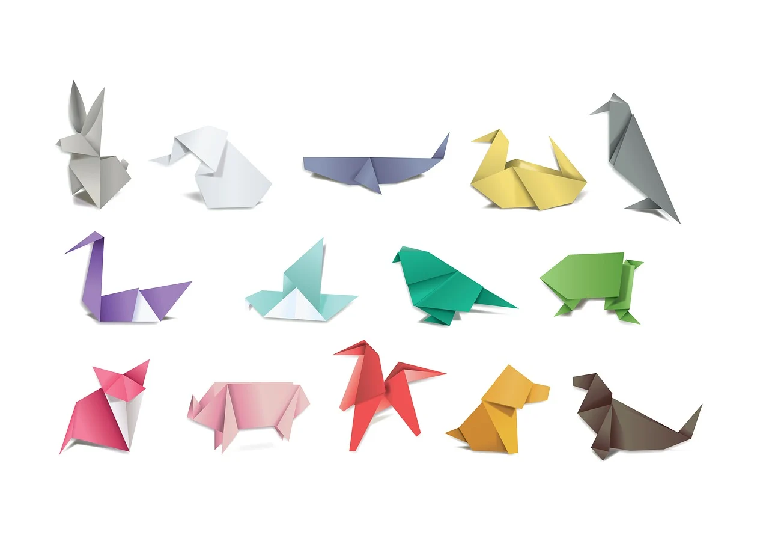

Slide 15
Conclusion
By combining these engaging activities, the first week of camp aims to create a positive and inclusive atmosphere where children can build connections, develop their creativity, and embrace the spirit of summer fun.

Slide 16

Debrief / Huddle
As a group, discuss the following questions:
One thing that was new to you regarding the content / lesson plans presented?
One thing that was familiar to you regarding the content / lesson plans presented?
Any stories or previous experiences regarding today’s content on Week 1 - Intro To Camp?

Slide 17

Thanks!
Do you have any questions?
support@atccenter.org
tel: (253) 368-9705
atccenter.org
Please keep this slide for attribution

