Slide 1

Week 10 - Multicultural Week: Embracing Diversity and Fostering Inclusive Understanding

Slide 2
Description:
Multicultural Week is a special program designed to celebrate and embrace the diversity of cultures around the world. Through engaging activities and interactive experiences, children are provided with opportunities to explore various aspects of different cultures, promoting inclusivity, and cultivating a sense of common ground understanding. This week-long journey encourages children to appreciate the beauty of diversity, foster empathy, and develop a global perspective that values and respects the uniqueness of every individual.

Slide 3
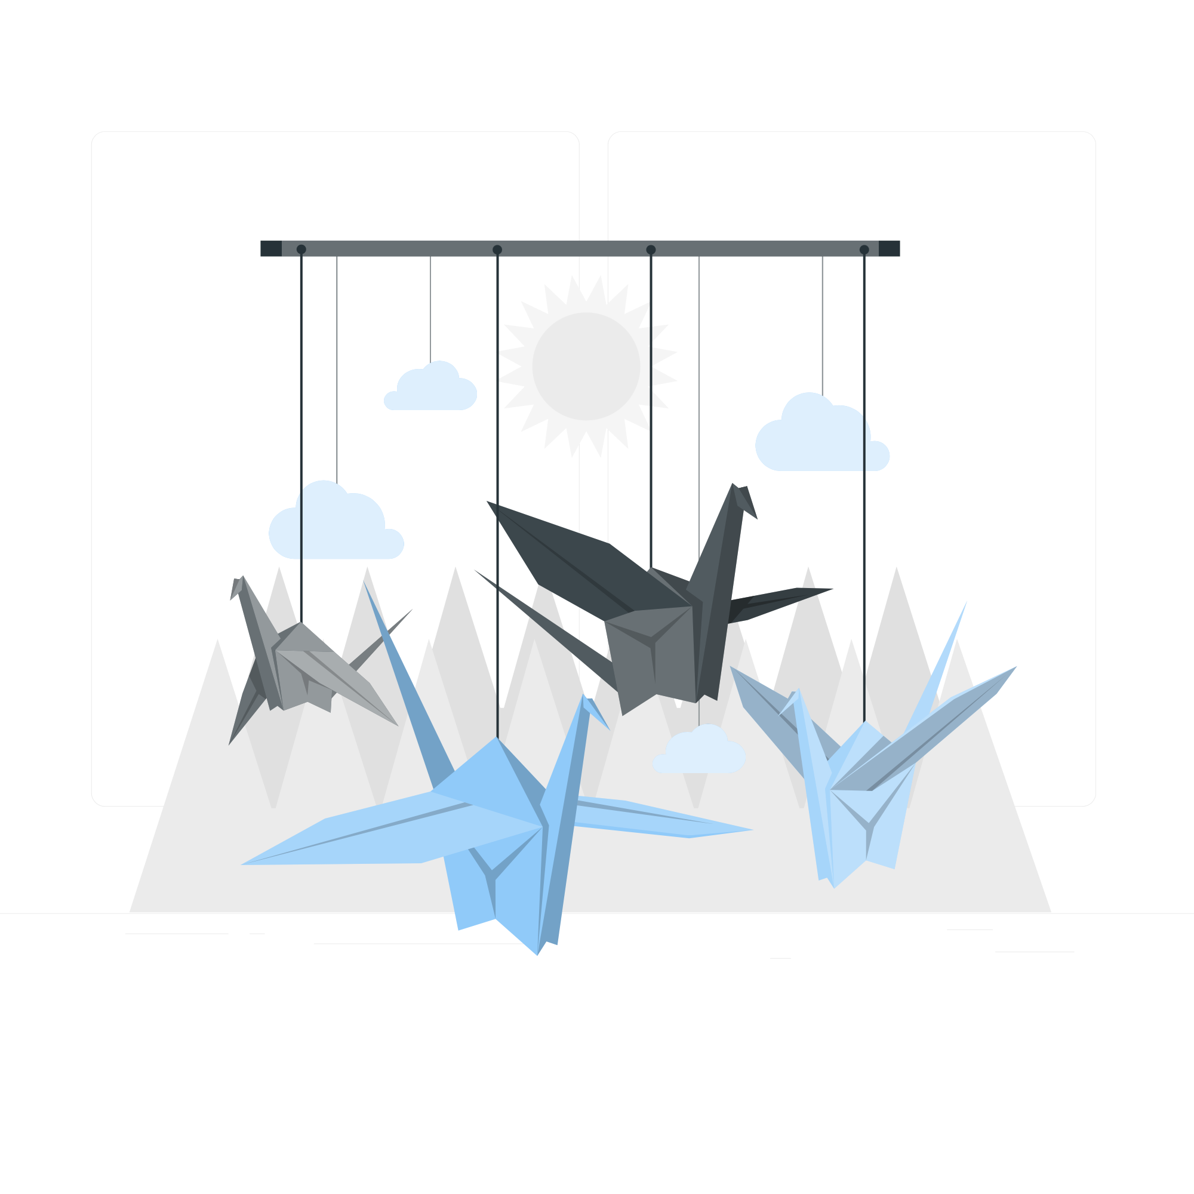
Lesson Plans
for Ages 0-3:

Slide 4
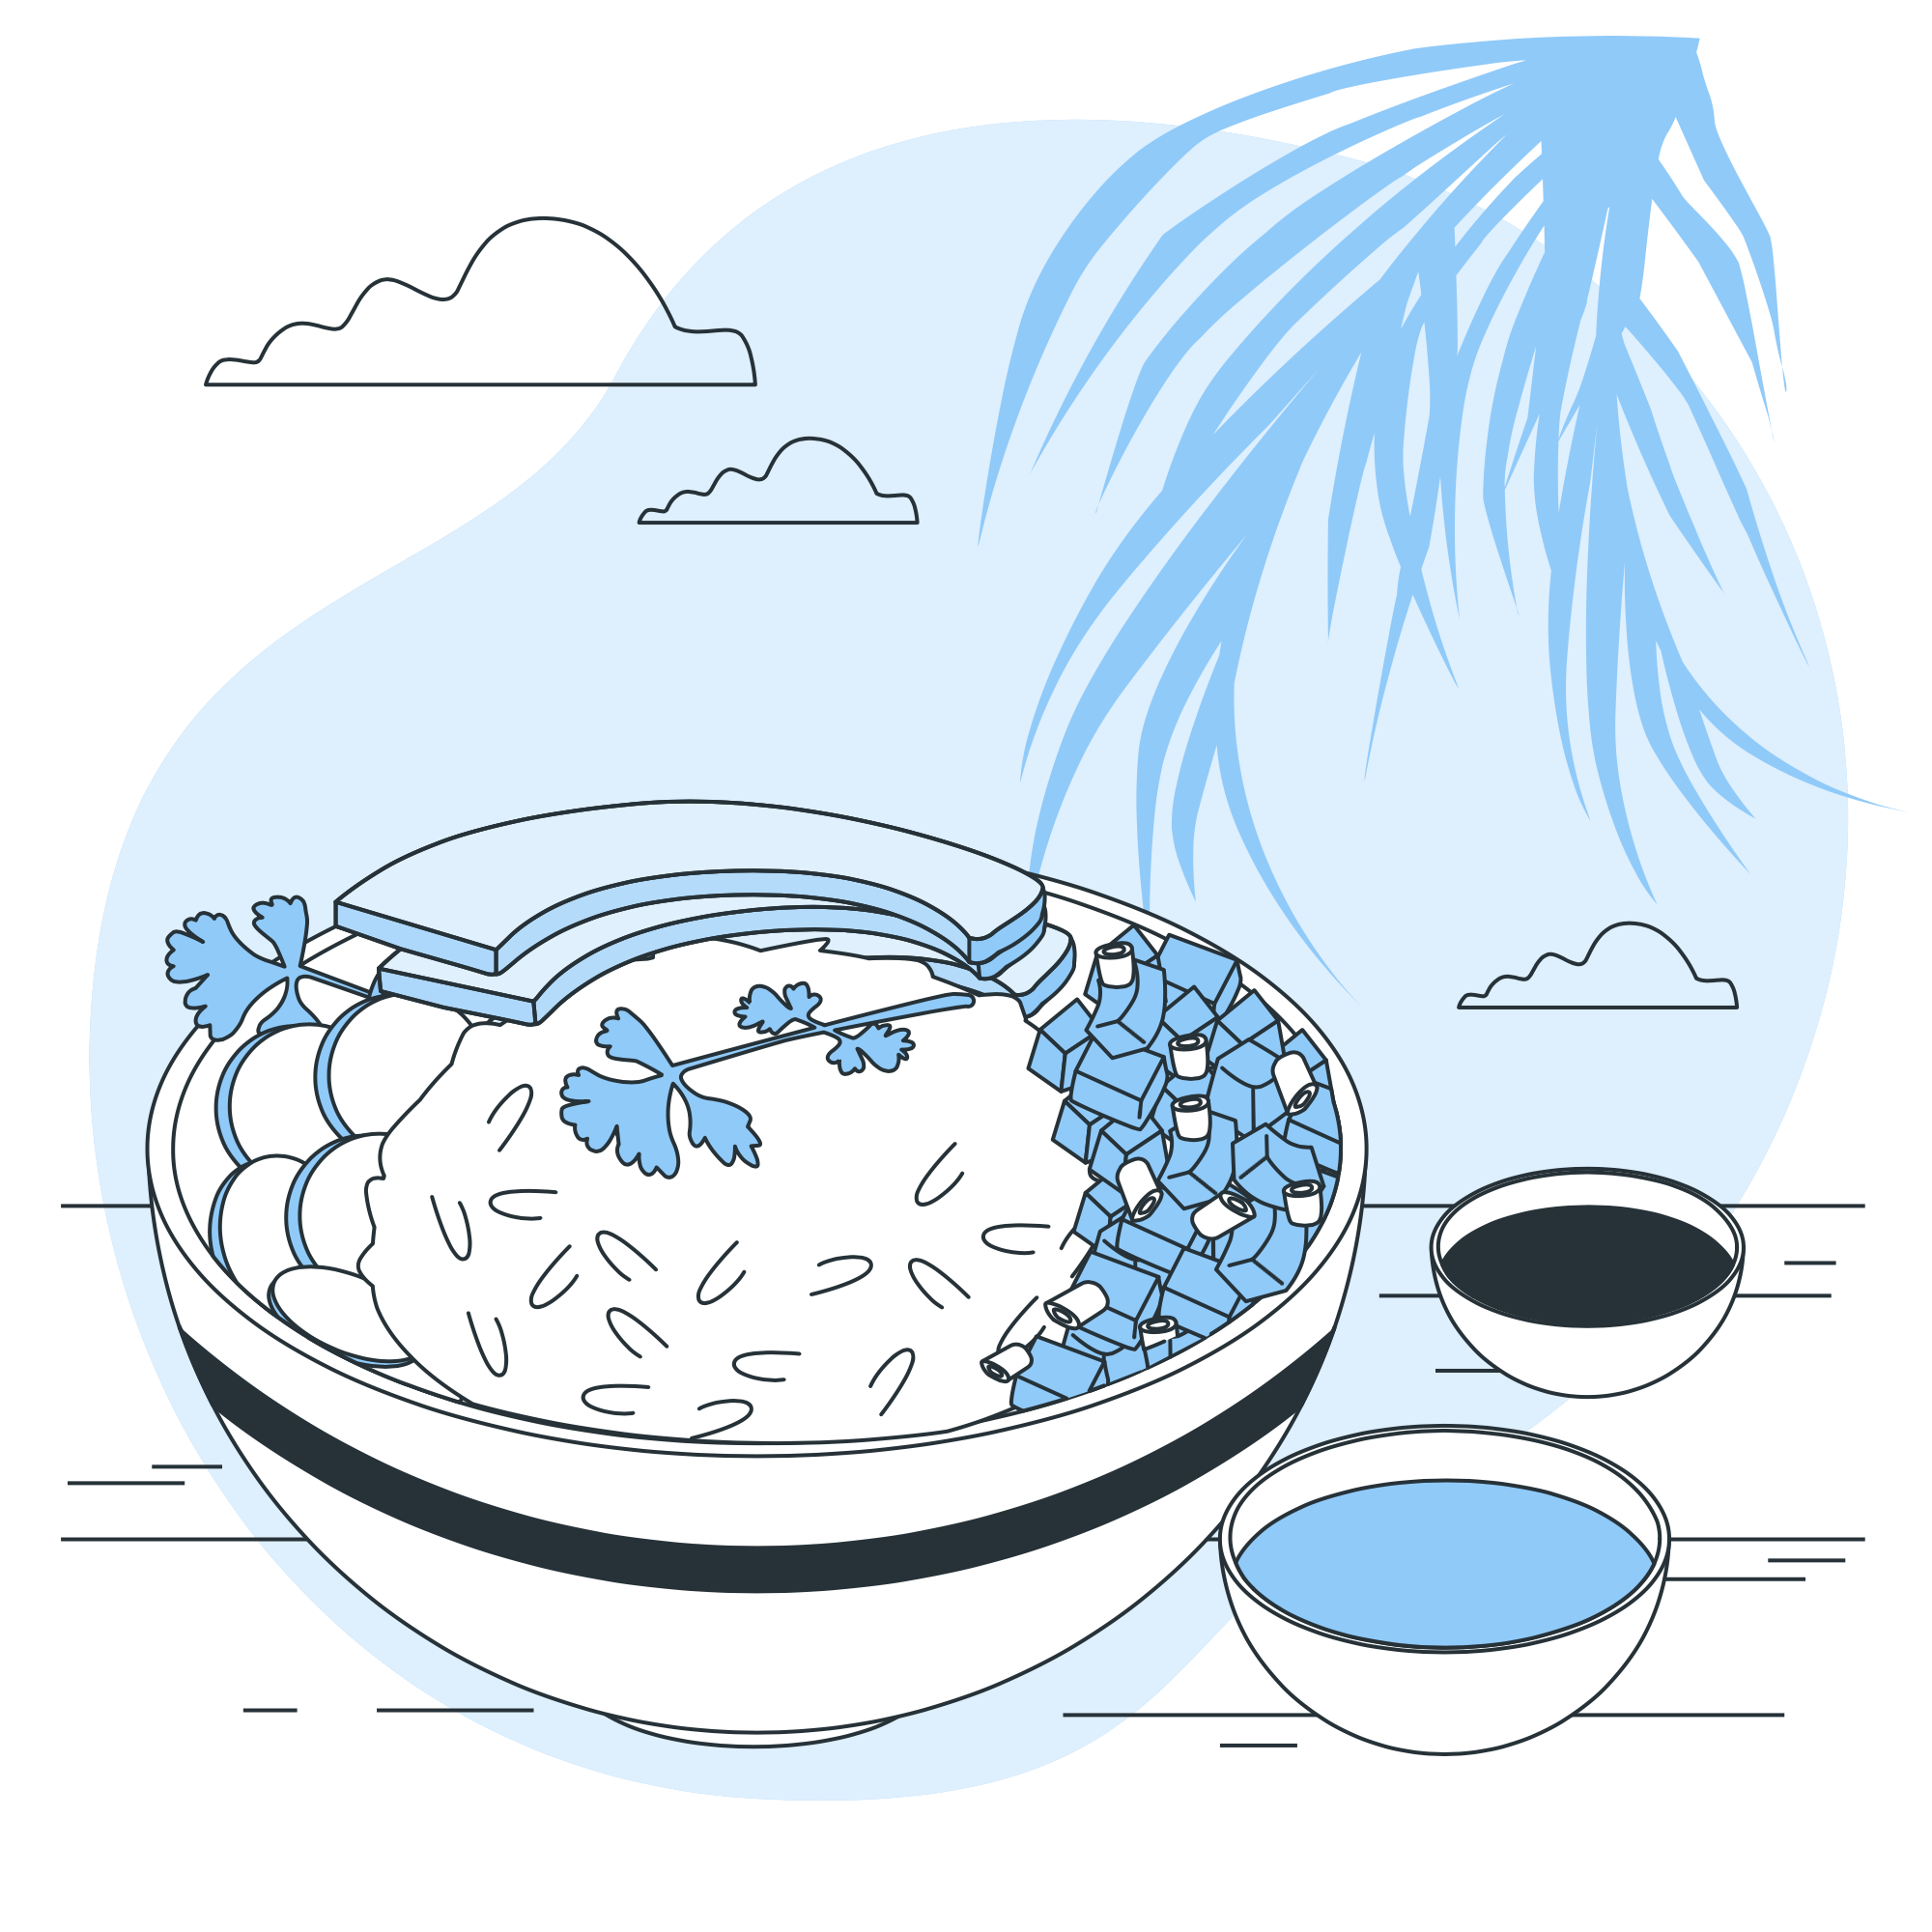
Lesson Plans for Ages 0-3:
1. Sensory Rice Play
Materials: Cooked rice, food coloring, sensory bin, small bowls, spoons
Duration: 20-30 minutes
Description: Sensory play with rice is an engaging way for infants and toddlers to discover the wonders of different textures and colors. By dyeing the rice with various food coloring, children are exposed to vibrant hues that stimulate their senses. Through scooping, pouring, and transferring rice using bowls and spoons, children develop their fine motor skills, sensory exploration, and color recognition abilities. This activity fosters an appreciation for diversity in sensory experiences and encourages inclusivity in exploring new textures and colors.

Slide 5



Lesson Plans for Ages 0-3:
2. Origami Animal Craft
Materials: Origami paper, instructions for simple animal origami (e.g., fish, bird, rabbit)
Duration: 30-45 minutes
Description: The art of origami offers a unique opportunity for toddlers and preschoolers to engage in cultural exploration through creative expression. By guiding children through the process of folding origami paper to create simple animal shapes, they develop their fine motor skills, concentration, and spatial awareness. This activity not only promotes an understanding of different art forms but also encourages children to appreciate the diverse ways in which cultures express their creativity. Emphasizing inclusivity, children are encouraged to unleash their imagination and create their own interpretations of the origami animals.

Slide 6
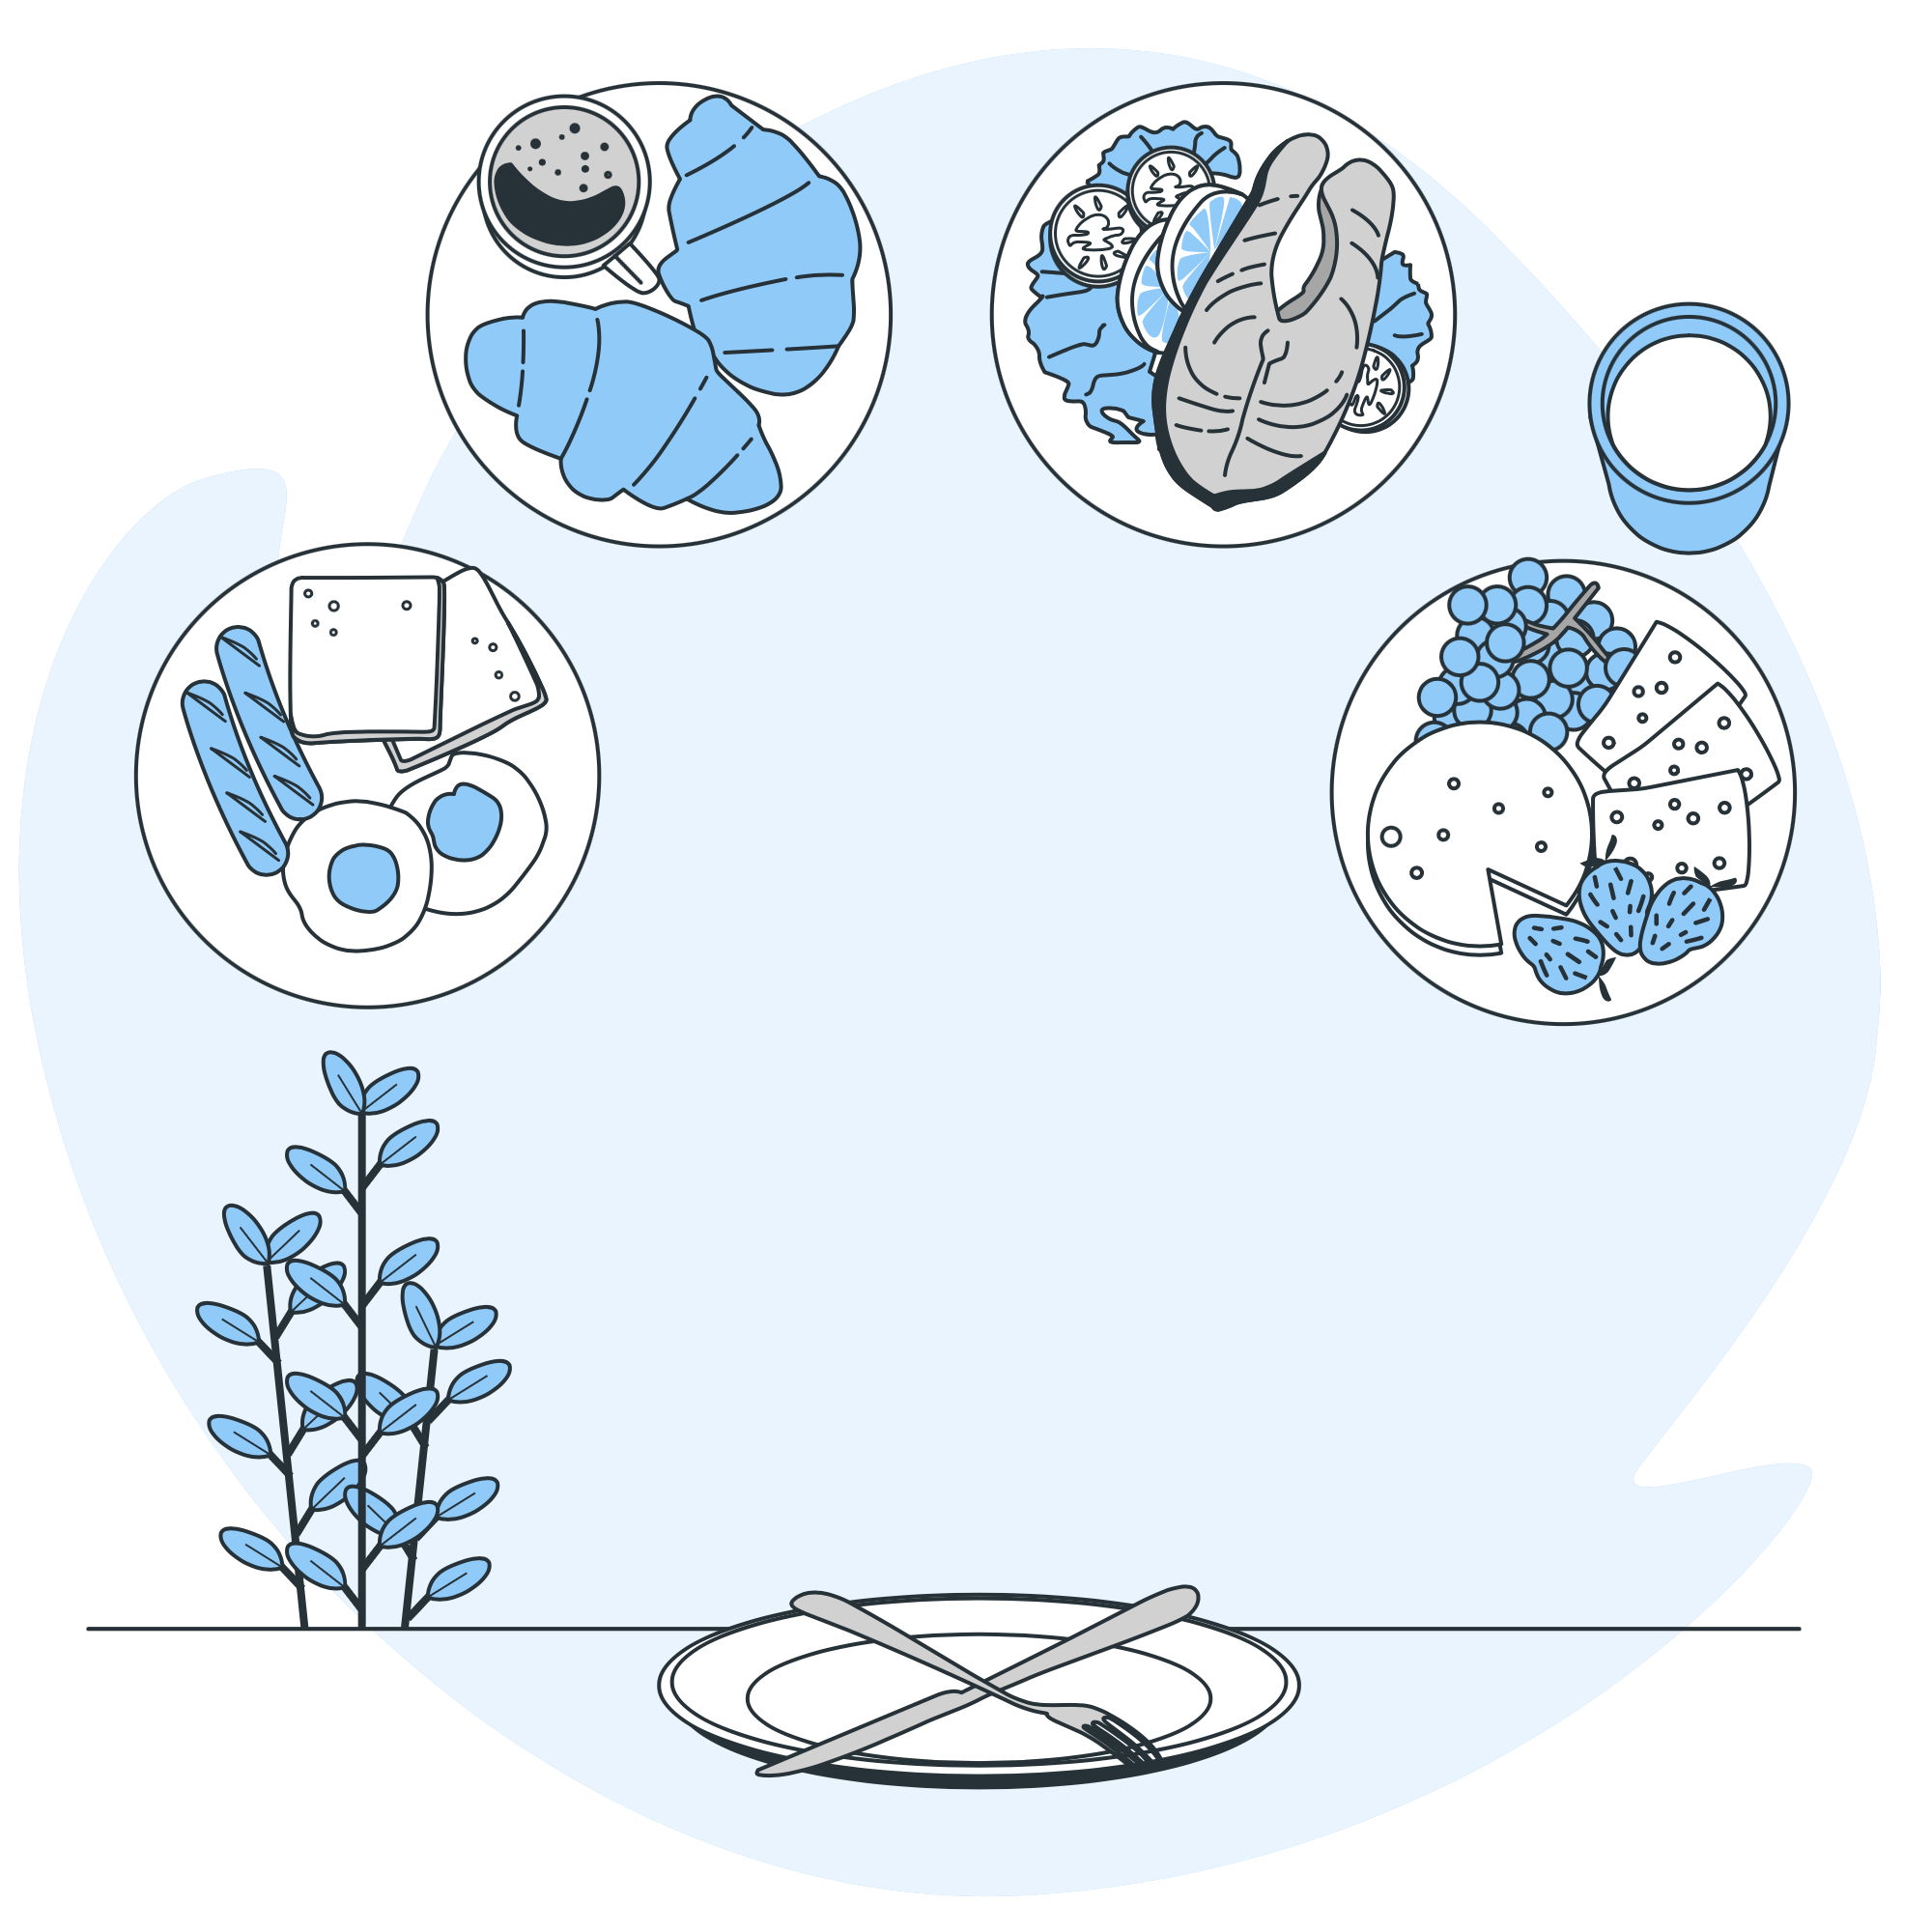
Lesson Plans for Ages 0-3:
3. Multicultural Food Tasting
Materials: Assorted snacks or dishes from different cultures
Duration: 20-30 minutes
Description: Through the Multicultural Food Tasting activity, children embark on a delightful culinary journey, exploring the tastes and flavors of diverse cultures. By providing a variety of snacks or dishes from different cultural backgrounds, children are exposed to new and exciting flavors, textures, and ingredients. This activity encourages an open-minded approach to food and fosters cultural appreciation. As children sample and discuss the distinctiveness of each dish, they develop an understanding of how different cultures celebrate their culinary traditions, promoting inclusivity and embracing diversity.

Slide 7
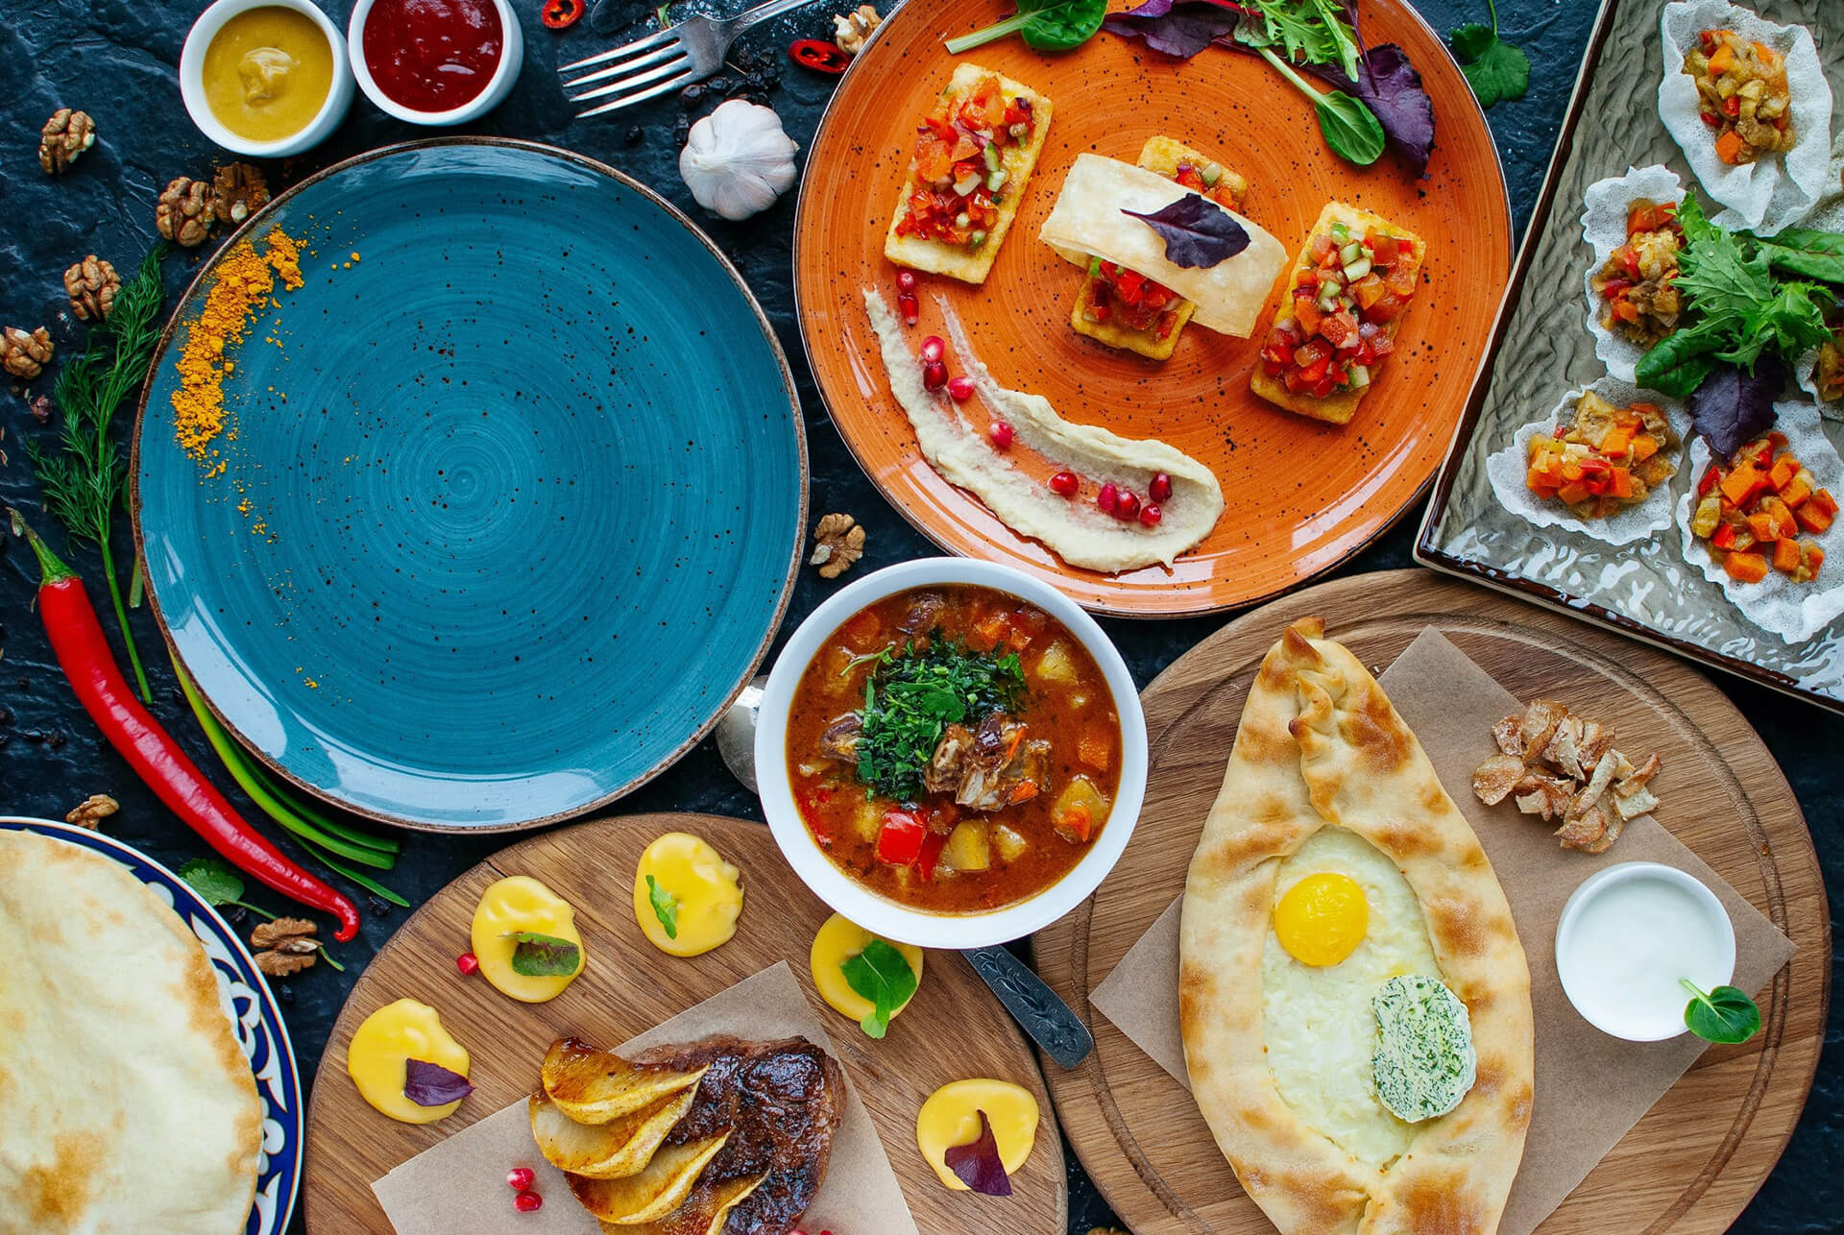

Slide 8
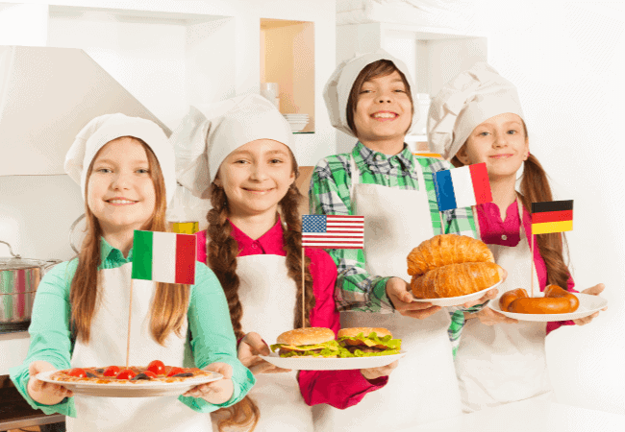

Slide 9
Song Lyrics (Applicable for all ages):
Verse 1: In this world, we come together, Diverse and unique, hand in hand. Different colors, cultures, and hearts, Embracing each other, a united band.
Chorus: We celebrate our diversity, In Multicultural Week, we find unity. Through language, food, and joyful play, Together we learn, each and every day.
Verse 2: Through art, we express our heritage, Colors and patterns, stories to be told. Origami animals, crafted with care, A symbol of cultures, new and old.
Chorus: We celebrate our diversity, In Multicultural Week, we find unity. Through language, food, and joyful play, Together we learn, each and every day.
Verse 3: Tasting flavors from around the world, Spices and ingredients, a global feast. Sharing dishes from diverse lands, Creating memories, a cultural feast.
Chorus: We celebrate our diversity, In Multicultural Week, we find unity. Through language, food, and joyful play, Together we learn, each and every day.
Note: Adjust the duration, materials, and complexity of the activities based on the age group and individual child's needs and abilities.

Slide 10
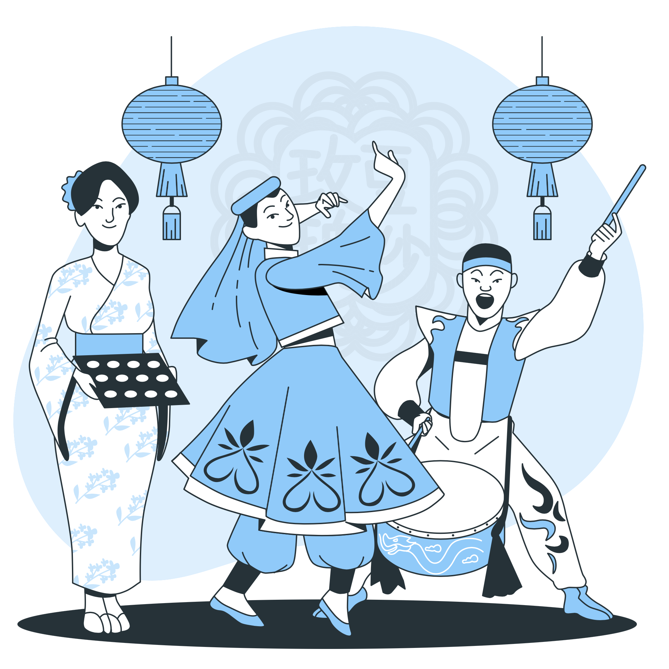
Lesson Plans
for Ages 4-7:

Slide 11

Lesson Plans for Ages 4-7:
1. Cultural Music and Dance Exploration
Materials: Music from various cultures, open space for movement
Duration: 45-60 minutes
Description: Through Cultural Music and Dance Exploration, children are introduced to the rich diversity of music and dance from different cultures. By playing music from various regions, children are encouraged to listen, move, and explore different rhythms and melodies. They learn simple dance moves or have the opportunity to create their own dances, promoting self-expression and cultural appreciation. This activity fosters inclusivity by showcasing the beauty of different dance styles and encouraging children to celebrate cultural diversity through movement.

Slide 12
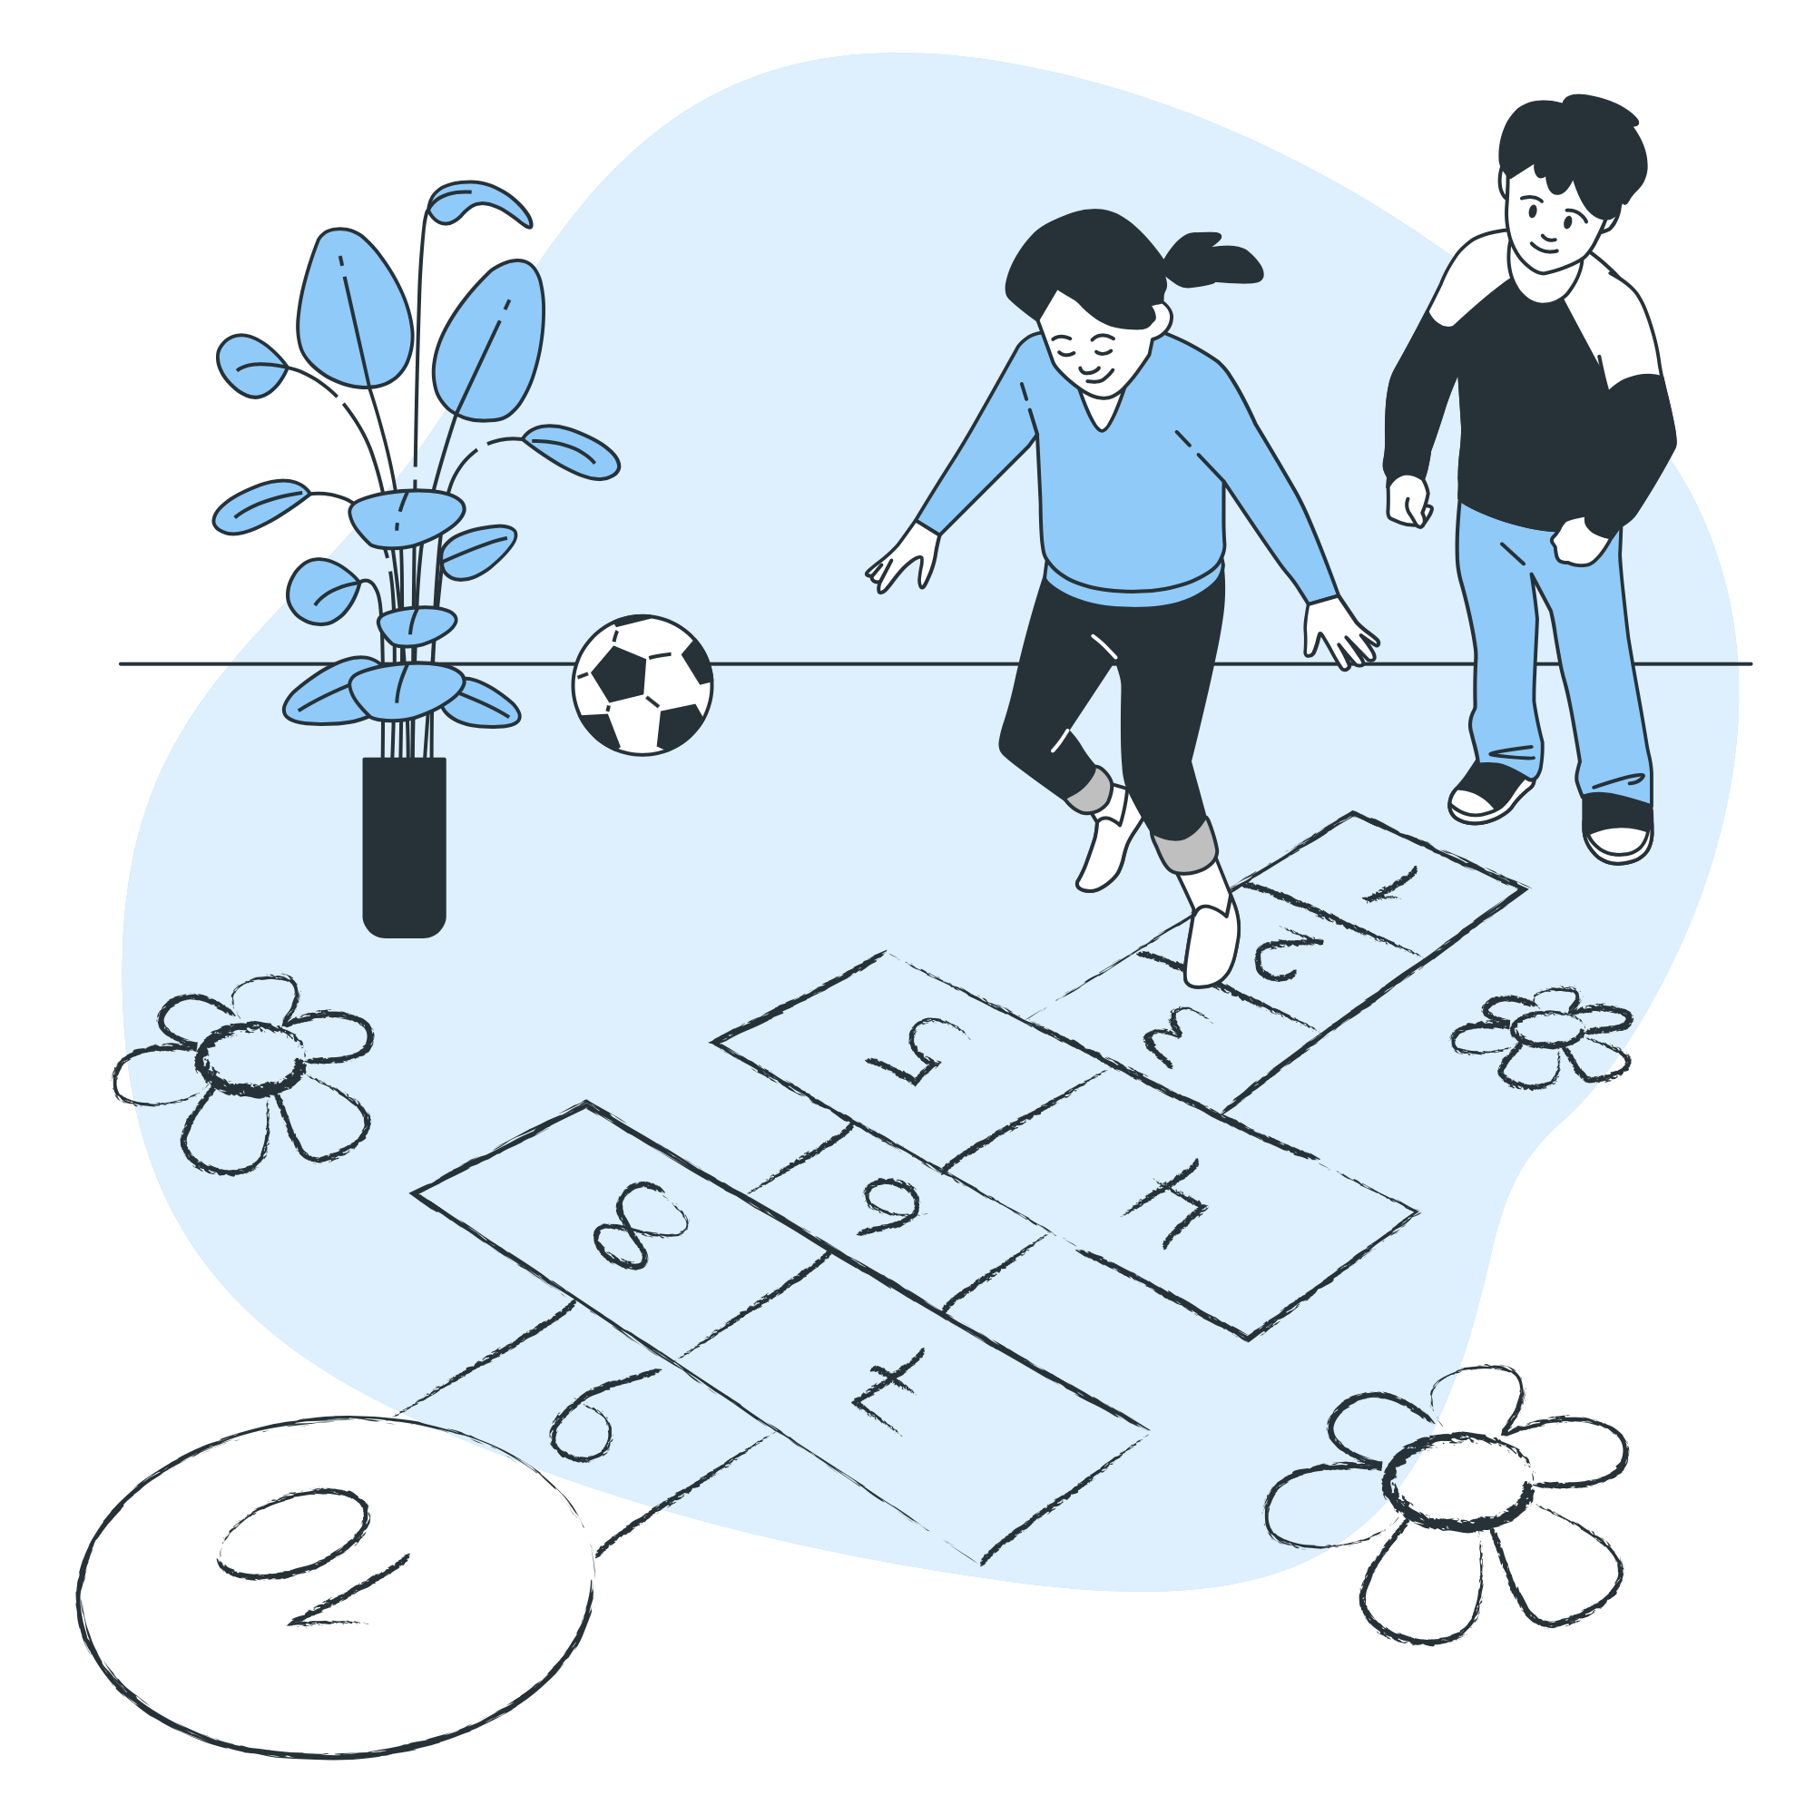
Lesson Plans for Ages 4-7:
2. Traditional Games from Around the World
Materials: Traditional games from different cultures (e.g., tag, hopscotch, jump rope)
Duration: 30-45 minutes
Description: Engaging children in Traditional Games from Around the World allows them to experience the joy of playing games that have been cherished in different cultures for generations. By teaching them the rules and techniques of games such as tag, hopscotch, or jump rope, children learn to appreciate the cultural heritage embedded within these activities. This activity promotes inclusivity and cooperation as children participate together, transcending cultural barriers and finding common ground through play.

Slide 13
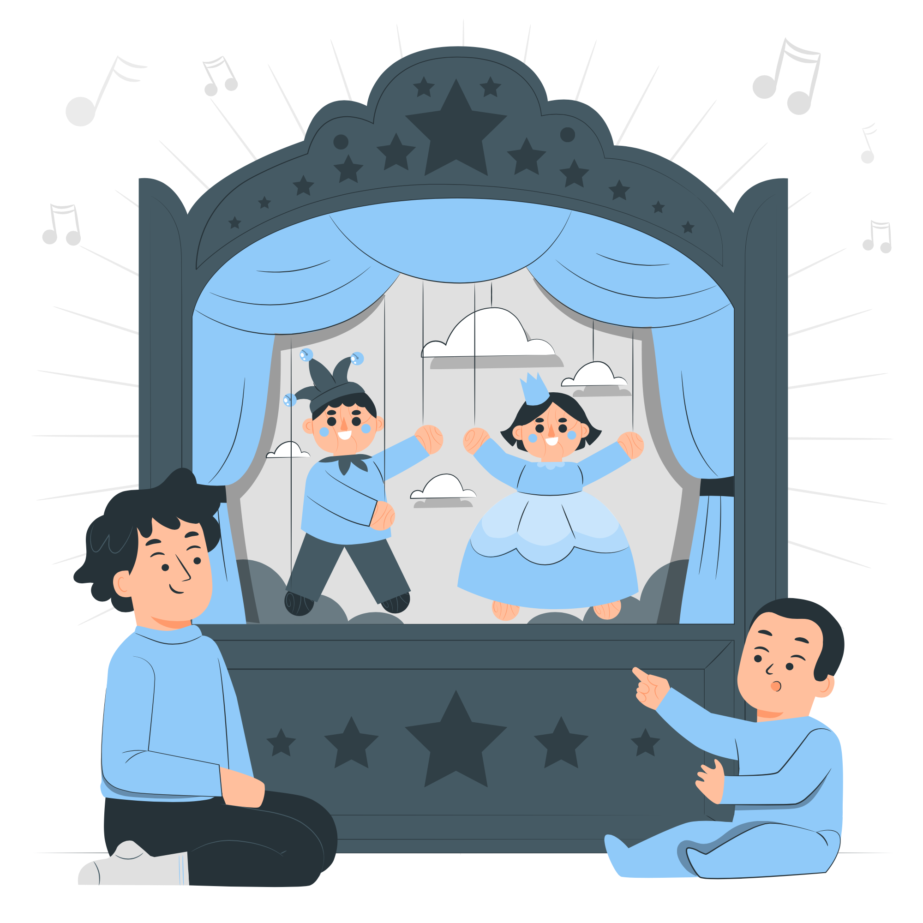

Lesson Plans for Ages 4-7:
3. Storytelling and Puppetry from Different Cultures
Materials: Storybooks or folktales from various cultures, puppets (optional)
Duration: 30-45 minutes
Description: Storytelling and Puppetry from Different Cultures provide children with an immersive experience of diverse cultural narratives. By sharing stories or folktales from different cultures, children are exposed to different storytelling traditions and themes. The use of puppets or props enhances the storytelling experience, capturing their imagination and creating a connection to the characters and settings. This activity encourages children to explore cultural elements, values, and lessons conveyed in the stories, fostering empathy and understanding.

Slide 14
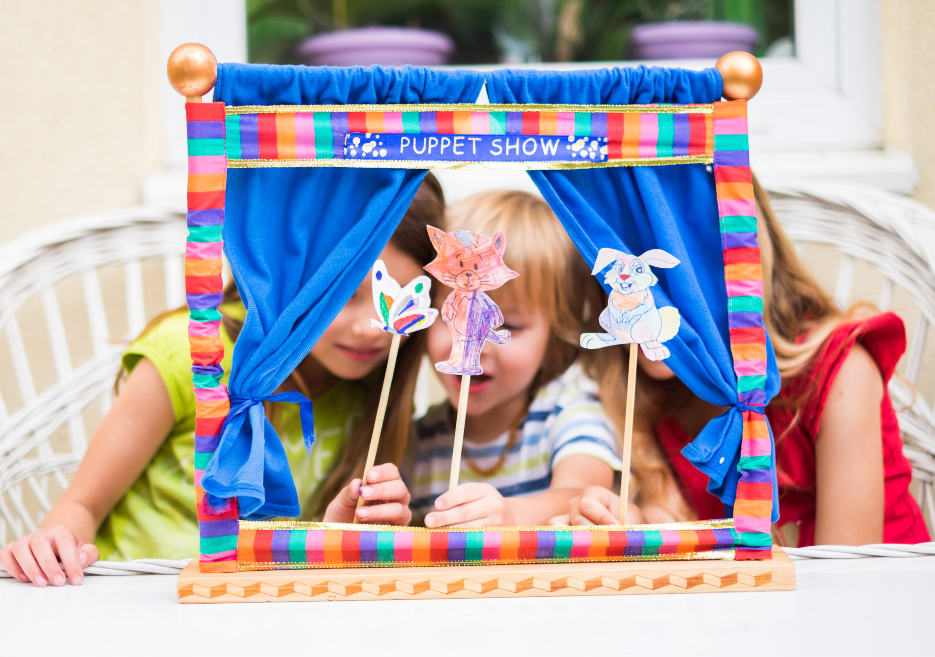

Slide 15
Song Lyrics (Applicable for all ages):
Verse 1: In this world, we come together, Diverse and unique, hand in hand. Different colors, cultures, and hearts, Embracing each other, a united band.
Chorus: We celebrate our diversity, In Multicultural Week, we find unity. Through language, food, and joyful play, Together we learn, each and every day.
Verse 2: Through art, we express our heritage, Colors and patterns, stories to be told. Origami animals, crafted with care, A symbol of cultures, new and old.
Chorus: We celebrate our diversity, In Multicultural Week, we find unity. Through language, food, and joyful play, Together we learn, each and every day.
Verse 3: Tasting flavors from around the world, Spices and ingredients, a global feast. Sharing dishes from diverse lands, Creating memories, a cultural feast.
Chorus: We celebrate our diversity, In Multicultural Week, we find unity. Through language, food, and joyful play, Together we learn, each and every day.
Note: Adjust the duration, materials, and complexity of the activities based on the age group and individual child's needs and abilities.

Slide 16

Lesson Plans
for Ages 8-11:

Slide 17


Lesson Plans for Ages 8-11:
1. World Cuisine Cooking Class
Materials: Ingredients for dishes from different cultures, cooking utensils, recipes
Duration: 60-90 minutes
Description: In the World Cuisine Cooking Class, children have the opportunity to explore and prepare dishes from various cultures. By providing them with step-by-step instructions, explaining ingredients, and teaching cooking techniques, they gain hands-on experience and develop culinary skills. Through this activity, children learn about different cooking traditions, flavors, and ingredients, fostering cultural appreciation and promoting inclusivity. At the end of the class, they enjoy the meal they have prepared together, celebrating the diversity of world cuisine.

Slide 18

Recipe: Chicken Curry
Ingredients:
500g boneless chicken, cut into pieces
1 onion, finely chopped
2 cloves of garlic, minced
1-inch piece of ginger, grated
2 tablespoons curry powder
1 can (400ml) coconut milk
2 tablespoons vegetable oil
Salt and pepper to taste
Fresh cilantro (optional, for garnish)

Slide 19
Recipe: Chicken Curry
Instructions:
Heat the vegetable oil in a large pan over medium heat.
Add the chopped onion, minced garlic, and grated ginger. Sauté until the onions are soft and translucent.
Add the curry powder and stir well to coat the onions and spices.
Add the chicken pieces to the pan and cook until they are browned on all sides.
Pour in the coconut milk and season with salt and pepper.
Cover the pan and simmer for about 20-25 minutes, or until the chicken is cooked through and tender.
Garnish with fresh cilantro, if desired.
Serve the chicken curry with steamed rice or naan bread.

Slide 20

Lesson Plans for Ages 8-11:
2. Cultural Art and Crafts Exploration
Materials: Art supplies (paper, paint, brushes, markers), reference materials on different cultural art forms
Duration: Multiple sessions (30-45 minutes each)
Description: Through Cultural Art and Crafts Exploration, children are encouraged to explore and create artwork inspired by different cultural art forms. By providing them with reference materials and demonstrating various techniques used in different cultures, such as painting, pottery, or textile art, children gain exposure to diverse artistic expressions. This activity fosters creativity, cultural understanding, and appreciation as children learn about the unique artistic traditions found around the world.

Slide 21
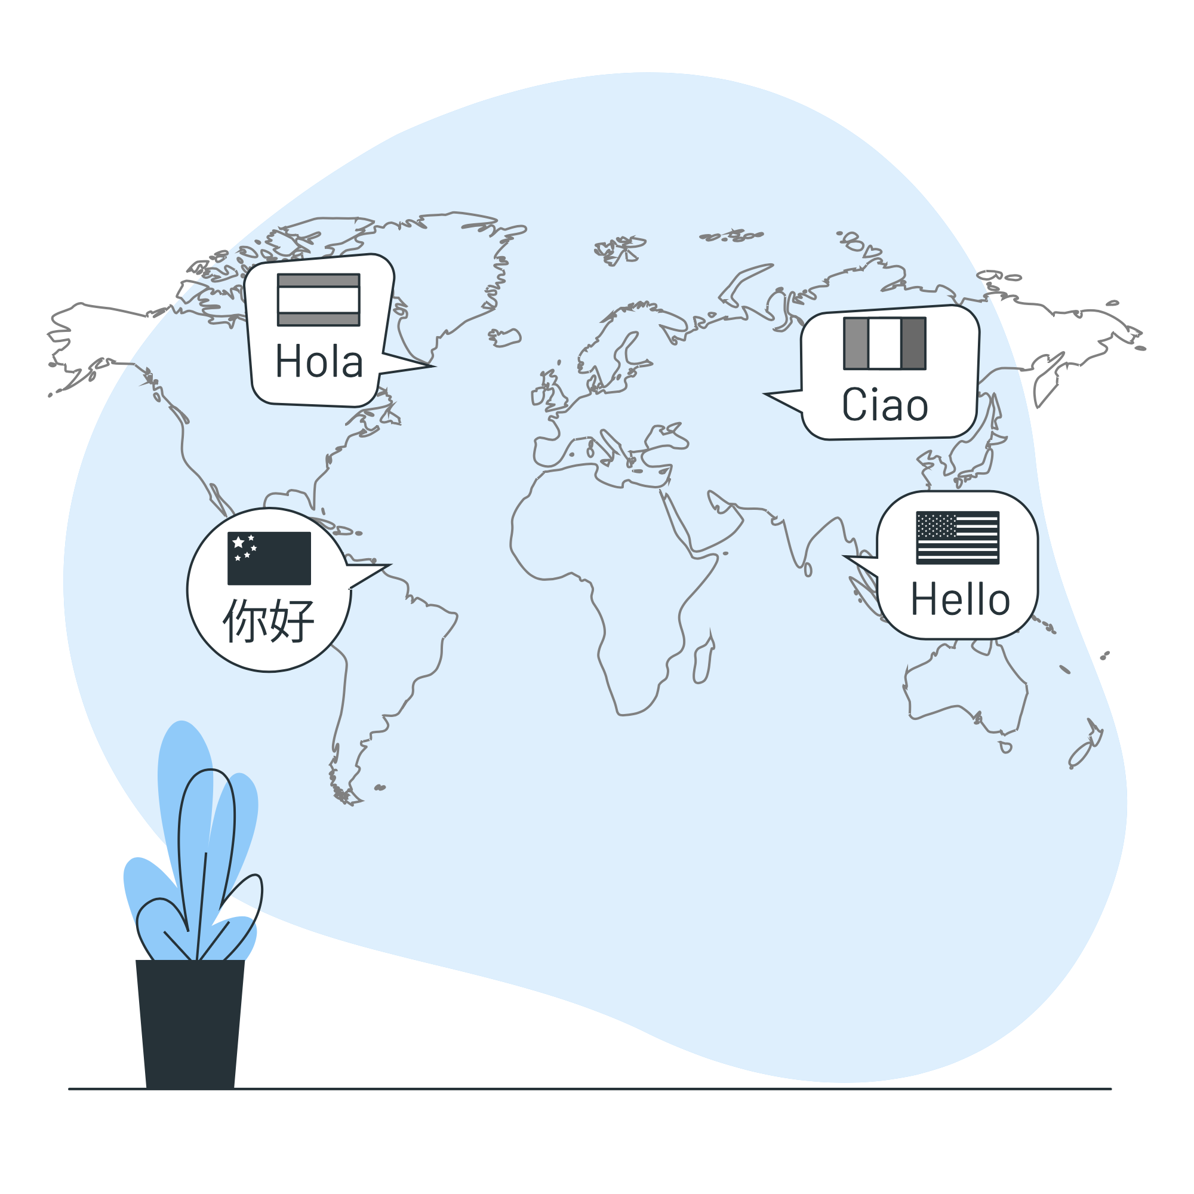
Lesson Plans for Ages 8-11:
3. Language Discovery Workshop
Materials: Basic language resources for different cultures, flashcards, interactive language activities
Duration: 45-60 minutes
Description: The Language Discovery Workshop introduces children to basic phrases and vocabulary from different languages. Through interactive language activities and games, they have the opportunity to learn and practice words and expressions from various cultures. This workshop promotes cultural understanding, language appreciation, and inclusivity by exposing children to different languages and encouraging them to embrace the richness of global linguistic diversity.

Slide 22
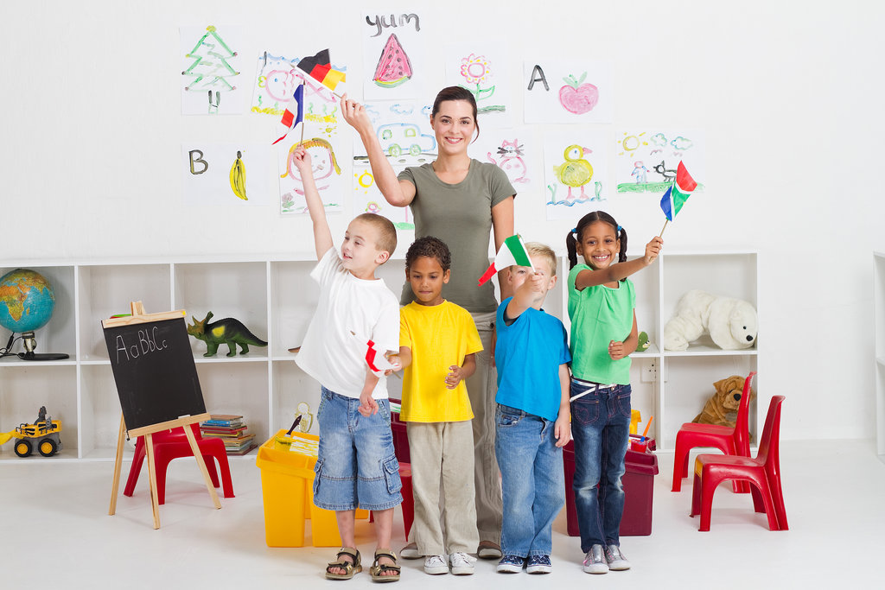

Slide 23


Slide 24
Field Trip Information:
Field Trip:
As part of Multicultural Week, organize a field trip to a local cultural festival or museum where children can experience a diverse range of cultures through exhibits, performances, and interactive activities.
Description:
The field trip during Multicultural Week offers children a firsthand experience of diverse cultures in a vibrant and interactive setting. By visiting a local cultural festival or museum, children have the opportunity to explore exhibits showcasing various cultural artifacts, traditions, and customs. They can engage in interactive activities such as traditional music and dance performances, craft demonstrations, and cultural games. This field trip promotes inclusivity, encourages cultural exchange, and enhances children's understanding of different cultural practices and beliefs. It provides a platform for them to appreciate the beauty of diversity and find common ground with others who may have different backgrounds and experiences.

Slide 25
Conclusion / Note:
Please note that specific details for the field trip, such as the location and schedule, can be added as per your preference and availability in your local area.

Slide 26
Song Lyrics - Song: “We Are One”
Verse 1: In this big world we live, so many cultures thrive, From east to west, and north to south, a rainbow in our eyes. With different colors, different sounds, we find our common ground, Celebrating diversity, in unity we're found.
Chorus: We are one, we are unique, In our differences, strength we seek. Through music, food, and dance, We embrace cultures, take a chance. We are one, we stand as friends, Inclusivity, our message sends, With open hearts and open minds, Together, in harmony, we bind.
Verse 2: From every corner of the globe, traditions we uphold, Languages spoken, stories told, a tapestry unfolds. Through art and craft, we express, our heritage we share, Finding beauty in the differences, we show how much we care.
(Chorus)
Bridge: Let's learn from one another, explore and understand, Embrace the rich tapestry, of every culture's hand. With respect and empathy, we'll bridge the divide, Together we can build a world, where unity will thrive.
(Chorus)
Outro: In this big world we live, diversity is our song, With open minds and hearts, we'll find where we belong. We are one, together we stand, Celebrating cultures, hand in hand.
Note: The song lyrics can be adjusted and modified to fit the style and preferences of your program and the children participating.

Slide 27

Debrief / Huddle
As a group, discuss the following questions:
One thing that was new to you regarding the content / lesson plans presented?
One thing that was familiar to you regarding the content / lesson plans presented?
Any stories or previous experiences regarding today’s content on Week 10 - Multicultural Week: Embracing Diversity and Fostering Inclusive Understanding?

Slide 28

Thanks!
Do you have any questions?
support@atccenter.org
tel: (253) 368-9705
atccenter.org
Please keep this slide for attribution

