Slide 1

Week 2 - Sports

Slide 2
Description:
Sports Week is dedicated to engaging children in various sports activities, promoting physical fitness, teamwork, problem-solving, and sportsmanship. Through structured lessons and games, children will develop their athletic abilities while also learning important values and life skills.

Slide 3

Lesson Plans
for Ages 0-3:

Slide 4
Lesson Plans for Ages 0-3:
1. Sensory Ball Play
Materials: Soft balls of different sizes, sensory bins
Duration: 15-20 minutes
Description: Encourage infants and toddlers to explore different types of balls and engage in sensory play. Focus on rolling, bouncing, and exploring different textures, promoting sensory development and coordination.
2. Music and Movement Olympics
Materials: Music, open space for movement
Duration: 20-30 minutes
Description: Create a mini "Olympics" experience through music and movement. Incorporate activities like marching, jumping, balancing, and hopping while playing energetic music. Emphasize the joy of movement and active participation.

Slide 5

Lesson Plans for Ages 0-3:
3. Colorful Obstacle Course
Materials: Cones, hula hoops, tunnels, colorful tape
Duration: 30-40 minutes
Description: Set up a simple obstacle course using colorful markers and props. Guide children to crawl under tunnels, hop through hula hoops, and walk along designated paths, promoting gross motor skills and spatial awareness.

Slide 6
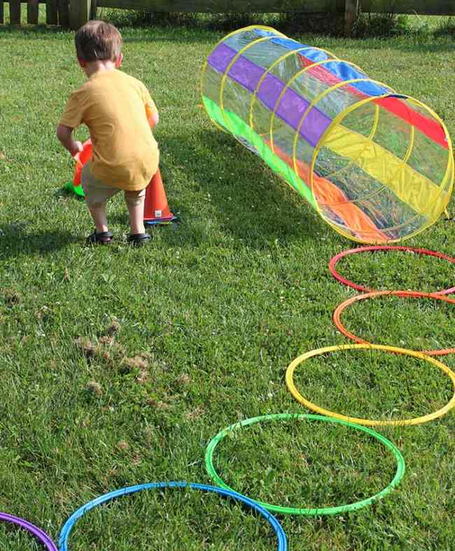
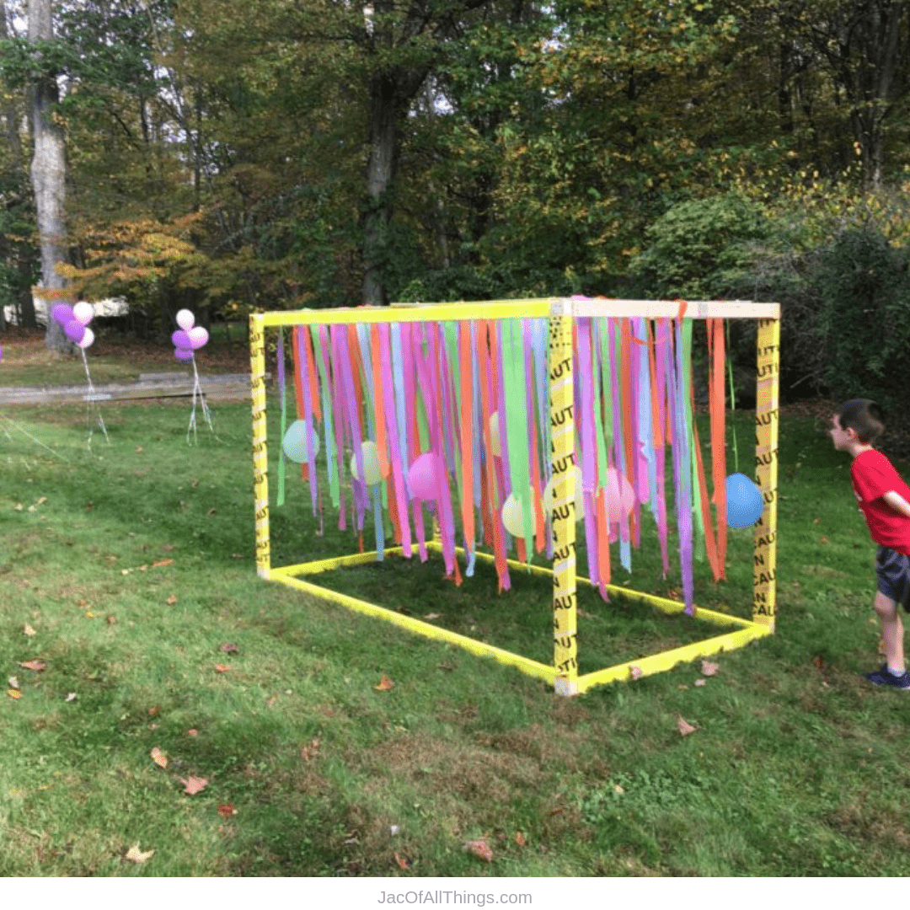

Slide 7

Lesson Plans
for Ages 4-7:

Slide 8
Lesson Plans for Ages 4-7:
1. Miniature Golf Adventure
Materials: Miniature golf set or DIY course, golf clubs, balls
Duration: 45-60 minutes
Description: Create a mini-golf experience for children, either with a miniature golf set or by designing a DIY course. Teach them basic golf techniques, such as putting and swinging, and let them practice their skills while emphasizing patience and focus.
2. Team Sports Day
Materials: Balls of various types, cones, jerseys or bibs
Duration: 1-2 hours
Description: Organize team-based sports activities like soccer, basketball, or relay races. Emphasize teamwork, cooperation, and friendly competition. Encourage children to support and encourage their teammates while practicing good sportsmanship.

Slide 9

Lesson Plans for Ages 4-7:
3. Fitness Circuit Challenge
Materials: Cones, exercise mats, stopwatch
Duration: 30-45 minutes
Description: Set up a fitness circuit with different stations, such as jumping jacks, squats, push-ups, and balance exercises. Guide children through each station, encouraging them to complete the challenges within a given time. Focus on building strength, endurance, and resilience.

Slide 10
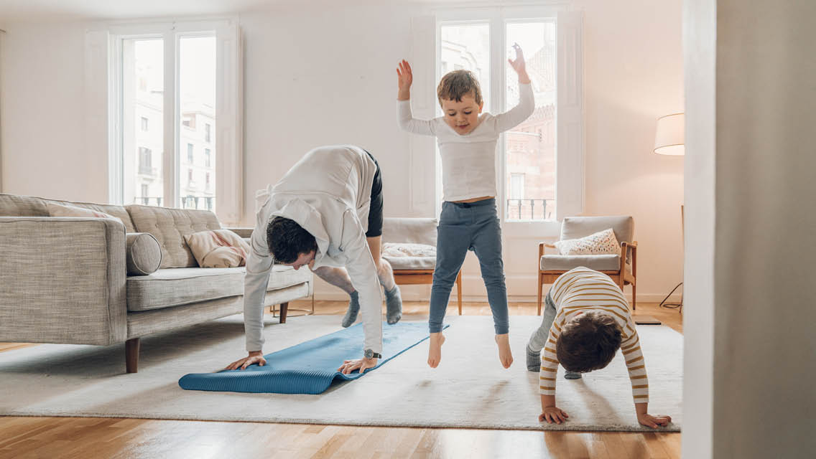


Slide 11
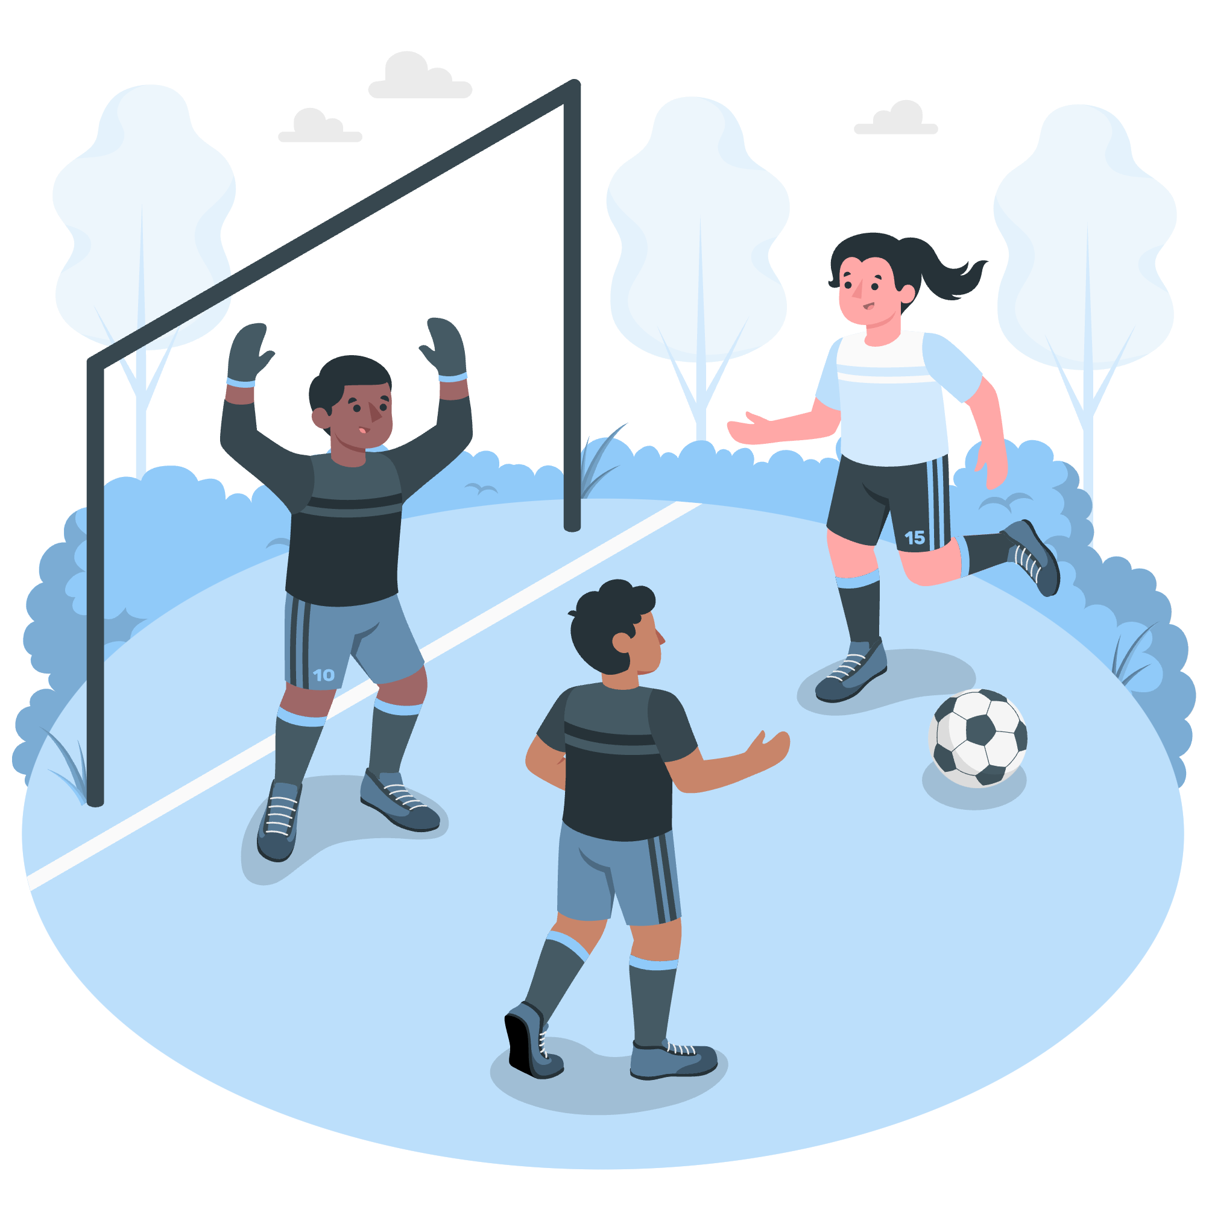
Lesson Plans
for Ages 8-11:

Slide 12
Lesson Plans for Ages 8-11:
1. Skill-Building Workshops
Materials: Equipment specific to the chosen sport, instructional materials
Duration: Multiple sessions (1-2 hours each
Description: Choose a specific sport, such as basketball, soccer, or tennis, and conduct skill-building workshops. Focus on teaching fundamental techniques, strategies, and teamwork related to the sport. Provide opportunities for practice and improvement.
2. Sportsmanship and Fair Play
Materials: Discussion prompts, sports videos
Duration: 30-45 minutes
Description: Engage children in discussions and activities centered around sportsmanship, fair play, and the importance of respecting opponents. Use examples from professional sports or real-life situations to facilitate understanding. Emphasize the value of integrity and good sportsmanship.

Slide 13

Lesson Plans for Ages 8-11:
3. Mini Olympics
Materials: Cones, stopwatch, medals or certificates
Duration: Half-day event
Description: Organize a mini-Olympics event where children can participate in various sports and challenges. Create different stations for activities like sprinting, long jump, throwing, and obstacle courses. Encourage friendly competition, teamwork, and celebrate individual and collective achievements with medals or certificates.

Slide 14
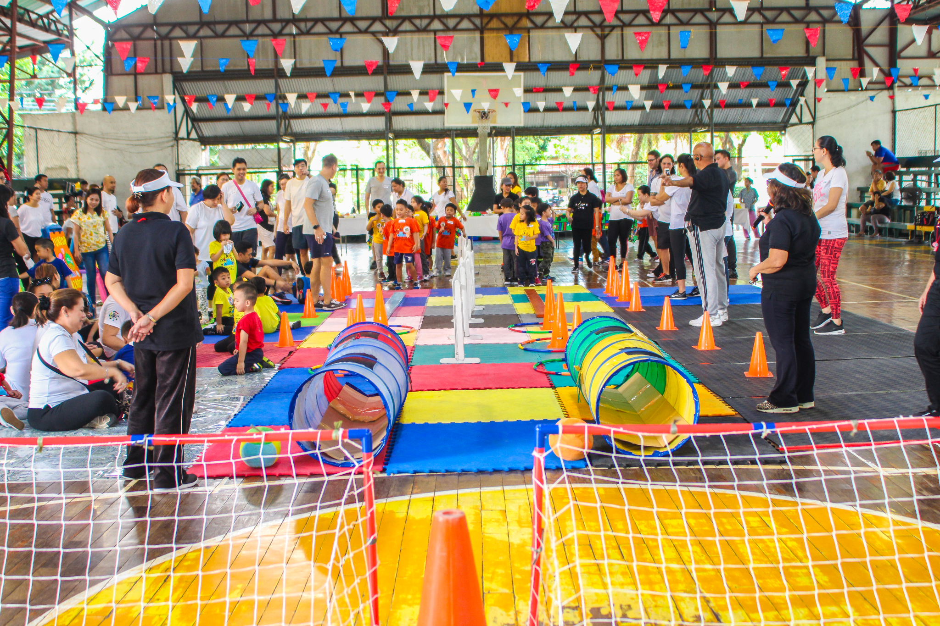


Slide 15

Debrief / Huddle
As a group, discuss the following questions:
One thing that was new to you regarding the content / lesson plans presented?
One thing that was familiar to you regarding the content / lesson plans presented?
Any stories or previous experiences regarding today’s content on Week 2 - Sports?

Slide 16

Thanks!
Do you have any questions?
support@atccenter.org
tel: (253) 368-9705
atccenter.org
Please keep this slide for attribution

