Slide 1
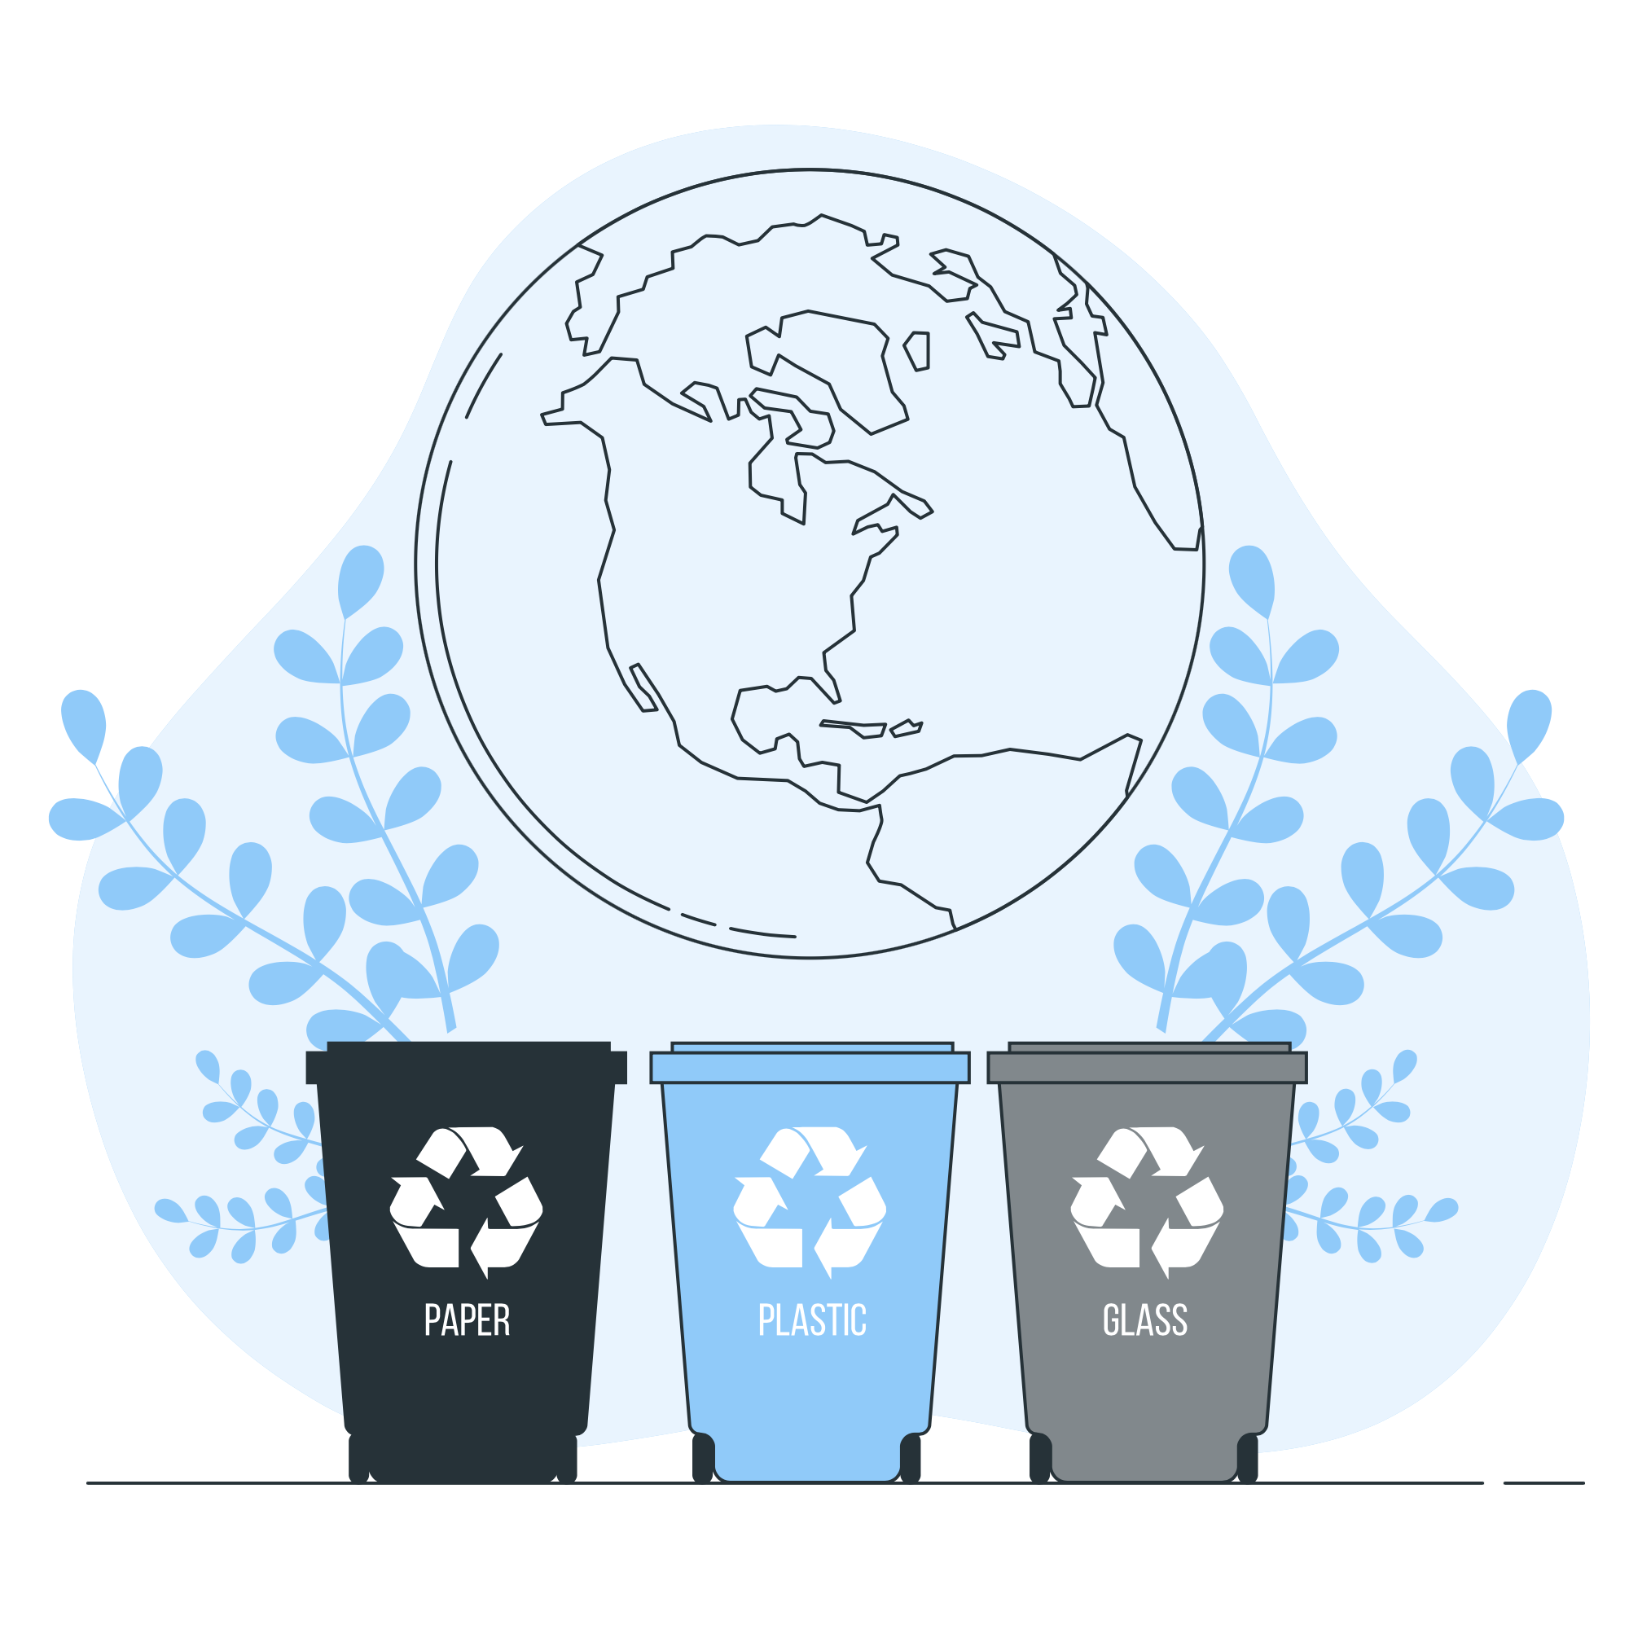
Week 3 - Recycling

Slide 2
Description:
This week focuses on promoting recycling awareness, creativity through art projects using recycled materials, and understanding the importance of sustainable practices. This program is proudly powered by PepsiCo, a leading company in sustainability initiatives. For more curriculum guidance and resources, please visit: PepsiCo Recycling Resources.

Slide 3

Lesson Plans
for Ages 0-3:

Slide 4
Lesson Plans for Ages 0-3:
1. Sensory Recycling Bins
Materials: Empty plastic containers, recycled materials (e.g., fabric scraps, paper rolls), sensory bins
Duration: 20-30 minutes
Description: Create sensory bins filled with recycled materials. Encourage infants and toddlers to explore the different textures and shapes while discussing the concept of recycling.
2. Recycled Collage
Materials: Recycled magazines, cardboard, glue, child-safe scissors
Duration: 30-45 minutes
Description: Assist children in cutting out pictures or shapes from recycled magazines. Provide them with cardboard and glue to create collages using the recycled materials.

Slide 5


Lesson Plans for Ages 0-3:
3. Bottle Cap Stamping
Materials: Bottle caps, washable paint, paper
Duration: 15-20 minutes
Description: Dip bottle caps into washable paint and encourage children to stamp them onto paper, creating colorful patterns and designs.

Slide 6
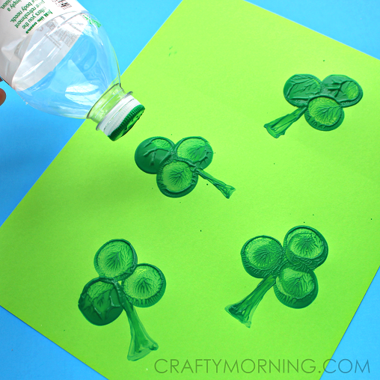

Slide 7

Lesson Plans for Ages 0-3:
4. Paper Mache Pinata Materials (Mandatory Participation):
Recycled newspaper, flour, water, balloons, colorful tissue paper, paint, ribbons or strings Duration: Multiple sessions (1-2 hours each) Description: Introduce the concept of paper mache and guide children in creating their own pinatas using recycled materials. Discuss the importance of reusing paper and transforming it into something new and fun.

Slide 8
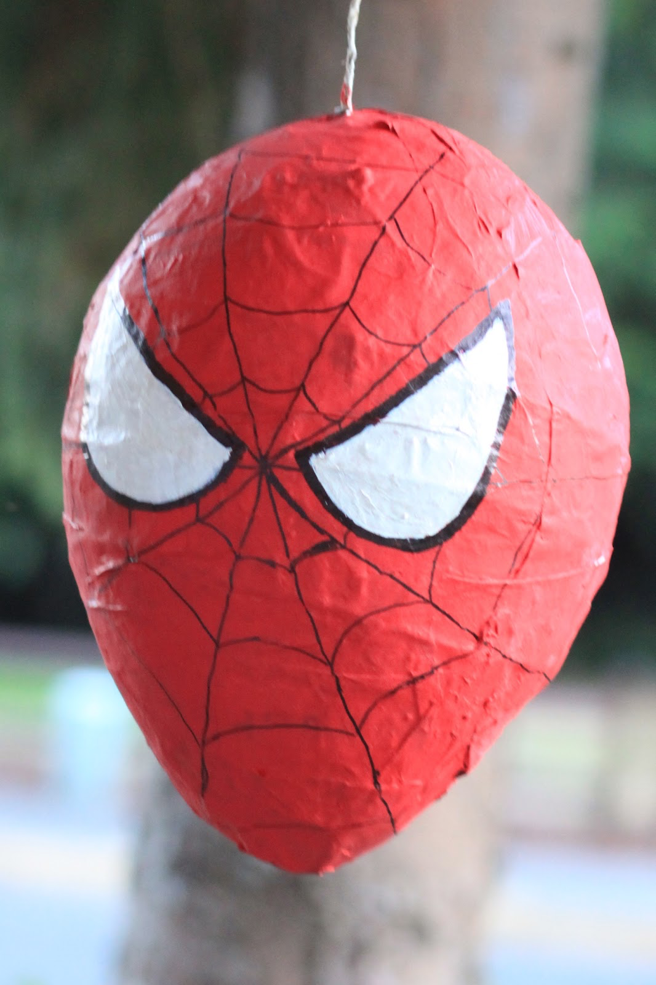
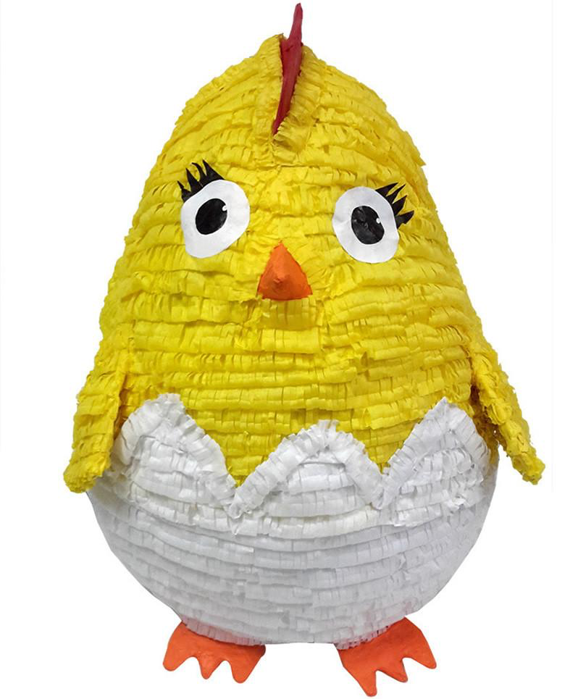

Slide 9
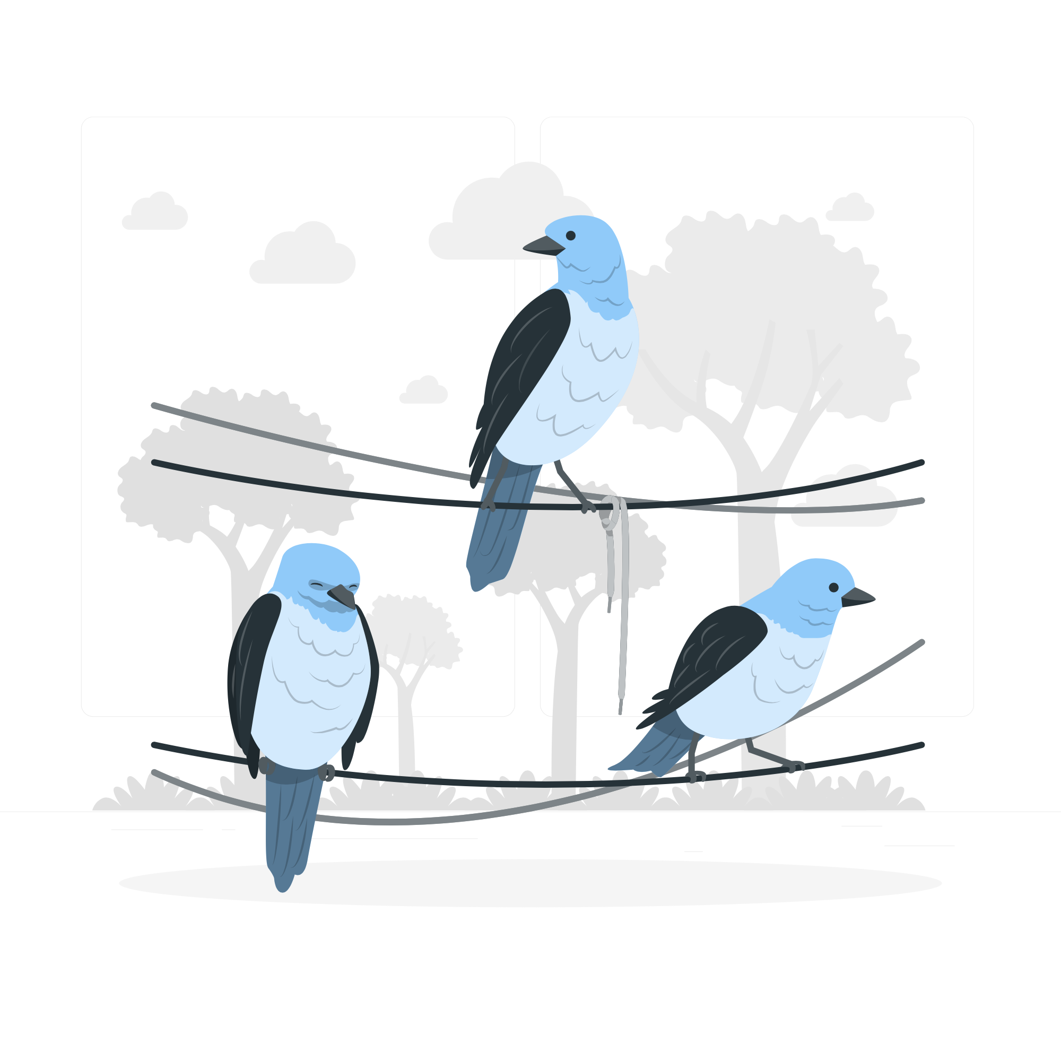
Lesson Plans
for Ages 4-7:

Slide 10
Lesson Plans for Ages 4-7:
1. Upcycled Bird Feeders
Materials: Recycled plastic bottles, birdseed, string, scissors
Duration: 30-45 minutes
Description: Help children cut holes in plastic bottles and fill them with birdseed. Attach strings to hang the feeders outside, promoting environmental awareness and attracting birds.
2. Recycled Sculptures
Materials: Assorted recycled materials (e.g., cardboard, egg cartons, plastic bottles), glue, scissors
Duration: 45-60 minutes
Description: Guide children to create sculptures using various recycled materials. Encourage them to experiment with shapes, textures, and different adhesives.

Slide 11
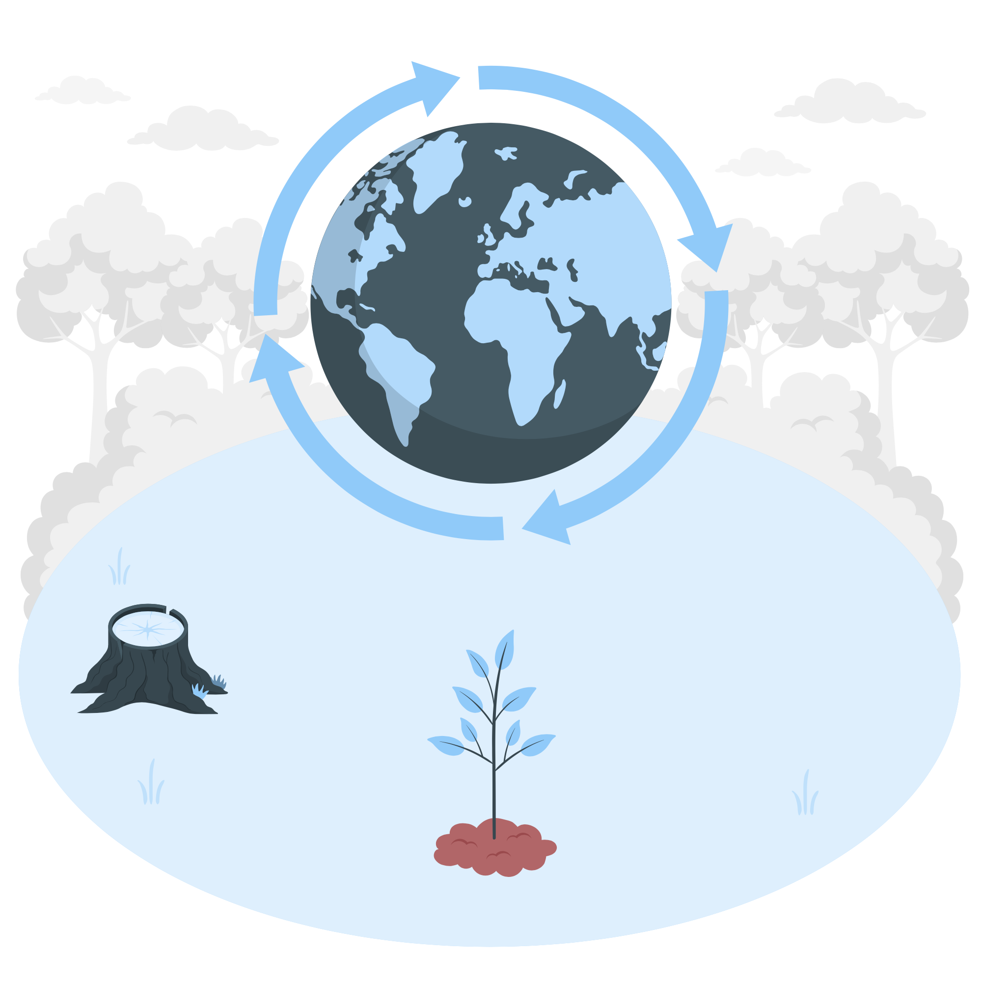
Lesson Plans for Ages 4-7:
3. Earth Day Mosaic
Materials: Recycled paper scraps, glue, poster board or cardboard
Duration: 30-45 minutes
Description: Provide children with recycled paper scraps and guide them to create a mosaic artwork on a poster board or cardboard, depicting Earth Day themes or natural landscapes.

Slide 12
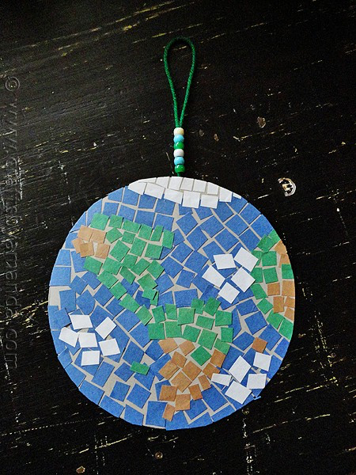
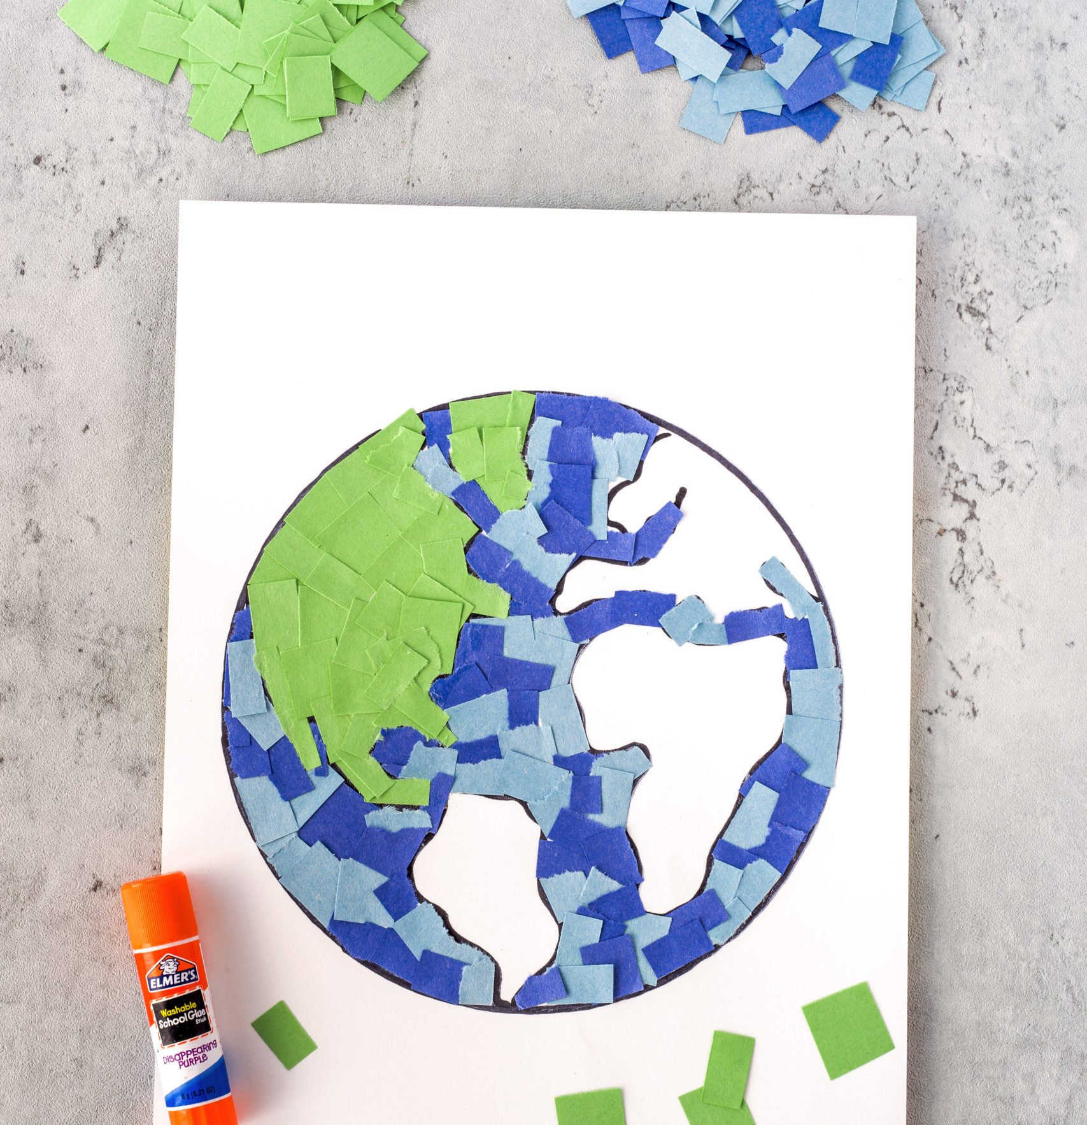

Slide 13
Lesson Plans for Ages 4-7:
4. Paper Mache Pinata Materials (Mandatory Participation):
Recycled newspaper, flour, water, balloons, colorful tissue paper, paint, ribbons or strings Duration: Multiple sessions (1-2 hours each) Description: Introduce the concept of paper mache and guide children in creating their own pinatas using recycled materials. Discuss the importance of reusing paper and transforming it into something new and fun.

Slide 15
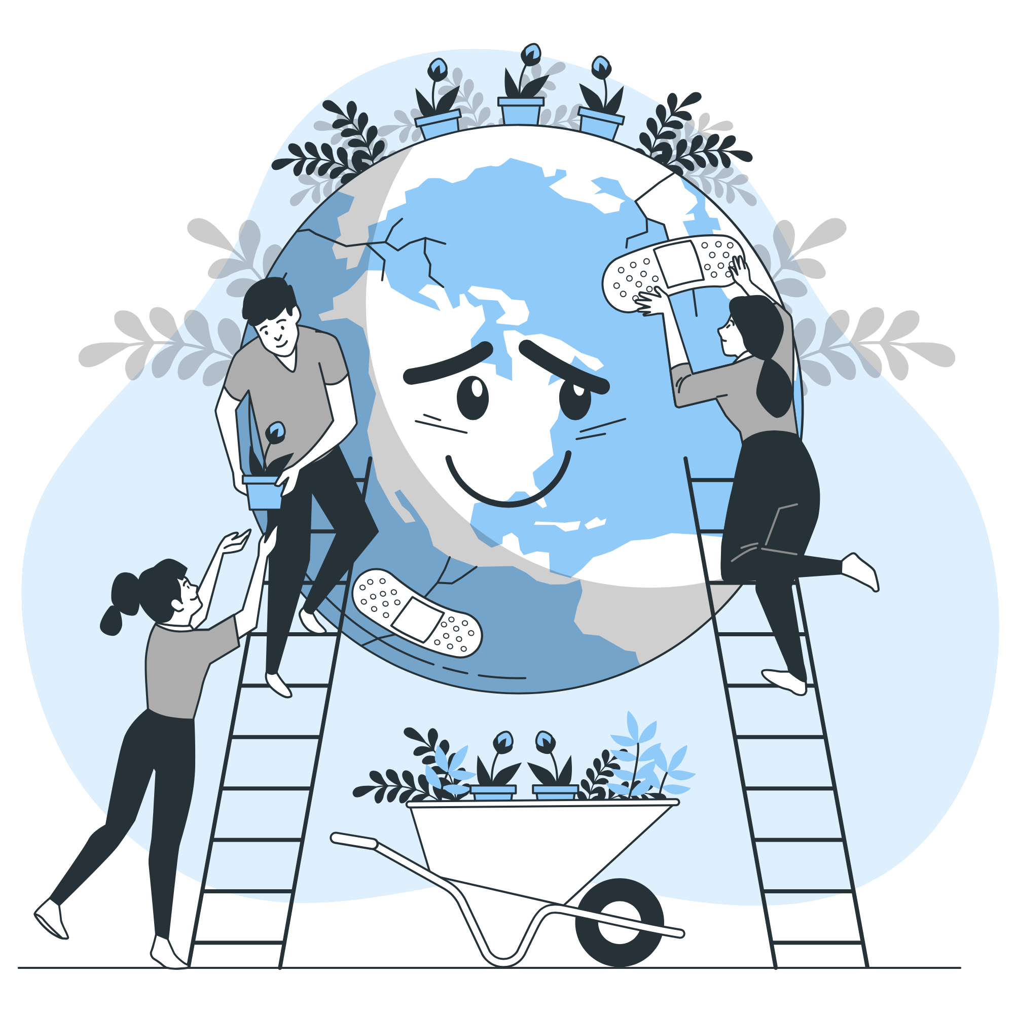
Lesson Plans
for Ages 8-11:

Slide 16
Lesson Plans for Ages 8-11:
1. Recycled Fashion Show
Materials: Assorted recycled materials (e.g., newspapers, plastic bags, fabric scraps), tape, scissors
Duration: Multiple sessions (1-2 hours each)
Description: Organize a recycled fashion show where children design and create unique outfits using recycled materials. Encourage creativity and sustainable fashion choices.
2. Environmental Awareness Poster
Materials: Poster board, markers, recycled magazines or printed images
Duration: 45-60 minutes
Description: Guide children to create posters promoting environmental awareness. They can cut out images or use markers to illustrate messages related to recycling, conservation, or protecting the planet.

Slide 17

Lesson Plans for Ages 8-11:
3. Recycled Paper Making
Materials: Recycled paper scraps, blender, water, mesh screens, sponges
Duration: 60-90 minutes
Description: Teach children the process of making recycled paper. Assist them in blending paper scraps, straining the pulp, and creating new paper sheets. Discuss the importance of paper recycling and reducing waste.

Slide 18
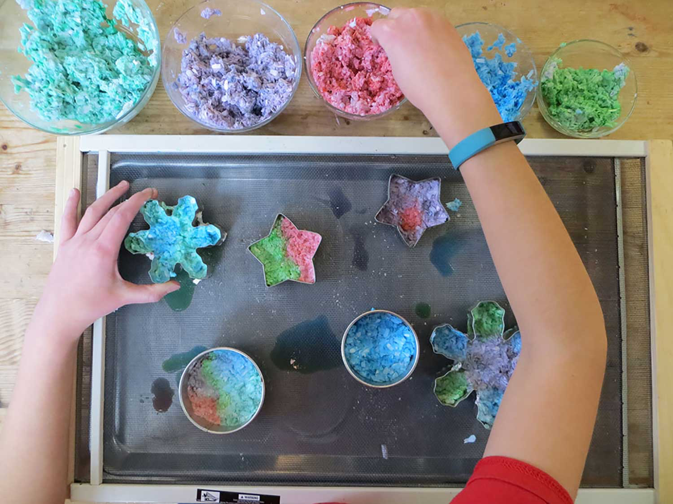

Slide 19
Lesson Plans for Ages 8-11:
4. Paper Mache Pinata Materials (Mandatory Participation):
Recycled newspaper, flour, water, balloons, colorful tissue paper, paint, ribbons or strings Duration: Multiple sessions (1-2 hours each) Description: Introduce the concept of paper mache and guide children in creating their own pinatas using recycled materials. Discuss the importance of reusing paper and transforming it into something new and fun.

Slide 21

Field Trip for Ages 8-11: Beach Clean-Up and the Great Garbage Reef of the Pacific Ocean

Slide 22
Field Trip for Ages 8-11:
Field Trip Details: only an option with proper staffing and coverage
Destination: Local beach or coastal area
Ratio: A maximum of four children per adult for safety and supervision
Activities: Beach cleanup, sorting and categorizing collected trash, creating sculptures from found materials, discussions about the importance of ocean conservation, and critical thinking questions to explore solutions to the plastic pollution problem.
Environmental Awareness Poster
Materials: Poster board, markers, recycled magazines or printed images
Duration: 45-60 minutes
Description: Guide children to create posters promoting environmental awareness. They can cut out images or use markers to illustrate messages related to recycling, conservation, or protecting the planet.

Slide 23
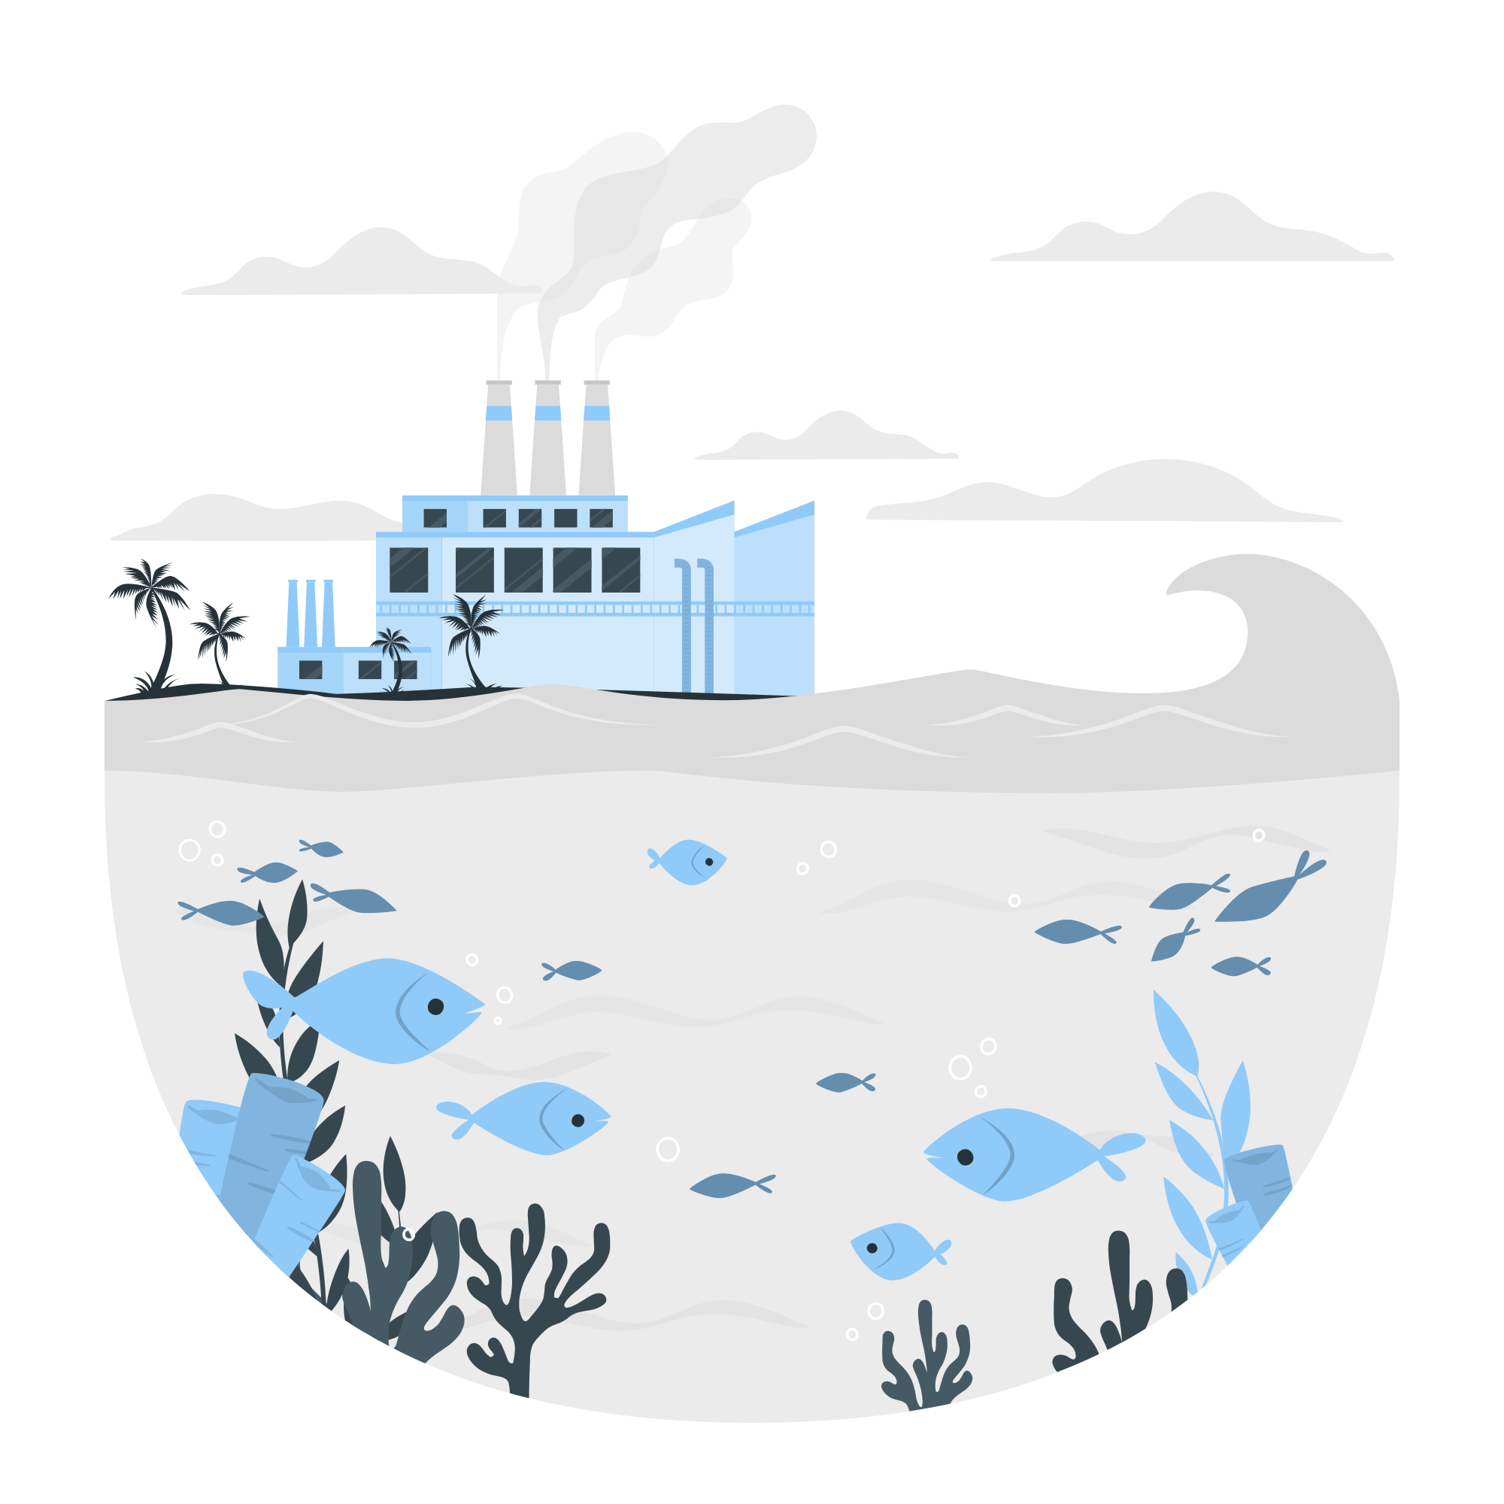
Field Trip for Ages 8-11:
3. Additional Activity: (Mandatory Participation)
The Great Trash Reef Simulation: Engage children in a research and critical thinking activity related to the "Great Trash Reef" of the Pacific Ocean. Provide information about the problem, its causes, and potential solutions. Encourage children to brainstorm ideas on how we can tackle this issue.

Slide 24
Field Trip for Ages 8-11:
Crafty Ideas to Help Limit Waste:
Upcycled Tote Bags: Use old t-shirts or fabric scraps to create reusable tote bags, reducing the need for single-use plastic bags.
Recycled Paper Beads: Teach children how to make colorful beads from recycled paper, which can be used for jewelry or decorations.
Egg Carton Garden: Transform empty egg cartons into mini planters and encourage children to grow their own small plants or herbs.

Slide 25
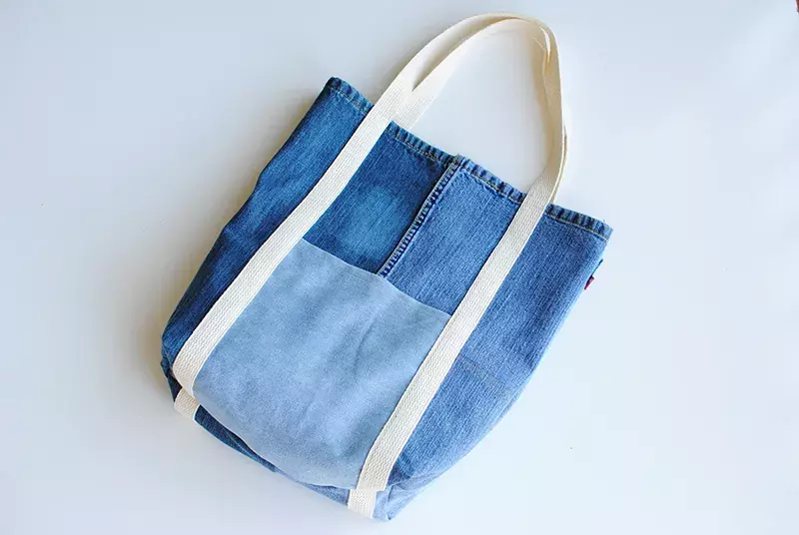

Slide 26
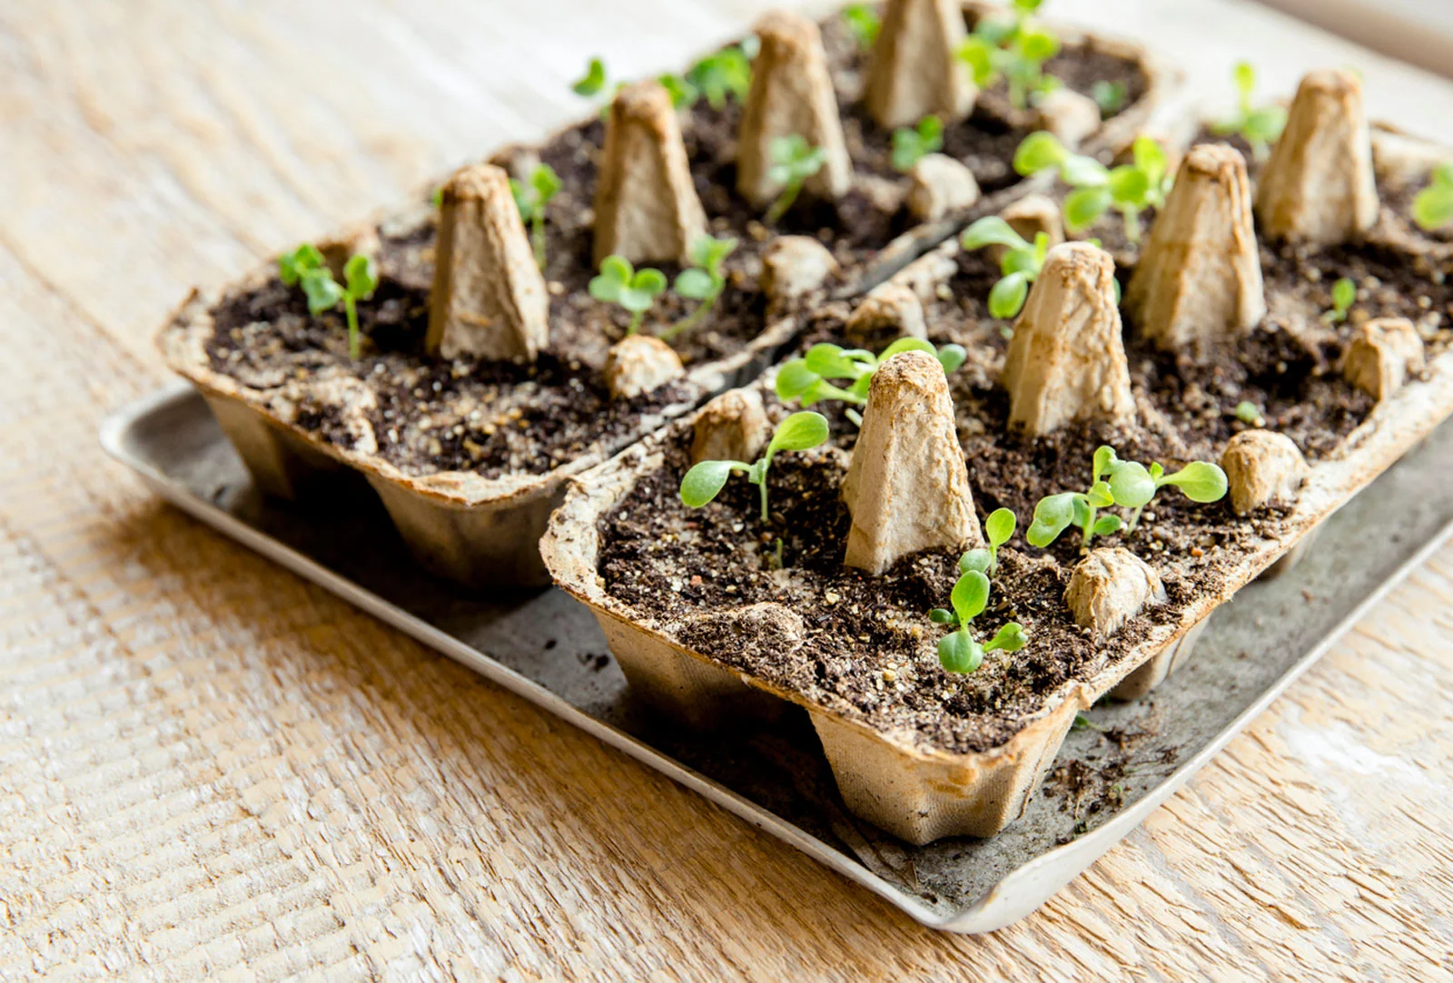

Slide 27

Debrief / Huddle
As a group, discuss the following questions:
One thing that was new to you regarding the content / lesson plans presented?
One thing that was familiar to you regarding the content / lesson plans presented?
Any stories or previous experiences regarding today’s content on Week 3 - Recycling?

Slide 28

Thanks!
Do you have any questions?
support@atccenter.org
tel: (253) 368-9705
atccenter.org
Please keep this slide for attribution

