Slide 1

Week 4 - Artistic Expressions

Slide 2

Lesson Plans
for Ages 0-3:

Slide 3
Lesson Plans for Ages 0-3:
1. Sensory Painting
Materials: Large sheets of paper, non-toxic washable paint, various tools for texture (e.g., sponges, brushes, cotton balls)
Duration: 20-30 minutes
Description: Set up a painting station where infants and toddlers can explore different textures and colors of paint using their hands or various tools. Encourage sensory exploration and self-expression.
2. Bubble Wrap Printing
Materials: Bubble wrap, non-toxic washable paint, large sheets of paper
Duration: 20-30 minutes
Description: Spread paint on the bubble wrap and help children press the painted side onto the paper, creating unique patterns and textures. Discuss the different effects achieved by varying pressure and colors.

Slide 4
Lesson Plans for Ages 0-3:
3. Nature Collage
Materials: Recycled materials (e.g., leaves, flowers, twigs), child-safe glue, paper or cardboard
Duration: 30-45 minutes
Description: Take children on a nature walk to collect natural materials. Assist them in creating collages by arranging and gluing the materials onto paper or cardboard, creating nature-inspired artwork.
4. Playdough Creations
Materials: Homemade or store-bought playdough, rolling pins, cookie cutters, other shaping tools
Duration: 30-45 minutes
Description: Provide children with playdough and various tools to create sculptures, shapes, and imaginative creations. Encourage them to explore different textures, colors, and forms.

Slide 5

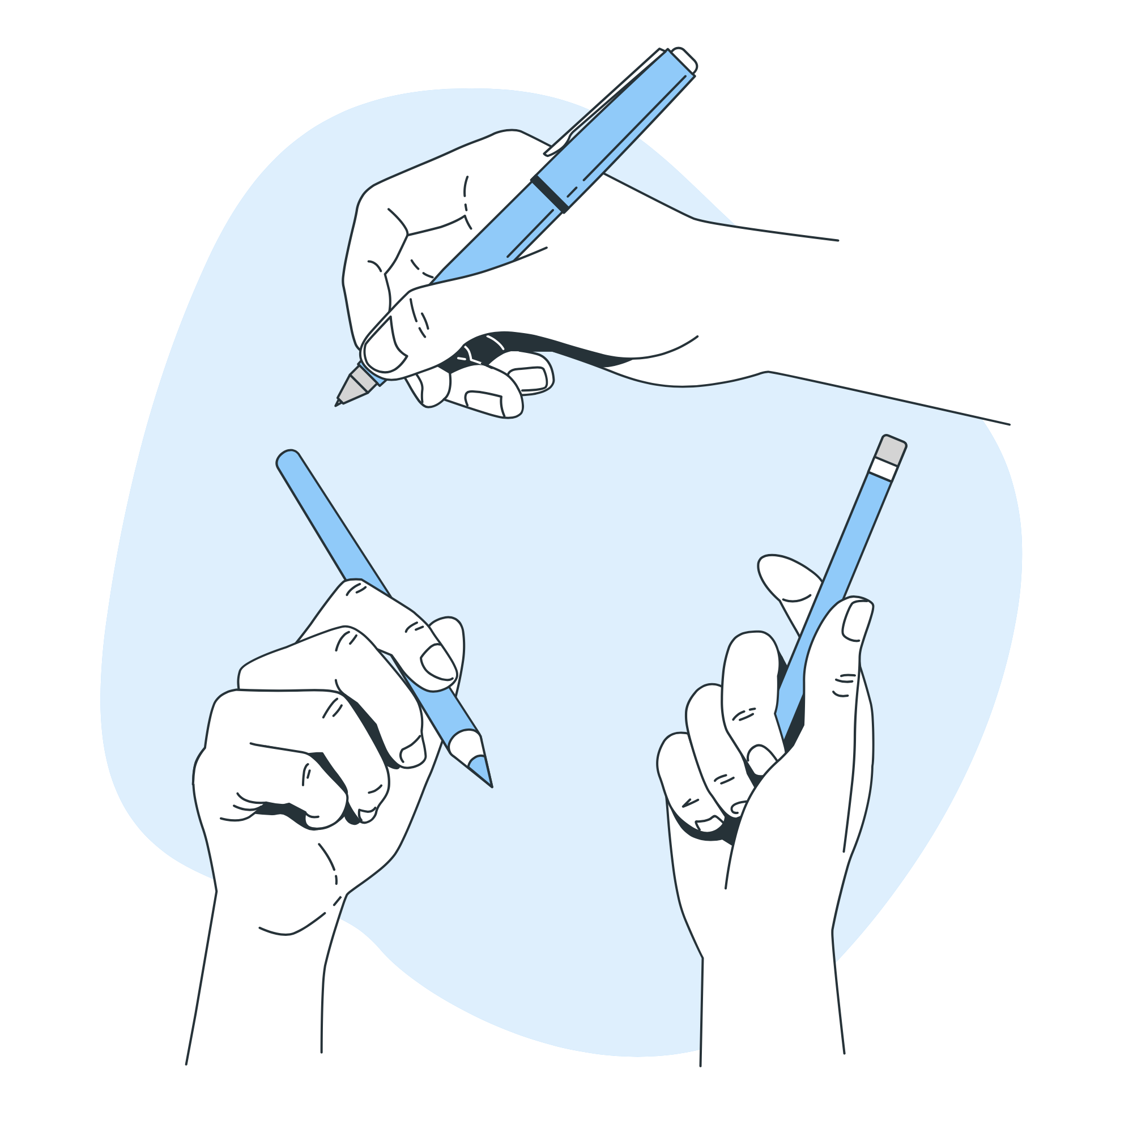
Lesson Plans for Ages 0-3:
5. Storytelling with Art
Materials: Large sheets of paper, markers, crayons, colored pencils
Duration: 30-45 minutes
Description: Read a story aloud to the children, and then ask them to illustrate their favorite part of the story using the art supplies. Encourage them to share their artwork and explain their choices.

Slide 6
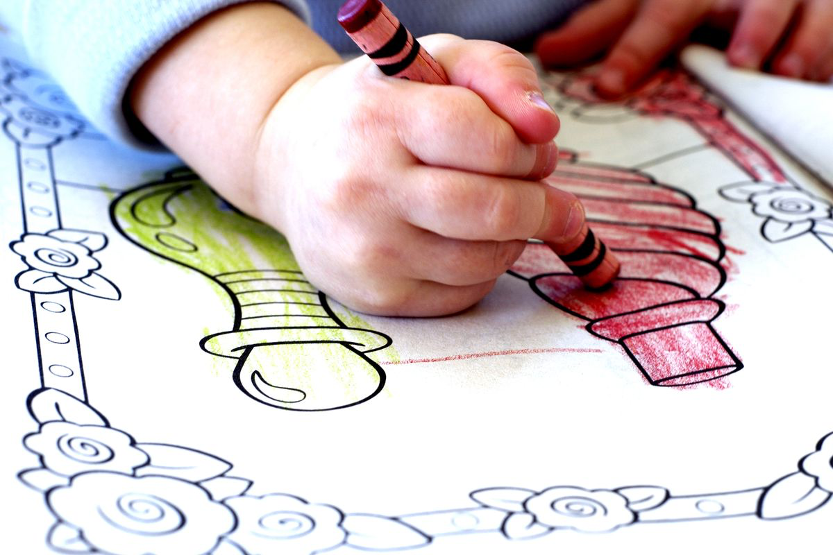
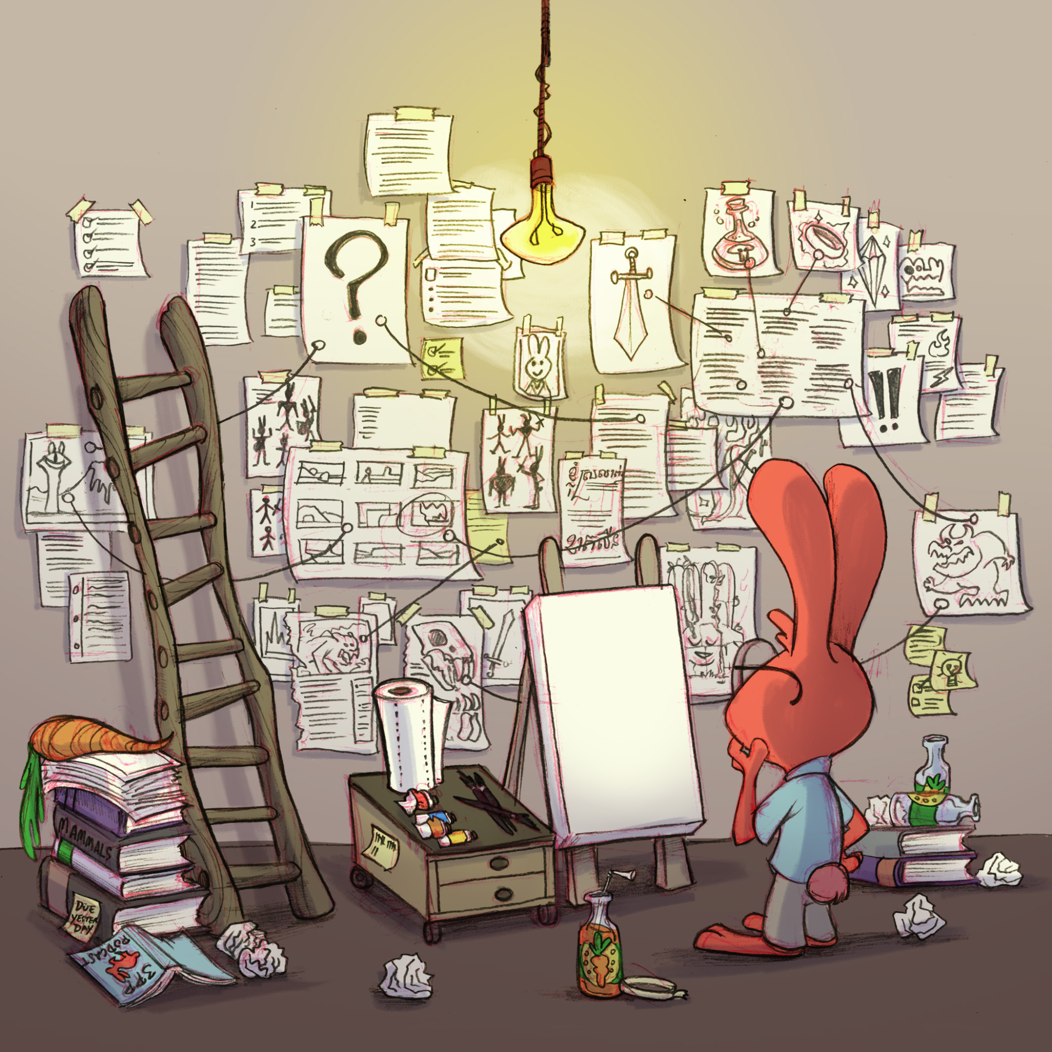

Slide 7

Lesson Plans for Ages 0-3:
6. Decorate Paper Mache Pinatas (Mandatory Participation):
*CREATED DURING THE PREVIOUS WEEK.
Materials: Non-toxic paint, paintbrushes, water cups, protective clothing or aprons
Duration: 30-45 minutes

Slide 8
Lesson Plans for Ages 0-3:
6. Decorate Paper Mache Pinatas (Mandatory Participation):
*CREATED DURING THE PREVIOUS WEEK.
Description: It's time to bring your paper Mache pinatas to life with color! In this lesson, we'll celebrate the knowledge we've gained about oceans and the importance of proper recycling techniques. Using non-toxic paint and brushes, children will have the opportunity to paint their paper Mache creations, infusing them with vibrant hues and personal artistic expressions.
As they engage in this activity, encourage discussions about the significance of recycling, protecting our water sources, and keeping our oceans clean. Emphasize the positive impact of their recycling efforts on the environment and the role they play in preserving our planet's beauty. This celebration serves as a reminder of their dedication to creating a sustainable future.
Let creativity flow and watch as their paper mache projects become colorful symbols of their commitment to the oceans and recycling

Slide 9
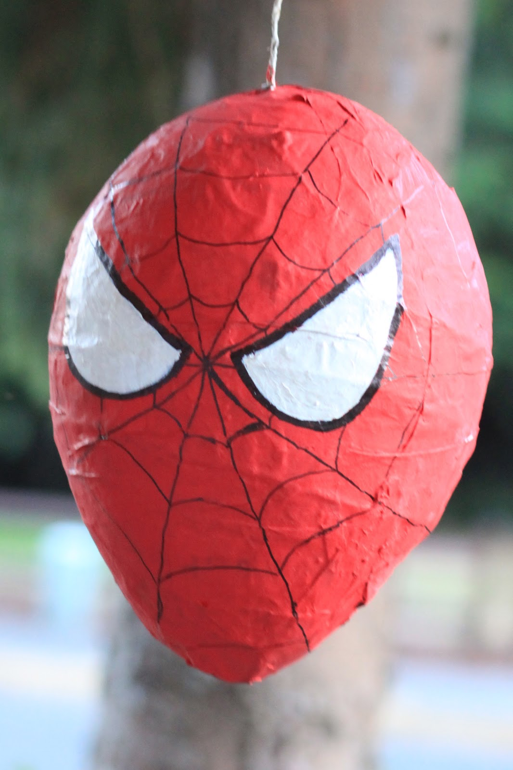
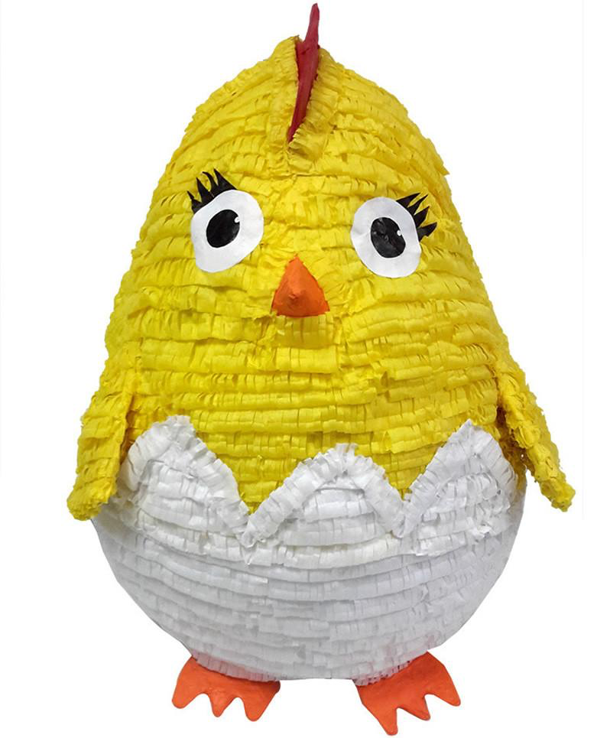

Slide 10

Lesson Plans
for Ages 4-7:

Slide 11
Lesson Plans for Ages 4-7:
1. Mixed Media Collage
Materials: Recycled materials (e.g., paper scraps, fabric, buttons, beads), glue, scissors, paper or canvas
Duration: 45-60 minutes
Description: Introduce children to mixed media art by providing a variety of recycled materials for them to create collages. Encourage layering and experimenting with different textures and materials.
2. Splatter Painting
Materials: Large sheets of paper, non-toxic washable paint, brushes or spoons
Duration: 30-45 minutes
Description: Demonstrate the technique of splatter painting and let children experiment with flicking paint onto the paper using brushes or spoons. Discuss the different effects achieved by varying paint consistency and force.

Slide 12
Lesson Plans for Ages 4-7:
3. Recycled Sculpture Garden
Materials: Recycled materials (e.g., cardboard, plastic bottles, tin cans), glue, scissors, paint (optional)
Duration: Multiple sessions (1-2 hours each)
Description: Guide children to create a sculpture garden using recycled materials. They can design and build sculptures, and optionally paint them to add color and vibrancy to the garden.
4. Printmaking with Found Objects
Materials: Recycled objects with interesting textures (e.g., bottle caps, lids, bubble wrap), non-toxic washable paint, paper
Duration: 45-60 minutes
Description: Explore printmaking by having children dip recycled objects into paint and press them onto paper, creating repetitive patterns and textures. Discuss the concept of printmaking and its connection to recycling.

Slide 13
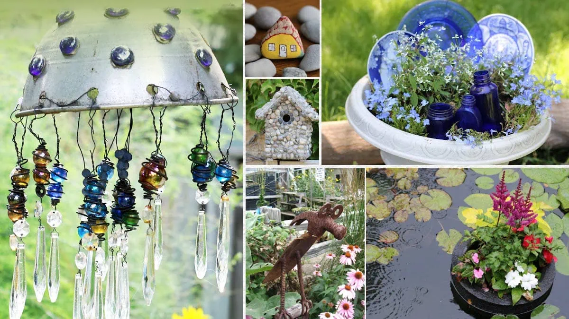
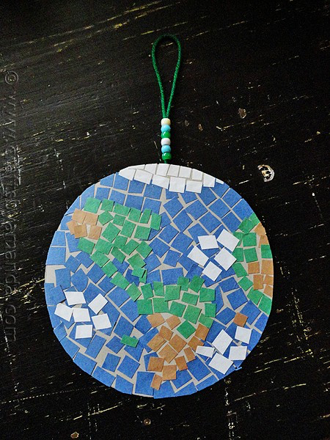
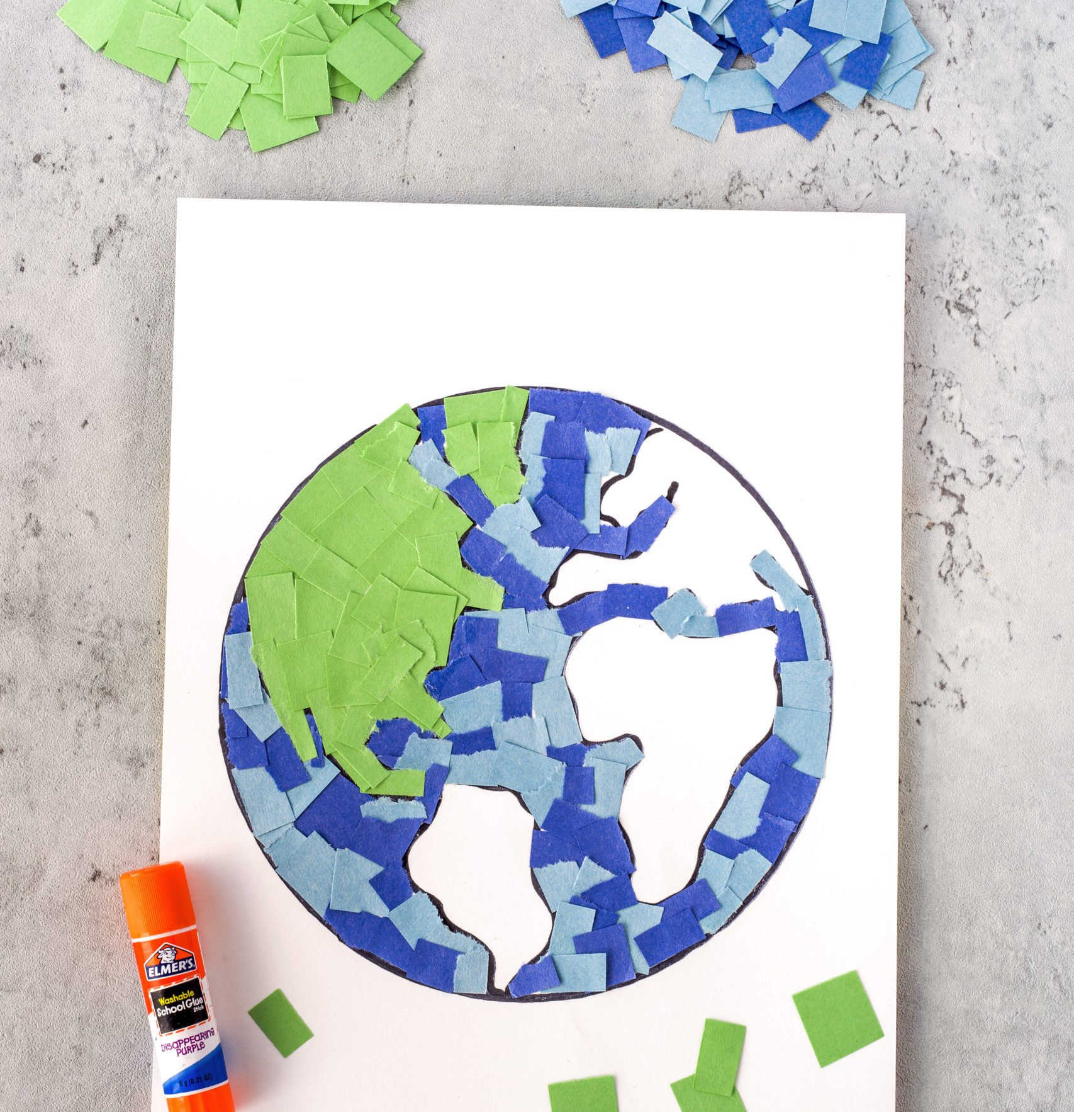

Slide 14
Lesson Plans for Ages 4-7:
5. Decorate Paper Mache Pinatas (Mandatory Participation):
*CREATED DURING THE PREVIOUS WEEK.
Materials: Non-toxic paint, paintbrushes, water cups, protective clothing or aprons
Duration: 30-45 minutes

Slide 15
Lesson Plans for Ages 4-7:
5. Decorate Paper Mache Pinatas (Mandatory Participation):
*CREATED DURING THE PREVIOUS WEEK.
Description: It's time to bring your paper Mache pinatas to life with color! In this lesson, we'll celebrate the knowledge we've gained about oceans and the importance of proper recycling techniques. Using non-toxic paint and brushes, children will have the opportunity to paint their paper Mache creations, infusing them with vibrant hues and personal artistic expressions.
As they engage in this activity, encourage discussions about the significance of recycling, protecting our water sources, and keeping our oceans clean. Emphasize the positive impact of their recycling efforts on the environment and the role they play in preserving our planet's beauty. This celebration serves as a reminder of their dedication to creating a sustainable future.
Let creativity flow and watch as their paper mache projects become colorful symbols of their commitment to the oceans and recycling

Slide 17
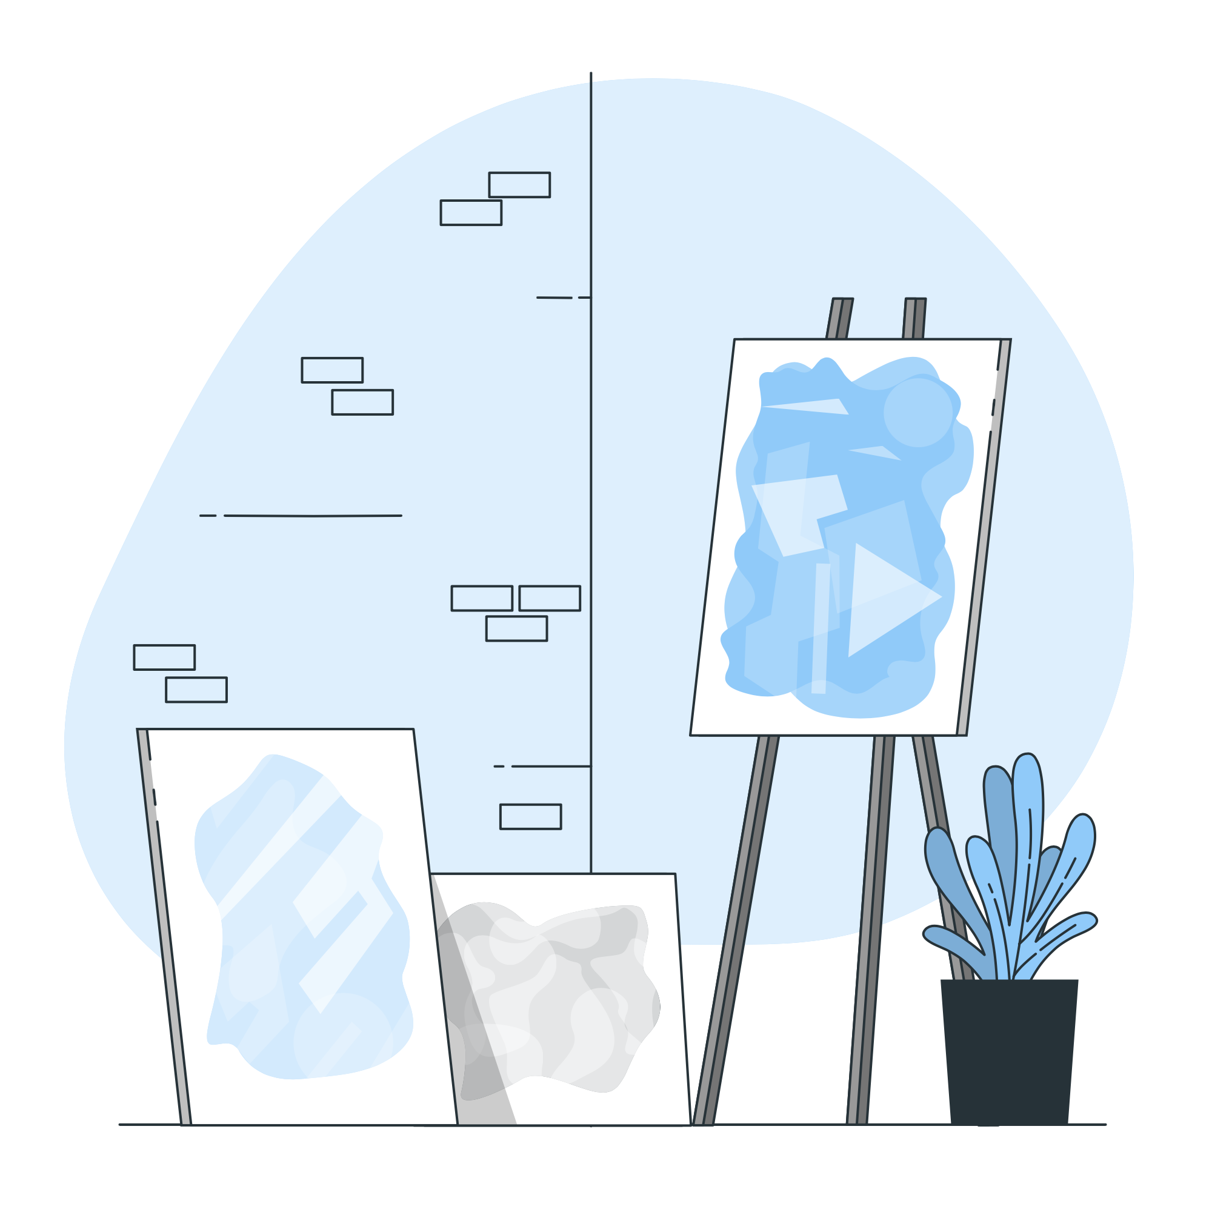
Lesson Plans
for Ages 8-11:

Slide 18
Lesson Plans for Ages 8-11:
1. Abstract Collage Art
Materials: Recycled materials (e.g., magazines, newspapers, fabric), scissors, glue, large sheets of paper or canvas
Duration: 60-90 minutes
Description: Teach children about abstract art and guide them in creating collages using recycled materials. Encourage them to experiment with different shapes, colors, and compositions.
2. Portrait Painting
Materials: Paint, paintbrushes, canvas or thick paper, reference photos or mirrors
Duration: Multiple sessions (1-2 hours each)
Description: Introduce children to portrait painting techniques and guide them in creating self-portraits or portraits of their peers using recycled materials. Discuss the importance of capturing facial expressions and emotions.

Slide 19

Lesson Plans for Ages 8-11:
3. Upcycled Sculpture Challenge
Materials: Assorted recycled materials (e.g., cardboard, plastic containers, wire), glue, scissors, paint (optional)
Duration: Multiple sessions (1-2 hours each)
Description: Present children with a challenge to create sculptures using only recycled materials. Encourage them to think critically and creatively while transforming ordinary objects into unique art pieces.

Slide 20
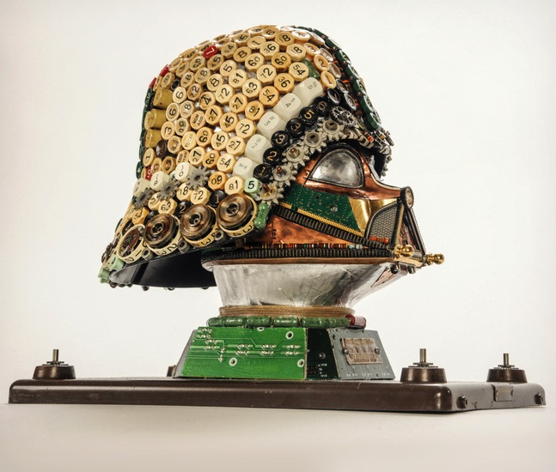

Slide 21
Lesson Plans for Ages 8-11:
4. Decorate Paper Mache Pinatas (Mandatory Participation):
*CREATED DURING THE PREVIOUS WEEK.
Materials: Non-toxic paint, paintbrushes, water cups, protective clothing or aprons
Duration: 30-45 minutes

Slide 22
Lesson Plans for Ages 8-11:
4. Decorate Paper Mache Pinatas (Mandatory Participation):
*CREATED DURING THE PREVIOUS WEEK.
Description: It's time to bring your paper Mache pinatas to life with color! In this lesson, we'll celebrate the knowledge we've gained about oceans and the importance of proper recycling techniques. Using non-toxic paint and brushes, children will have the opportunity to paint their paper Mache creations, infusing them with vibrant hues and personal artistic expressions.
As they engage in this activity, encourage discussions about the significance of recycling, protecting our water sources, and keeping our oceans clean. Emphasize the positive impact of their recycling efforts on the environment and the role they play in preserving our planet's beauty. This celebration serves as a reminder of their dedication to creating a sustainable future.
Let creativity flow and watch as their paper mache projects become colorful symbols of their commitment to the oceans and recycling

Slide 24

Debrief / Huddle
As a group, discuss the following questions:
One thing that was new to you regarding the content / lesson plans presented?
One thing that was familiar to you regarding the content / lesson plans presented?
Any stories or previous experiences regarding today’s content on Week 4 - Artistic Expression?

Slide 25

Thanks!
Do you have any questions?
support@atccenter.org
tel: (253) 368-9705
atccenter.org
Please keep this slide for attribution

