Slide 1
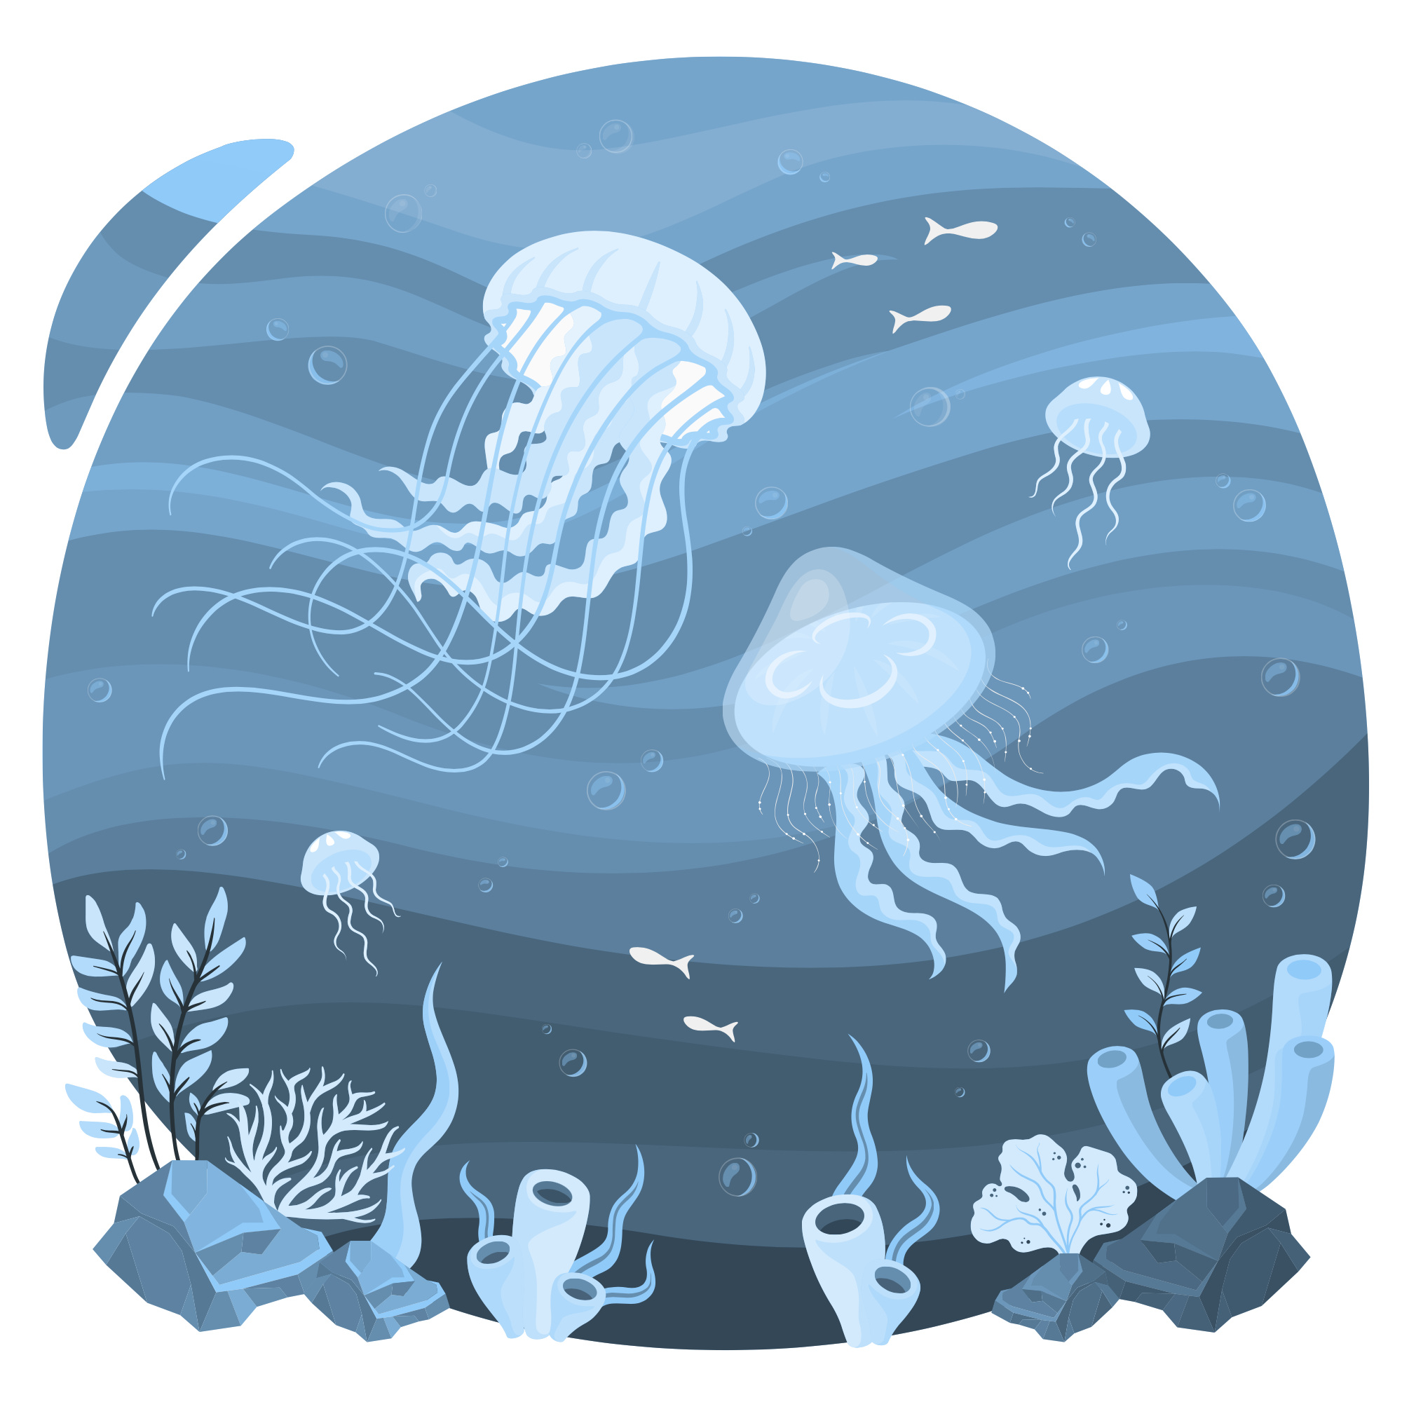
Weeks 5 & 6 - Water Play Extravaganza & Ocean Exploration

Slide 2
Description:
Immerse yourself in a two-week camp experience filled with water play activities, crafts, and a captivating field trip to the aquarium. Explore the wonders of the ocean and its fascinating marine life through engaging and educational experiences suitable for children of all ages.

Slide 3
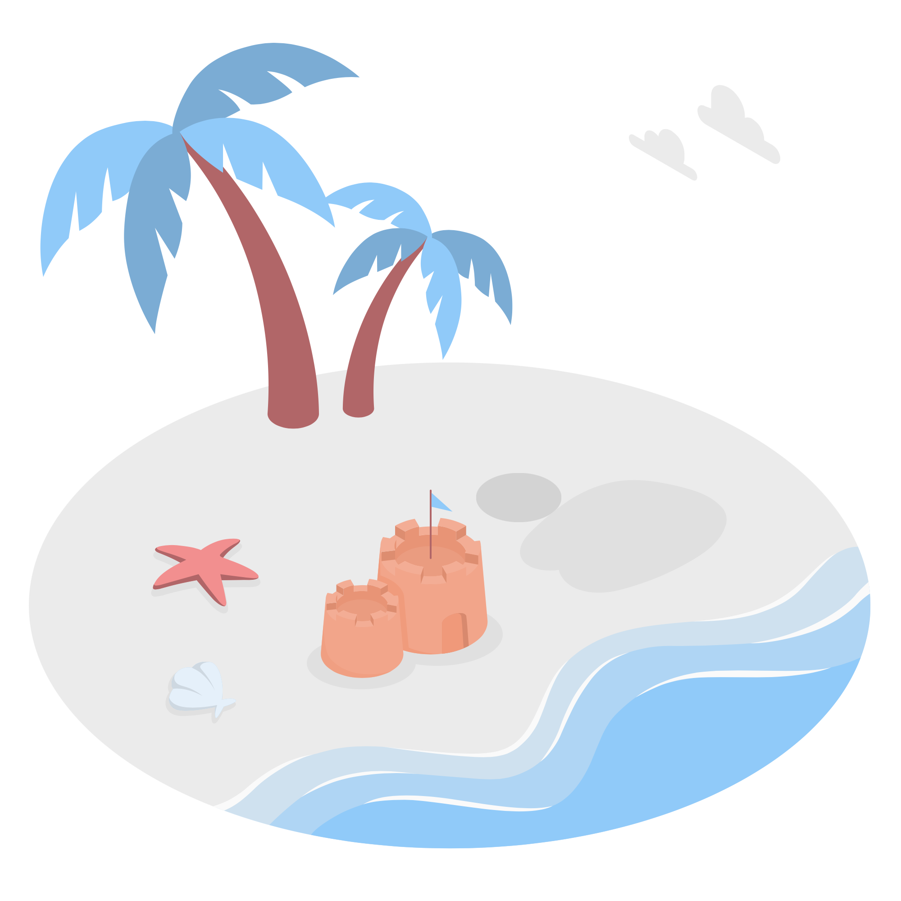
Lesson Plans
for Ages 0-3:

Slide 4
Lesson Plans for Ages 0-3:
1. Ocean Sensory Bin
Materials: Water table or basin, blue food coloring, ocean-themed toys (e.g., plastic fish, seashells), scoops, cups
Duration: 20-30 minutes
Description: Encourage infants and toddlers to explore the water table filled with blue-tinted water and ocean-themed toys. Let them pour, scoop, and play, engaging their senses and imagination.
2. Fishy Finger Painting
Materials: Large paper or canvas, washable paint in various colors, fish-shaped sponges or cutouts
Duration: 20-30 minutes
Description: Assist children in creating colorful fish prints by dipping fish-shaped sponges or cutouts into washable paint and pressing them onto paper.

Slide 5
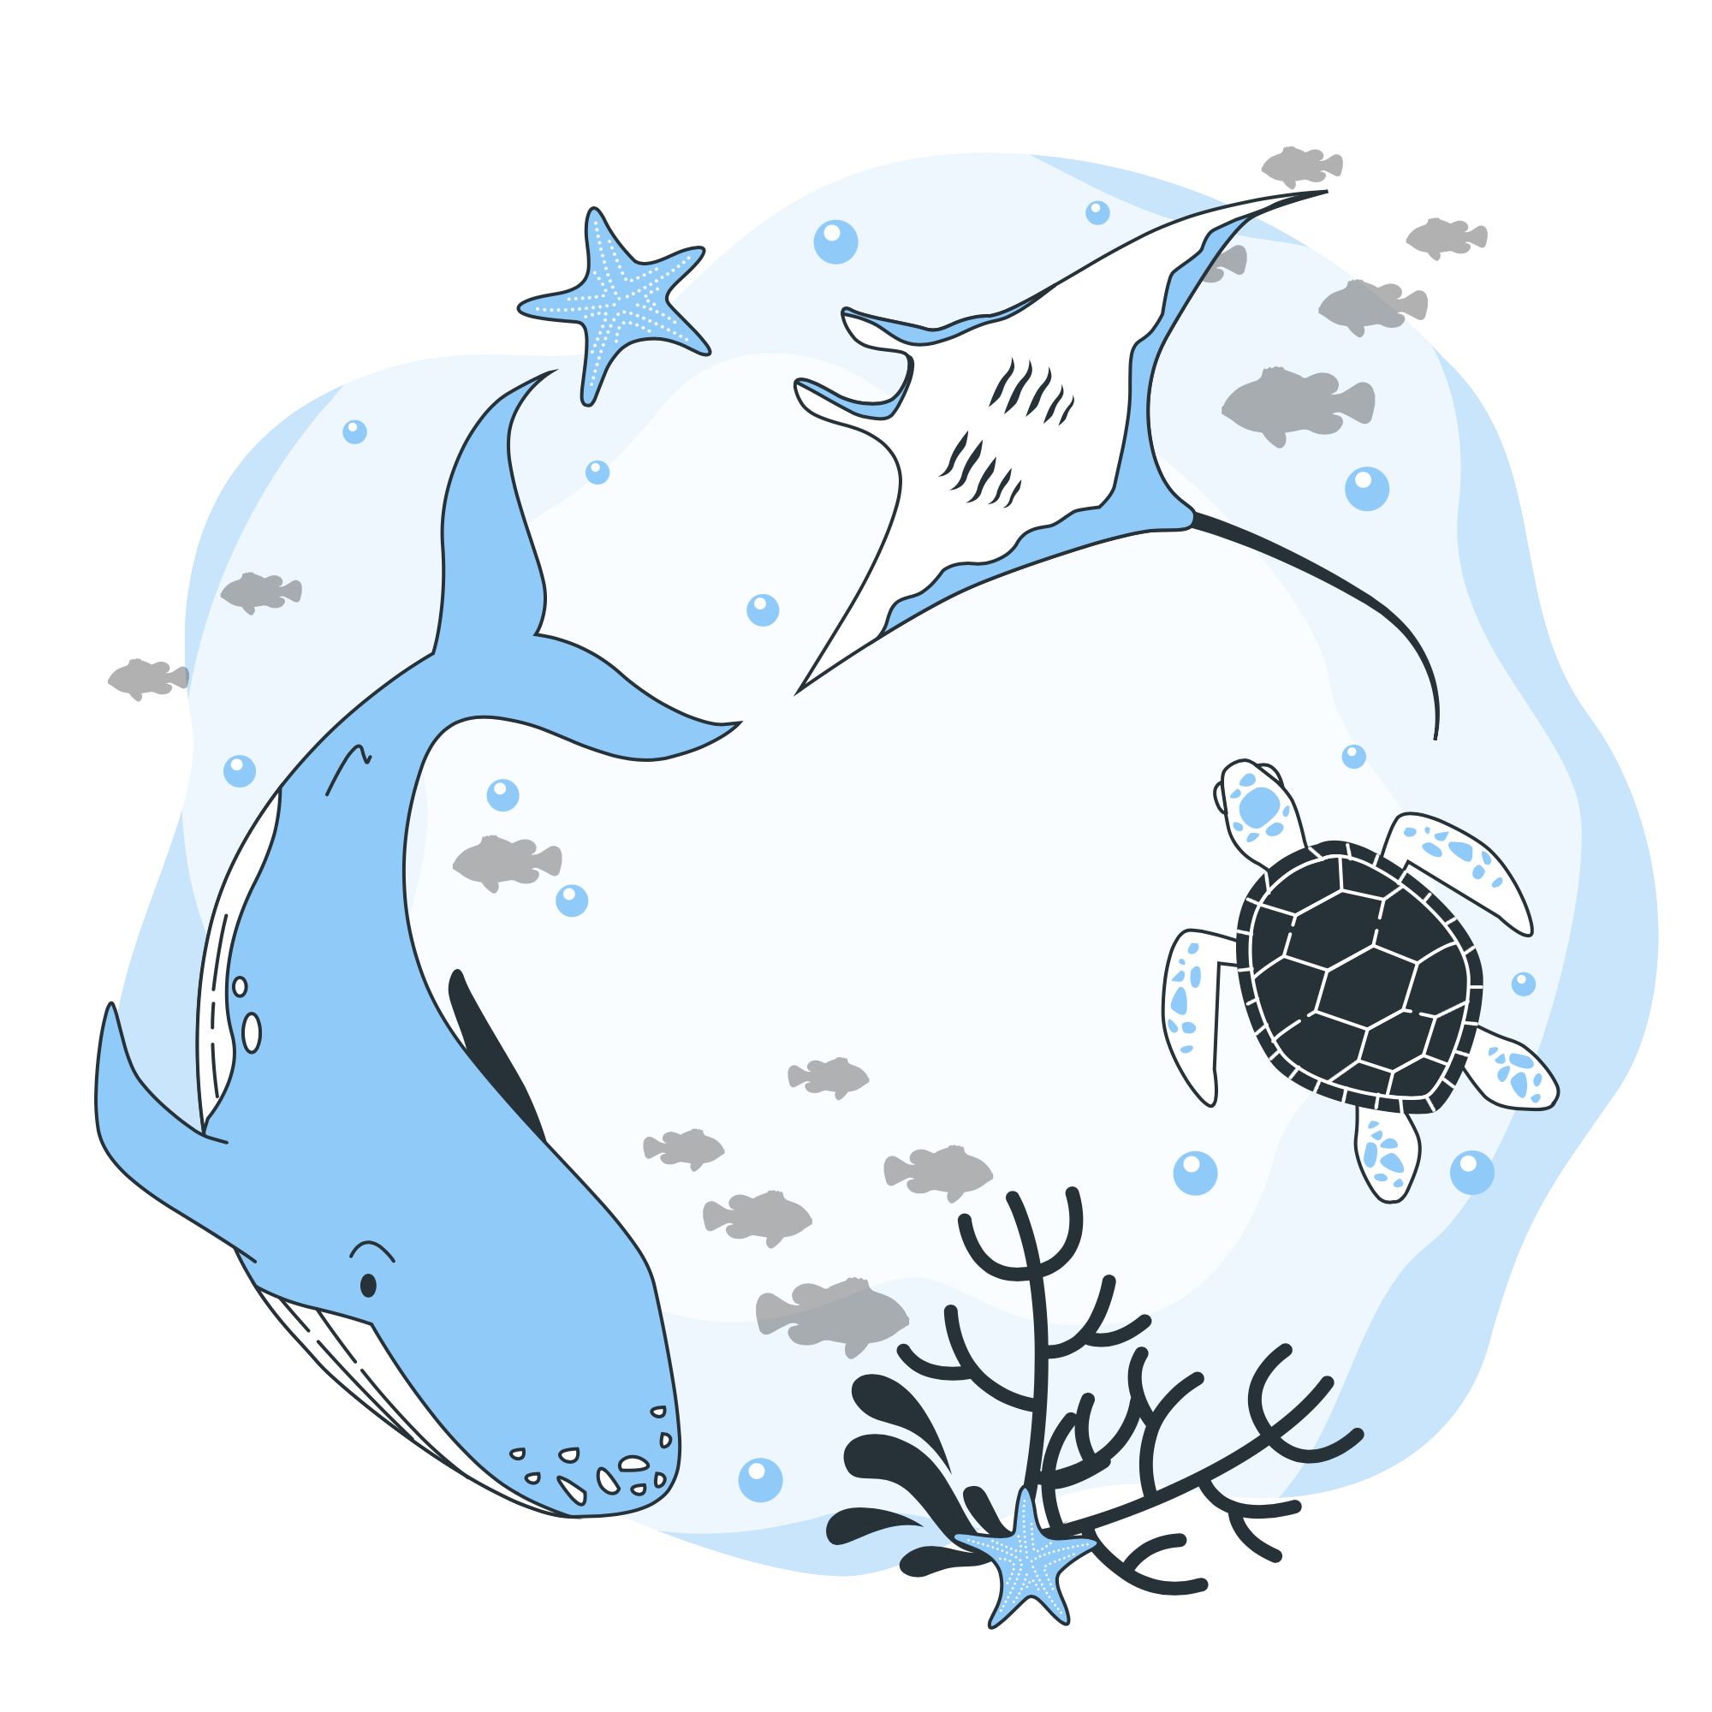
Lesson Plans for Ages 0-3:
3. Water Play with Ocean Animals
Materials: Water table or basin, ocean animal toys, cups, sponges, water scoops
Duration: 30-45 minutes
Description: Fill the water table with water and add ocean animal toys. Encourage children to engage in imaginative play, exploring different water activities with the ocean animals.

Slide 6
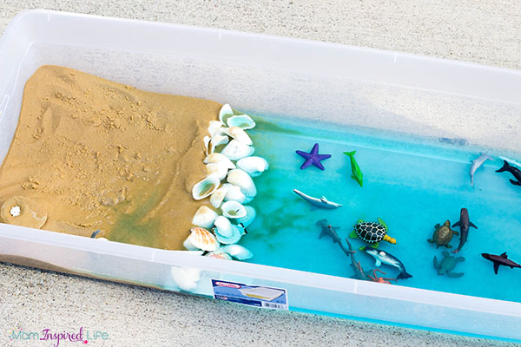

Slide 7
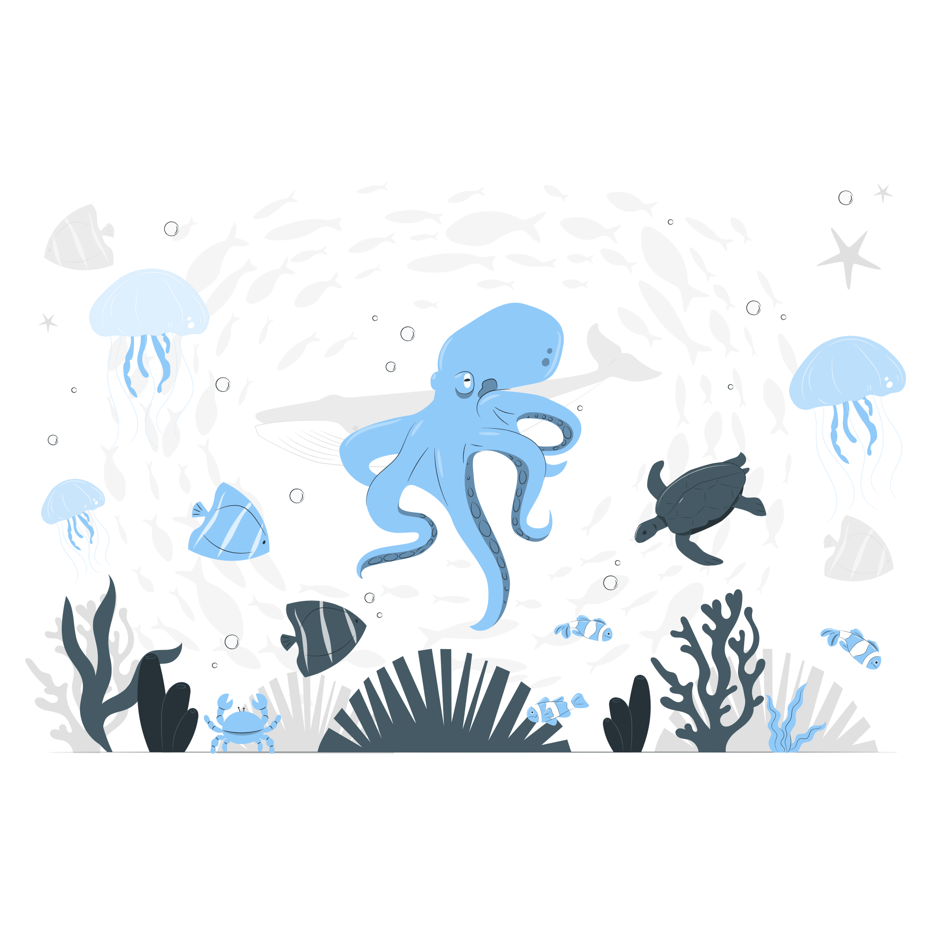
Lesson Plans
for Ages 4-7:

Slide 8
Lesson Plans for Ages 4-7:
1. Ocean Animal Yoga
Materials: Yoga mats or towels
Duration: 20-30 minutes
Description: Lead children through a series of yoga poses inspired by ocean animals. Discuss the characteristics and movements of each animal while promoting flexibility and relaxation.
2. Underwater Diorama
Materials: Shoebox, blue construction paper or paint, ocean-themed stickers or cutouts, glue, markers
Duration: 45-60 minutes
Description: Assist children in creating underwater dioramas inside shoeboxes. Use blue construction paper as the background and decorate with ocean-themed stickers or cutouts.

Slide 9
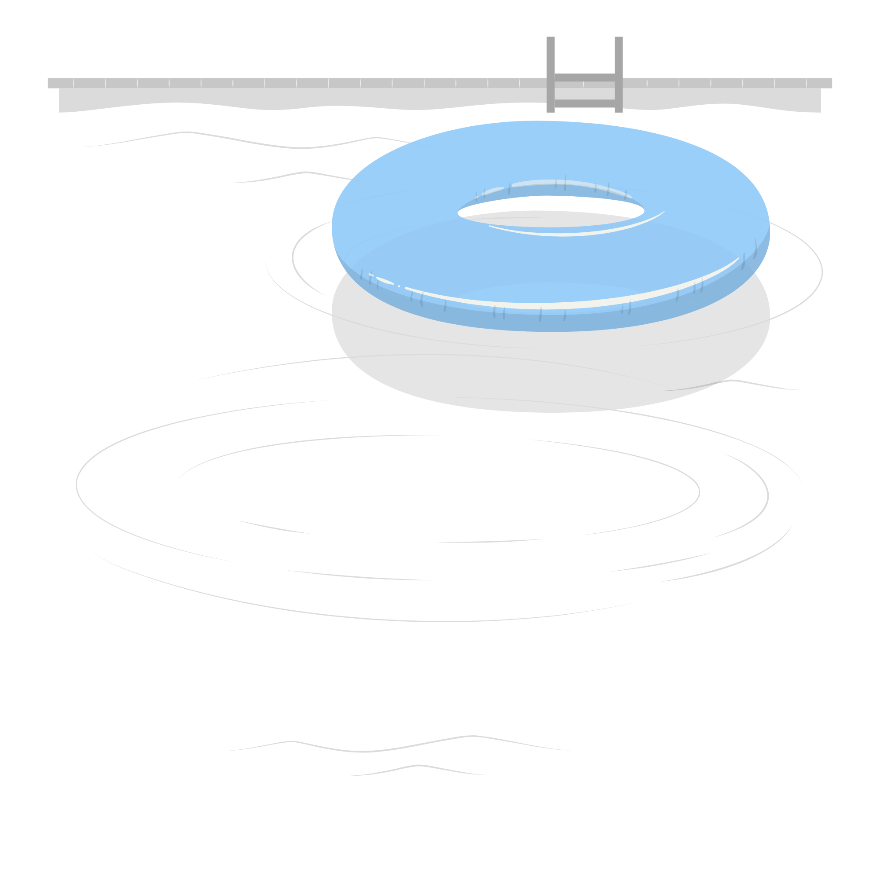
Lesson Plans for Ages 4-7:
3. Water Science Experiments
Materials: Water, various containers (cups, bottles), objects that float or sink, food coloring (optional)
Duration: 30-45 minutes
Description: Conduct simple water science experiments to explore buoyancy, sinking, floating, and color mixing. Encourage children to make predictions and observe the outcomes.

Slide 10
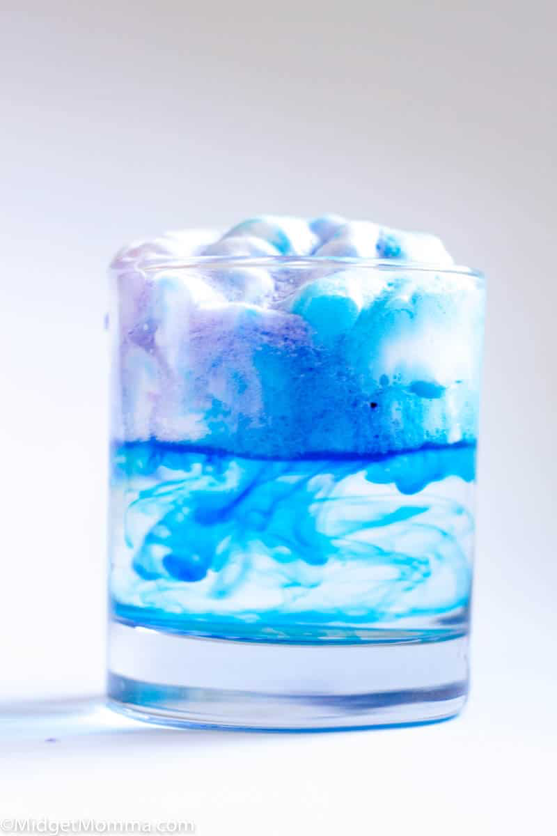
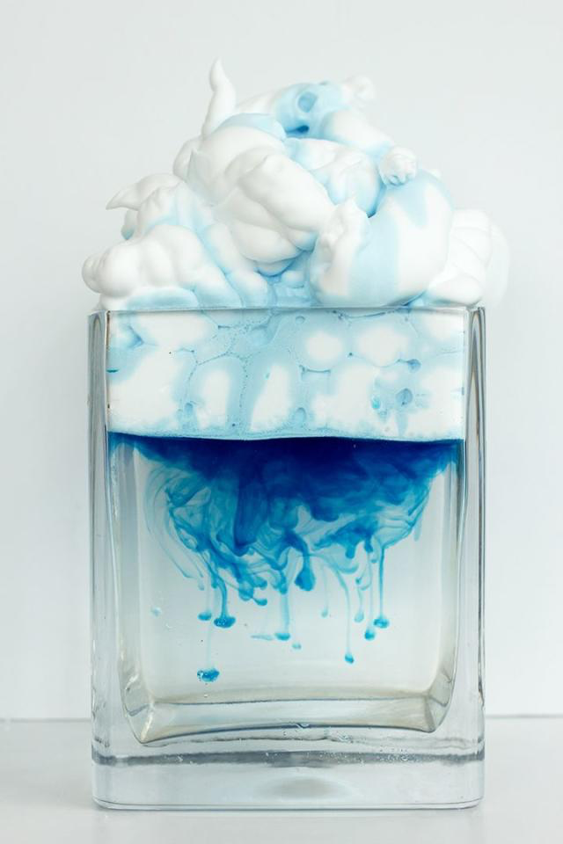

Slide 11
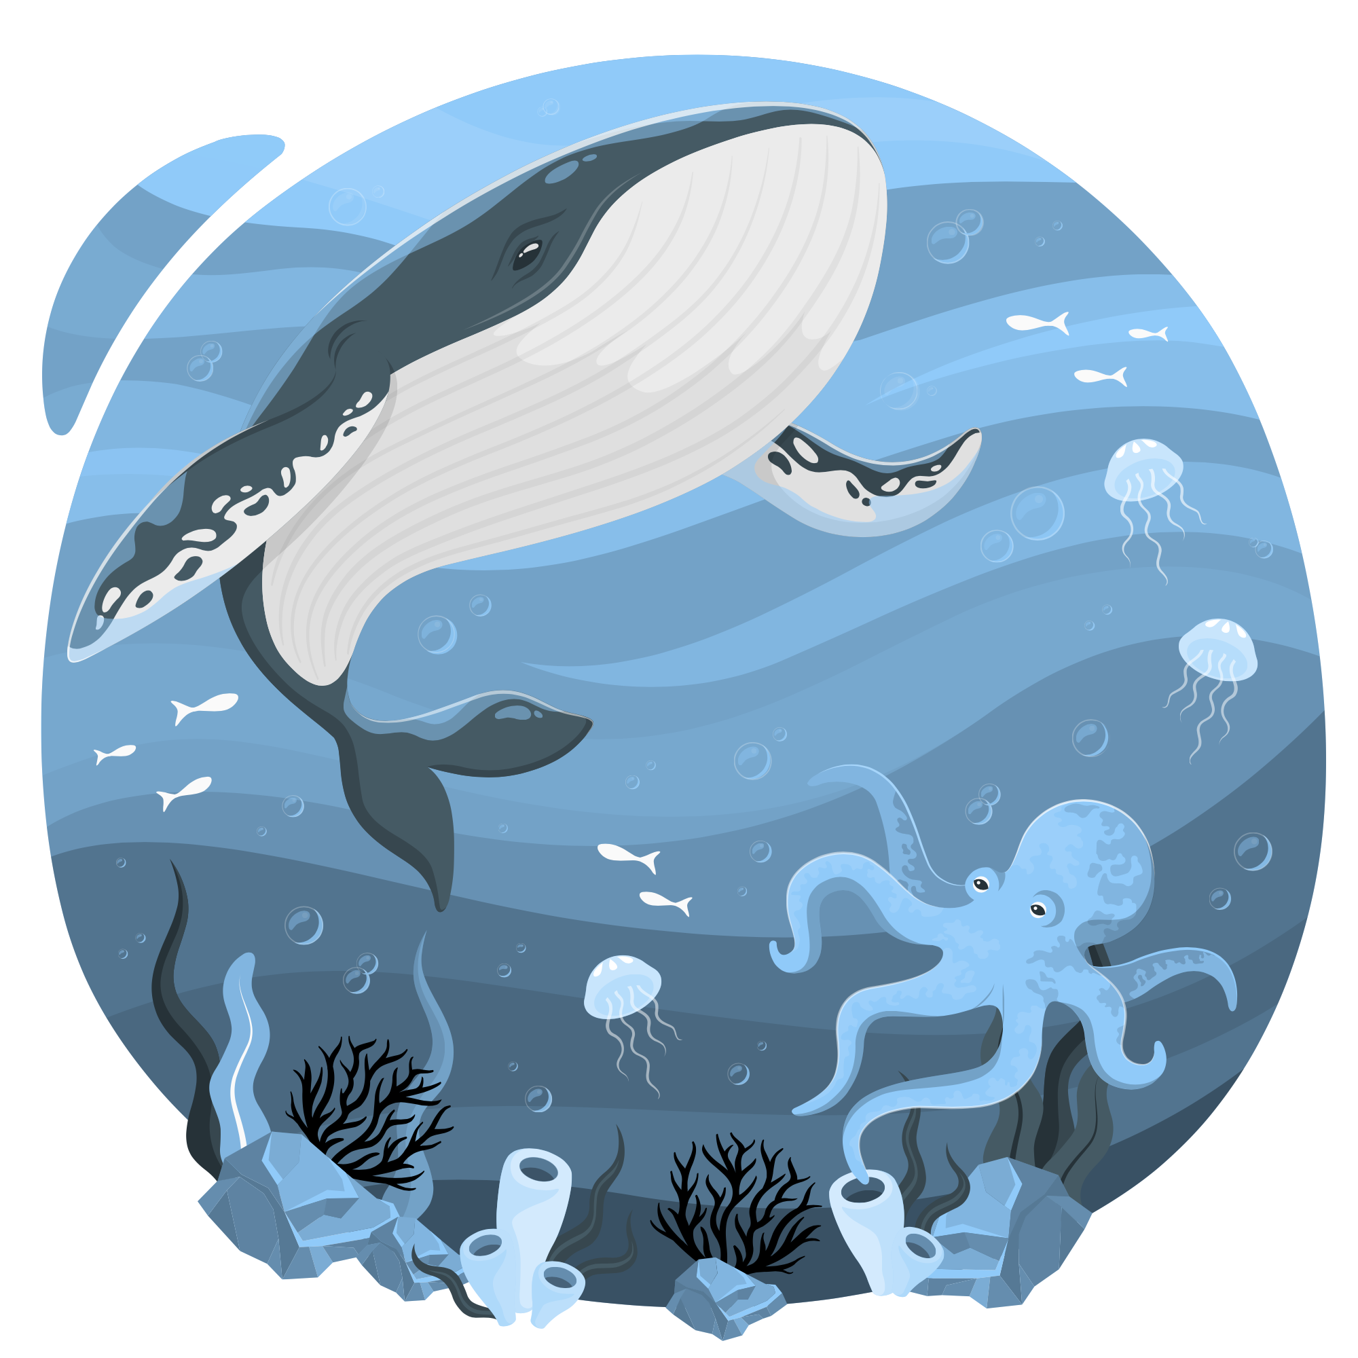
Lesson Plans
for Ages 8-11:

Slide 12
Lesson Plans for Ages 8-11:
1. Marine Life Research Project
Materials: Library books, internet access, writing materials
Duration: Multiple sessions (1-2 hours each)
Description: Assign each child a specific marine animal to research. Provide resources such as library books and internet access for them to gather information about their chosen animal's habitat, diet, behavior, and conservation status. Encourage them to create presentations or reports to share their findings with the rest of the group.
2. Ocean Artifacts Exhibition
Materials: Various ocean-themed artifacts (e.g., seashells, coral pieces, driftwood), display tables, labels, art supplies
Duration: Multiple sessions (1-2 hours each)
Description: Invite children to collect and bring in various ocean-themed artifacts from their beach visits or personal collections. Set up a display area with tables and labels. Guide them in arranging the artifacts, creating informative labels, and adding artistic touches to enhance the exhibition. Encourage them to share interesting facts about each artifact.

Slide 13
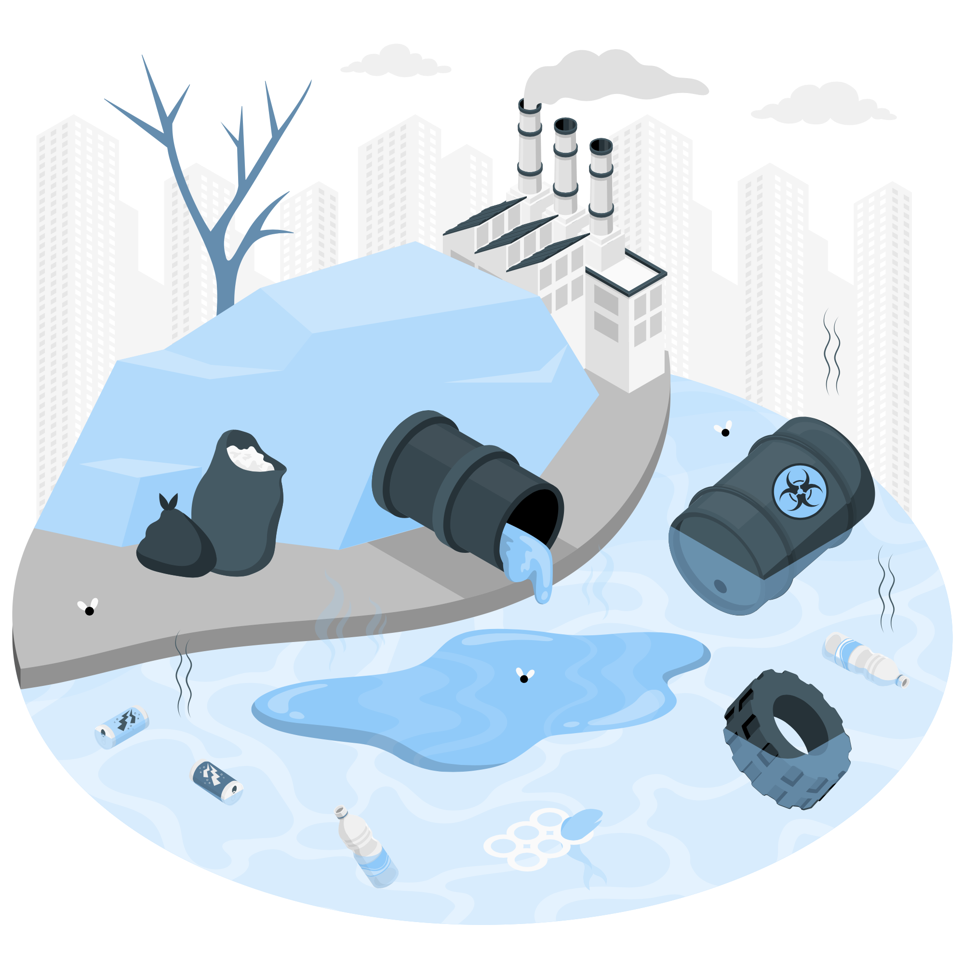
Lesson Plans for Ages 8-11:
3. Ocean Conservation Campaign
Materials: Poster board, markers, art supplies
Duration: Multiple sessions (1-2 hours each)
Description: Engage children in an ocean conservation campaign project. Discuss the importance of protecting marine life and conserving the ocean ecosystem. Guide them in creating posters or informative campaigns that raise awareness about ocean conservation. They can illustrate the importance of reducing plastic waste, promoting sustainable fishing practices, and taking action to protect marine habitats.

Slide 14
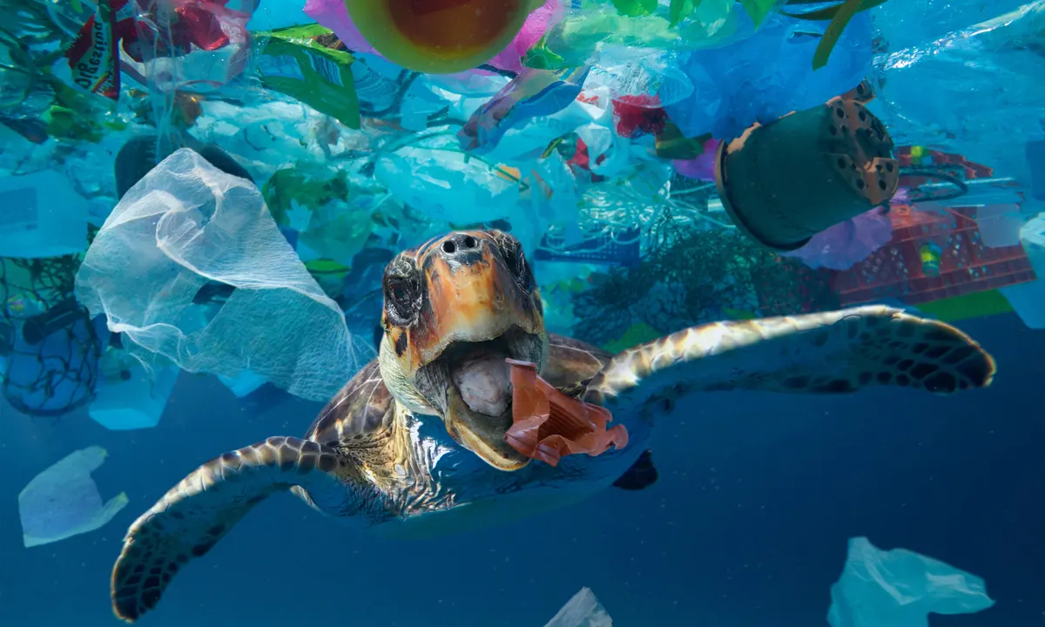

Slide 15
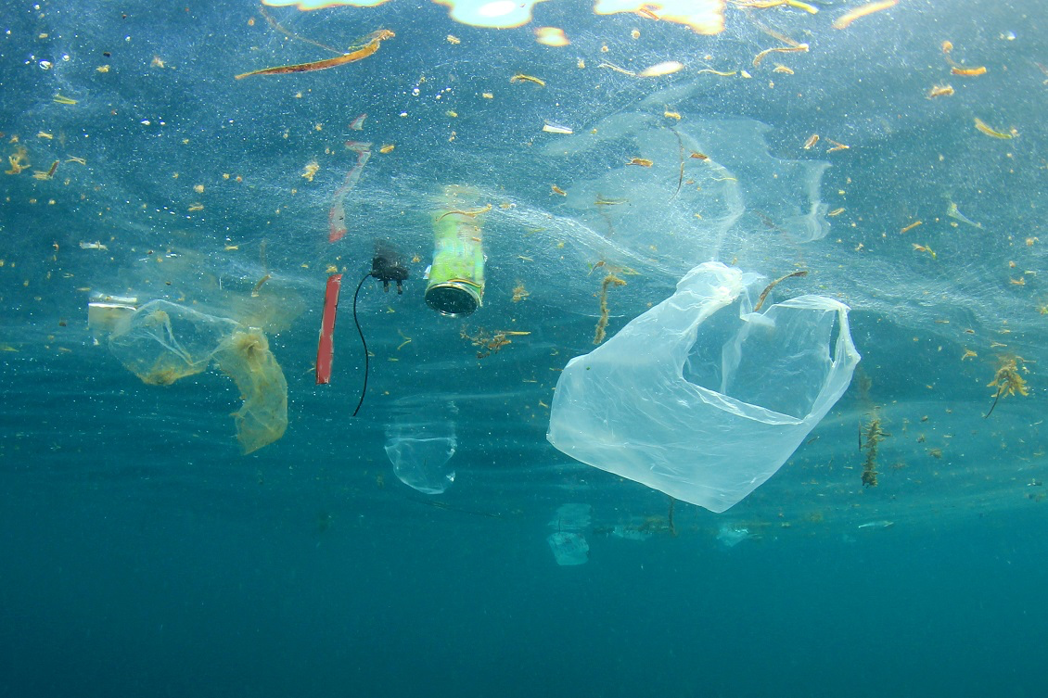

Slide 16

Field Trip: Aquarium Adventure (Ages 2.5 and Up)

Slide 17

Field Trip for Ages 2.5 and Up:
Description:
Embark on an exciting field trip to the local aquarium. Children of all ages, including 2.5 and up, will have the opportunity to explore the wonders of the underwater world. They will observe a wide range of marine life, learn about different ecosystems, and gain a deeper understanding of ocean conservation through interactive exhibits, educational displays, and engaging activities provided by the aquarium staff.

Slide 18
Conclusion / Reminder
Please ensure that the activities and presentations during the aquarium field trip are age-appropriate and suitable for all participants, including the younger age group. Enjoy the immersive experience at the aquarium!

Slide 19

Debrief / Huddle
As a group, discuss the following questions:
One thing that was new to you regarding the content / lesson plans presented?
One thing that was familiar to you regarding the content / lesson plans presented?
Any stories or previous experiences regarding today’s content on Weeks 5 & 6 - Water Play Extravaganza & Ocean Exploration?

Slide 20

Thanks!
Do you have any questions?
support@atccenter.org
tel: (253) 368-9705
atccenter.org
Please keep this slide for attribution

