Slide 1

Week 7 - NASA: Plant the Moon Project

Slide 2
Description:
Embark on a space-themed adventure with NASA-inspired activities and projects. Engage in the Plant the Moon challenge sponsored by NASA, where children will learn about lunar colonization and participate in planting activities.

Slide 3
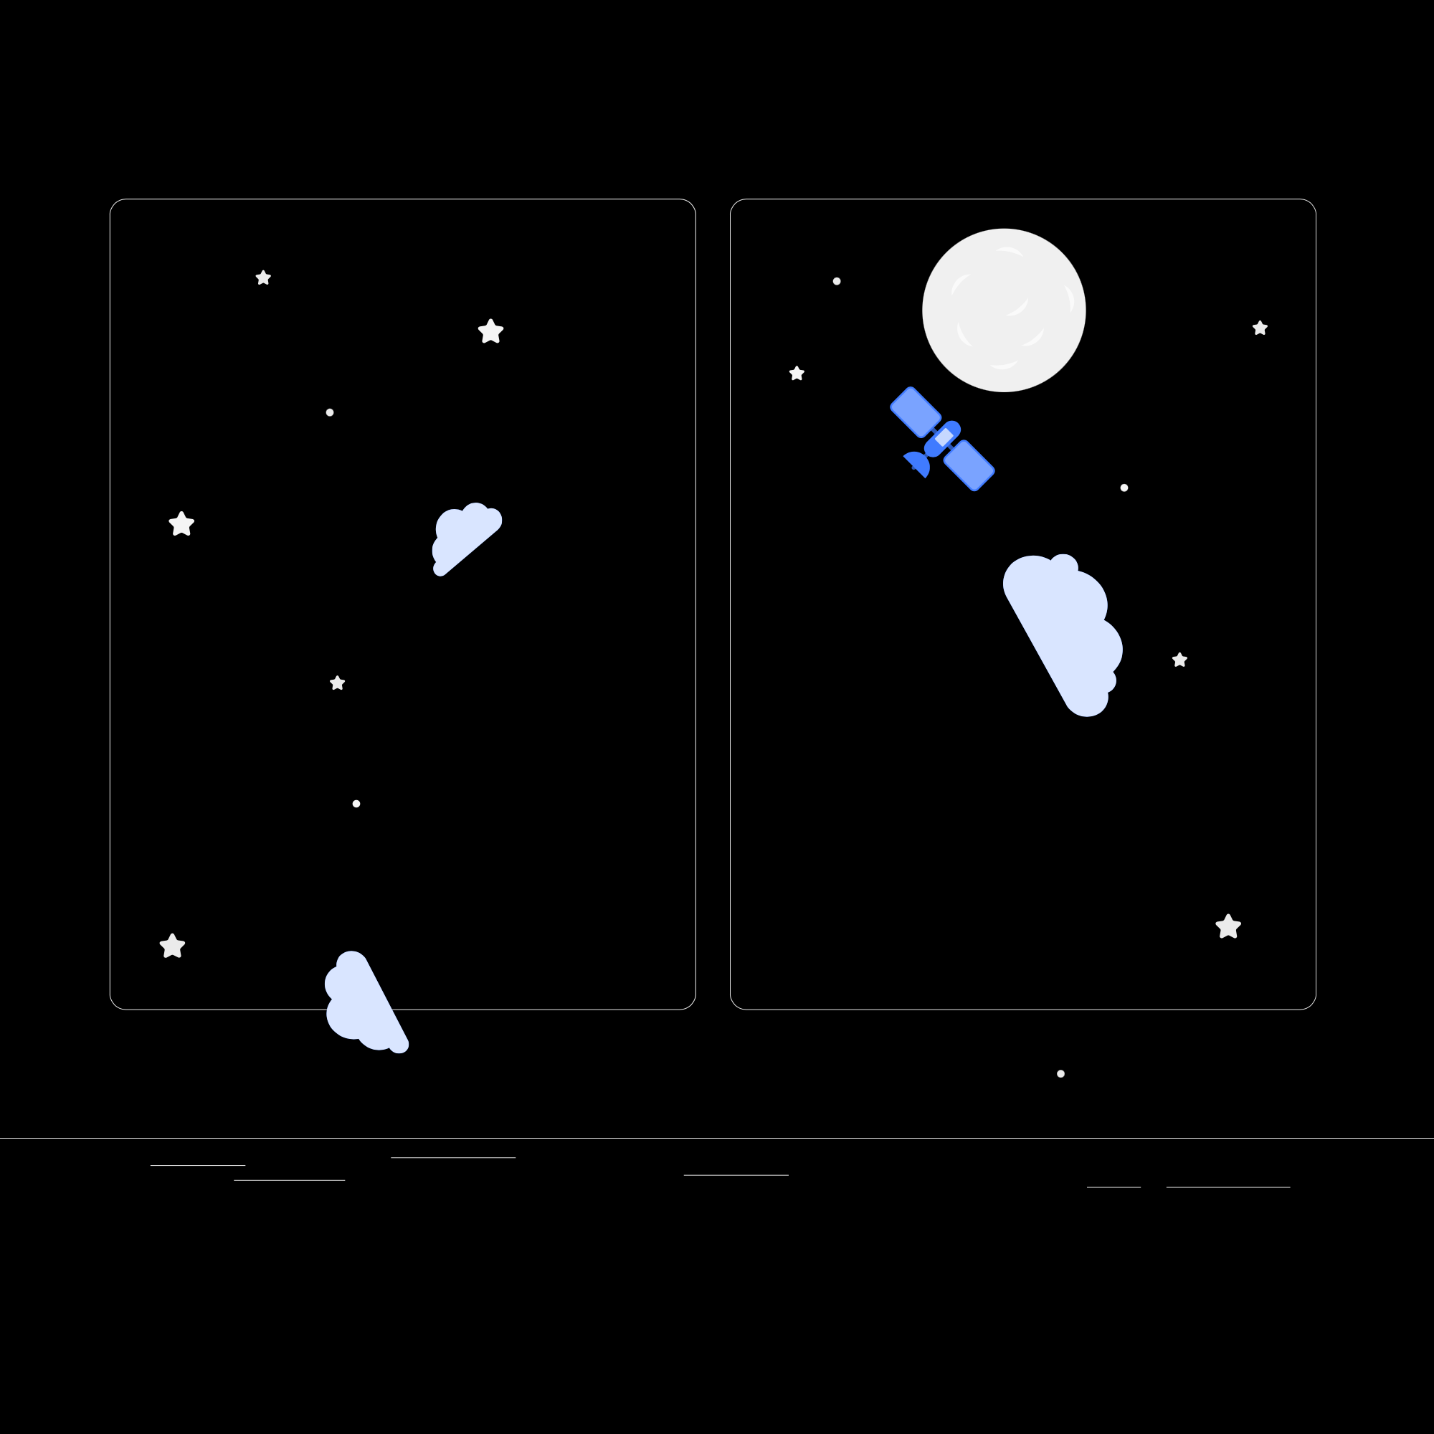
Description (continued):
This group project will happen over the course of summer and submitted to NASA for more information go to The Challenge – Plant the Moon Challenge

Slide 4
Overview of Plant The Moon Challenge:
The Plant the Moon challenge is an initiative by NASA to explore the possibilities of lunar colonization. Children will discover the importance of sustaining life on the moon by planting seeds and understanding the challenges and innovations required for successful growth.

Slide 5

Lesson Plans
for Ages 0-3:

Slide 6
Lesson Plans for Ages 0-3:
1. Sensory Space Exploration
Materials: Sensory materials (e.g., moon sand, glitter, foil), toy rockets or spaceships
Duration: 20-30 minutes
Description: Set up a sensory exploration area with different materials that resemble the moon's surface. Let infants and toddlers touch, feel, and play with the sensory materials while incorporating toy rockets or spaceships into their play.
2. Space-themed Songs and Rhymes
Materials: Song lyrics or rhymes related to space (e.g., "Twinkle, Twinkle, Little Star")
Duration: 10-15 minutes
Description: Engage infants and toddlers in singing space-themed songs or reciting rhymes related to stars, planets, and space exploration. Use props or visual aids to enhance the experience.

Slide 7
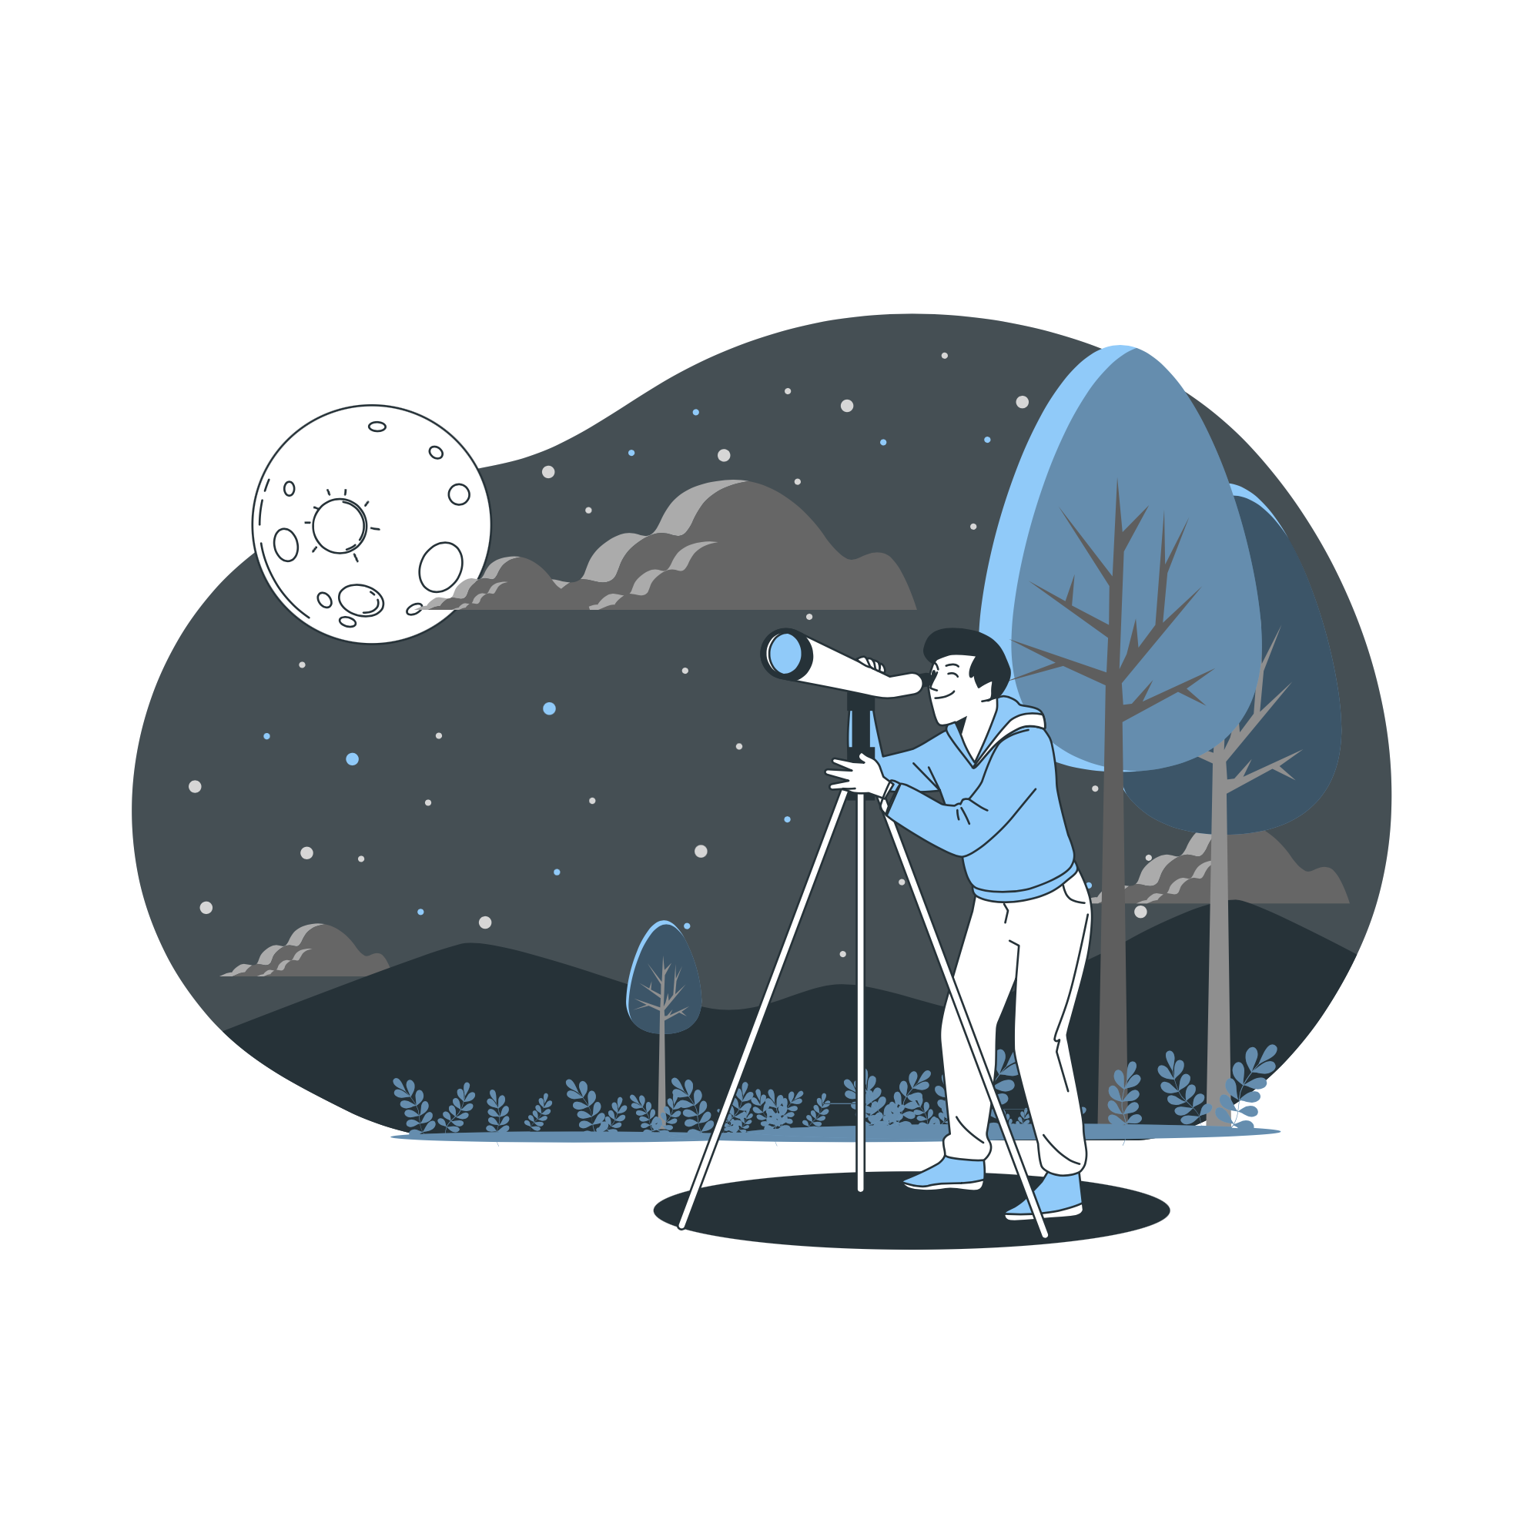
Lesson Plans for Ages 0-3:
3. Moon Phases Craft
Materials: Paper plates, black construction paper, white and gray paint, glue, craft sticks
Duration: 30-45 minutes
Description: Assist children in creating a moon phases craft using paper plates. Cut out different shapes from black construction paper to represent the moon phases. Let children paint the plates white and gray to depict the phases and attach the cutout shapes accordingly.

Slide 8
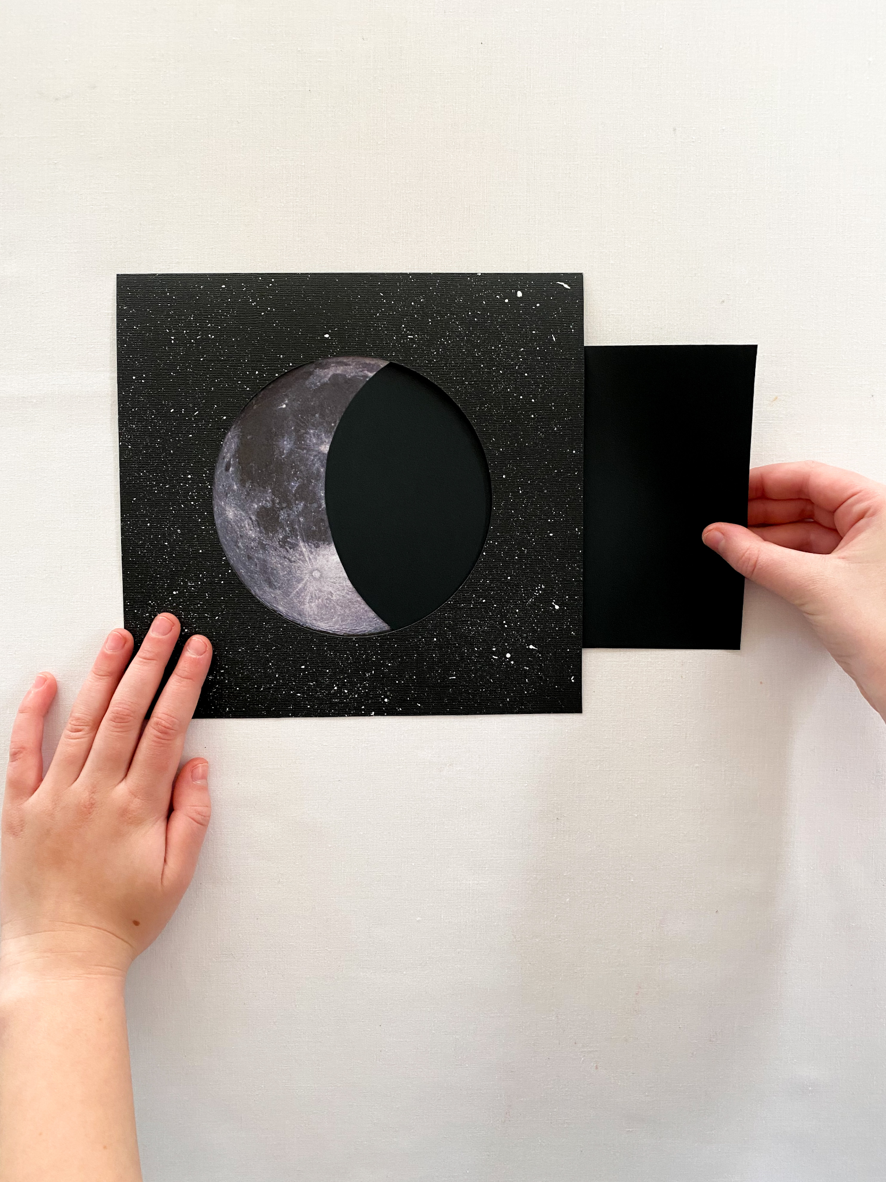

Slide 9


Lesson Plans for Ages 0-3:
4. A Moon Phase Food Craft Gf option available - Be aware of food allergies
Moon Phases Sensory Activity Materials: Oreo cookies (or similar cream-filled cookies)
Duration: 15-20 minutes
Description: Demonstrate the different phases of the moon using Oreo cookies. Show children how to scrape off the cream to represent the different lunar phases (new moon, crescent, half moon, full moon). Discuss the reasons behind the changing appearance of the moon.

Slide 10
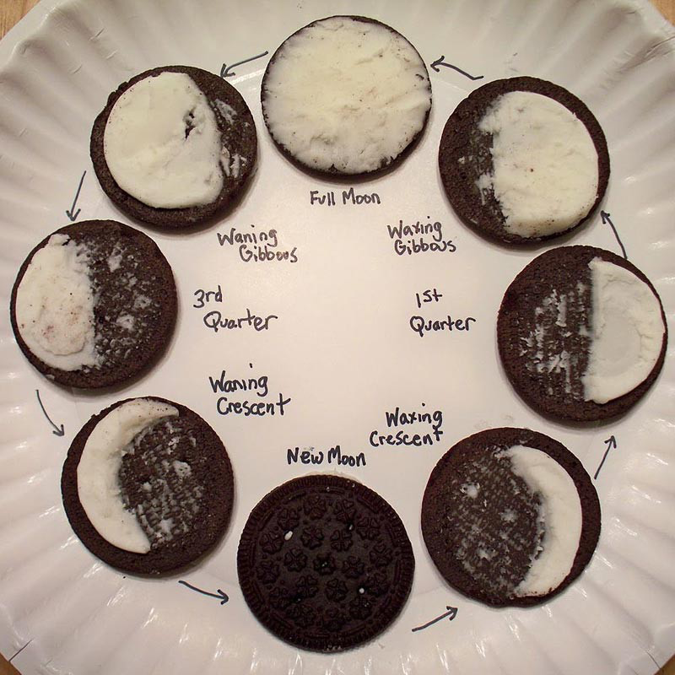

Slide 11
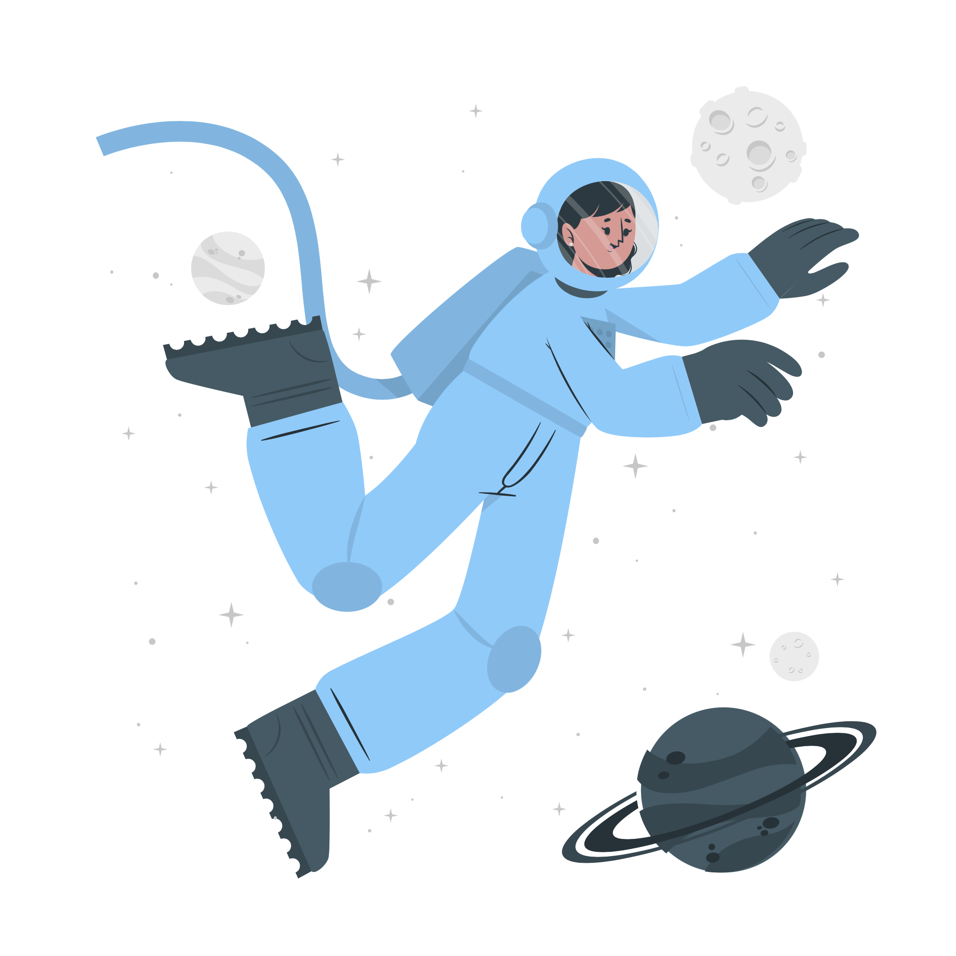
Lesson Plans
for Ages 4-7:

Slide 12
Lesson Plans for Ages 4-7:
1. Astronaut Training Camp
Materials: Obstacle course props (e.g., cones, hula hoops, tunnels), stopwatch or timer
Duration: 30-45 minutes
Description: Set up an astronaut training camp with various physical activities and challenges. Create an obstacle course that incorporates tasks such as crawling through tunnels, jumping over cones, and balancing on designated spots. Time children as they complete the course and encourage friendly competition.
2. Rocket Science Experiment
Materials: Film canisters, baking soda, vinegar, craft supplies for decorating rockets
Duration: 45-60 minutes
Description: Guide children in creating simple film canister rockets. Assist them in adding baking soda and vinegar to the canister, quickly sealing it, and placing it upside down. Watch as the chemical reaction causes the rocket to launch into the air.

Slide 13
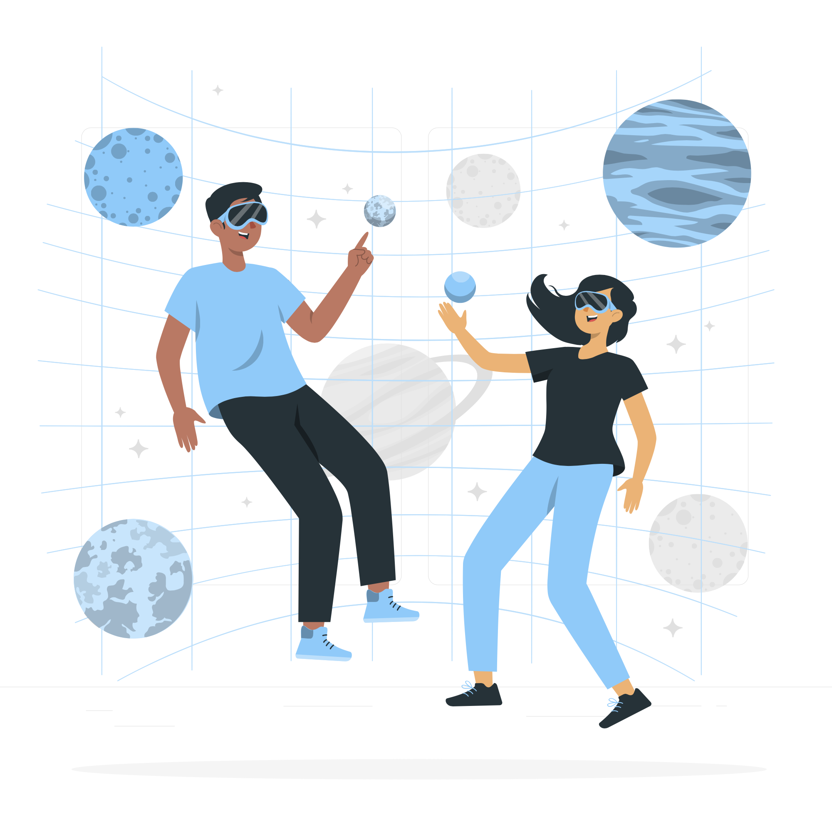
Lesson Plans for Ages 4-7:
3. Virtual Space Journey
Materials: Computer or tablet with internet access, NASA's interactive online resources or videos
Duration: 30-45 minutes
Description: Take children on a virtual space journey by exploring NASA's interactive online resources or videos. Watch footage of space missions, learn about different celestial bodies, and engage in interactive activities designed for their age group.

Slide 14
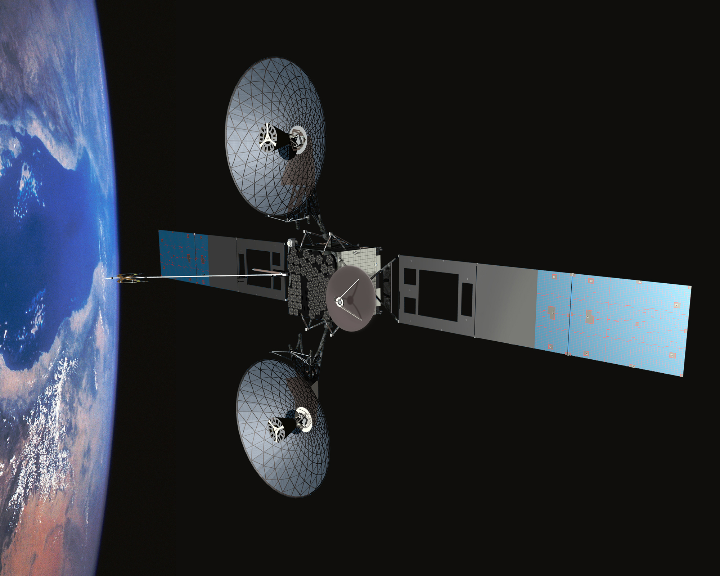

Slide 15
Lesson Plans for Ages 4-7:
4. A Moon Phase Food Craft Gf option available - Be aware of food allergies
Moon Phases Sensory Activity Materials: Oreo cookies (or similar cream-filled cookies)
Duration: 15-20 minutes
Description: Demonstrate the different phases of the moon using Oreo cookies. Show children how to scrape off the cream to represent the different lunar phases (new moon, crescent, half moon, full moon). Discuss the reasons behind the changing appearance of the moon.

Slide 16
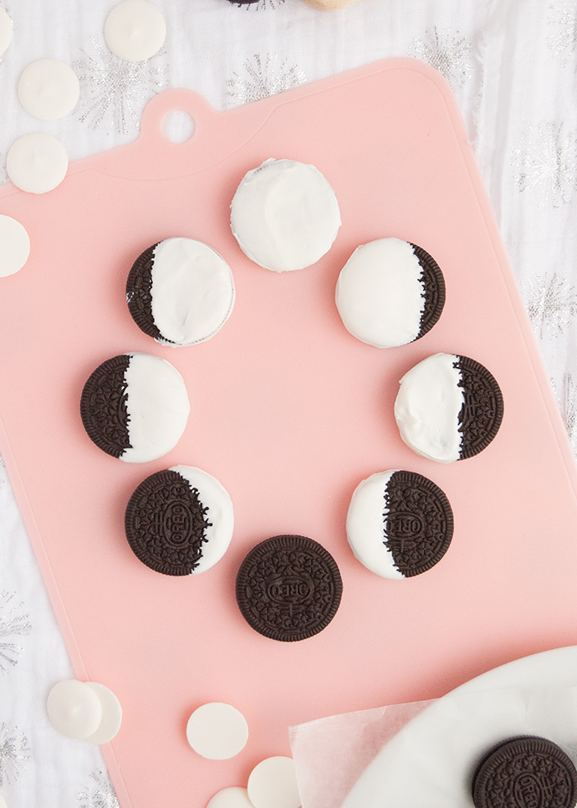

Slide 17

Lesson Plans
for Ages 8-11:

Slide 18
Lesson Plans for Ages 8-11:
1. Mission to Mars STEM Challenge
Materials: Craft supplies (e.g., cardboard, tape, straws), small objects to represent Mars rovers
Duration: Multiple sessions (1-2 hours each)
Description: Engage children in a STEM challenge where they design and build their own Mars rovers using craft supplies. Encourage them to consider factors like durability, mobility, and payload capacity. Test and improve their designs through various challenges.
2. Astronomical Research Project
Materials: Library books, internet access, writing materials
Duration: Multiple sessions (1-2 hours each)
Description: Assign children a specific astronomical topic to research, such as a planet, star, or galaxy. Provide resources for them to gather information, take notes, and create presentations or reports to share their findings.

Slide 19

Lesson Plans for Ages 8-11:
3. Virtual Space Agency Visit
Materials: Computer or tablet with internet access, virtual tours or presentations from space agencies or observatories
Duration: 60-90 minutes
Description: Arrange a virtual visit to a space agency or observatory through their online platforms. Let children explore interactive tours, watch presentations about space missions, and engage in Q&A sessions with experts.

Slide 20
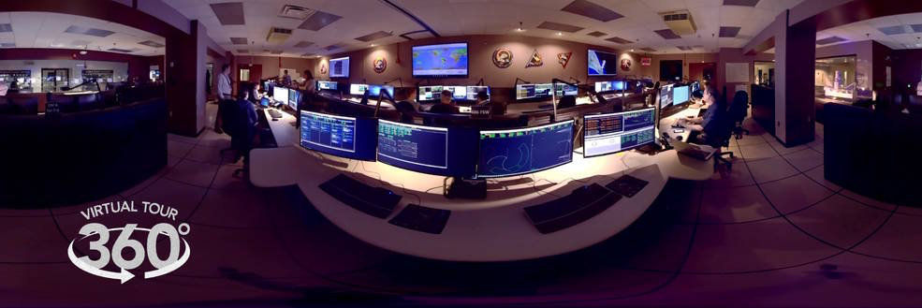

Slide 21
Lesson Plans for Ages 8-11:
4. A Moon Phase Food Craft Gf option available - Be aware of food allergies
Moon Phases Sensory Activity Materials: Oreo cookies (or similar cream-filled cookies)
Duration: 15-20 minutes
Description: Demonstrate the different phases of the moon using Oreo cookies. Show children how to scrape off the cream to represent the different lunar phases (new moon, crescent, half moon, full moon). Discuss the reasons behind the changing appearance of the moon.

Slide 22
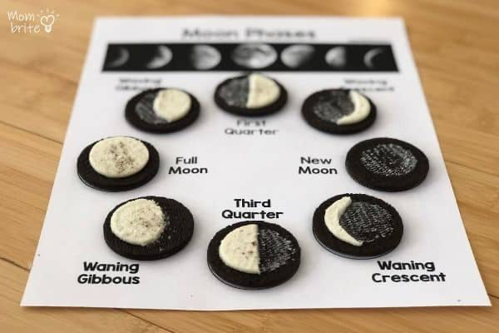

Slide 23

Resources:
Note: "The Planet Song" into the appropriate lesson plan to teach students about the planets.
Space food – Dehydrated ice cream sandwiches and strawberries order link- Amazon.com: Astronaut Foods Freeze-Dried Ice Cream Sandwich, NASA Space Dessert, Vanilla, 12 Count : Grocery & Gourmet Food - Be aware of allergies

Slide 24

Field Trip: Museum of Flight and Space Exploration (Ages 5 and Up) - Packed lunch provided.

Slide 25
Field Trip for Ages 5 and Up:
Description:
Embark on an exciting field trip to the Museum of Flight and Space Exploration, where students will have the opportunity to immerse themselves in the captivating world of aerospace history and space exploration. This engaging excursion will spark their curiosity and deepen their understanding of the vastness and wonder of outer space.
Safety Measures:
The safety and well-being of our students are of utmost importance. To ensure a safe and enjoyable experience, we will maintain a student-to-teacher ratio of 6:1, providing adequate supervision and guidance throughout the field trip. Our trained staff will be vigilant in ensuring the students' safety and adherence to museum rules and regulations.

Slide 26
Field Trip for Ages 5 and Up:
Exploration Activities:
During the field trip, students will have the opportunity to explore a wide range of exhibits that showcase real spacecraft, astronaut artifacts, and interactive displays. They will delve into the history of space travel, learn about significant space missions, and discover the fascinating technology behind space exploration. Engaging museum guides will provide informative and interactive presentations to enhance the students' learning experience.
Interactive Experiences:
The Museum of Flight and Space Exploration offers hands-on activities and simulators that allow students to experience the thrill of space missions. They can take part in simulated space missions, try out astronaut training exercises, and even experience the sensation of walking on the moon through virtual reality simulations. These interactive experiences will ignite their imagination and inspire a sense of wonder about the vastness of the universe.

Slide 27
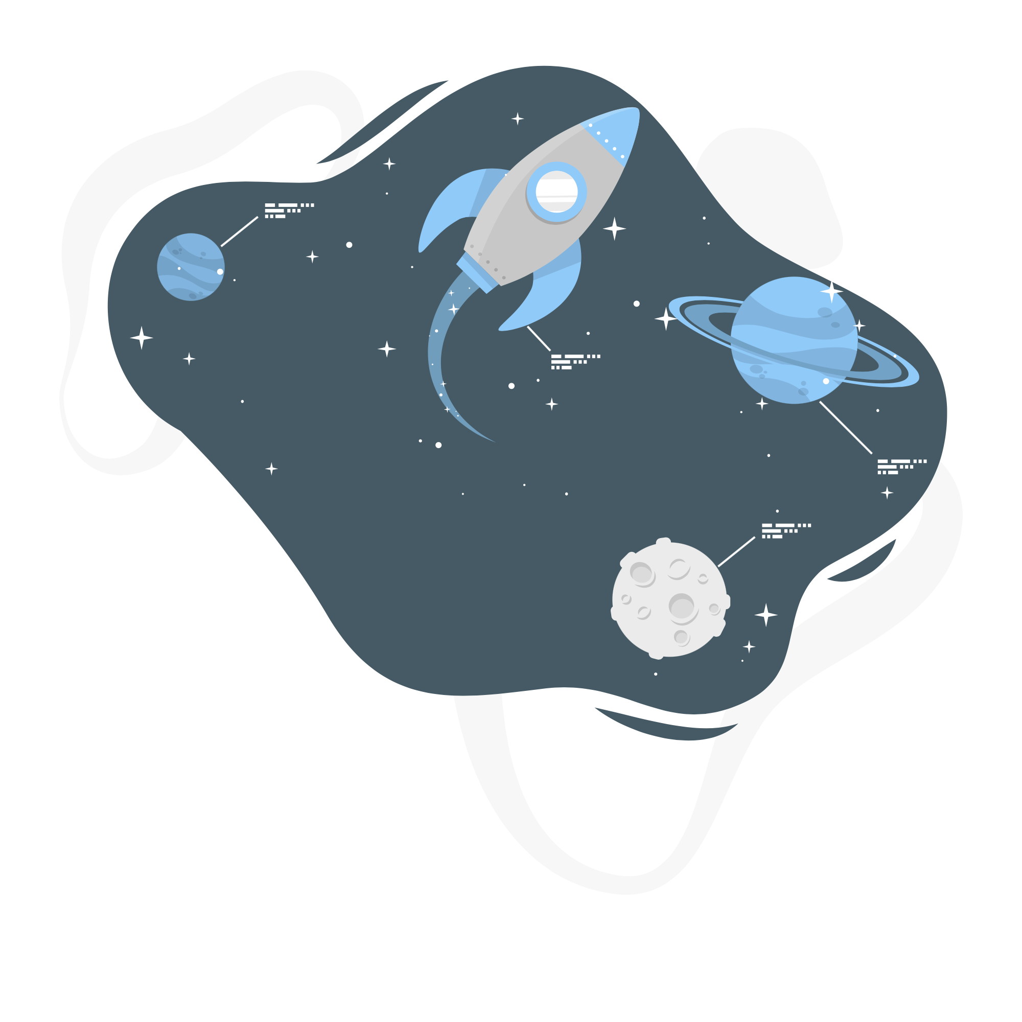
Field Trip for Ages 5 and Up:
Educational Opportunities:
Knowledgeable museum staff will be available to answer students' questions and provide insights into the world of aerospace and space exploration. Students will have the chance to engage in discussions, participate in educational workshops, and gain a deeper understanding of the scientific and technological advancements that have propelled humanity's journey into space.

Slide 28
Conclusion / Note:
It is crucial to emphasize the importance of proper behavior and respect for museum exhibits and guidelines. Remind students to listen attentively to museum staff and follow all instructions to ensure a positive and enriching experience for everyone.
In some situations this trip may be replaced &/or include a trip to the local military air base. All trips are not a guarantee to camp however anticipated.

Slide 29

Debrief / Huddle
As a group, discuss the following questions:
One thing that was new to you regarding the content / lesson plans presented?
One thing that was familiar to you regarding the content / lesson plans presented?
Any stories or previous experiences regarding today’s content on Week 7 - NASA: Plant the Moon Project?

Slide 30

Thanks!
Do you have any questions?
support@atccenter.org
tel: (253) 368-9705
atccenter.org
Please keep this slide for attribution

