Slide 1

Week 8 - Science: Discover the Wonders of the Natural World!

Slide 2
Description:
Immerse yourself in the captivating world of science during this engaging and educational Science Week. Through hands-on experiments and exploration of natural phenomena, children will develop a deep appreciation for the core fundamentals of scientific inquiry. This week aims to foster curiosity, critical thinking, and a love for discovering how the world works.

Slide 3

Lesson Plans
for Ages 0-3:

Slide 4
Lesson Plans for Ages 0-3:
1. Sensory Exploration with Rocks
Materials: Various rocks of different shapes, sizes, and textures
Duration: 20-30 minutes
Description: Introduce infants and toddlers to the sensory wonders of the natural world through hands-on exploration with rocks. By touching, feeling, and observing the unique properties of rocks, children will develop early scientific inquiry skills and enhance their sensory development.
2. Sink or Float Experiment
Materials: Large container of water, various objects (e.g., plastic toys, wooden blocks), towel or paper for drying
Duration: 30-45 minutes
Description: Engage infants and toddlers in a sink or float experiment to ignite their curiosity and encourage scientific predictions and observations. Through this activity, children will learn about object properties and develop early problem-solving skills.

Slide 5

Lesson Plans for Ages 0-3:
3. Colorful Volcanic Eruption
Materials: Baking soda, vinegar, dish soap, food coloring, small container
Duration: 20-30 minutes
Description: Spark excitement and scientific curiosity with a colorful volcanic eruption experiment. By combining simple ingredients and witnessing the vibrant eruption, children will be introduced to the concept of chemical reactions and learn about cause and effect relationships.

Slide 6
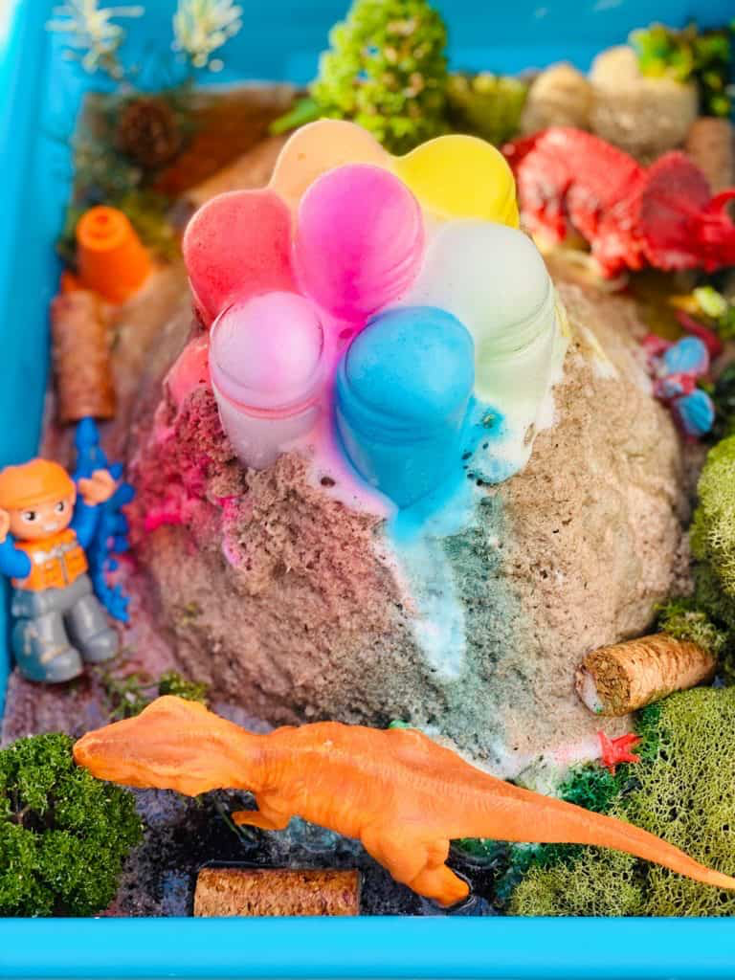

Slide 7
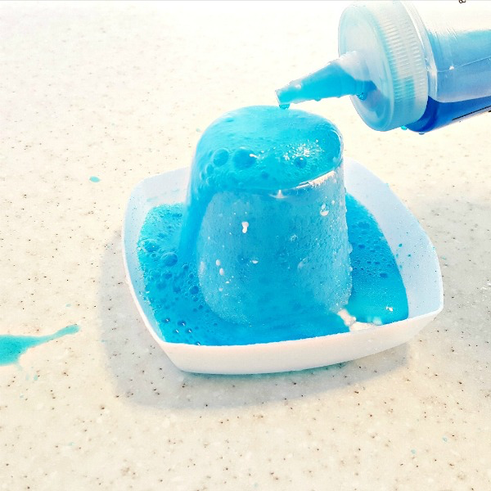

Slide 8


Lesson Plans
for Ages 4-7:

Slide 9
Lesson Plans for Ages 4-7:
1. Crystal Creations
Materials: Borax, pipe cleaners, wide-mouth jars, boiling water, food coloring (optional)
Duration: Multiple sessions (30-45 minutes each)
Description: Dive into the world of crystals as children create mesmerizing borax crystal formations. By observing the growth of crystals and discussing the scientific principles behind them, children will develop an understanding of crystalline structures and the process of crystal growth.
2. Bread Mold Experiment
Materials: Slices of bread, ziplock bags, spray bottle with water, magnifying glass
Duration: Multiple sessions (20-30 minutes each)
Description: Engage children in a bread mold experiment to explore the fascinating world of microbiology. Through the observation and documentation of mold growth in different environmental conditions, children will develop scientific inquiry skills and gain an understanding of living organisms.

Slide 10

Lesson Plans for Ages 4-7:
3. Balloon Rocket Race
Materials: Balloons, string, straws, tape, measuring tape
Duration: 30-45 minutes
Description: Experience the thrill of a balloon rocket race while exploring the principles of physics. By designing and launching balloon rockets, children will engage in scientific predictions, measurements, and discussions about motion, forces, and energy.

Slide 11
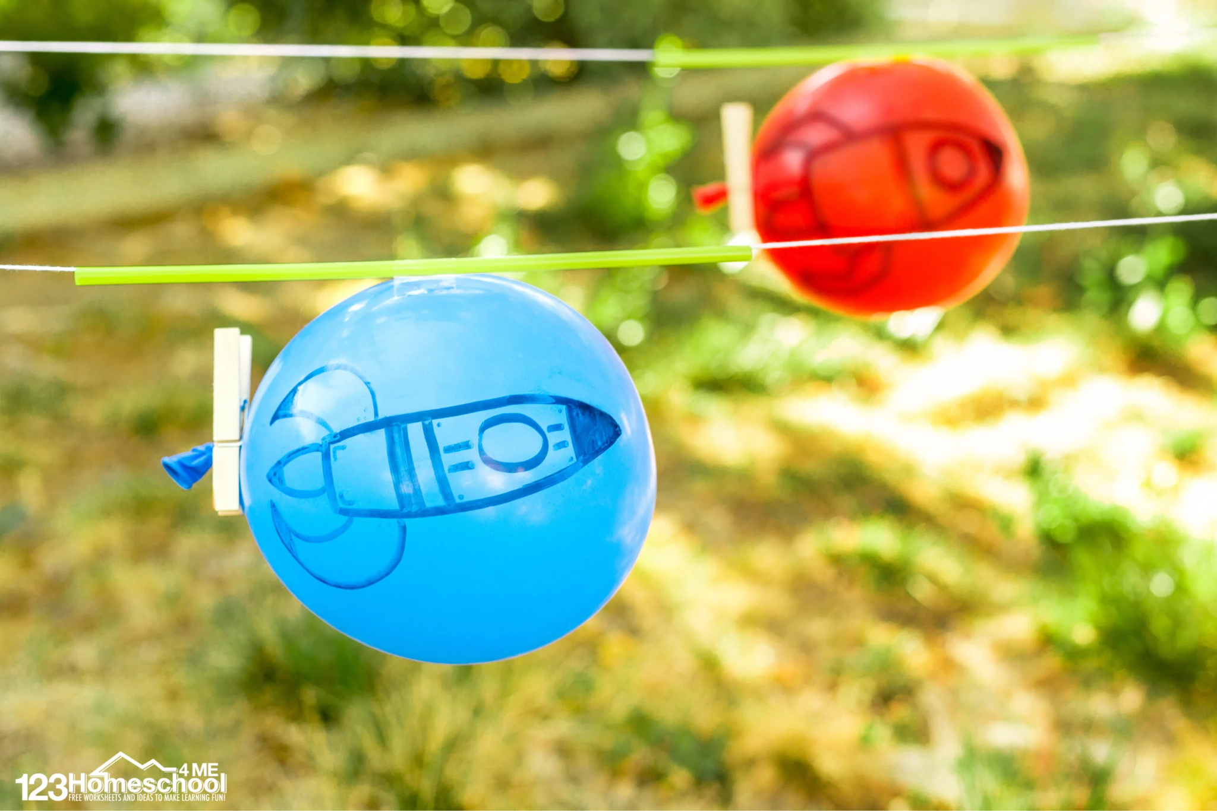

Slide 12
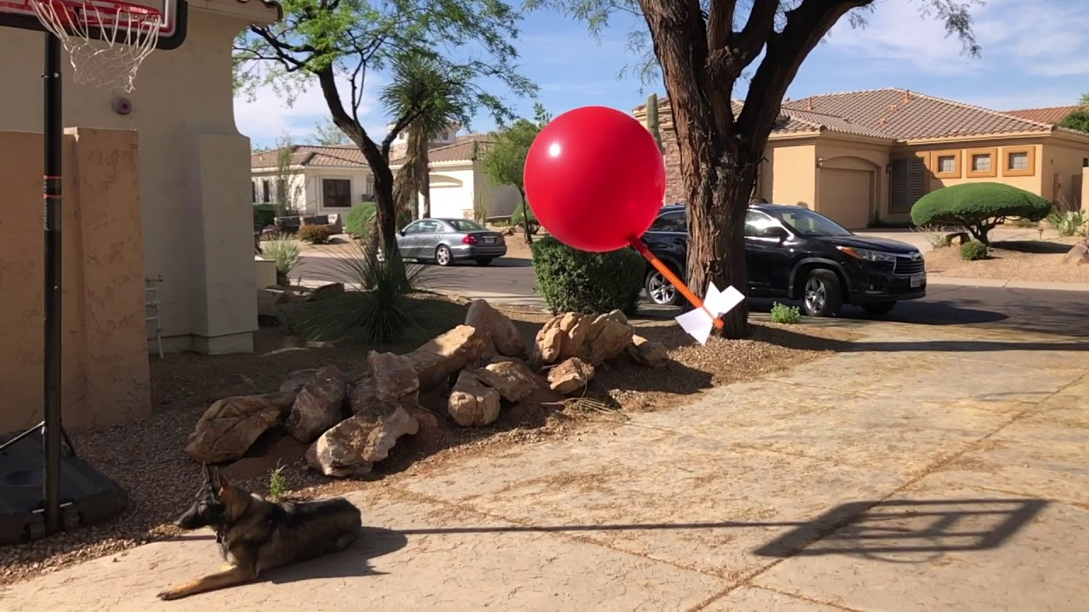

Slide 13
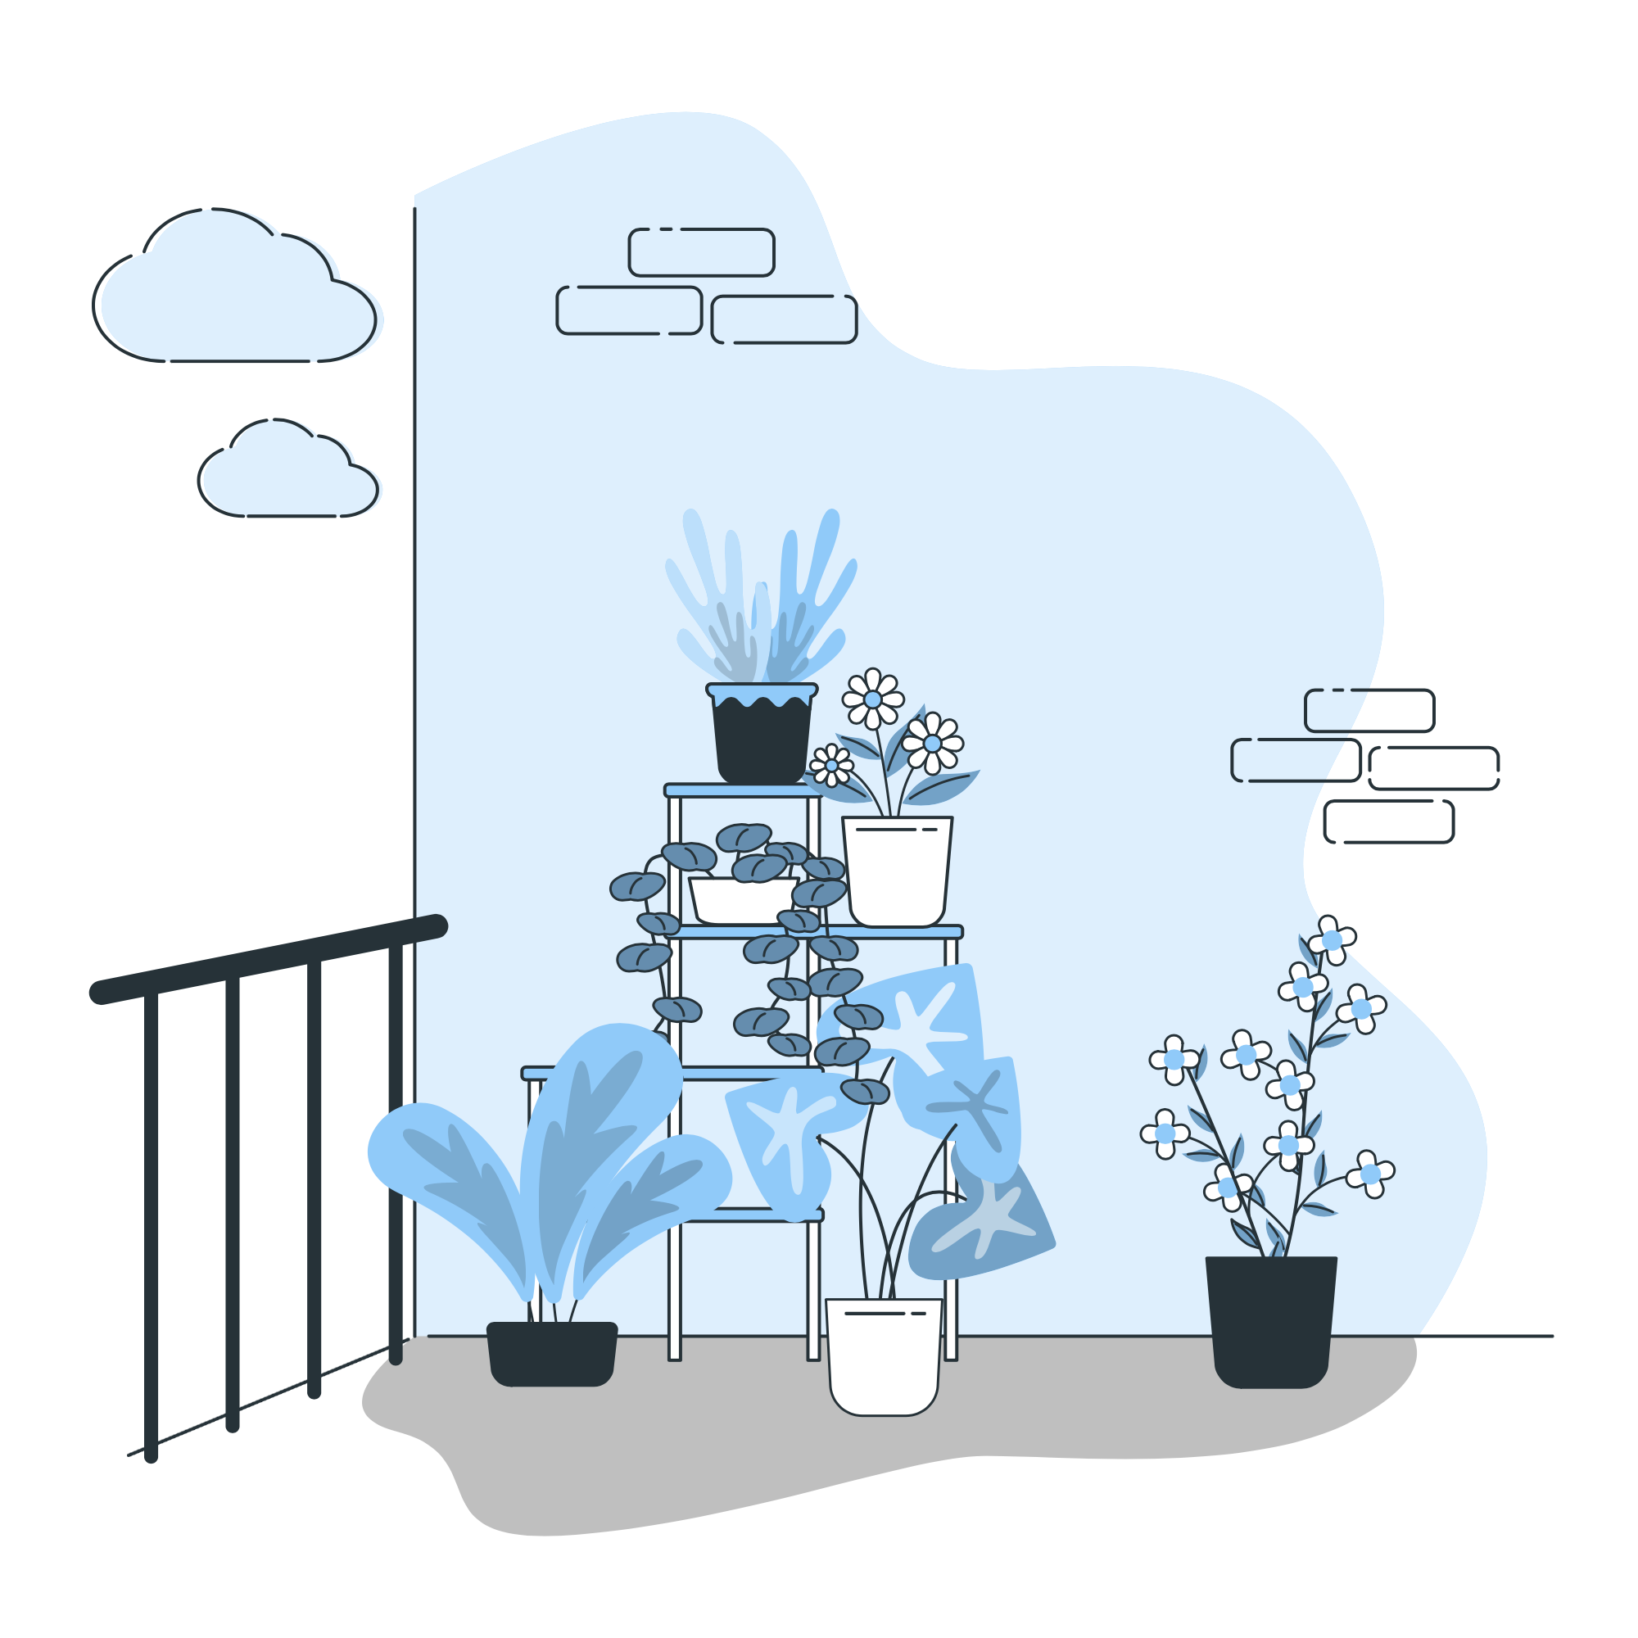
Lesson Plans
for Ages 8-11:

Slide 14
Lesson Plans for Ages 8-11:
1. Investigating Photosynthesis
Materials: Potted plants, sunlight, black construction paper, scissors
Duration: Multiple sessions (30-45 minutes each)
Description: Engage children in a scientific investigation of photosynthesis. By examining the effects of sunlight on plant growth through the use of black construction paper, children will deepen their understanding of the vital process of photosynthesis and the role of light energy in plant development.
2. Density Tower Experiment
Materials: Various liquids (e.g., water, oil, syrup), clear cups, small objects with different densities (e.g., paper clips, buttons)
Duration: Multiple sessions (30-45 minutes each)
Description: Dive into the concept of density as children create captivating density towers. Through layering different liquids and objects with varying densities, children will explore the principles of density and learn how substances interact and settle based on their mass and volume.

Slide 15
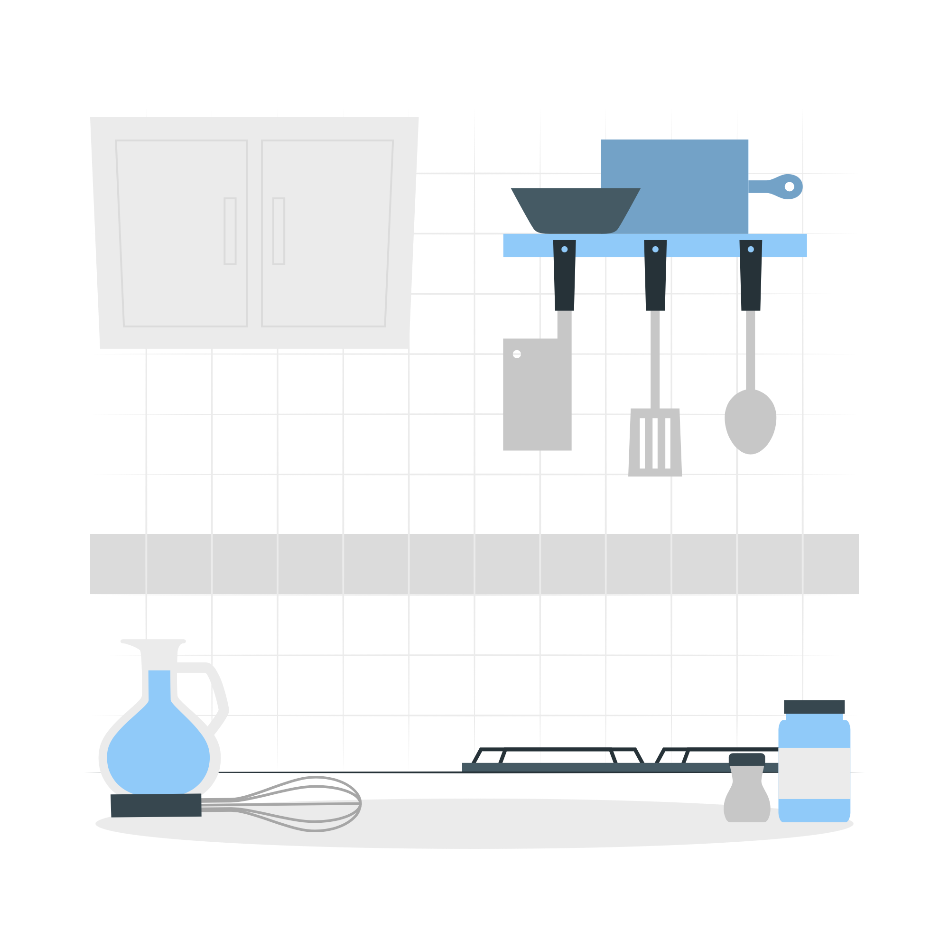
Lesson Plans for Ages 8-11:
3. Kitchen Chemistry: Edible Slime
Materials: Cornstarch, food coloring, water, mixing bowls, spoons
Duration: 30-45 minutes
Description: Unleash the scientist within as children delve into kitchen chemistry by creating edible slime. By mixing cornstarch, water, and food coloring, children will investigate the unique properties of non-Newtonian fluids and learn about the science behind this intriguing substance.

Slide 16
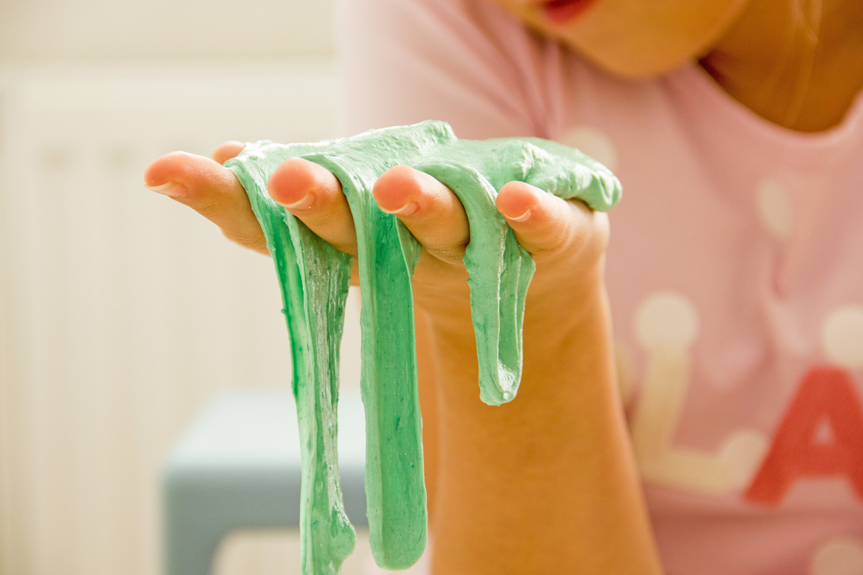

Slide 17
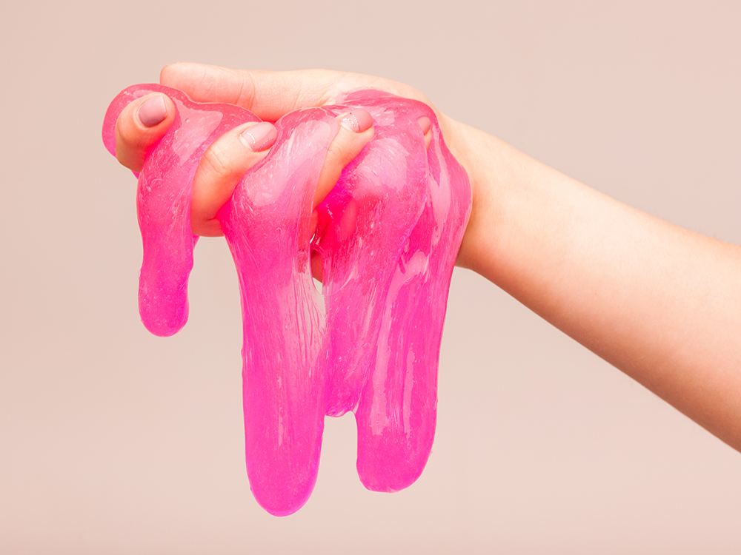

Slide 18
Conclusion / Reminder:
Remember to adjust the duration and specific instructions of the activities based on the age group and individual children's needs and abilities. Let Science Week ignite a passion for scientific exploration and inspire a lifelong love for learning!
ALERT - Be cautious of skin allergens and never create lesson plans with toxic materials.

Slide 19

Debrief / Huddle
As a group, discuss the following questions:
One thing that was new to you regarding the content / lesson plans presented?
One thing that was familiar to you regarding the content / lesson plans presented?
Any stories or previous experiences regarding today’s content on Week 8 - Science: Discover the Wonders of the Natural World!?

Slide 20

Thanks!
Do you have any questions?
support@atccenter.org
tel: (253) 368-9705
atccenter.org
Please keep this slide for attribution

