Slide 1

Week 9 - Sediment Week: Explore the Marvels of Sedimentary Materials!

Slide 2
Description:
Immerse yourself in the captivating world of sediment as we delve into the formation and properties of different types of sedimentary materials. Sediment Week aims to spark curiosity and deepen understanding of the fascinating processes that shape our Earth. Through engaging experiments and activities, children will discover the significance of sediment in our daily lives, including its presence in food and its role in geological formations.

Slide 3

Lesson Plans
for Ages 0-3:

Slide 4
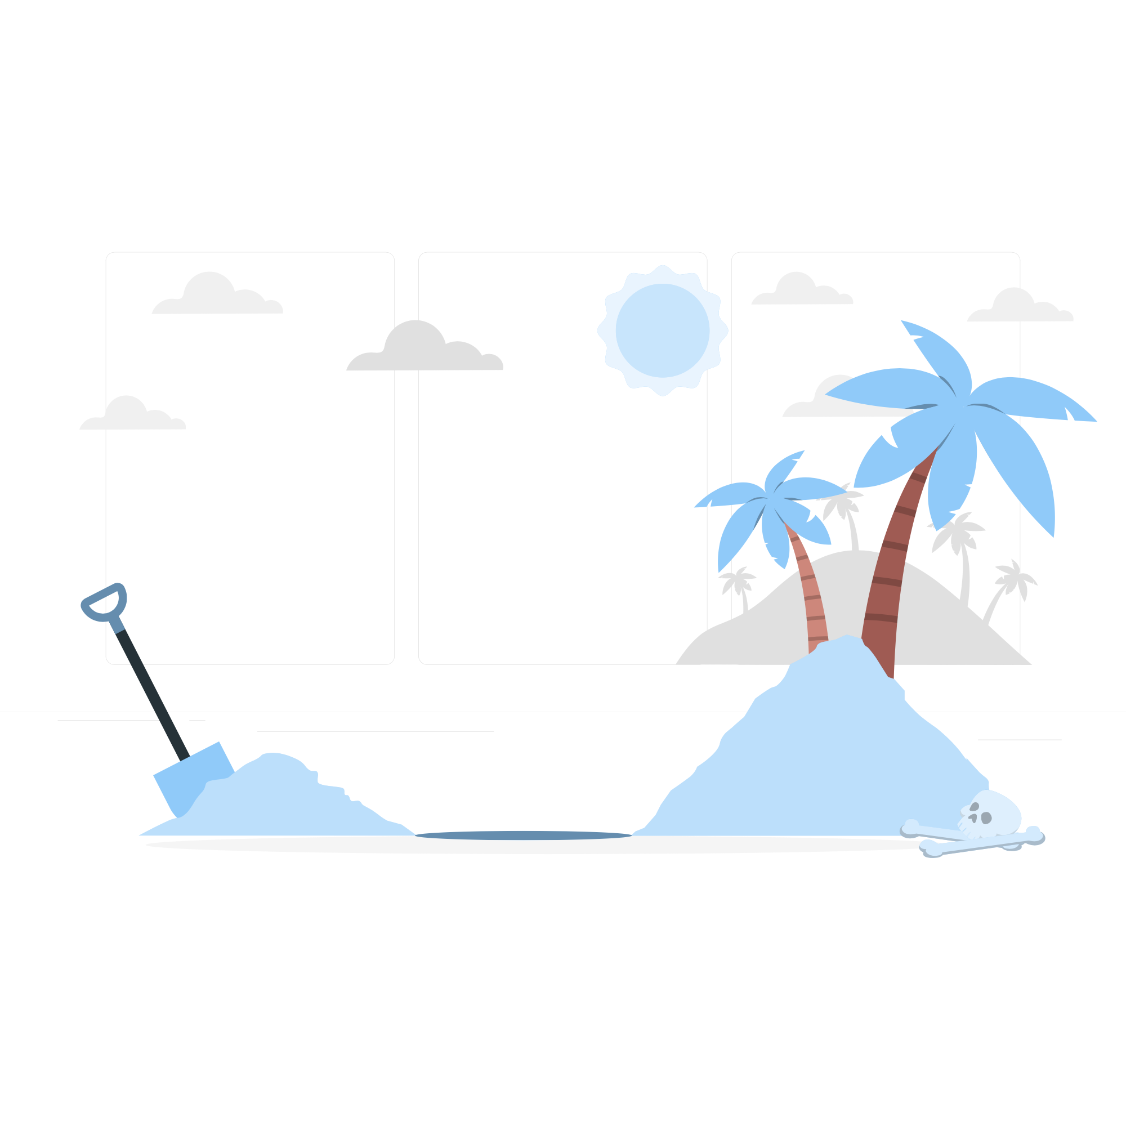
Lesson Plans for Ages 0-3:
1. Sensory Sand Play
Materials: Play sand, small containers, scoops, toy shovels
Duration: 20-30 minutes
Description: Provide infants and toddlers with a sensory sand play experience. Fill a designated play area with play sand and provide small containers, scoops, and toy shovels. Encourage children to explore the texture and feel of the sand, scoop it, pour it into containers, and engage in open-ended play. This activity enhances sensory awareness, fine motor skills, and introduces children to the natural properties of sediment.

Slide 5


Lesson Plans for Ages 0-3:
2. Slime Exploration
Materials: Homemade slime (recipes: glue, liquid starch or borax, food coloring), small containers
Duration: 20-30 minutes
Description: Introduce infants and toddlers to the world of slime, emphasizing its connection to sedimentary materials. Prepare homemade slime using simple recipes involving glue, liquid starch or borax, and food coloring (optional). Provide small containers for each child. Encourage sensory exploration by allowing children to stretch, squish, and manipulate the slime. This activity promotes sensory development and introduces the unique properties of sediment-like substances.

Slide 6
Lesson Plans for Ages 0-3:
3. Gem Sorting and Sensory Bin
Materials: Assorted gemstones (plastic or real), sensory bin or tray, scoops, sorting containers
Duration: 30-45 minutes
Description: Create a gemstone sorting and sensory bin activity to introduce infants and toddlers to the beauty and diversity of sedimentary materials. Fill a sensory bin or tray with various gemstones (plastic or real) and provide scoops and sorting containers. Encourage children to sort the gems based on their properties, such as color, shape, or size. Let them explore the shiny and textured surfaces of the gemstones. This activity enhances cognitive skills, sensory exploration, and introduces the concept of sorting based on sedimentary characteristics.

Slide 7
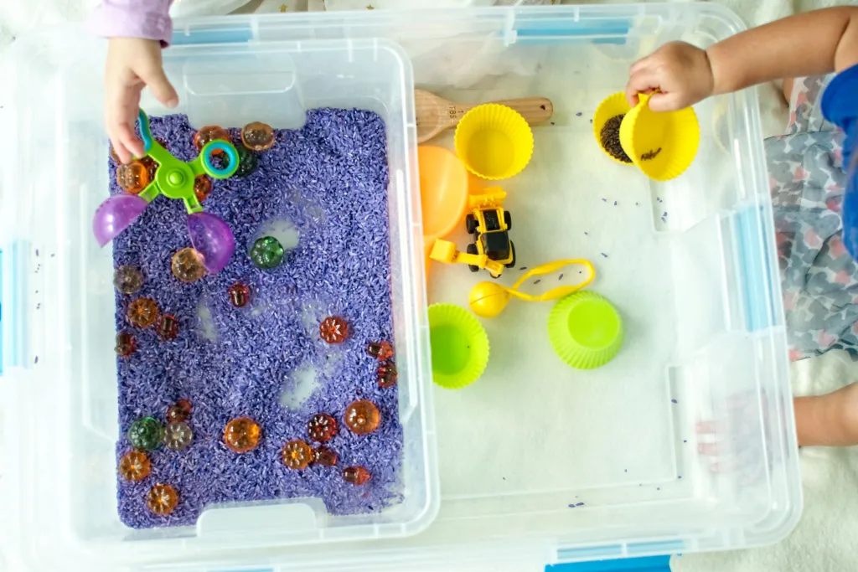

Slide 8
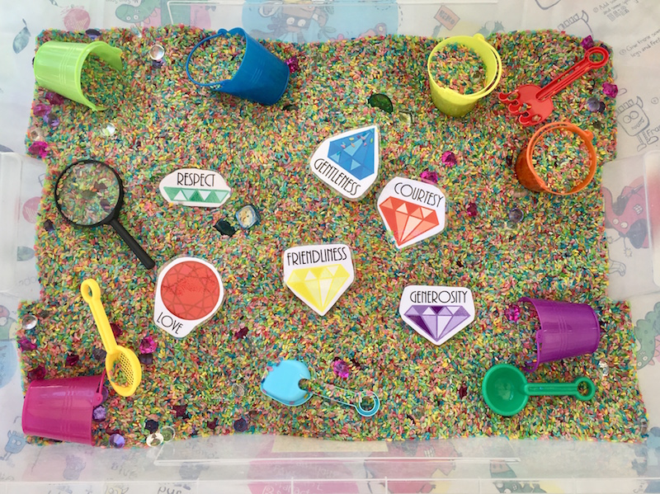

Slide 9
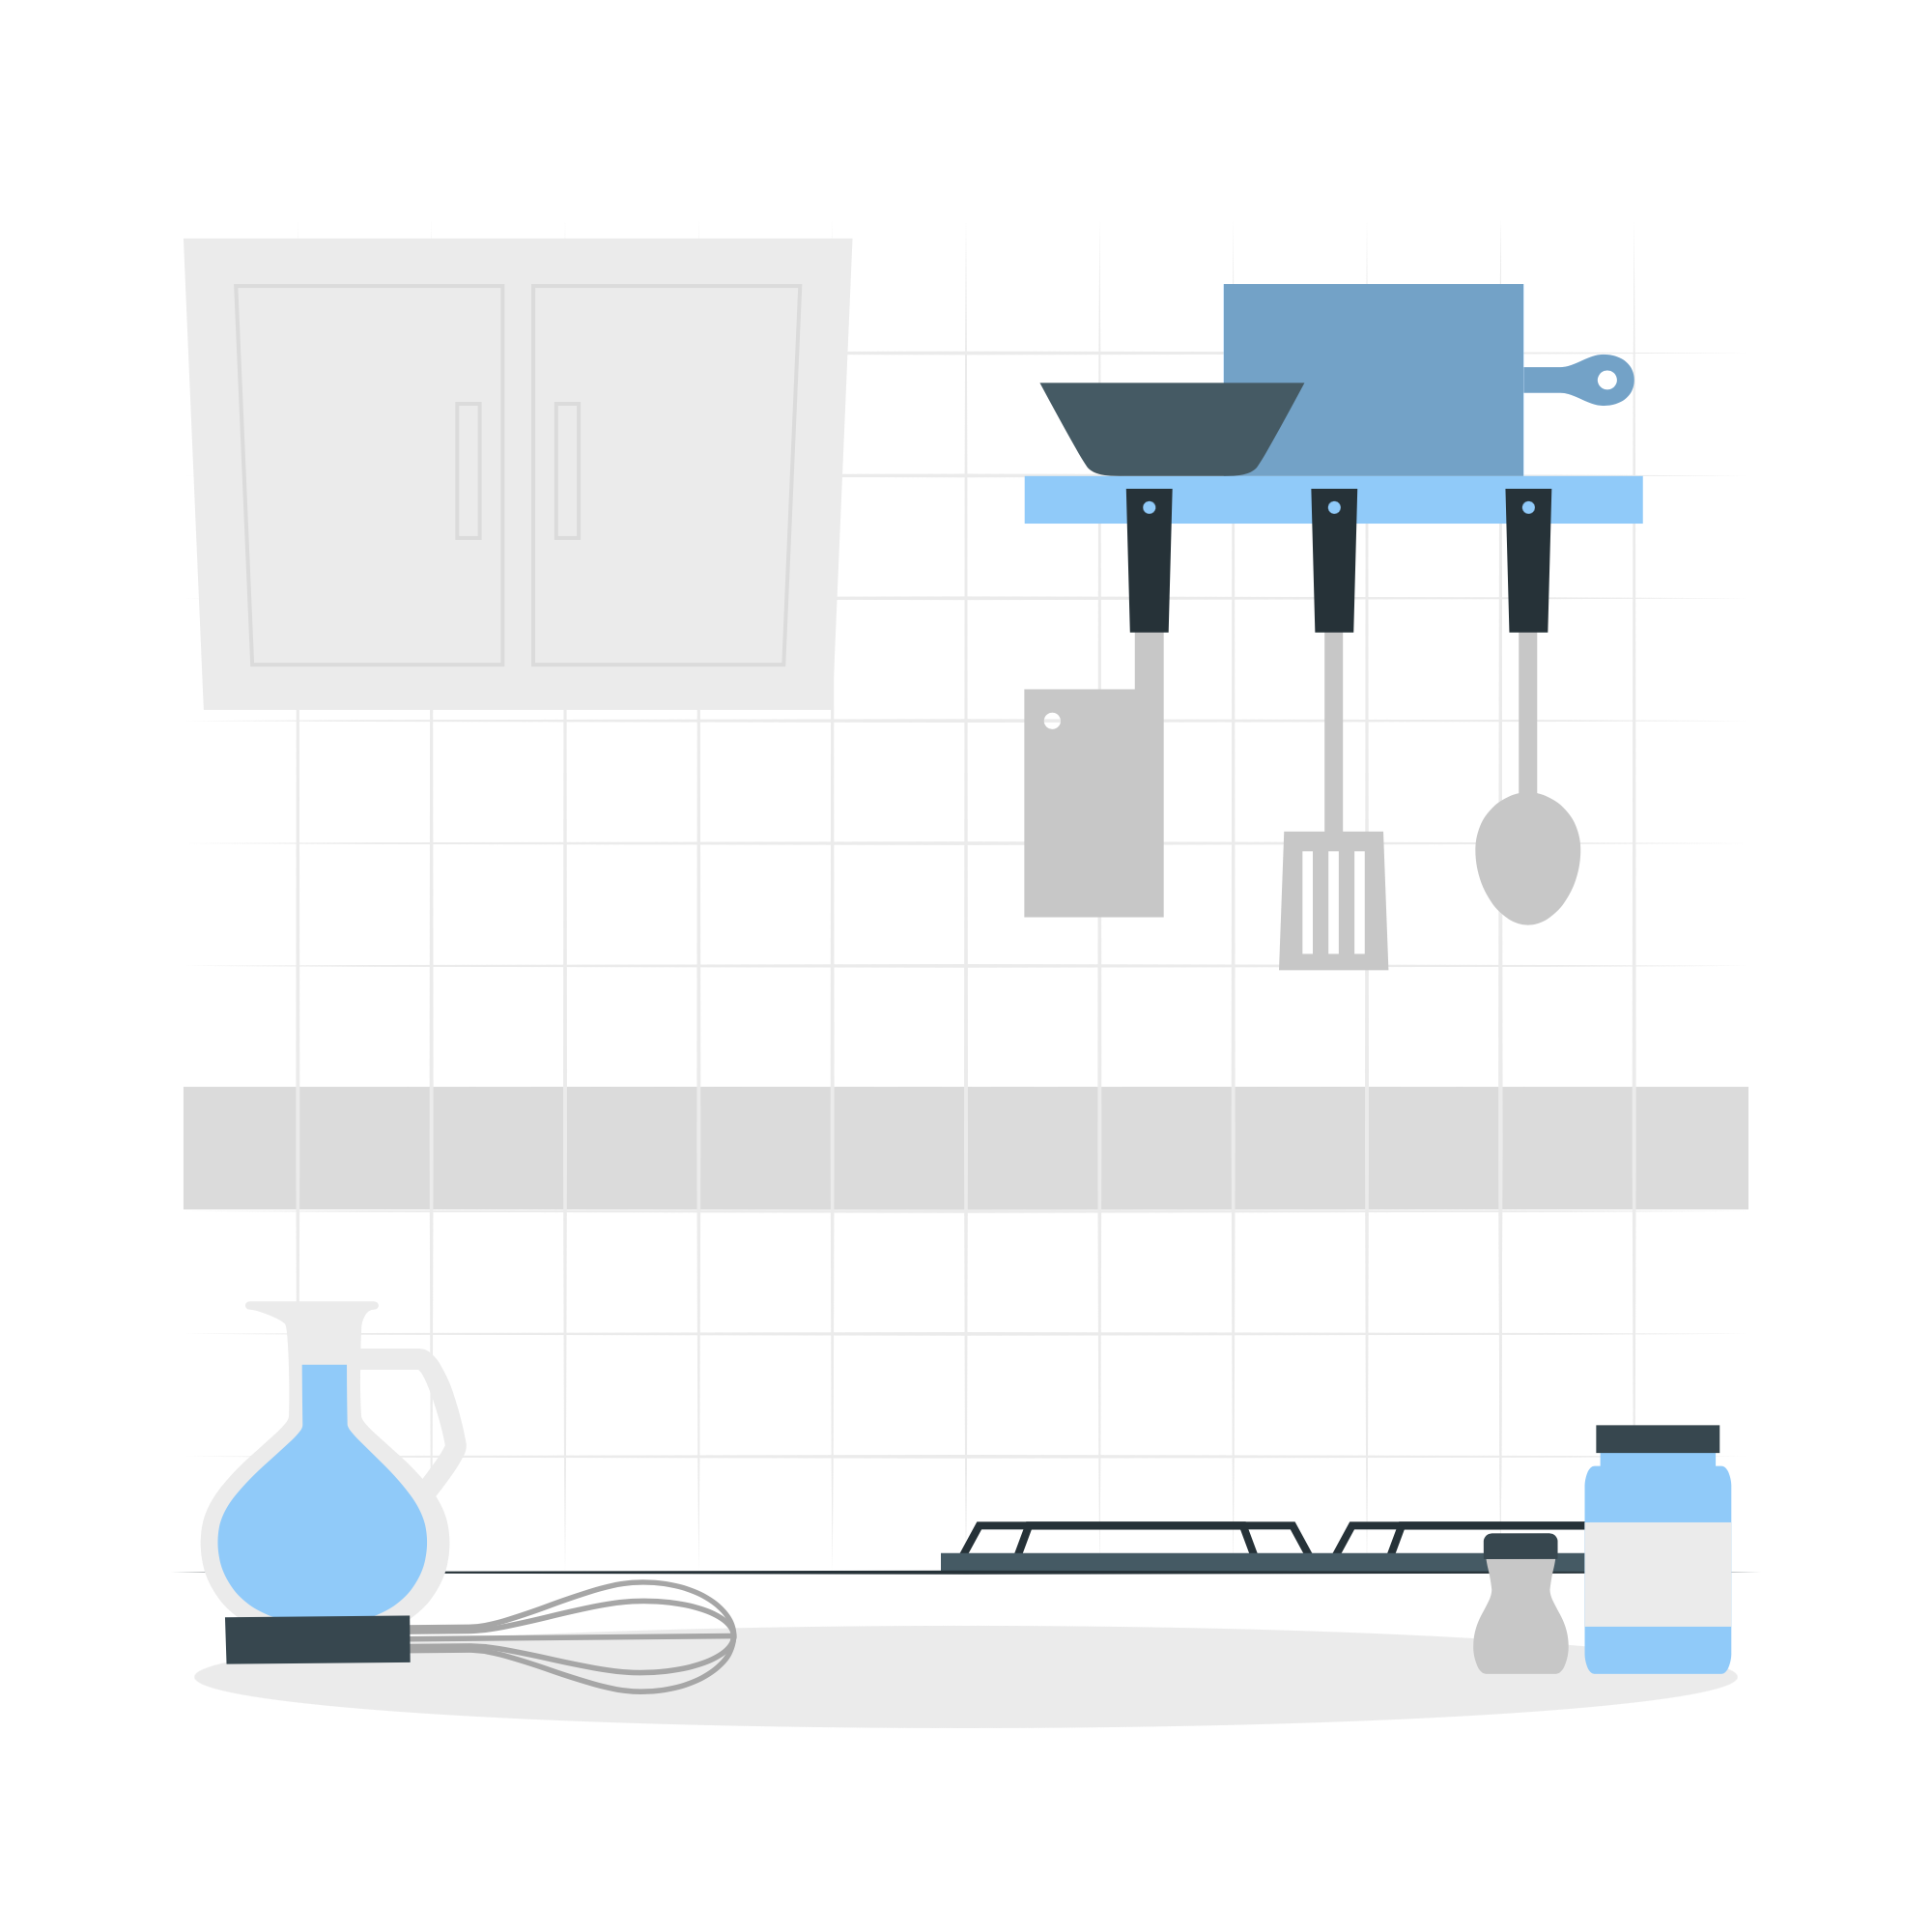
Lesson Plans
for Ages 4-7:

Slide 10

Lesson Plans for Ages 4-7:
1. Oobleck Exploration
Materials: Cornstarch, water, mixing bowls, food coloring (optional)
Duration: 30-45 minutes
Description: Engage children in an oobleck exploration, linking it to the properties of sediment. In a mixing bowl, combine cornstarch and water to create a non-Newtonian fluid. Add food coloring (optional) for visual appeal. Invite children to observe and experiment with the oobleck's unique characteristics. Discuss how the oobleck behaves differently under different conditions, such as solidifying under pressure and becoming liquid when left at rest. This activity encourages scientific observation, experimentation, and introduces the concept of sediment-like behavior.

Slide 11
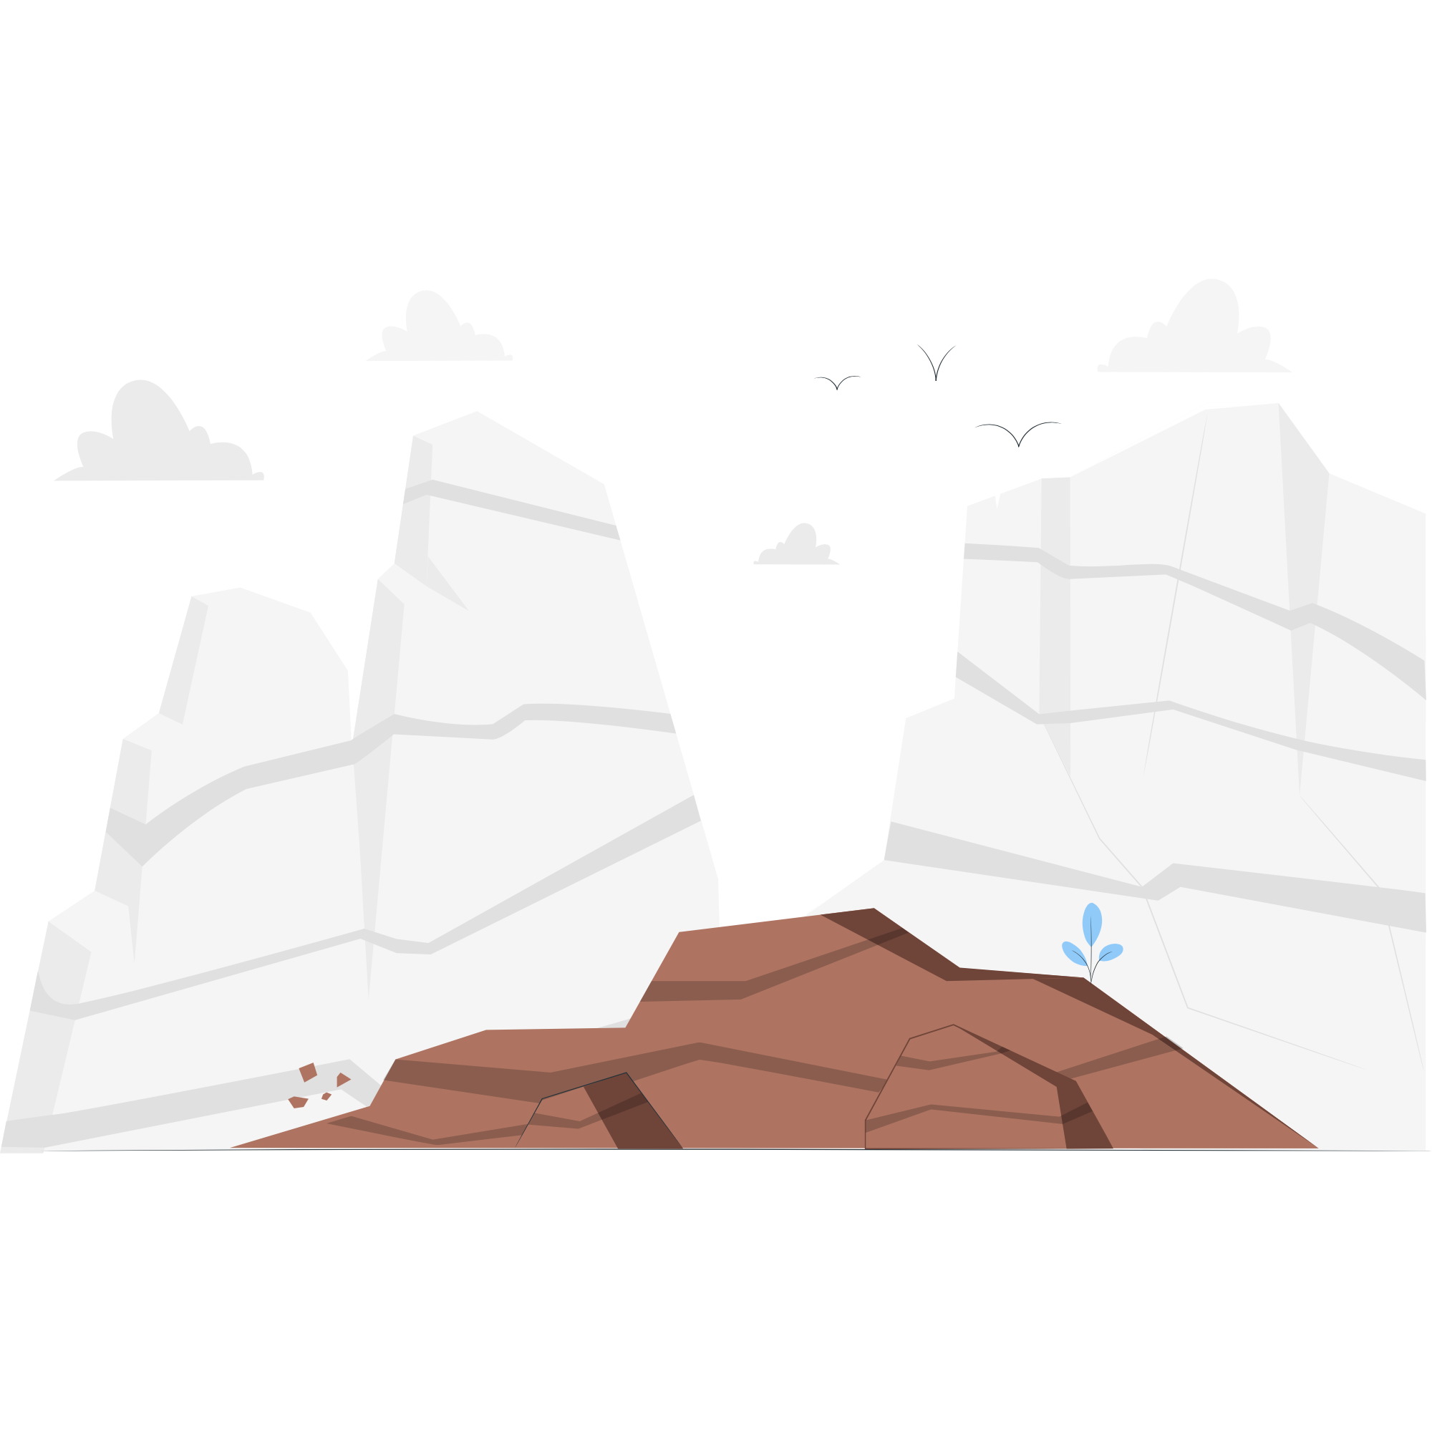
Lesson Plans for Ages 4-7:
2. Sedimentary Rock Formation
Materials: Sand, pebbles, clay, clear plastic containers, water
Duration: Multiple sessions (30-45 minutes each)
Description: Guide children in creating their own sedimentary rock formations, mimicking the natural geological processes. Provide clear plastic containers and layers of sand, pebbles, and clay. Encourage children to layer these materials within the containers, simulating the process of sedimentation. After each layer, add a small amount of water to represent the compaction and cementation of sediments. Over multiple sessions, discuss the formation of sedimentary rocks and observe the different layers visible in the containers. This activity fosters understanding of the geological history of rocks and introduces the concept of layering in sedimentary formations.

Slide 12

Lesson Plans for Ages 4-7:
3. Exploring Sedimentary Foods
Materials: Various food items with sedimentary origins (e.g., salt, rice, wheat), magnifying glasses, plates
Duration: 30-45 minutes
Description: Embark on a fascinating exploration of sedimentary foods, highlighting their geological connections and nutritional significance. Provide children with a variety of food items derived from sedimentary processes, such as salt, rice, or wheat. Encourage them to closely examine the foods using magnifying glasses and discuss the presence of sedimentary components. Guide a discussion on the importance of these foods in our diets, particularly in relation to their mineral content, such as iron from iron-rich sediments. This activity promotes scientific observation, critical thinking, and an appreciation for the connections between geology and everyday life.

Slide 13
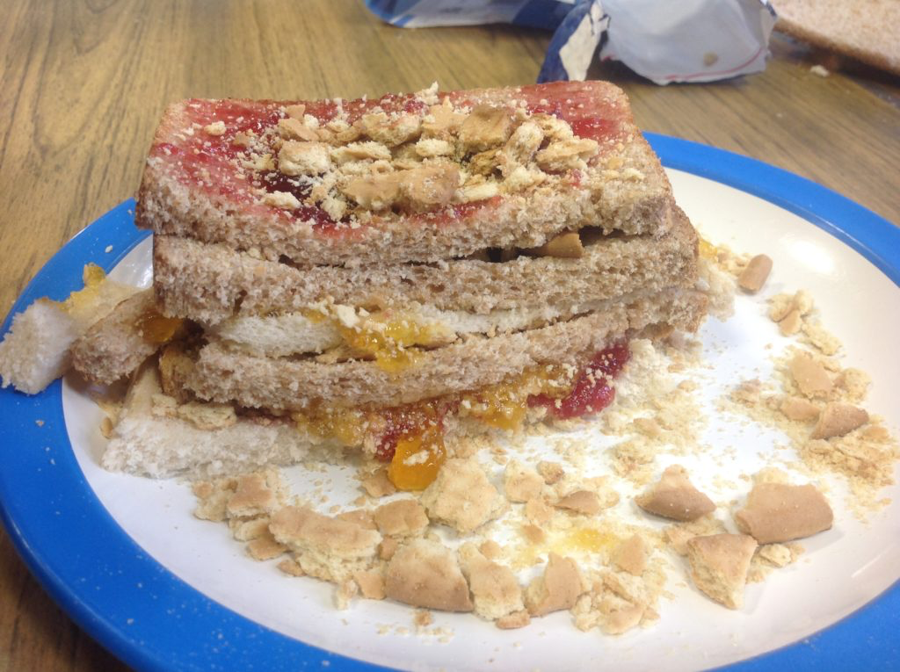

Slide 14
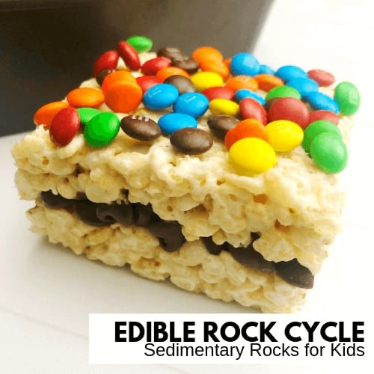

Slide 15
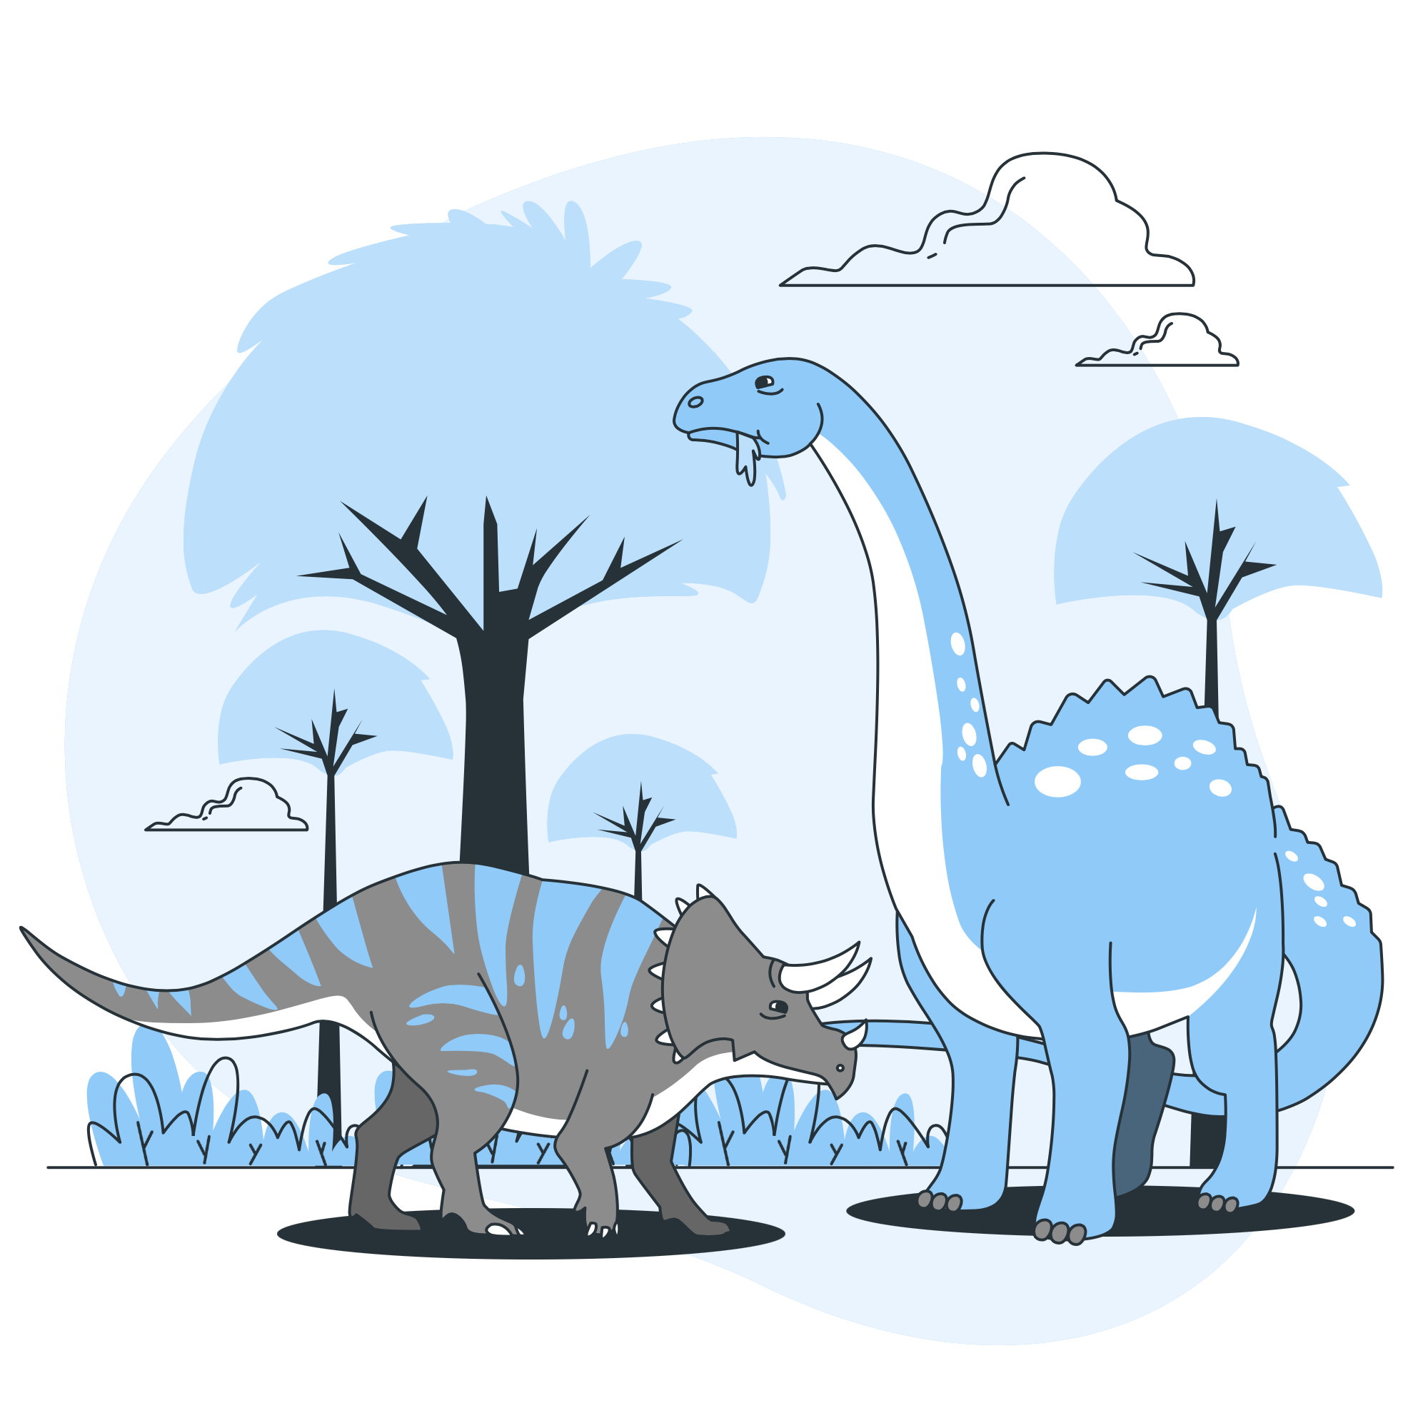
Lesson Plans
for Ages 8-11:

Slide 16
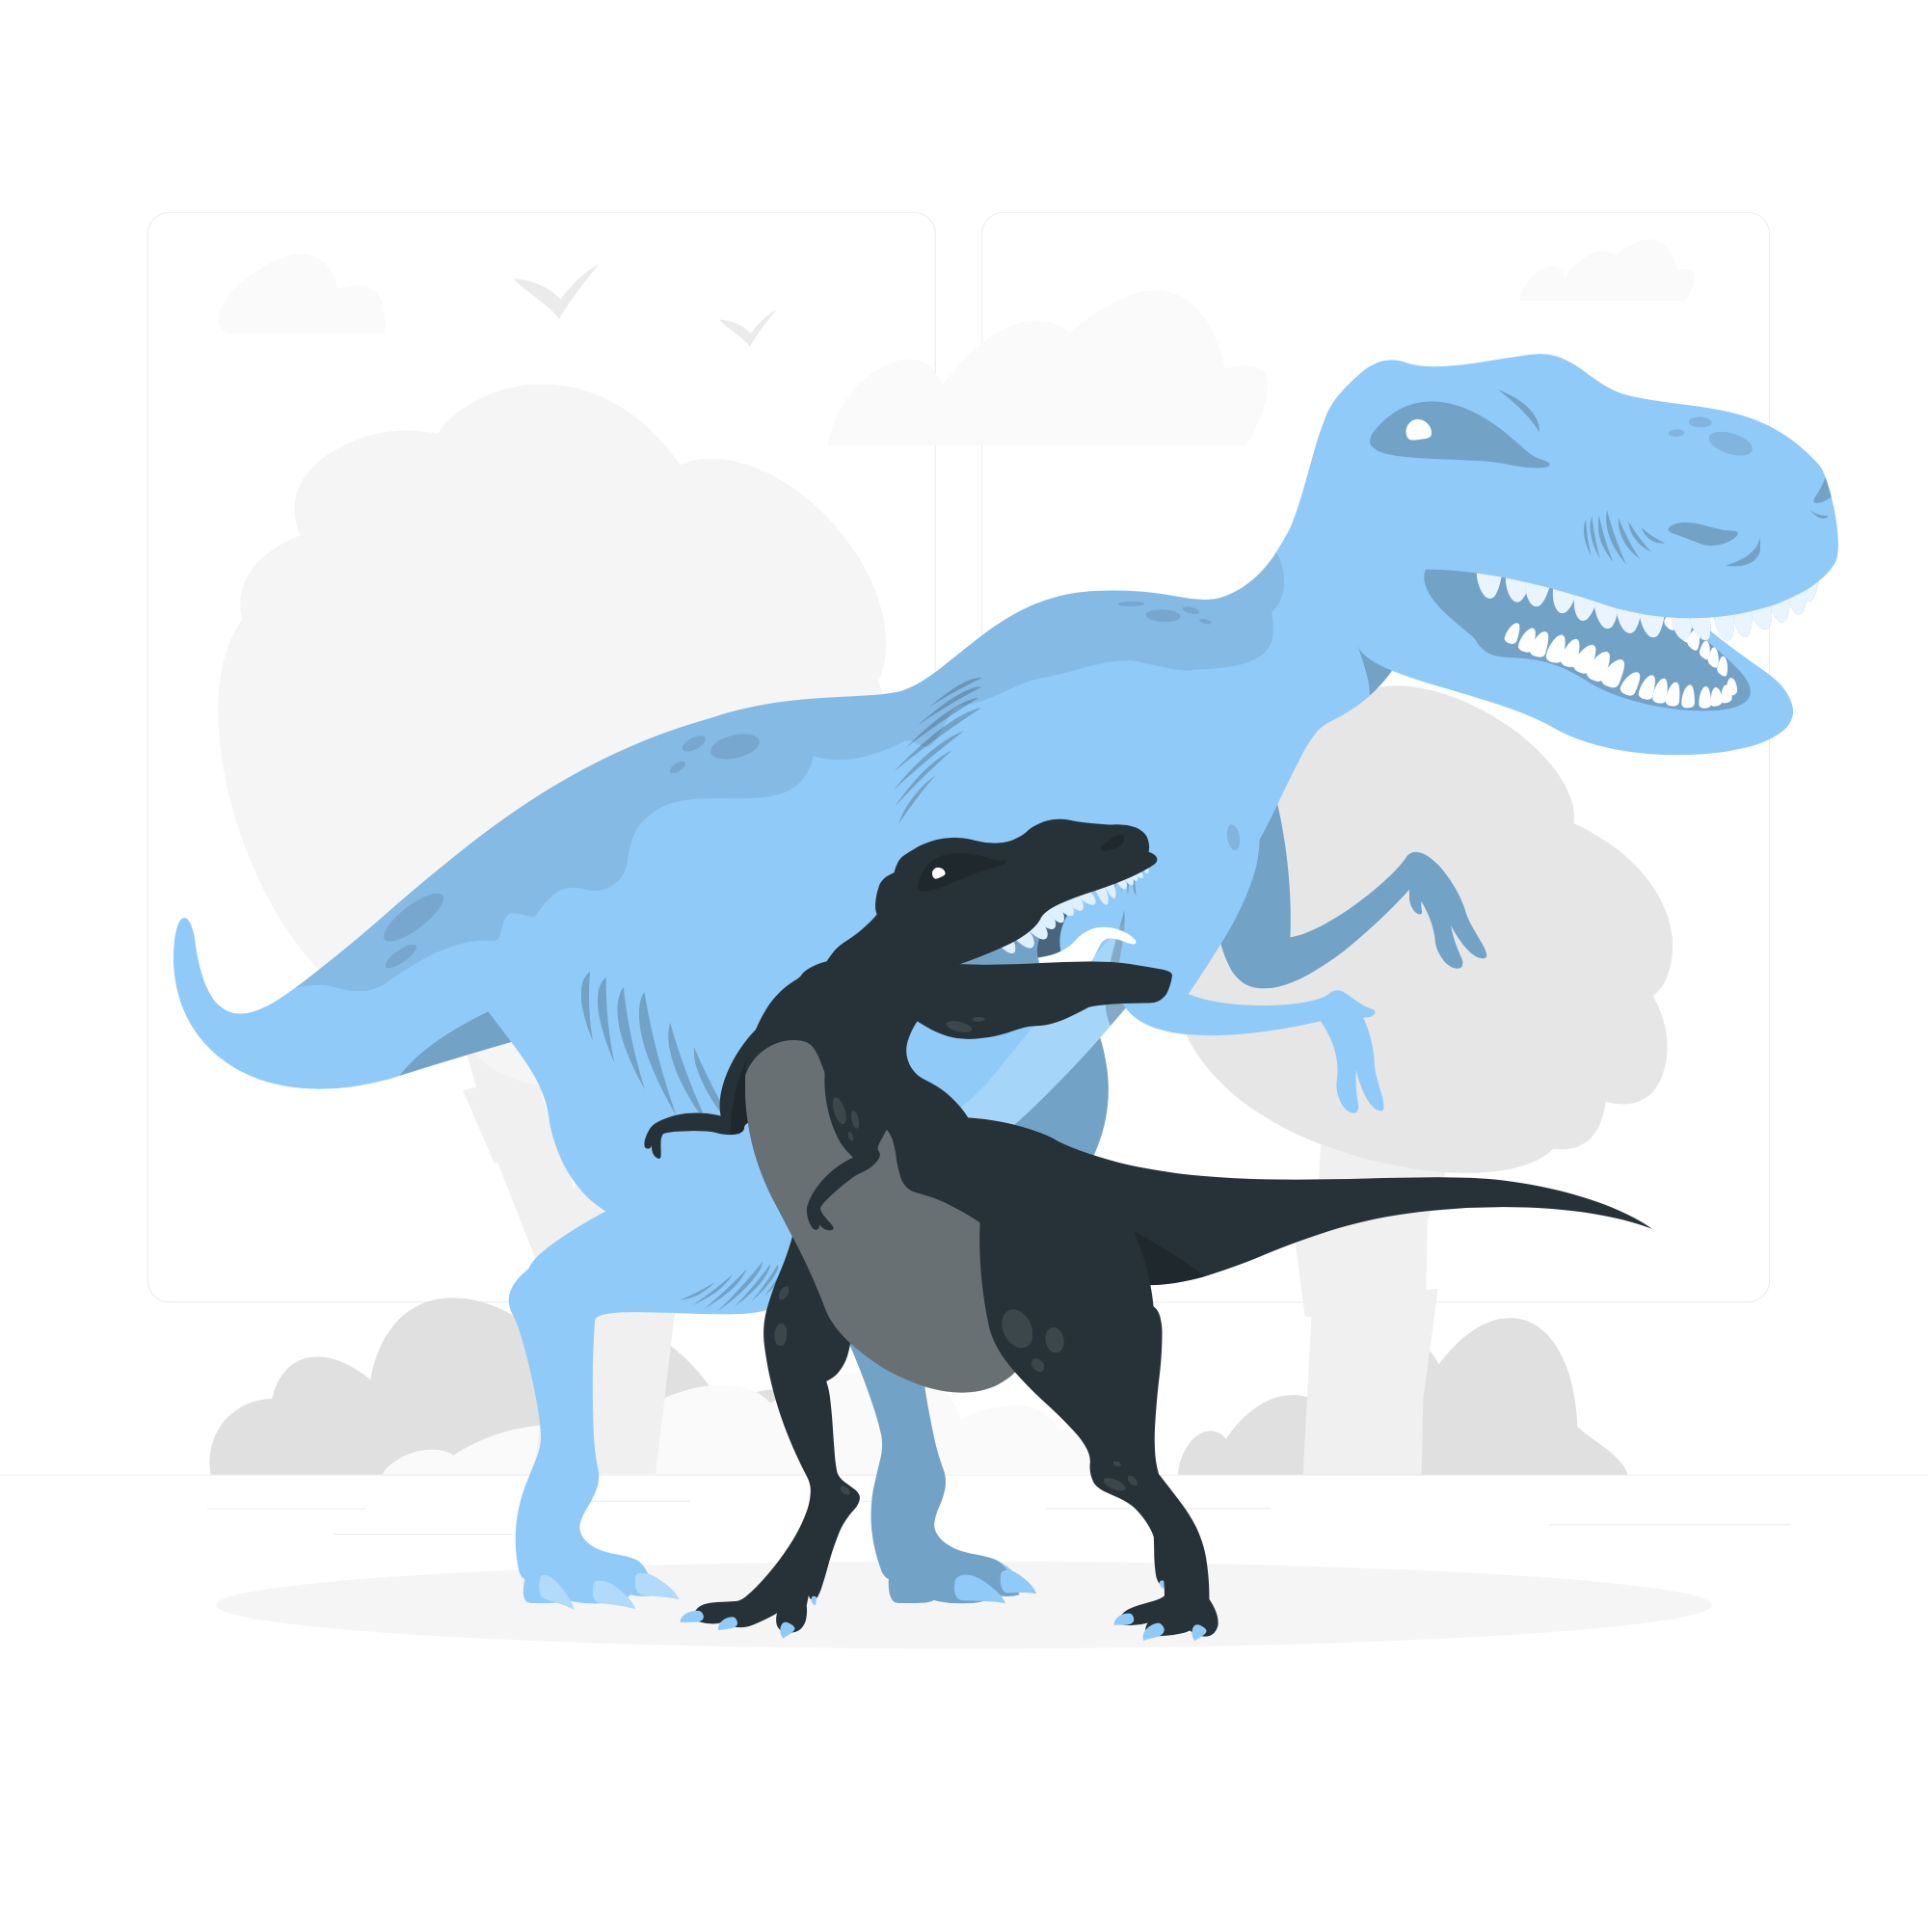
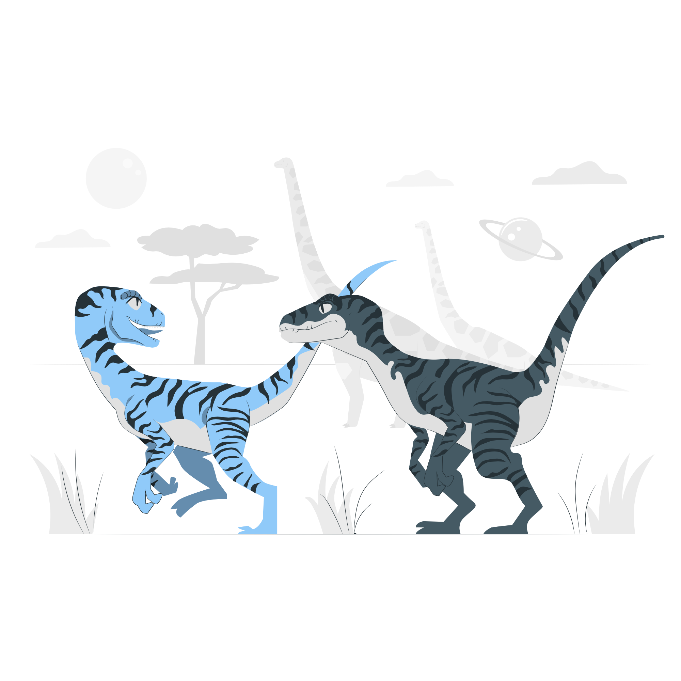
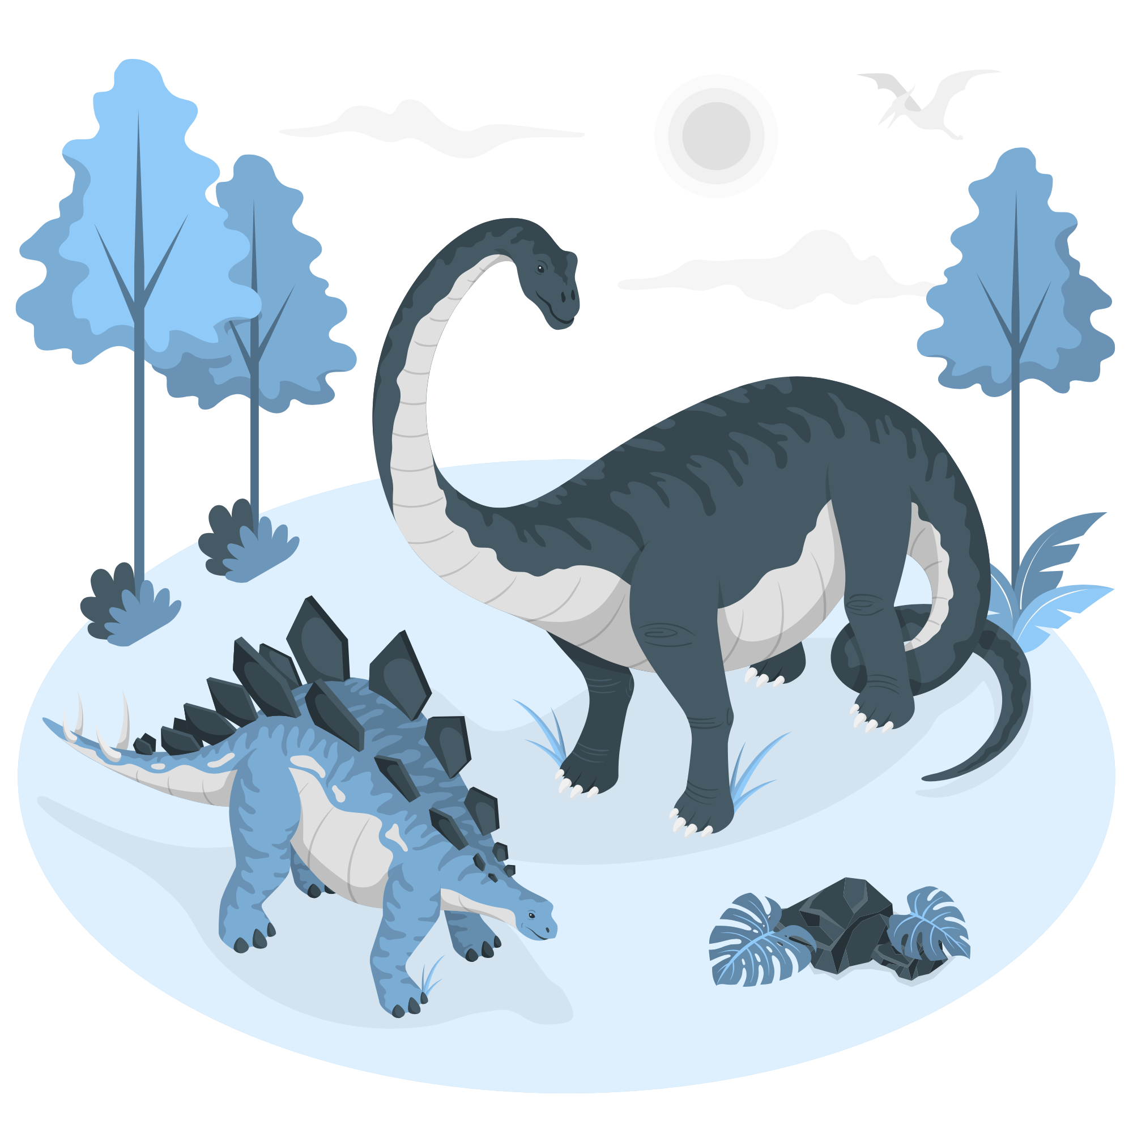
Lesson Plans for Ages 8-11:
1. DIY Fossil Making
Materials: Clay or playdough, small plastic or toy animals, baking tray, plaster of Paris
Duration: Multiple sessions (30-45 minutes each)
Description: Engage children in the exciting process of creating their own fossils. Provide clay or playdough and small plastic or toy animals. Instruct them to press the animals into the clay, creating impressions. Then, make a mold of the impressions using plaster of Paris. Allow the plaster to dry and harden, creating their own unique fossils. Discuss the process of fossilization, emphasizing the role of sediment in preserving organic materials. This activity encourages creativity, understanding of paleontology, and hands-on exploration of sediment-related phenomena.

Slide 17

Lesson Plans for Ages 8-11:
2. Sediment Sorting Challenge
Materials: Assorted sediment materials (sand, gravel, clay, etc.), sorting trays or containers
Duration: 30-45 minutes
Description: Challenge children's observational and categorization skills through a sediment sorting challenge. Provide them with various sediment materials, such as sand, gravel, clay, and more. Supply sorting trays or containers and encourage them to categorize and sort the sediments based on their properties, such as size, texture, and composition. Guide discussions on the significance of sediment properties in geological processes and the formation of different sedimentary rock types. This activity enhances critical thinking, scientific observation, and geological understanding.

Slide 18


Lesson Plans for Ages 8-11:
3. Landform Diorama Project
Materials: Cardboard or shoebox, art supplies, clay or modeling dough, natural materials (rocks, sand, twigs), glue
Duration: Multiple sessions (varies based on complexity)
Description: Guide children in an immersive project where they create their own landform dioramas. Provide cardboard or shoeboxes as the base and a variety of art supplies, such as clay or modeling dough, rocks, sand, twigs, and glue. Instruct them to represent different landforms, such as mountains, rivers, valleys, and beaches, using the materials provided. Encourage them to label and explain the features of each landform, emphasizing the role of sedimentary processes in their formation. This activity fosters creativity, critical thinking, and a deeper understanding of sediment's impact on shaping Earth's topography.

Slide 19
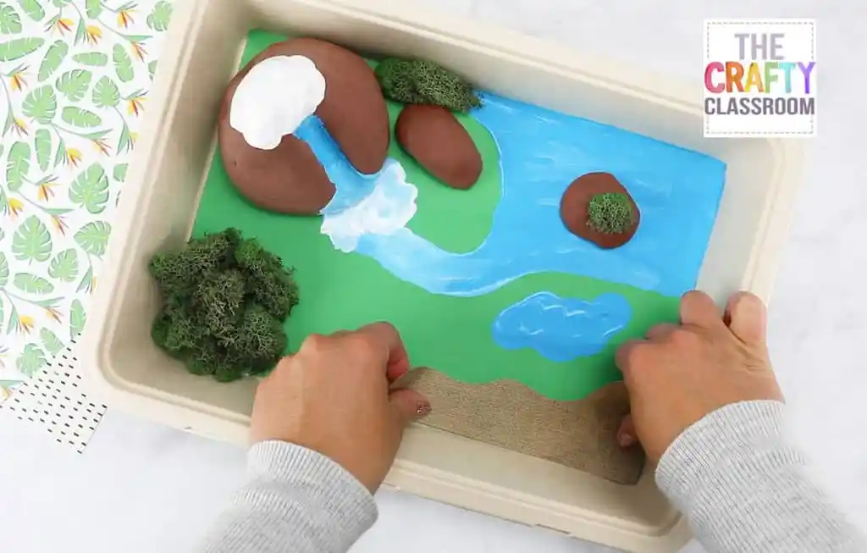

Slide 20
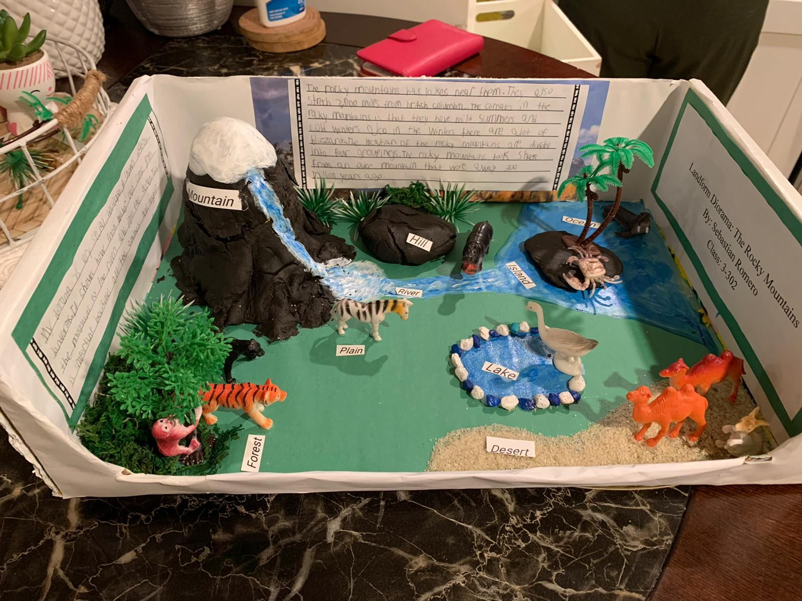

Slide 21
Conclusion / Note:
Adjust the duration, materials, and complexity of the activities based on the age group and individual children's needs and abilities. Sediment Week aims to cultivate a sense of wonder about the geological processes that shape our planet and their relevance in everyday life.

Slide 22

Debrief / Huddle
As a group, discuss the following questions:
One thing that was new to you regarding the content / lesson plans presented?
One thing that was familiar to you regarding the content / lesson plans presented?
Any stories or previous experiences regarding today’s content on Week 9 - Sediment Week: Explore the Marvels of Sedimentary Materials!?

Slide 23

Thanks!
Do you have any questions?
support@atccenter.org
tel: (253) 368-9705
atccenter.org
Please keep this slide for attribution

