Slide 1
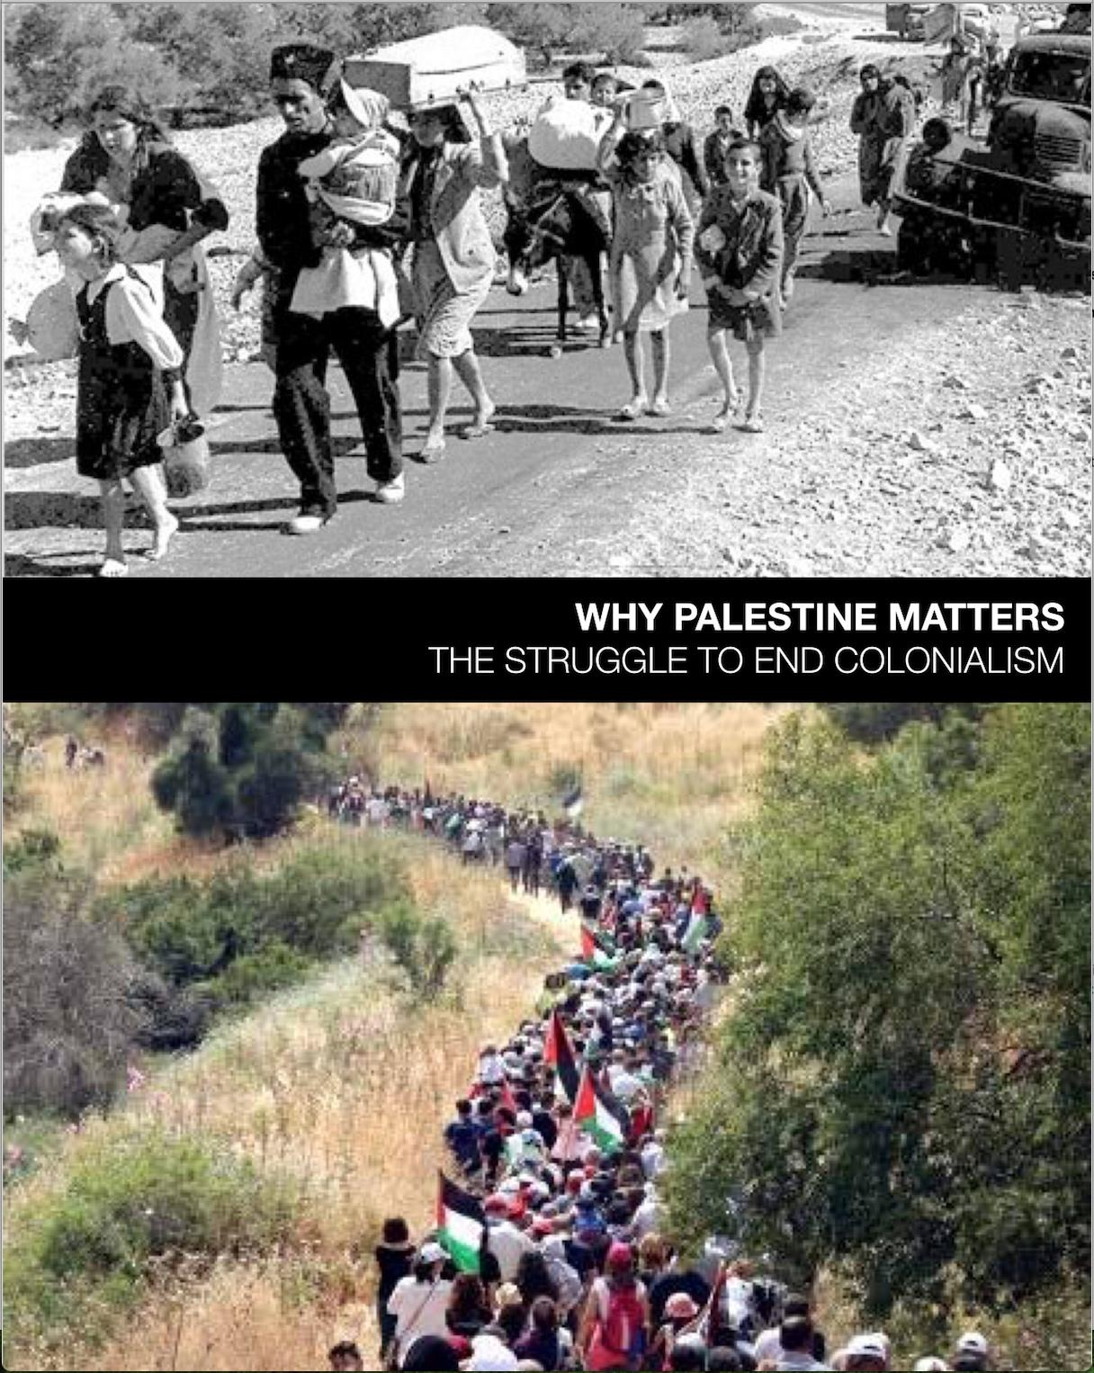
Why Palestine Matters,
The Struggle To End Colonialism
presented to APCE
by co-editors
Noushin Framke
and
Susan Landau
Galveston, TX
2019
Notes:
Let’s begin with a prayer:
Forgiving, Merciful and Righteous One:
Forgiving One: Your love is higher than the starry heavens.
Merciful One: Your kindness is deeper than the ocean.
Righteous One: Let each of us be the transformation of your love and kindness into energy for speaking the truth, and for reconciling with one another.
AMEN
2 min.
As Presbyterians, as a result of our last General Assembly’s action, we acknowledge whose land we are on before proceeding with our work. Acknowledging the land is a transformative act that works to undo the intentional erasure of Indigenous.
So today, we acknowledge that we are gathered here on Karankawa and Akokisa tribal lands. We consider our own place in the story of colonization and the legacy of taking lands from the native peoples of this continent.
***
Galveston Island was originally inhabited by members of the Karankawa and Akokisa tribes who called the island Auia.(Aw-we-yaa). Sadly, the Karankawa peoples are now extinct, but they lived here along the Gulf of Mexico where their presence has been traced back at least 2,000 years. ... Sadly, the last known Karankawas were killed or died by the 1860s. We honor their story and history on this land we are on today.
[The island's first permanent European settlements were constructed around 1816 by the pirate Louis-Michel Aury to support Mexico's rebellion against Spain]

Slide 2
Introduction
Notes:
2 min.
Noushin: Introduce yourself
I am a presbyterian elder and a founding member of the IPMN, the denomination’s Israel/Palestine Mission Network.
I’ve served 8 years on a permanent General Assembly Committee called REAC - Racial Equity Advocacy Committee. And for 6 years I served as that committee’s liaison on MRTI - The Mission Responsibility Through Investment Committee - this is the committee that does corporate engagement representing the church as a shareholder, working to change their bad policies. So I’ve been deeply involved in Presbyterian efforts to change the situation on the ground in Israel/Palestine for well over a decade now.

Slide 3
PC(USA) Mideast Policies
see: theIPMN.org
or
bit.ly/pcusamideast
Notes:
2 min.
The Presbyterian Church has moved a long way towards a more just position on Palestine and this has a lot to do with IPMN - the mission network that we are here representing today.
IPMN was created by an overture to the GA in 2004. We are the only mission network of more than 40 to have a GA mandate.
As our mandate calls for, we seek to demonstrate solidarity, educate about the facts on the ground, and change the conditions that erode the humanity of both Israelis and Palestinians.
We are Presbyterians in over 80 presbyteries across the country. Since we began sending overtures to GA in 2006, we have been instrumental in moving our denomination’s policies on Palestine toward more just positions for Palestine.

Slide 4
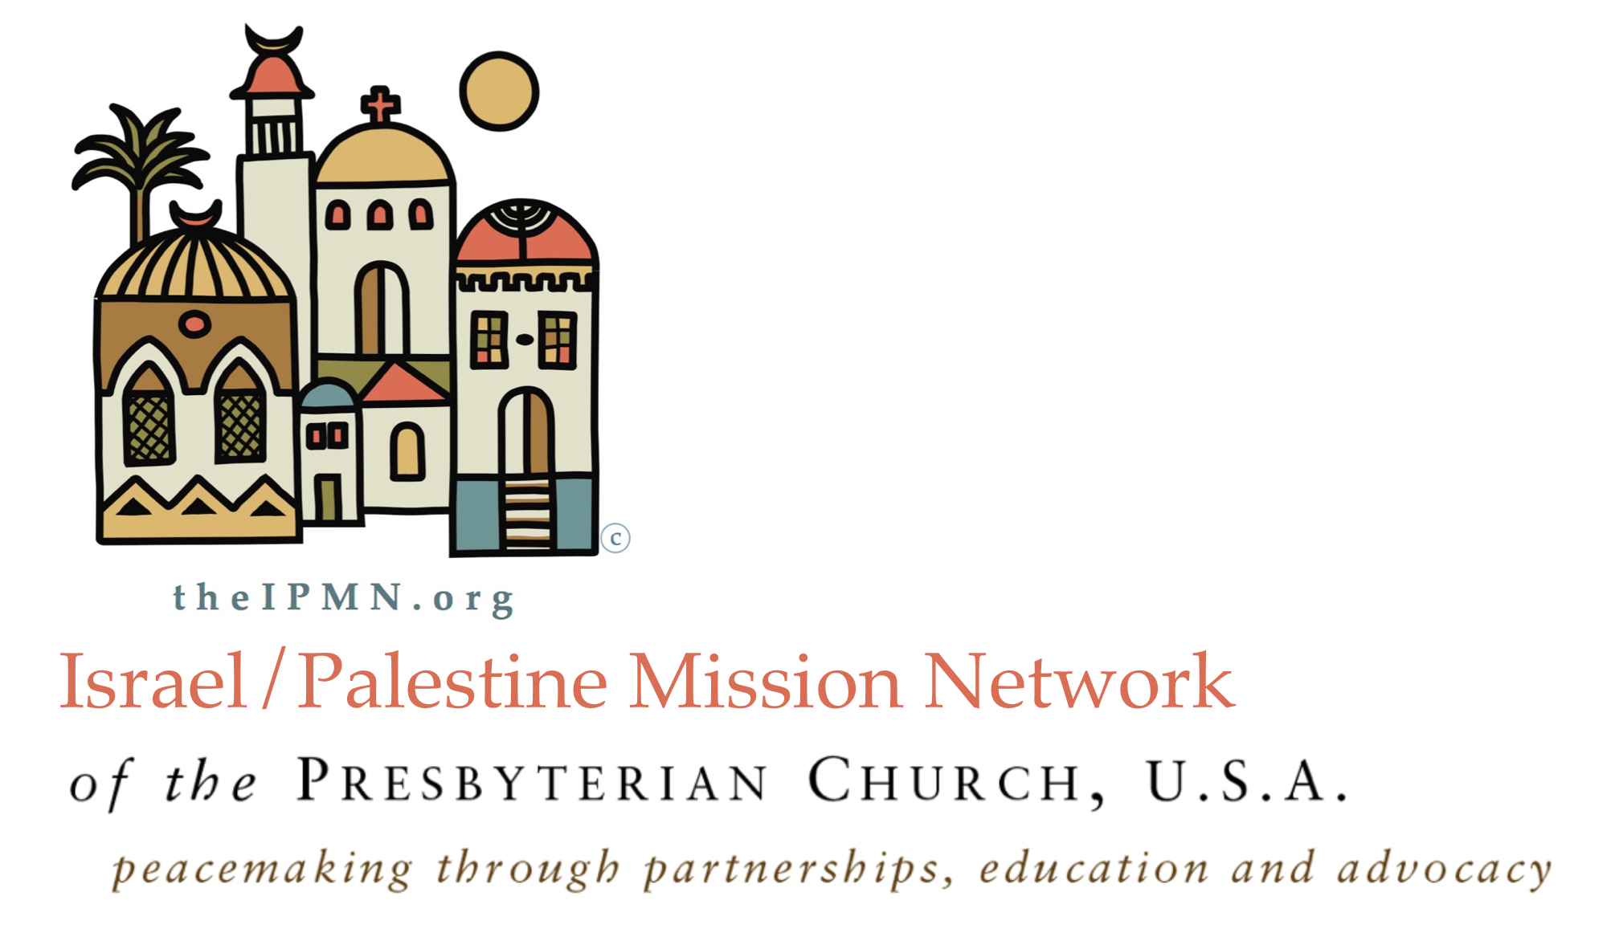
Notes:
2 min.
Part of our mandate is to educate Presbyterians on what’s happening on the ground in Palestine. For this reason, and because Presbyterians have a great history and record of excellent educational resources, we have been writing and publishing books and study guides.
Introduce IPMN publications
Talk about genesis of Why Palestine Matters

Slide 5
Today’s Workshop:
Introduction
Palestine & Why it Matters
Justice and Equality Framework
Our History of Complicity in Injustice
Intersectionality as a Way Forward
Q & A
Notes:
1 min.
This is our agenda of what we’ll be covering today. Our presentation style will include: didactic, interactive, group exercises, and a few short video clips. We’ll go through our material, with time for questions and comments at the end.

Slide 6
“The project of human liberation is not limited to Palestine,
but it also
cannot proceed without Palestine.”
~from Introduction of the book
Notes:
By linking Palestine to all struggles for justice, we make clear that the project for human liberation is about justice for all people everywhere.
Introduce Susan

Slide 7
Critical Distinctions and Caveats
Judaism
Zionism
Notes:
SUSAN SELF-INTRO, with show and tell, 5 min.
Self intro… grounded in a rights-based, anti-racism, anti-discrimination framework that includes antisemitism, requires we make a clear distinction between Judaism and Zionism:
JUDAISM is a religion that values justice for all people.
ZIONISM is a political ideology that advocates a Jewish national homeland in historic Palestine.
All Jews ARE NOT Zionists.
Criticism of discriminatory policies and practices of the state of Israel is not inherently antisemitic.
Advocating equality and human rights for Palestinians is not in itself antisemitic.
In this context, the best way to confront antisemitism is participation in a global movement for justice.

Slide 8
Part 2
Palestine
And Why it Matters
Notes:
As Noushin mentioned, emerging political realities sparked our understanding that advocacy for social justice could no longer be effective by focusing on single issues. The task of educating about Palestine required a global context that linked Palestine to other justice struggles. And, we needed to make the case for why Palestine still matters.

Slide 9
Pop Quiz
on Palestine
there are no wrong answers :)
Notes:
With a smorgasbord of workshops to choose from today, we’re glad you selected this one. Noushin and I want to get a sense of “Who’s in the Room,” particularly we want to know more about your familiarity with and exposure to information on Palestine.
We’d like to have some fun with this. I’m going to ask a few questions. Please raise your hand if your answer is “yes.”
(see if we need to show the JVP video as Palestine 101)

Slide 10
Video: PALESTINE 101 by Jewish Voice for Peace
JVP VIDEO
Notes:
Notice if anything is new, surprising, or contradicts prior information you have had.

Slide 11
Part 3
Justice and Equality
Framework
Notes:
Our approach is a rights-based framework - that all people have basic human rights, dignity, and the right to self determination.

Slide 12
Injustice anywhere
is a threat to justice everywhere.
We are caught in an inescapable network of mutuality, tied to a single garment of destiny.
Whatever affects one directly affects all indirectly…
~Martin Luther King, Jr.
Notes:
Take a moment to read and reflect on this.
If you only remember one thing from this workshop, let it be this.
Here’s what we mean:
All injustice is tied to political, social, and economic structures.
Some people profit; others are excluded and vulnerable.
To re-imagine a world where everyone is treated with dignity requires self awareness and understanding who we are in relation to others. From there we identify connections, and build alliances.

Slide 13
Intersecting Justice Issues Include:
Human Rights ... Education … Civil Rights …
Economic justice…Sex and Gender Justice … Health/Mental Health Care… Gentrification Environmental Justice … Child Welfare ... Disability Rights … Police Brutality … Food Justice… Militarism … Mass Incarceration … Gun Control … Sex Trafficking … Free Speech ... Minimum Wage … Labor Rights …
Notes:
Look over this list.
Some of these are issues that may be close to your heart.
All liberation struggles, including anti-racism, and all forms of discrimination, are rooted in and must address systemic economic and structural inequalities.

Slide 14
video: Should we join the struggle? From BLM to Palestinian Rights
Notes:
This video clip illustrates how to expand your lens to include interlinking struggles by starting exactly where you are, with whatever justice struggle you are involved in.

Slide 15
Part 4
Our History of Complicity
in Injustice
Notes:
NOUSHIN
The task of confronting injustice requires a basic understanding of historical precedents that help us understand how we got to where we are now.

Slide 16
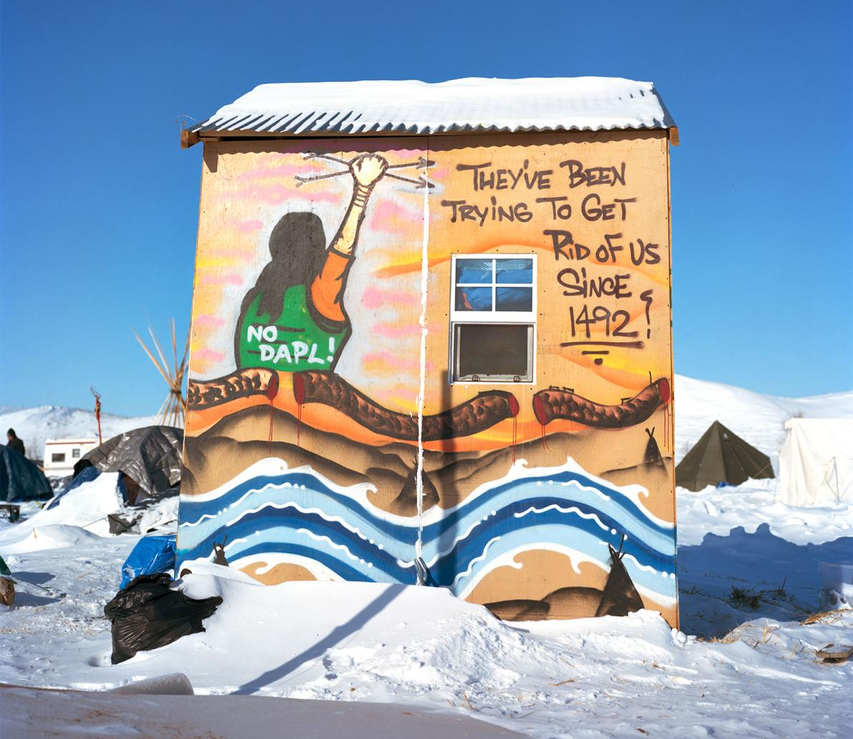
Settler Colonialism
Notes:
READ DEFINITION:
Settler Colonialism is the domination of one group of people by another for the purpose of land acquisition and/or resource extraction. It is a structure of domination by colonizers over the colonized.
We will explore this concept in conjunction with our own history and Israel’s current politics.
We are looking at a picture from Standing Rock, North Dakota –
READ picture –
DAPL is the Dakota Access Pipe Line
Let’s unpack Settler Colonialism.

Slide 17
The Doctrine of Discovery
The Papal Bull of 1493 played a central role in the conquest of the New World. The Bull stated that any land not inhabited by Christians was available to be “discovered, claimed, and exploited by Christian rulers.”
This “Doctrine of Discovery” became the basis of all European claims in the Americas as well as the foundation for the United States’ western expansion.
Notes:
How many of you have heard of it?
In 2018, the 223rd GA confessed our complicity and repudiated the Doctrine of Discovery.
What is it?
[NOW read slide - click ea paragraph in]

Slide 18
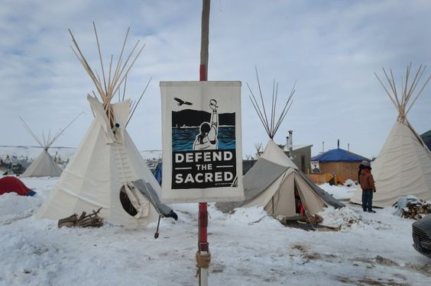
Relevance Today
The Doctrine of Discovery reinforced the dehumanization of many (Jews, Arabs, Africans, et al.) and contributes to the ideology of white nationalism today.
—Rev. Dr. Walt Davis, Christian Ethicist
Prof. Emeritus, San Francisco Seminary
Notes:
One of our handouts is a 4-page resource that covers all this and there is a link in the handout to the full 14-page report.

Slide 19
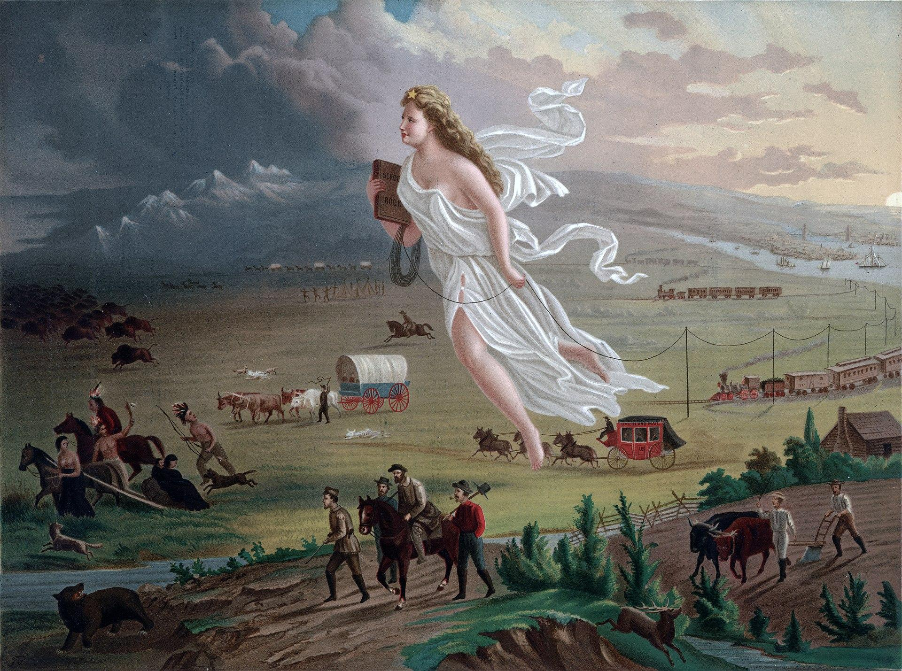
“American Progress” by John Gast, 1872
Notes:
We’re going to consider
United States and Israel as examples of Settler Colonialism.
This 1872 painting by John Gast called “American Progress” shows a white woman floating across the plains of our continent. The female figure is a depiction of Columbia who wears the Star of Empire above her forehead, carries a school book under her right arm, and is the herald of a new reality, driving Indigenous people, bison, and other animals out of the picture and into oblivion.
Take a moment to look at the detail in the painting. We are looking at the Doctrine of Discovery and manifest destiny in process.
****
more if needed:
[Historian Roxanne Dunbar-Ortiz, writing in An Indigenous Peoples’ History of the United States (Beacon Press, 2014), describes the significance of the Columbia persona:
The Columbus myth suggests that from US independence onward, colonial settlers saw themselves as part of a world system of colonization. “Columbia,” the poetic, Latinate name used in reference to the United States from its founding throughout the nineteenth century, was based on the name of Christopher Columbus. The “Land of Columbus” was—and still is—represented by the image of a woman in sculptures and paintings, by institutions such as Columbia University, and by countless place names, including that of the national capital, the District of Columbia.]
https://ratical.org/ratville/US-Settler-Colonialism.html

Slide 20
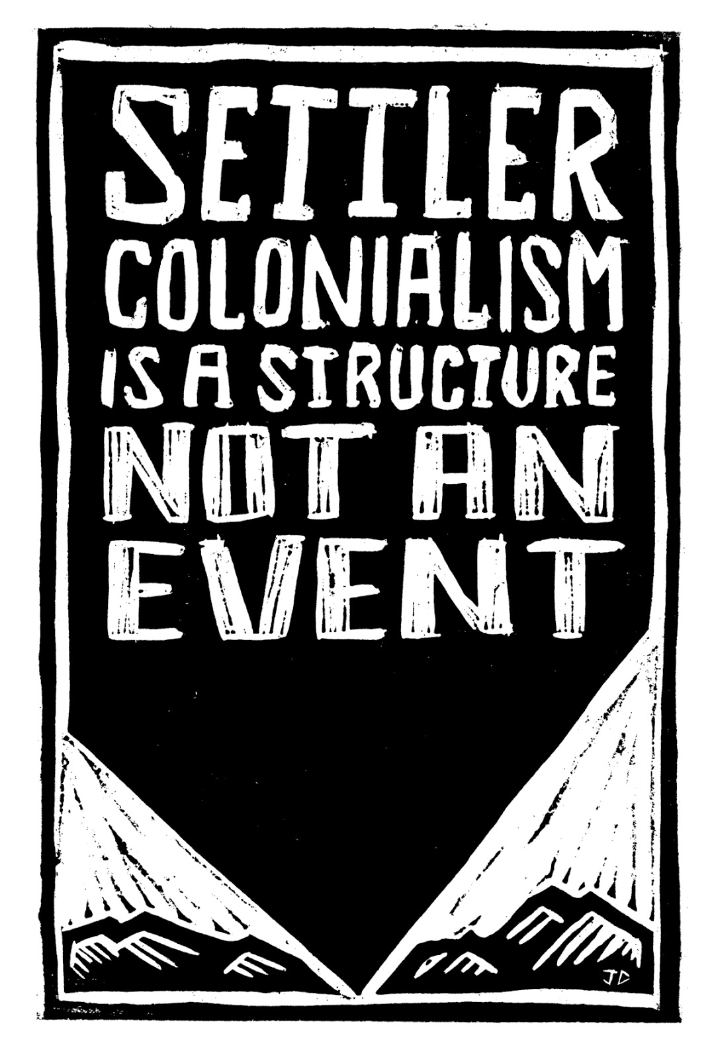
… settler colonialism
is premised on the
“elimination of the native”,
this being achieved
through either
physical elimination or assimilation policies
that sought to transform indigenous populations
into “white people”.
~Patrick Wolfe
Australian anthropologist and ethnographer whose seminal work sparked a surge in studies of settler colonial societies.
Notes:
Take a moment to read the slide
Patrick Wolfe challenged the standard triumphal narrative of civilizing the frontier through pioneering individualism, which is what we saw in Gast’s painting of Columbia.
Wolfe distilled his decades of work into describing settler colonialism as a structure.
He maintained that we are not talking about something that happened but about an enduring infrastructure.

Slide 21
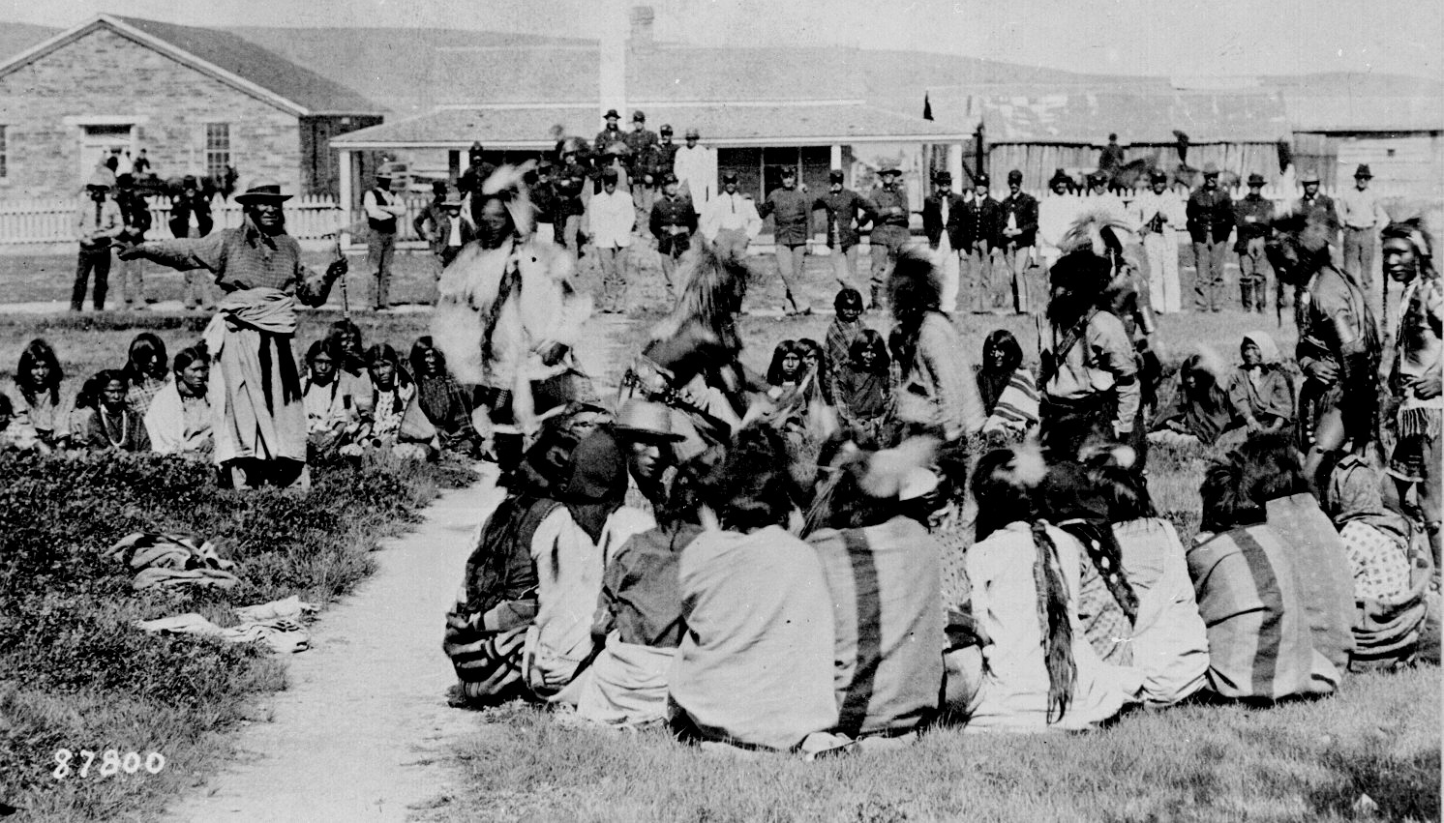
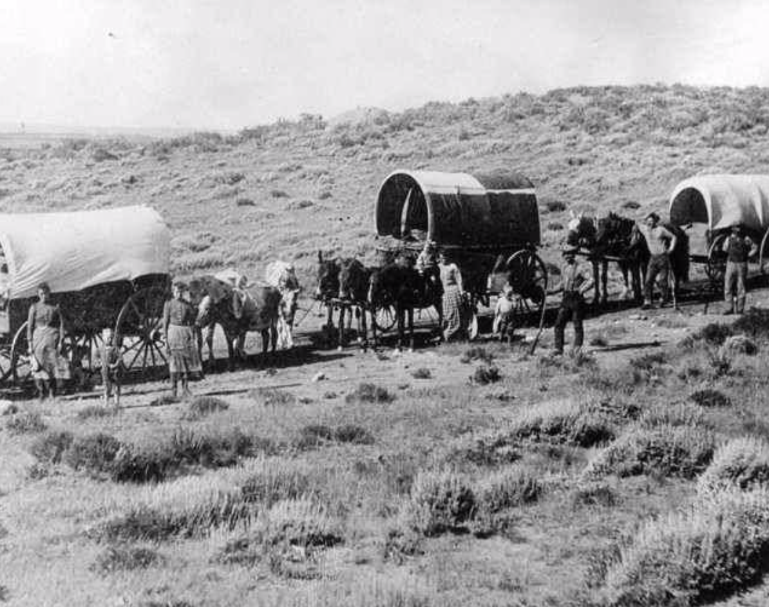
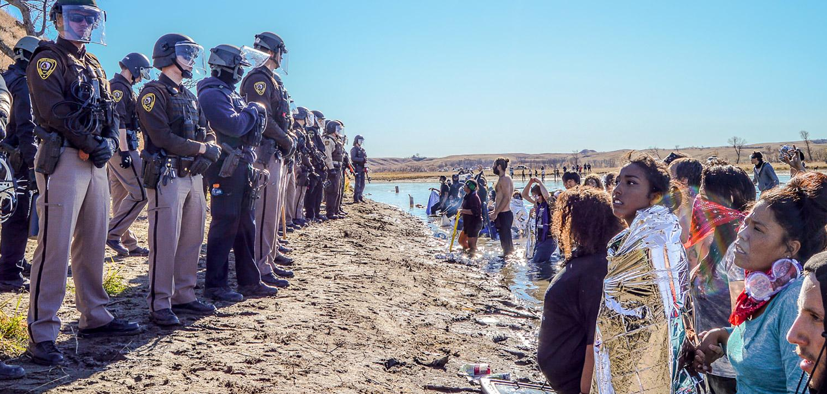
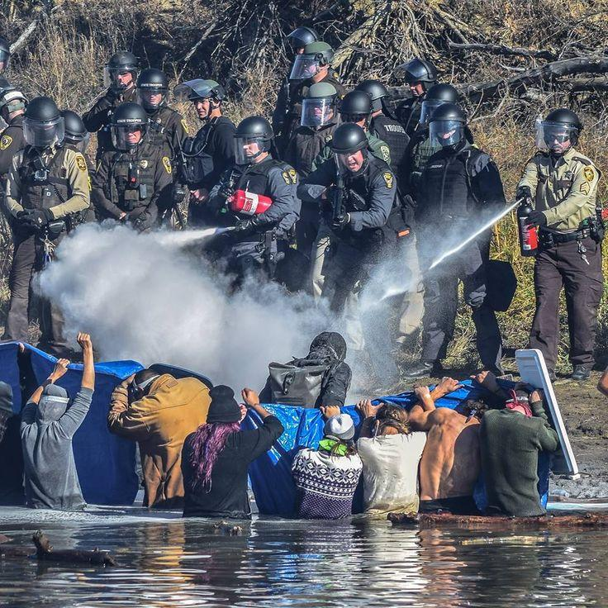
Settler-colonialism is...
Notes:
Quoting Patrick Wolfe, Settler Colonialism is a form of colonialism that is exclusive. It’s a ‘winner take all’, a zero-sum game, whereby outsiders come to a country, and seek to take it away from the people who already live there, remove them, replace them, and displace them, and take over the country, and make it their own.”
Here we are looking at American Settler Colonialism, past and present
***
top left: 1892, Shoshone Indians waiting outside at Ft. Washakie, Wyoming Indian reservation
top right: 1880, wagon train in Colorado, captioned: Some of the toughest, bravest people gave it their all to go west and start a new life
bottom: 2016, Standing Rock Water Protectors in N. Dakota protesting the DAPL - Dakota Access Pipeline - note the militarize forces spraying the protestors

Slide 22
video: Ilan Pappe defines Settler Colonialism
Notes:
Israeli historian Ilan Pappe encourages a shift in our language about the situation in Israel-Palestine from occupation, which is temporary, to describe the realities of Israeli settler colonialism.
Play video

Slide 23
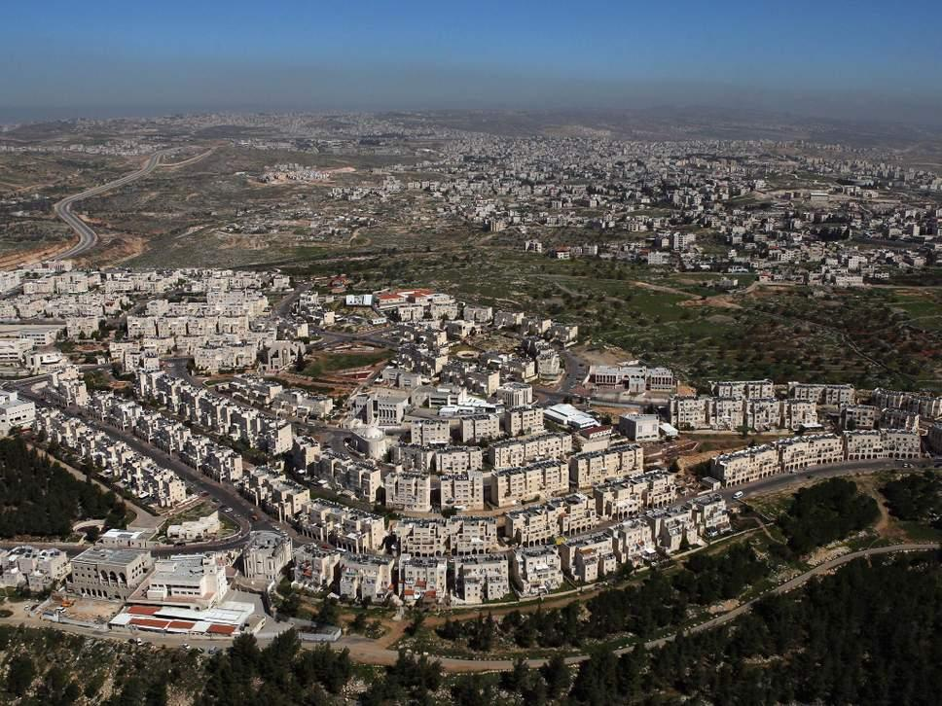
ISRAEL AS A SETTLER COLONIAL PROJECT
Notes:
SUSAN
This is a Jewish-Only settlement in East Jerusalem, illegal under international law, and built on Palestinian land.
Israel is a settler colonial project. Israeli violations of Palestinian human rights are intentional, and a direct consequence of ideological, political, legal, economic, and military systems designed to promote Israel as a Jewish nation state.

Slide 24
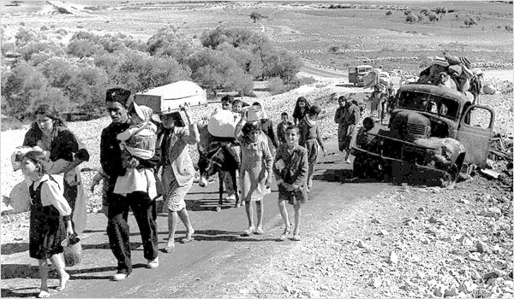
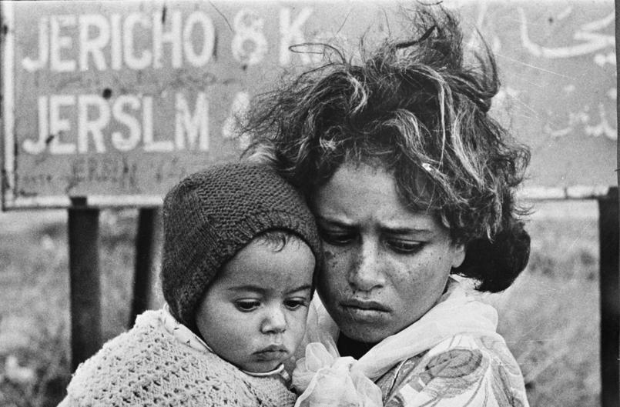
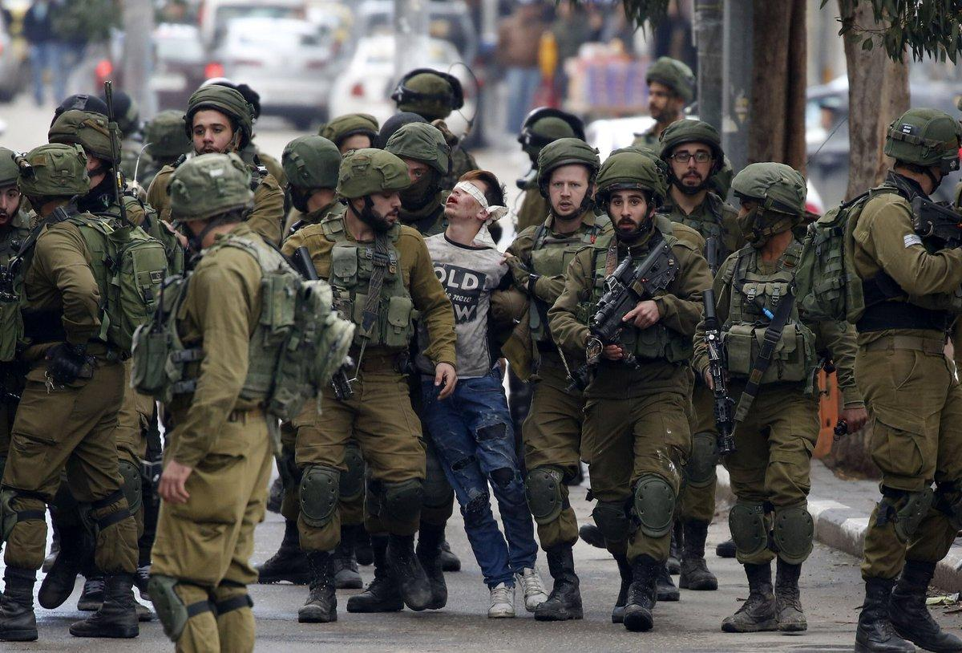
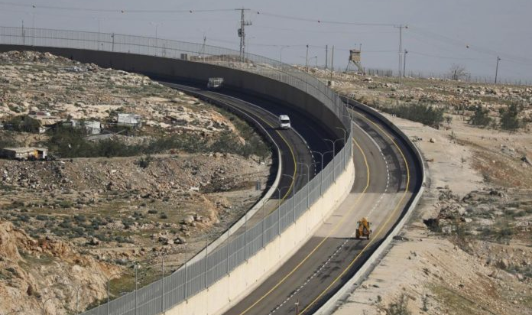
Settler-colonialism is...
Notes:
Settler colonialism replaces the indigenous population by confiscation of land and water, and systemic erasure of their culture.
Here we are looking at settler colonialism in Palestine
Hebron scene –
This newly opened segregated road separates Israelis from Palestinians with a wall.
(Opened in December 2018)

Slide 25
Video: excerpt of Buffy St. Marie with images of Native Americans
Notes:
Let’s close out this section with time for a silent meditation with Native American singer Buffy St. Marie.

Slide 26
Part 5
Intersectionality
as the way forward
Notes:
Raise your hand if you have heard the word “Intersectionality.”

Slide 27
Demystifying Intersectionality
a new paradigm
to address injustice
by linking
all global struggles
for justice.
Notes:
Intersectionality:
explores common ground
connects justice movements
to form coalitions
to address systemic injustice
for empowerment and change.

Slide 28
Intersectionality promotes...
...understanding of human beings as shaped by the interaction of different social locations (e.g., ‘race/ethnicity, indige-neity, gender, class, sexuality, geography, age, disability/ability, migration status, religion.)
These interactions occur within a context of connected systems and structures of power (e.g., laws, policies, state governments and other political and economic unions, religious institutions, media.) Through such processes, interdependent forms of privilege and oppression shaped by colonialism, imperialism, racism, homophobia, ableism, and patriarchy are created.
~Olena Hankivsky, PhD.
Founder and Director of the Institute for Intersectionality Research and Policy
Simon Fraser University, Vancouver, Canada
Notes:
This is a lot of words.
Take a moment to read this, and then we’ll unpack it..
There are 3 parts to the definition:

Slide 29
Breaking it Down
...understanding of human beings as shaped by the interaction of different social locations (e.g., ‘race/ethnicity, indige-neity, gender, class, sexuality, geography, age, disability/ability, migration status, religion.)
~Olena Hankivsky, PhD.
Notes:
READ SLIDE
This refers to who you are, what intersections you live in. For example, a Muslim woman with disabilities. That’s three intersections.

Slide 30
Breaking it Down
These interactions occur within a context of connected systems and structures of power (e.g., laws, policies, state governments and other political and economic unions, religious institutions, media.)
~Olena Hankivsky, PhD.
Notes:
READ SLIDE
Here we’re talking about how individuals and groups interface with systems of power and control - such as laws, policies, government, etc. - that determine risks and access to resources.

Slide 31
Breaking it Down
Through such processes, interdependent forms of privilege and oppression shaped by colonialism, imperialism, racism, homophobia, ableism, and patriarchy are created.
~Olena Hankivsky, PhD.
Notes:
READ SLIDE
What emerges is clarity about who profits and who is vulnerable.
Solidarity results from acknowledging and acting on common bonds.

Slide 32
Video - When I See Them, I See Us
Notes:
Introduction to video:
THIS VIDEO WAS CREATED BY PERSONS INVOLVED IN THE EVENTS that took place during the summer of 2014, when state-sanctioned racialized violence was on full display by the U S and Israel.

Slide 33
Where I Stand
Notes:
Where I stand Exercise
Social Location Social location is a set of information that determines an individual's place within the community.
All people have a social location defined by their gender, race, social class, age, ability, religion, sexual orientation, and geographic location.
Each group membership confers a certain set of social roles and rules, power, and privilege (or lack of), which heavily influence identity and experience.
This exercise is not original, but is has been adapted to this workshop. If you have done something like this at another time, that’s a plus, as this will build upon your previous experience by adding a new intersection - your connection to the struggle for justice in Israel/Palestine.
I will read instructions and we’ll begin. Encourage participants to look around the room and comment on their experience.

Slide 34
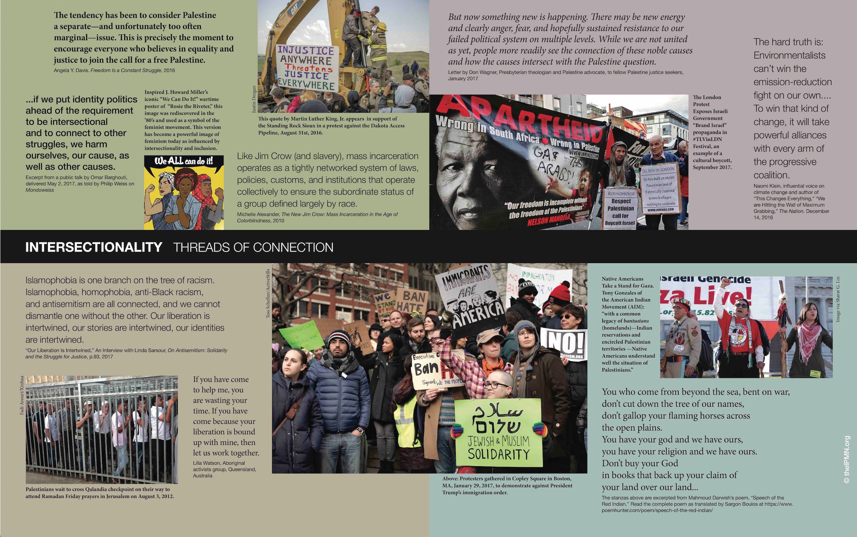
Tour the Banners
What we do flows from who we are...
Identify cross-movement struggles
Name the issues
Explore connections/allies
Where do you stand in solidarity? Who do you stand with?
Implications for education/ advocacy
Notes:
Take a personal moment to reflect on what you have just experienced, as we move directly into our next exercise.
What intersections in justice struggles connect for you?
What surprises you about the banners?

Slide 35
Video: An Intersectional Awakening
Notes:
Vic Mensa is an African American rap artist who went to Palestine and saw himself in the mirror of Palestine. He wrote an opinion piece about what he saw in Palestine in Time magazine and wrote a song after his trip to Palestine and the violence in Charlottesville, Virginia. This is a short clip, which, fair warning, as with most rap songs, it is rated EXPLICIT.

Slide 36
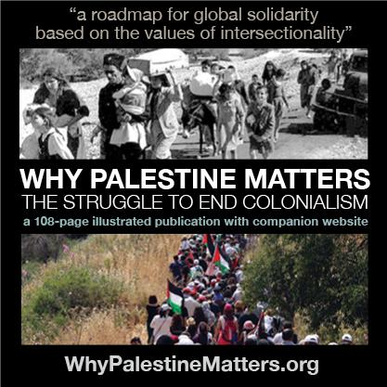
Part 6
Q & A
Notes:
This is your opportunity to comment and ask questions as a means of integrating the learning

