Slide 1
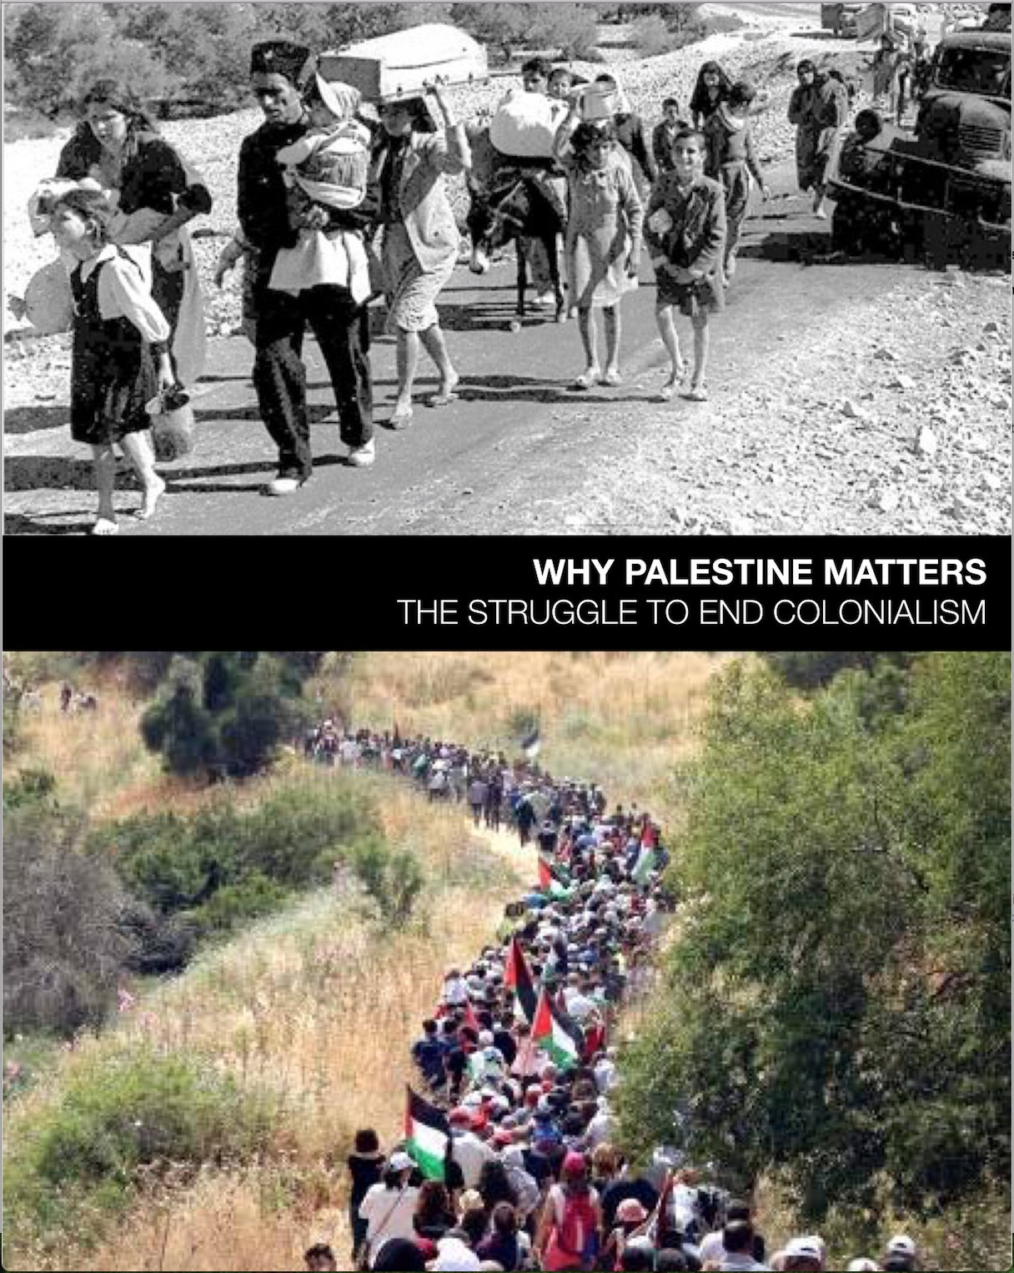
WHY PALESTINE MATTERS
The Struggle to End Colonialism
A 5-week course

Slide 2
WEEK ONE
An Intersectional Approach to Justice
Chapter 2

Slide 3
CRITICAL DISTINCTIONS and CAVEATS
JUDAISM
is a religion that values justice
for all people.
ZIONISM
is an ideology that supports
a Jewish national homeland
in historic Palestine.
All Jews
ARE NOT Zionists.
Criticism of discriminatory policies of the state of Israel
is not inherently antisemitic.
Advocating equality
and human rights for Palestinians
is not in itself antisemitic.
Notes:
from IPMN Statement on Antisemitism:
Judaism and Jewish identity encompass a diversity of religious and secular expressions and a robust, varied set of traditions, cultures, and lived experiences. Definitions of antisemitism that treat criticism of Israel or of Zionism as inherently antisemitic are inaccurate and harmful.” (jvp.org/antisemitism)
The majority of Jews are not Israeli, and not all citizens of Israel are Jewish. Not all Jews are Zionists; Israel does not represent or speak for all Jews. Criticism of the discriminatory policies and practices of the state of Israel —which privilege Jews over non-Jews— is not inherently antisemitic, in the same way that criticism of Trump Administration policies is not un-American. To reiterate, anti-Zionism is not antisemitism.
We conclude that the best way to stand against antisemitism is to stand in solidarity with all struggles for justice against all racism, bigotry, oppression and injustice.

Slide 4
HANDOUTS
Grounding Principles for the Course
Ground Rules for the Course
Lexicon
Doctrine of Discovery
IPMN Statement on Antisemitism

Slide 5
“Injustice anywhere is a threat to justice everywhere. We are caught in an inescapable network of mutuality, tied to a single garment of destiny. Whatever affects one directly affects all indirectly…”
~ Martin Luther King, Jr.

Slide 6
Intersecting justice issues include:
Human rights ... Education … Civil rights … Economic justice…Sex and gender justice … Health/mental health care… Gentrification Environmental Justice … Child welfare ... Disability rights … Police brutality … Food justice… Militarism … Mass incarceration … gun control …sex trafficking … Free speech Minimum wage … labor rights …

Slide 7
Course Overview

Slide 8
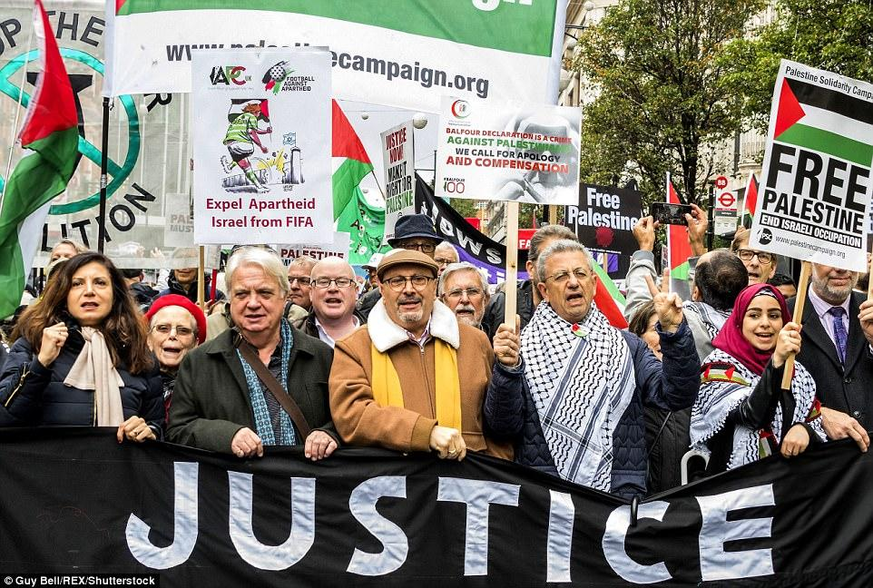
By linking Palestine...
...to all struggles for justice, we make clear that the project for human liberation is about justice for all people everywhere.

Slide 9
Our Focus…
Palestine
Settler Colonialism
Intersectionality
Cross-Movement Organizing

Slide 10
Our Work...
Understand historical legacies of racism, patriarchy, and colonialism
Rethink single-issue model of political struggles
Explore connection across borders, movements, etc.
Create effective alliances

Slide 11
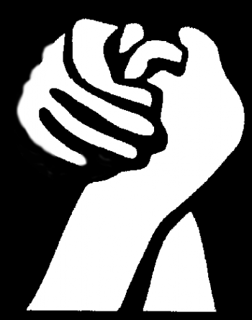
Reflection
If you have come to help me,
you are wasting your time.
If you have come because
your liberation
is bound up with mine,
then let us work together.
Lila Watson
Aboriginal Activist
Queensland, Australia

Slide 12
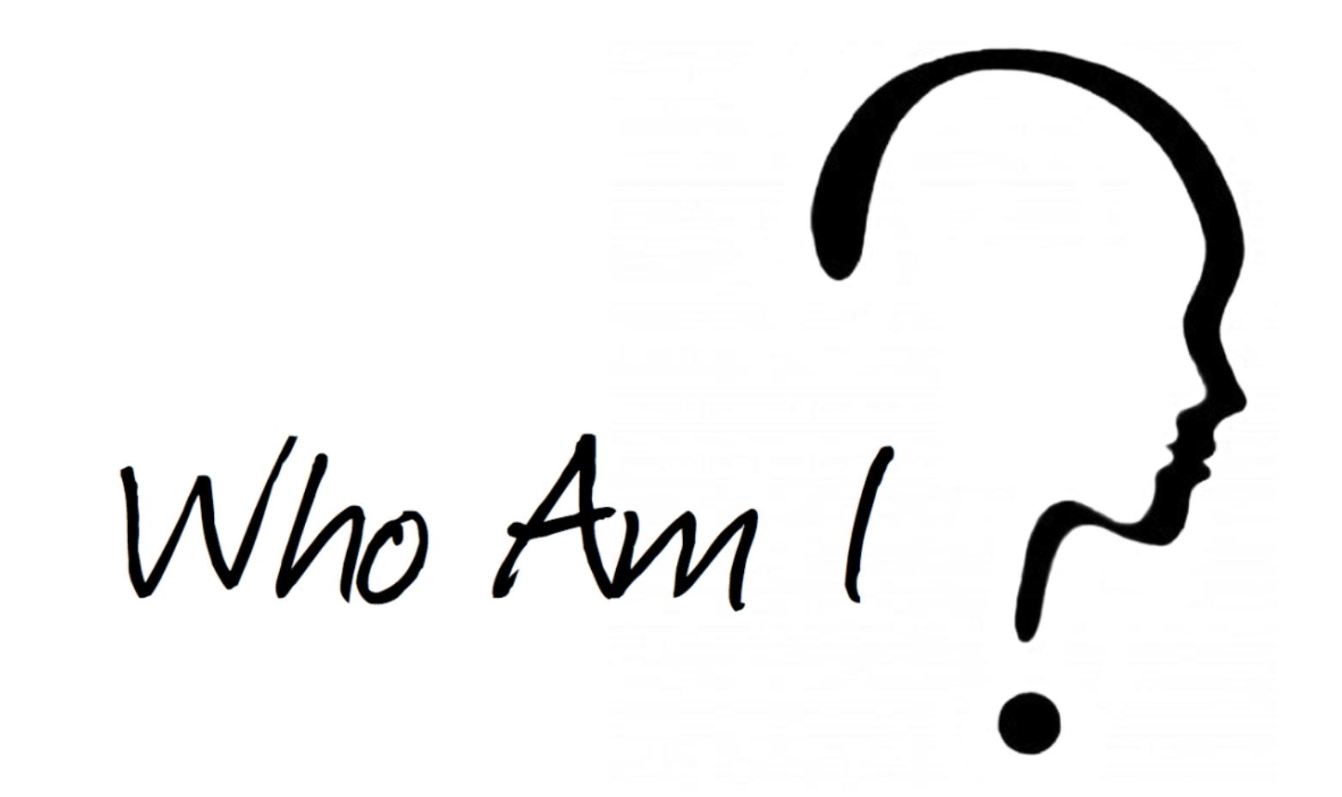
WHO’S IN THE ROOM?
Brief Introductions
Who am I?
White, Jewish, Senior
What issues impact my life?
Medicare, Social Security, Health care
What issues do I care about?
Palestine, education, mass incarceration

Slide 13
PLAY VIDEO
Chapter 1
“Should we join the struggle?
From BLM to Palestinian Rights”

Slide 14
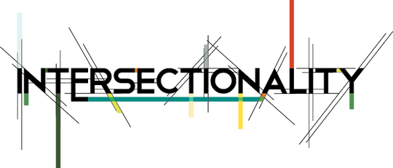
Demystifying

Slide 15
is a new paradigm
to address injustice
by linking all global struggles
for justice.

Slide 16
explores common ground
connects justice movements
to form coalitions
to address systemic injustice
for empowerment
and change.

Slide 17
Intersectionality promotes...
...an understanding of human beings as shaped by the interaction of different social locations (e.g., ‘race/ethnicity, indige-neity, gender, class, sexuality, geography, age, disability/ability, migration status, religion.) These interactions occur within a context of connected systems and structures of power (e.g., laws, policies, state governments and other political and economic unions, religious institutions, media.) Through such processes, interdependent forms of privilege and oppression shaped by colonialism, imperialism, racism, homophobia, ableism, and patriarchy are created.
~Olena Hankivsky, PhD.
(Why Palestine Matters, page 20)

Slide 18
Intersectionality promotes…
an understanding of human beings as shaped by the interaction of different social locations (e.g., ‘race/ethnicity, indige-neity, gender, class, sexuality, geography, age, disability/ability, migration status, religion.)

Slide 19
These interactions...
occur within a context of connected systems and structures of power
(e.g., laws, policies, state governments, and other political and economic unions, religious institutions, media.)

Slide 20
Through such processes...
interdependent
forms of
privilege and
oppression
are created.
~Olena Hankivsky, PhD.

Slide 21
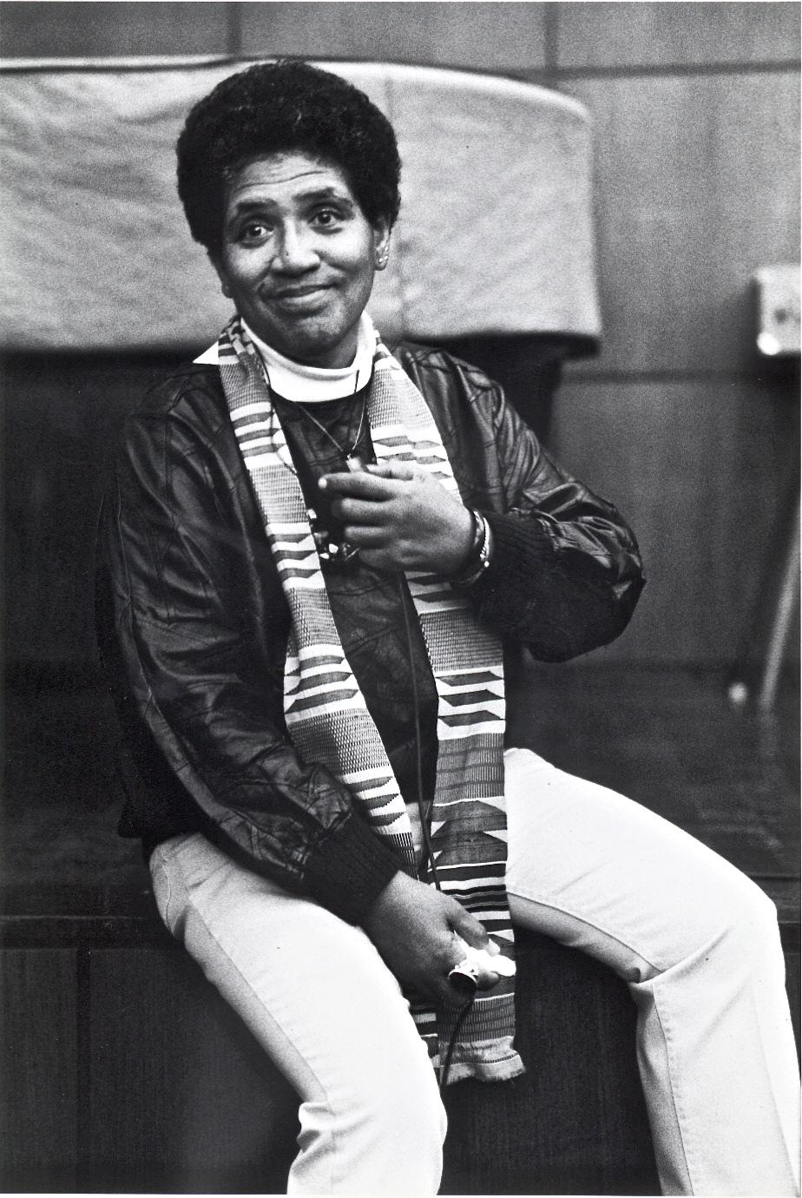
Intersectionality has evolved...
...from a theory of how oppression works to a notion of how people can fight it.
There is no such thing as
a single-issue struggle
because we do not lead
single-issue lives.
~Audre Lorde
Feminist Poet

Slide 22
Banners
The banners move beyond single-issues
to stand in solidarity
with other justice struggles
across movements and borders.
Cross-movement connections
create effective alliances
critical to building
a global justice movement.

Slide 23
Banner Tour
Identify cross-movement struggles
Note inter-linking oppressions
Where are you in solidarity?
What are implications for education, organizing, advocacy?

Slide 24
PLAY VIDEO
Chapter 2
When I See Them, I See Us
When I see us, I see them…

Slide 25
The project of human liberation
is not limited to Palestine,
but it also cannot proceed
without Palestine.
from the Introduction
Why Palestine Matters,
The Struggle to End Colonialism

