Slide 1
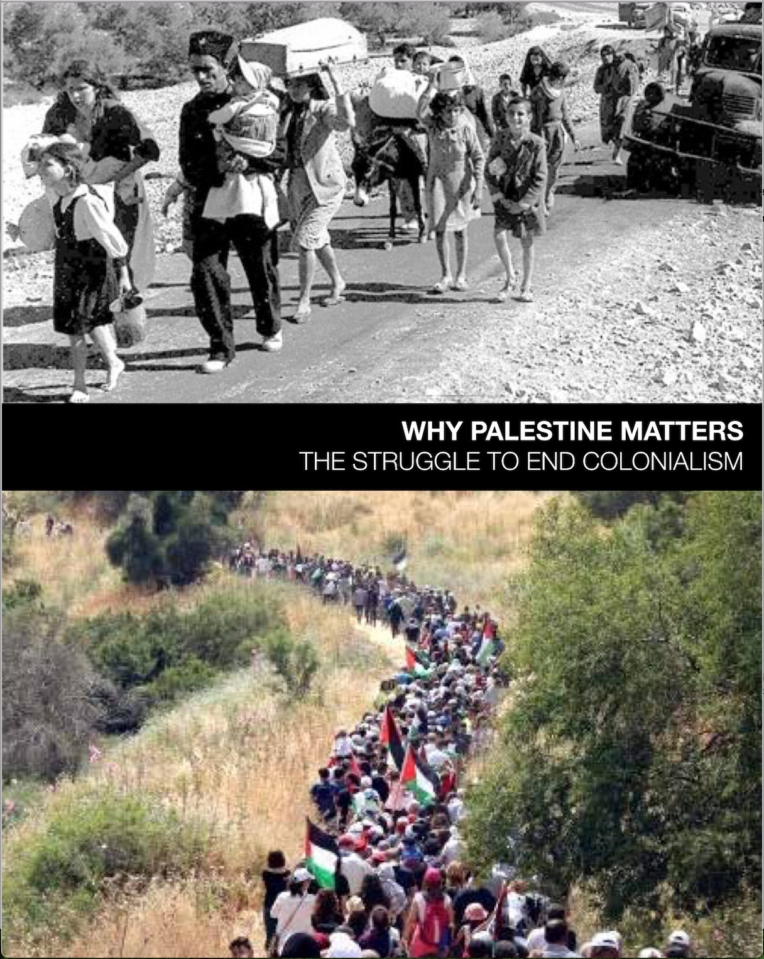
WHY PALESTINE MATTERS
The Struggle to End Colonialism
A 5-week course
Facilitated by

Slide 2
Week Two
Palestine Through The Lens Of Colonialism And Intersectionality
Chapter 1
Rethinking Narratives
From a Palestinian Perspective

Slide 3
Warm Up
Silently read “Rethinking Narratives”, pages 10-11.
In small groups read and discuss Jonathan Ofir’s quote on page 10.
“​ ​If​ ​the​ ​r​oots​ ​of​ ​a​ ​conflict​ ​show​ ​you​ ​that​ ​it’s​ ​not​ ​really​ ​a​ ​conflict​ ​but​ ​rather​ ​a​ ​case​ ​of​ ​colonial aggression,​ ​then​ ​you​ ​have​ ​to​ ​think​ ​differently​ ​about​ ​its​ ​historical​ ​extension​ ​into​ ​the​ ​present...​ ​the current​ ​state​ ​of​ ​Israel​ ​is​ ​an​ ​extension​ ​of​ ​that​ ​original​ ​massive​ ​1948​ ​ethnic​ ​cleansing,​ ​with​ ​its subsequent​​ ​1967​ ​ethnic​ ​cleansings,​ ​and​ ​on​ ​to​​ ​present-day​​ ​ethnic​ ​cleansings​ ​which​ ​occur​ ​even in​ ​what​ ​is​ ​called​ ​‘Israel​ ​proper’,​ ​targeting​ ​Israeli​ ​citizens​ ​who​ ​are​ ​non-Jewish.”
~Jonathan​ ​Ofir,​ ​Israeli​ ​writer,​ ​​​2017
Notes:
What are the implications?

Slide 4
Settler Colonialism
Notes:
The task of confronting injustice requires we understand historical precedents for how we got to where we are. We will explore this concept in conjunction with our own history and Israel’s current politics.
DEFINITION:
Settler Colonialism is the domination of one group of people by another for the purpose of land acquisition and/or resource extraction. It is a structure of domination by colonizers over the colonized.
Let’s unpack the Who, what, where, when, why?

Slide 5
DOCTRINE OF DISCOVERY
The Papal Bull of 1493 played a central role in the conquest of the New World. The Bull stated that any land not inhabited by Christians was available to be “discovered, claimed, and exploited by Christian rulers.”
This “Doctrine of Discovery” became the basis of all European claims in the Americas as well as the foundation for the United States’ western expansion.
Notes:
We may not have heard of the Doctrine of Discovery, but we continue to live this theology of entitlement, preserved and enshrined through international law.
It is the root of the system we recognize today as white supremacy.
This is the logic of fifteenth-century Christendom that endowed European conquerors with self-assumed divine title over all ‘discovered’ land and peoples”.
Land and people were subjugated, and their resources served the Church and crown.
This meant destruction for indigenous peoples as the Christian gospel was distorted to underwrite conquest.
How many here have heard of it?
In 2016, the 222nd General Assembly adopted recommendations for action on the Doctrine of Discovery, calling the church to “confess its complicity and repudiate the Doctrine of Discovery.”
In 2018, the 223rd GA repudiated it in an extensive report with specific recommendations.
Handout in folders.

Slide 6
PLAY VIDEO
Ilan Pappe on Settler Colonialism
Chapter 3
Notes:
Israeli historian Ilan Pappe teaches the importance of language in how we frame the situation in Israel-Palestine. He discusses the realities of Israel not as an occupation, which is a temporary situation, but rather as settler colonialism which began in the 19th century. This is an excerpt of a one hour lecture that is available online. This clip is on our book’s website.
AFTER: Anything new, surprising?

Slide 7
“The logic of settler colonialism...
...is that it destroys in order to replace. Assimilation involves the systematic stripping away of indigenous culture and replacing it with that of the dominant culture.”
~Patrick Wolfe
Australian Anthropologist
renown on settler colonialism
Notes:
Patrick Wolfe was an Australian anthropologist and ethnographer whose work sparked a surge in studies of settler colonial societies. He used theories of colonialism and indigenous resistance to generate new and different ways of viewing Australia’s history that challenged the standard triumphal narrative of civilizing the frontier through pioneering individualism.
Patrick Wolfe distilled his decades of work into talking not about something that happened but about putting in place an enduring infrastructure that destroyed indigenous.
culture and replaced it with that of the dominant culture.

Slide 8
“Settler-colonialism is...
...a form of colonialism that is exclusive. It’s a ‘winner take all’, a zero-sum game, whereby outsiders come to a country, and seek to take it away from the people who already live there, remove them, replace them, and displace them, and take over the country, and make it their own.”
~Patrick Wolfe
Australian Anthropologist
renown settler colonialism scholar
Notes:
Settler colonialism replaces the indigenous population by confiscation of land and water, systemic erasure of their culture.
The operative logic of settler colonialism may be to “eliminate the native,”
Yet still indigenous peoples exist, resist, and persist;

Slide 9
A Palestinian Perspective
In an uneven power structure,
racism feeds the exceptionalism
of the powerful and
the dehumanization of the powerless.
~G.J. Tarazi
Chapter 1
Notes:
GJ spent 37 years as in Public education and when he retired he was a college professor. Founding board member of the Palestinian Christian Alliance for Peace

Slide 10
Tools of Domination in Colonialism
Methods to gain power
Retain dominance
Interaction with indigenous population
Exceptionalism
Dehumanization
Exploitation of natural resources
Notes:
It is his contention that colonialism uses methods that are intentional, purposeful, destructive, and long lasting.
from CHAPTER ONE: G.J. Tarazi’s analysis Exceptionalism & Dehumanization:
To Name, Examine, Repair

Slide 11
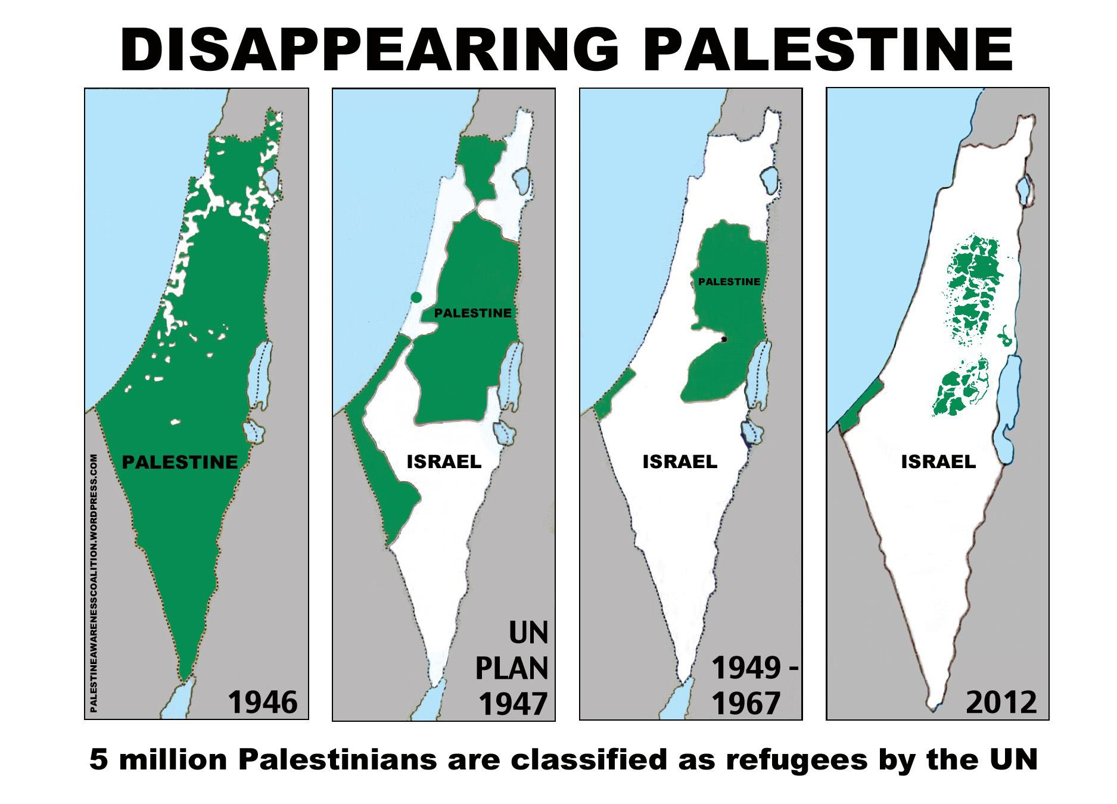
CONSIDER...
Zionism
is an
example of
modern
Settler Colonialism.
Notes:
How is this or is this not true in light of Pappe, Wolfe, abd Tarazi?
Domination of one group of people by another
For the purpose of land acquisition and/or resource extraction of colonized by colonizers
Attitude of exceptionalism and dehumanization of those who are not like them.
Israel is a settler colonial project. Israeli violations of Palestinian human rights are intentional, and a direct consequence of ideological, political,legal, economic, and military systems designed to promote Israel as a Jewish nation state.

Slide 12
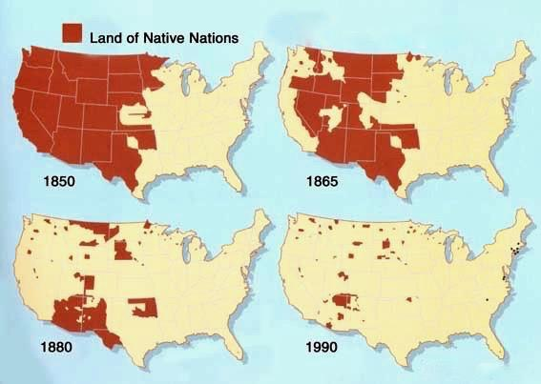
NAMING THE PARALLELS
Settler colonialism as an [infra]structure
African Americans
Native Americans
Palestinians
Notes:
How the other looked, spoke, living practices, religion, ethnocentric practices,
Land taken by force
Relocation and displacement of people
“Catastrophe”, Superiority, supremacy, slavery
Bible as a weapon
Racism, apartheid
Water (Flint, Gaza); siege
Mass incarceration, detention, legal discrimination, abuse of children
State violence, police brutality

Slide 13
SILENT REFLECTION
PLAY VIDEO
Buffy St. Marie - Chapter 2
Notes:
Buffy Sainte-Marie (born February 20, 1941 at Piapot Reserve in Saskatchewan, Canada) is a Cree singer-songwriter, musician, composer, visual artist, pacifist, educator, social activist, and philanthropist.

Slide 14
Can joint solidarity struggles
lead to policy changes?

