Slide 1
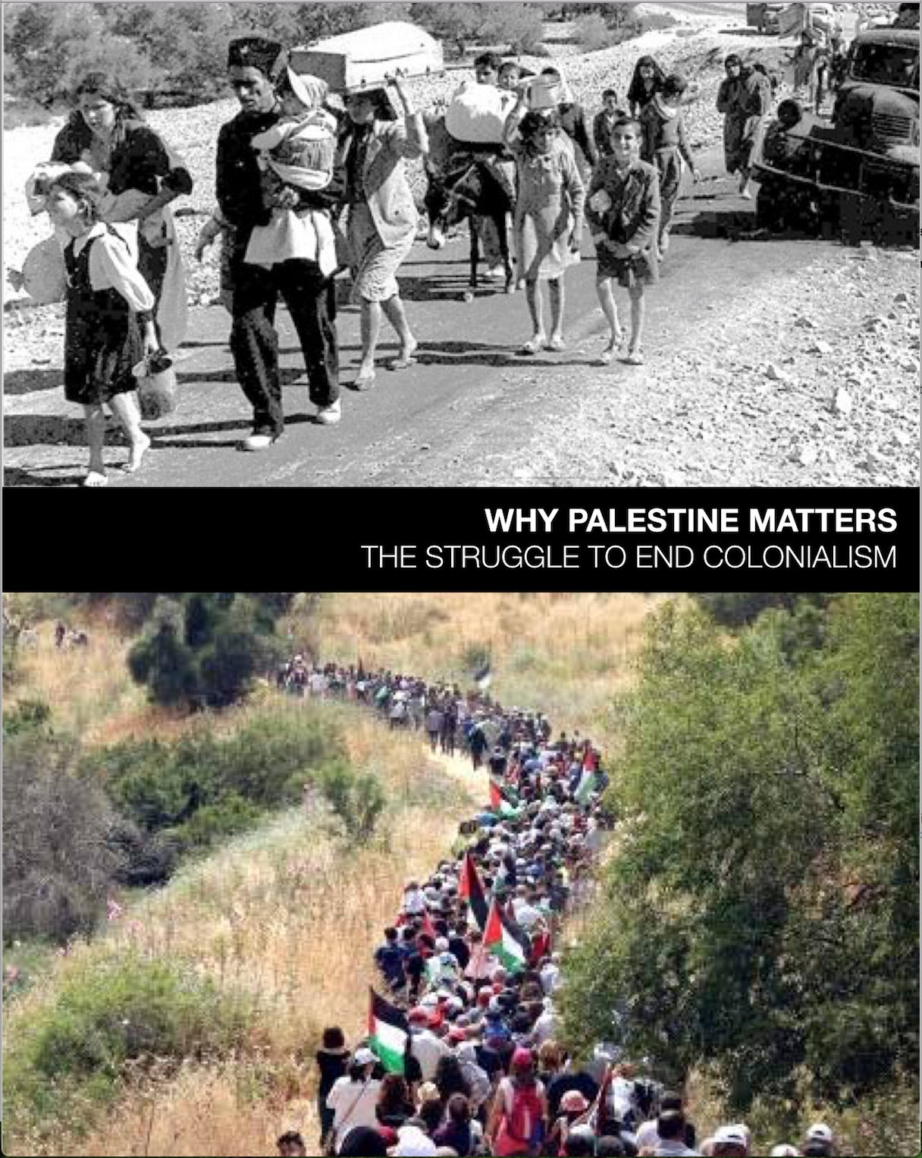
WHY PALESTINE MATTERS
The Struggle to End Colonialism
A 5-week course
Facilitated by

Slide 2
Week Three
CONTEMPORARY REALITIES
Chapters 4 & 5
RACISM, NORMALIZATION, AND
CULTURAL APPROPRIATION

Slide 3
From Settler Colonialism to Nation State
“The logic of settler colonialism
is tied to space and identity.”
J. Getzoff, p. 51
Notes:
Review how settler colonialism sets up the contemporary realities of Israel as a nation state,
and we’ll close with how Israel rebrands itself and normalizes the dehumanization .
Ethnic settler states restrict minority and indigenous populations’ land access rights
Rights are given and taken based on one’s identity.

Slide 4
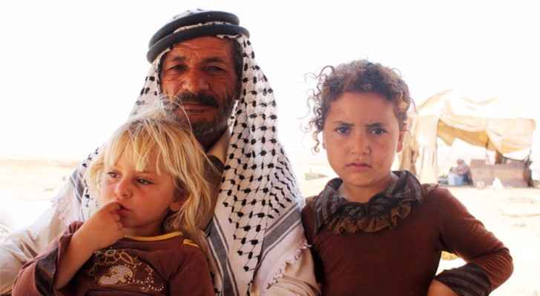
The Bedouin: Exceptionalism & Dehumanization in the Naqab/Negev
“regularization”and
“urbanization”
displacement and dispossession
Notes:
Most precious resources are land and water.
Unrecognized villages still denied all services – roads, electricity, water, trash pick up. All housing illegal, hence tents.
Bedouin way of life (agrarian) threatens the settler colonial heart of Zionism.
efforts to push Bedouin onto small plots of farmland and destroy their nomadic agrarian culture and to become wage earners
Israel’s response to the ancient nomadic people, the Bedouin, evidenced in Umm al-Hiran and the South Hebron Hills
Citizenship vs national rights, which only Jewish citizens have.

Slide 5
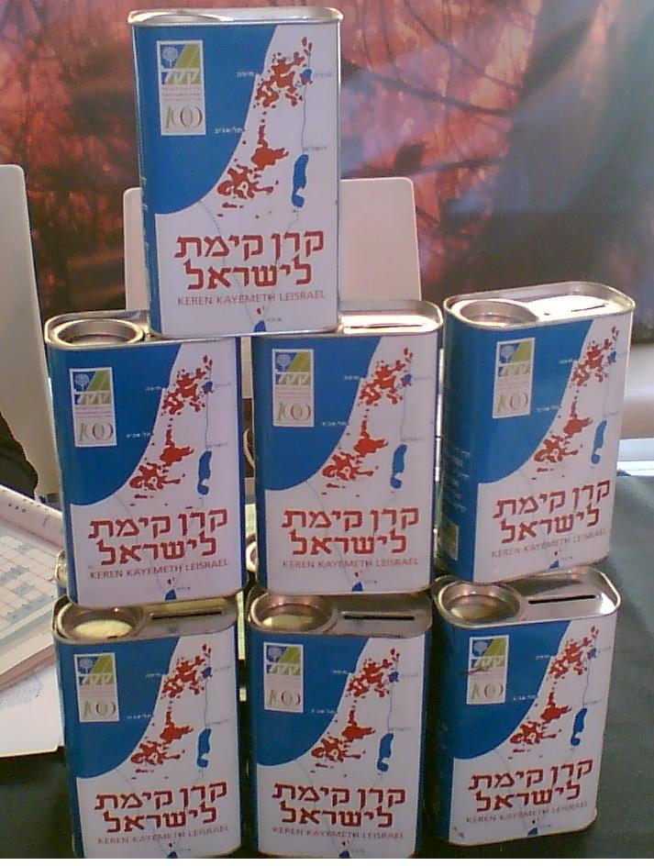
Turning pine trees
into weapons of war through...
JUDAIZATION
and
MEMORICIDE
What do they mean?
How do they function?
Jewish National Fund Collection Boxes raised funds for planting European pine trees in land taken from Palestinians.
Notes:
Transformation of Palestinian space into Jewish space
Intended to disconnect Palestinians from their land and ensure Jewish demographic and spatial dominance
Turning pine trees into weapons of war
In place of 500 razed Palestinian towns and villages, Israel planted new communities with Hebraicized names
ERASURE
Erased from space and Consciousness – depopulated villages maps

Slide 6
CONSIDER...
...if there is a conflict
between a Jew’s national right and a
Palestinian’s individual citizenship right,
the Jewish national right
will invariably be given priority
by officials and the courts.
~Jonathan Cook, p. 47
Notes:
Legal measures are used to disconnect Palestinians from their land and ensure Jewish demographic and spatial dominance.
With Judaization as a national value, the Israeli government could justify the forcible transfer of populations, and with discrimination enshrined, non-Jewish people have limited ways of challenging unequal access to land, housing, or state resources

Slide 7
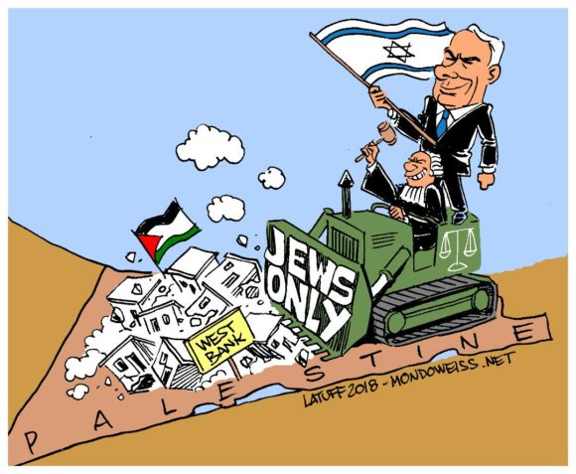

Slide 8
Excerpts from
Israel's Declaration of Independence - May 1948
The Land of Israel (Eretz Israel) was the birthplace of the Jewish people. Here their spiritual religious and political identity was shaped…
The State of Israel will be open for Jewish immigration and for the ingathering of the Exiles;
it will foster the development of the country for all its inhabitants;
it will ensure complete equality of social and political rights to all its inhabitants irrespective of religion, race or sex;

Slide 9
Excerpts from
Israel's Declaration of Independence - May 1948
It will guarantee freedom of religion, conscience, language, education and culture; it will safeguard the Holy Places of all religions and it will be faithful to the principles of the Charter of the United Nations. .....
We appeal - in the very midst of the onslaught launched against us now for months - to the Arab inhabitants of the State of Israel...
preserve peace and participate in the upbuilding of the State on the basis of full and equal citizenship and due representation in all its provisional and permanent institutions...
Placing our trust in the "Rock of Israel" we affix our signatures...

Slide 10
Israel codifies Jewish Privilege
2018 Nation-State Law
even if 1 in 5 people are not Jewish
Israel is the historic homeland of Jewish people who have unique right to self-determination
Flag, menorah, national anthem is “Hatikva”
Jerusalem is the capital
Hebrew is the only official language
Israel open to Jewish alliyah (immigration)
Encourage/promote Jewish settlement
Hebrew calendar
Independence Day
Holocaust Remembrance Day
Notes:
Underpinnings of Jewish Entitlement
Annexation Laws
Judaization
Jewish supremacy
Discriminatory housing and immigration are national values
Land and water claims
Settlements/ By-pass roads
Displacement planning
Restricted political participation
Waste management
Replace Arab names with Hebrew ones
Unequal access to legal recourse
Apartheid policies in Israel
Claims to Jerusalem as the capital of Israel
The Land of Israel is the historic homeland of the Jewish people, in which the State of Israel was established.”
"The right to exercise national self-determination in the State of Israel is unique to the Jewish people”

Slide 11
VIDEO
Israel’s New Racism - Chapter 4
The Nation - David Sheen & Max Blumenthal
Notes:
Read from David Sheen, 2019
Sheen (Canadian independent journalist and filmmaker, reporting from Israel-Palestine) -Blumenthal (American journalist, author, blogger)
What stands out? Why is this video important?
The rising tide of white nationalism, racism and hatred directed at Jewish people and other vulnerable minorities in our country. And we must call for an end to the extreme rhetoric, laced with bigotry and racism, that is dominating our national discourse and breeding violence. Caravans, HIAS

Slide 12
Rebranding A Country Chapter 5

Slide 13
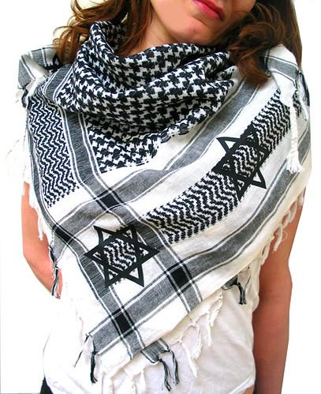
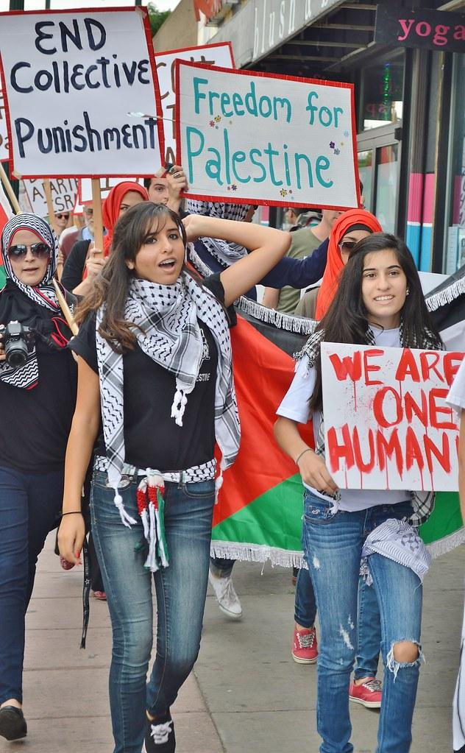
Whose Kufiya
is it anyway?
A Global Symbol
of Solidarity

Slide 14
VIDEO
Normalize This
Chapter 5
Play Twice

Slide 15
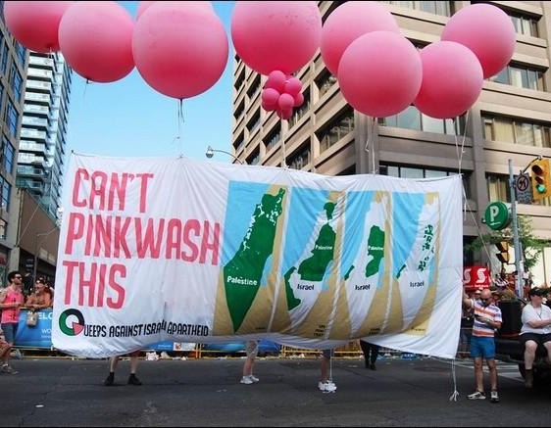
Rethinking Normalization
CONSIDER...
Groups, movies, books, events, projects, products, performances, initiatives, experiences, advertising, etc. that rebrand Israel through normalization and appropriation.

Slide 16
VIDEO
Pinkwashing
Chapter 5

Slide 17
VIDEO
How to Make Hummus
Chapter 5

