Slide 1
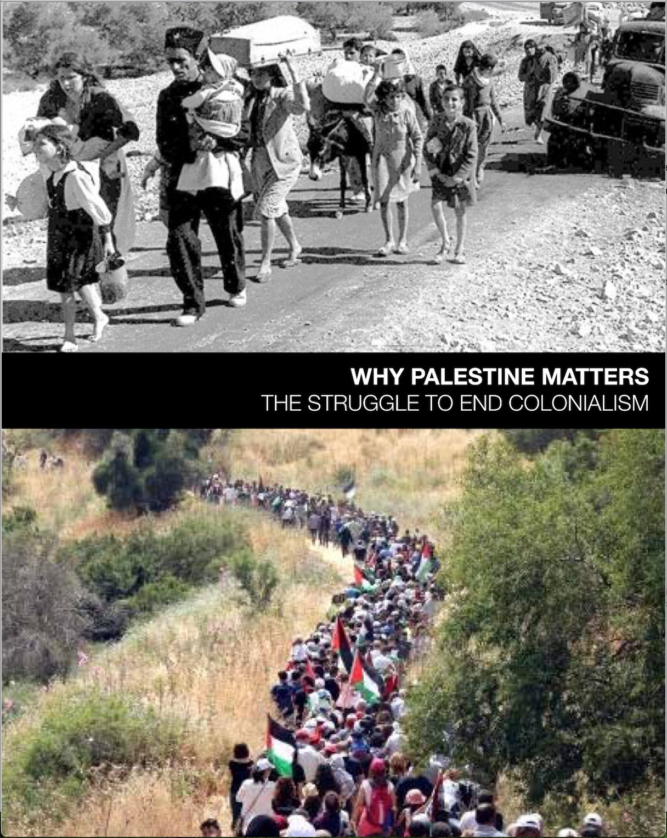
WHY PALESTINE MATTERS
The Struggle to End Colonialism
A 5-week course
Facilitated by

Slide 2
Week Four
RESISTANCE
Chapters 4 & 7

Slide 3
OUTLINE
Resistance
Liberation Theology
BDS Basics & Blowback
Sanctuary as Resistance
Changing the discourse

Slide 4
What does resistance look like?
Notes:
Gaza and WB- staying
South and Central Americans leaving
Standing Rock -Native Americans and allies protest pipeline
US – BLM, Me too,
POWER bus loads trips to Harrisburg to advocate fully funding education
Protests at ICE
Lobbying
Building schools in Palestine

Slide 5
Liberation Theology
as Resistance
Notes:
Liberation Theology
Note: If tt is an option, invite someone knowledgeable on this subject to present on this topic.
Based on Christison’s “Liberation Theology as Resistance,” on page 83, the following points are important:
Roots of liberation theology come from Latin America in the 50’s and 60’s as empowerment for the poor and oppressed.
The Old Testament claim of God’s covenant with the Jews granting Jews exclusive right to the land of historic Palestine must be rejected if God is just.
The theology of resistance to Zionism for Palestinians speaks to Muslims and Christians.
Episcopal priest Naim Ateek promoted a specifically Palestinian liberation theology through the Sabeel Ecumenical Liberation Theology Center in Jerusalem.
In 2009, Palestinian church leaders gathered to call on churches worldwide to stand in solidarity and action with the plight of Palestinian Christians. Based on a similar document in South Africa in 1985, this is known a Kairos Palestine.
If no speaker on this, another option is to play the short FOSNA video (in Ch. 7) about Naeem Ateek, Palestinian Liberation Theologian.

Slide 6
On 9 July 2005,
Palestinian Civil Society calls for
Boycott, Divestment and Sanctions
against Israel
until it complies with
International Law
and Universal Principles of
Human Rights.

Slide 7
Palestinian Call for Boycott, Divestment, and Sanctions Against Israel
Notes:
BDS activists want companies to stop doing business in Israel, consumers to stop buying Israeli products, and academics and cultural figures to stop collaborating with Israeli colleagues.
Direct action to interrupt business as usual and change the story

Slide 8
BDS is ...
...a strategy of targeted action
aimed to effect changes in behavior.
a non-violent response
to systemic Israeli violence against Palestinians
grounded in universal human rights and international law
Notes:
Intent?
Realistic?
Surprises or new info?
Anti-semitism

Slide 9
The BDS Movement Demands
Freedom
End to the occupation and colonization of all Arab lands
Equality
Full rights for Palestinian citizens of Israel
Justice
Right of return for Palestinian refugees to their homes and lands

Slide 10
BOYCOTT
by individuals and groups
consumer, Academic, Cultural, Sports
DIVESTMENT
by investors
withdrawal of financial support
SANCTIONS
by governments
Governmentally imposed withholding of aid, embargo, trade status
Notes:
Direct action to interrupt business as usual
Large corporations have tremendous political power
Companies manufacturing weapons and tear gas canisters
Arms Export Control Act

Slide 11
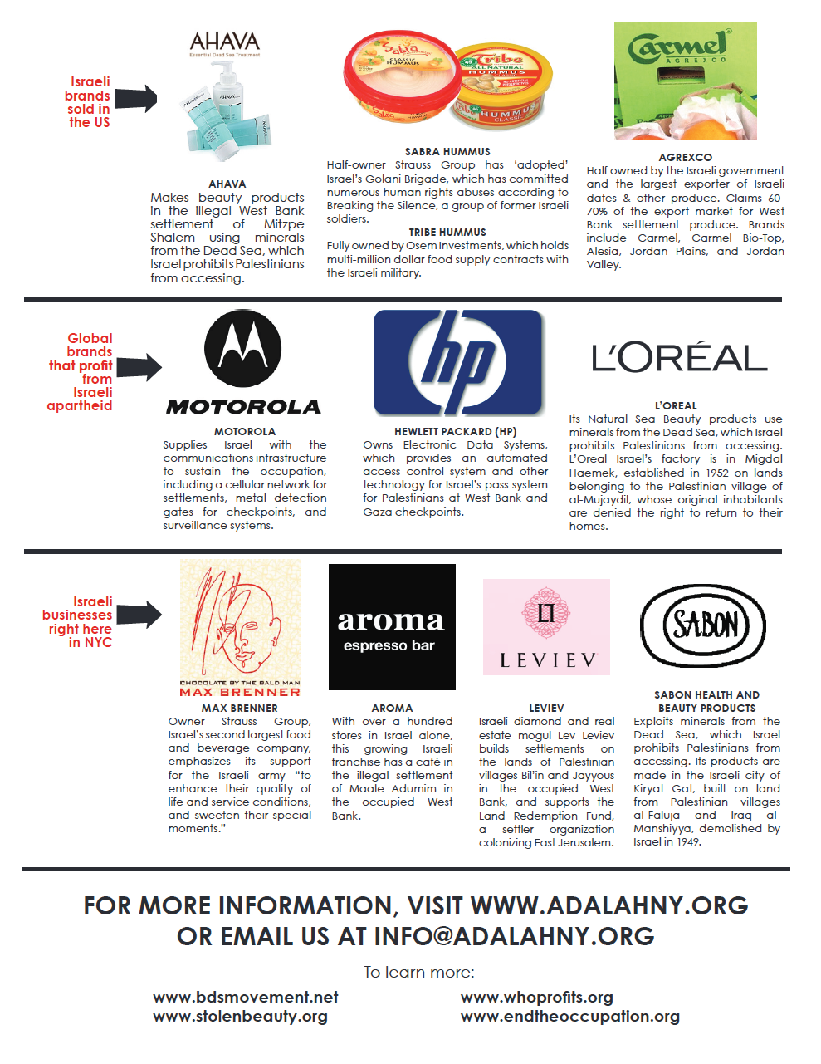
bdsMovement.net
StolenBeauty.org
WhoProfits.org
Notes:
Track your own complicity –That’s where your power is; leverage your connections

Slide 12
Anti-Boycott Legislation
FREE SPEECH
and
First Amendment Rights
Notes:
Some 26 states, from New York to Texas to Rhode Island to South Carolina, have regulations on the books to block BDS activists from accomplishing their goals. Another 13 states have bills pending
Require businesses contracting with the state to affirm that they are not participating in a boycott of Israel.
They don’t punish or prevent individuals from boycotting Israel – unless they are individual contractors, as was the case with speech pathologist in Texas. Or Mennonite school contractor in Kansas.
The two federal courts that have ruled on such bills have declared them to be unconstitutional violations of the First Amendment speech rights of American citizens.

Slide 13
SANCTUARY
AS
RESISTANCE

Slide 14
How immigration in the U.S.
intersects with Palestine
Border
Surveillance
Family Separation
Denial Of Rights
Denial Of Citizenship
Ice Raids
Deportation
Role Of Us Policies In Creating Problem
The Wall
Military Surveillance
Family Separation
2-tier Justice System
Denial Of Citizenship
Checkpoints
Administrative Detention
Role of Us Aid to Israel
Refugees
Notes:
Immigration is an example of a justice struggle that intersects with Palestine.

Slide 15
Changing the Discourse
TOWARD A MORE JUST WORLD

Slide 16
Changing the Discourse
H.R. 2407: Promoting Human Rights for Palestinian Children Living Under Israeli Military Occupation Act
NO WAY TO TREAT A CHILD ACT
Bill introduced by Rep. Betty McCollum (D-MN) with 31 co-sponsors.
Requires the Secretary of State to certify annually that no funds obligated or expended in the previous year by the United States for assistance to Israel have been used to support the ill-treatment of Palestinian children detained by Israeli forces from the occupied West Bank.
Notes:
We are not going to support US tax dollars funding Israel’s cruel brutal and dehumanizing system of juvenile military detention of Palestinian children. .
In the 115th Congress, we spearheaded efforts to introduce H.R. 4391, the first-ever bill in the U.S. Congress on Palestinian human rights. We ended the congressional session with 31 members of Congress supporting the bill.
Sadly, H.R. 4391 is no longer a "live" bill, as all bills introduced during a congressional session that do not make it through the entire legislative process are dead.
We are working on legislative advocacy initiatives in the new 116th Congress, including reintroducing an updated version of H.R. 4391.
» Follow us on Twitter for updates: https://twitter.com/nwttac

Slide 17
And…
Marc Lamont Hill Stays the Course After CNN Fires Him for
Pro-Palestine Speech at U.N.
December 18, 2018

Slide 18
And…
Rescinding, then Reversing on Civil Rights Award
to Angela Davis
‘We Will Not Be Bullied into Silence.'
Over 350 Scholars and Civil Rights Movement Veterans Speak Out in Support of Palestinian Rights
and Angela Davis.

Slide 19
PLAY VIDEO
Punishing Supporters of Palestine
Chapter 7

Slide 20
“Time to Break the Silence on Palestine”
Ground-breaking Op-Ed column in the NY Times by Michelle Alexander, January 19, 2019:
“Martin Luther King Jr. courageously spoke out about the Vietnam War. We must do the same when it comes to this grave injustice of our time.”

Slide 21
Jewish Voice for Peace Announces Position on Zionism
Jewish Voice for Peace is guided by a vision of justice, equality and freedom for all people.
We unequivocally oppose Zionism because it is counter to those ideals.

Slide 22
An Emerging Theory of Change
Links all struggles for equality, justice
End to discrimination and racism
Values: Equality, justice, freedom
Notes:
This theory of change stands apart from a tendency to separate the Palestinian struggle from other movements for justice, or to characterize Israel as a wholly unique historical and legal regime.
WHATEVER YOU DO THAT SUPPORTS THESE VALUES IS SOLIDARITY WORK and includes Palestine.

Slide 23
“De-exceptionalizing” Palestine/Israel
...a commitment to joint struggle
to embed Palestinian rights
into existing progressive discourse,
policy and practice.
Notes:
Stop making exceptions when it comes to Palestine. De-exceptionalizing Palestine/Israel represents a commitment to joint struggle, intersectional analysis, personal and political accountability, and the principled pursuit of collective liberation.

Slide 24
PLAY VIDEO
Vic Mensa - We Can Be Free
Chapter 1
Notes:
We’ll close with this short, rather explicit video clip by
Vic Mensa, an African American rap artist who went to Palestine and saw himself in the mirror of Palestine.
He wrote an opinion piece about what he saw in Palestine in Time magazine and wrote a song after his trip to Palestine and the violence in Charlottesville, Virginia.

Slide 25
OPTIONAL VIDEO
The Danger of Neutrality - Chapter 7
A TED Talk by Ann Baltzer

