Slide 1
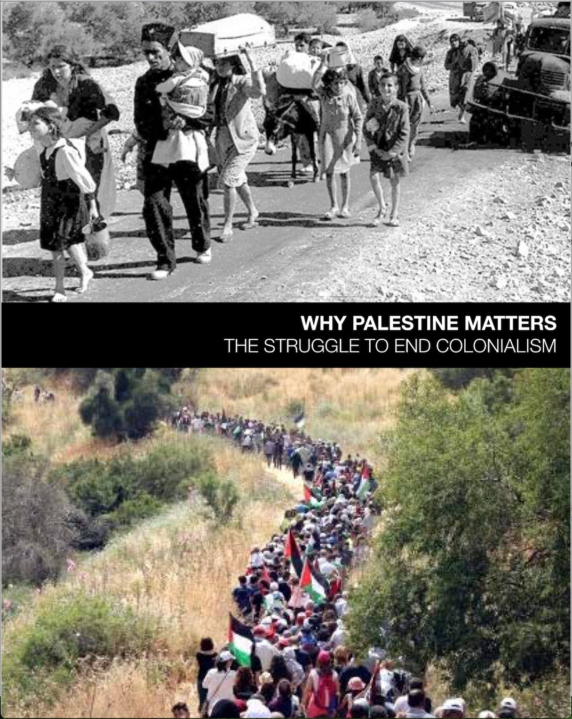
WHY PALESTINE MATTERS
The Struggle to End Colonialism
A 5-week course
Facilitated by

Slide 2
Week Five
International Law
and Equal Rights
Foreward
by Richard Falk
and
Epilogue
by Jonathan Kuttab

Slide 3
OUTLINE
Welcome/Debrief
International Law – Richard Falk
Jonathan Kuttab
Reflections
Solidarity, support, commitments
Evaluations

Slide 4
Milestones
in 2017
100th anniversary of Balfour Declaration
UN General Assembly Resolution 181, partition and Jerusalem (over 70 years.)
Israeli military occupation of West Bank, East Jerusalem, and Gaza Strip since 1967 War.

Slide 5
INTERNATIONAL LAW
Right of a people to self-determination
1966, Article 1 of UN Human Rights Conventions
Acquisition of territory by force illegal
Security Council Resolution 242
withdrawal from territories
Fourth Geneva Convention Relative to protection of Civilian Persons in Time of War forbids collective punishment
Right of Return
Crime of Apartheid, 1973 Colonial rule and settlement became illegal

Slide 6
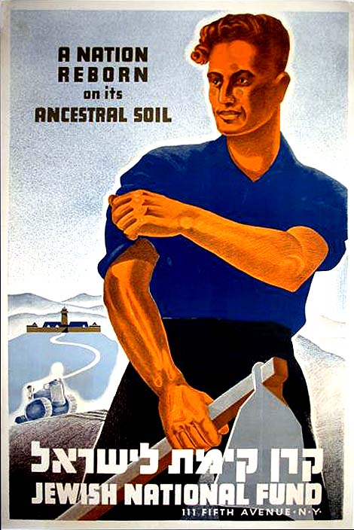
Falk on why
2-state solution
never came about
The main leaders of the Zionist movement never accepted the approach that their political leaders publicly endorsed.

Slide 7
Policies/Actions to Restore Justice
Self-determination for all
Dismantle structures of domination and discrimination
End apartheid
Any legitimate state(s) must not be ethnic or religious
Equality under the law; uphold human rights
Negotiation by parties involved, not imposed from outside

Slide 8
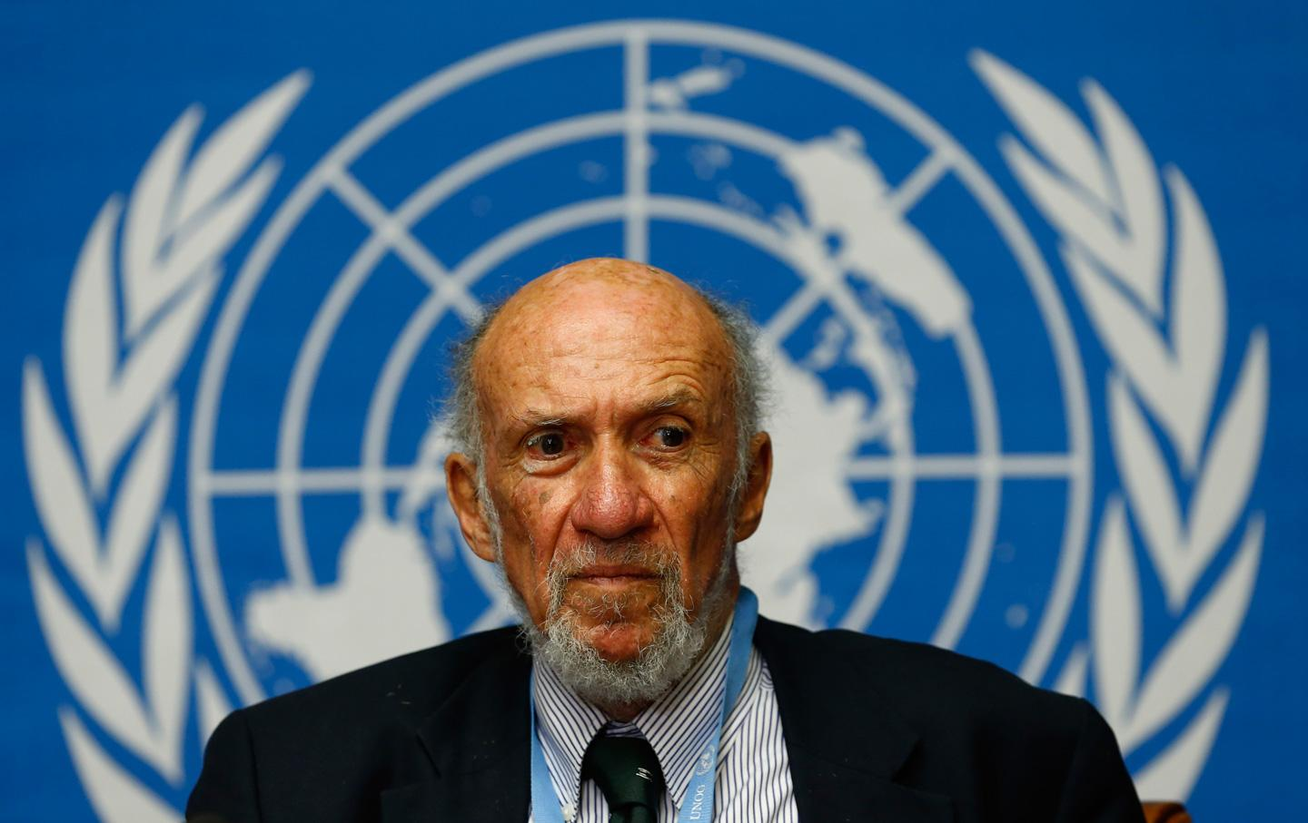
Richard Falk
Discuss the facts and ideas
in Falk’s Foreward
in light of
Israel’s 2018
Nation-State Law.

Slide 9
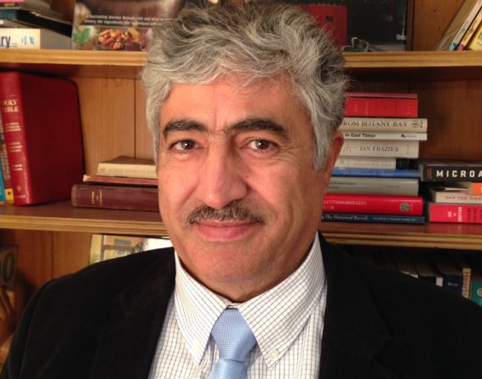
KUTTAB’S PROPOSED OPTIONS
End the Siege of Gaza
Abandon Palestinian armed resistance
Acknowledge Palestinian humanity
End arbitrary actions and systems that subjugate Palestinians

Slide 10
Kuttab: Israel c(sh)ould immediately...
End administrative detentions and release detainees
End restrictions on normal movement of goods and services between Israel and West Bank, and Gaza and West Bank.
Remove all barriers and checkpoints within the WB, allowing movement of persons and goods
Grant Palestinians permission to build in Area C, control of zoning and planning
Create legislative and constitutional demands for equality
Same law for all; civilian not military courts

Slide 11
Discuss your reactions to the options
and proposals Kuttab suggests:
Would you add/ omit anything from his lists?
Discuss the reasonability of his ideas?
What is the impact of his positivity?
How would implementation of his ideas change the narrative of settler colonialism?

Slide 12
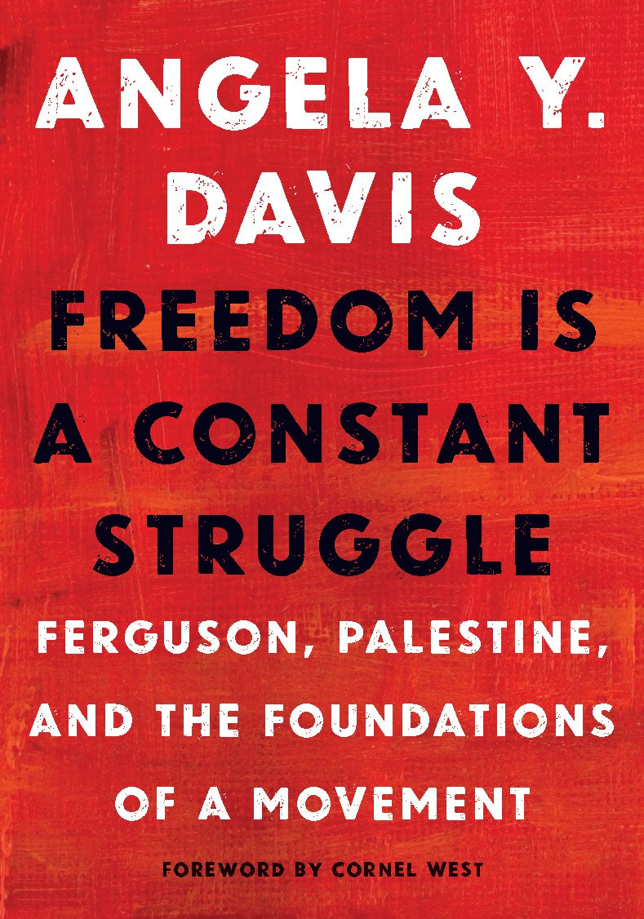
Angela Davis
“Palestine
is at the forefront
of the collective struggle.”
page 79 in WPM
Palestinian resistance
is connected to the
Movement for Black Lives
and the struggle for
justice and dignity.

Slide 13
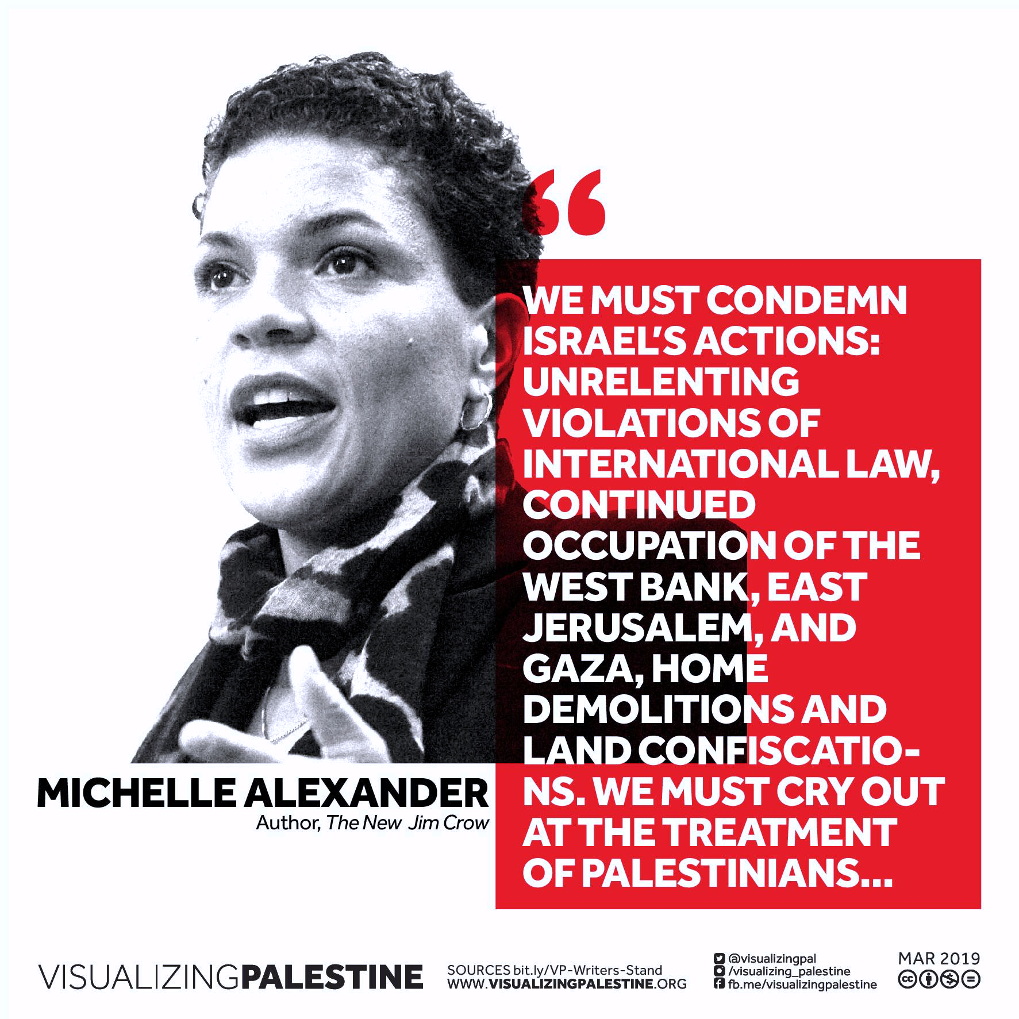

Slide 14
REFLECTION
“In this new year, I aim to speak with greater courage and conviction about injustices beyond our borders, particularly those that are funded by our government, and stand in solidarity with struggles for democracy and freedom. My conscience leaves me with no other choice.”
~Michelle Alexander, NY Times Op-Ed
author, The New Jim Crow

Slide 15
REFLECTION
The personal impact of this class…
Intersections of which I have become aware include…
How I will show support and solidarity going forward…
Notes:
We’re going to begin with a music video and some images. Please use this time to reflect on the the previous four weeks, the impact of the class…What stands out?

Slide 16
PLAY VIDEO
FLY LOVE, Rim Banna
Chapter 7

Slide 17
Closing the Circle
Tonight I make a personal commitment of solidarity and support to…

Slide 18
Please complete and return
CLASS EVALUATIONS

Slide 19
PLAY VIDEO
personal reflection
“WE ARE THE WORLD”
in Epilogue videos

Slide 20
Thank you
for being part of this journey.
May we all go forward in
solidarity and strength!

