Slide 1
SAE Filter Test Methods
Standards Committee
September 13-15, 2022
Diesel Corrosion Control
SAE J1488 Micelle Filtration

Slide 2
What We Will Cover
Summary - Why Corrosion Now?
Details – micelles, biosurfactants
How SAE J1488 micelle filtration controls corrosion
What tests to use
Long term diesel storage
Home heating diesel storage
Notes:
Most generator owners not aware of corrosion risk

Slide 3
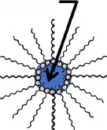
Summary: Why Corrosion Now?
*KEY* water has migrated into the fuel column, water bonds with surfactants to form a bottom layer of micelles
Microbial growth dramatically increases in the bottom micelle layer, MIC greatly increases

Slide 4
Summary: Why Corrosion Now?
Water “hidden” in micelle, traditional filters cannot touch water to remove it
Traditional water tests cannot detect water “hidden” in micelles
*KEY* both water and surfactants are polar molecules, neat diesel is not polar

Slide 5
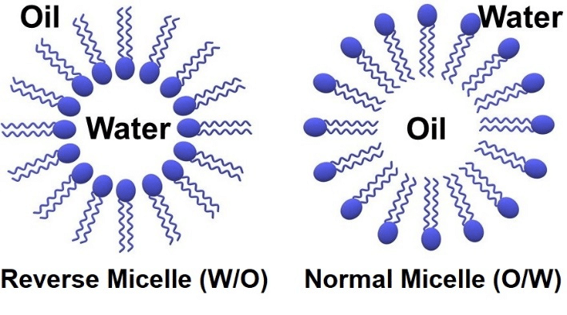
Basics: What is a Micelle? 2 D
Polar Head of Surfactant Bonds to Water
Notes:
Water droplet not shown
2D model
polar head surfactant bonds to water droplet

Slide 6
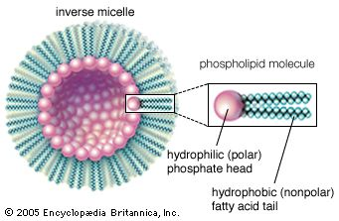
What is a Micelle? 3 D
Water droplet encapsulated by surfactant molecules
The fatty acid tail forms a barrier, isolating the water
from filter material, water tests, and diesel
Micelle settles to bottom
Micelle small, biodiesel molecule approx. 50 atoms
Note water droplet not shown
A 3D example of a reverse micelle, a phospholipid molecule

Slide 7
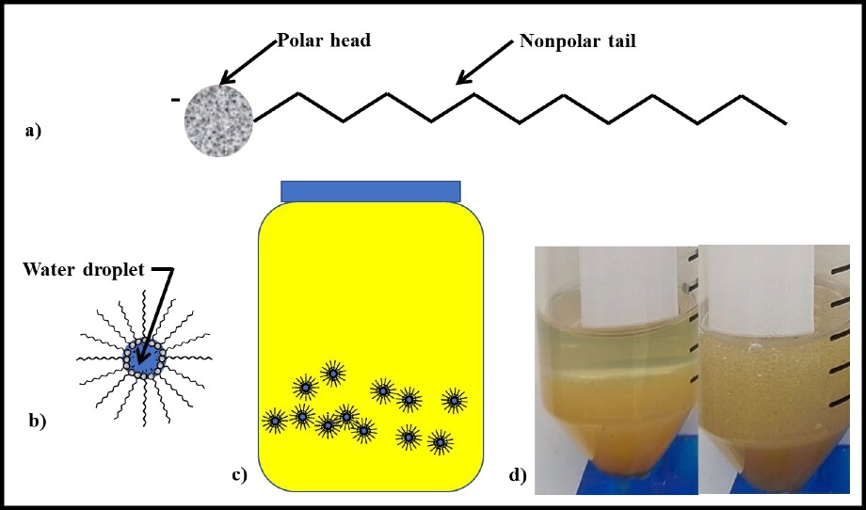
Latest CRC Research, July 2021, Micelles
Figure 62. Surfactants – a) schematic of surfactant molecule showing polar head and nonpolar tail; b) schematic of invert-emulsion micelle encapsulating water droplet and nonpolar tails extending into the medium (i.e., fuel); c) schematic of invert emulsion micelles dispersed in fuel; d) photo of 10 mL each fuel and water – left: before shaking; right: 24h after shaking (note stability of invert emulsion).
CRC Project DP-07-16-01, “Identification of Potential Parameters Causing Corrosion of Metallic Components in Diesel Fuel Underground Storage Tanks”: "The results from this 12-week study confirmed that the presence of free-water was essential to corrosion."
Notes:
Most important part of study:
Micelles explain: J1488 filtration results and fuel sample results
Molecular weight of ULSD and biodiesel similar, they stay mixed
Micelles settle to bottom, taking water and surfactants
Both water and biodiesel removed from body of fuel, and concentrated towards bottom.
<100 ppm water mid tank, bottoms 3,000 to 3000 ppm, no freestanding water
little biodiesel mid tank? reduced lubricity
Layer greatly increased microbial growth volume

Slide 8
Microbial Growth Volume Dramatically Increases
Tank
LSD Before 2006
Microbial growth volume thickness sheet of paper
Free Standing Water
Tank
ULSD/Biodiesel
Micelle microbial growth volume thickness up to 6 inches
More microbes, more acids, more corrosion, more biosurfactants . . .
Notes:
Neat diesel not polar.
To give an idea of scale, we have printers at home, a bundle of paper is an inch thick, and holds 200 sheets, times number of inches of the micelle layer

Slide 9
Biosurfactants
Thanks to Dr. Fred Passman for introducing me to the concept of biosurfactants:
“In my experience, microbial production of biosurfactants is the primary cause of invert emulsion formation in fuels.”
In addition to producing acids, microbes produce biosurfactants

Slide 10
Corrosion Mechanism
B5 produced by blending 100% ULSD with 100% biodiesel
Biodiesel creates the initial micelle layer
Microbial growth greatly increases, which then produce acids and biosurfactants, which form more micelles with newly absorbed water, increasing the micelle layer, which produce more biosurfactants and more acids …….
Notes:
My understanding is the blending of neat ULSD and biodiesel create the initial micelle bottom layer (invert emulsion) which then becomes populated with microbes, which create biosurfactants, and hence create more micelles increasing the layer thickness

Slide 11
SAE J1488 Micelle Filtration
The only diesel industry filtration test for biodiesel blends
Updated in 2010 to address difficulty in filtering water encased in micelles
*KEY* Filtering of Micelles 200 ppm Water Controls Microbial Growth and Corrosion
200 ppm is also the warranty limit for generator manufacturers, OEM’s want fuel sample with warranty claims, now denying claims

Slide 12
SAE J1488 Test Procedure
J1488 two phase test:
1st phase uses pure diesel, tests free water filtration
2nd phase B20 equivalent ~IFT 17: tests micelle filtration
2500 ppm water added to each test phase

Slide 13
SAE J1488 Test Procedure
Results:
1st phase – free water: all filters very efficient ~ 100 %
2nd phase – micelles: – filter cannot contact water encapsulated in micelle, low efficiency
Need a 92% filtration efficiency to keep water < 200 ppm: 2500 * ( 1 - .92 ) = 200

Slide 14
Field Results – SAE J1488 Micelle Filtration
J1488 Field Results
Over 10+ Years
All installed J1488 filtration sites are below limits
for water, TAN, and particulates
J1488 filtration effective at controlling corrosion
Notes:
I have taken fuel samples over 10 years, both J1488 filtered fuel, and non filtered fuel

Slide 15
SAE J1488 and Biodiesel Adoption
SAE J1488 micelle filtration is the key technology to enhance the safe adoption of biodiesel

Slide 16
Lab Tests for Micelles and Corrosion
ASTM D664 (TAN ) – Total Acid Number – .08 limit
ASTM D6304 Karl Fisher (KF): Traditional water tests cannot detect water in micelles
ISO 4406 Particulate: also indicates microbial growth
Visual: look for hazy fuel, visible water, particulate, corrosion
In addition to corroding the diesel infrastructure, the public is at risk:
Notes:
In addition to corroding the diesel infrastructure:

Slide 17
Corrosion, Threat to Emergency Generators
35,000+ psi, designs for 60,000+ psi
Acidified fuel corrodes injectors, micron
sized needles, holes: single injector failure
stops generator
Water in micelles bypass filters, damage injectors
Reduced lubricity, friction damage
Emissions increase, spray patterns affected
Corrosion Control: install SAE J1488 filtration on long term storage tanks
Injector holes/needle tips micron size
Notes:
60% of major outages now costing more than $100,000
Over 75% of IT leaders experienced an outage in the last 36 months, and 20% of those outages were ranked “severe”
Over 75% of survey respondents reported that their most recent outage could have been prevented with better practices and procedures in place – up 25% from 2019

Slide 18
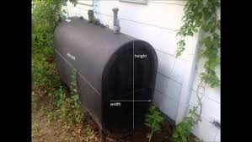
Corrosion, Threat to Home Heating Storage
Tens of thousands of thin walled small tanks installed, 275 gallons
Acidified fuel corrodes tanks, piping, injectors in furnaces & boilers
Increased risk of environmental contamination
Emissions increase
Corrosion Control:
J1488 filtration on Terminal Storage
Notes:
Farm house tank failed, insurance company spent $500,000. jacking up the house and remediating the soil

Slide 19
Relevant Research Papers
CRC Project DP-07-16-01 2021
“Identification of Potential Parameters Causing Corrosion of Metallic Components in Diesel Fuel Underground Storage Tanks”
USAF, U of Oklahoma, B20 year long study, 2020
“In situ Linkage of Fungal and Bacterial Proliferation to Microbiologically Influenced Corrosion”
EPA 2016 “Investigation Of Corrosion-Influencing Factors In Underground Storage Tanks With Diesel Service”
Battelle Report 2012 Corrosion in Systems Storing and Dispensing Ultra Low Sulfur Diesel (ULSD), Hypotheses Investigation
Moisture Absorption In Biodiesel And Its PetroDiesel Blends 2007
15 – 25 X pure diesel, 1,000 – 1,700 ppm, hits saturation in a day

Slide 20
About Pat Smyth: Speaker
Speaker:
June 2022 ASTM Working Group on Diesel Corrosion
Sept 2018 National Tanks Conference Louisville Ky
November 2018 National Association Corrosion Engineers (NACE) Washington DC November 2018
Presented EPA Washington DC, Office of Underground Storage Tanks, Sept 2016
Lecturer in BioFuelNet Canada’s Advanced Biofuels Course, hosted on McGill University’s myCourses platform. http://biofuelnet.ca/advanced-biofuels-course/

Slide 21
Pat Smyth: Industry Articles
BioFuels Digest 2016
“SAE J1488_201010 needed for Diesel Infrastructure Corrosion Prevention”
Uptime Institute 2017
“Reconsider Your Diesel Fuel Supply”
Steel Tank Institute (STI) June 2019
“Diesel Tank Corrosion Mechanism, and Corrosion Control”
Mission Critical Magazine October 2019
“Keep Generators and Storage Tanks Alive in the Wake of the Corrosion Crisis”
Electrical Generating Systems Association November 2019
EGSA largest organization dedicated to On-Site Power Generation, and includes emergency generator manufacturers

Slide 22
Corrosion Control in Stored Diesel
Pat Smyth
613-794-6090
patsmyth@octanesystemsinc.com
www.octanesystemsinc.com

