Slide 1
ASTM D02 Committee Week
June 2022 Seattle
Diesel Corrosion and Micelle Control
Control with SAE J1488
Micelle Filtration

Slide 2
What We Will Cover
Summary - Why corrosion and micelles Now?
Details – micelles, biosurfactants
Damage to tanks and emergency generators
Predicting damage in long term diesel storage
How SAE J1488 micelle filtration controls corrosion and micelles
What tests to use

Slide 3
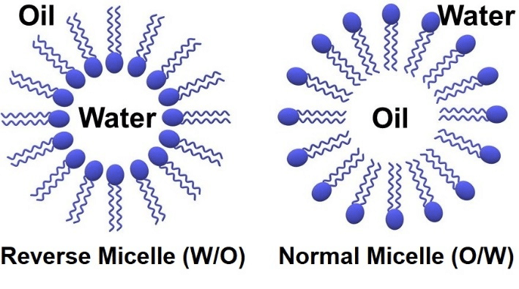
Summary: Why Corrosion Now?
*KEY* water has migrated into the fuel column, water bonds with surfactants to form a bottom layer of micelles
Water concentrated in bottom layer in micelles,
little or no free water
Microbial growth dramatically increases in the
bottom micelle layer
MIC (Microbial Influenced Corrosion) greatly increases

Slide 4
Summary: Why Corrosion Now?
Water “hidden” in micelle, traditional filters cannot touch water to remove it, micelles bypass filters and damage injectors
Traditional water tests cannot detect water “hidden” in micelles

Slide 5
Basics: What is a Micelle? 2 D
*KEY* both water and surfactants are polar molecules
Polar Head of Surfactant Bonds to Water
Encapsulates Water
Note water droplet not shown

Slide 6
What is a Micelle? 3 D
Water droplet encapsulated by surfactant molecules
The fatty acid tail forms a barrier, isolating the water
from filter material, water tests, and fuel
Surfactant Molecules
Micelle small, surfactant molecule approx. 50 atoms
Micelles settles to bottom, concentrate water and surfactants on bottom, reduce lubrication
Water Droplet
A cutaway 3D example of an inverse micelle

Slide 7
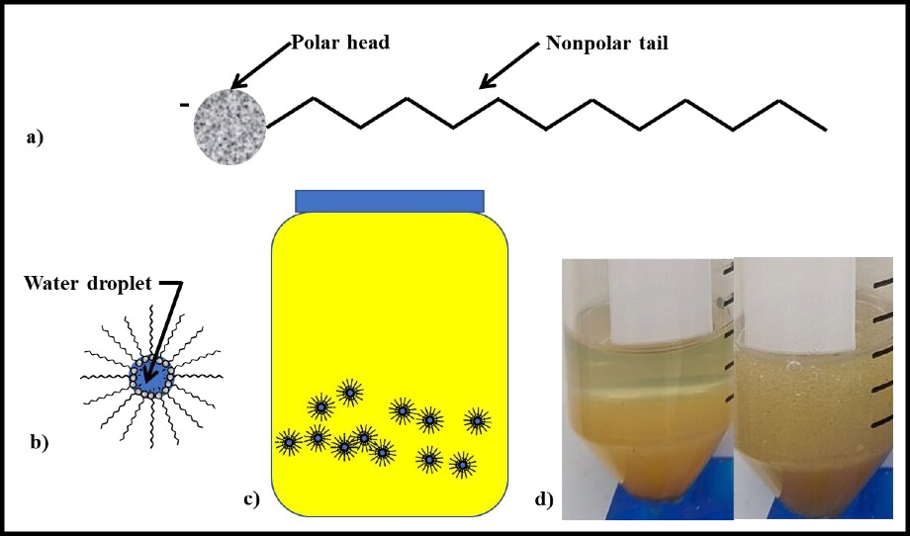
Latest CRC Research, July 2021, Micelles
Figure 62. Surfactants – a) schematic of surfactant molecule showing polar head and nonpolar tail; b) schematic of invert-emulsion micelle encapsulating water droplet and nonpolar tails extending into the medium (i.e., fuel); c) schematic of invert emulsion micelles dispersed in fuel; d) photo of 10 mL each fuel and water – left: before shaking; right: 24h after shaking (note stability of invert emulsion).
CRC Project DP-07-16-01, “Identification of Potential Parameters Causing Corrosion of Metallic Components in Diesel Fuel Underground Storage Tanks”: "The results from this 12-week study confirmed that the presence of free-water was essential to corrosion."

Slide 8
Microbial Growth Volume Dramatically Increases
Tank
LSD Before 2006
Microbial growth volume thickness sheet of paper
Free Standing Water
Tank
ULSD/Biodiesel
Microbial growth volume up to 6 inches thick, microbes produce acids
More microbes, more acids, more corrosion, more biosurfactants . . .

Slide 9
Biosurfactants
Thanks to Dr. Fred Passman for introducing me to the concept of biosurfactants: “In my experience, microbial production of biosurfactants is the primary cause of invert emulsion formation in fuels.”

Slide 10
Biosurfactants
From page 2 USAF study: “In situ Linkage of Fungal and Bacterial Proliferation to Microbiologically Influenced Corrosion in B20 Biodiesel Storage Tanks”
“copious amounts of fatty acids are produced as bi-products of
the metabolism of FAME by microorganisms”
Fatty acids are biosurfactants

Slide 11
Corrosion Mechanism: Detail
B5 produced by blending dry 100% ULSD with dry 100% biodiesel
B5 absorbs water from the atmosphere, creates the initial micelle layer
Microbial growth greatly increases, microbes produce acids and biosurfactants, which form more micelles with newly absorbed water, increasing the micelle layer, which produce more biosurfactants and more acids, turbocharging the corrosion process

Slide 12
Predicting Damage in Long Term Storage
Two Factors - Time Stored, Concentration
B20 year long study USAF, U of Oklahoma, severe contamination after one year, one tank pulled after 9 months
Field Test Results
B4 Stored 10 Years
TAN .29, (.08 limits); Water 30,000 ppm, (200 ppm limits)
B4 Stored 5 Years
TAN .12, Water 5,000 ppm

Slide 13
Corrosion, Threat to Emergency Generators, Engines
Acidified fuel corrodes injectors, the
micron sized needles and orifice; all metal
components – valves, pistons
Single injector failure stops engine
Generator software hunts for power range for
injectors, if outside specs, shuts generator down
Emissions increase, spray patterns affected
Injector orifice/needle tips micron size

Slide 14
Micelles Bypass Filters, Damage Injectors
35,000+ psi, designs for 60,000+ psi
Damage to injector needle and orifice by pitting and steam explosions
Emissions increase, spray patterns affected
Power reduced, water dilutes fuel

Slide 15
Micelles Bypass Filters, Damage Engine
Reduced lubricity, surfactants provide lubrication, concentrated in micelle bottom layer, remainder of fuel low lubrication, friction damage to injectors, pistons, all moving parts

Slide 16
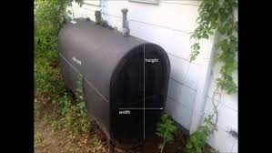
Corrosion, Threat to Home Heating Storage
Tens of thousands of thin walled 275 gallon tanks installed
Acidified fuel corrodes tanks, piping, injectors in furnaces & boilers
Increased risk of environmental
contamination
Emissions increase
Furnace burners fail

Slide 17
Lab Tests for Micelles and Corrosion
ASTM D664 (TAN ) – Total Acid Number – .08 limit
ASTM D6304 Karl Fisher (KF): Traditional water tests cannot detect water in micelles – 200 ppm OEM generator limit
Visual: look for hazy fuel, particulate, corrosion

Slide 18
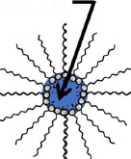
Corrosion Control: SAE J1488 Micelle Filtration
One industry has addressed micelle removal: the diesel industry filtration test for biodiesel blends, SAE J1488
Updated in 2010 to address difficulty in filtering water encased in surfactants
*KEY* Filtering of micelles 200 ppm water controls microbial growth, hence corrosion, and scouring damage to injectors

Slide 19
Corrosion Control: SAE J1488 Micelle Filtration
200 ppm is also the water warranty limit for generator manufacturers, OEM’s want fuel sample with warranty claims, now denying claims
Similarly, Injector manufacturers have stringent rules for fuel quality for injector warranty
Note J1488 filtration removes water, surfactants are returned to tank

Slide 20
Field Results – SAE J1488 Filtration
J1488 Field Results
Over 10+ Years
All of my installed J1488 filtration sites are below limits for water, TAN, and particulates
Non J1488 filtered tanks all have excessive levels
J1488 filtration effective at controlling corrosion and micelle numbers

Slide 21
SAE J1488 Test Procedure
J1488 two phase test:
1st phase uses pure diesel, tests free water filtration
2nd phase uses B20 equivalent ~IFT 17: tests micelle filtration
2500 ppm water added to each test phase

Slide 22
SAE J1488 Test Procedure
Results:
1st phase – free water: all filters very efficient ~ 100 %
2nd phase – micelles: – filter cannot contact water encapsulated in micelle, low efficiency
Need a 92% filtration efficiency to keep water < 200 ppm: 2500 * ( 1 - .92 ) = 200
< 200 ppm water controls microbial growth, and MIC, vast majority of micelles removed

Slide 23
SAE J1488 and Diesel Corrosion Control
SAE J1488 micelle filtration
is the key technology to enhance the safe use of diesel by removing micelles formed by surfactants

Slide 24
Relevant Research Papers
CRC Project DP-07-16-01 2021
“Identification of Potential Parameters Causing Corrosion of Metallic Components in Diesel Fuel Underground Storage Tanks”
USAF, U of Oklahoma, B20 year long study, 2020
“In situ Linkage of Fungal and Bacterial Proliferation to Microbiologically Influenced Corrosion”
EPA 2016 “Investigation Of Corrosion-Influencing Factors In Underground Storage Tanks With Diesel Service”
Battelle Report 2012 Corrosion in Systems Storing and Dispensing Ultra Low Sulfur Diesel (ULSD), Hypotheses Investigation
Moisture Absorption In Biodiesel And Its PetroDiesel Blends 2007
15 – 25 X more water in pure biodiesel vs pure diesel, 1,000 – 1,700 ppm, hits saturation in a day

Slide 25
About Pat Smyth: Speaker
Sept 2022 SAE Test Standards Committee
June 2022 ASTM Working Group on Diesel Corrosion, Member
Sept 2018 National Tanks Conference Louisville Ky
November 2018 National Association Corrosion Engineers (NACE) Washington DC
Sept 2016 EPA Washington DC, Office of Underground Storage Tanks
Lecturer in BioFuelNet Canada’s Advanced Biofuels Course, hosted on McGill University’s myCourses platform

Slide 26
From SAE J1488 Test Procedure
Emulsified Water/Fuel Separation Test Procedure “https://www.sae.org/standards/content/j1488_201010/ page 1
Water in fuels is one of the major causes of diesel engine maintenance problems. The effects of water in fuel are characterized by corrosion of fuel system parts, plugging of filters and orifices and, in some cases, failure of fuel injection equipment. Water in fuel … becomes acidic, and enhances corrosion in fuel injection systems as well as in the engine itself. The presence of water also encourages microbiological growth, which generates orifice and filter restricting sludge. Further, due to displacement of fuel lubrication in close tolerance injector parts, and rapid expansion of heated water at the fuel injector tip, galling, and more serious failure may also occur.”

